Slide 1

Ucr ucpath transaction pilot
Personal data change

Slide 2

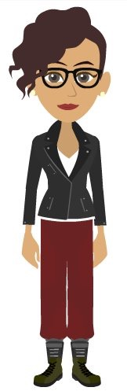
TRAINER INTRODUCTION
Shannon Minter
Title: UCPath Business Support Analyst
Department: UCPath Campus Support Center
Year(s) @UC: 2 1/2
Previous Experience: 14 years of professional human resources analyst experience, focusing on classification & compensation, training development, position management, and recruitment.

Slide 3
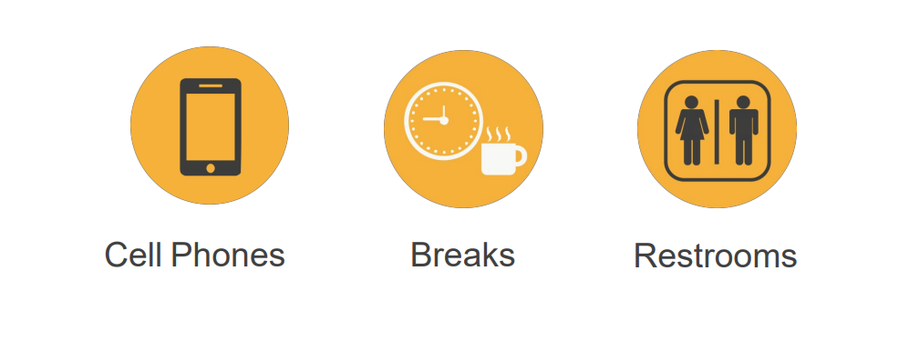
HOUSEKEEPING

Slide 4
LEARNING OBJECTIVES
Describe Person Data Change
Describe Personal Data Change roles
Describe UCPath Center’s (UCPC) role in Personal Data Change
Direct an Employee to Make a Personal Data Change in ESS
Approve POI request
Update a Personal Data Change for an Employee

Slide 5
LEARNING TOPICS
PERSONAL DATA DEFINITION
PERSONAL DATA CHANGE PROCESS OVERVIEW
PERSONAL DATA – TEMPLATE TRANSACTION
ROLE DESCRIPTION
VIEW PERSONAL INFORMATION
SMART HR TRANSACTION PAGE
DIRECT UPDATES TO EMPLOYEE INFORMATION
SHAREPOINT INSTRUCTIONS

Slide 6
Personal Data Definition

Slide 7

PERSONAL DATA DEFINITION
Personal data is information that is unique to each employee. For example; your name, personal email address, education credentials, and contact information.
Personal Data Changes begin with the employee’s decision to update personal data in UCPath, and ends with the notification to the employee that the necessary changes took place.
An employee or administrator can initiate these Personal Data Changes.
The Personal Data Change may result in additional follow up (e.g., benefits implications, supporting documentation) that is outside the Personal Data Change.

Slide 8
Personal Data Change Process Overview

Slide 9
PERSONAL DATA CHANGES – OVERVIEW
There are four methods to update personal data in UCPath:
UCPath Portal
  In most cases, employees enter their own personal data changes using the UCPath portal. Updates that can be made from the Portal include: name, personal email, emergency contacts, home and mailing address, employee disclosures, phone number, ethnic groups, military status, and disability status.
UCPath Template Transaction
  This method can be used to update the personal data mentioned above, but must be used to update: date of birth or Social Security Number.
    These types of updates require Social Security Number Verification (SSNVS) before processing into UCPath.

Slide 10
PERSONAL DATA CHANGES – OVERVIEW (continued)
Case Management
  This method is used for transactions that require document verification. The verification is performed by Location or by UCPC WFA Production. Location initiates a case and WFA Production enters the update directly in UCPath. For example, for a gender marker change, the employee must submit a copy of a government issued ID, which indicates gender, to substantiate the request.
Direct Update in UCPath
  This method is used when the Template Initiator must update certain personal information pages on behalf of an employee. Examples include Emergency Contacts, Additional Names, and Security Clearance.

Slide 11
PERSONAL DATA CHANGES – BUSINESS RULES
Business Rules | Plan/Program/Policy | Implications
No documentation required for | Email Address (personal) Emergency Contact Home and Mailing Address Disclosure of Information Phone Number (personal) | This information writes directly to the database and no intervention is needed by the UCPath Center unless the employee calls for assistance (UCPC will walk the employee through Employee Self-Service)

Slide 12
PERSONAL DATA CHANGES – BUSINESS RULES (continued)
Business Rules | Plan/Program/Policy | Implications
Documentation required for | Education Degree/Highest Degree Achieved Licensure/Certification Legal Name (verified through SSNVS) | The UCPath Center uses SSNVS to check for legal name changes, date of birth, and Social Security Number (SSN) corrections. SSNSV is a government service. UCR maintains responsibility for verifying documentation for changes to Education Degree/Highest Degree Achieved and Licensures/Certification.

Slide 13
PERSONAL DATA CHANGES – BUSINESS RULES (continued)
Business Rules | Plan/Program/Policy | Implications
Social Security Number Verification Service SSNVS) | http://www.socialsecurity.gov/employer/ssnvsHandbook.pdf | The UCPath Center uses the handbook to walk through the process of verifying Name, DOB, and SSN in the SSNVS.
The complete Transactional Matrix for this process (Person Data Changes/Person Profile Approval Role) can be accessed here.

Slide 14
PERSONAL DATA – KEY SYSTEM STEPS
Navigate to the
Smart HR Transactions page
Select the Personal Data template
Enter personal data and attach supporting documentation as needed
View Personal Information
Save and Submit

Slide 15
EMPLOYEE SUBMITS VIA EMPLOYEE SELF-SERVICE
Employee enters personal data change (see Personal Data Changes Matrix for available transactions) in Employee Self-Service.
With the exception of a legal name change request, the personal data change writes directly to the database in UCPath.
In the case of a legal name change request, UCPC runs proposed legal name through the Social Security Number Verification Service (SSNVS) via UCPC.
Requests to update Highest Education Level and Licensures & Certifications are sent to the employee's Transactional Unit for verification and approval. Approval remains at the Location.
The complete Transactional Matrix for this process (Person Data Changes/Person Profile Approval Role) can be accessed here.

Slide 16
EMPLOYEE SUBMITS VIA UCPATH CASE MANAGEMENT
Employee opens case with UCPC requesting personal data change (see Personal Data Changes Matrix for available transactions).
The following transactions are verified using SSNVS in UCPC: Legal Name, Date of Birth, Gender, Social Security Number before writing to the database.
Requests to update Highest Education Level and Licensures & Certifications are sent to the employee's Transactional Unit for verification and approval. Approval remains at the Location.
The complete Transactional Matrix for this process (Person Data Changes/Person Profile Approval Role) can be accessed here.

Slide 17
TRANSACTIONAL UNIT SUBMITS UCPATH TEMPLATE TRANSACTION REQUEST
Transactional Unit initiates a Personal Data Change Template Transaction request in UCPath (see Personal Data Changes Matrix for available transactions).
All Template Transactions are reviewed (AWE) by the Shared Services Center for compliance. Veteran Status, Highest Education Level, Ethic Groups, Home/Mailing Address, Phone Numbers, and Email Addresses are approved at the location and write directly to the database after AWE approval.
The following transactions are forwarded to UCPC for review and SSNVS check: Legal Name, Date of Birth, Gender, Social Security Number.
The complete Transactional Matrix for this process (Person Data Changes/Person Profile Approval Role) can be accessed here.

Slide 18
TRANSACTIONAL UNIT ENTER PERSONAL INFORMATION IN UCPATH
Transactional Unit enters changes to Additional Names, Emergency Contacts, and/or Security Clearance (only used for LiveScan ID) directly into UCPath Personal Information.
Change(s) write directly to the databases. No AWE required.

Slide 19

CHECK YOUR UNDERSTANDING

Slide 20
CHECK YOUR UNDERSTANDING
Name the four way that Personal Data can be update?
What types complete by an employee ESS are written directly to the database?
What updates completed by the Transaction unit will be written directly to the database?
What does SSNVS stand for?

Slide 21
Personal Data Template Transaction

Slide 22
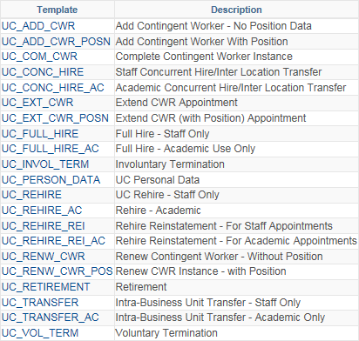
PERSONAL DATA – TEMPLATE TRANSACTION
Use the UC Personal Data template to update an employee’s personal information.
The UC Personal Data template can be used for staff or academic employees.
If the employee has jobs in multiple business units, the employee’s personal data should be updated by the employee’s Primary Job Location.
Available Templates

Slide 23
Role Description

Slide 24


Role Description
1. Employee
2. Transactional Unit
3. Shared Service Center
4. UCPath Center

Slide 25

Enters Personal Data Change in Employee Self-Service.
Opens a case with UCPC to change personal data.
Role Description
1. Employee
2. Transactional Unit
3. Shared Service Center
4. UCPath Center

Slide 26
Initiates UCPath Personal Data Change Template Transaction Request.
Enters Additional Names, Emergency Contacts, and/or Security Clearance on employee’s behalf.
Reviews and approves locally-approved change requests (highest degree earned and any certifications or licensures).
Verifies documentation for Gender change (if not initiated via SSNVS).
Role Description
1. Employee
UCPath AWE Approver for Template Transactions.
2. Transactional Unit
3. Shared Service Center
4. UCPath Center

Slide 27
UCPath AWE Approver for Template Transactions.
Role Description
1. Employee
2. Transactional Unit
3. Shared Service Center
4. UCPath Center

Slide 28
Runs select proposed changes through SSNVS.
If no match, UCPC contacts the employee/transactional unit that the change was not approved.
Role Description
1. Employee
2. Transactional Unit
3. Shared Service Centers
4. UCPath Center

Slide 29
CHECK YOUR UNDERSTANDING

Slide 30
CHECK YOUR UNDERSTANDING
What is the name of the template in UCPath is used to update Personal Data?
What is UCPC’s role if there is not SSNVS match?

Slide 31
View Personal Information

Slide 32
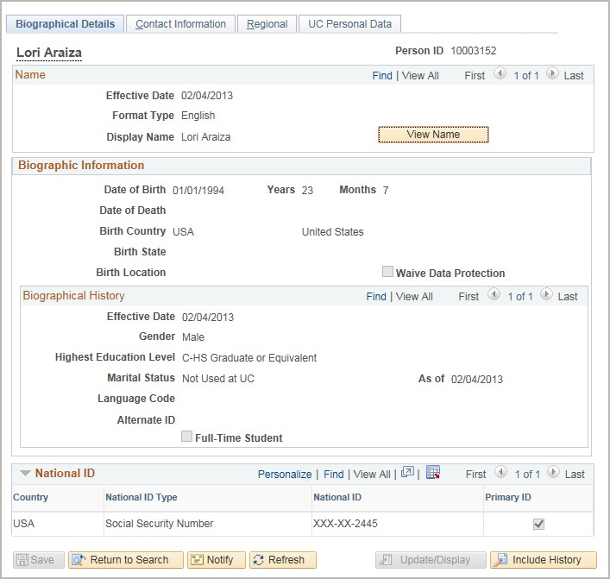
VIEW PERSONAL INFORMATION
Navigation:
PeopleSoft Menu > Workforce Administration > Personal Information > Modify a Person
Review an employee’s personal information using the Modify a Person component.

Slide 33
Smart HR Transaction Page

Slide 34
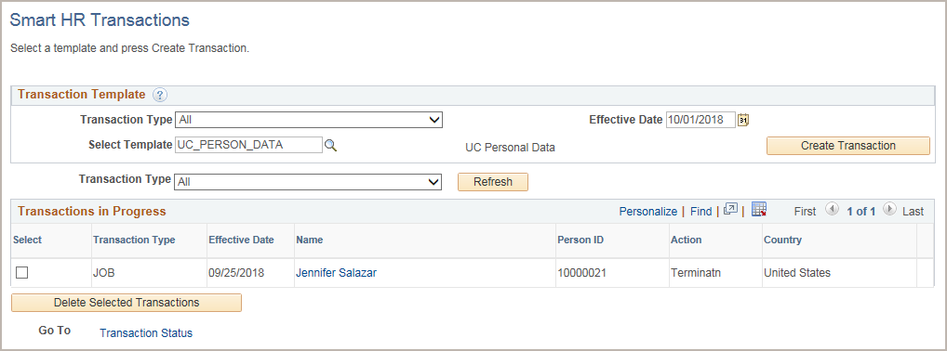
SMART HR TRANSACTION PAGE
Navigation: PeopleSoft Menu > Workforce Administration >Smart HR Template > Smart HR Transactions
Select the personal data template.
Enter the Effective Date of the template transaction.
Click Create Transaction to begin entry of the template transaction.

Slide 35
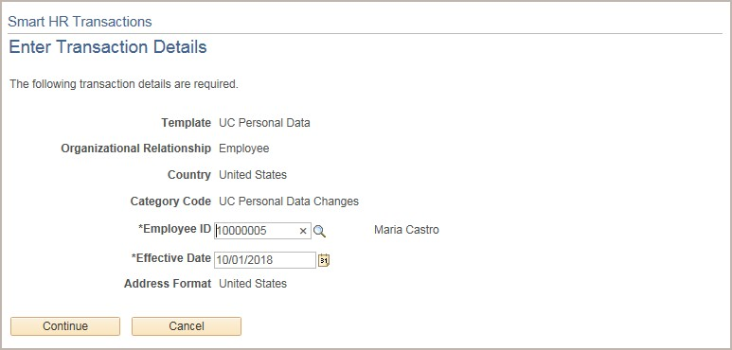
ENTER TRANSACTION DETAILS PAGE
The Personal Data Changes template does not have any Reason Codes.
Important
The Effective Date is populated based on your entry on the previous page.
Ensure that you entered the correct
Effective Date.
Click the Employee ID search button to locate the employee.
Click Continue to enter the remaining details of the personal data change.

Slide 36
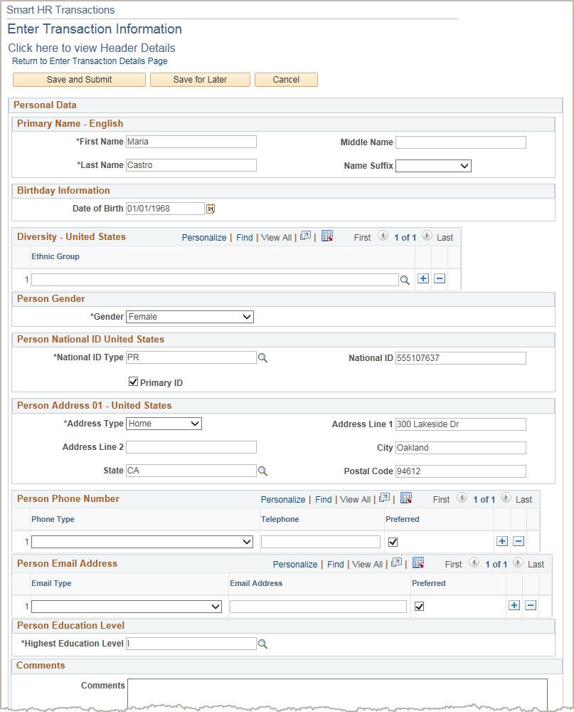
ENTER TRANSACTION INFORMATION PAGE
The employee’s existing personal information is automatically displayed.
Update the employee’s personal data.
Enter a comment to inform UCPC WFA Production specifically what field was updated.
When complete, click the Save and Submit button to submit the template for review and approval.

Slide 37
Direct Updates to Employee Information

Slide 38
DIRECT UPDATES TO EMPLOYEE INFORMATION
You have the security to update the following types of personal information directly in UCPath (on behalf of an employee):
Emergency Contacts
Additional Names
Security Clearance

Slide 39
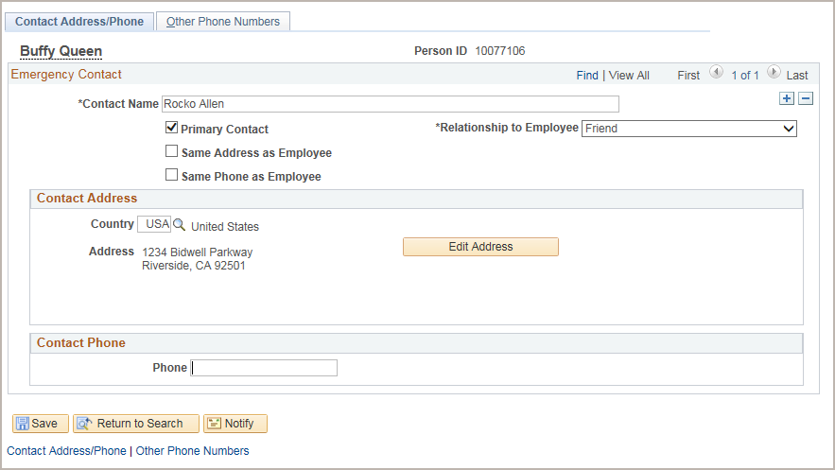
PERSONAL INFORMATION– EMERGENCY CONTACTS
Navigation: PeopleSoft Menu > Workforce Administration > Personal Information > Personal Relationships > Emergency Contact
Click + to add a new person along with their contact information to the employee’s emergency contact list.
You also can update the information for existing contacts.

Slide 40
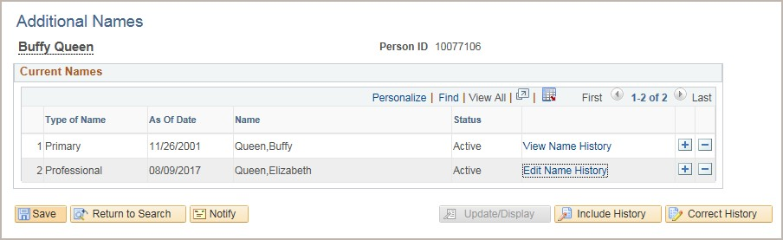
PERSONAL INFORMATION – ADDITIONAL NAMES
Navigation: PeopleSoft Menu > Workforce Administration > Personal Information > Biographical > Additional Names
In this example, you can see that Buffy Queen also goes by Elizabeth Queen.
Click + to add a name for the employee.

Slide 41
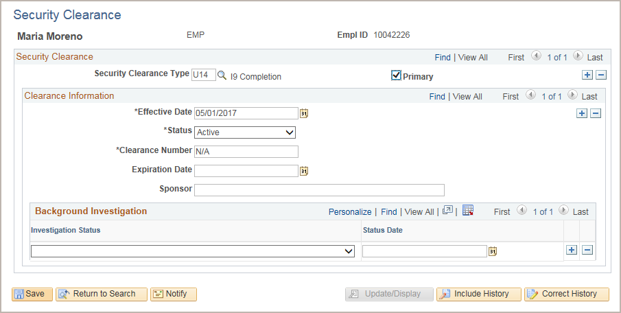
PERSONAL INFORMATION – SECURITY CLEARANCE
Navigation: PeopleSoft Menu > Workforce Administration Personal Information > Security Clearance
I-9 information should not be deleted, added, or updated. However, you can add new rows to enter other security clearance type information.

Slide 42
CHECK YOUR UNDERSTANDING

Slide 43
CHECK YOUR UNDERSTANDING
What screen do you use to view an employees Personal Data?
Provide an example of the types of data that is saved on the Security Clearance page.

Slide 44
SharePoint Instructions

Slide 45
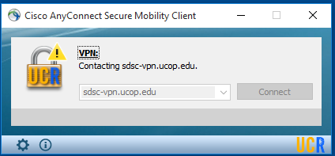
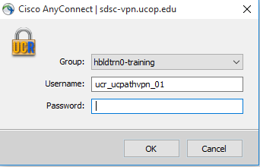
SHAREPOINT LIST INSTRUCTIONS
Open the Cisco AnyConnect client.
Enter the VPN name: sdsc-vpn.ucop.edu
Click Connect.
Select the Group: hbldtrn0-training
Enter one of the following username:
• ucr_ucpathvpn_01 Row 1 and Row 2
• ucr_ucpathvpn_02 Row 3 and 4
  ucr_ucpathvpn_02 Row 5 and 6
The VPN password for the week of 7/15/19 is: !!1_Meat_Most!!
Once Connected to the VPN:
Go to https://hbldtrn0.ucpath-build.devops.universityofcalifornia.edu/psp/HBLDTRN0/?cmd=login&languageCd=ENG&
Enter the Tester ID\Password provided in the SharePoint Scenarios.

Slide 46
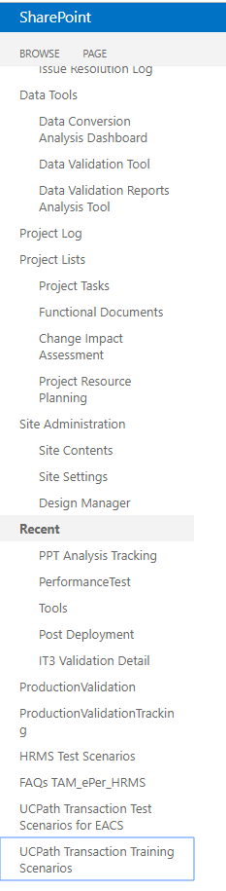
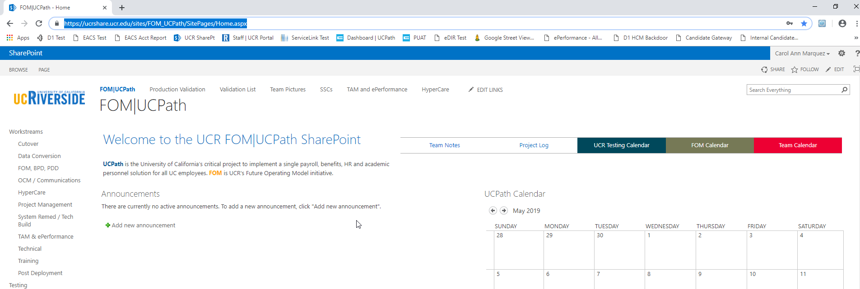
SHAREPOINT LIST INSTRUCTIONS
Testing SharePoint: https://ucrshare.ucr.edu/sites/FOM_UCPath/SitePages/Home.aspx
Preferred browsers are Internet Explorer and Chrome. (Save the link as a favorite)
Select UCPath Transaction Training Scenarios from the left side Quick Menu:

Slide 47
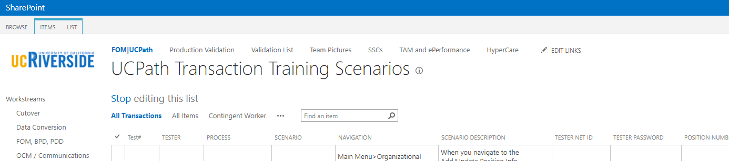
VIEWING LIST OPTIONS
When the list opens, note the tabs at the top of the screen:

Slide 48
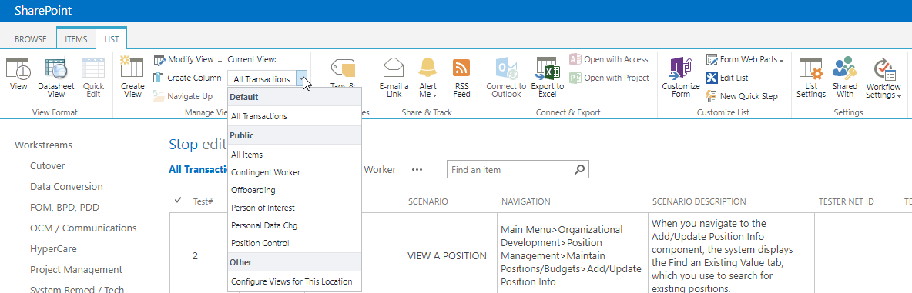
VIEWING LIST OPTIONS - part 2
By selecting ‘List’ you can filter the view on the process you are transacting. The default view is All Transactions. Select a specific transaction type to view the list containing only those transactions:

Slide 49
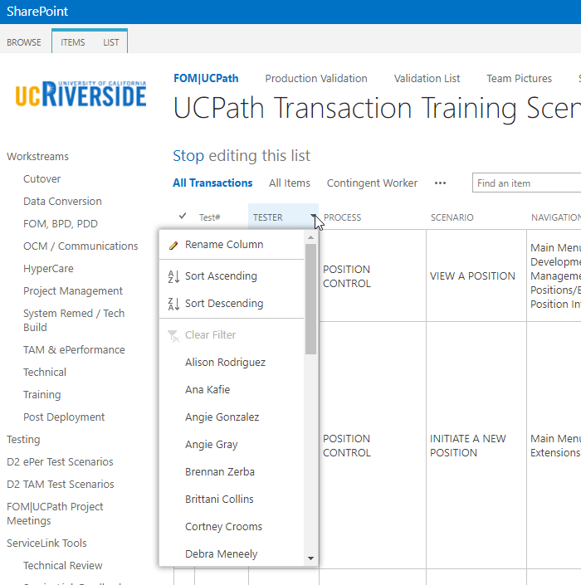
UPDATING AND EDITING A SHAREPOINT LIST
Many functions of a SharePoint list are similar to MS Excel, except that it is in a central location and can be accessed / updated by multiple people at the same time.
Use the list headers to filter and sort. Only you will see these temporary changes.
By selecting your name in the drop-down, you will have easy access to only your transactions. This is especially helpful if your name appears several pages into the list.

Slide 50
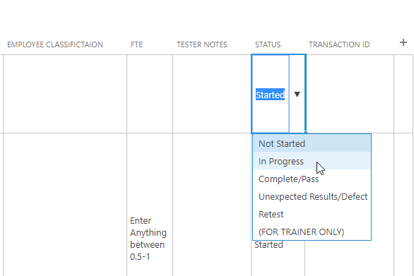
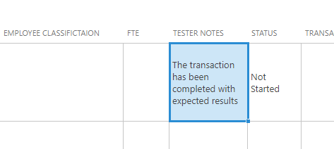
UPDATING AND EDITING A SHAREPOINT LIST part 2
You can update your test by editing directly by clicking into the cell. Some cells are controlled by a drop-down choice, others are free-form. To save your change, click in another cell.

Slide 51

THINGS TO REMEMBER
If a POI later becomes an employee or a Contingent Worker (CWR), then their assigned Person ID becomes their Employee ID.
POI records that create a Person ID in UCPath are approved using Automated Workflow Engine (AWE). POI instances added to existing Person IDs do not use AWE.
UCPath Center does not add nor maintain POI records in UCPath. However, only UCPC can update a POI’s address and phone number. Locations must create a case to have UCPC update this information.

Slide 52
LEARNING OBJECTIVES
Having completed this course, you should be able to:
Describe Person Data Change
Describe Personal Data Change roles
Describe UCPath Center’s (UCPC) role in Personal Data Change
Direct an Employee to Make a Personal Data Change in ESS
Approve POI request
Update a Personal Data Change for an Employee

Slide 53
APPENDIX
Person of Interest Process Map
Person of Interest Road Map

Slide 54
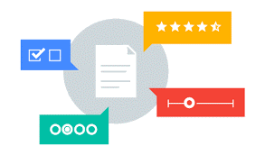
Your Feedback Please
http://bit.ly/ucpathpilottraining

Slide 55


Slide 56


