Slide 1
Ucr ucpath transaction pilot
Ucpath and process summary overview

Slide 2
TRAINER INTRODUCTION
Shannon Minter
Title: UCPath Principal HR Business Analyst
Department: UCPath Campus Support Center
Year(s) @UC: 2 1/2
Previous Experience: 14 years of professional human resources analyst experience, focusing on classification & compensation, training development, position management, and recruitment.

Slide 3
TRAINER INTRODUCTION
LaKesha Welch
Title: CSC Team Lead/UCPath Business Support Analyst
Department: UCPath Campus Support Center
Year(s) @UC: 5 1/2
Previous Experience: 15 years Lead Business analyst/Functional Analyst support

Slide 4
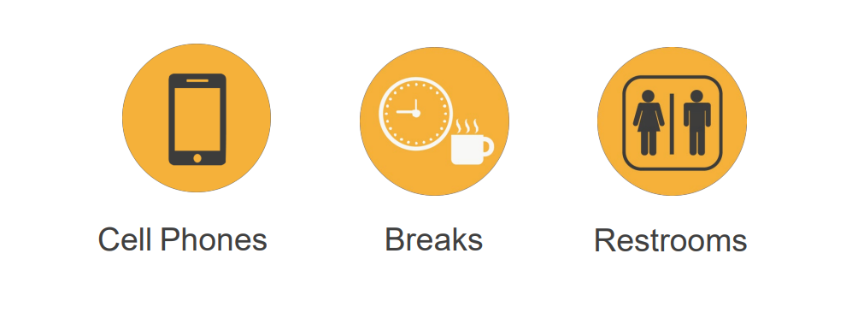
HOUSEKEEPING

Slide 5
LEARNING OBJECTIVES
Understand the definitions for each process
Understand how to navigate through UCPath
Understand how each of the hand-offs work in each process and the roles and responsibilities of the Transactional Unit, Shared Services Center and the Central Office(s).
Understand the policy implications of each process
Understand the key things to remember from each process

Slide 6
REVISITNG LEARNING TOPICS
INTRO TO PEOPLESOFT AND UCPATH
PAYROLL CALENDARS AND AUTOMATED PROCESSES
ON BEHALF CASE MANAGEMENT
POSITION CONTROL
CONTINGENT WORKER
PERSONAL DATA CHANGES
PERSON OF INTEREST
ONE–TIME PAYMENTS
VOLUNTARY TERMINATION
KNOW ISSUES, WORKAROUNDS,TROUBLSHOOTING AND DOWNSTREAM IMPACTS
INTERACTIVE ACTIVITY
APPENDIX
FEEDBACK

Slide 7
INTRO TO PEOPLESOFT

Slide 8
LEARNING OBJECTIVES
Recognize and define key UCPath terms and acronyms
Describe Approval Workflow Engine in UCPath
Learn how to view comments and clone a template transaction
Describe how the WFA Overview and Employee Lifecycle work

Slide 9
SELECT UCPATH TERMS AND ACRONYMS
Approval Workflow Engine
Effective Date
UCPath
(AWE) systematically routes transactions in UCPath to designated roles (example Initiator) for approval at UCR. Once these UCR approvals are complete, transactions are either routed to the UCPath Center for finalization
Defines a type of earning
Date on which the associated information takes effect. The information is in effect until a new entry is made with a more current effective date. We do not have “stop dates” on effective dated data. The Effective Date usually defaults to the system's current date.
UC Payroll, Academic Personnel, Timekeeping and HR: A UC-Wide Initiative, coordinated by UC Office of the President
Effective sequence indicated in what order the data was input or changes on a particular date.
Earn code
Effective Sequence

Slide 10
THINGS TO REMEMBER
Effective Date is the date the transaction will take place. Remember to pay attention to this date when doing Retro and Future dating transactions.
If you find yourself navigating to the same pages and/or components, you may want to bookmark them to avoid having to constantly navigate through many menus.
View comments entered by a Location Initiator or Approver in the Smart HR Transaction Page.
Clone a transaction that was cancelled or denied in the Transaction Status Page. If you clone a transaction denied at the location, both the original and the clone appear in the list.
Tip: The cloned (new) transaction appears below the original denied transaction in the default sorting of the list.

Slide 11
THINGS TO REMEMBER
If you aren’t searching by the EMPL ID, always change the operator from “Begins with” which is always the default, to “Contains”, by clicking on the arrows.
When navigating in UCPath always use the buttons and links within the site to navigate. Do not use the Back and Next buttons in your web browser toolbar.
Your security access to key pages and components in the UCPath Workcenter is the same as your access to those pages and components from the PeopleSoft Menu.
There is no effective sequencing on position; therefore, when a correction is needed with an effective date that already exists on the position, UCPC will have to make the correction. This is done through an on behalf of case management case.

Slide 12
Payroll Calendars Overview

Slide 13
LEARNING OBJECTIVES
Understand Milestones on UCPath Payroll Processing Schedule
Understand Criticality and Impact of Payroll Milestones
Recognize and define key UCPath terms and acronyms
Understand Payroll-impacting Inbound Files
Understand UCPath Automated Processes
Understand SSC Calendar Deadlines and SLA
Insert Learning Objective Review Topic Here

Slide 14
PAYROLL CALENDARS DEFINITION
The UCPath Payroll Process involves a series of actions and interfaces to process gross to net paychecks and finalize the payroll balances each pay cycle.
The process begins with calculating initial hours, taxes, and deductions. An iterative calculation routine will produce various validation edits for review, as well as data for subsequent processes and reports.
The process ends when payments are calculated and confirmed in UCPath, and employees receive both their paychecks and earnings statements correctly through direct deposit or paper check.
The UCPath Center enforces a strict timeline for payroll processing deadlines that all UC locations must adhere to.

Slide 15
UCPATH CENTER DEADLINES DEFINITIONS
Pay Calculation
Initial UCPath Payroll process that calculates paycheck data based on inputs (i.e. interface files, data changes, etc.) from upstream processes and configuration.
Pay Confirm
Delivered process that finalizes paycheck data.
AM Post Confirm
A series of processes that update the Absence Management components of payroll transactions.
GL Post Confirm
A series of processes that update the general ledger to reflect payroll transactions that have been processed.
Pay Statement on UCPath
Date on Payroll calendar when earnings statements are accessible to employees in the UCPath portal.
Leave Accrual Available on UCPath
Date on Payroll calendar when updated accrual balances are visible to employees in the UCPath portal.

Slide 16
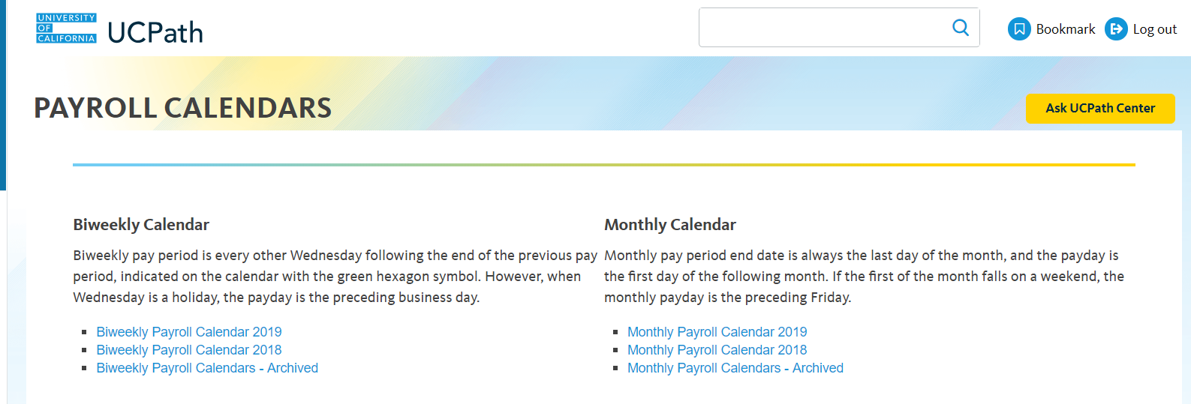
NAVIGATION TO SCHEDULES & CALENDARS IN UCPATH PORTAL
Navigation to Payroll Processing Schedules
UCPath Portal > Quicklinks > Payroll Calendars & Schedules > Payroll Processing Schedules
Navigation to Payroll Calendars
UCPath Portal > Quicklinks > Payroll Calendars & Schedules > Payroll Calendars

Slide 17
THINGS TO REMEMBER
Payroll Deadlines are enforced by the UCPath Center for all UC Locations.
Payroll Deadlines cannot be moved or rescheduled by locations.
Monthly-paid and Biweekly-paid employee populations are processed in separate Payroll instances and adhere to different Payroll Processing deadlines.
The UCPath Center Publishes a new Payroll Schedule for the year in the UCPath Portal.
The UCPath Payroll Processing Schedule is subject to change throughout year.

Slide 18
On Behalf of Case Management Overview

Slide 19
LEARNING OBJECTIVES
Initiate a UCPath SalesForce Case
Insert Learning Objective Review Topic Here
Monitor a UCPath SalesForce Case
Insert Learning Objective Review Topic Here
Reopen a UCPath SalesForce Case
Insert Learning Objective Review Topic Here
SharePoint Objectives
Insert Learning Objective Review Topic Here

Slide 20
ON BEHALF OF DEFINITION
On Behalf Of Case Management is the task of submitting an inquiry or an update on behalf of another employee or yourself to the UCPath Center via the UCPath website. This process is also used for the following common tasks (Not an exhaustive list):
Update, modify, edit, or change an employee/CWR information.
Open a Case for Transactions created on behalf of the employee, that did not process correctly, or were improperly cancelled by UCPath.
To make specific Personal Data Change updates as defined in the Future State Process Design (FSPD).

Slide 21
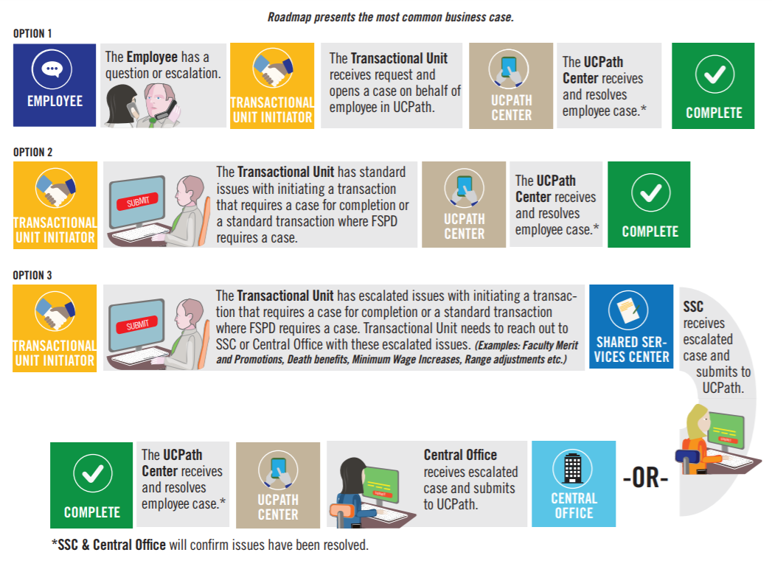
ROADMAP

Slide 22
NAVIGATION
Navigation: UCPath Center > Ask UCPath Center
Navigation: UCPath Center > Help/FAQ > Ask UCPath Center

Slide 23
HANDOFF MATRIX
Category | Purview | General Approach | Transactions Initiated by SSC only
Cases related to STANDARD transaction entry that requires UCPC entry | Transactional Unit | STANDARD corrections or updates initiated by the Transactional Unit for non-pay impacting, non-benefit related fields. For example correction of the following fields: Date of Birth Personal Data Name Address | ------

Slide 24
HANDOFF MATRIX
Category | Purview | General Approach | Transactions Initiated by SSC only
Cases related to ESCALATED transaction entry that requires UCPC entry | SSC | Any ACCRUAL or BENEFITS related issues that require a correction or a case. DCP Retirement Cancellation of Benefits Issues with reinstatement Deductions A lapse in benefits coverage Damage Payments Service Credit Adjustments | Retroactive Compensation Changes Overpayments Off Cycle Checks Final Pay Next Day Checks Missed Pay resolution Leave of Absence Issues Requests Sabbatical Credit Adjustments

Slide 25
HANDOFF MATRIX
Category | Purview | General Approach | Transaction Update Types
Cases related to ESCALATED transaction entry that requires UCPC entry | Central Office | ESCALATED corrections by the central office need to be corrected by the central office Glacier Issues | Merit and Promotion updates Minimum wage increases Range Adjustments Certain Benefits Issue
On Behalf of Cases | Employee | STANDARD issues that the employee has tried to resolve or needs resolved where they need assistance on STANDARD cases the transactional unit can assist by opening on behalf of cases to help the employee as requested. For cases related to ESCALATED transaction types of issues the transactional units should coordinate with the SSC regarding who will open the case on behalf of the employee EE needs W-2 or other tax document Personal Data changes made via case management

Slide 26
POLICY IMPLICATIONS
Specifically to SalesForce, you need to insure you have used the correct Category and Topic to insure your Case is received by the correct team. However, there are UCPath Policies that must be followed when a user needs help to update certain information:
If a person wants you to help them update his/her W-2, a form must be used; you cannot submit a case for that issue. This also applies to updating an address, email, or any personal information for an employee. If you have questions about how to update something for someone, it is best to call Employee Services for guidance.

Slide 27
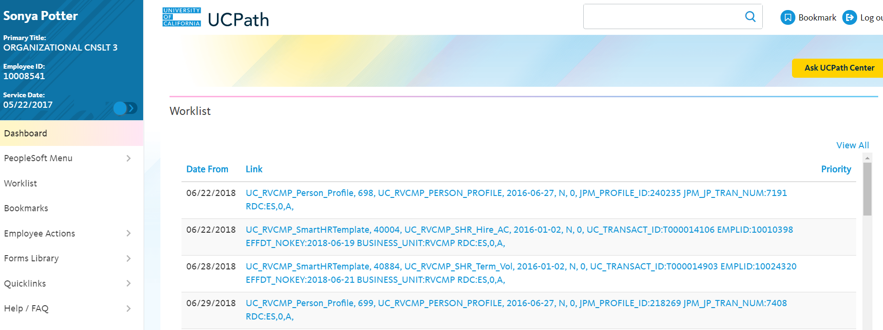
ON BEHALF OF ASK UCPATH
Navigation: Ask UCPath Center
Note: This example uses sample images as seen on a computer. Sample images appear differently on a tablet or smartphone, but the steps remain the same.
Click the Ask UCPath Center Button

Slide 28
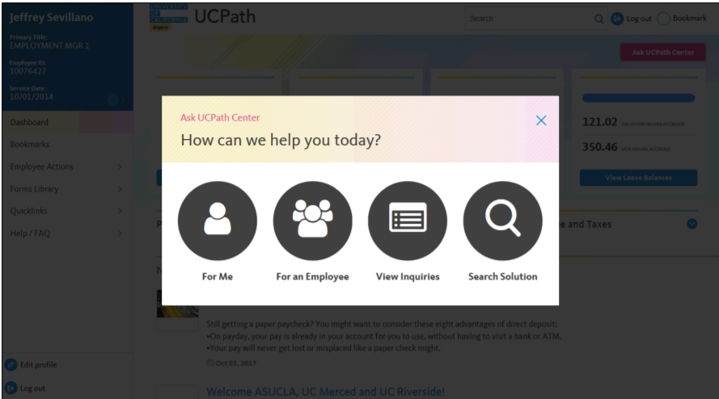
ON BEHALF OF HOW CAN WE HELP YOU TODAY?
If you are authorized to submit an issue for an employee, the “Ask UCPath Center, How can we help you today?” pane appears.
In this example, we will submit a payroll question for an employee.
Click the For an Employee button.

Slide 29
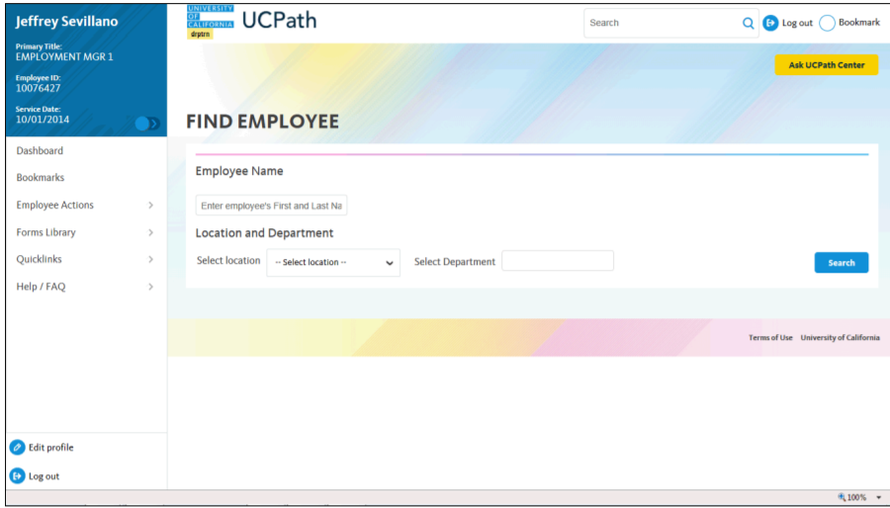
ON BEHALF OF FIND EMPLOYEE
On the Find Employee page, search for the employee by name or by location and department.
For this example, enter name Sonya Potter in the Employee Name field and click Search.
Enter Employee Name
Click Search

Slide 30
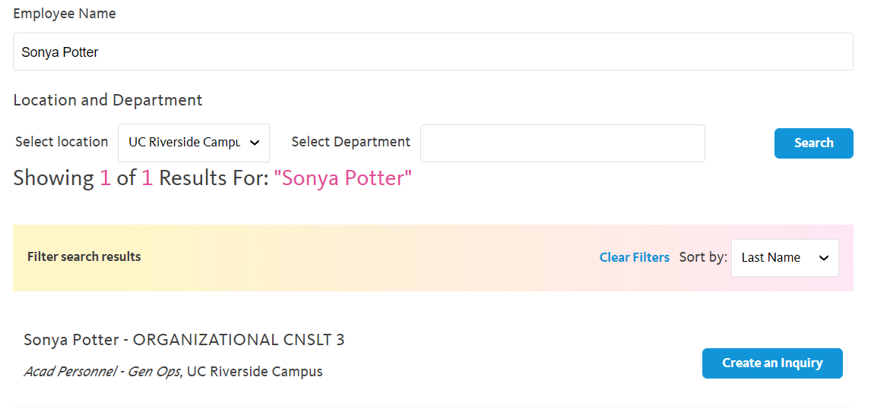
ON BEHALF OF SEARCH AND CREATE AN INQUIRY
UCPath returned one result.
Click Create an Inquiry.

Slide 31
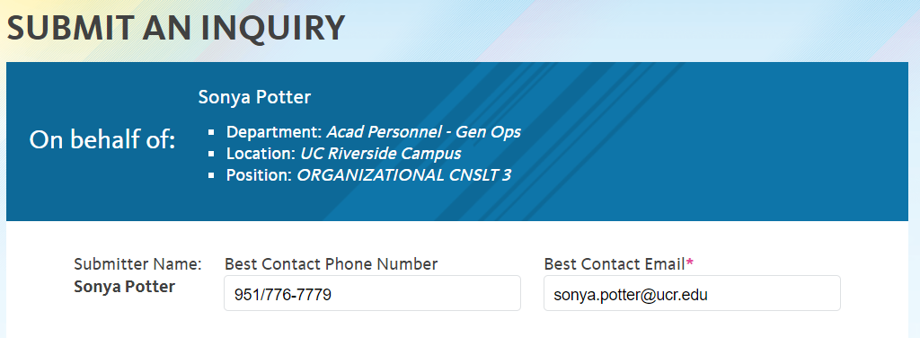
ON BEHALF OF PHONE NUMBER & EMAIL
Your phone number automatically populates in the Best Contact Phone Number field from your Salesforce record. You can override with a different number. The phone number field is a text field, so it will not format with dashes or slashes.
Your email automatically defaults from your Salesforce record. You can override the email by clicking in the Best Contact Email field and entering a new email address.
951-827-6587

Slide 32
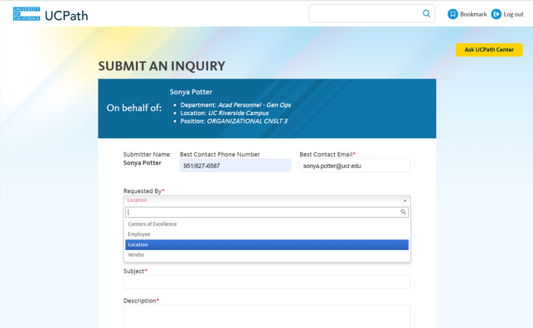
ON BEHALF OF REQUESTED BY
Click the button to the right of the Requested By field.
Select the Requested By most associated to your request.
In this example, select Location.

Slide 33
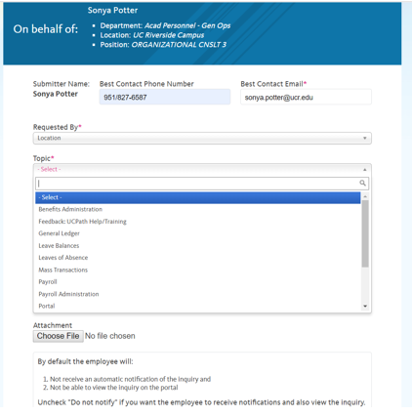
ON BEHALF OF TOPIC
In Topic, select the topic area associated with your inquiry.
In this example, select Payroll.

Slide 34
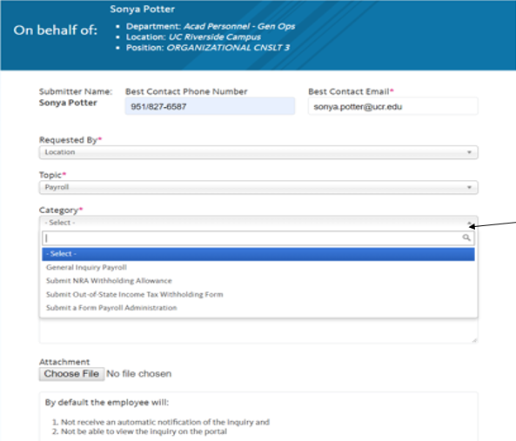
ON BEHALF OF CATEGORY
In Category, select the category area associated with your inquiry.
In this example, select General Inquiry Payroll.

Slide 35
ON BEHALF OF TOPICS & CATEGORIES- EMPLOYEE
Please instruct employees to use this option in the Requested by drop down when opening a Case for themselves.
Requested by | Topic | Category
Employee | Benefits | General Inquiry Benefits, Submit EOI – Disability Coverage, Submit HAS Life Insurance and AD & D Form, Submit Health Benefits Life Event, Submit Late Enrollment Request Form, Submit Newly Eligible Enrollment Form, Submit UCPC UBEN109 COBRA Qualifying Event Form
 | Feedback: UCPath Help/Training | Correction, Suggestion
 | Human Resources | General Inquiry Human Resources
 | Leave Balances | General Inquiry Leave Balances
 | Leaves of Absence | Disability/Life Insurance, Leave of Absence with Pay, Leave of Absence Without Pay
 | Open Enrollment | COBRA, Enrollment Confirmation, General Question, Leave of Absence, Life Event, New Hire, Open Enrollment Form, Other
 | Payroll | General Inquiry Payroll, Submit NRA Withholding Allowance, Submit Out-of-State Income Tax Withholding Form, Submit a Form Payroll Administration
 | Portal | Access Issue, General Inquiry Portal
 | Records Request | Submit a Form Records Request

Slide 36
ON BEHALF OF TOPICS & CATEGORIES- LOCATION
Locations and Shares Service Centers will use these Requested by options when opening a Case.
Requested by | Topic | Category
Location | Benefits Administration | General Inquiry Benefits Administration, Premium Reconciliation, Quality Care Unit, Submit a Form Benefits Administration, UCRP Service Credit Verification
 | Feedback: UCPath Help/Training | Correction, Suggestion
 | General Ledger | Cost Recovery, Financial Control Journal, General Inquiry General Ledger, Quality Care Unit, Request an Action in UCPath
 | Leave Balances | General Inquiry Leave Balances
 | Leaves of Absence | Disability/Life Insurance, Leave of Absence with Pay, Leave of Absence Without Pay
 | Mass Transactions | Mass Hires, Mass Pay Changes
 | Payroll | General Inquiry Payroll, Submit NRA Withholding Allowance, Submit Out-of-State Income Tax Withholding Form, Submit a Form Payroll Administration
 | Payroll Administration | Instant Pay Card, Payroll Admin T&A Batch Error, Payroll Process Errors/Reconciliation, Quality Care Unit, Submit Recurring Additional Pay Correction Request Form, Submit a Form Payroll Administration
 | Portal | Access Issue, General Inquiry Portal

Slide 37
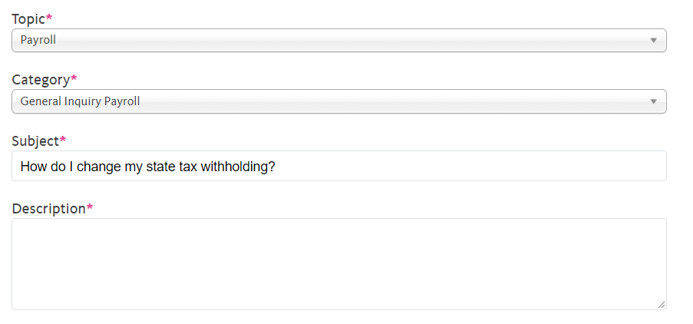
ON BEHALF OF SUBJECT
Click in the Subject field.
Enter the desired information in the Subject field.
For this example, enter How do I change my state tax withholding?

Slide 38
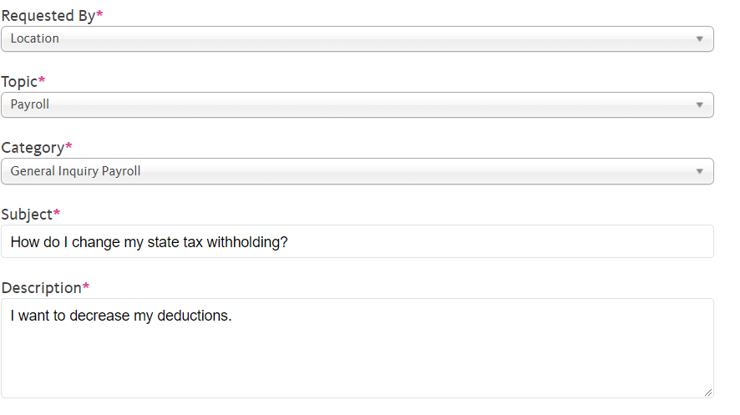
ON BEHALF OF DESCRIPTION
Click in the Description field.
Enter the desired information into the Description field.
For this example, enter I want to decrease my deductions.

Slide 39
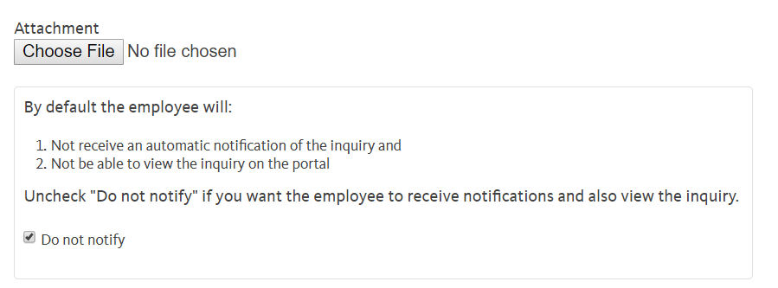
ON BEHALF OF ATTACHING A FILE
You can ONLY ADD ONE attachment when entering on behalf of others Cases. More attachments can be added after you save the initial entry.
Accepted formats include: MS Office suite, PDF, JPD, TIFF, PNG, or WAV.
By default, the Do not notify check box means that the employee will receive no notifications and cannot view the inquiry. If you want the employee to receive notifications and see the inquiry online, Deselect the check box.

Slide 40
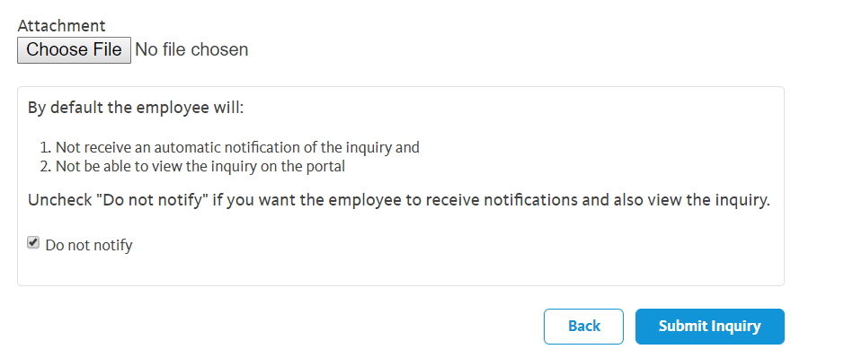
ON BEHALF OF SUBMIT INQUIRY
Click the Submit Inquiry button when completed.

Slide 41
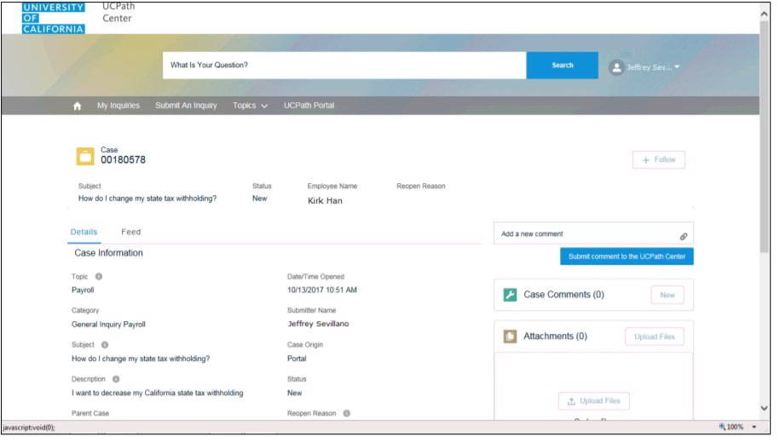
ON BEHALF OF CASE RESULTS
Results: a Case Number was assigned to the inquiry.
You can review the inquiry in the Details sections.
The Submitters Name appears.
You have Submitted an inquiry on behalf of an employee.
Case Number
Sonya Potter
Submitter’s Name
Sonya Potter

Slide 42
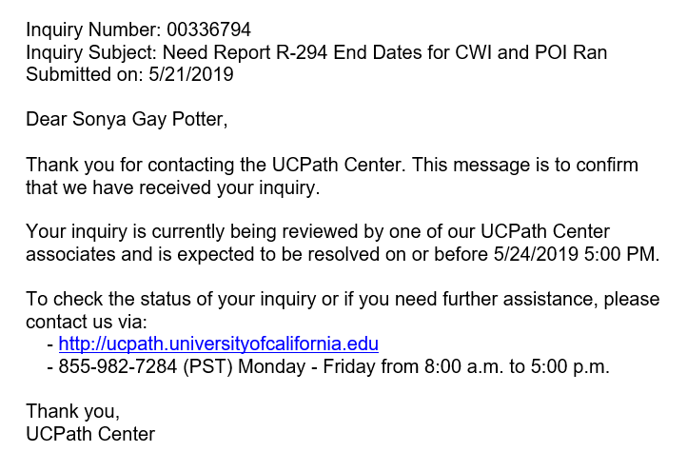
ON BEHALF OF EMAIL RECEIPT
Submitter will receive an email notification from UCPath with Inquiry number and a date to be resolved by.
IF you deselected the Do Not Notify checkbox, the employee will also receive an email with the same info.
00180578
How do I change my state tax withholding?

Slide 43
MATERIALS
Resource material regarding how to open on Behalf of Cases to UCPath is located here please utilize these documents as a reference.
On Behalf of Case Management:
Submit Case to UCPath Center
Submit Case (on Behalf of Employee) to UCPath Center
Reopen Closed UCPath Center Case
Monitor UCPath Center Cases
On Behalf of Case Management Infographic
On Behalf of Case Management Process Workbook
On Behalf of Case Management Process Map

Slide 44
THINGS TO REMEMBER
Follow up on your cases weekly, however it can take UCPath a long time to complete a case, keep following up. If you do not get a response, you should contact the CSC support team at ucpathhelp@ucr.edu to escalate your matter.
Phone Number to call for UCPC – Employee Service line (ES) 855-982-7284, Quality Care Unit (QCU) – 951-787-5470 used for escalation calls.
UCPath Center Portal has an area for Trending Questions and Feature Topics you can use to help to find answers for your questions - https://ucpathsupport.force.com/askucpath/s/
On Behalf of Topics and Categories, please refer to the list of Topics and Categories to categorized your Case correctly. If it is not categorized correctly, it could delay your issue from being reviewed timely by UCPath.

Slide 45
Position Control Overview

Slide 46
PROCESS DEFINITION
UCPath Position Data Management refers to the process of creating and editing existing position data within PeopleSoft. Position data includes Business Unit, Department, Location, Establishment ID, Job Code, FLSA Status, Union Code, Reports To, Salary Plan, Salary Grade, FTE, and Standard Hours.

Slide 47
POSITION CONTROL ROADMAP

Slide 48
NAVIGATION
Navigation: PeopleSoft Menu > UC Customizations > UC Extensions > Positon Control Request
Navigation: PeopleSoft Menu > UCPath Workcenter > Positon Control Request

Slide 49
POSITION DATA MANAGEMENT DOWNSTREAM IMPACTS
Issue: Incorrect maintaining manager / supervisor relationship on position.
Downstream Impact: Failure to ensure the appropriate supervisor relationship is establish could impact pay. Not maintaining this data affects TARS and Performance Management data.
Note: Position data is used organizational planning, recruitment, career planning, and budgeting. Position captures the life-cycle of position changes, such as reclassifications, position status, and incumbents.

Slide 50
HANDOFF MATRIX
Process | Position/ Funding | Category | Transactional Unit Responsibility | SSC/Central Office Responsibility
Position Control | Position | New position request or updating vacant positon | Updating vacant or creating new position via POSITION CONTROL page | In Phase 1, SSCs review and approve or deny positions via AWE
Position Control | Funding | Updating Simple FAU | Update position FAU in FAU tool | none
Position Control | Funding | Funding for Positions with Complex FAUs, HCOMP, Salary Cap | Submit request for complex funding for positions via ServiceLink using the FAU Change request form or SnapShap (HARVEST/CHASS ONLY) Note: This is a temporary solution for the complex FAU | SSC fulfills the request
Position Control | Position | Updating a Multi-Headcount Position | Submit request to revise position via the ServiceLink Update Position form | SSC Position Control Administrator will update position Updates ServiceLink or SnapShot tool

Slide 51
POLICY IMPLICATIONS
Individuals within an Org/Dept. responsible for Position Management actions must have completed all required training to ensure thorough understanding of complex business processes with cross-functional impact, e.g., impact of Position changes to benefits eligibility, accruals, Concurrent Jobs, payroll, budgets, funding, etc.
Before a new position is created or a position is updated in a way that affects funding, Org/Dept. leadership will determine that a funding source and available funds exist for that Position.
The Initiator of a transaction cannot also serve as an approver for the same transaction.

Slide 52
MATERIALS
Resource material regarding how to transact within UCPath using Position Control is located here please utilize these documents as a reference for how to transact.
Position Control:
View Position Information
Initiate Update Vacant Position Request
Initiate New Position Control Request
Position Control Infographic
Position Control Process Workbook
Position Control Process Map
Position Control Checklist

Slide 53
THINGS TO REMEMBER
It is important to review the HRDW Position Report for existing positions; this can be used before creating new positions.
If new position has a complex FAU or earn codes, such as add’l comp, summer salary etc., submit request to SSC to create.
Wait 1 day to add FAU positon in FAU tool. Failure to add FAU prior to any funds being paid will result in the funds hitting the default fund and require a SCT.
Changes to multi-head count positions can only be made by a Position Administrator in a Shared Services Center.

Slide 54
Contingent Worker Overview

Slide 55
PROCESS DEFINITION
Contingent Workers are defined as individuals engaged by the University of California on a non-permanent basis to complete a specific function or task who do NOT have an employee relationship with UCR and do NOT receive remuneration through UCPath. An example of a contingent worker is a volunteer, since they are not paid, but also agency workers who perform work for UCR, but are paid through their agency. As such, all contingent workers, including temporary agency workers MUST be entered in UCPath for tracking purposes.

Slide 56
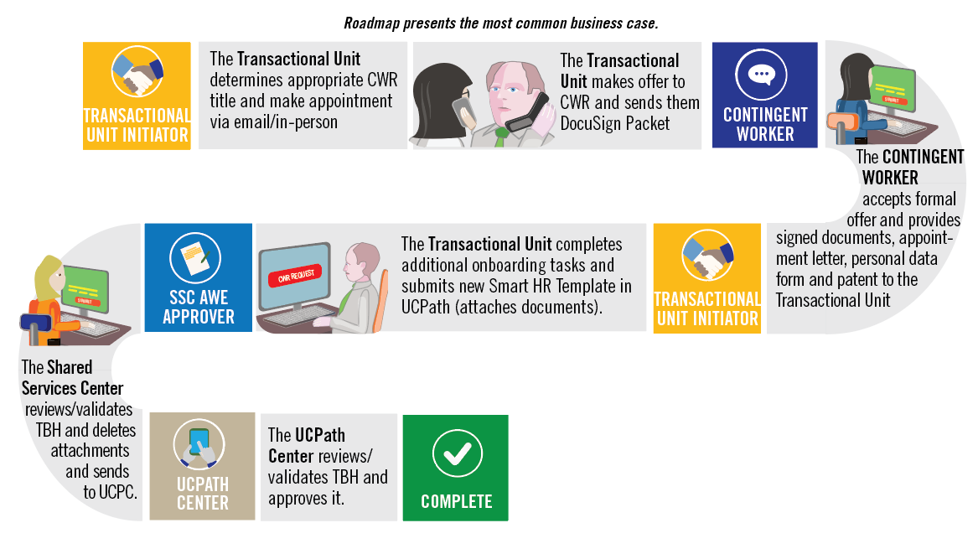
CONTINGENT WORKER ROADMAP
Note: CWR signs hard copy patent acknowledgement form during onboarding

Slide 57
NAVIGATION
Navigation: PeopleSoft Menu > Workforce Administration > Smart HR Template > Smart HR Transactions

Slide 58
POLICY IMPLICATIONS
ALL contingent workers, including temporary agency workers MUST be entered in UCPath
Contingent Workers are defined as individuals engaged by the University of California on a non-permanent basis to complete a specific function or task who do NOT have an employee relationship with UCR and do NOT receive remuneration through UCPath. An example of a contingent worker is a volunteer, since they are not paid, but also agency workers who perform work for UCR, but are paid through their agency. As such, all contingent workers, including temporary agency workers MUST be entered in UCPath for tracking purposes.
If you have an agency worker working in your department that is not in UCPath, they will need to be entered ASAP. Prior to requesting that they be entered in UCPath, please determine if the contingent worker in question needs a position.
If a contingent worker in your department supervises UCR employee, please create a position for them first. Generally, contingent workers will not supervise UCR employees, and will therefore not require a position. In that case, contingent worker can be added to UCPath using a job code. Job codes for contingent workers ALWAYS start with the prefix CWR.
If a contingent worker does NOT supervise UCR Employee(s), they can be Onboarded without a Position.

Slide 59
CONTINGENT WORKER DOWNSTREAM IMPACTS
Issue: CWR was entered in UCPath BUT was not processed through the NetID affiliation process.
Result: CWR will not receive NetID or access to needed systems.
Downstream impact: Failure to follow the NetID Affiliate process will prevent or delay employee from gaining required system access.
*An enhancement that automatically generates a NetID after a template is submitted in UCPath is pending.
Issue: Employee has two NetIDs.
Result: Employee will have two profile accounts in the system and will experience log in issues
Downstream Impact: Employee will have trouble accessing SSO. ITS Identity Management will review and determine which NetID should be used, merge accounts where needed and deactivate one of the NetIDs to restore the employees access. The employee will be notified which NetID is ready for use.

Slide 60
HANDOFF MATRIX
Process | Employee | Transactional Unit | SSC | UCPC | Central Office
CWR | Provides signed appointment letter, personal data form and patent. | Receives employee paperwork
CWR |  | Process Smart HR Template for CWR, including attachments, Needs to review Smart HR Template page and/or email to verify that it was approved/denied by SSC that it needs to be re-entered / cloned. | Review and approve/deny Smart HR Template for CWR and attached documents in AWE
CWR |  | Needs to review Transaction Status page and/or email to verify that it was approved/denied by UCPC that it needs to be re-entered / cloned. The Transactional Unit initiator contacts the SSC via Zoom, email, or phone, when UCPC cancels a transaction. |  | Reviews locally approved CWR template
CWR |  | Pilot Unit should reach out to central office for any questions regarding policy prior to processing template | SSCs should reach out to central office for any questions regarding policy prior to approving template |  | Respond to any policy questions

Slide 61
HANDOFF MATRIX
Process | Category | CWR Responsibility | Transactional Unit Responsibility | SSC Responsibility | Central Office Responsibility
CWR | Background Check and Live Scan | Receives simplybookme. Link and completes requested background check | Book fingerprint appointments through simply book me. This may occur before the template is submitted. Receives background check results from SSC | The results are sent to Central HR and the SSC receive an email stating if the background check is successful or not. SSC then emails the department to let them know that the employee can start work | Receive background check results and sends email to SSC. Labor Relations notifies SSC and Transactional Unit if there is an issue with the background check

Slide 62
HANDOFF MATRIX
Process | Category | CWR Responsibility | Transactional Unit Responsibility | SSC Responsibility | Central Office Responsibility
CWR | Standard Case Management Issues | ------ | Transactional Unit Initiators are responsible for opening STANDARD cases directly in Saleforce for transactions that they are initiating per the case management matrix. ESCALATED cases are to be elevated to the SSC per the On Behalf of Case Management Matrix. | ------ | ------

Slide 63
MATERIALS
Resource material regarding how to transact within UCPath for Contingent Worker is located here please utilize these documents as a reference for how to transact.
Contingent Worker:
Contingent Worker Template Transactions – Action Reason Codes and Descriptions
Initiate Renew Contingent Worker (With Position) Template Transaction
Initiate Renew Contingent Worker (No Position) Template Transaction
Initiate Extend Contingent Worker (With Position) Template Transaction
Initiate Extend Contingent Worker (No Position) Template Transaction
Initiate Complete Contingent Worker Instance Template Transaction
Initiate Add Contingent Worker (With Position) Template Transaction
Initiate Add Contingent Worker (No Position) Template Transaction
CWR Onboarding Checklist
Contingent Worker Infographic
CWR Process Workbook
CWR Process Map

Slide 64
THINGS TO REMEMBER
SSC’s will continue to enter background check results in UCPath on the Security Clearance for both Phase 1 and Phase 2.
CWR’s need to be entered into UCPath and ALSO go through the Net ID Affiliate process. An enhancement that automatically generates a Net ID after a template is submitted in UCPath is pending.
Transactional Unit will attach the Personal Data Form and Appointment Letter to TBH.
CWR’s do not need to sign the Oath.
You can clone a transaction that has been denied or cancelled in the Smart HR Template.

Slide 65
Personal Data Changes Overview

Slide 66
PROCESS DEFINITION
Personal Data is information that is unique to each employee. For example: your name, personal email address, education credentials, and contact information.

Slide 67
PERSONAL DATA CHANGES ROADMAP

Slide 68
NAVIGATION
Navigation: PeopleSoft Menu > Workforce Administration > Smart HR Template > Smart HR Transactions

Slide 69
HANDOFF MATRIX
Process | Employee Updates | Transactional Unit | SSC | UCPath
Personal Data Change | Employee Updates Information: Email address (personal), Emergency contact, Home and mailing addresses, Disclosure of information, Phone number (personal) | ------ | ------ | ------
Personal Data Change | Employee Updates: Education Degree/Highest Degree Achieved, Licensure/Certification, Legal Name (verified through SSNVS) | ------ | Validation and approval for Education Degree/Highest Degree Achieved, and Licensure/Certification | Legal Name change is verified through SSNVS
* The Central Offices have no responsibilities in this process

Slide 70
HANDOFF MATRIX
Process | Employee Updates | Transactional Unit | SSC | UCPath
Personal Data Change | Provides information to transactional unit | Transactional Updates Information: Email address (personal), Emergency contact, Home and mailing addresses, Disclosure of information, Phone number (personal) | SSCs review, approve, or deny via AWE | ------
Personal Data Change | Provides information to transactional unit | Transactional Updates Information: Education Degree/Highest Degree Achieved, Licensure/Certification, Legal Name (verified through SSNVS) | Validation and approval for Education Degree/Highest Degree Achieved, and Licensure/Certification | Legal Name change is verified through SSNVS
* The Central Offices have no responsibilities in this process

Slide 71
POLICY IMPLICATIONS
To ensure accuracy with the employee’s legal name, UCPC runs proposed changed legal name through SSNVS and only makes the personal data change if there is a match. If no match, UCPC notifies employee that change was rejected.
Gender Identity & Sexual Orientation can be updated by the employee in Employee Self-service (ESS); however, changes to gender require a valid government issued ID that indicates gender should be submitted with request or verified via SSNVS.

Slide 72
MATERIALS
Resource material regarding how to transact within UCPath for Personal Data is located here please utilize these documents as a reference for how to transact.
Personal Data Change:
Personal Date Changes Matrix
Personal Data Change Template Transactions – Action Reason Codes and Descriptions
Initiate Personal Data Change Template Transaction (Staff/Acad)
Update Personal Information – Security Clearance
Update Personal Information – Additional Names
Update Personal Information – Emergency Contacts
View Personal Information
Personal Data Change Infographic
Personal Data Change Process Workbook
Personal Data Change Process Map

Slide 73
THINGS TO REMEMBER
Employees can make most updates to their personal data directly in UCPath and are written directly to the database.
Documentation is required when updating Education Degree/Highest Degree Achieved, Licensure/Certification, Legal Name or Gender.
Changes requiring documentation is will not be written to the database until change is verified.
When personal data changes are made by the SSC or Transactional Pilot, AWE is required.

Slide 74
Person of Interest Overview

Slide 75
PROCESS DEFINITION
A Person Of Interest (POI) is someone who is tracked by Locations for various reasons, such as a potential hire or potential external resource. Locations are responsible for adding and maintaining POI records in UCPath.

Slide 76
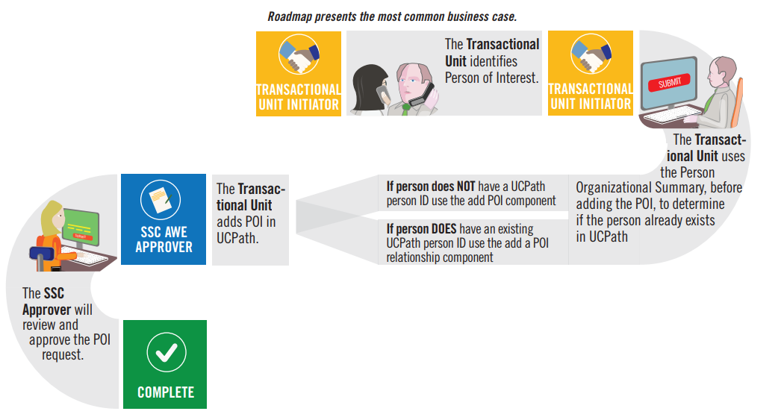
PERSON OF INTEREST ROADMAP

Slide 77
NAVIGATION
To add a Person of Interest:
Navigation: PeopleSoft Menu > UC Customization > UC Extensions > Person of Interest -Add
To add a Person of Interest Relationship:
Navigation: PeopleSoft Menu > Workforce Administration > Personal Information > Organizational Relationship >
Add POI Relationship
To Maintain a Person of Interest Relationship:
Navigation: PeopleSoft Menu > Workforce Administration > Personal Information > Organizational Relationship >
Maintain POI Relationship

Slide 78
HANDOFF MATRIX
Process | Category | CWR Responsibility | Transactional Unit Responsibility | SSC Responsibility | Central Office Responsibility | UCPC
POI | Identifying POI | ------ | POI is identified | ------ | ------ | ------
POI | Person Org Summary | ------ | Before adding POI use the Person Organizational Summary to determine if person exists in UCPath | ------ | ------ | ------
POI | Adding POI | ------ | Transactional Unit Initiator adds POI if the person does not have a UCPath Person ID Transactional Unit adds POI Relationship if the person has an existing UCPath Person ID | ------ | ------ | ------

Slide 79
HANDOFF MATRIX
Process | Category | CWR Responsibility | Transactional Unit Responsibility | SSC Responsibility | Central Office Responsibility | UCPC
POI | Approving POI | ------ | ------ | SSC AWE approver approves a person of Interest from the worklist, the link in the AWE email, or from the Person of Interest Approval Page | ------ | ------
POI | Assigning a Person ID | ------ | ------ | ------ | ------ | ------

Slide 80
HANDOFF MATRIX
Process | Category | CWR Responsibility | Transactional Unit Responsibility | SSC Responsibility | Central Office Responsibility | UCPC
POI | Resubmitting and Cloning Template Transaction | ------ | Responsible for cloning and resubmitting template transaction | If SSC AWE Approver denies the transaction, the transaction will go back to the initiator in the transactional unit | ------ | UCPath assigns the Person ID and creates the POI record when the request is approved

Slide 81
POLICY IMPLICATIONS
A person, whether a POI, a contingent worker (CWR), or an employee (EMP), should have only one Person ID in UCPath.
POIs are assigned a POI Type in UCPath. At minimum, each UCPath Business Unit has four POI types:
Assoc Of Pres/Chancellor
Potential Hire/Academic
Exter Compliance/Auditor
Potential Hire/Staff

Slide 82
MATERIALS
Resource material regarding how to transact within UCPath for Person of Interest is located here please utilize these documents as a reference for how to transact.
Person of Interest:
View Person Organizational Summary
Extend or Inactivate POI
Approve POI
Add Person of Interest
Add Person of Interest Relationship
POI Infographic
POI Process Workbook
POI Process Map

Slide 83
THINGS TO REMEMBER
Locations are responsible for adding and maintaining POI records in UCPath. A POI is not an employee of the University; and will not receive compensation through UCPath.
A POI does not have Position Data or Job Data in UCPath.
POIs are assigned a Person ID, instead of an Employee ID. If a POI later becomes an employee or a Contingent Worker (CWR), then their assigned Person ID becomes their Employee ID.
POI records that create a Person ID in UCPath are approved using Automated Workflow Engine (AWE). POI instances added to existing Person IDs do not use AWE.
UCPath Center does not add nor maintain POI records in UCPath. However, only UCPC can update a POI’s address and phone number. Locations must create a case to have UCPC update this information.

Slide 84
One-Time Pay Overview

Slide 85
PROCESS DEFINITION
The One Time Pay process is the method to add a flat dollar amount payment for staff and academic employees to be processed in a specific pay period.
The Transactional Units will have the opportunity to submit one-time payments for employees within their Accountability Structures.
The process begins when a department initiator in a Transactional Unit submits a one-time payment transaction for an employee in UCPath.
The process ends when all Payroll processes have been completed for the applicable pay period and the employee receives the payment on their paycheck.

Slide 86
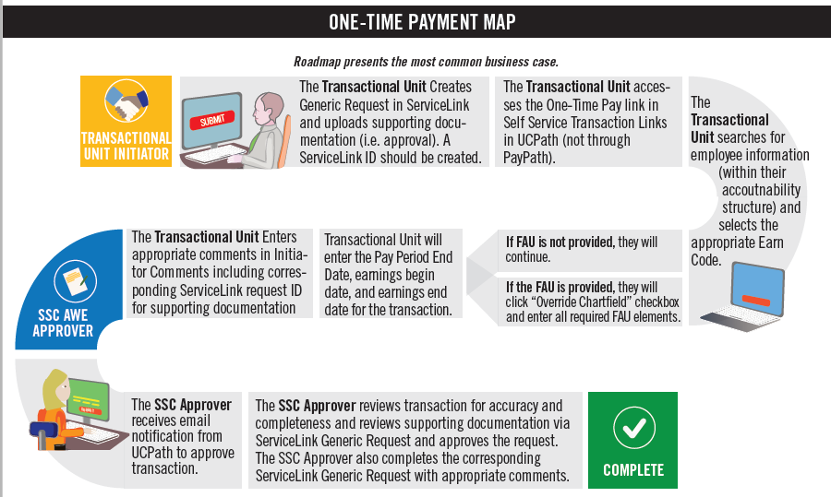
One Time Pay Roadmap

Slide 87
NAVIGATION
Navigation: PeopleSoft Menu > UC Customizations > UC Extensions > Self Service Transactions Links

Slide 88
HANDOFF MATRIX
Scenarios | One Time Payment | Contact UCR Payroll | ServiceLink Request
STAR/SPOT award for one employee. | X
STAR/SPOT awards for entire department. |  |  | X
By-agreement Payments/Earnings for UNEX faculty. |  |  | X
Honoraria pay for UCR faculty on pay status. | X
Regular payments for instructors. (i.e. Rec Center Instructors) | X
Interlocation Honoraria Payment for Faculty. |  | X
Staff Administrative Stipends Exceeding One Pay Period (Recurring Additional Pay). |  |  | X
Other One-Time Additional Compensations (i.e. Staff Stipend for One Pay Period). | X
Summer Session Payments for Non-Faculty Academics | X
Faculty Summer Salary Recurring Additional Payments (Non-research/Payroll Certification) |  |  | X
Transactional Unit submits the one time payments transaction, and the SSC approves the transaction
Transactional unit must also create a generic Servicelink request to attach supporting documentation for approval.

Slide 89
POLICY IMPLICATIONS
PPSM 30 - Compensation - https://policy.ucop.edu/doc/4010400/PPSM-30
UC Policy regarding compensation rules for exempt and non-exempt UC employees.
Policy also outlines acceptable additional cash compensation scenarios. (Refer to Section III. Policy text, B., 7-8 of policy).
PPSM 30 Local Guidance – Compensation - https://hr.ucr.edu/policies/policiesandcontracts/local_guidance_30_compensation.pdf
UCR guidance for PPSM 30 UC Policy.
APM Policy – Additional Compensation Honoraria - https://www.ucop.edu/academic-personnel-programs/_files/apm/apm-666.pdf
UC Policy regarding Additional Compensation requirements for honoraria payments for Academic Appointments.

Slide 90
THINGS TO REMEMBER
Transactional Unit must create a generic ServiceLink request to attach supporting documentation for approval.
SSCs cannot clone denied one-time payments, if they are denied they always have to be re-entered.
Transactional Unit submits one-time payment transaction, and SSC will approve the transaction.
Transactional Units can only submit one-time payment transactions for employees within their accountability structure.

Slide 91
ONE TIME PAY DOWNSTREAM IMPACTS
Issue: Incorrect earn code selected. Earn Codes will need to be selected appropriately.
Downstream impact: If an earn code is incorrect then financial management impacts will occur. To correct this issue, a Payroll Adjustment is required. Earnings cannot be transferred to different earn codes, so a Salary Cost Transfer will not work in this scenario.
Issue: Using the incorrect schedule affects timing around when a transaction is submitted AND approved in UCPath. It is critical to ensure transactions meet payroll deadlines. The One Time Pay page does not display an error message when transactions are submitted past the payroll deadline for a particular pay period.
Downstream Impact: If a One Time Pay transaction is submitted AND approved against a pay period after its deadline, the transaction will be rejected/unprocessed, resulting in a delay in the employee’s payment. To correct the issue, the transaction would need to be submitted against a future payroll for that employee. If the payment is urgent (i.e. the employee’s primary source of earnings), reach out to your Shared Services partners for assistance/guidance. (Note: refer to the UCPath Production Processing Schedule Deadline in the UCPath Portal –“PayPath/Mass Hire” column; denotes the approval deadline for one time payments for a particular pay cycle/period).

Slide 92
ONE TIME PAY DOWNSTREAM IMPACTS
Issue: Failure to add /department approvals will delay the approval process. One Time Pay process requires documentation/department approvals be attached to Generic ServiceLink requests for Shared Service Center Approvers to reference when approving in UCPath.
Downstream Impact: If a One Time Payment is submitted in UCPath and there is no corresponding Generic ServiceLink Request with supporting documentation, there may be a delay in when the transaction is approved. To minimize this delay, it is critical to create the corresponding request. Failure to do so can result in a transaction being “denied” which could cause the employee’s payment to be delayed.
Issue: Incorrect FAU values entered on “Chartfield Override”.
Downstream Impact: If the incorrect FAU values are submitted on a One Time Pay transaction then financial management impacts will occur. To correct this issue when it occurs, a Salary Cost Transfer (SCT) can be performed.

Slide 93
Voluntary Termination & Retirement Overview

Slide 94
PROCESS DEFINITION
The process of Voluntary Termination starts with the employee’s decision to resign or retire, and ends with the final payment information being transferred to the UCPath Center Payroll Production team. Voluntary terminations are processed for both staff and academic employees. There are benefits and payroll implications of voluntary terminations. These are dealt with in separate processes.
The process ends with the confirmation that the employee has been separated, all access to systems and facilities has been updated or terminated, and all outstanding university and employee obligations related to compensation are settled.

Slide 95
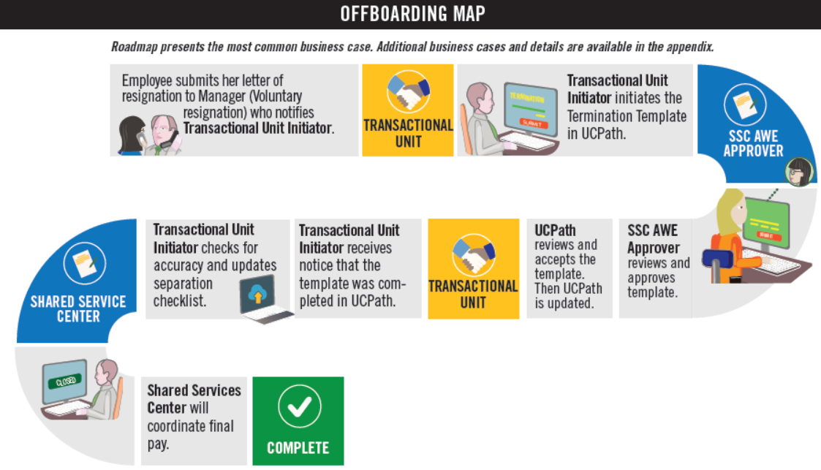
OFFBOARDING ROADMAP
NOTE: This is the High Level Happy Path map
For complete map, consult the Voluntary Termination/Retirement Infographic.

Slide 96
NAVIGATION
Navigation: PeopleSoft Menu > Workforce Administration > Smart HR Template > Smart HR Transactions

Slide 97
HANDOFF MATRIX
Process | Employee | Transactional Unit | SSC | UCPC
Offboarding | Provides Resignation | Received Resignation
Offboarding |  | Process Termination Template including attachments, Needs to review Smart HR Template page and/or email to verify that it was approved or that it needs to be re-entered / cloned | Review Termination Template and attached documents in AWE
Offboarding |  | Needs to review Transaction Status page and/or email to verify that it was approved or that it needs to be re-entered / cloned. The Transactional Unit initiator contacts the SSC via Zoom, email, or phone, when UCPC cancels a transaction. |  | Reviews locally approved termination template
Offboarding |  | Verify that SSC has processed final pay | Processes Final Pay Automatically (once termination template is approved)

Slide 98
POLICY IMPLICATIONS
Labor and Relations and the Central Office should be notified or consulted with upon termination of employee to discuss any implications that may arise.
UCR Local Procedure on Separation Actions
Personnel Policy 64 – Termination and Job Abandonment
Leaving UC Employment
APM – 700-30 Presumptive Resignation Policy and Procedures
Timeline for Implementing the Presumptive Resignation Process Under APM - 700

Slide 99
VOLUNTARY TERMINATION & RETIREMENT DOWNSTREAM IMPACTS
Issue: Voluntary terminations and retirements are very similar; be sure to select the appropriate template when creating the transaction.
Downstream Impact: to employee if retirement is not processed according to UCPC requirements; creates delays in getting AWE approvals and final pay.
Issue: The Last Date Worked auto populates with a date that is one day prior to the Effective Date. Ensure your dates are correct.
Downstream Impact: to pay/Service credit/retirement
Example: If an employee desires to retirement effective 7/1, a 1-day break is service is required. For 7/1/19 retirements, the last day worked was 6/27/19, the one day break in service was 6/28/19. The dates may change each year, so prior to processing, confirm with CSC.

Slide 100
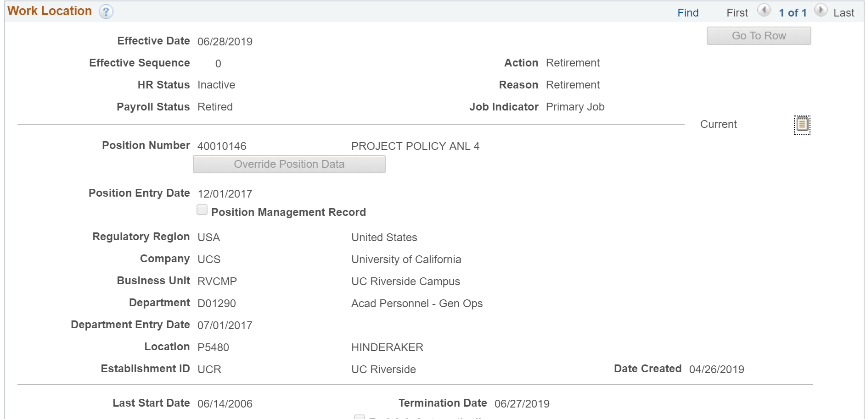
VOLUNTARY TERMINATION & RETIREMENT (continued)
Project Policy ANL 4

Slide 101
MATERIALS
Resource material regarding how to transact within UCPath for Offboarding Voluntary Termination and Retirement is located here please utilize these documents as a reference for how to transact.
Offboarding Voluntary Termination:
Offboarding Checklist
Voluntary Termination / Retirement Template Transactions – Action Reason Codes and Descriptions
Initiate Voluntary Termination Template Transaction
Voluntary Termination (Offboarding) Infographic
Voluntary Termination (Offboarding) Process Workbook
Voluntary Termination (Offboarding) Process Map

Slide 102
Known Issues, Workarounds, Troubleshooting and Downstream Impacts
Notes:
Before going to the next slide, engage the class and ask what known issues and workarounds they are already aware of.
CWR NetID issues
Next day check process ending and now using PayCard

Slide 103
KNOWN ISSUE: MISSING PAY
Issue: Employee missing pay that creates a hardship.
Result: If an employee has a hardship due to missing pay, two options are available.
Insta Paycard can be requested for up 70% of the gross pay. The request is made via the SSC.
Employee can wait for an off-cycle check. This process normally takes about 72 business hours.
Downstream Impact: Employee will need to wait until the next on-cycle if the missing pay is not addressed.

Slide 104
EMERITUS APPOINTMENT
Issue: It is important to add emeritus appointment as retirement occurs.
Downstream Impact: Failure to add can result in loss of access to research, email, etc., after 90 days.
Note: Process to reinstate access can take up to a week or more. - Impact

Slide 105
DEFAULT FUNDING - SCT
Issue: All newly created positions are given default funding.
Once a position is created and available in the FAU tool, the correct FAU needs to be added, prior to any funds being paid out.
Downstream Impact: Failure to maintain correct FAU will result in future SCTs.

Slide 106
UCPATH DATES
Issue: Incorrect effective dating
Incorrect chronological record of historic, current and future data:
Current Effective Date - Date that is less than or equal to the current system date.
Historic Effective Date – Dates that are less than the current information
Future Effective Date – Effective dates that are greater than the current information
Retro Effective Date – Date prior to the current pay period begin date
Issue: Incorrect Effective dates for inter-campus transfer
Downstream Impact: Breaks in service, retirement tier changes, new probation period to serve
Notes:
Voice over definition for each
Impact across the board: time and effort, poor customer perception, increase in support request csc, central office, ssc, ucpc

Slide 107
UCPATH DATES (continued)
Issue: Incorrect Effective dates for end of fiscal year retirements
Downstream Impact: no compounded COLA for the employee
Issue: Incorrect effective sequencing (By policy, there is an order in which actions should occur)
Downstream Impact: incorrect chronological record, incorrect compensation and Range adjustment
Range Adjustment
Merit increase
Reclassification
Notes:
Voice over definition for each
Impact across the board: time and effort, poor customer perception, increase in support request csc, central office, ssc, ucpc

Slide 108
THINGS TO REMEMBER
Voluntary and Involuntary transactions are very similar, be sure to select the appropriate template when creating the transaction. Be sure to select the correct Action/Reason code, or if needed, contact Labor and Relations for direction on which one is the appropriate one to use for the employee.
Effective Date is the date the transaction will take place.
The Last Date Worked auto populates with a date that is one day prior to the Effective Date.
Initiators can submit templates only for employees within departments for which they have security access. If needed, you must coordinate with other departments for terminating other UC jobs.

Slide 109
THINGS TO REMEMBER
If termination is due to death, only one termination template should be initiated. UCPC WFA Production will terminate all other UC Jobs for the employee.
Make note of your transaction ID for reference to find your transaction later.
Shared Service Centers will continue to transact for final pay. Final Pay should be submitted for any employee.
You can clone a transaction that has been denied or cancelled in the Smart HR Template.

Slide 110
THINGS TO REMEMBER
The transaction units will maintain a valid Offboarding checklist.
If a transaction is cancelled by UCPath, the transactional unit will need to advise the SSC of the action, and why it happened.
The employee will have access to the Former Employee portal for 36 months after termination.
The Employee is responsible for confirming retirement eligibility prior to submitting the retirement request.

Slide 111
THINGS TO REMEMBER
Enterprise Directory is updated 30 days after Staff termination, 90 days after Faculty Termination, and 180 days after Termination for Post-Docs. Affiliates have until the end date set up for them when the account was created. In all cases, the account can be immediately inactivated in the Enterprise Directory by a departmental Enterprise Directory admin or ITS Super User.

Slide 112
LEARNING OBJECTIVES REVIEW
Having completed this course, you should be able to:
Know what each process is and what it means
Access and initiate transactions in UCPath
Understand where the hand offs in each process are
Understand the policy behind each process
Understand the key concepts and takeaways from each process

Slide 113
APPENDIX
On behalf case management Process Map
Position control Process Map
Contingent worker Process Map
Personal data changes Process Map
Person of interest Process Map
One–time payments Process Map
Voluntary termination Process Map

Slide 114
APPENDIX
Navigation: PeopleSoft Menu > Workforce Administration > Smart HR Template > Smart HR Transactions
Navigation: PeopleSoft Menu > UCPath Workcenter
Navigation: PeopleSoft Menu > Workforce Administration > Job Information > Review Job Information > Workforce Job Summary
Navigation: PeopleSoft Menu > Workforce Administration > Smart HR Template > Transaction Status
Navigation: PeopleSoft Menu > UC Customizations > UC Extensions > Position Control Request
Navigation: PeopleSoft Menu > UC Customizations > UC Extensions > PayPath Actions

Slide 115
Ucr ucpath transaction pilot
Readiness assessment review

Slide 116
Go, No-Go Business Readiness Areas - Transactional Units:
Identification of transaction processing primary and backup resources for pilot
Review of core pilot processes and understanding of handoffs
Mandatory pilot training (online, in-person and dress rehearsal)
Identification of SLA for departmental customers
Operationalize the Pilot work within your unit

Slide 117
Readiness Status Report

Slide 118
Schedule for Submission
We will use this information to evaluate our progress for the Pilot , identify any risks and compile it for submission to our leadership for a targeted 8/1 go live decision. Please submit your completed spreadsheet on the following schedule.
Tuesday 7/23 by noon
Tuesday 7/30 by noon
We will send the document specific to your unit on Thursday 7/18

Slide 119
Additional Topics for Review
Expectations
Monitoring/Auditing your transactions
What to do when you need help
Where do I go for Support?

Slide 120
Ucr ucpath transaction pilot
Questions, comments,
feedback

Slide 121
Where to go for Support?
DEPARTMENT/CENTRAL OFFICE – Policy, merit or promotion action - department central office, netid (in specific instances-netid affiliate process)
SSC: Question about pay and transactions submitted by the SSC, netid. Question about UCPC cancelled transactions. Question about handoffs for Pilot transactions. AWE Approval or Denial.
Benefits: Contact your SSC and the HR Benefits team
CSC: UCPath Training, UCPath/SSC Escalations, advocates, urgent time sensitive, issue impacting large populations.
Employees: escalations, graduate students
CSC: Catch all if you don’t know where to go or just want to hand off contact the CSC

Slide 122
Your Feedback Please
http://bit.ly/ucpathpilottraining

