Slide 1
Ucr ucpath transaction pilot
Voluntary termination & retirement

Slide 2
TRAINER INTRODUCTION
Sonya Potter
Title: Graduate Student Support Lead UCPath Business Support Analyst
Department: Campus Support Center
Years at UC: 2 years
Previous Experience: 16+ years of experience in creating detailed business processes, re-case business flow into system specifications, develop job aids, training, and testing documents for established national industry competitive technology platforms.

Slide 3
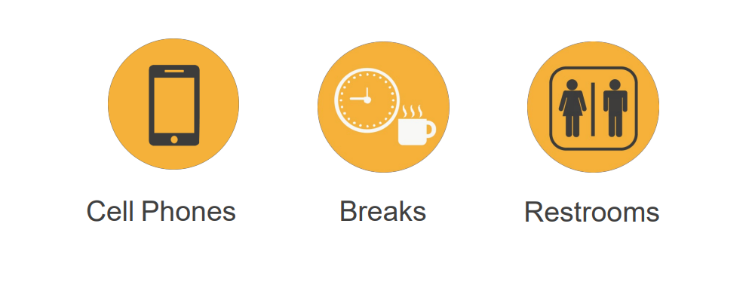
HOUSEKEEPING

Slide 4
LEARNING OBJECTIVES
Understand what a Voluntary Termination and Retirement is
Review Voluntary Termination and Retirement Process Overview
Review Voluntary Termination and Retirement Action Reason Codes
Review Voluntary Termination and Retirement Template Transaction
I

Slide 5
LEARNING TOPICS
LECTURE & REVIEW
VOLUNTARY TERMINATION DEFINITION
RETIREMENT DEFINITION
VOLUNTARY TERMINATION PROCESS OVERVIEW
RETIREMENT PROCESS OVERVIEW
VOLUNTARY TERMINATION ACTION REASON CODES
RETIREMENT ACTION REASON CODES
ROLE DESCRIPTION
VOLUNTARY TERMINATION TEMPLATE TRANSACTION
RETIREMENT TEMPLATE TRANSACTION

Slide 6
LEARNING TOPICS
HANDS ON TRAINING
SHAREPOINT INSTRUCTIONS

Slide 7
Voluntary Termination Definition

Slide 8
VOLUNTARY TERMINATION DEFINITION
The process of Voluntary Termination starts with the employee’s decision to resign his/her job at University of California Riverside.
Voluntary terminations are processed for both staff and academic employees. There are benefits and payroll implications of voluntary terminations, these are dealt with in separate processes.
The process ends when final pay has been processed by the Shared Service Center, the confirmation that the employee has been separated, all access to systems and facilities has been updated or terminated, and all outstanding university and employee obligations related to compensation are settled.

Slide 9
Retirement Definition

Slide 10
RETIREMENT DEFINITION
Retirement is defined as when an employee voluntarily resigns from all UC jobs and initiates payments through UCRP.
The process ends with the confirmation that the employee has been separated, all access to systems and facilities has been updated or terminated, and all outstanding university and employee obligations related to compensation are settled.

Slide 11
Voluntary Termination Process Overview

Slide 12
VOLUNTARY TERMINATION - OVERVIEW
There are two templates available for terminations: Voluntary and Involuntary.
Initiate a voluntary termination template when:
An employee decides to resign their UC employment.
Available Templates
NOTE: The process of initiating an Involuntary Termination template will be discussed during Phase II of the Pilot.

Slide 13
VOLUNTARY TERMINATION – OVERVIEW
The termination template is used for academic and staff terminations.
Initiators can submit templates only for employees within departments for which they have security access. If needed, you must coordinate with other departments for terminating other UC jobs.

Slide 14
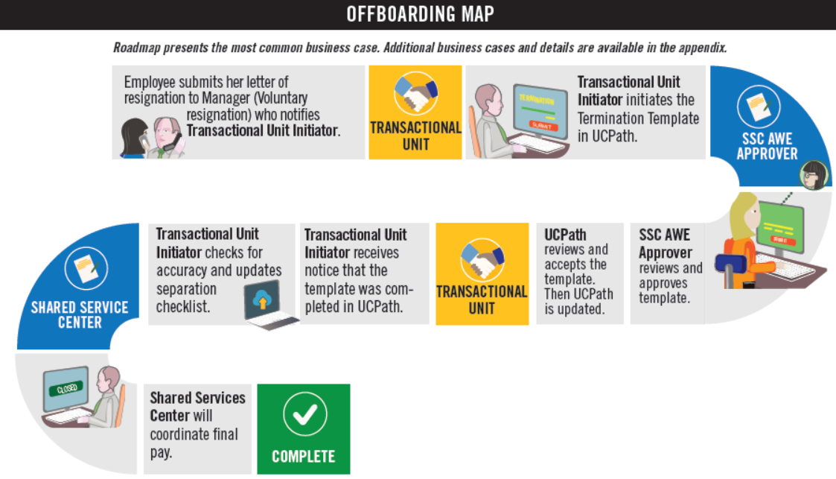
OFFBOARDING MAP
NOTE: This is the High Level Happy Path map
For complete map, consult the Voluntary Termination/Retirement Infographic.

Slide 15
TERMINATION – KEY SYSTEM STEPS
Important:
When reviewing the Person Org Summary Page, look for other jobs the employee may have. This will help to coordinate with other Depts./Orgs.
Important:
The SSC will initiate final pay on all Termination transactions.
Enter termination details and attach supporting documents as needed
Review Person Org Summary page
Navigate to the
Smart HR Transactions page
Select the Termination template
Save and Submit
Initiate final pay

Slide 16
Retirement Process Overview

Slide 17
RETIREMENT – OVERVIEW
Initiate a retirement template when an employee decides to retire.
There is one retirement template that is used for both academic and staff employees.
When UCPC WFA Production receives a retirement transaction, they will retire the employee from ALL UC jobs.
Available Templates

Slide 18
RETIREMENT – KEY SYSTEM STEPS
Important:
When reviewing the Person Org Summary Page, look for other jobs the employee may have. This will help to coordinate with other Depts./Orgs.
Important:
The SSC will initiate final pay on all Termination transactions.
Enter retirement details and attach supporting documents as needed
Review Person Org Summary page
Navigate to the
Smart HR Transactions page
Select the Retirement template
Save and Submit
Initiate final pay

Slide 19
CHECK YOUR UNDERSTANDING

Slide 20
CHECK YOUR UNDERSTANDING
When does the process end for Voluntary Termination and Retirement?
True or False: An employee is retiring from UCR but has multiple jobs one of which is in your department. You submit the Voluntary termination/Retirement template and that will terminate him from all jobs.
Multiple Choice: Who is the AWE Approver for a Voluntary Termination?
SSC
Department
Central Payroll
Notes:
Answer #1 - The process ends with the confirmation that the employee has been separated, all access to systems and facilities has been updated or terminated, and all outstanding university and employee obligations related to compensation are settled.
Answer #2 You cannot, you must coordinate with other SSC’s or Departments.
Answer #3 – SSC

Slide 21
Voluntary Termination Action Reason Codes

Slide 22
VOLUNTARY TERMINATION ACTION REASON CODES
There are various Action Reason Codes for Voluntary Termination; some, however, are for very specific circumstances. If you have a question on which Action Reason Code to use, please contact AP or HR central offices for guidance.
Action Reason | Description
CAR – Career to Per Diem | Use for termination of career appointment. Employee will be rehired into a Per Diem position. Must have a one-day break in service. These individuals will be required to sign a waiver form as part of the rehire process.
TR1 – Release from Trial Employment (Voluntary) | Use for release from trial employment initiated by the employee.
AAJ – Resign – Accept Another Job | Use for termination due to employee accepting another job.
SCH – Resign – Attend School | Use for termination due to employee planning to attend school.
The complete Voluntary Termination / Retirement Template Transactions – Action Reason Codes and Descriptions Job Aid can be accessed here.

Slide 23
VOLUNTARY TERMINATION ACTION REASON CODES (continued)
Action Reason | Description
DWJ – Resign – Dissatisfied w/ Job | Use for termination due to employee being dissatisfied with job.
JAB – Resign – Job Abandonment | Use for termination due to job abandonment.
LAJ – Resign – Look for Another Job | Use for termination due to employee looking for another job.
MIL – Resign – Military Service | Use for termination due to employee planning to enter military service.
MOA – Resign – Moved Out of Area | Use for termination due to employee moving out of area.
The complete Voluntary Termination / Retirement Template Transactions – Action Reason Codes and Descriptions Job Aid can be accessed here.

Slide 24
VOLUNTARY TERMINATION ACTION REASON CODES (continued)
Action Reason | Description
NRG – Resign – No Reason Given | Use for termination when employee does not provide a reason.
PER – Resign – Personal Reasons | Use for termination due to personal reasons.
QWN – Resign – Quit Without Notice | Use for termination due to employee quitting without notice.
SLF – Resign – Self Employment | Use for termination due to employee planning to work for him/herself.
FRL – Resign – Fail to Return from Leave | Use for termination due to employee’s failure to return from an approved leave of absence.
The complete Voluntary Termination / Retirement Template Transactions – Action Reason Codes and Descriptions Job Aid can be accessed here.

Slide 25
Retirement Action Reason Code

Slide 26
RETIREMENT ACTION REASON CODE
Action Reason | Description
RET – Retirement | Use for retirement.
The complete Voluntary Termination / Retirement Template Transactions – Action Reason Codes and Descriptions Job Aid can be accessed here.

Slide 27
Role Description

Slide 28
TRANSACTION ROLES
1: Employee
2: Department
3: Shared Service Center
4: International Students and Scholars Office
5: Central Office
6: Transactional Unit
7: UCPath Center
8: Org Authority

Slide 29
TRANSACTION ROLES
Informs supervisor/department of resignation/retirement
Returns UC assets to department
1: Employee
2: Department
3: Shared Service Center
4: International Students and Scholars Office
5: Central Office
6: Transactional Unit
7: UCPath Center
8: Org Authority

Slide 30
TRANSACTION ROLES
Informs the Transactional Unit of the employee’s resignation/retirement
Fulfills Offboarding department tasks such as:
Coordination of return of assets
Coordinate exit interview
Remove or revise system access
1: Employee
2: Department
3: Shared Service Center
4: International Students and Scholars Office
5: Central Office
6: Transactional Unit
7: UCPath Center
8: Org Authority

Slide 31
TRANSACTION ROLES
AWE Approver for transactions (Phase 1)
Transacts final pay
Maintain performance metric spreadsheet (AWE denials & UCPC cancellations)
1: Employee
2: Department
3: Shared Service Center
4: International Students and Scholars Office
5: Central Office
6: Transactional Unit
7: UCPath Center
8: Org Authority

Slide 32
TRANSACTION ROLES
Is notified of the employee’s Offboarding if the employee is a non-resident
1: Employee
2: Department
3: Shared Services
4: International Students and Scholars Office
5: Central Office
6: Transactional Unit
7: UCPath Center
8: Org Authority

Slide 33
TRANSACTION ROLES
Responsible for HR/AP process designs
Provide subject matter expertise in technical/complex areas
Interface with HR/AP business partners and institutional leadership
APO is notified by Org. AP directors of Offboarding and deaths for academic positions
1: Employee
2: Department
3: Shared Service Center
4: International Students and Scholars Office
5: Central Office
6: Transactional Unit
7: UCPath Center
8: Org Authority

Slide 34
TRANSACTION ROLES
Primary point of contact for managers and unit level leadership
Represent the needs of the individual business unit
Initiates UCPath Template for Voluntary Offboarding & Retirement
Opens UCPath cases on behalf of employees when needed (see On Behalf Case Management Workbook)
Monitors Transaction Status page for transaction status
AWE Approver for transaction (for Phase II)
1: Employee
2: Department
3: Shared Service Center
4: International Students and Scholars Office
5: Central Office
6: Transactional Unit
7: UCPath Center
8: Org Authority

Slide 35
TRANSACTION ROLES
Processes Voluntary Termination/Retirement templates
Notifies initiator when transaction is canceled or approved
Processes final pay per policy/bargaining unit contracts
1: Employee
2: Department
3: Shared Services
4: International Students and Scholars Office
5: Central Office
6: Transactional Unit
7: UCPath Center
8: Org Authority

Slide 36
TRANSACTION ROLES
Responsible for ensuring the appropriate policy is followed
1: Employee
2: Department
3: Shared Service
4: International Students and Scholars Office
5: Central Office
6: Transactional Unit
7: UCPath Center
8: Org Authority

Slide 37
Change Impacts

Slide 38
CHANGE IMPACTS
The submission of a template transaction for Voluntary Termination will be initiated by the Transactional Unit, which used to be done by the SSC. This means that the initiator will initiate the process, but SSC will be responsible for approving/validating the transaction via AWE in Phase 1.
SSC AWE Approver needs to add a comment when transaction is denied. Note: Only done if SSC AWE Approver denies the transaction before going to UCPC
The SSC will continue to process final pay
In the event that UCPath Cancels a transaction, the transactional unit will need to notify the SSC of the Cancellation.

Slide 39
CHECK YOUR UNDERSTANDING

Slide 40
CHECK YOUR UNDERSTANDING
Name the Action/Reason Code for Resign No Reason Given
True or False: One of the responsibilities of the department when Offboarding an employee is to Remove System Access?
Name the responsibilities of the SSC from the Transaction Roles
Transacts Final Pay
Maintain performance metric spreadsheet
Approve AWE
All of the Above
Notes:
Answer #1 – NRG
Answer #2 -
True
#3 All Above

Slide 41
Voluntary Termination Template Transaction

Slide 42
SMART HR TRANSACTIONS PAGE
Navigation: PeopleSoft Menu > Workforce Administration >Smart HR Template > Smart HR Transactions
Select the appropriate termination template (voluntary).
Enter the Effective Date of the template transaction.
Click Create Transaction to begin entry of the template transaction.

Slide 43
ENTER TRANSACTIONS DETAILS PAGE
Important:
The Effective Date is populated based on your entry on the previous page.
Ensure that you entered the correct Effective Date.
Enter the details for the termination
Effective Date Definition:
Date on which the associated information takes effect. The information is in effect until a new entry is made with a more current effective date. We do not have “stop dates” on effective dated data. The Effective Date usually defaults to the system's current date.
Effective Dating: Effective Dating is used to maintain and view a complete chronological record of historic, current, and future data.
Current Effective Date – Date that is less than or equal to the current system date.’
Historic Effective Date – Dates that are less than the current information
Future Effective Date – Effective dates that are greater than the current information
Retro Effective Date – Date prior to the current pay period begin date
Select the correct Employee ID and Employment Record Number for the job to terminate. If the employee has multiple assignments, submit a termination template for all jobs, as necessary.
Select the appropriate
Reason Code.
Click Continue to enter the remaining details of the template.

Slide 44
ENTER TRANSACTION INFORMATION
The Last Date Worked automatically populates with a date that is one day prior to the Effective Date.
If the Effective Date is a Monday, the Last Date Worked defaults to the previous workday (Friday).
The Last Date Worked field can be changed, if needed; however, the Last Date Worked must be prior to the Effective Date.
IF the Last Date Worked was not the day prior, you MUST change the date to what the last day was.
Update the Last Date Worked if needed, and enter a Comment.

Slide 45
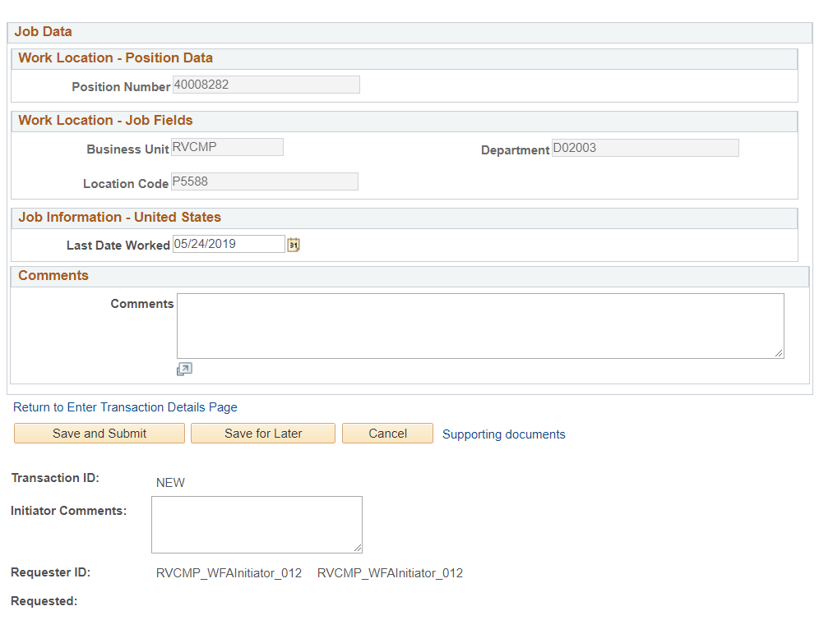
VOLUNTARY TERMINATION TEMPLATE SUPPORTING DOCS
Use the Supporting documents link to attach supporting documents

Slide 46
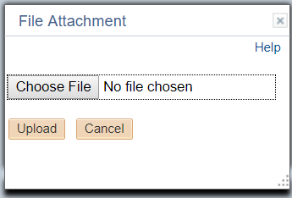
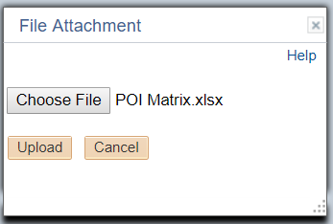
VOLUNTARY TERMINATION TEMPLATE SUPPORTING DOCS
The supporting documents window will appear
Click the Upload button
The File Attachment window will appear
Click the Choose File button
Your document window will open. Select the document, and click OK
The File Attachment window will appear again with the chosen file
Click the Upload button
The supporting documents window will appear again with the file attachment
Click OK

Slide 47
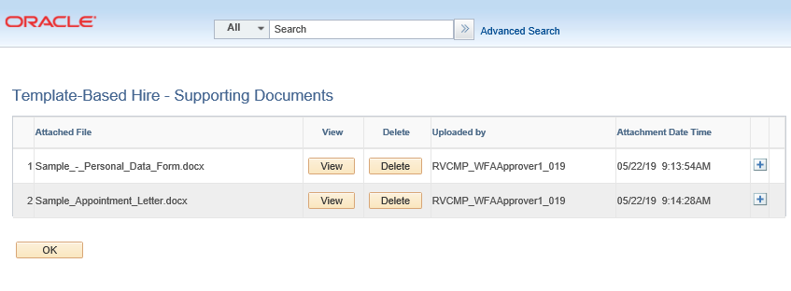
DELETING SUPPORTING DOCUMENTS
Click Delete to remove supporting documents provided by the Transitional Unit Initiator
Click the Yes button.

Slide 48
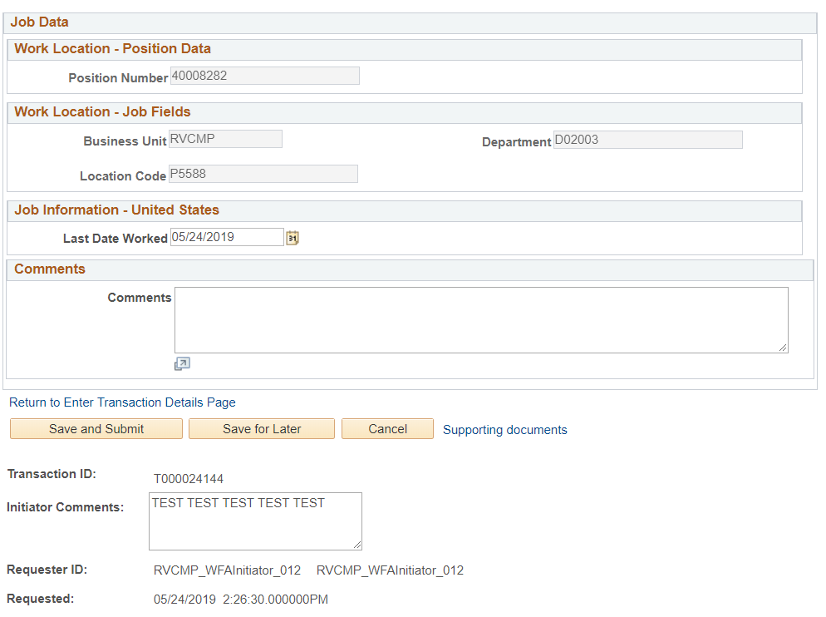
VOLUNTARY TERMINATION TEMPLATE SAVE & SUBMIT
Select Save and Submit.
NOTE: you can select the Save for Later button if you are not finished with the transaction, and will come back to it later.
Important:
After you Save and Submit, The Transaction ID will generate
Make Note of the Transaction ID for future reference

Slide 49
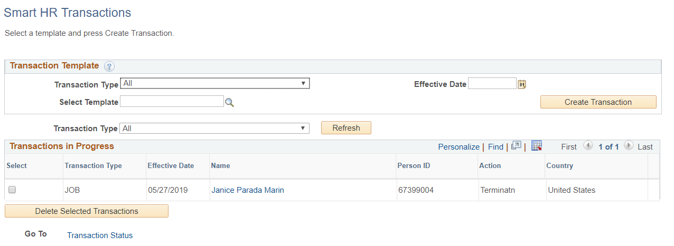
VOLUNTARY TERMINATION TRANSACTION STATUS
The template transaction is routed for approval and appears in the Transaction in Progress section until it is processed.

Slide 50
TERMINATION – FINAL PAY
Final pay is required when an employee is separated, and all other jobs are terminated or retired.
The termination and retirement templates provide a link for initiating final pay after entering the template. The Shared Service Center will use this link to initiate Final Pay.
The Shared Service Center will initiate Final Pay on any termination template.

Slide 51
Retirement Template Transaction

Slide 52
SMART HR TRANSACTIONS PAGE
Navigation: PeopleSoft Menu > Workforce Administration > Smart HR Template > Smart HR Transactions
Click Create Transaction to begin entry of the template transaction.
Enter the Effective Date of the template transaction.
Select the retirement template.

Slide 53
ENTER TRANSACTIONS DETAILS PAGE
Important:
The Effective Date is populated based on your entry on the previous page.
Ensure that you entered the correct Effective Date.
Enter the details for the retirement.
Effective Date Definition:
Date on which the associated information takes effect. The information is in effect until a new entry is made with a more current effective date. We do not have “stop dates” on effective dated data. The Effective Date usually defaults to the system's current date.
Effective Dating: Effective Dating is uses to maintain and view a complete chronological record of historic, current and future data.
Current Effective Date – Date that is less than or equal to the current system date.’
Historic Effective Date – Dates that are less than the current information
Future Effective Date – Effective dates that are greater than the current information
Retro Effective Date – Date prior to the current pay period begin date
Select the correct Employee ID and Employment Record Number for the job to retire. If an employee retires from UC, only one retirement template needs to be initiated; UCPC WFA Production will retire all other jobs for the employee, as needed.
Click Continue to enter the remaining details of the template.
There is only one Reason Code for the retirement template.
NOTE:
UCPC is taking ownership to confirm if employee should be retired from all jobs.
Departments/Orgs. need to review Person Org Summary page to coordinate with other departments if needed, to terminate/retire an employee from all jobs.

Slide 54
ENTER TRANSACTION INFORMATION
The Last Date Worked automatically populates with a date that is one day prior to the Effective Date.
If the Effective Date is a Monday, the Last Date Worked defaults to the previous workday (Friday).
The Last Date Worked field can be changed, if needed; however, the Last Date Worked must be prior to the Effective Date.
IF the Last Date Worked was not the day prior, you MUST change the date to what the last day was.
Update the Last Date Worked if needed, and enter a Comment

Slide 55
RETIREMENT – FINAL PAY
Final pay is required when an employee is separated, and all other jobs are terminated or retired.
The termination and retirement templates provide a link for initiating final pay after entering the template. The Shared Service Center will use this link to initiate Final Pay.
The Shared Service Center will initiate Final Pay on any termination template.

Slide 56
CHECK YOUR UNDERSTANDING

Slide 57
CHECK YOUR UNDERSTANDING
Where in UCPath do you start the transaction for Voluntary Termination?
True or False Effective Date is the last date employee worked?
3. Choose the correct definition of Historic Effective Date
1. Dates that are less than or equal to the current system date
2. Date prior to the current pay period begin date
3. Dates that are less than the current information
Notes:
#1 – Smart HR Transactions
#2 – False it is Date on which the associated information takes effect.
#3 – Types of Effective Dating
Current Effective Date – Date that is less than or equal to the current system date.’
Historic Effective Date – Dates that are less than the current information
Future Effective Date – Effective dates that are greater than the current information
Retro Effective Date – Date prior to the current pay period begin date
#4 – Write down the Transaction ID Number

Slide 58
Approve Transaction

Slide 59
AWE APPROVER ROLE
For Phase 1 of the Pilot, the Shared Service Centers will be responsible for validating and approving the Template Based Transactions for Voluntary Termination via AWE.

Slide 60
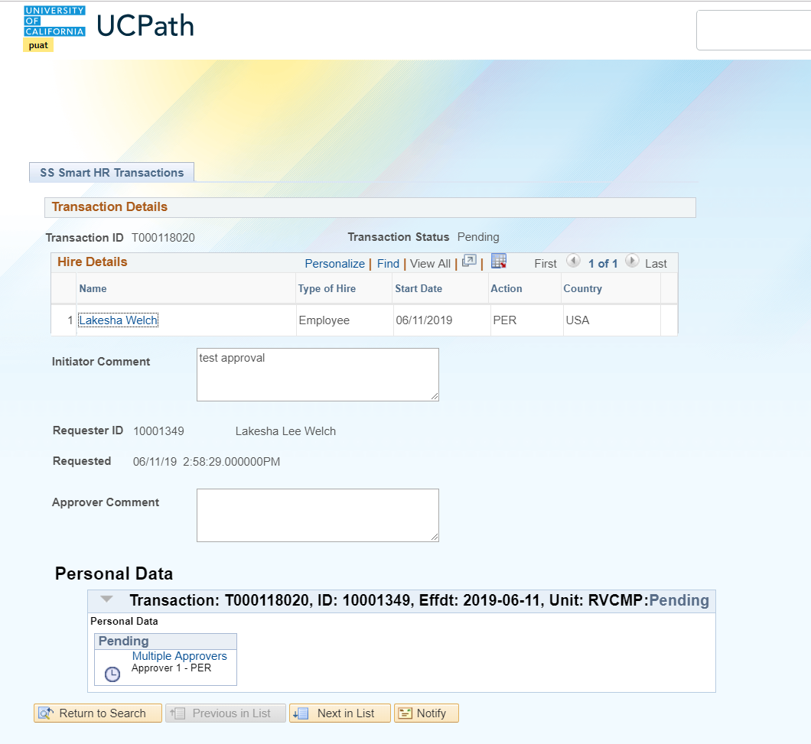
TRANSACTION DETAILS PENDING
Navigation: PeopleSoft Menu > Workforce Administration > Smart HR Template > Smart HR Transactions > Transaction Details
The transaction will remain in a Pending Status until the AWE Approver approves or denies the transaction.
If Approved, the next step in the process will be UCPath review. UCPath has the option of Approving or Cancelling the transaction.

Slide 61
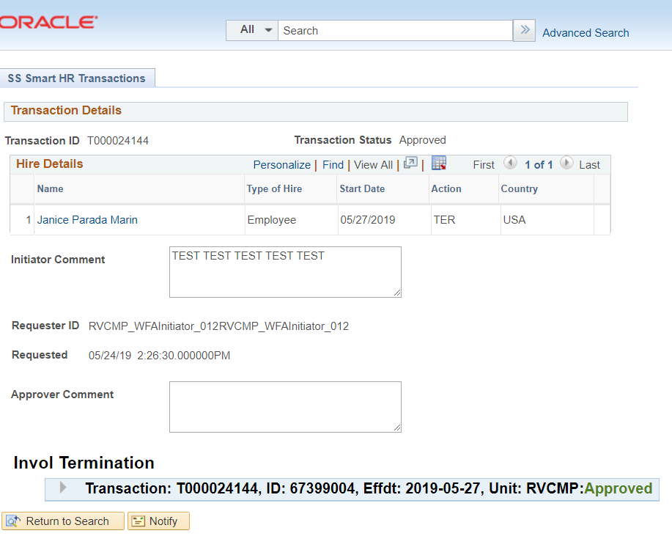
TRANSACTION DETAILS APPROVED
Navigation: PeopleSoft Menu > Workforce Administration > Smart HR Template > Smart HR Transactions > Transaction Details
Important:
Transactors will need to monitor the Transaction Details view for the status of their transactions.
Transaction Approved by AWE

Slide 62
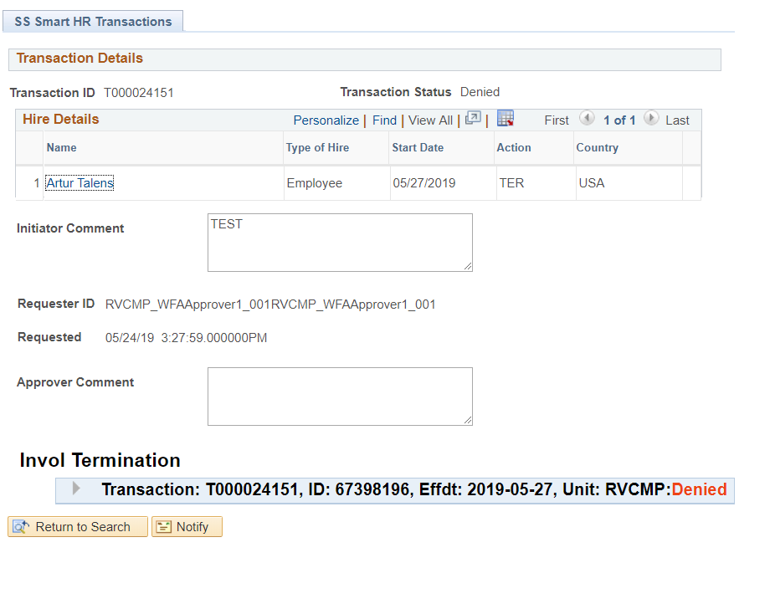
TRANSACTION DENIED/CANCELLED
Navigation: PeopleSoft Menu > Workforce Administration > Smart HR Template > Smart HR Transactions > Transaction Details
In the event that the template is denied by the AWE approver in the SSC, the template is returned (with comments) to the Transactional Unit Initiator to correct and resubmit.
The Transactional Unit Initiator will be able to clone the transaction from the Transaction Status page.
If the Transaction is Cancelled by UCPath, the Transactor will receive an email with an explanation on why it was cancelled.
The Transactor must contact the SSC to inform them of the cancellation.
Transaction Denied by AWE

Slide 63
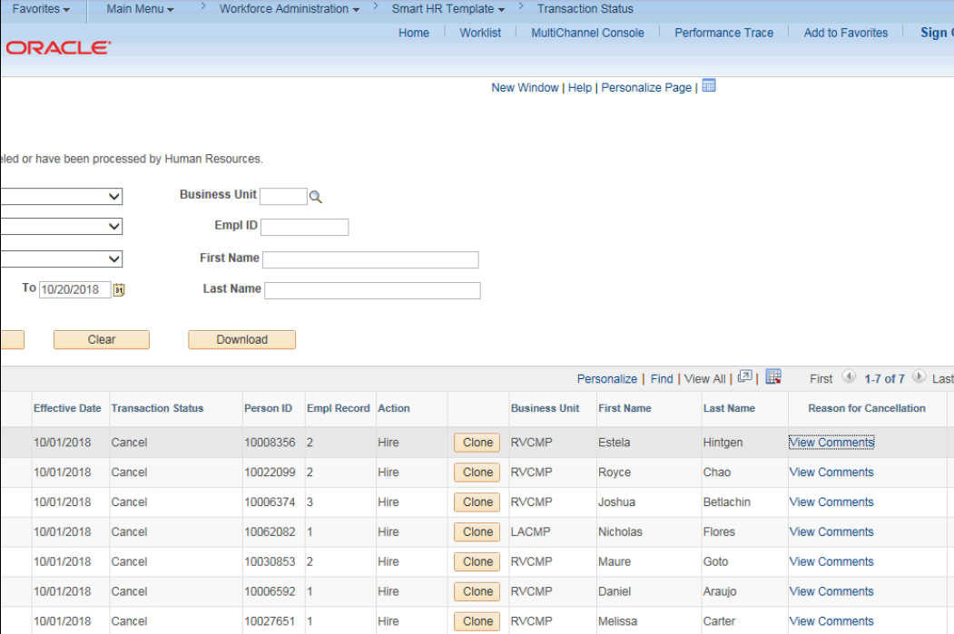
VIEW CANCELLATION COMMENTS FROM UCPC
Navigation: PeopleSoft Menu > Workforce Administration > Smart HR Template > Smart HR Transactions > Transaction Status
When a transaction is cancelled by UCPC WFA Production, comments are entered to explain why the transaction was cancelled. Template Initiators can View Comments under Reason for Cancellation and, if needed, Clone the transaction to resubmit it with necessary corrections.
Note: To view comments about a transaction that was denied by a Location AWE Approver you must navigate to the SS Smart HR Transactions page and review the Approver Comments field.

Slide 64
CHECK YOUR UNDERSTANDING

Slide 65
CHECK YOUR UNDERSTANDING
Where do you monitor Transactions?
What status are transactions in when you first enter the transaction:
Approval
Denied
Cancelled
Pending
3.True or False the SSC can Cancel a Transaction?
Notes:
#1 Transaction Details
#2 Pending
#3 UCPath Only, SSC will Deny.

Slide 67
SharePoint Instructions & Hands on Training

Slide 68
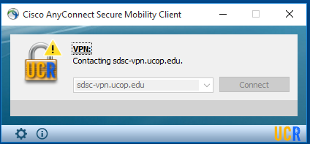
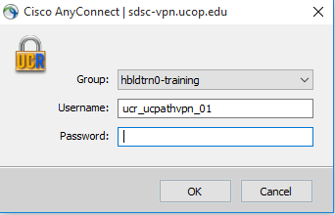
SHAREPOINT LIST INSTRUCTIONS
Open the Cisco AnyConnect client.
Enter the VPN name: sdsc-vpn.ucop.edu
Click Connect.
Select the Group: hbldtrn0-training
Enter one of the following username:
• ucr_ucpathvpn_01 Row 1 and Row 2
• ucr_ucpathvpn_02 Row 3 and 4
ucr_ucpathvpn_02 Row 5 and 6
The VPN password for the week of 7/15/19 is: !!1_Meat_Most!!
Once Connected to the VPN:
Go to https://hbldtrn0.ucpath-build.devops.universityofcalifornia.edu/psp/HBLDTRN0/?cmd=login&languageCd=ENG&
Enter the Tester ID\Password provided in the SharePoint Scenarios.

Slide 69
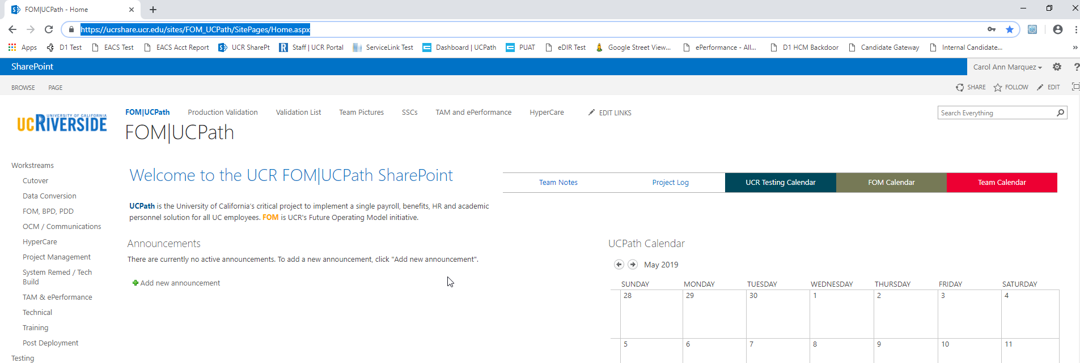
SHAREPOINT LIST INSTRUCTIONS
Testing SharePoint: https://ucrshare.ucr.edu/sites/FOM_UCPath/SitePages/Home.aspx
Preferred browsers are Internet Explorer and Chrome. (Save the link as a favorite)
Select UCPath Transaction Training Scenarios from the left side Quick Menu:

Slide 70
VIEWING LIST OPTIONS
When the list opens, note the tabs at the top of the screen:

Slide 71
VIEWING LIST OPTIONS part 2
By selecting ‘List’ you can filter the view on the process you are transacting. The default view is All Transactions. Select a specific transaction type to view the list containing only those transactions:

Slide 72
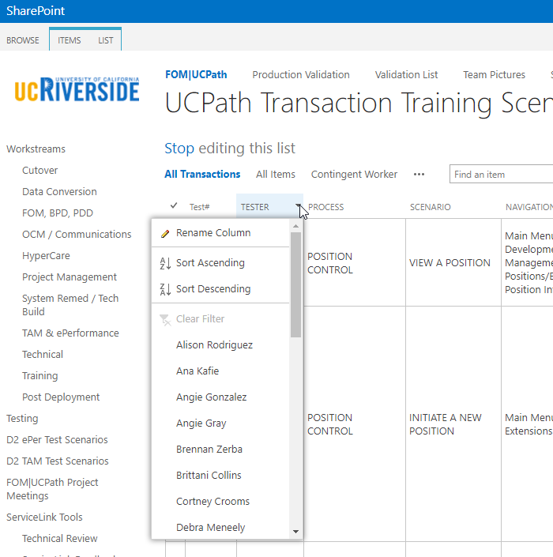
UPDATING AND EDITING A SHAREPOINT LIST
Many functions of a SharePoint list are similar to MS Excel, except that it is in a central location and can be accessed / updated by multiple people at the same time.
Use the list headers to filter and sort. Only you will see these temporary changes.
By selecting your name in the drop-down, you will have easy access to only your transactions. This is especially helpful if your name appears several pages into the list.

Slide 73
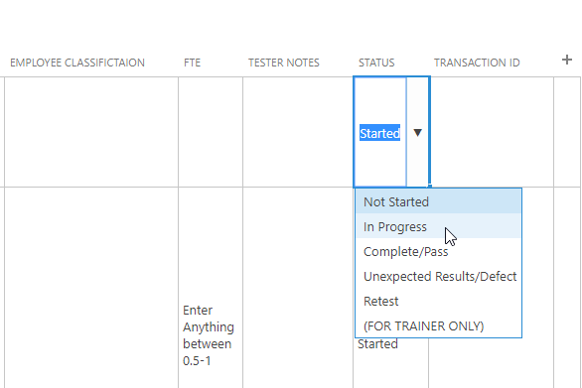
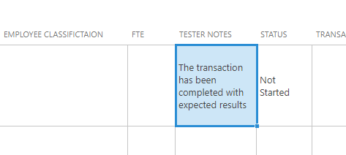
UPDATING AND EDITING A SHAREPOINT LIST part 2
You can update your test by editing directly by clicking into the cell. Some cells are controlled by a drop-down choice; others are free-form. To save your change, click in another cell.

Slide 74
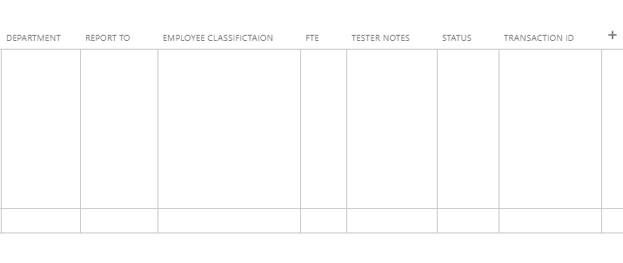
UPDATING VOLUNTARY TERMINATION ON SHAREPOINT
You can update your scenario by editing directly into the cell. Some cells are controlled by a drop-down choice, others are free-form. To save your change, click in another cell.

Slide 75
UPDATING VOLUNTARY TERMINATION (continued)
Field Name | Definition
Tester Net ID | Test User’s Login Name
Tester Password | Test User’s Password
Position Number | Terminated Employee’s Position Number
Bus Unit | Terminated Employee’s Business Unit
Location Code | Terminated Employee’s Location
Terminated Employee/Testing | Terminated Employee’s Name
Job Code | Terminated Employee’s Job Code Number
Department | Name of Terminated Employee’s Department
Report To | Terminated Employee’s (Supervisor/Manager) Report To
Employee Classification | Terminated Employee’s Employee Classification
FTE | Terminated Employee’s FTE Amount
Tester Notes | Tester Notes
Status | Enter current status of scenario (New, In Progress, etc.)
Transaction ID | Enter Transaction ID after submitting Voluntary Termination Templ.

Slide 76
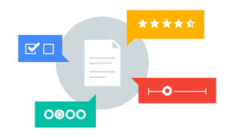
Your Feedback Please
http://bit.ly/ucpathpilottraining

