Slide 1
Ucr ucpath transaction pilot
Person of interest

Slide 2
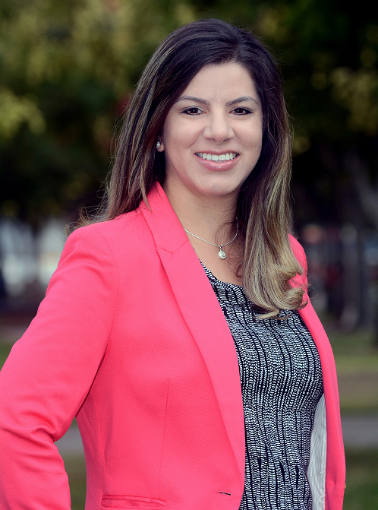
TRAINER INTRODUCTION
Alexandra Rollins
Title: UCPath Business Process and Training Lead
Department: UCPath Campus Support Center
Year @UC: 2 years
Previous Experience: 5+ years of experience in Organizational Development, Consulting, Training and Leadership Development

Slide 3
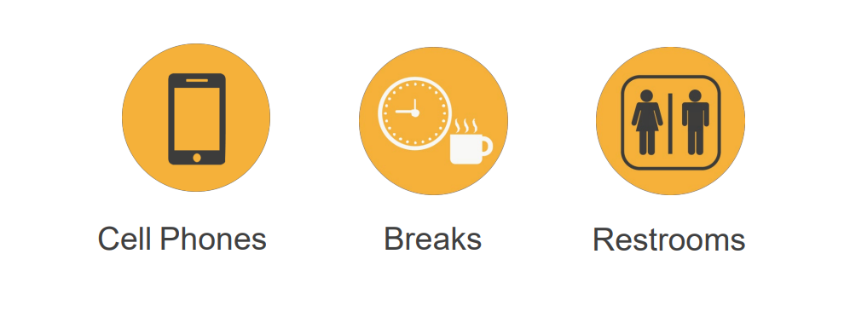
HOUSEKEEPING

Slide 4
LEARNING OBJECTIVES
Describe Person of Interest (POI)
Describe POI roles
Describes UCPath Center’s (UCPC) role in Person of Interest
Add a POI
Add a POI Relationship
Extend or Inactivate a POI

Slide 5
LEARNING TOPICS Lecture and Review
POI Definition
POI Types
Pilot Roles Descriptions
Change Impacts
Things to Remember
Learning Objectives Review
Appendix
Feedback

Slide 6
LEARNING TOPICS Hands on Training
Add Person of Interest
Add Person of Interest Relationship
Maintain Person of Interest Relationship
SharePoint Instructions

Slide 7
POI Definition

Slide 8
PERSON OF INTEREST DEFINTION
A person of interest (POI) is someone who is tracked by Locations for various reasons, such as a potential hire or potential external resource. Locations are responsible for adding and maintaining POI records in UCPath.
The POI relationship is at the Business Unit (Location = RVCMP) level, the department/unit should be noted for location purposes only.
POI is created when there is a location need for a person that is not performing any duties or functions in the service of the location to exist in UCPath (for location access issues, system access, etc.).
A POI is not an employee of the University; and will not receive compensation through UCPath.
A POI does not have Position Data or Job Data in UCPath.
POIs are assigned a Person ID, instead of an Employee ID.
If a POI later becomes an employee or a Contingent Worker (CWR), then their assigned Person ID becomes their Employee ID.
POI records that create a Person ID in UCPath are approved using Automated Workflow Engine (AWE). POI instances added to existing Person IDs do not use AWE.
UCPath Center does not add nor maintain POI records in UCPath. However, only UCPC can update a POI’s address and phone number. Locations must create a case to have UCPC update this information.
Notes:
Person ID/Employee ID voice ID

Slide 9
PERSON OF INTEREST OVERVIEW
POI security is based on the Business Unit assigned to the POI instance.
POIs do not:
Have Job Data
Have UCPath Self Service access
Receive compensation through UCPath
POIs are assigned a POI Type in UCPath. At minimum each UCPath Business Unit has four POI types.
Assoc Of Pres/
Chancellor
Potential Hire/
Academic
Exter Compliance/ Auditor
Potential
Hire/
Staff

Slide 10
PERSON OF INTEREST – PERSON ID
UCPath assigns a Person ID to POIs.
A person, whether a POI, a contingent worker (CWR) or an employee (EMP), should have only one Person ID in UCPath.
A Person ID can have multiple POI, CWR and EMP instances in UCPath. Each instance is a separate record. This gives Locations and UCPC the ability to see a person’s relationship instances with other Locations.
Use the Person Organizational Summary page in UCPath to view a person’s relationship instances with UC Locations.
Example
Person ID 12345 could have a POI record for UCLA campus (LACMP), an EMP record for UC Riverside campus (RVCMP) and a CWR record for UC Merced campus

Slide 11
PERSON OF INTEREST – SYSTEM PROCESS
Transactional Unit Initiator
Determine if person in UCPath, then enter/update POI or add new POI relationship
SSC AWE Approver
Review and approve or deny POI request
AWE

Slide 12
CHECK YOUR UNDERSTANDING

Slide 13
CHECK YOUR UNDERSTANDING
Are POIs paid in UCPath?
Are POIs employees of the University?
What is the reasoning for adding a POI to UCPath?
What should you do before adding a POI in UCPath?
Notes:
No
A POI is not an employee of the University; and will not receive compensation through UCPath.
(POI) is someone who is tracked by Locations for various reasons, such as a potential hire or potential external resource.
Before adding a POI instance into UCPath, use the Person Organizational Summary page to determine if the person already exists in UCPath. Locations are responsible for adding and maintaining POI records in UCPath

Slide 14
POI Type ID

Slide 15
POI TYPE ID
ID | POI Types | Description
00600 | UC Assoc. of President/ Chancellor | Family members of a Chancellor or the President.
00601 | UC Potential Hire - Academic | Tracking of Potential Academic Hires and is used at the discretion of the location such as: Used to add potential hires into the system ahead of offer being made. This is typically used for access provisioning for Academic and Executive recruiting. Allows locations to track candidates that are undergoing evaluation as to whether or not that location would hire them.
00602 | UC External Compliance Auditor | An employee of a federal, state or other regulatory body conducting an audit or other compliance review of UC, and with those agencies or persons in which there is a contract in place.
00603 | UC Potential Hire - Staff | Tracking of Potential Staff Hires and is used at the discretion of the location.

Slide 16
Roles

Slide 17
TRANSACTION ROLES
1: Transactional Unit
2: ORG Authority
3: Shared Services Center
4: UCPath Center

Slide 18
TRANSACTION ROLES
Identifies the POI and determines if the person already exists in UCPath; if the POI is not already in UCPath; the transactional unit will add them to UCPath as a POI
Transactional Unit Initiator can add and maintain POIs in UCPath
Transactional Unit Initiator can
Add Person of Interest
Maintain POI Relationship
Add POI Relationship
Update POI data via On Behalf Case
1: Transactional Unit (Initiator)
2: ORG Authority
3: Shared Services Center (AWE Approver)
4: UCPath Center
Notes:
Add voice over Person Org Summary

Slide 19
TRANSACTION ROLES
Responsible for ensuring the appropriate policy if followed
1: Transactional Unit (Initiator)
2: ORG Authority
3: Shared Services Center (AWE Approver)
4: UCPath Center

Slide 20
TRANSACTION ROLES
Responsible for approving transactional activities and providing client support
Reviews and approves or denies POI request and is responsible for notifying the Transactional Unit if their request was denied
1: Transactional Unit (Initiator)
2: ORG Authority
3: Shared Services Center (AWE Approver)
4: UCPath Center

Slide 21
TRANSACTION ROLES
UCPath Center does not add nor maintain POI records in UCPath. However, they are the only ones that can update a POIs address and phone number
UCPath System automatically assigns a Person ID and creates the POI record when the request is approved
1: Transactional Unit (Initiator)
2: ORG Authority
3: Shared Services Center (AWE Approver)
4: UCPath Center

Slide 22
Change Impacts

Slide 23
CHANGE IMPACTS
The submission of template transaction for POI will be initiated by the Transactional Unit, which used to be done by the SSC. This means that the initiator will initiate the process, but SSC will be responsible for approving/validating via AWE for Phase 1.
Policy Guidelines
AP/HR is working on a matrix that outlines when to hire a CWR, POI and when to go through the Net ID affiliate process so proper campus guidelines are followed.

Slide 24
Add Person of Interest

Slide 25
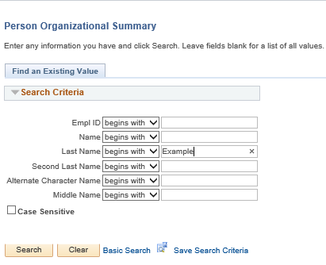
PERSON ORGANIZATIONAL SUMMARY: SEARCH PAGE
Navigation: PeopleSoft Menu > Workforce Administration > Personal Information > Person Organizational Summary
Before adding a POI instance for a person into UCPath, determine if the person already exists in UCPath using the Person Organizational Summary page.
Search by Last Name and determine if a POI, CWR or EMP instance already exists for the person.
Check to see if Ellie Example exists in UCPath. Enter her last name and click Search.

Slide 26
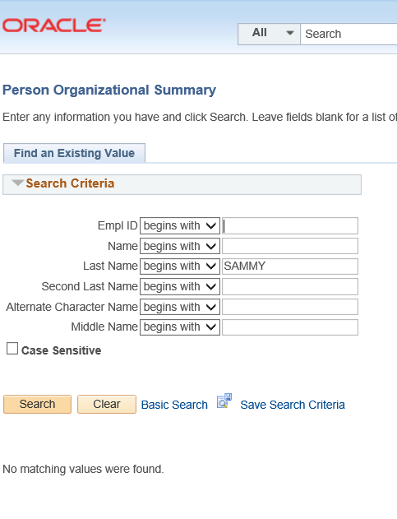
PERSON ORGANIZATIONAL SUMMARY: NO MATCH
Navigation: PeopleSoft Menu > Workforce Administration > Personal Information > Person Organizational Summary
The following example shows that there are no matching values found for the name entered.

Slide 27
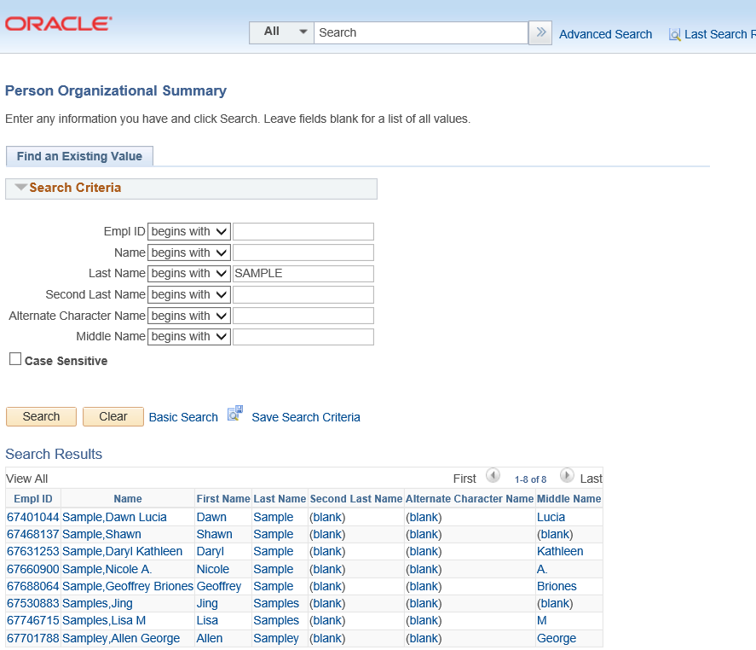
PERSON ORGANIZATIONAL SUMMARY: POSSIBLE MATCH
Navigation: PeopleSoft Menu > Workforce Administration > Personal Information > Person Organizational Summary
The following example shows that there are many matching values found for the name entered.

Slide 28
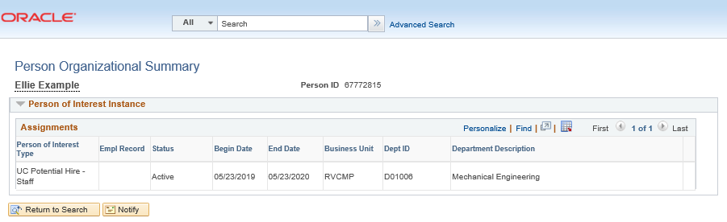
PERSON ORGANIZATIONAL SUMMARY: EXACT MATCH
Navigation: PeopleSoft Menu > Workforce Administration > Personal Information > Person Organizational Summary
The following example shows that Ellie Example has a Person ID in UCPath and an existing POI instance for UC Riverside.

Slide 29
ADD PERSON OF INTEREST
Navigation: PeopleSoft Menu > UC Customization > UC Extensions > Person of Interest -Add
A person of interest (POI) is someone who is tracked by Locations for various reasons, such as potential hire or potential external resource.
Click the Add A New Value tab.
Click Add a New Value

Slide 30
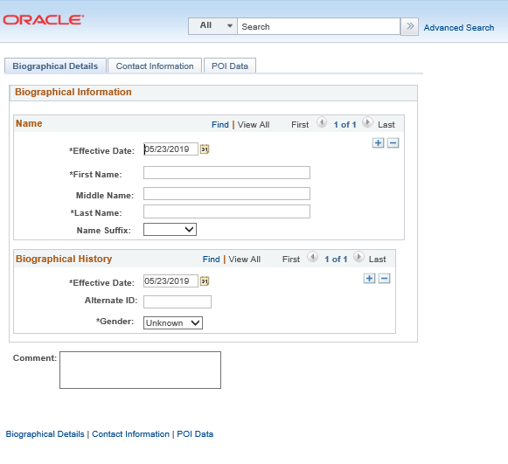
ADD PERSON OF INTEREST (continued)
The Effective Date field, which appears twice on this page, defaults to the current date but can be modified.

Slide 31
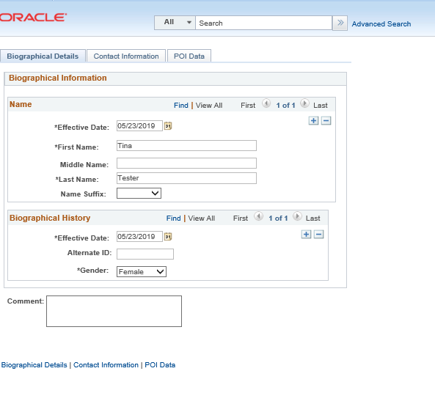
ADD PERSON OF INTEREST – BIOGRAPHICAL DETAILS
The following UCPath fields are required by UCPC for all POI Transactions. Enter the following in the Biographical Details tab:
First Name
Last Name
Middle Name (Optional)
Alternate ID (Optional) Date entered in this field appears on the Modify a Person page.
Click the button to the right of the Gender field.
The Comment field is an optional field.
Go to the next tab by clicking on the Contact Information tab.

Slide 32
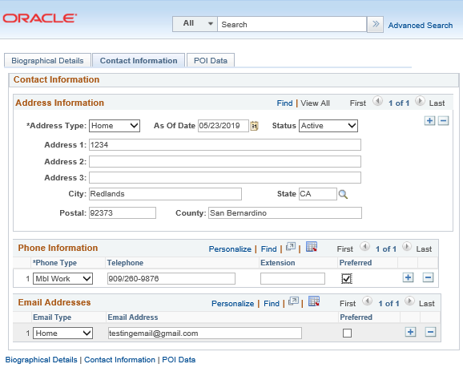
ADD PERSON OF INTEREST CONTACT INFORMATION
The following UCPath fields are required by UCPC for all POI Transactions. Enter the following in the Contact Information tab:
Address Information section is formatted for US addressed only.
City
State
Postal
County
Phone Information (You must enter at least one phone number for POI) Select the Preferred option.
Email addresses are optional for POIs.
If necessary, click the Add a New Row button to insert an additional Phone Number or Email address.
Note that the Address 2 and the Address 3 fields are extra fields for long addresses. These are not used to enter a second or third address for the POI.

Slide 33
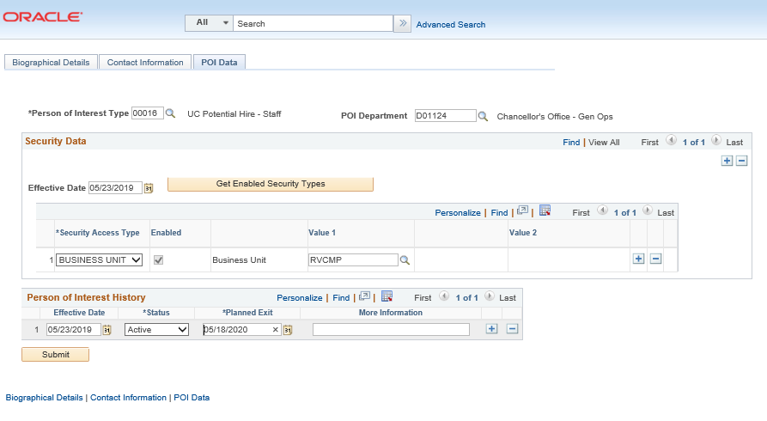
ADD PERSON OF INTEREST – POI DATA
The following UCPath fields are required by UCPC for all POI Transactions. Enter the following in the POI Data tab:
Look up Person of Interest Type
POI Department
Security Access Type
Look up Value 1 and
select UC location.
County
Phone Information
Status
Planned Exit
Click Submit.
Notes:
(You must enter at least one phone number for POI) Select the Preferred option.

Slide 34
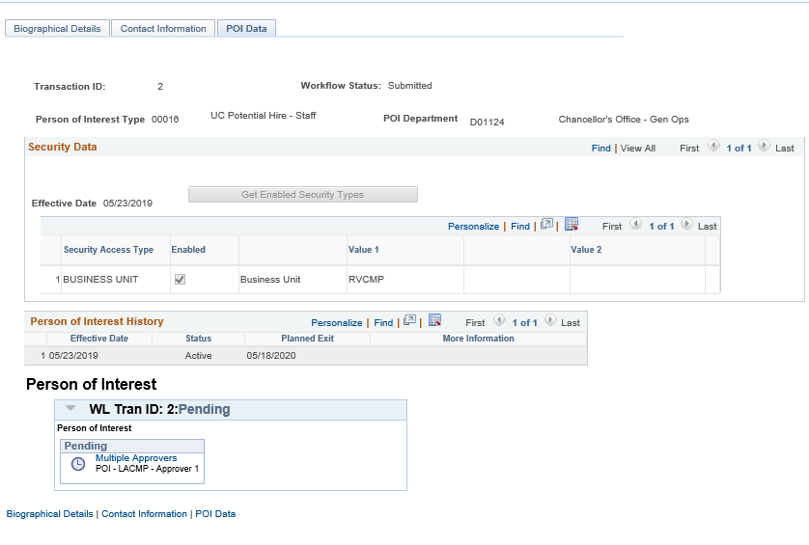
ADD PERSON OF INTEREST
You have created a Person ID and a person of interest instance in UCPath for someone who is not currently in UCPath.
The Workflow Status indicates Transaction has been submitted

Slide 35
Add Person of Interest Relationship

Slide 36
ADD A NEW PERSON OF INTEREST RELATIONSHIP
Navigation: PeopleSoft Menu > Workforce Administration > Personal Information > Organizational Relationship >
Add POI Relationship
Use the Add POI Relationship to add a new person of interest (POI) instance for someone that already has a Person ID (EMPL ID) in UCPath.
Add POI Relationship does not use AWE.
Click the Look Up EMPL ID button.
Click the Look Up Person of Interest Type button.

Slide 37
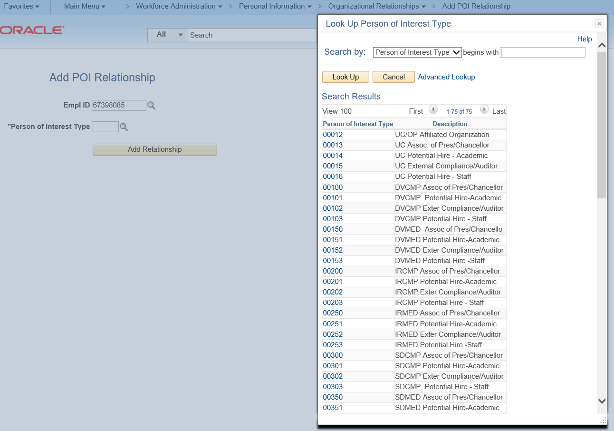
ADD A NEW PERSON OF INTEREST RELATIONSHIP
Navigation: PeopleSoft Menu > Workforce Administration > Personal Information > Organizational Relationship >
Add POI Relationship

Slide 38
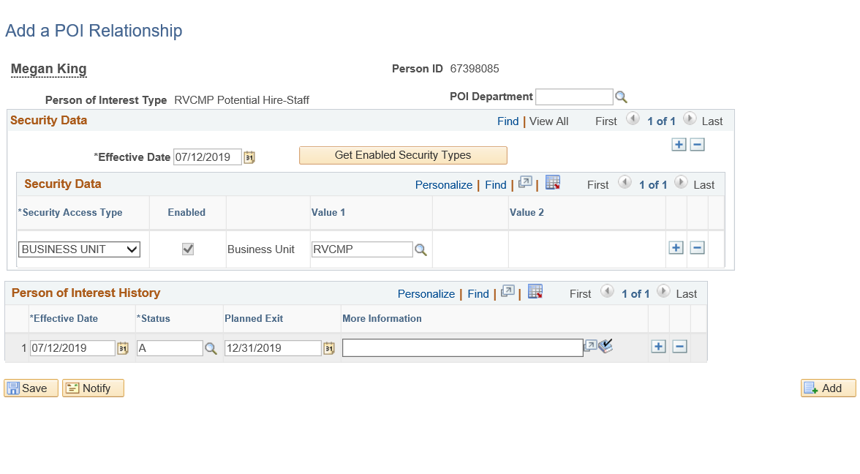
ADD A NEW PERSON OF INTEREST RELATIONSHIP
Navigation: PeopleSoft Menu > Workforce Administration > Personal Information > Organizational Relationship >
Add POI Relationship
The Add a POI Relationship page appears.
Update the Effective Date as needed.
Click the Look up POI Department. (Optional)
Security Access Type is required. Click the Business Unit list item.
Value 1 is a required field in which you will select your location business unit. Click the look up Value 1 button.
The Status defaults to A for Active.
Planned Exit is a required field.
Click Add. Click Yes.
Click Save to add the new Person ID instance.
You have added a new POI instance for someone who already has a Person ID.

Slide 39
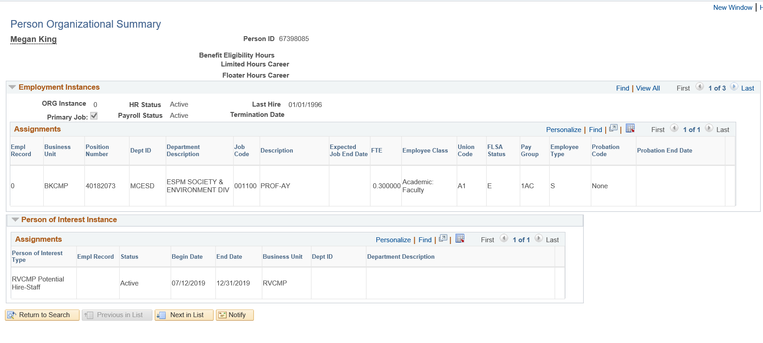
ADD A NEW PERSON OF INTEREST RELATIONSHIP
Navigation: PeopleSoft Menu > Workforce Administration > Personal Information > Person Organizational Summary
You can also check on the Person Organizational Summary page to see what you just added.

Slide 40
Maintain Person of Interest Relationship

Slide 41
MAINTAIN A POI RELATIONSHIP: SEARCH PAGE
Navigation: PeopleSoft Menu > Workforce Administration > Personal Information > Organizational Relationship >
Maintain POI Relationship
Use to update the Planned Exit date for a POI instance.
Use to change the POI Status for a POI instance from Active to Inactive.
Search by EMPL ID, Person of Interest Type, Last Name, Name.
Historic POI data appears when you select Include History.

Slide 42
UPDATE PLANNED EXIT DATE
Navigation: PeopleSoft Menu > Workforce Administration > Personal Information > Organizational Relationship >
Maintain POI Relationship
Click the Add a New Row button to insert a new effective-dated row.
Update the Planned Exit date on the new row.
Enter comments in the More Information field, if desired.
Click Save.
Update Planned Exit Date Information.

Slide 43
INACTIVATE A POI INSTANCE
Navigation: PeopleSoft Menu > Workforce Administration > Personal Information> Organizational Relationship >
Maintain POI Relationship
Click the Add a New Row button to insert a new effective-dated row.
Update the Status on the new row.
Enter comments in the More Information field, if desired.
Click Save.
Update Status by clicking on the look up.

Slide 44
INACTIVE POI ON PERSON ORGANIZATIONAL SUMMARY PAGE
Navigation: PeopleSoft Menu > Workforce Administration > Personal Information > Person Organizational Summary
This example shows POI Laural Craigen as inactive for RVCMP Potential Hire-Academic.

Slide 45
CHECK YOUR UNDERSTANDING

Slide 46
CHECK YOUR UNDERSTANDING
Who is responsiblee for adding POIs into UCPath?
When are POI records approved using Approval Workflow?
When do POI records not use AWE?
Notes:
Locations are responsible for adding and maintaining POI records in UCPath.
POI records that create a Person ID in UCPath are approved using Automated Workflow Engine (AWE).
POI instances added to existing Person IDs do not use AWE. UCPath Center does not add nor maintain POI records in UCPath. However, only UCPC can update a POI’s address and phone number. Locations must create a case to have UCPC update this information.

Slide 47
SharePoint Instructions & Hands on Training

Slide 48
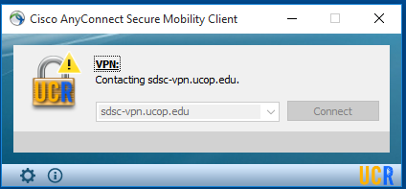
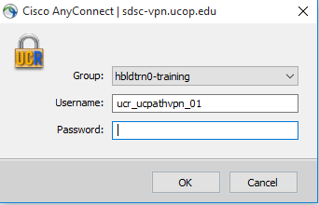
SHAREPOINT LIST INSTRUCTIONS
Open the Cisco AnyConnect client.
Enter the VPN name: sdsc-vpn.ucop.edu
Click Connect.
Select the Group: hbldtrn0-training
Enter one of the following username:
• ucr_ucpathvpn_01 Row 1 and Row 2
• ucr_ucpathvpn_02 Row 3 and 4
ucr_ucpathvpn_02 Row 5 and 6
The VPN password for the week of 7/15/19 is: !!1_Meat_Most!!
Once Connected to the VPN:
Go to https://hbldtrn0.ucpath-build.devops.universityofcalifornia.edu/psp/HBLDTRN0/?cmd=login&languageCd=ENG&
Enter the Tester ID\Password provided in the SharePoint Scenarios.

Slide 49
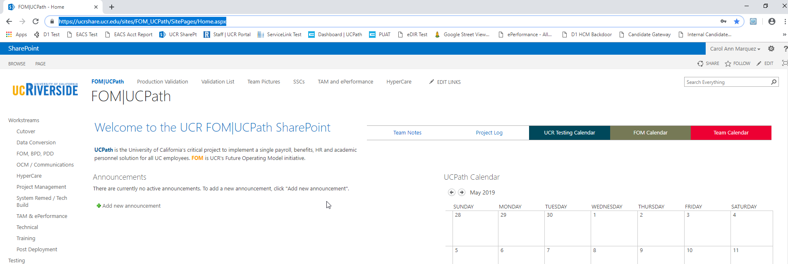
SHAREPOINT LIST INSTRUCTIONS
Testing SharePoint: https://ucrshare.ucr.edu/sites/FOM_UCPath/SitePages/Home.aspx
Preferred browsers are Internet Explorer and Chrome. (Save the link as a favorite)
Select UCPath Transaction Training Scenarios from the left side Quick Menu:

Slide 50
VIEWING LIST OPTIONS
When the list opens, note the tabs at the top of the screen:

Slide 51
VIEWING LIST OPTIONS part 2
By selecting ‘List’ you can filter the view on the process you are transacting. The default view is All Transactions. Select a specific transaction type to view the list containing only those transactions:

Slide 52
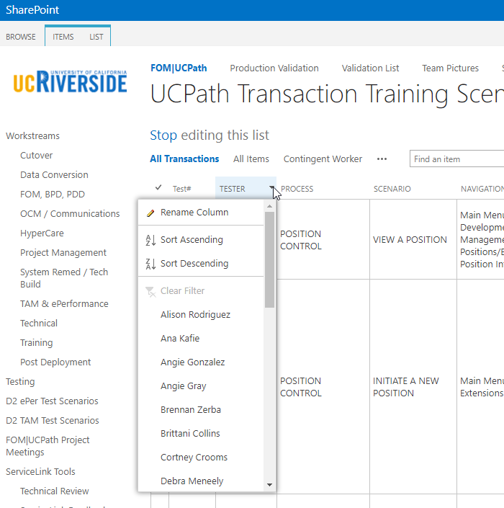
UPDATING AND EDITING A SHAREPOINT LIST
Many functions of a SharePoint list are similar to MS Excel, except that it is in a central location and can be accessed / updated by multiple people at the same time.
Use the list headers to filter and sort. Only you will see these temporary changes.
By selecting your name in the drop-down, you will have easy access to only your transactions. This is especially helpful if your name appears several pages into the list.

Slide 53
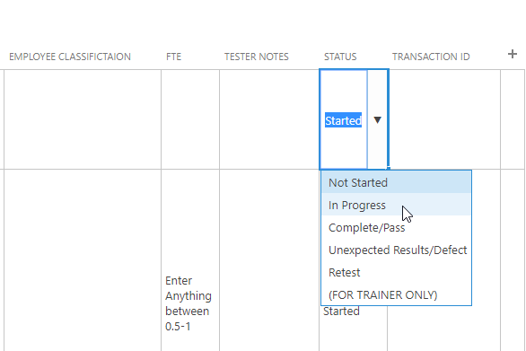
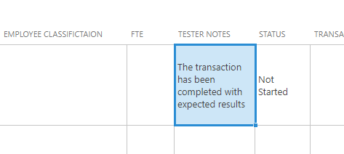
UPDATING AND EDITING A SHAREPOINT LIST part 2
You can update your test by editing directly by clicking into the cell. Some cells are controlled by a drop-down choice, others are free-form. To save your change, click in another cell.

Slide 54
THINGS TO REMEMBER
A person of interest (POI) is someone who is tracked by Locations for various reasons, such as a potential hire or potential external resource. Locations are responsible for adding and maintaining POI records in UCPath.
A POI is not an employee of the University; and will not receive compensation through UCPath.
A POI does not have Position Data or Job Data in UCPath.
POIs are assigned a Person ID, instead of an Employee ID.

Slide 55
THINGS TO REMEMBER
Before adding a POI instance into UCPath, use the Person Organizational Summary page to determine if the person already exists in UCPath. Locations are responsible for adding and maintaining POI records in UCPath.
Use the Add Person of Interest component if the person does not have a UCPath Person ID.
Use the Person of Interest Approval page to approve/deny a POI request.
Use the Maintain POI Relationship component to extend or inactive a POI.

Slide 56
THINGS TO REMEMBER
If a POI later becomes an employee or a Contingent Worker (CWR), then their assigned Person ID becomes their Employee ID.
POI records that create a Person ID in UCPath are approved using Automated Workflow Engine (AWE). POI instances added to existing Person IDs do not use AWE.
UCPath Center does not add nor maintain POI records in UCPath. However, only UCPC can update a POI’s address and phone number. Locations must create a case to have UCPC update this information.

Slide 57
LEARNING OBJECTIVES REVIEW
Having completed this course, you should be able to:
Describe Person of Interest (POI)
Describe POI roles
Describe UCPath Center’s (UCPC) role in Person of Interest
Add POI
Approve POI request
Add POI Relationship
Extend of Inactivate a POI

Slide 58
APPENDIX
Person of Interest Process Map
Person of Interest Road Map

Slide 59
Your Feedback Please
http://bit.ly/ucpathpilottraining

