Slide 1

Ucr ucpath transaction pilot
Troubleshooting & understanding downstream impacts

Slide 2

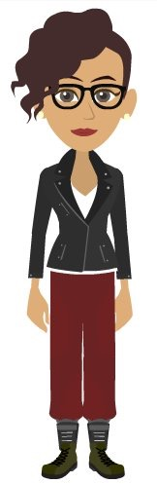
TRAINER INTRODUCTION
Shannon Minter
Title: UCPath Business Support Analyst, Escalation Lead
Department: UCPath Campus Support Center
Year(s) @UC: 2 1/2
Previous Experience: 14 years of professional human resources business analyst experience, focusing on payroll, position management, classification & compensation, training, & testing.

Slide 3
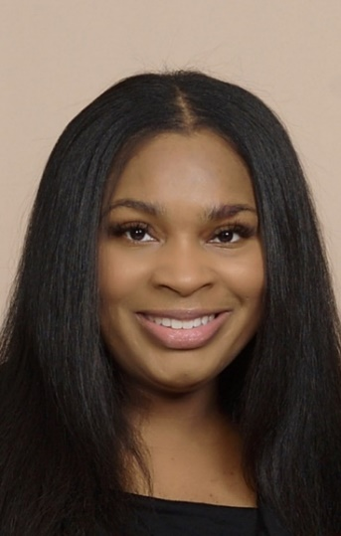
TRAINER INTRODUCTION
LaKesha Welch
Title: UCPath Business Support Analyst, Team Lead
Department: UCPath Campus Support Center
Year(s) @UC: 5 1/2
Previous Experience: 15 years Lead Business analyst/Functional Analyst support

Slide 4
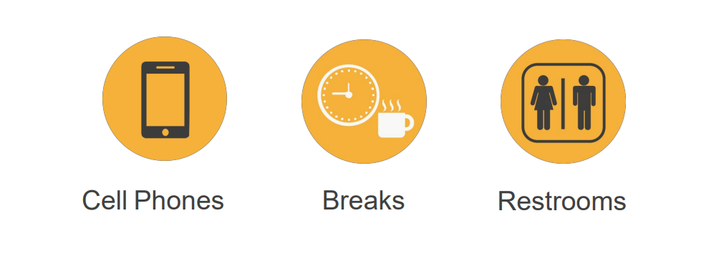
HOUSEKEEPING

Slide 5
Change
Modify
Confirm
Notes:
We know that a lot of the people in the room already have payroll and UCPath knowledge. Through class is designed to either change, modify or confirm what you already know.
Change: For those of you new to using UCPath, we want to change your understanding of how to use the system for processing.
Modify: If you have some experience, we want to modify your understanding, so that you have a strong understanding of the Pilot processes.
Confirm: We know that many of you are SMEs in your departments and had extensive PPS experience. We want to confirm what you already know and put you know into context with the Pilot processes.

Slide 6
LEARNING OBJECTIVES
Know common issues that impact employees
How to access resources to correct / prevent errors
Learn from the lessons shared by current users
Understand the policy behind each process and how to mitigate errors
Understand the key concepts and takeaways from each process
Notes:
We know that a lot of the people in the room already have payroll and UCPath knowledge. Through class is designed to either change, modify or confirm what you already know.
Change: For those of you new to using UCPath, we want to change your understanding of how to use the system for processing.
Modify: If you have some experience, we want to modify your understanding, so that you have a strong understanding of the Pilot processes.
Confirm: We know that many of you are SMEs in your departments and had extensive PPS experience. We want to confirm what you already know and put you know into context with the Pilot processes.

Slide 7
LEARNING TOPICS
DEFINITION
CRADLE TO GRAVE TRANSACTION MATRIX
KNOWN ISSUES AND WORKAROUNDS
FINDING ISSUES
WHAT TO DO WHEN SOMETHING GOES WRONG
THINGS TO REMEMBER
LEARNING OBJECTIVES REVIEW
APPENDIX
FEEDBACK

Slide 8
DEFINITION
What we mean:
Troubleshooting – Finding out what went wrong with a transaction
Downstream impacts – the impacts that occur to the employee(s) due to transaction processing errors or known impacts.

Slide 9
Cradle to Grave Transaction Matrix

Slide 10
CRADLE TO GRAVE TRANSACTION MATRIX
Process | Task Description
Data Changes/Position Updates | Supervisor change, Update Auto Termination Flag, ASMD (low risk transactions)
 | Compensation Change, FTE changes, Stipend addition (high risk transactions)
Offboarding | Complete CWR Instance
On Behalf of case management | Benefits issue, Direct Deposit issue,
Onboarding | Hire/Rehire Employees
 | Add/Renew/Extend Contingent Workers (non-Employees)
 | POI (non-Employees)
 | I9 Process
 | Background Check
Personal Data Change | Address or other personal data change
Position Management | FTE Approval/Position Creation
Work Re-Authorization | Reauthorization EE's with expired documents
The complete Cradle to Grace Transaction Matrix can be accessed here.

Slide 11
Known Issues and Workarounds
Notes:
Before going to the next slide, engage the class and ask what known issues and workarounds they are already aware of.
CWR NetID issues
Next day check process ending and now using PayCard

Slide 12



KNOWN ISSUE: CONTINGENT WORKER ACCESS/NETID
Issue: CWR was entered in UCPath BUT was not processed through the NetID affiliation process.
Result: CWR will not receive NetID or access to needed systems.
  Downstream impact: Failure to follow the NetID Affiliate process will prevent or delay employee from gaining required system access.
  *An enhancement that automatically generates a NetID after a template is submitted in UCPath is pending.
Issue: Employee has two NetIDs.
Result: Employee will have two profile accounts in the system and will experience log in issues
  Downstream Impact: Employee will have trouble accessing SSO. ITS Identity Management will review and determine which NetID should be used, merge accounts where needed and deactivate one of the NetIDs to restore the employees access. The employee will be notified which NetID is ready for use.

Slide 13
KNOWN ISSUE: MISSING PAY
Issue: Employee missing pay that creates a hardship.
Result: If an employee has a hardship due to missing pay, two options are available.
  Insta Paycard can be requested for up 70% of the gross pay. The request is made via the SSC.
  Employee can wait for an off-cycle check. This process normally takes about 72 business hours.
  Downstream Impact: Employee will need to wait until the next on-cycle if the missing pay is not addressed.

Slide 14
Finding Issues

Slide 15
ONE-TIME PAYMENT
Issue: Incorrect earn code selected. Earn Codes will need to be selected appropriately.
  Downstream impact: If an earn code is incorrect, then financial management impacts will occur. Additional SCTs may need to be processed.
Issue: Using the incorrect schedule effects timing around when a transaction is submitted AND approved in UCPath. It is critical to ensure transactions meets payroll deadlines.
  Downstream Impact: Employee’s pay could be delayed
Issue: Failure to add /department approvals will delay the approval process. One Time Pay process requires documentation/department approvals be attached to requests for Shared Service Center Approvers to reference when approving in UCPath.
  Downstream Impact: Employee’s pay could be delayed

Slide 16
VOLUNTARY TERMINATION & RETIREMENT
Issue: Voluntary terminations and retirements are very similar; be sure to select the appropriate template when creating the transaction.
  Downstream Impact: to employee if retirement is not processed according to UCPC requirements; creates delays in getting AWE approvals and final pay.
Issue: The Last Date Worked auto populates with a date that is one day prior to the Effective Date. Ensure your dates are correct.
  Downstream Impact: to pay/Service credit/retirement
  Example: If an employee desires to retirement effective 7/1, a 1-day break is service is required. For 7/1/19 retirements, the last day worked was 6/27/19, the one day break in service was 6/28/19. The dates may change each year, so prior to processing, confirm with CSC.

Slide 17
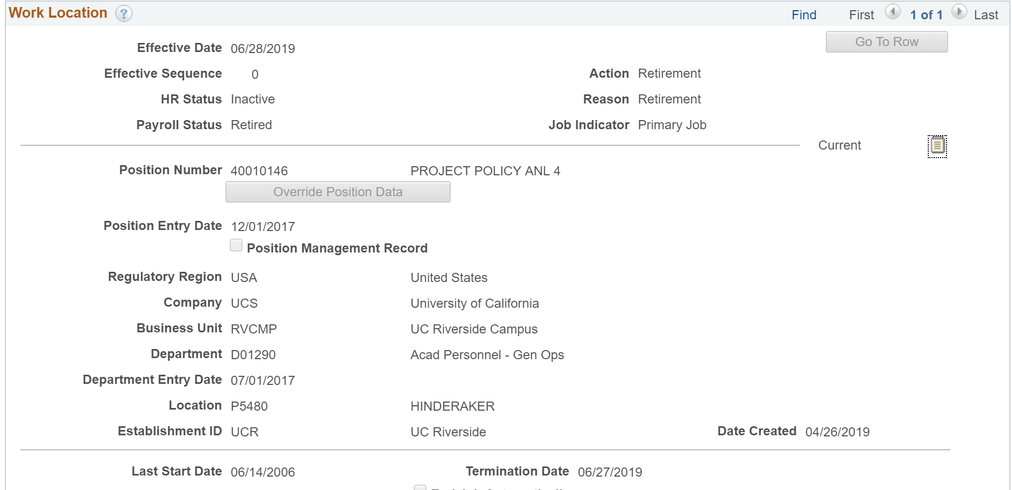
VOLUNTARY TERMINATION & RETIREMENT (continued)
Project Policy ANL 4

Slide 18
EMERITUS APPOINTMENT
Issue: It is important to add emeritus appointment as retirement occurs.
  Downstream Impact: Failure to add can result in loss of access to research, email, etc., after 90 days.
    Note: Process to reinstate access can take up to a week or more. - Impact

Slide 19
DEFAULT FUNDING - SCT
Issue: All newly created positions are given default funding.
  Once a position is created and available in the FAU tool, the correct FAU needs to be added, prior to any funds being paid out.
    Downstream Impact: Failure to maintain correct FAU will result in future SCTs.

Slide 20
POSITION DATA MANAGEMENT
Issue: Incorrect maintaining manager / supervisor relationship on position.
  Downstream Impact: Failure to ensure the appropriate supervisor relationship is establish could impact pay. Not maintaining this data affects TARS and Performance Management data.
  Note: Position data is used organizational planning, recruitment, career planning, and budgeting. Position captures the life-cycle of position changes, such as reclassifications, position status, and incumbents.

Slide 21
UCPATH DATES
Issue: Incorrect effective dating
  Incorrect chronological record of historic, current and future data:
    Current Effective Date - Date that is less than or equal to the current system date.
    Historic Effective Date – Dates that are less than the current information
    Future Effective Date – Effective dates that are greater than the current information
    Retro Effective Date – Date prior to the current pay period begin date
Issue: Incorrect Effective dates for inter-campus transfer
  Downstream Impact: Breaks in service, retirement tier changes, new probation period to serve
Notes:
Voice over definition for each
Impact across the board: time and effort, poor customer perception, increase in support request csc, central office, ssc, ucpc

Slide 22
UCPATH DATES (continued)
Issue: Incorrect Effective dates for end of fiscal year retirements
  Downstream Impact: no compounded COLA for the employee
Issue: Incorrect effective sequencing (By policy, there is an order in which actions should occur)
  Downstream Impact: incorrect chronological record, incorrect compensation and Range adjustment
    Range Adjustment
    Merit increase
    Reclassification
Notes:
Voice over definition for each
Impact across the board: time and effort, poor customer perception, increase in support request csc, central office, ssc, ucpc

Slide 23
WHAT TO DO WHEN SOMETHING GOES WRONG?
Notify impacted employee(s) that the issue is being reviewed, and provide a follow-up time to reach back out with a status.
Document issue and contact appropriate resources:
Shared Services Centers
Citrus
Harvest
POSSC
R’Shared

Slide 24
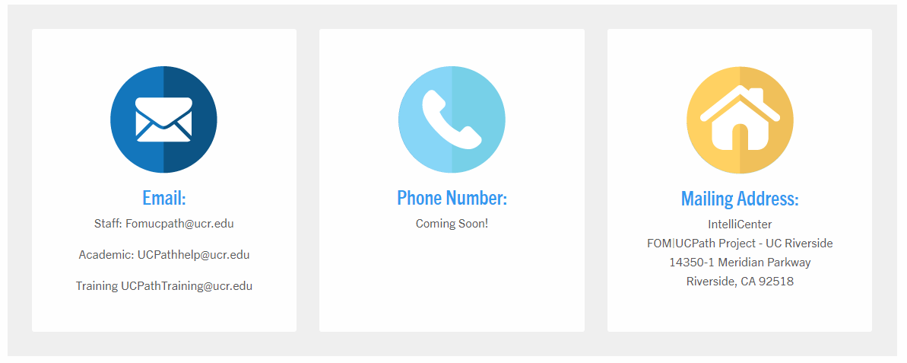

UCPATH CAMPUS SUPPORT CENTER (CSC)

Slide 25
UCPATH CENTER
Phone Number to call for UCPath Center – 855-982-7284
Creating an On Behalf Of Ask (Case) with UCPath

Slide 26
LEARNING OBJECTIVES REVIEW
Having completed this course, you should be able to:
Know common issues that impact employees
How to access resources to correct / prevent errors
Learn from the lessons shared by current users
Understand the policy behind each process and how to mitigate errors
Understand the key concepts and takeaways from each process

Slide 27


THINGS TO REMEMBER
Be proactive: Ensure proper effective dates are used, be sure you are using the proper ERN code, Transaction type, proper templates are used, double check transaction prior to submission, record transaction ID for tracking.
Transactors and approvers, review all transactions for completeness and accuracy. Avoid the need for correction. Remember - it takes a lot longer and a lot more effort to correct and enter in UCPath than it did in PPS.
If you believe that there has been an error, document and report.
Errors in UCPath should be resolved quickly. Employees have an expectations that their paycheck will be correct.

Slide 28
APPENDIX

Slide 29
APPENDIX
GRADUATE STUDENTS
POST DOCS
UCPATH DATES – INTERLOCATION TRANSFER
OPENING CASES WITH UCPATH CENTER

Slide 30

GRADUATE STUDENTS
Issue: Incorrect graduate student DCP/FICA exemptions/deductions
Downstream Impact: over or underpaid
Downstream Impact: reconciliation to get students paid properly through one of the hardship payment methods
Issue: Incomplete or expired Visa information in Glacier
Downstream Impact: over or underpaid
Downstream Impact: (rare) Employee issue moved to Labor Relations
Notes:
Provide tips – FTE correct, units –validating they are a student
Visa – need to be eligible to work in USA to receive paycheck. Issue must be resolved in the system in order for the student to receive pay (can impact faculty and staff as well. Students are the most impacted). Tax treaty also need to be maintained, once expired they are now eligible for the deductions. Students who are not registered for class in the summer BUT still have a job on campus are ELIGIBLE for the DCP/FICA deductions. –add to appendix
Example of moved to Labor relations – do not comply with ID verification

Slide 31
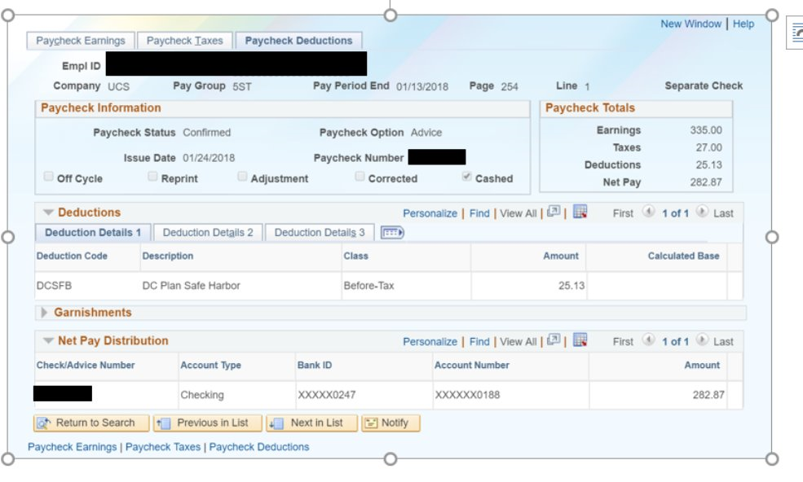
GRADUATE STUDENTS (continued)

Slide 32
POST DOCS
Issue: Postdoc anniversary date expired.
  Downstream Impact: Failure to update the anniversary date impacts the PTO allotment allocation.
  Note: The Postdoc anniversary date marks one year of employment, and represents when the Postdoc will receive his/her merit increase to the next level (if extended), and also insures that the Postdoc will receive their PTO and SICK leave allotment. Anniversary date must be updated at each annual appointment/renewal.

Slide 33
UCPATH DATES – INTERLOCATION TRANSFER
Issue: Incorrect Effective dates for interlocation campus transfer. Ensure your dates are correct.
Downstream Impact: Breaks in service, retirement tier changes and new probation period to serve.
Notes:
Voice over definition for each
Impact across the board: time and effort, poor customer perception, increase in support request csc, central office, ssc, ucpc

Slide 34
Opening Cases with UCPath Center

Slide 35
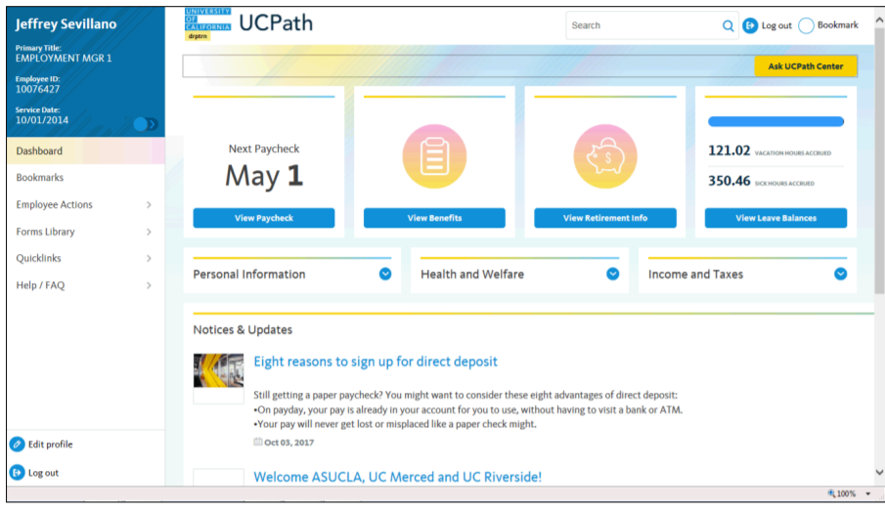
ON BEHALF OF ASK UCPATH
Navigation: Ask UCPath Center or
Note: This example uses sample images as seen on a computer. Sample images appear differently on a tablet or smartphone, but the steps remain the same.
Click the Ask UCPath Center Button
1

Slide 36
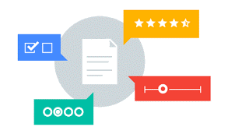
Your Feedback Please
http://bit.ly/ucpathpilottraining

Slide 37


Slide 38


