Slide 1
Ucr ucpath transaction pilot
Contingent Worker

Slide 2
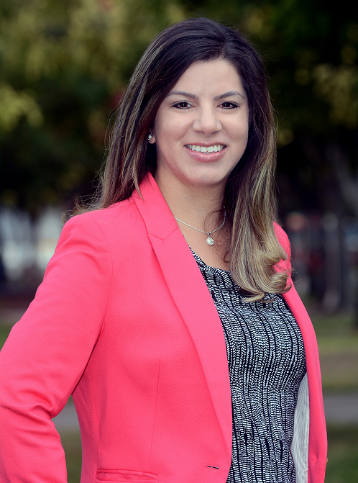
TRAINER INTRODUCTION
Alexandra Rollins
Title: UCPath Business Process and Training Lead
Department: UCPath Campus Support Center
Year @UC: 2 years
Previous Experience: 5+ years of experience in Organizational Development, Consulting, Training and Leadership Development

Slide 3
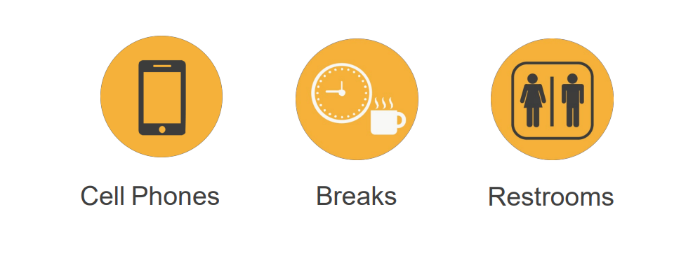
HOUSEKEEPING

Slide 4
LEARNING OBJECTIVES
Add, Renew, and Extend a Contingent Worker (With Position)
Add, Renew, and Extend a Contingent Worker (No Position)
Complete a Contingent Worker
Clone a denied or cancelled Contingent Worker Transaction

Slide 5
LEARNING TOPICS LECTURE AND REVIEW
Contingent Worker Definition
Contingent Worker Job Codes
Contingent Worker Action Reason Codes
Pilot Roles Descriptions
Change Impacts
Learning Objectives Review
Things to Remember
Appendix
Feedback

Slide 6
LEARNING TOPICS HANDS ON TRAINING
Contingent Workers (With Position)
Add
Renew
Extend
Contingent Workers (No Positon)
Add
Renew
Extend
Complete Contingent Worker
Clone a denied/canceled transaction
SharePoint Instructions and Hands on Training

Slide 7
CWR Definition

Slide 8
CONTINGENT WORKER DEFINTION
Contingent Workers (CWR) are defined as individuals engaged by the University of California on a non-permanent basis to complete a specific function or task who do NOT have an employee relationship with UCR and do NOT receive remuneration through UCPath.
An example of a contingent worker is a volunteer, since they are not paid, but also agency workers who perform work for UCR, but are paid through their agency. As such, all contingent workers, including temporary agency workers MUST be entered in UCPath for tracking purposes.
CWR is created when there is a location need for a person to exist that is providing services to the location, however, they are doing it on a non-permanent basis or potentially paid by a 3rd party (e.g. consultant, contractor, etc.)
CWR will have Job Data, including specific Employee Classes (i.e. contingent worker academic or contingent worker staff), and distinct job codes (e.g. volunteer, affiliated research, clinical associate, etc.)

Slide 9
CWR Job Codes

Slide 10
CONTINGENT WORKER JOB CODES
Job Code | CWR Types | Description | Employee Class
CWR002 | LBL/DOE Postdoc | Lawrence Berkeley Lab/Department of Energy Postdoc. | Academic
CWR003 | Visiting Student Res Graduate | A graduate student on leave from enrollment at a home institution to participate in a short-term (not to exceed 12 mos.) educational project under the supervision of an academic appointee; must be enrolled in a degree granting program at an institution of higher education other than the University of California; must service an academic purpose for the unit in which they are visiting (APM 430) | Academic
CWR007 | Clin Assoc/Admitting Physician | A community medical practitioner granted access to UC health care facilities. | Academic
CWR013 | Community College Instructor | An instructor at a community college. Most likely utilized in GSOE | Academic
CWR015 | Visiting Scholar | A person on leave from an academic appointment or other employment, to participate in a short-term (not to exceed 12 mos.) educational, research, or other academic project under the supervision of an academic appointee; terminal degree required (APM 430) | Academic
CWR016 | Visiting Student Researcher | External (to your location) students visiting your location to advance their learning through research. An undergraduate student on leave from enrollment at a home institution to participate in a short-term (not to exceed 12 mos.) educational project under the supervision of an academic appointee; must be enrolled in a degree granting program at an institution of higher education other than the University of California; must service an academic purpose for the unit in which they are visiting (APM 430) | Academic

Slide 11
CONTINGENT WORKER JOB CODES
Job Code | CWR Types | Description | Employee Class
CWR021 | Research Fellow | A non-salaried appointment for visiting fellows who come to the University, such as: a National Research Council Fellow; a Social Science Research Council Fellow; a Commonwealth Fund Fellow; a Rockefeller Foundation Fellow; or as a traveling fellow from other universities; PhD required (APM 355) | Academic
CWR022 | Research Associate | A non-salaried appointment for visiting scholars and scientists of distinguished standing who may be recommended by departments for such association with the University; PhD required (APM 355) | Academic
CWR004 | Staff Intern | An individual providing service to UC as part of a bone fide internship program designed primarily for the benefit of the intern and in conjunction with an appropriate academic degree program. | Staff
CWR005 | Affiliated Research Institute | An employee of an organization that has a relationship with UC, such as a research institute sponsoring a join research project with UC. Can also be used for HHMI or Ludwig workers or LBL workers needing access to campus facilities. | Staff
CWR006 | Individual Contractor/Consultant | An individual providing consulting services to UC as an independent contractor or through a third-party independent contractor/company. Payment for services is paid through Accounts Payable. | Staff
CWR009 | Temp Agency Staff – Health | A temporary employee hired and paid through a third-party temporary employment agency and working in a UC health care facility. | Saff
CWR010 | Temp Agency Staff – Non-Health | A temporary employee hired and paid through a third-party temporary employment agency and not working in a UC health care facility. | Staff
CWR020 | Staff Emeritus | Emeritus/a status is an honor granted by the chancellor upon retirement of a University of California, Riverside staff member who has provided outstanding service to the university. | Staff

Slide 12
CONTINGENT WORKER JOB CODES
ID | CWR Types | Description | Employee Class
CWR011 | Staff Volunteer | Volunteer an individual providing service directly to and under the supervision of the university with no promise or expectation of compensation. The following groups are not considered volunteers: a. Individuals whose service is provided in pursuit of personal educational goals or to earn educational credit. b. Individuals receiving payment for services rendered from a non-university of California pay source (e.g., visitors receiving per diem or support from home institutions, employees of an organization with a contract to use university facilities). c. Individuals affiliated with and providing services on behalf of an external agency or service organization (e.g., Red Cross volunteers) d. Off-campus volunteers sponsored by but not under the direct supervision of the university (e.g., student teachers). e. Groups or individuals providing fundraising, public outreach, or other support services as described in UC Policy on Support Groups, Campus Foundations, and Alumni Associations. f. Individuals holding academic “without salary” appointments. g. Retired employees desiring occasional access to university facilities. | Staff
CWR014 | Affiliated Organization | Someone on campus that is in service and requires a NetID for some duration of time. | Both

Slide 13
CONTINGENT WORKER JOB CODES
ID | CWR Types | Description | Employee Class
CWR017 | UC Employee – Different BU | Any Academic of Staff UC employee that is in service to UCR, may use for Search committee members for AP recruit | Both

Slide 14
CHECK YOUR UNDERSTANDING

Slide 15
CHECK YOUR UNDERSTANDING
You need to hire a person to help your department for the next 6 months, you decide to go through an agency to help with your hire. This person is paid through their agency, do you still need to add them in UCPath?
Are Contingent Workers paid in UCPath?
When would you hire a Contingent Worker?
What is the reasoning for adding a Contingent Worker to UCPath?

Slide 16
Action Reason Codes

Slide 17
CONTINGENT WORKER ACTION REASON CODES
Add Contingent Worker
Action: ADD
Action reason: ADD
Completion - Contingent Worker
Action: COM
Contingent Worker Extension
Action: CW
Contingent Worker Renewal
Action: RNW
Action reason: COM
Action reason: CWE
Action reason: RNW

Slide 18
Roles

Slide 19
Transaction Roles
1: Transactional Unit Initiator
2: Transactional Unit Approver (Phase 2)
3: Transactional Unit Supervisor/Manager
4: ORG Authority
5: Shared Services Center (Approver)
6: Central Office
7: Contingent Worker
8: UCPath Center

Slide 20
Transaction Roles
Confirms that CWR is the appropriate hire type with consultation from the Central Office(s)
Initiates UCPath Smart HR Transaction and initiates background check as applicable
Completes Offboarding process or rescinds offer
Initiates the NetID Affiliate process
Provide CWR with system access via EACS
Transactional Unit sets up Lab Safety Training for CWRs in the sciences
Maintains employee file/documentation
1: Transactional Unit Initiator
2: Transactional Unit Approver (Phase 2)
3: Transactional Unit Supervisor/Manager
4: ORG Authority
5: Shared Services Center (Approver)
6: Central Office
7: Contingent Worker
8: UCPath Center

Slide 21
Transaction Roles
Responsible for validating Smart HR transaction via AWE and providing support as per the Pilot Support Matrix
Resolves issues with Smart HR Transaction when needed and opens STANDARD cases as applicable per the On-Behalf of Case Management Matrix
1: Transactional Unit Initiator
2: Transactional Unit Approver (Phase 2)
3: Transactional Unit Supervisor/Manager
4: ORG Authority
5: Shared Services Center (Approver)
6: Central Office
7: Contingent Worker
8: UCPath Center

Slide 22
Transaction Roles
Responsible for ensuring the appropriate policy is followed
Verifies that mandatory Lab Safety training has been taken
Works with Transactional Unit/Initiator to resolve issues during onboarding process
As Appropriate, Request for Equipment, Required Training, Facilities & Systems access, Office/Lab Setup, etc.
1: Transactional Unit Initiator
2: Transactional Unit Approver (Phase 2)
3: Transactional Unit Supervisor/Manager
4: ORG Authority
5: Shared Services Center (Approver)
6: Central Office
7: Contingent Worker
8: UCPath Center

Slide 23
Transaction Roles
Responsible for ensuring the appropriate policy is followed
1: Transactional Unit Initiator
2: Transactional Unit Approver (Phase 2)
3: Transactional Unit Supervisor/Manager
4: ORG Authority
5: Shared Services Center (Approver)
6: Central Office
7: Contingent Worker
8: UCPath Center

Slide 24
Transaction Roles
Responsible for validating Smart HR transactions via AWE and providing support as per the Pilot Support Matrix (Phase 1)
Responsible for updating UCPath with results of the background check on the security clearance page (Phase 1 and Phase 2)
Note: In Phase 2 the approver role will be moving to the Transactional Unit
1: Transactional Unit Initiator
2: Transactional Unit Approver (Phase 2)
3: Transactional Unit Supervisor/Manager
4: ORG Authority
5: Shared Services Center (Approver)
6: Central Office
7: Contingent Worker
8: UCPath Center

Slide 25
Transaction Roles
Responsible for process design, and policy guidelines
Provide subject matter expertise in policy related questions
1: Transactional Unit Initiator
2: Transactional Unit Approver (Phase 2)
3: Transactional Unit Supervisor/Manager
4: ORG Authority
5: Shared Services Center (Approver)
6: Central Office
7: Contingent Worker
8: UCPath Center

Slide 26
Transaction Roles
Accepts Offer/Contract
Signs Required Documents
Completes Required items such as Training (e.g. Lab Safety), Background Check (if requested)
1: Transactional Unit Initiator
2: Transactional Unit Approver (Phase 2)
3: Transactional Unit Supervisor/Manager
4: ORG Authority
5: Shared Services Center (Approver)
6: Central Office
7: Contingent Worker
8: UCPath Center

Slide 27
Transaction Roles
Processes Smart HR Transaction and creates employee job record
1: Transactional Unit Initiator
2: Transactional Unit Approver (Phase 2)
3: Transactional Unit Supervisor/Manager
4: ORG Authority
5: Shared Services Center (Approver)
6: Central Office
7: Contingent Worker
8: UCPath Center

Slide 28
CHECK YOUR UNDERSTANDING

Slide 29
CHECK YOUR UNDERSTANDING
Who is responsible for initiating the Smart HR Transaction?
Who initiates the NetID affiliate process?
Who is responsible for approving the CWR Smart HR Transaction through AWE?
Who is responsible for verifying that lab safety training has been taken?

Slide 30
Change Impacts

Slide 31
CHANGE IMPACTS
The submission of template transaction for Contingent Worker will be initiated by the Transactional Unit, which used to be done by the SSC. This means that the initiator will initiate the process, but SSC will be responsible for approving/validating TBH transaction via AWE for Phase 1, and this will move to Transactional Unit in Phase 2.
SSC’s will continue to enter background check results in UCPath on the Security Clearance for both Phase 1 and Phase 2.
CWRs DO NOT need to sign the Oath per policy.

Slide 32
CHANGE IMPACTS (continued)
Transactional Unit will attach the Personal Data Form and Appointment Letter to TBH.
CWR’s need to be entered into UCPath and ALSO go through the Net ID Affiliate process. An enhancement is pending that automatically generates a Net ID after a template is submitted in UCPath.

Slide 33
CHECK YOUR UNDERSTANDING

Slide 34
CHECK YOUR UNDERSTANDING
What documentation do CWR’s need to sign?
What documentation do they not need to sign?
Notes:
CWRs DO NOT need to sign the Oath per policy.

Slide 35
Contingent Workers (With Position)

Slide 36
CONTINGENT WORKER (WITH POSITION)
If a contingent worker in your department supervises UCR employees, you will need to create a position for them first. Generally, contingent workers will not supervise UCR employees and will therefore not require a position. In that case, contingent worker can be added to UCPath using a job code. Job codes for contingent workers ALWAYS start with the prefix CWR.
If a contingent worker does NOT supervise UCR Employee(s), they can be Onboarded without a Position.

Slide 37
Initiate Add CWR (With Position)

Slide 38
ADD CONTINGENT WORKER (WITH POSITION)
Navigation: PeopleSoft Menu > Workforce Administration > Smart HR Template > Smart HR Transactions
Use the Smart HR Transactions page to initiate a template Transaction.
Select the appropriate add contingent worker template. Notice there are two add contingent worker templates, one for adding a contingent worker with a position and one for adding a contingent worker without a position.
Click the UC_ADD_CWR_POSN list item.
Use the Select Template field to
Select the appropriate template
Enter the effective date for the selected template
Click Create Transaction

Slide 39
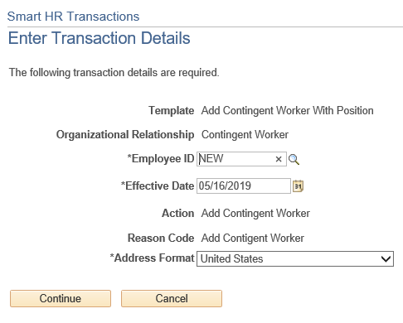
ADD CONTINGENT WORKER (WITH POSITION)
Navigation: PeopleSoft Menu > Workforce Administration > Smart HR Template > Smart HR Transactions
After the WFA Production team at UCPath Center processes the new hire template, the system automatically generates the next sequential UC Employee ID number for the individual.
The Effective Date is populated based on the entry on the previous page.
Click the Continue button.

Slide 40
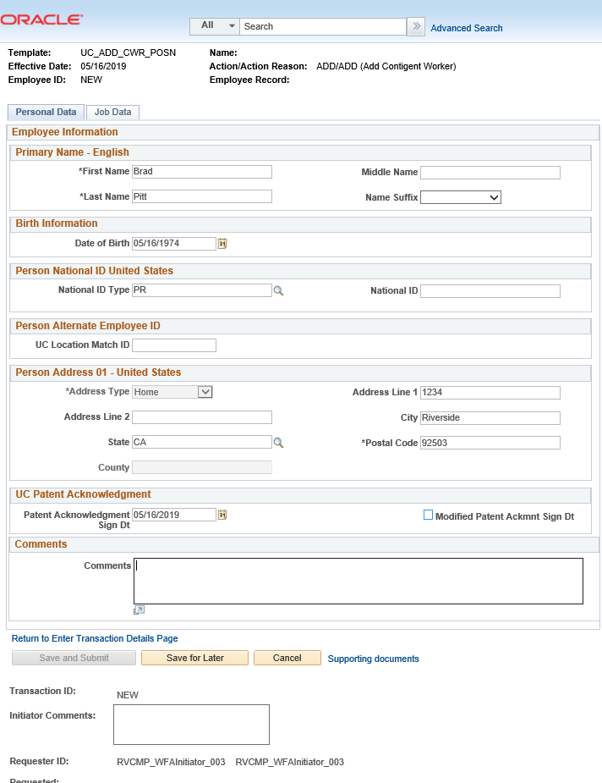
ADD CONTINGENT WORKER (WITH POSITION)
The following UCPath fields are required by UCPC for all CWR Transactions. Enter the following in the Personal Data tab:
First name
Last name
Date of Birth
Address line 1
City
State
Postal Code
Patent Acknowledgment Sign Date
If applicable, to indicate the person did not originally sign the standard Patent Acknowledgement form, select Modified Patent Ackmnt Sign Dt check box.

Slide 41
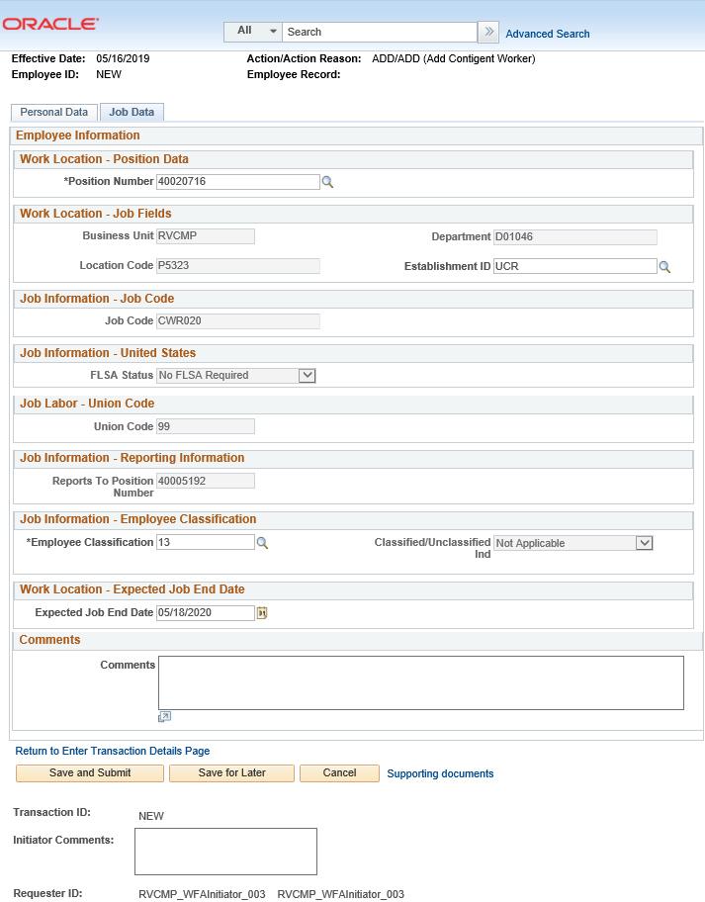
ADD CONTINGENT WORKER (WITH POSITION)
The following UCPath fields are required by UCPC for all CWR Transactions. Enter the following in the Job Data tab:
Position Number
Business Unit (auto-populates when Position number is added)
Department (auto-populates when Position number is added)
Location Code (auto-populates when Position number is added)
Establishment (auto-populates when Position number is added)
Job Code (auto-populates when Position number is added)
FLSA Status (auto-populates when Position number is added)
Union Code (auto-populates when Position number is added)
Reports to Position Number (auto-populates when Position number is added)
Employee Classification
Expected Job End Date
Use the Supporting documents to attach the Personal Data Form and Appointment Letter.
Click Save and Submit.
Notice that a new field called
Positon Number appears on the Job Data Tab. If a contingent worker supervises employees they will need to be added with a position.

Slide 42
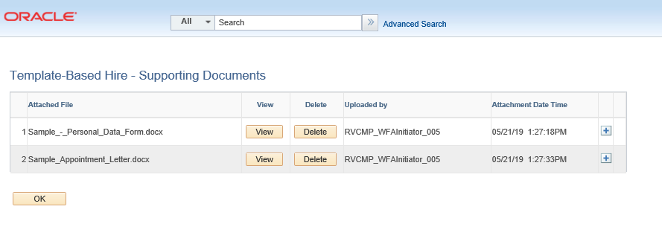
ADD CWR SUPPORTING DOCUMENTS
To attach documents, click on the Supporting Documents link on either the Personal Data or Job Data tabs.
Click on the to add more supporting documents.
Click Save and Submit on either the Personal Data or Job Data tab.

Slide 43
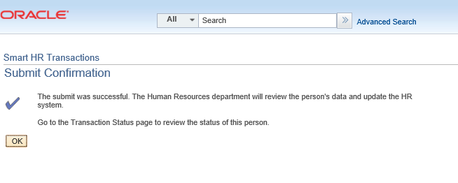
ADD CWR SUPPORTING DOCUMENTS
Once you have clicked Save and Submit, you will receive a confirmation.
Click on the OK button.

Slide 44
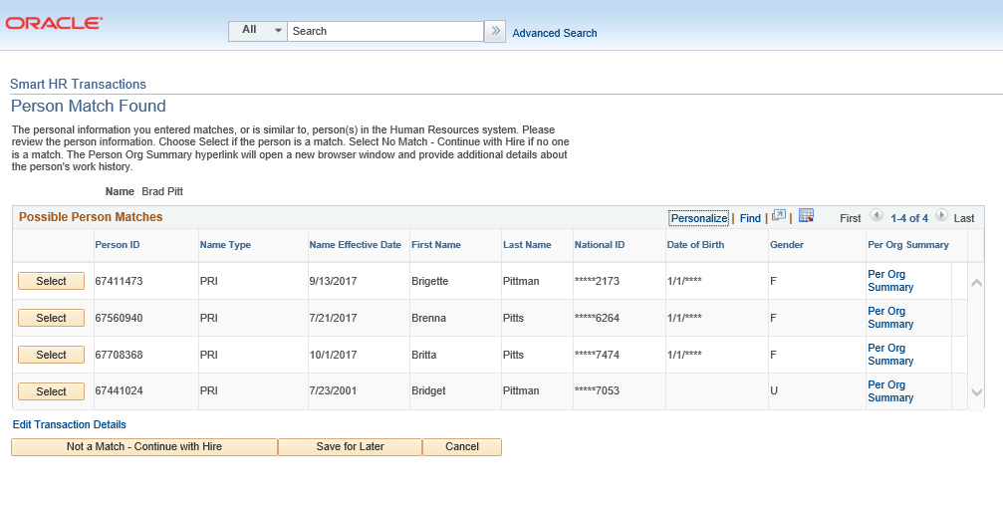
PERSON MATCH FOUND
Sometimes the personal information you entered matches, or is similar to, a person already existing in UCPath. Please review the person information. Choose Select if the person is a match. Select No Match – Continue with Hire if no one is a match. The Person Org Summary hyperlink will open a new browser window and provide additional details about the person’s work history.
For this scenario click Not a Match – Continue with Hire.

Slide 45
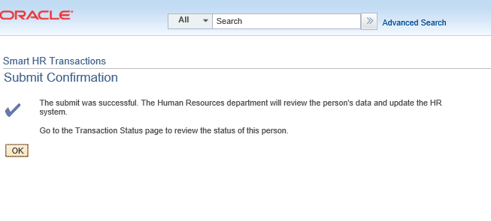
SUBMIT CONFIRMATION
Once the transaction has been submitted, the initiator will receive a confirmation.
Click the OK button to go to the Transaction Status page to review the status of this person.
The template transaction is routed for approval and appears in the Transactions in Progress section until it is processed.
You have initiated a contingent worker (with Position) template transaction.

Slide 46
Initiate Renew CWR
(With Position)

Slide 47
RENEW A CONTINGENT WORKER (WITH POSITION)
Navigation: PeopleSoft Menu > Workforce Administration > Smart HR Template > Smart HR Transactions
Use the Smart HR Transactions page to initiate a template Transaction.
Select the appropriate add contingent worker template. Notice there are two add contingent worker templates: one for adding a contingent worker with a position, and one for adding a contingent worker without a position.
Click the UC_RENW_CWR_POS list item.
Use the Select Template field to
Select the appropriate template
Enter the effective date for the selected template
Click Create Transaction

Slide 48
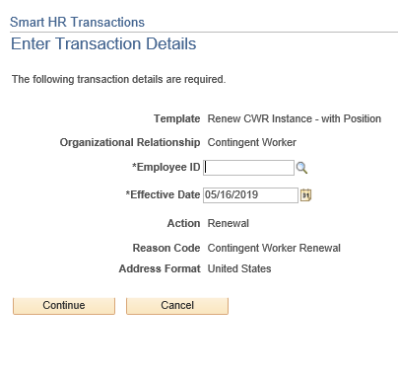
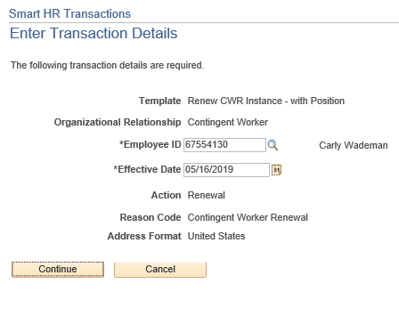
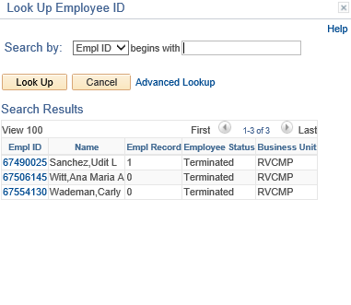
RENEW A CONTINGENT WORKER (WITH POSITION)
In the Employee ID field, enter the person’s ID number, or use the lookup search and select it. You can enter or select only the CWR records to which you have UCPath department access.
Click Continue once you select the appropriate Employee ID.

Slide 49
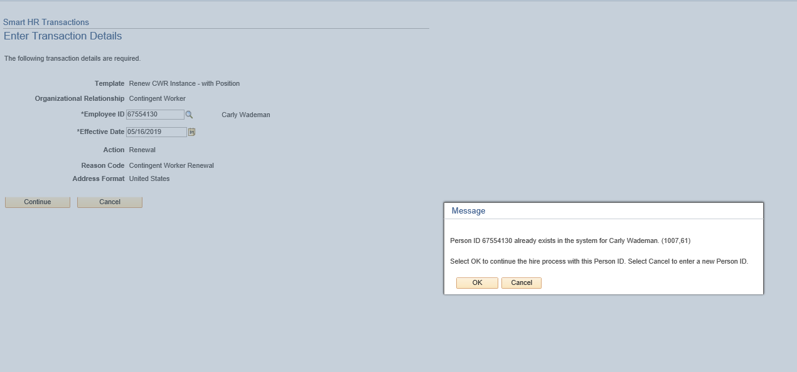
RENEW A CONTINGENT WORKER (WITH POSITION)
UCPath displays a message indicating the individual already exists in the system. Verify that the displayed employee ID and name corresponds with the individual for which you are renewing employment.
Click the OK button.

Slide 50
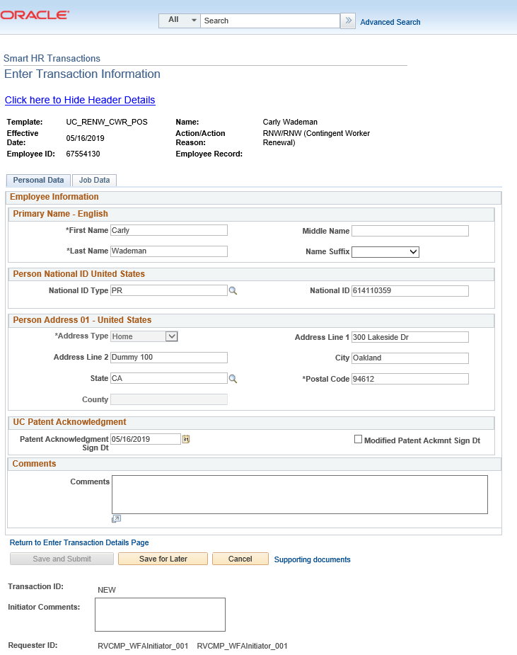
RENEW A CONTINGENT WORKER (WITH POSITION)
The renew contingent worker template includes two tabs: Personal Data and Job Data.
The employee’s Personal Data automatically populates. Update the personal information if needed.

Slide 51
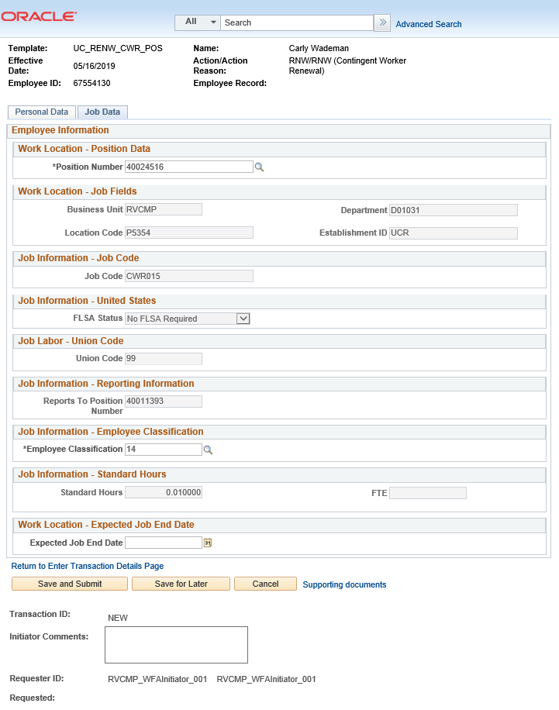
RENEW A CONTINGENT WORKER (WITH POSITION)
The renew contingent worker template includes two tabs: Personal Data and Job Data.
Update the employee’s Job Data information.
The following UCPath fields are required by UCPC for all CWR Transactions. Enter the following in the Job Data tab:
Position Number
Business Unit (auto-populates when Position number is added)
Department (auto-populates when Position number is added)
Location Code (auto-populates when Position number is added)
Establishment (auto-populates when Position number is added)
Job Code (auto-populates when Position number is added)
FLSA Status (auto-populates when Position number is added)
Union Code (auto-populates when Position number is added)
Reports to Position Number (auto-populates when Position number is added)
Employee Classification
Standard Hours
Expected Job End Date
Use the Supporting documents to attach the Personal Data Form and Appointment Letter.
Click Save and Submit.

Slide 52
RENEW CWR SUPPORTING DOCUMENTS
To attach documents, click on the Supporting Documents link on either the Personal Data or Job Data tabs.
Click on the to add more supporting documents.

Slide 53
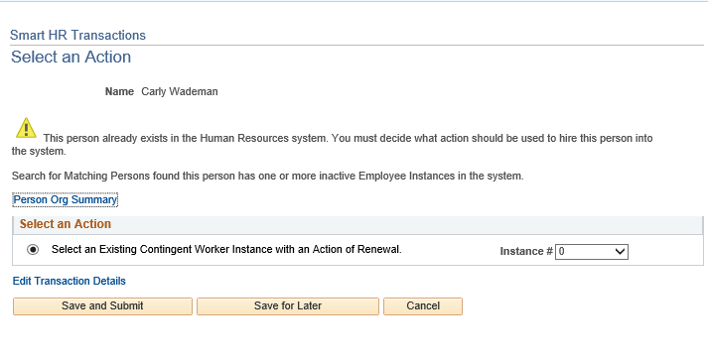
RENEW A CONTINGENT WORKER (WITH POSITION)
The system displays the Select an Action page.
If the person has only one inactive employee record (instance) within your business unit, then that number is defaulted. If the person has more than one inactive employee record within your business unit, then the lowest number is defaulted. Select the instance you are renewing.
Click the Save and Submit button.

Slide 54
SUBMIT CONFIRMATION
Once the transaction has been submitted, the initiator will receive a confirmation.
Click the OK button to go to the Transaction Status page to review the status of this person.
The template transaction is routed for approval and appears in the Transactions in Progress section until it is processed.
You have initiated a renew contingent worker (without Position) template transaction.

Slide 55
Initiate Extend CWR
(With Position)

Slide 56
EXTEND A CONTINGENT WORKER (WITH POSITION)
Navigation: PeopleSoft Menu > Workforce Administration > Smart HR Template > Smart HR Transactions
Use the Smart HR Transactions page to initiate a template Transaction.
Select the appropriate add contingent worker template. Notice there are two add contingent worker templates: one for adding a contingent worker with a position, and one for adding a contingent worker without a position.
Click the UC_EXT_CWR_POSN list item.
Use the Select Template field to
Select the appropriate template
Enter the effective date for the selected template
Click Create Transaction

Slide 57
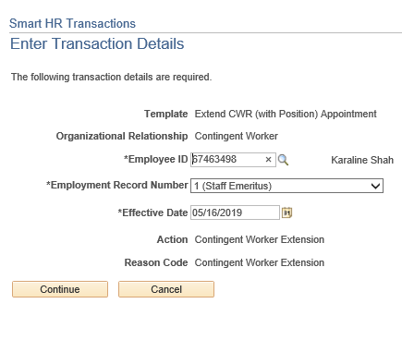
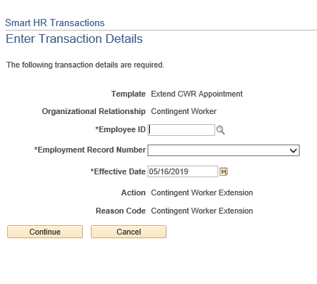
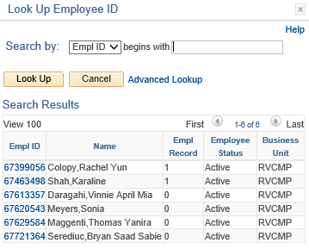
EXTEND A CONTINGENT WORKER (WITH POSITION)
In the Employee ID field, enter the person’s ID number or use the lookup search and select it. You can enter or select only the CWR records to which you have UCPath department access.
Click Continue once you select the appropriate Employee ID.

Slide 58
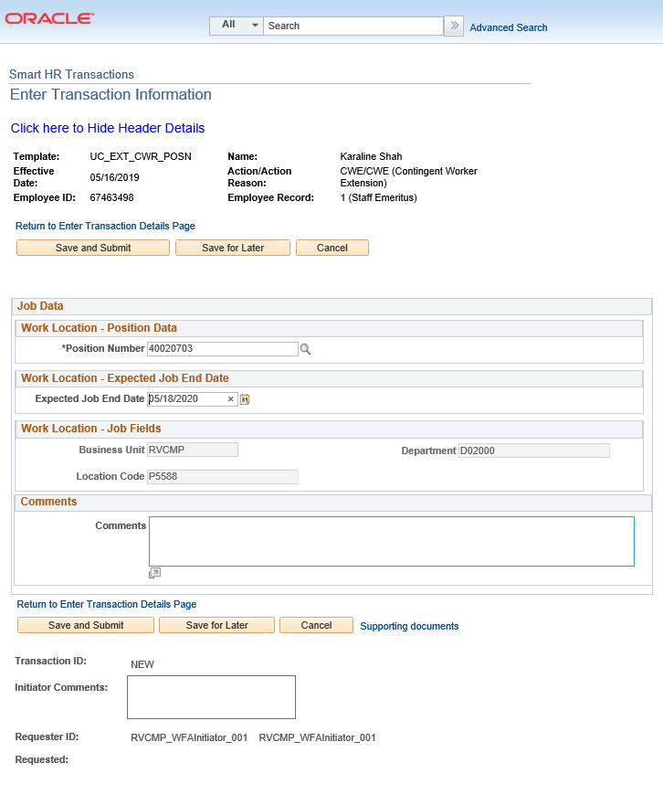
EXTEND A CONTINGENT WORKER (WITH POSITION)
The Extend contingent worker template includes the Job Data tab.
The following UCPath fields are required by UCPC for all CWR Transactions. Enter the following in the Job Data tab:
Position Number
Business Unit (auto-populates when Position number is added)
Department (auto-populates when Position number is added)
Location Code (auto-populates when Position number is added)
Expected Job End Date
Use the Supporting documents to attach the Personal Data Form and Appointment Letter.
Click Save and Submit.

Slide 59
EXTEND CWR SUPPORTING DOCUMENTS
To attach documents, click on the Supporting Documents link on either the Personal Data or Job Data tabs.
Click on the to add more supporting documents.

Slide 60
SUBMIT CONFIRMATION
Once the transaction has been submitted, the initiator will receive a confirmation.
Click the OK button to go to the Transaction Status page to review the status of this person.
The template transaction is routed for approval and appears in the Transactions in Progress section until it is processed.
You have initiated a extend contingent worker (with Position) template transaction.

Slide 61
CHECK YOUR UNDERSTANDING

Slide 62
CHECK YOUR UNDERSTANDING
What page in UCPath do you use to initiate a CWR template transaction?
If a CWR in your department supervises UCR employees what do you do?
If a CWR does NOT supervise UCR employees what do you do?
Notes:
If a contingent worker in your department supervises UCR employees, you will need to create a position for them first. Generally, contingent workers will not supervise UCR employees and will therefore not require a position. In that case, contingent worker can be added to UCPath using a job code. Job codes for contingent workers ALWAYS start with the prefix CWR.
If a contingent worker does NOT supervise UCR Employee(s), they can be Onboarded without a Position.

Slide 63
Contingent Workers (No Position)

Slide 64
Initiate Add CWR
(No Position)

Slide 65
ADD CONTINGENT WORKER (NO POSITION)
Navigation: PeopleSoft Menu > Workforce Administration > Smart HR Template > Smart HR Transactions
Use the Smart HR Transactions page to initiate a template Transaction.
Select the appropriate add contingent worker template. Notice there are two add contingent worker templates: one for adding a contingent worker with a position, and one for adding a contingent worker without a position.
Click the UC_ADD_CWR list item.
Use the Select Template field to
Select the appropriate template
Enter the effective date for the selected template
Click Create Transaction

Slide 66
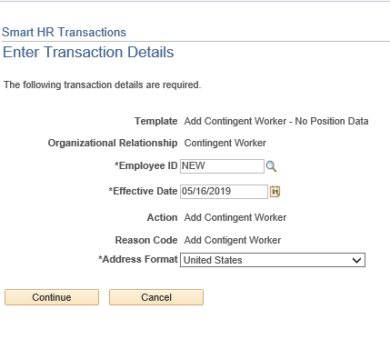
ADD CONTINGENT WORKER (NO POSITION)
Navigation: PeopleSoft Menu > Workforce Administration > Smart HR Template > Smart HR Transactions
After the WFA Production team at UCPath Center processes the new hire template, the system automatically generates the next sequential UC Employee ID number for the individual.
The Effective Date is populated based on the entry on the previous page.
Click the Continue button.

Slide 67
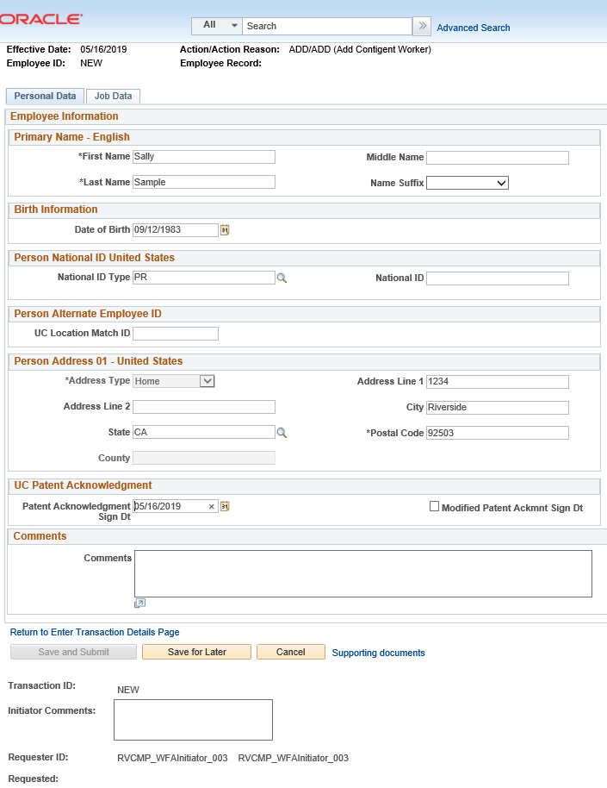
ADD CONTINGENT WORKER (NO POSITION)
The following UCPath fields are required by UCPC for all CWR Transactions. Enter the following in the Personal Data tab:
First name
Last name
Date of Birth
Address line 1
City
State
Postal Code
Patent Acknowledgment Sign Date
If applicable, to indicate the person did not originally sign the standard Patent Acknowledgement form, select Modified Patent Ackmnt Sign Dt check box.

Slide 68
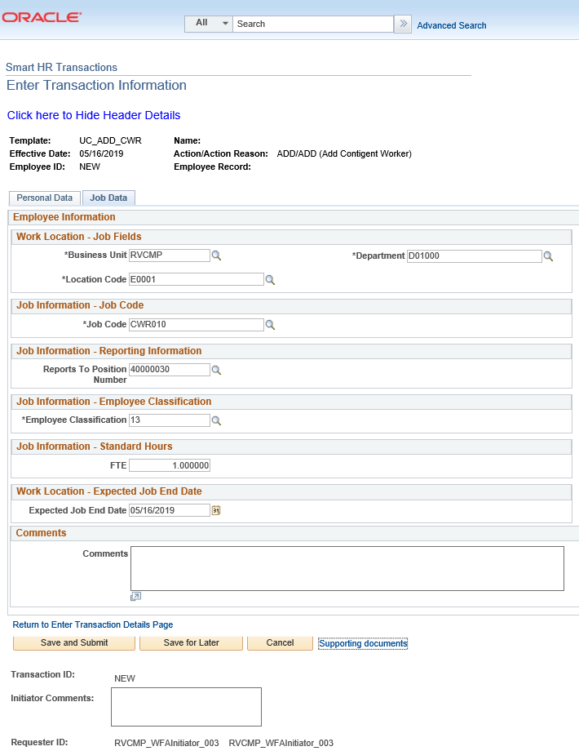
ADD CONTINGENT WORKER (NO POSITION)
The following UCPath fields are required by UCPC for all CWR Transactions. Enter the following in the Job Data tab:
Business Unit
Department
Location
Job Code
Employee Class
FTE
Reports to Position Number
Expected Job End Date
Use the Supporting documents to attach the Personal Data Form and Appointment Letter.
Click Save and Submit.

Slide 69
ADD CWR SUPPORTING DOCUMENTS
To attach documents click on the Supporting Documents link on either the Personal Data or Job Data tabs.
Click on the to add more supporting documents.
Click Save and Submit on either the Personal Data or Job Data tab.

Slide 70
SUBMIT CONFIRMATION
Once the transaction has been submitted, the initiator will receive a confirmation.
Click the OK button to go to the Transaction Status page to review the status of this person.
The template transaction is routed for approval and appears in the Transactions in Progress section until it is processed.
You have initiated a contingent worker (without Position) template transaction.

Slide 71
Initiate Renew CWR
(No Position)

Slide 72
RENEW A CONTINGENT WORKER (NO POSITION)
Navigation: PeopleSoft Menu > Workforce Administration > Smart HR Template > Smart HR Transactions
Use the Smart HR Transactions page to initiate a template Transaction.
Select the appropriate add contingent worker template. Notice there are two add contingent worker templates: one for adding a contingent worker with a position, and one for adding a contingent worker without a position.
Click the UC_RENW_CWR list item.
Use the Select Template field to
Select the appropriate template
Enter the effective date for the selected template
Click Create Transaction

Slide 73
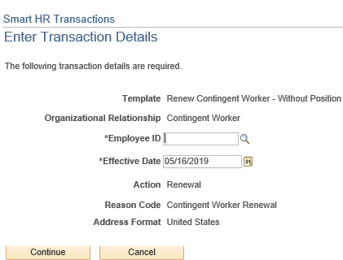
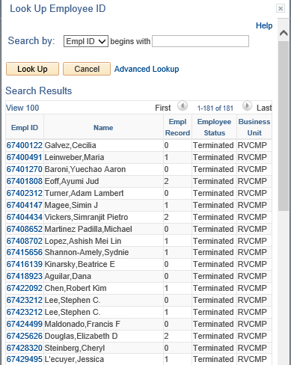
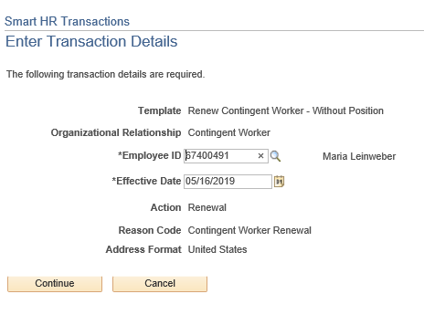
RENEW A CONTINGENT WORKER (NO POSITION)
In the Employee ID field, enter the person’s ID number or use the lookup search and select it. You can enter or select only the CWR records to which you have UCPath department access.
Click Continue once you select the appropriate Employee ID.

Slide 74
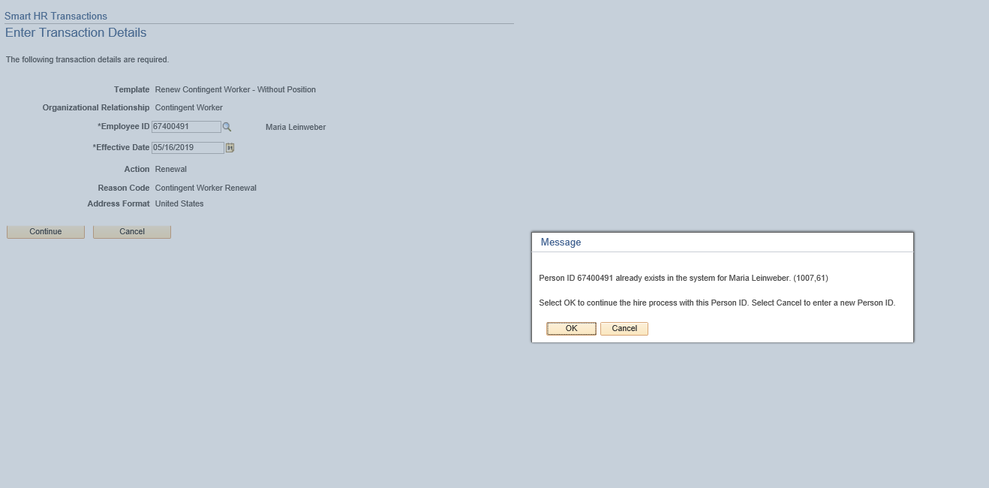
RENEW A CONTINGENT WORKER (NO POSITION)
UCPath displays a message indicating the individual already exists in the system. Verify that the displayed employee ID and name corresponds with the individual for which you are renewing employment.
Click the OK button.

Slide 75
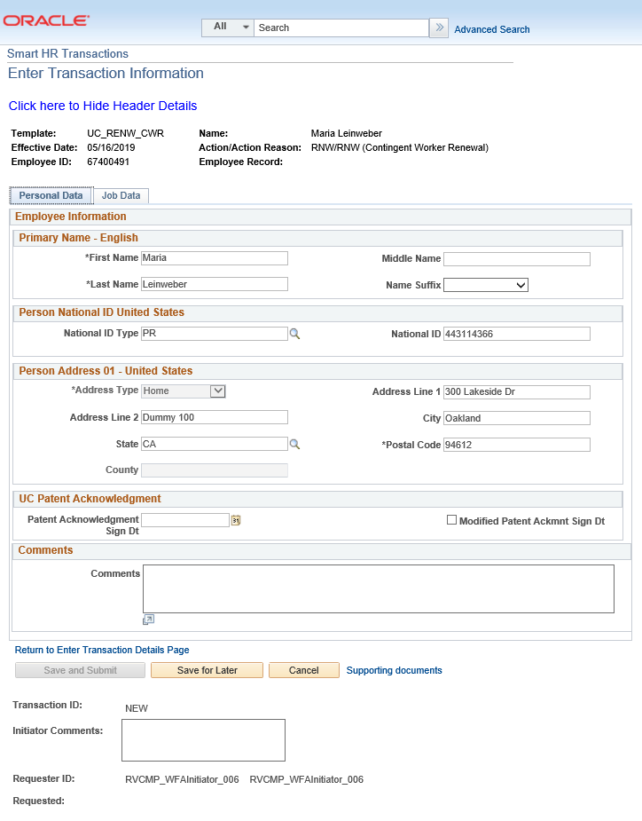
RENEW A CONTINGENT WORKER (NO POSITION)
The renew contingent worker template includes two tabs: Personal Data and Job Data.
The employee’s Personal Data automatically populates. Update the personal information if needed.

Slide 76
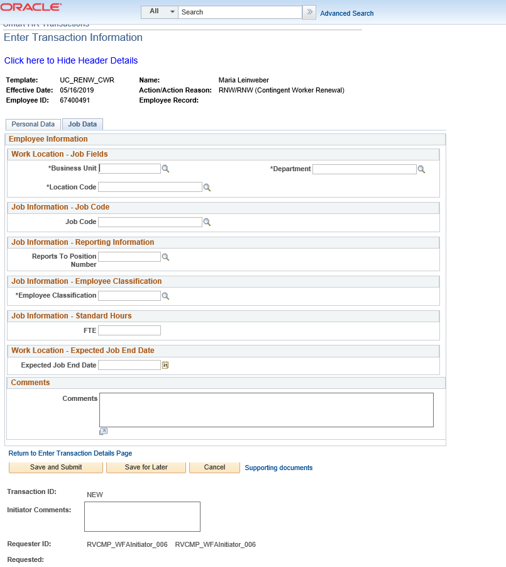
RENEW A CONTINGENT WORKER (NO POSITION)
The renew contingent worker template includes two tabs: Personal Data and Job Data.
Update the employee’s Job Data information.
The following UCPath fields are required by UCPC for all CWR Transactions. Enter the following in the Job Data tab:
Business Unit
Department
Location
Job Code
Employee Classification
FTE
Reports to Position Number
Expected Job End Date
Use the Supporting documents to attach the Personal Data Form and Appointment Letter.
Click Save and Submit.

Slide 77
RENEW CWR SUPPORTING DOCUMENTS
To attach documents, click on the Supporting Documents link on either the Personal Data or Job Data tabs.
Click on the to add more supporting documents.

Slide 78
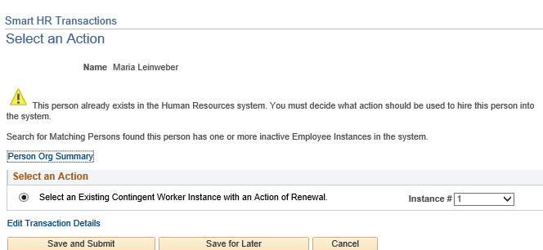
RENEW A CONTINGENT WORKER (NO POSITION)
The system displays the Select an Action page.
If the person has only one inactive employee record (instance) within your business unit, then that number is defaulted. If the person has more than one inactive employee record within your business unit, then the lowest number is defaulted. Select the instance you are renewing.
Click the Save and Submit button.

Slide 79
SUBMIT CONFIRMATION
Once the transaction has been submitted, the initiator will receive a confirmation.
Click the OK button to go to the Transaction Status page to review the status of this person.
The template transaction is routed for approval and appears in the Transactions in Progress section until it is processed.
You have initiated a renew contingent worker (without Position) template transaction.

Slide 80
Initiate Extend CWR
(No Position)

Slide 81
EXTEND A CONTINGENT WORKER (NO POSITION)
Navigation: PeopleSoft Menu > Workforce Administration > Smart HR Template > Smart HR Transactions
Use the Smart HR Transactions page to initiate a template Transaction.
Select the appropriate add contingent worker template. Notice there are two add contingent worker templates: one for adding a contingent worker with a position, and one for adding a contingent worker without a position.
Click the UC_EXT_CWR list item.
Use the Select Template field to
Select the appropriate template
Enter the effective date for the selected template
Click Create Transaction

Slide 82
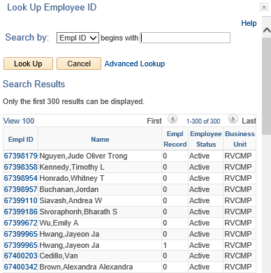
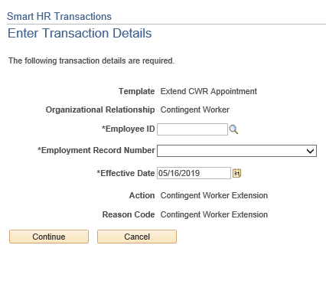
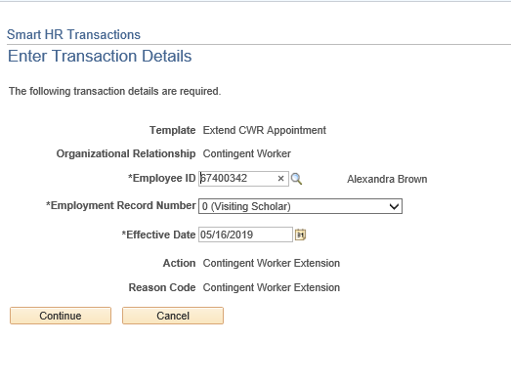
EXTEND A CONTINGENT WORKER (NO POSITION)
In the Employee ID field, enter the person’s ID number or use the lookup search and select it. You can enter or select only the CWR records to which you have UCPath department access.
Click Continue once you select the appropriate Employee ID.

Slide 83
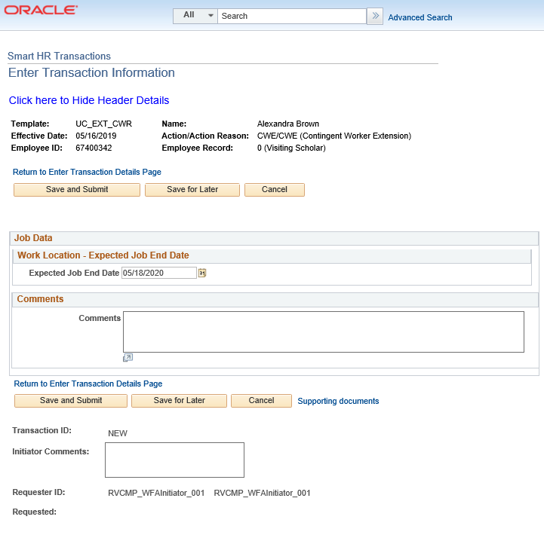
EXTEND A CONTINGENT WORKER (NO POSITION)
The Extend contingent worker template includes the Job Data tab.
The following UCPath field is required by UCPC for all CWR Transactions. Enter the following in the Job Data tab:
Expected Job End Date.
Use the Supporting documents to attach the Personal Data Form and Appointment Letter.
Click Save and Submit.

Slide 84
EXTEND CWR SUPPORTING DOCUMENTS
To attach documents, click on the Supporting Documents link on either the Personal Data or Job Data tabs.
Click on the to add more supporting documents.

Slide 85
SUBMIT CONFIRMATION
Once the transaction has been submitted, the initiator will receive a confirmation.
Click the OK button to go to the Transaction Status page to review the status of this person.
The template transaction is routed for approval and appears in the Transactions in Progress section until it is processed.
You have initiated a extend contingent worker (with Position) template transaction.

Slide 86
Initiate CWR

Slide 87
INITIATE COMPLETE CWR
Navigation: PeopleSoft Menu > Workforce Administration > Smart HR Template > Smart HR Transactions
Use the Smart HR Transactions page to initiate a template Transaction.
Select the appropriate add contingent worker template. Notice that there is only one template for completing a Contingent Worker.
Click the UC_COM_CWR list item.
Use the Select Template field to
Select the appropriate template
Enter the effective date for the selected template
Click Create Transaction

Slide 88
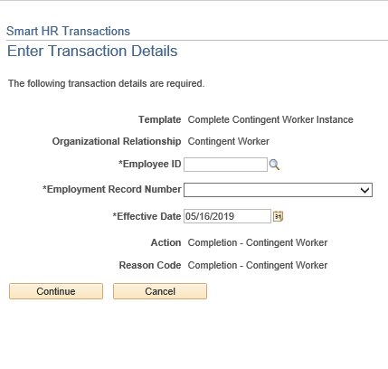
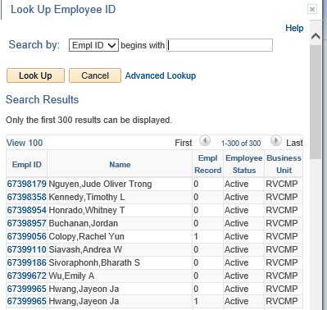
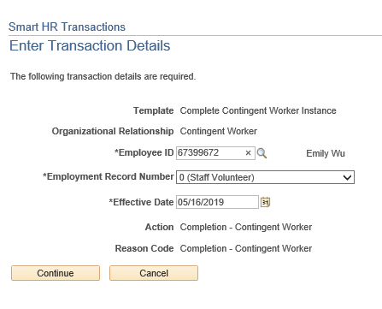
INITIATE COMPLETE CWR
In the Employee ID field, enter the person’s ID number or use the lookup search and select it. You can enter or select only the CWR records to which you have UCPath department access.
Click Continue once you select the appropriate Employee ID.

Slide 89
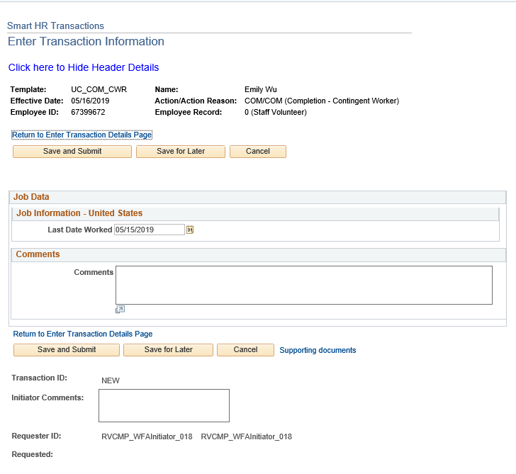
INITIATE COMPLETE CWR
The complete contingent worker template includes the Job Data tab.
The Last Date Worked field value defaults to one business day prior to the effective date you entered on the previous page.
If the effective date is a Monday, then the Last Date Worked field defaults to the prior Friday’s date. You can update this value, if necessary.

Slide 90
SUBMIT CONFIRMATION
Once the transaction has been submitted, the initiator will receive a confirmation.
Click the OK button to go to the Transaction Status page to review the status of this person.
The template transaction is routed for approval and appears in the Transactions in Progress section until it is processed.
You have initiated a complete contingent worker template transaction.

Slide 91
Clone a Denied/Canceled Transaction

Slide 92
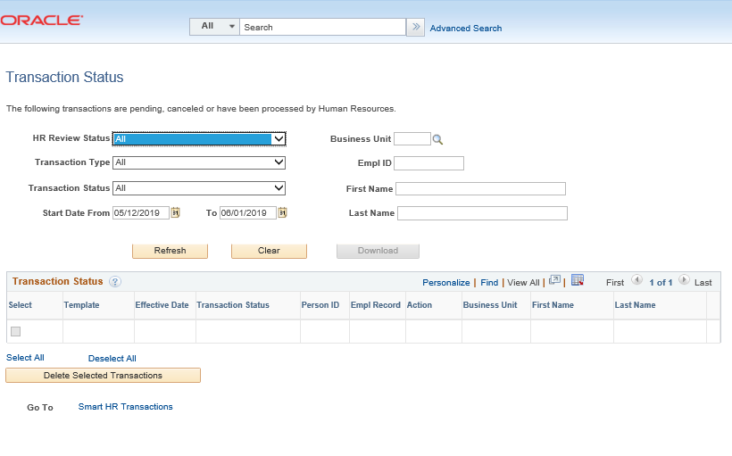
CLONING A TRANSACTION
Navigation: PeopleSoft Menu > Workforce Administration > Smart HR Template > Transaction Status
The AWE Approver/UCPC denied/canceled the transaction, which is routed back to the Initiators Transaction Status page.
Click Refresh on the Transaction Status page to view your transactions.

Slide 93
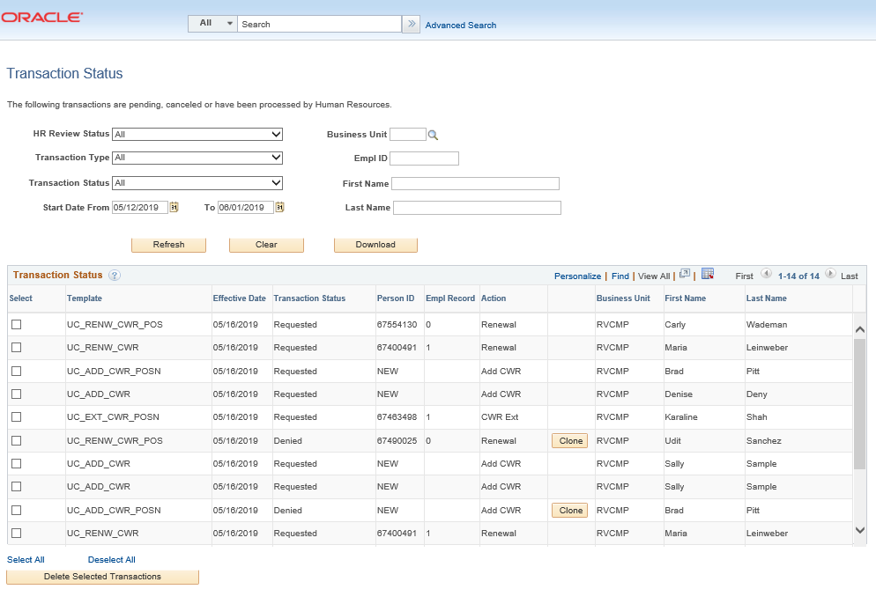
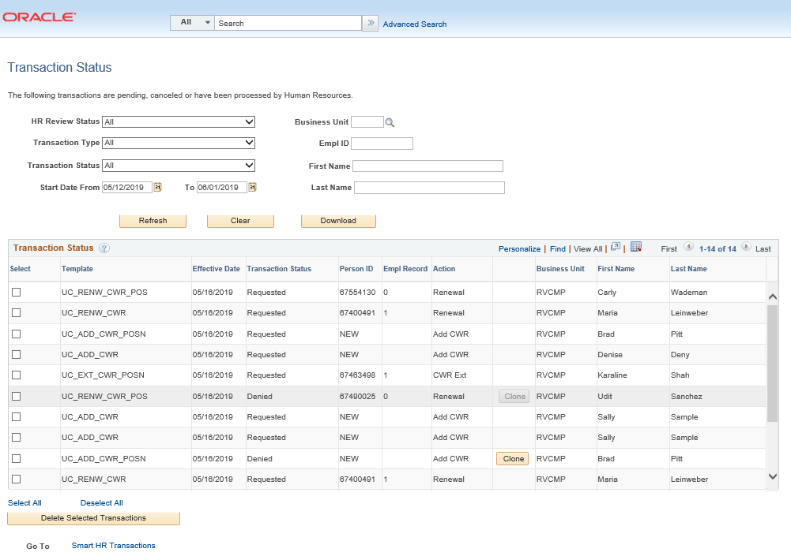
CLONING A TRANSACTION
Navigation: PeopleSoft Menu > Workforce Administration > Smart HR Template > Transaction Status
The Initiator is able to Clone transaction by clicking on the Clone button.
Once you click the Clone button, the button will grey out.
Go to Smart HR Transactions at the bottom of the page to access the cloned template.
The cloning function is available when:
A template transaction is denied by a location approver, or when a template transaction is cancelled by UCPC WFA Production.
TIP: Smart HR Transactions.

Slide 94
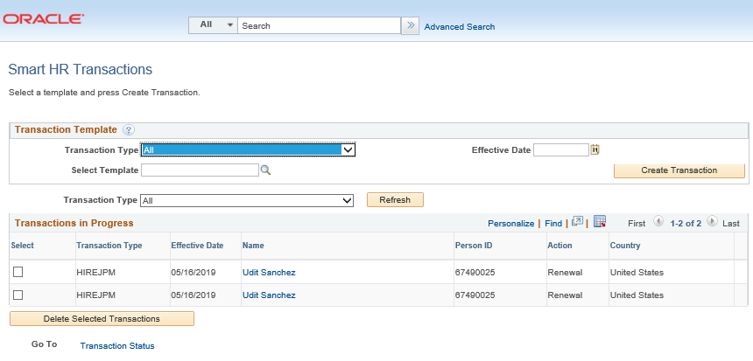
CLONING A TRANSACTION
Initiator will be able to view the cloned transaction.
Click on the person’s name below to resubmit transaction with necessary corrections.
Transaction number 2 is the cloned transaction; click on this transaction to resubmit.
Transaction number 1 is the original transaction; click on this transaction to view denial comments.
TIP: If you click on the original transaction #1, you will not be able to click the Save and Submit button because it will be greyed out. The cloned transaction will always be on the bottom of the original transaction.
1
Original Transaction
2
Cloned Transaction

Slide 95
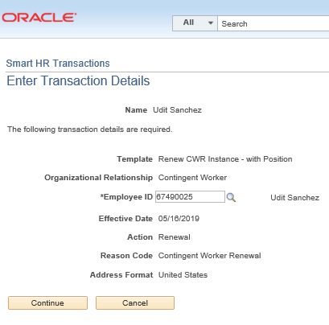
VIEW DENIAL COMMENTS FROM AWE LOCATION APPROVER
Navigation: PeopleSoft Menu > Workforce Administration > Smart HR Template > Smart HR Transactions
Click on person’s name.
The Transaction Details will appear on the screen. Click on Continue.
UCPath displays a message indicating the individual already exists in the system.
Click the OK button.
Initiator views comments in the Smart HR Transactions page.
Initiator clones in the Transaction Status page.

Slide 96
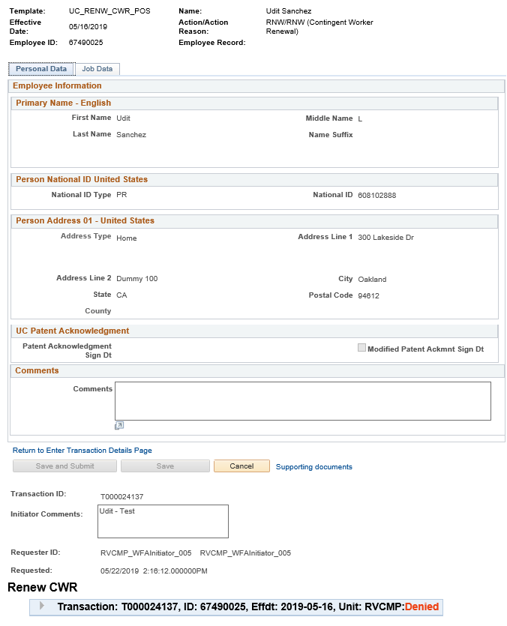
VIEW DENIAL COMMENTS FROM AWE LOCATION APPROVER
1
2
The original submitted transaction appears. Notice that the Save and Submit buttons on the bottom are greyed out.
To view denial comments from the AWE Approver, click on the arrow.

Slide 97
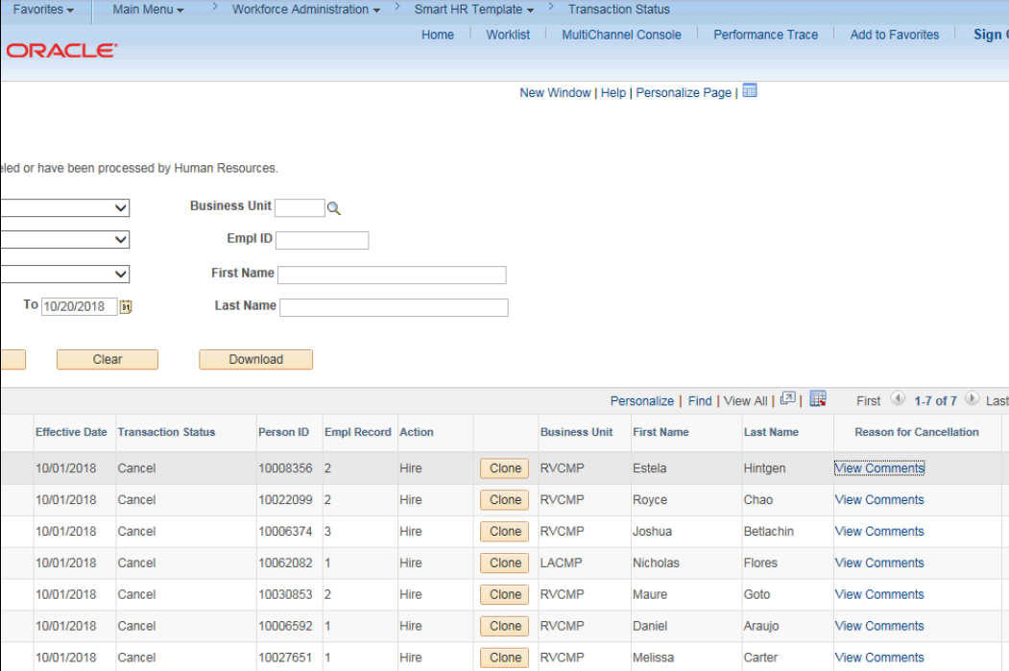
VIEW DENIAL COMMENTS FROM UCPC
Navigation: PeopleSoft Menu > Workforce Administration > Smart HR Template > Transaction Status
When a transaction is cancelled by UCPC WFA Production, comments are entered to explain why the transaction was cancelled.
Template Initiators can View Comments under Reason for Cancellation and, if needed, Clone the transaction to resubmit it with necessary corrections.
Note: To view comments about a transaction that was denied by a Location AWE Approver, you must navigate to the SS Smart HR Transactions page and review the Approver Comments field.
Click for UCPC Job Aid

Slide 98
CLONING A TRANSACTION
After you have cloned the transaction, go to Smart HR Transactions at the bottom of the page.
Transaction number 2 is the cloned transaction. Click on the person’s name to resubmit transaction.
Cloned Transaction
1
Original Transaction
2
Cloned Transaction

Slide 99
CLONING A TRANSACTION (continued)
Click on person’s name.
The Transaction Details will appear on the screen. Click on Continue.
UCPath displays a message indicating the individual already exists in the system. Verify that the displayed employee ID and name corresponds with the individual for which you are renewing employment.
Click the OK button.

Slide 100
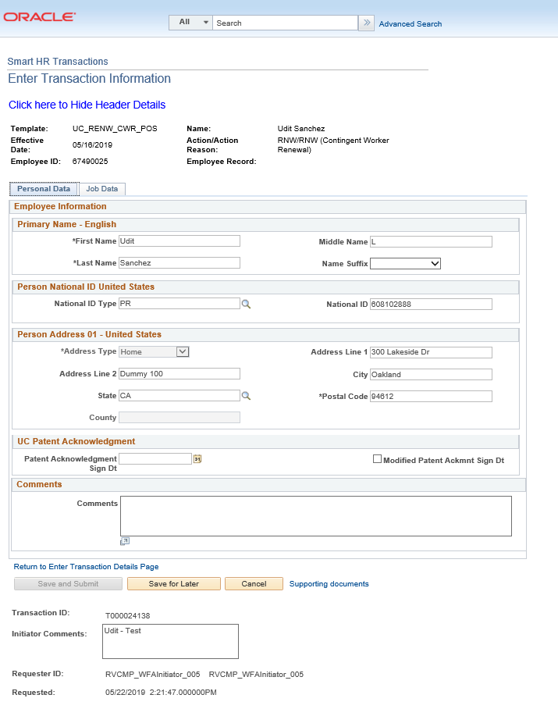
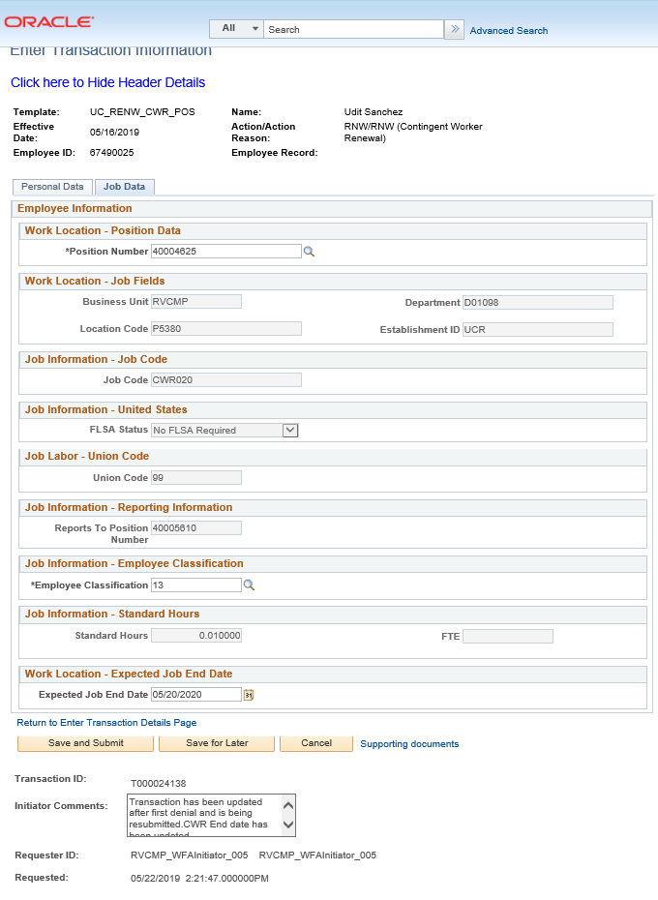
CLONING A TRANSACTION (continued)
Click Save and Submit to resubmit transaction.
Notice that you can now Save and Submit the cloned transaction.

Slide 101
SUBMIT CONFIRMATION
Once the transaction has been submitted, the initiator will receive a confirmation.
Click the OK button to go to the Transaction Status page to review the status of this person.
The template transaction is routed for approval and appears in the Transactions in Progress section until it is processed.
You have resubmitted a contingent worker template transaction.

Slide 102
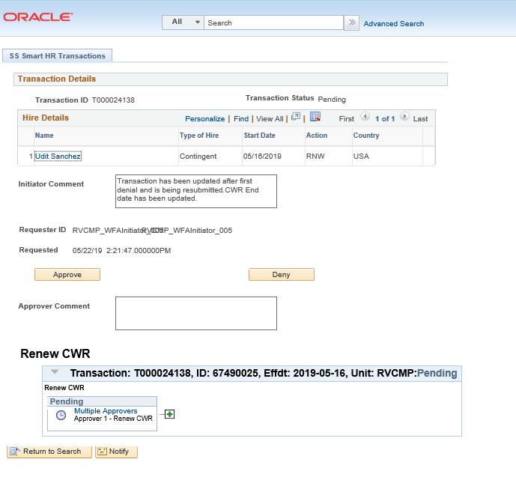
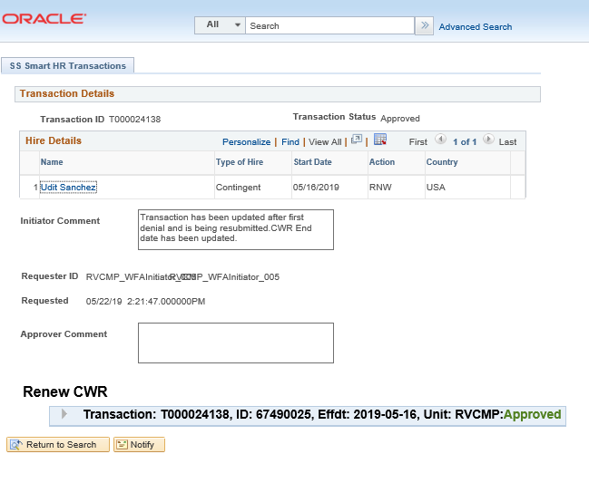
RESUBMITTED CLONED TRANSACTION
The template transaction is routed to AWE for approval once again.
Template has been resubmitted and has been approved.

Slide 103
CHECK YOUR UNDERSTANDING

Slide 104
CHECK YOUR UNDERSTANDING
Can you clone a CWR transaction if it has been cancelled or denied?
When is the cloning function available?
Initiator views comments in what page?
Initiator clones in what page?
Notes:
1. The cloning function is available when:
A template transaction is denied by a location approver, or when a template transaction is cancelled by UCPC WFA Production.
2. Initiator views comments in the Smart HR Transactions page.
Initiator clones in the Transaction Status page.

Slide 105
SharePoint Instructions and Hands on Training

Slide 106
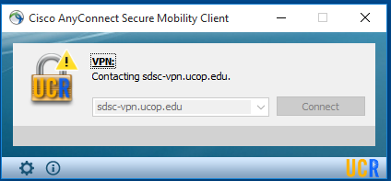
SHAREPOINT LIST INSTRUCTIONS
Open the Cisco AnyConnect client.
Enter the VPN name: sdsc-vpn.ucop.edu
Click Connect.
Select the Group: hbldtrn0-training
Enter one of the following username:
• ucr_ucpathvpn_01
• ucr_ucpathvpn_02
The VPN password for the week of 7/8/19 is: ~~9+Game+Rome~~
Once Connected to the VPN:
Go to https://hbldtrn0.ucpath-build.devops.universityofcalifornia.edu/psp/HBLDTRN0/?cmd=login&languageCd=ENG&
Enter the Tester ID\Password provided in the SharePoint Scenarios.

Slide 107
SHAREPOINT LIST INSTRUCTIONS
Testing SharePoint: https://ucrshare.ucr.edu/sites/FOM_UCPath/SitePages/Home.aspx
Preferred browsers are Internet Explorer and Chrome. (Save the link as a favorite)
Select UCPath Transaction Training Scenarios from the left side Quick Menu:

Slide 108
VIEWING LIST OPTIONS
When the list opens, note the tabs at the top of the screen:

Slide 109
VIEWING LIST OPTIONS part 2
By selecting ‘List’ you can filter the view on the process you are transacting. The default view is All Transactions. Select a specific transaction type to view the list containing only those transactions:

Slide 110
UPDATING AND EDITING A SHAREPOINT LIST
Many functions of a SharePoint list are similar to MS Excel, except that it is in a central location, and can be accessed / updated by multiple people at the same time.
Use the list headers to filter and sort. Only you will see these temporary changes.
By selecting your name in the drop-down, you will have easy access to only your transactions. This is especially helpful if your name appears several pages into the list.

Slide 111
UPDATING AND EDITING A SHAREPOINT LIST part 2
You can update your test by editing directly by clicking into the cell. Some cells are controlled by a drop-down choice, others are free-form. To save your change, click in another cell.

Slide 112
LEARNING OBJECTIVES REVIEW
Having completed this course, you should be able to:
Add, Renew and Extend a Contingent Worker (With Position)
Add, Renew and Extend a Contingent Worker (No Position)
Complete a Contingent Worker
Clone a denied or cancelled Contingent Worker Transaction

Slide 113
THINGS TO REMEMBER
SSC’s will continue to enter background check results in UCPath on the Security Clearance for both Phase 1 and Phase 2.
CWR’s need to be entered into UCPath and ALSO go through the Net ID Affiliate process. An enhancement that automatically generates a Net ID after a template is submitted in UCPath is pending.
Transactional Unit will attach the Personal Data Form and Appointment Letter to TBH.
CWR’s do not need to sign the Oath.
You can clone a transaction that has been denied or cancelled in the Smart HR Template.

Slide 114
APPENDIX
Contingent Worker Process Map
Contingent Worker Road Map

Slide 115
Your Feedback Please
http://bit.ly/ucpathpilottraining

