Slide 1
Ucr ucpath transaction pilot
One Time Pay Process

Slide 2
TRAINER INTRODUCTION
NAME: Andrea Campos
Title: Business Systems Analyst
Department: Business & Financial Services
Years at UCR: 3 Years

Slide 3
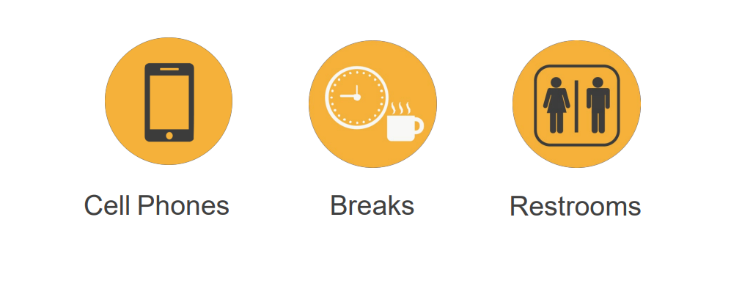
HOUSEKEEPING

Slide 4
LEARNING OBJECTIVES
Understand the definition of a One Time Pay Transaction.
Understand the scenarios that are “in scope” for the Transaction Pilot One Time Pay process.
Understand the various roles and responsibilities involved in the Transaction Pilot One Time Pay process.
Learn how to initiate One Time Pay Transactions in UCPath.
Understand EACS Roles involved in the Transaction Pilot One Time Pay process.
Understand Approval workflow involved in Transaction Pilot One Time Pay process.

Slide 5
LEARNING TOPICS
One Time Pay Process Definition
One Time Pay Process Overview
Transactions Roles
EACS Roles
Change Impacts
Initiate a Generic Request in ServiceLink
Initiate One Time Pay Transaction
How To Approve a One Time Pay Transaction
How To Deny a One Time Pay Transaction
How To View a One Time Pay Transaction
SharePoint Instructions

Slide 6
One Time Pay Process Definition

Slide 7
ONE TIME PAY PROCESS DEFINITION
The One Time Pay process is the method to add a flat dollar amount payment for staff and academic employees to be processed in a specific pay period.
The Transactional Units will have the opportunity to submit one-time payments for employees within their Accountability Structures.
The process begins when a department initiator in a Transactional Unit submits a one-time payment transaction for an employee in UCPath.
The process ends when all Payroll processes have been completed for the applicable pay period and the employee receives the payment on their paycheck.

Slide 8
HANDOFF MATRIX
Scenarios | One Time Payment | Contact UCR Payroll | ServiceLink Request
STAR/SPOT award for one employee. | Transactional Unit
STAR/SPOT awards for entire department. |  |  | To SSC
By-agreement Payments/Earnings for UNEX faculty. |  |  | To SSC
Honoraria pay for UCR faculty on pay status. |  |  | To SSC
Regular payments for instructors in Transactional Unit Depts. (i.e. Rec Center Instructors) | Transactional Unit
Interlocation Honoraria Payment for Faculty. |  | UCR Payroll Team (Payroll Coordination & Analysis)
Staff Administrative Stipends Exceeding One Pay Period (Recurring Additional Pay). |  |  | To SSC
Other One-Time Additional Compensations (i.e. Staff Stipend for One Pay Period). | Transactional Unit
Summer Session Payments for Non-Faculty Academics |  |  | To SSC
Faculty Summer Salary Recurring Additional Payments (Non-research/Payroll Certification) |  |  | To SSC
This matrix walks through common use case scenarios involving non-regular/base payments, and which process they involve.
The scenarios marked under the One Time Payment column are in scope for this Pilot process.

Slide 9
One Time Pay Process Overview

Slide 10
ONE TIME PAY PROCESS
Transactional Units submit One Time Pay Transactions in UCPath and Generic Requests in ServiceLink (with supporting documentation attached).
AWE Approvers in the Shared Service Centers (SSC) review and approve (or deny) transactions.
One Time Payment Appears on Employee's Paycheck

Slide 11
Transaction Roles

Slide 12
Transaction Roles
1: Transactional Unit Initiator
2: Transactional Unit Approver (Phase 2)
3: UCR Business & Financial Services
4: Shared Services Center
5: Central Office
6: Employee
7: UCPath Center

Slide 13
Transaction Roles
Primary point of contact for managers and unit level leadership
Represent the needs of the individual Transactional Unit and ORG as appropriate
Initiates One Time Pay transaction in UCPath
Initiates corresponding Generic Request in ServiceLink with supporting documentation attached.
(Note: needs to be provisioned the Generic Initiator Role in EACS).
Confirms the appropriate action and local procedures, documentation, consultations, and communications have taken place prior to submitting the transaction in UCPath. In addition, applicable collectives bargaining agreements, personnel policies and academic personnel policies have been followed.
Responsible for verifying and maintaining any necessary documentation for person’s one-time payments.
Responsible for ensuring that one-time payments are charged to the appropriate Full-accounting Unit (FAU) and are in compliance with University policies and guidelines.
1: Transactional Unit Initiator
2: Transactional Unit Approver (Phase 2)
3: UCR Business & Financial Services
4: Shared Services Center
5: Central Office
6: Employee
7: UCPath Center

Slide 14
Transaction Roles
Responsible for validating One Time Pay transaction via AWE and providing support as per the Pilot Support Matrix
Confirms the appropriate action and local procedures, documentation, consultations, and communications have taken place prior to approving the request in UCPath. In addition, applicable collectives bargaining agreements, personnel policies and academic personnel policies have been followed.
Responsible for verifying and maintaining any necessary documentation for person’s one-time payments.
1: Transactional Unit Initiator
2: Transactional Unit Approver (Phase 2)
3: UCR Business & Financial Services
4: Shared Services Center
5: Central Office
6: Employee
7: UCPath Center

Slide 15
Transaction Roles
Responsible for disseminating error reports received by the UCPath Center of One Time Pay transactions containing errors.
1: Transactional Unit Initiator
2: Transactional Unit Approver (Phase 2)
3: UCR Business & Financial Services
4: Shared Services Center
5: Central Office
6: Employee
7: UCPath Center

Slide 16
Transaction Roles
Responsible for validating One Time Pay transactions and providing support as per the Pilot Support Matrix (Phase 1)
1: Transactional Unit Initiator
2: Transactional Unit Approver (Phase 2)
3: UCR Business & Financial Services
4: Shared Services Center
5: Central Office
6: Employee
7: UCPath Center

Slide 17
Transaction Roles
Responsible for process design, and policy guidelines
Provide subject matter expertise in policy related questions
1: Transactional Unit Initiator
2: Transactional Unit Approver (Phase 2)
3: UCR Business & Financial Services
4: Shared Services Center
5: Central Office
6: Employee
7: UCPath Center

Slide 18
Transaction Roles
Receives One Time Pay earnings on their pay check.
1: Transactional Unit Initiator
2: Transactional Unit Approver (Phase 2)
3: UCR Business & Financial Services
4: Shared Services Center
5: Central Office
6: Employee
7: UCPath Center

Slide 19
Transaction Roles
The UCPath Center is not involved in approving One Time Pay transactions.
Notifies UCR Business & Financial Services office of transaction errors.
1: Transactional Unit Initiator
2: Transactional Unit Approver (Phase 2)
3: UCR Business & Financial Services
4: Shared Services Center
5: Central Office
6: Employee
7: UCPath Center

Slide 20
EACS Roles Required

Slide 21
Enterprise Access Control System EACS
The Enterprise Access Control System (EACS) is a companion system to the campus Enterprise Directory.
The Enterprise Directory authenticates users via UCR NetID and password, while EACS determines whether or not individual users have the authority to access particular systems and applications.

Slide 22
EACS ROLES REQUIRED FOR ONE TIME PAY PROCESS
UCPATH ROLES REQUIRED
Unit One Time Pay Initiator
This role must be provisioned by Department Systems Access Administrators (SAA) in the Enterprise Access Control System (EACS) in order to initiate one time pay transactions in UCPath.
Unit One Time Pay Approver
This role must be provisioned by Shared Services Center SAAs in EACS in order to approve one time pay transactions in UCPath for Phase 1 of the Pilot Project.
This role is provisioned to Transactional Units
This role is provisioned to SSCs.

Slide 23
EACS ROLES REQUIRED FOR ONE TIME PAY PROCESS
SERVICELINK ROLES REQUIRED
Generic Initiator
This role must be provisioned by Department Systems Access Administrators (SAA) in the Enterprise Access Control System (EACS) in order to initiate the corresponding Generic Request for Supporting Documentation attachments.
This role is provisioned to Transactional Units
Generic Shared Services Fulfiller
This role must be provisioned by Shared Services Center SAAs in EACS in order to receive the corresponding Generic Request for Supporting Documentation attachments ; Phase 1 of the Pilot Project.
This role is provisioned to SSCs.

Slide 24
Change Impacts

Slide 25
CHANGE IMPACTS
Before, the Transactional Unit would use ServiceLink with the “Job Data Changes Request form”; now, the Transactional Unit will have to enter the transaction in UCPath. However, UCPath does not allow attachment uploads, so the Units will have to take an extra step and create a generic request in ServiceLink in order to attach supporting documents.
SSC will not have documents if TU does not use SL to attach, and therefore will not be able to approve appropriately. SSCs will be able to look at Transaction and Attachments (ServiceLink) and approve.
Earn Codes will need to be selected appropriately (a cheat sheet will be provided) – if this is incorrect then financial management impacts will occur.
Timing around when a transaction is submitted AND approved in UCPath is critical to ensure it meets payroll deadlines.

Slide 26
Initiate a Generic Request in
ServiceLink

Slide 27
INITIATE A GENERIC REQUEST IN SERVICELINK
The One Time Pay transaction page in UCPath does not have the ability to upload attachments.
Supporting Documentation is required for all transactions for audit purposes before transactions can be approved.
In Phase 1 of the Pilot Project, Transactional Units are required to create a Generic Request in ServiceLink with supporting documentation attached when submitting One Time Pay transactions.
AWE approvers in the SSCs are required to review the supporting documentation prior to approving One Time Pay Transactions in UCPath.

Slide 28
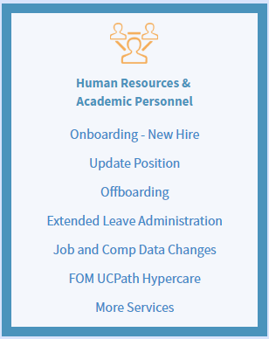
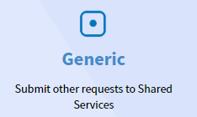
INITIATE A GENERIC REQUEST IN SERVICELINK
Navigate to ServiceLink via the R’Space Portal. You can do this by clicking “Authorized Applications”. (Note: must be provisioned the Generic Initiator role in EACS).
Click on “More Services” under Human Resources & Academic Personnel.
Click on the “Generic Request” icon to begin.

Slide 29
INITIATE A GENERIC REQUEST IN SERVICELINK
The Generic Request form will now be visible. In the Transaction Type dropdown, select the “Other – One Time Pay Attachments” option.
Enter the appropriate Effective Date for this request.
Enter the employee’s name (Last Name, First Name) for this request.

Slide 30
INITIATE A GENERIC REQUEST IN SERVICELINK
Select the appropriate Position # for this employee.
Select the appropriate Accountability Structure.
Enter all appropriate comments for this request.
Click on the Add Attachment button to upload the supporting documentation for this request.

Slide 31
INITIATE A GENERIC REQUEST IN SERVICELINK
Once all required fields have been filled in and all supporting documentation is attached, click on the “Submit” button.
*For more information about ServiceLink Navigation, refer to the FOM|UCPath Training: ServiceLink Navigation for Initiators

Slide 32
CHECK YOUR UNDERSTANDING
True or False
When submitting a One Time Pay transaction in UCPath, transactors can attach supporting documentation to their request.
Answer
FALSE
There is no ability to attach documents onto a One Time Pay transaction in UCPath, therefore a Generic ServiceLink request is required.

Slide 33
Initiate a One Time Pay Transaction

Slide 34
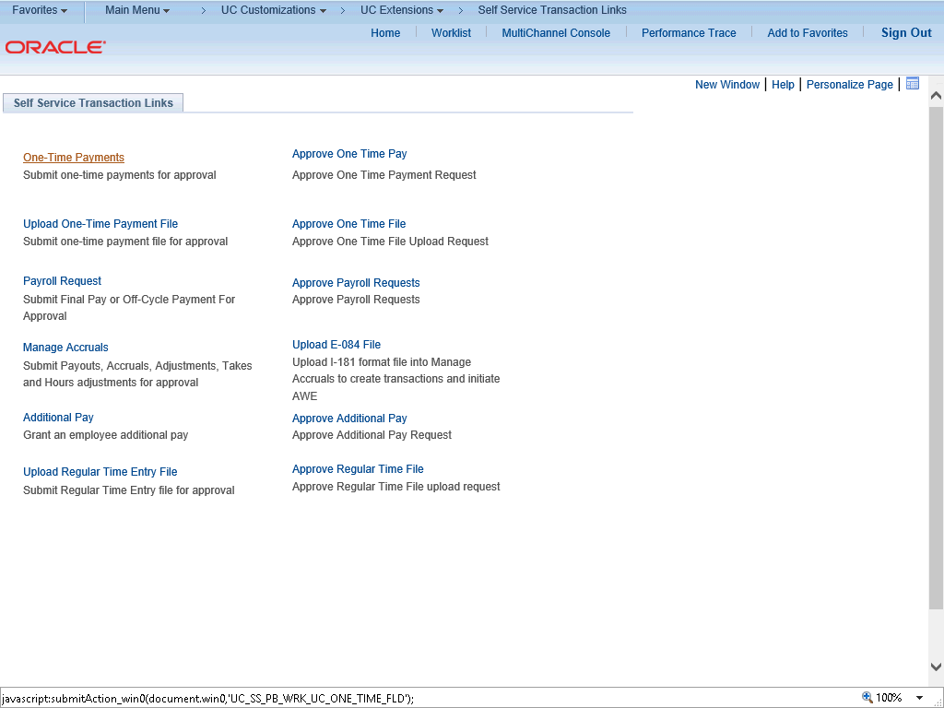
INITIATE A ONE TIME PAY TRANSACTION
Navigation: PeopleSoft Menu > UC Customizations > UC Extensions > Self Service Transactions Links
Use this task to submit a one-time payment request in UCPath.

Slide 35
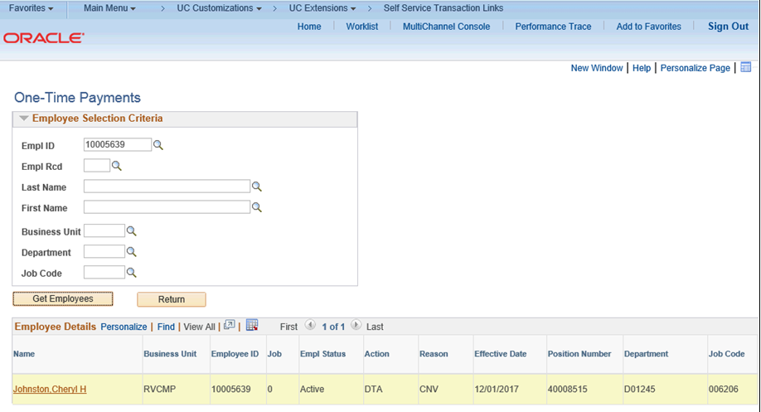
INITIATE A ONE TIME PAY TRANSACTION
Click the One-Time Payments link.
Enter search criteria for the employee. The fastest way to locate the employee is to enter the employee's ID. Click in the Empl ID field.
Enter the desired information into the Empl ID field.
Click the Get Employees button.

Slide 36
INITIATE A ONE TIME PAY TRANSACTION
The system displays the search results at the bottom of the page. If no records match the search criteria, the search grid is blank. If multiple records match the search criteria, the system displays a list of employees who match that criteria.
In this example, you entered an employee ID for an employee who has only one employee record (Empl Record 0) in UCPath, so the system returned only one search result.

Slide 37
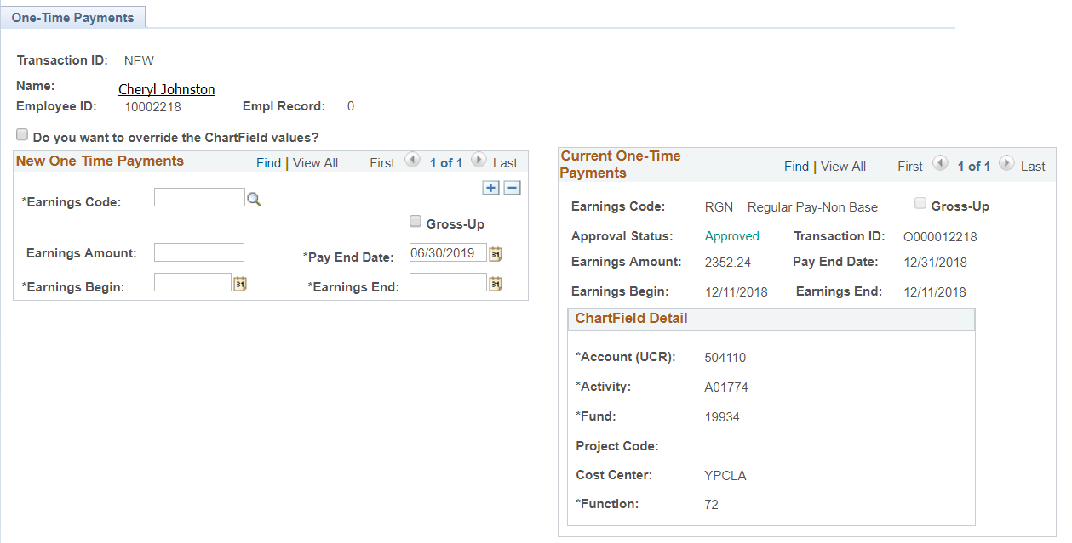
INITIATE A ONE TIME PAY TRANSACTION
Use the One-Time Payments page to enter the payment details, including the earnings code and the dollar amount.
Notice that the Transaction ID field displays NEW. When you successfully complete all required fields and submit the request for review and approval, the system automatically assigns the ID number.

Slide 38
INITIATE A ONE TIME PAY TRANSACTION
8. If the employee has any current one-time payment requests that are unapproved or unprocessed by payroll, they appear on the right side of the page.
9. If applicable, select the Do you want to override the Chartfield values? check box to display the Chartfield Detail section. Update Chartfield values only when directed. For this example, do not override the Chartfield values.

Slide 39
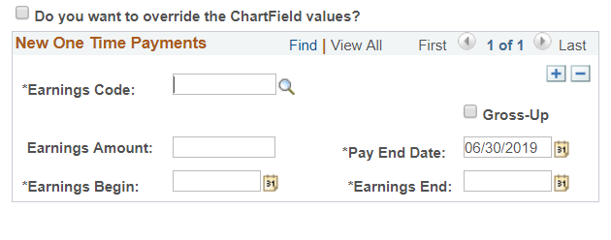
INITIATE A ONE TIME PAY TRANSACTION
In the Earnings Code field, select the appropriate earnings code value from the list. Earnings codes in the list are based on the codes available for the employee’s Pay Group. The list includes only those codes that allow flat amounts. Click in the Earnings Code field.
Enter the desired information into the Earnings Code field.
Press the [Tab] key.
If applicable, select the Gross-Up check box to indicate that the employee should be reimbursed for the taxes paid on this payment. For this example, do not select the check box.

Slide 40
INITIATE A ONE TIME PAY TRANSACTION
In the Earnings Amount field, enter the one-time payment dollar amount. This can be a positive or negative amount. Click in the Earnings Amount field.
Enter the desired information into the Earnings Amount field.
The Pay End Date field defaults to the end date of the current pay cycle (monthly or biweekly, based on the employee’s Pay Group). Accept the default value. Only on-cycle pay calendars are referenced; off-cycle pay calendars are ignored.
Click in the Earnings Begin field.

Slide 41
INITIATE A ONE TIME PAY TRANSACTION
For the Earnings Begin and Earnings End fields, enter the dates associated with the payment. Earnings Begin and Earnings End values should not be greater than Pay End Date. The dates should fall within either the FLSA Calendar for non-exempt employees (1 week) or the Pay Calendar for exempt employees (1 month).
Enter the desired information into the Earnings Begin field.
In the Earnings End field, enter the other end of date range to which this payment applies. For one-time payments, this date might be the same as the earnings begin date.
Click in the Earnings End field. Enter the desired information into the Earnings End field.

Slide 42
INITIATE A ONE TIME PAY TRANSACTION
Enter the desired information into the Earnings End field.
In the Initiator Comment field, enter additional information regarding this transaction. This information is specifically for the approver and UCPath Center processors. Be sure to include specific details about the request you are submitting.
Click in the Initiator Comment field.
Follow Location standards when entering comments. The notes are stored with the data.
Enter the desired information into the Initiator Comment field.
Click the Submit button to initiate approval routing via workflow.

Slide 43
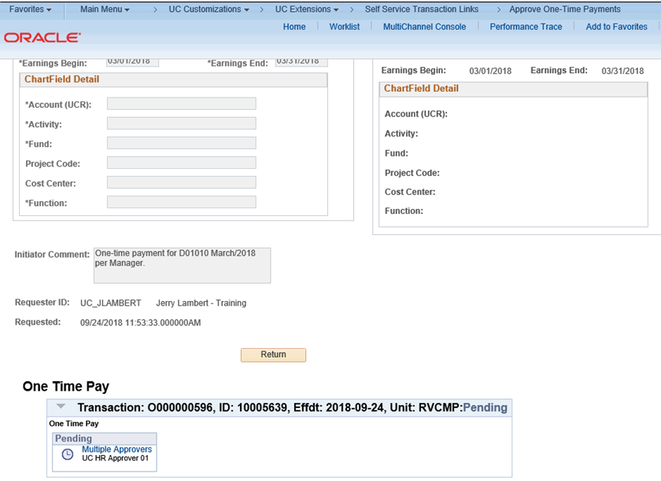
INITIATE A ONE TIME PAY TRANSACTION
After you click Submit, if there are no errors, the system generates and displays a unique Transaction ID.
After you submit the request for approval, the transaction status and details appear on the right side of the page.
The Approval Status field displays a status of Pending until the request is approved or denied.

Slide 44
INITIATE A ONE TIME PAY TRANSACTION
Notice that the Transaction ID field on this side of the page also displays the unique, system-generated transaction ID number, which you can use later to access the transaction and check its status.
If you override the existing Chartfield values in your request, the override values appear in the Chartfield Detail section.
If necessary, scroll down to display additional page details.
Click the scroll bar.

Slide 45
INITIATE A ONE TIME PAY TRANSACTION
The Requester ID and Requested date/time stamp appear.
The One Time Pay approval routing section displays the transaction ID, employee ID, effective date, business unit and status.
You have submitted a one-time payment request.

Slide 46
CHECK YOUR UNDERSTANDING
True or False
The Chartfield Override feature allows transactors to override current funding for this One Time Pay transaction only and will not permanently change the employee’s position funding.
Answer
True
Transactors can use this feature to charge a One Time Pay transaction to an alternate funding source and it will not change the position’s future funding.

Slide 47
How to Approve a One Time Pay Transaction

Slide 48
AWE APPROVAL ROLE
PHASE 1
For Phase 1 of the Pilot, the Shared Services Center will be responsible for validating and approving the One Time Pay transactions.
The AWE Approver in SSC will be responsible for reviewing supporting documentation attached to the corresponding Generic ServiceLink Requests.
PHASE 2
For Phase 2 of the Pilot, the Transactional Unit will be responsible for validating and approving the One Time Pay transactions.
The AWE Approver established in the Transactional Unit will be responsible for deleting the attachments the Initiator in the Transactional Unit attached to the corresponding Generic ServiceLink Requests.
Note: in Phase 2, there may no longer be a need to create a Generic ServiceLink request for attachments, since Transactional Units will approve their own transactions.

Slide 49
APPROVE A ONE TIME PAY TRANSACTION
Navigation: To open a transaction that is pending approval, navigate to your Worklist in UCPath and click the appropriate transaction link, or Click the transaction link in the system-generated email notification.
The One-Time Payments page displays details for the pending payment.
As you review a transaction in UCPath, refer to your local business process, which may include specific approval guidelines.

Slide 50
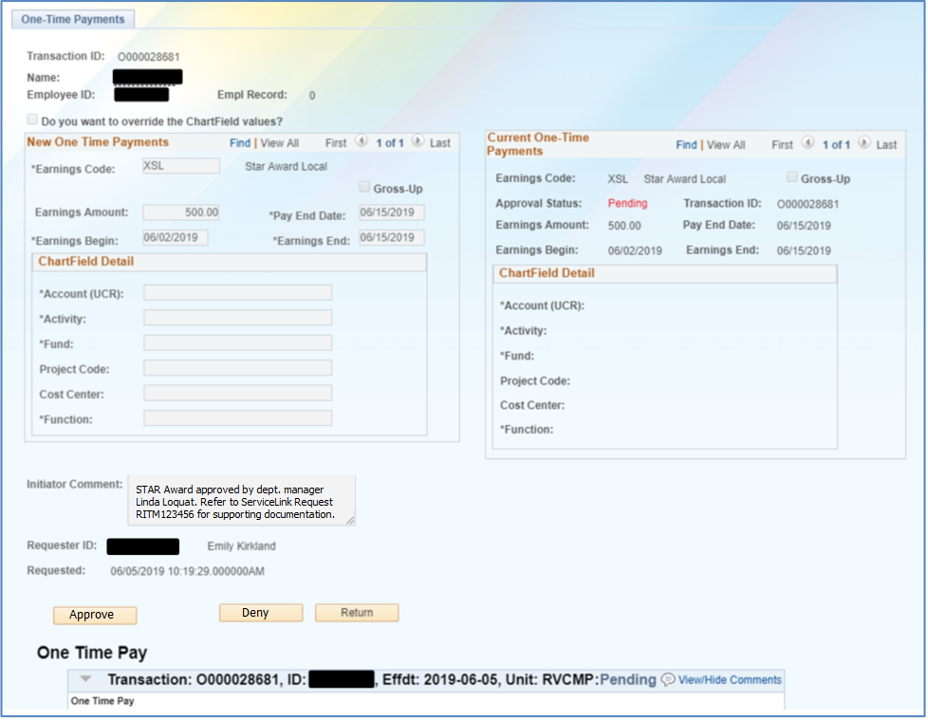
APPROVE A ONE TIME PAY TRANSACTION
The system displays the Requester ID and Name of the user who submitted the transaction for approval. The system also displays the date and time it was submitted.
Be sure to review any detail listed in the Initiator Comment field before you begin your review. Initiators use this field to include information that may be useful during the approval process. In this example, the initiator did not enter any comments.
For one time pay requests initiated by Pilot Transaction Units, a corresponding Generic ServiceLink Request should have been created to capture supporting documentation for the approval. The Initiator Comments should include the ServiceLink transaction ID.

Slide 51
APPROVE A ONE TIME PAY TRANSACTION
The transaction header displays the Transaction ID number, the employee's Name, the Employee ID number and the Empl Record number.

Slide 52
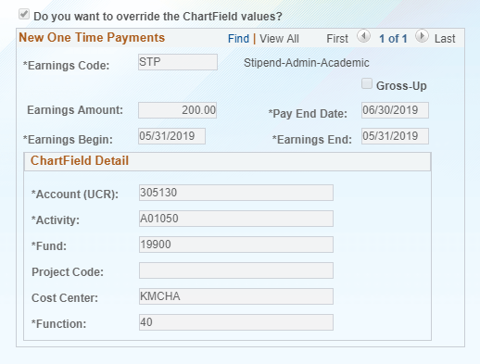
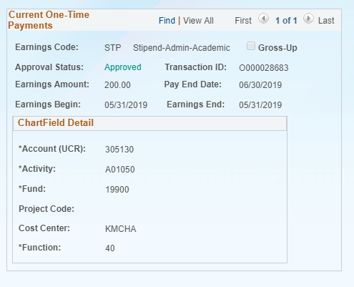
APPROVE A ONE TIME PAY TRANSACTION
If the initiator edited Chartfield values, the Do you want to override the Chartfield values? check box is selected and the Chartfield Detail section displays override details. In this example, the requester did not override the default Chartfield values.
The New One Time Payments section provides details regarding the payment request, including the earnings code and payment amount.

Slide 53
APPROVE A ONE TIME PAY TRANSACTION
The Current One Time Payments section provides details regarding the employee's current additional payments. In this example, the only additional pay for the employee is the pending payment awaiting approval.

Slide 54
APPROVE A ONE TIME PAY TRANSACTION
In this example, there is only one row of data as indicated by the 1 of 1 value. Be sure to verify whether there are multiple rows to review and approve.
If there are multiple rows, use the View All link to display all rows of data on a page. When this feature is enabled, the link changes to read View 1, so that you can return to the original setting.

Slide 55
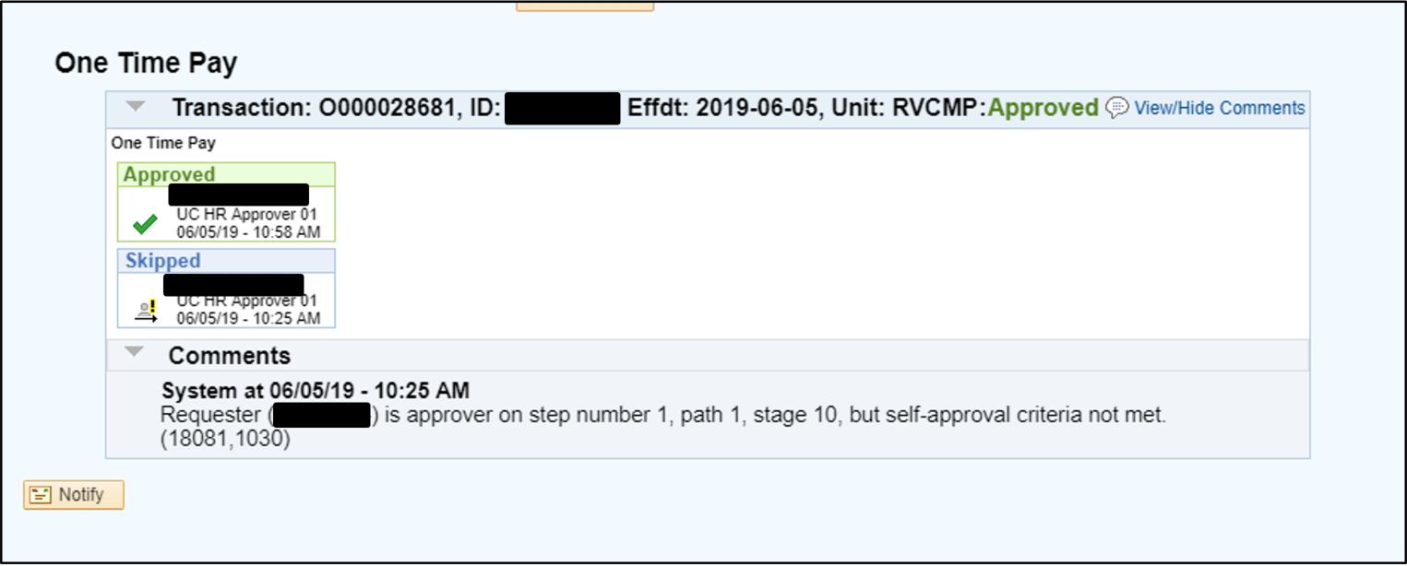
APPROVE A ONE TIME PAY TRANSACTION
In the Initiator Comments section, there should be a reference to a corresponding Generic ServiceLink Request. Locate this request in ServiceLink and ensure that the appropriate supporting documentation is attached and is acceptable prior to approving the transaction.
After you review the supporting documentation and the transaction details, you can approve, push back (if applicable) or deny the transaction. If necessary, you can click the Return button to return to the search page to search for another transaction. Comments are required if you push back or deny a transaction.
When you are ready to approve the transaction, click the Approve button.

Slide 56
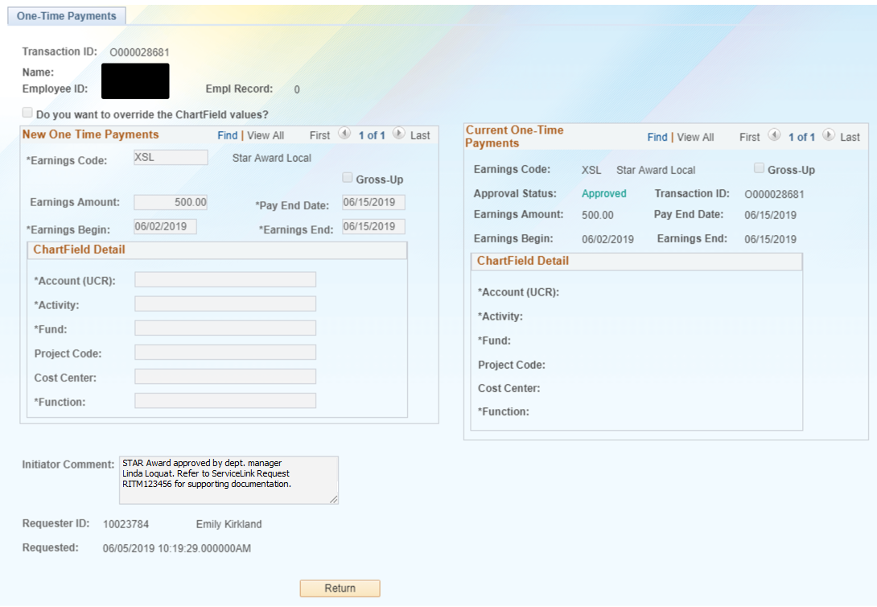
APPROVE A ONE TIME PAY TRANSACTION
After you approve a transaction, the transaction page no longer displays the approval action buttons. The approval status monitor (the One Time Pay section in this example) remains at the bottom of the page. This section displays the approval workflow details, including completed and pending approvals.
The Approval Status field displays Pending until final approval. Upon final approval, this field displays Approved.
AWE Approvers must also complete the corresponding Generic Request in ServiceLink. It is best to reference the UCPath Transaction ID in the “comments” when completing the request.

Slide 57
How to Deny a One Time Transaction

Slide 58
DENY A ONE TIME PAY TRANSACTION
Navigation: To open a transaction that is pending approval, navigate to your Worklist in UCPath and click the appropriate transaction link or Click the transaction link in the system-generated email notification.
The One-Time Payments page displays details for the pending payment.
As you review a transaction in UCPath, refer to your local business process, which may include specific approval guidelines.

Slide 59
DENY A ONE TIME PAY TRANSACTION
The system displays the Requester ID and Name of the user who submitted the transaction for approval. The system also displays the date and time it was submitted.
Be sure to review any detail listed in the Initiator Comment field before you begin your review. Initiators use this field to include information that may be useful during the approval process. In this example, the initiator did not enter any comments.
For one time pay requests initiated by Pilot Transaction Units, a corresponding Generic ServiceLink Request should have been created to capture supporting documentation for the approval. The Initiator Comments should include the ServiceLink transaction ID.

Slide 60
DENY A ONE TIME PAY TRANSACTION
The transaction header displays the Transaction ID number, the employee's Name, the Employee ID number and the Empl Record number.

Slide 61
DENY A ONE TIME PAY TRANSACTION
If the initiator edited Chartfield values, the Do you want to override the Chartfield values? check box is selected and the Chartfield Detail section displays override details. In this example, the requester did not override the default Chartfield values.
The New One Time Payments section provides details regarding the payment request, including the earnings code and payment amount.

Slide 62
DENY A ONE TIME PAY TRANSACTION
The Current One Time Payments section provides details regarding the employee's current additional payments. In this example, the only additional pay for the employee is the pending payment awaiting approval.

Slide 63
DENY A ONE TIME PAY TRANSACTION
In this example, there is only one row of data as indicated by the 1 of 1 value. Be sure to verify whether there are multiple rows to review and approve.
If there are multiple rows, use the View All link to display all rows of data on a page. When this feature is enabled, the link changes to read View 1, so that you can return to the original setting.

Slide 64
DENY A ONE TIME PAY TRANSACTION
In the Initiator Comments section, there should be a reference to a corresponding Generic ServiceLink Request. Locate this request in ServiceLink and ensure that the appropriate supporting documentation is attached.
After you review the transaction details, you can approve, push back (if applicable) or deny the transaction. If necessary, you can click the Return button to return to the search page to search for another transaction. Comments are required if you push back or deny a transaction.
If the transaction is not approved, click the Deny button.

Slide 65
DENY A ONE TIME PAY TRANSACTION
After you approve a transaction, the transaction page no longer displays the approval action buttons. The approval status monitor (the One Time Pay section in this example) remains at the bottom of the page. This section displays the approval workflow details, including completed and pending approvals.
The Transaction Status will display as “Denied”
When transactions are denied, they cannot be cloned. A new transaction would need to be submitted.
End of Procedure.

Slide 66
How to View a One Time Transaction

Slide 67
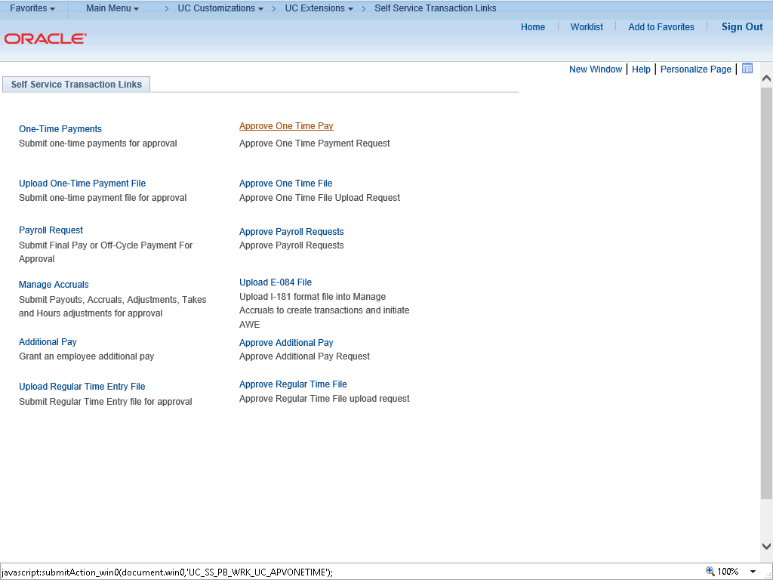
VIEW A ONE TIME PAY TRANSACTION
Navigation: PeopleSoft Menu > UC Customizations > UC Extensions > Self Service Transaction Links
The Self Service Transaction Links page provides access to several payroll-related pages to initiate requests and also view/approve requests. Users with inquiry-only access use the following approval links to view information:
Approve One Time Pay
Approve One Time File
Approve Payroll Requests
Click the Approve One Time Pay link.

Slide 68
VIEW A ONE TIME PAY TRANSACTION
Use the Find an Existing Value tab to search for a one-time pay transaction. If you do not know the Transaction ID, you can search by Empl ID. You may also include the Approval Status in your search criteria.
Click in the Empl ID field.
Enter the desired information into the Empl ID field.
Click the Search button.
The One-Time Payments page is comprised of three sections:
Header information at the top of the page.
New One Time Payments section on the left side of the page
Current One-Time Payments section on the right side of the page.

Slide 69
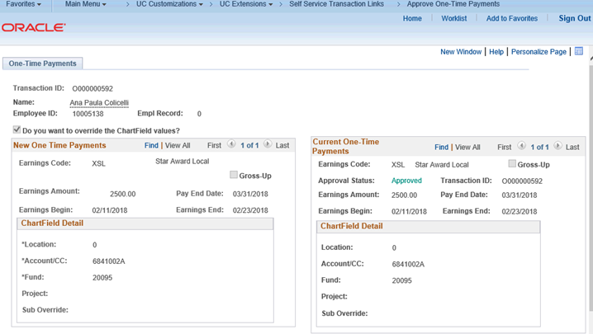
VIEW A ONE TIME PAY TRANSACTION
The left side of the page displays the New One Time Payments section. Initiators use this section to create new general deductions.
This section displays the latest entry, which also appears in the Current One-Time Payments section on the right side of the page. If no payments exist for the employee, both sides of the page display no data.

Slide 70
VIEW A ONE TIME PAY TRANSACTION
The approval process details appear at the bottom of the page. The transaction ID, employee ID, effective date, business unit and status appear in the blue header. The approvers appear in the section details. Click the approver ID number to see the approver details.
Note: The Notify button at the bottom of the page is not enabled for inquiry-only users.
When you are done with your review, click the Return button.

Slide 71
CHECK YOUR UNDERSTANDING
True or False
One Time Pay transactions can be cloned.
Answer
False
One Time Pay transactions cannot be cloned.
If a transaction is denied, it must be re-entered.

Slide 72
SharePoint Instructions and Hands on Training

Slide 73
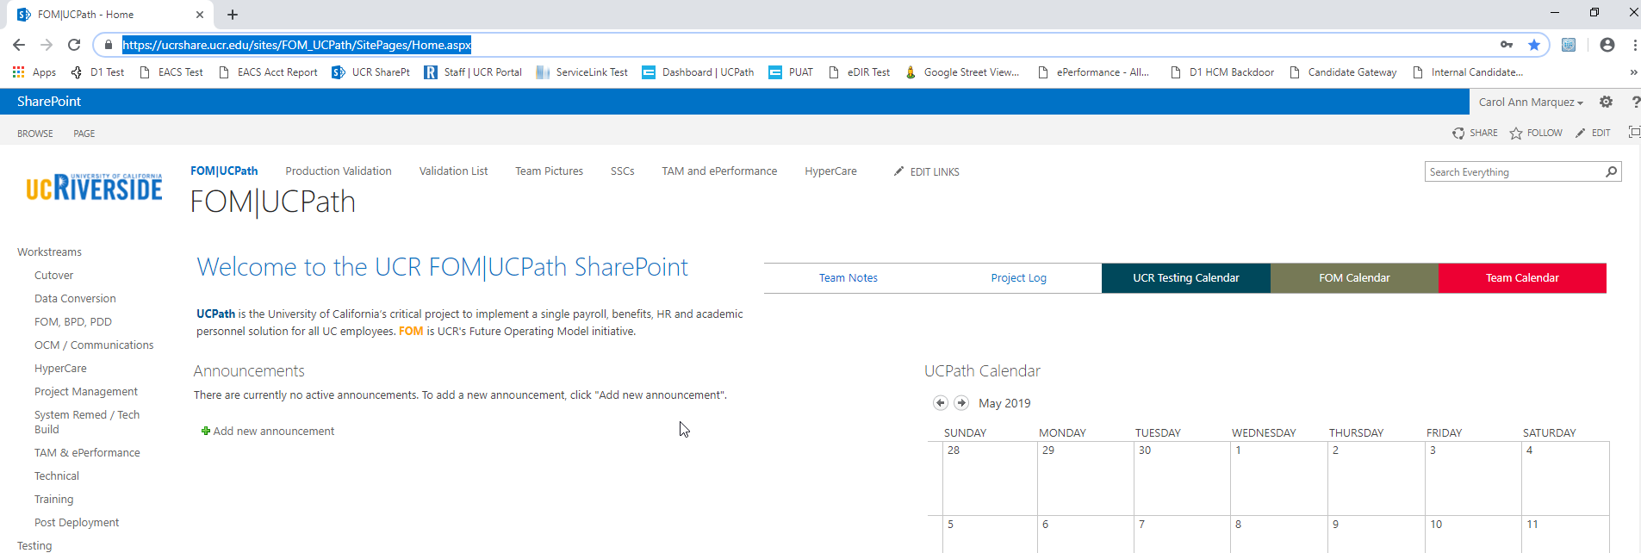
SHAREPOINT LIST INSTRUCTIONS
Testing SharePoint: https://ucrshare.ucr.edu/sites/FOM_UCPath/SitePages/Home.aspx
Preferred browsers are Internet Explorer and Chrome. (Save the link as a favorite)
Select UCPath Transaction Training Scenarios from the left side Quick Menu:

Slide 74
VIEWING LIST OPTIONS
When the list opens, note the tabs at the top of the screen:

Slide 75
VIEWING LIST OPTIONS part 2
By selecting ‘List’ you can filter the view on the process you are transacting. The default view is All Transactions. Select a specific transaction type to view the list containing only those transactions:

Slide 76
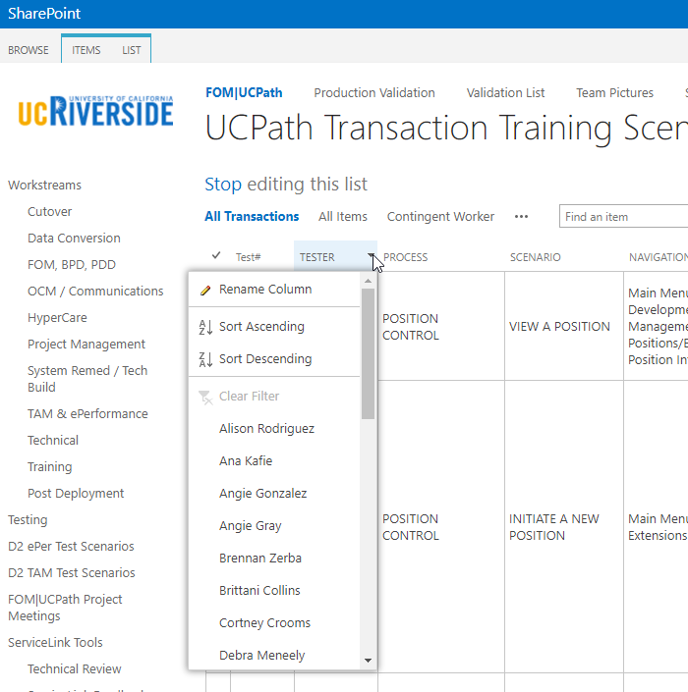
UPDATING AND EDITING A SHAREPOINT LIST
Many functions of a SharePoint list are similar to MS Excel, except that it is in a central location, and can be accessed / updated by multiple people at the same time.
Use the list headers to filter and sort. Only you will see these temporary changes.
By selecting your name in the drop-down, you will have easy access to only your transactions. This is especially helpful if your name appears several pages into the list.

Slide 77
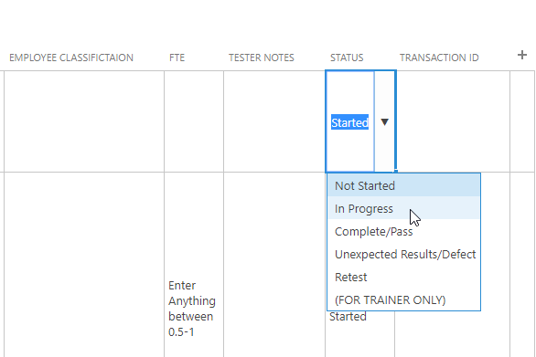
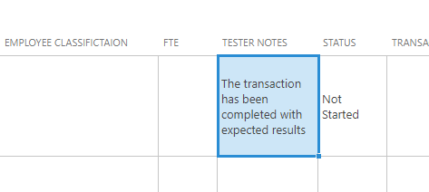
UPDATING AND EDITING A SHAREPOINT LIST part 2
You can update your test by editing directly by clicking into the cell. Some cells are controlled by a drop-down choice; others are free-form. To save your change, click in another cell.

Slide 78
LEARNING OBJECTIVES REVIEW
Having completed this course, you should be able to:
Understand the definition of a One Time Pay Transaction.
Understand the scenarios that are “in scope” for the Transaction Pilot One Time Pay process.
Understand the various roles and responsibilities involved in the Transaction Pilot One Time Pay process.
Initiate One Time Pay Transactions in UCPath.
Understand EACS Roles involved in the Transaction Pilot One Time Pay process.
Understand Approval workflow involved in Transaction Pilot One Time Pay process.

Slide 79
THINGS TO REMEMBER
One Time Pay Initiators can only submit requests for employees within their accountability structure.
One Time Pay transactions initiated by Transactional Units will be approved by their Shared Services Center (Phase 1).
Transactional Units must create a generic ServiceLink request to attach supporting documentation for approval.
It’s important to review the UCPath Payroll Schedule when submitting transactions to ensure they appear in the correct pay period.

Slide 80
CHECK YOUR UNDERSTANDING
Name 1 scenario that In Scope for the Pilot One Time Pay Process for the GRAND PRIZE.
Answer
STAR/SPOT award for one employee.
Regular payments for instructors in Transactional Unit Depts. (i.e. Rec Center Instructors)
Other One-Time Additional Compensations (i.e. Staff Stipend for One Pay Period).

Slide 81
APPENDIX
ServiceLink Navigation Training – FOM|UCPath Training: ServiceLink Navigation for Initiators
Links to Policies and Procedures
PPSM 30 - Compensation - https://policy.ucop.edu/doc/4010400/PPSM-30
PPSM 30 Local Guidance – Compensation - https://hr.ucr.edu/policies/policiesandcontracts/local_guidance_30_compensation.pdf
APM Policy – Additional Compensation Honoraria - https://www.ucop.edu/academic-personnel-programs/_files/apm/apm-666.pdf

Slide 82
Your Feedback Please
http://bit.ly/ucpathpilottraining

