Slide 1

Ucr ucpath transaction pilot
ON BEHALF OF case management

Slide 2

TRAINER INTRODUCTION
Sonya Potter
Title: UCPath Business Support Analyst, Graduate Student Support Lead
Department: UCPath Campus Support Center
Years @UC: 2 years
Previous Experience: 16+ years of experience in creating detailed business processes, re-case business flow into system specifications, develop job aids, training, and testing documents for established national industry competitive technology platforms.

Slide 3
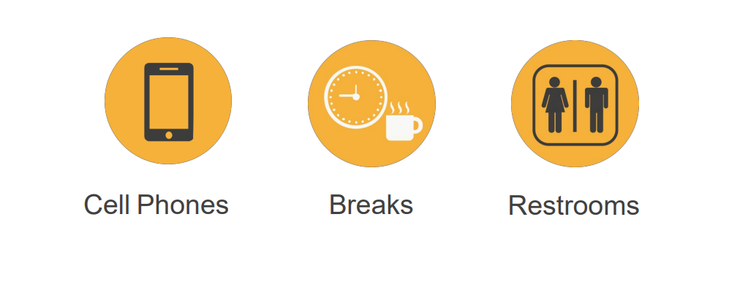
HOUSEKEEPING

Slide 4
LEARNING OBJECTIVES
Initiate a UCPath SalesForce Case
Insert Learning Objective Review Topic Here
Monitor a UCPath SalesForce Case
Insert Learning Objective Review Topic Here
Reopen a UCPath SalesForce Case
Insert Learning Objective Review Topic Here
Insert Learning Objective Review Topic Here

Slide 5
LEARNING TOPICS
LECTURE & REVIEW
ON BEHALF OF DEFINITION
CASE MANAGEMENT MATRIX
ROLES
CHANGE IMPACTS
INITIATE ON BEHALF OF CASE
MONITOR UCPATH CENTER CASES
REOPEN CASE

Slide 6
LEARNING TOPICS
Demo
Demo

Slide 7
On Behalf of Definition

Slide 8

ON BEHALF OF DEFINITION
On Behalf Of Case Management is the task of submitting an inquiry or an update on behalf of another employee or yourself to the UCPath Center via the UCPath website. This process is also used for the following common tasks (Not an exhaustive list):
Update, modify, edit, or change an employee/CWR information.
Open a Case for Transactions created on behalf of the employee, that did not process correctly, or were improperly cancelled by UCPath.
To make specific Personal Data Change updates as defined in the Future State Process Design (FSPD).

Slide 9
On Behalf of Matrix

Slide 10
ON BEHALF OF CASE MANAGEMENT MATRIX
Category | Purview | General Approach | Transaction Update Types
Cases related to STANDARD transaction entry that requires a Case in SalesForce | Transactional Unit | Any transactions initiated at the Transactional Unit that involves STANDARD corrections or require a case for non-pay impacting non-benefit related issues For example: Personal Data Updates, i.e. DOB, SSN, Address, Email etc.

Slide 11
ON BEHALF OF CASE MANAGEMENT MATRIX (continued)
Category | Purview | General Approach | Transaction Update Types
Cases related to ESCALATED transaction entry that requires a Case in SalesForce | SSC | Any transactions defined as ESCALATED to the SSC and INITIATED by the SSC or a transaction that needs to be corrected can be opened by the SSC. Transactional units should NOT open cases for these escalated items Any PAY related transactions that require a correction or a case that involves the following fields: Comp Rate Effective Date Pay Group One-Time Pay Job Frequency FTE Additional Pay | Retroactive Compensation Changes Overpayments Off Cycle Checks Final Pay Next Day Checks Missed Pay resolution Leave of Absence Issues Requests Sabbatical Credit Adjustments

Slide 12
ON BEHALF OF CASE MANAGEMENT MATRIX (continued)
Category | Purview | General Approach | Transaction Update Types
Cases related to ESCALATED transaction entry that requires a Case in SalesForce | SSC | Any ACCRUAL or BENEFITS related issues that require a correction. For example: DCP Cancellation of Benefits Deductions Damage Payments Retirement Issues with reinstatement A lapse in benefits coverage Service Credit Adjustments | Retroactive Compensation Changes Overpayments Off Cycle Checks Final Pay Next Day Checks Missed Pay resolution Leave of Absence Issues Requests Sabbatical Credit Adjustments

Slide 13
ON BEHALF OF CASE MANAGEMENT MATRIX (continued)
Category | Purview | General Approach | Transaction Update Types
Cases related to ESCALATED transaction entry that requires UCPC entry | Central Office | Any transactions entered in the central office needs to be corrected by the central office Any transactions managed by the central office For example: Glacier Issues | Merit and Promotion updates Minimum wage increases Range Adjustments Certain Benefits Issue

Slide 14
ON BEHALF OF CASE MANAGEMENT MATRIX (continued)
Category | Purview | General Approach | Transaction Update Types
On Behalf of Cases | Employee | Issues that the employee has tried to resolve or needs resolved where they need assistance on STANDARD cases the transaction unit can assist by opening on behalf of cases to help the employee as requested. For cases related to ESCALATED transaction types of issues the transactional units should coordinate with the SSC regarding who will open the case on behalf of the employee. For example: EE needs to update personal data EE needs W-2 or other tax document

Slide 15
ON BEHALF OF CASE MANAGEMENT MATRIX (continued)
Category | Purview | General Approach | Transaction Update Types
Cases related to ESCALATED transaction entry that requires a Case in SalesForce | Campus Support Center | Any transactions defined as ESCALATED can be sent to the CSC. The transaction can be INITIATED by Transactional Unit, SSC or Employee. This can include when a transaction needs to be corrected. Any PAY related transactions that require a correction or a case that involves the following fields: Comp Rate Job Frequency Effective Date FTE Pay Group Additional Pay One-Time Pay | Merit and Promotion updates Minimum wage increases Range Adjustments Retroactive Compensation Changes Overpayments Off Cycle Checks Final Pay Next Day Checks Missed Pay resolution Leave of Absence Issues Requests Sabbatical Credit Adjustments

Slide 16
ON BEHALF OF CASE MANAGEMENT MATRIX (continued)
Category | Purview | General Approach | Transaction Update Types
Cases related to ESCALATED transaction entry that requires a Case in SalesForce | Campus Support Center | Any ACCRUAL or BENEFITS related issues that require a correction. For example: DCP Retirement Cancellation of Benefits Issues with reinstatement Deductions A lapse in benefits coverage Damage Payments Service Credit Adjustments

Slide 17
Roles

Slide 18


Transaction Roles
1: Employee
2: Transactional Unit
3: Shared Service Center
4: Central Office
5: UCPath Campus Support Center

Slide 19

Transaction Roles
Employee has question or needs personal data updated in UCPath, they can open a Case on their own behalf
If an employee needs help to resolve an issue or has an urgent need they can email the following for support:
  UCPathhelp@ucr.edu for Academic Personnel
  FOMUCPath@ucr.edu for Staff
  After July 1st they will only use: UCPathhelp@ucr.edu
1: Employee
2: Transactional Unit
3: Shared Service Center
4: Central Office
5: UCPath Campus Support Center

Slide 20
Transaction Roles
Transactional Unit receives employee request(s) and opens a Case on Behalf of Employee
Transactional Unit can open a Case on Transactions that need a correction in UCPath
1: Employee
2: Transactional Unit
3: Shared Service Center
4: Central Office
5: UCPath Campus Support Center

Slide 21
Transaction Roles
SSC opens Cases on behalf of employee or escalates Cases when employee reaches out
SSC reaches out to department so they can open a case on behalf of employee
SSC opens Escalated Cases that falls within SSC purview (i.e. Next Day check, Overpayment etc.)
SSC opens Cases when a transaction needs correction
1: Employee
2: Transactional Unit
3: Shared Service Center
4: Central Office
5: Campus Support Center

Slide 22
Transaction Roles
Central Office is contacted by Employee with an issue and the Central Office opens up a ticket on behalf of employee with UCPath
Receives escalated Cases
Opens Cases that fall within the Central Office purview
1: Employee
2: Transactional Unit
3: Shared Service Center
4: Central Office
5: UCPath Campus Support Center

Slide 23
Transaction Roles
UCPath Campus Support Center (CSC) is contacted by Employee with an urgent issue and the CSC opens up a ticket on behalf of employee with UCPath
Receives escalated Cases from SSC or Transactional Unit
Opens Cases that fall within the UCPath Campus Support Center purview
1: Employee
2: Transactional Unit
3: Shared Service Center
4: Central Office
5: UCPath Campus Support Center

Slide 24
Change Impacts

Slide 25
CHANGE IMPACTS
The submission of Salesforce/Case can now be initiated by the Transactional Unit on behalf of the employee, which used to be done by the SSC. This means that the initiator will initiate the process, monitor, and reopen when necessary.
SSC’s will continue to enter Cases in Salesforce.

Slide 26
Initiate an On Behalf Of Case

Slide 27
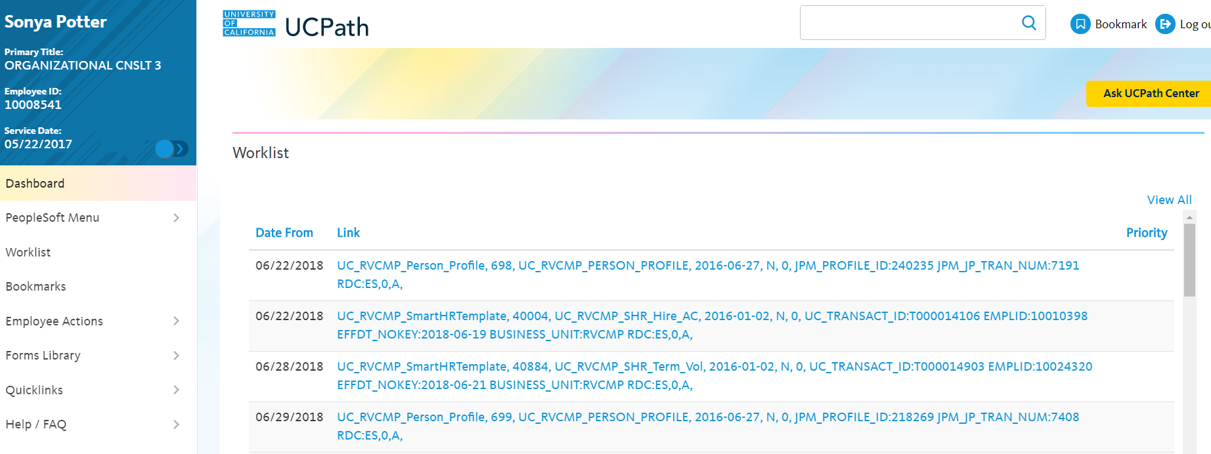
ON BEHALF OF ASK UCPATH
Navigation: Ask UCPath Center
Note: This example uses sample images as seen on a computer. Sample images appear differently on a tablet or smartphone, but the steps remain the same.
Click the Ask UCPath Center Button

Slide 28
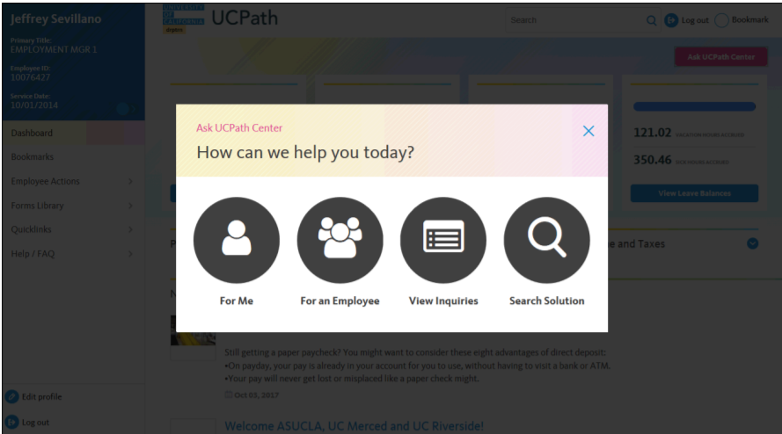
ON BEHALF OF HOW CAN WE HELP YOU TODAY?
If you are authorized to submit an issue for an employee, the “Ask UCPath Center, How can we help you today?” pane appears.
In this example, we will submit a payroll question for an employee.
Click the For an Employee button.

Slide 29
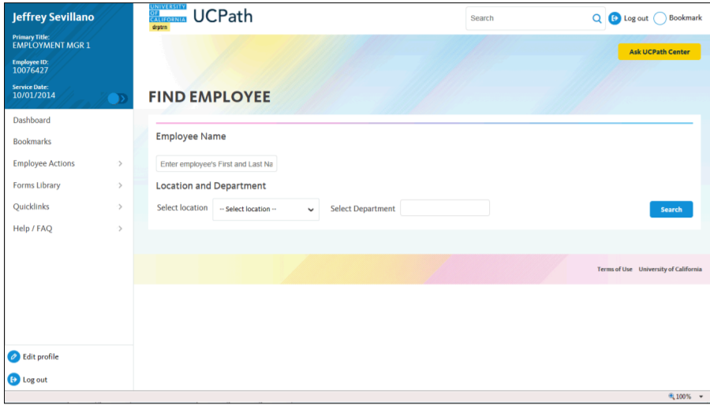
ON BEHALF OF FIND EMPLOYEE
On the Find Employee page, search for the employee by name or by location and department.
For this example, enter name Sonya Potter in the Employee Name field and click Search.
Enter Employee Name
Click Search

Slide 30
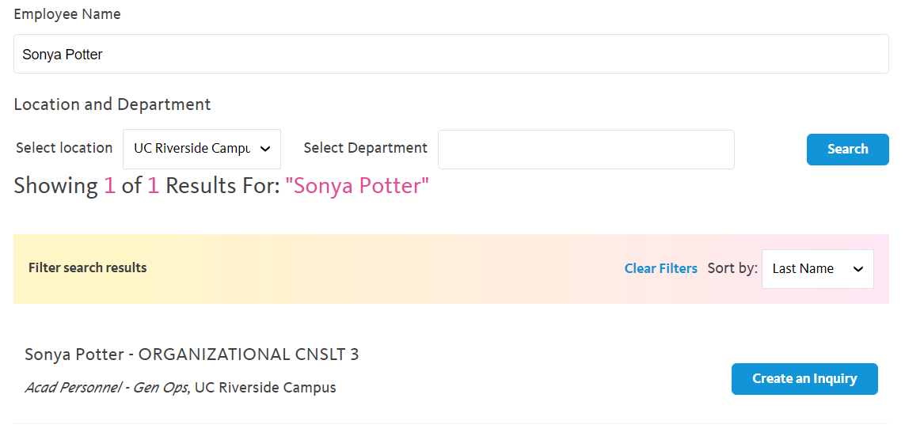
ON BEHALF OF SEARCH AND CREATE AN INQUIRY
UCPath returned one result.
Click Create an Inquiry.

Slide 31
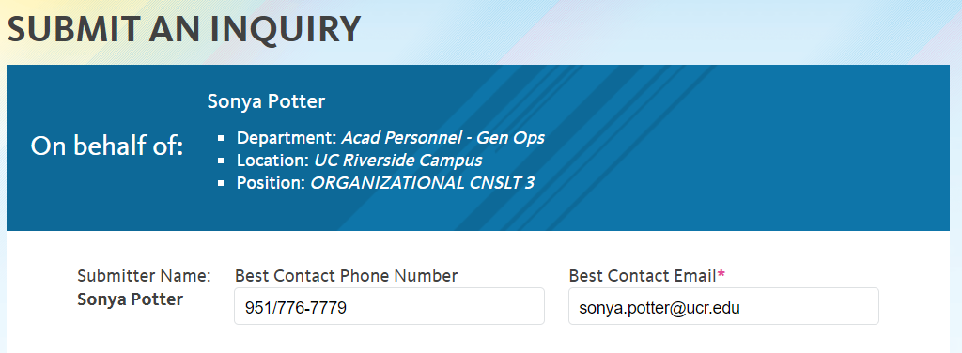
ON BEHALF OF PHONE NUMBER & EMAIL
Your phone number automatically populates in the Best Contact Phone Number field from your Salesforce record. You can override with a different number. The phone number field is a text field, so it will not format with dashes or slashes.
Your email automatically defaults from your Salesforce record. You can override the email by clicking in the Best Contact Email field and entering a new email address.
951-827-6587

Slide 32
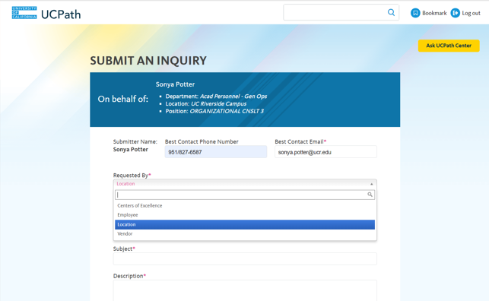
ON BEHALF OF REQUESTED BY
Click the button to the right of the Requested By field.
Select the Requested By most associated to your request.
In this example, select Location.

Slide 33
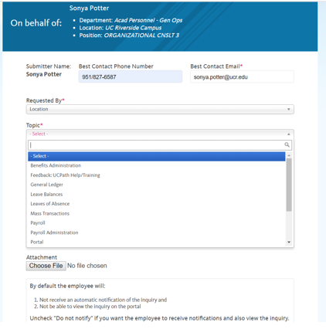
ON BEHALF OF TOPIC
In Topic, select the topic area associated with your inquiry.
In this example, select Payroll.

Slide 34
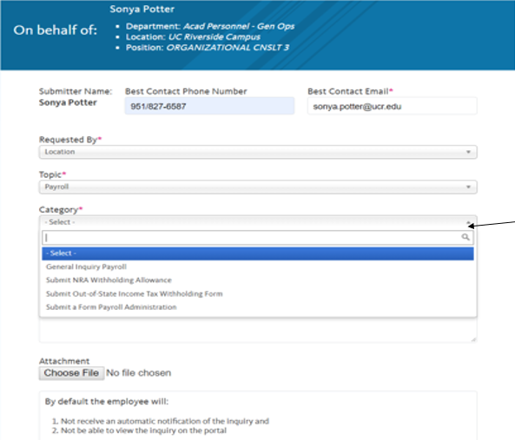
ON BEHALF OF CATEGORY
In Category, select the category area associated with your inquiry.
In this example, select General Inquiry Payroll.

Slide 35
ON BEHALF OF TOPICS & CATEGORIES- EMPLOYEE
Please instruct employees to use this option in the Requested by drop down when opening a Case for themselves.
Requested by | Topic | Category
Employee | Benefits | General Inquiry Benefits, Submit EOI – Disability Coverage, Submit HAS Life Insurance and AD & D Form, Submit Health Benefits Life Event, Submit Late Enrollment Request Form, Submit Newly Eligible Enrollment Form, Submit UCPC UBEN109 COBRA Qualifying Event Form
 | Feedback: UCPath Help/Training | Correction, Suggestion
 | Human Resources | General Inquiry Human Resources
 | Leave Balances | General Inquiry Leave Balances
 | Leaves of Absence | Disability/Life Insurance, Leave of Absence with Pay, Leave of Absence Without Pay
 | Open Enrollment | COBRA, Enrollment Confirmation, General Question, Leave of Absence, Life Event, New Hire, Open Enrollment Form, Other
 | Payroll | General Inquiry Payroll, Submit NRA Withholding Allowance, Submit Out-of-State Income Tax Withholding Form, Submit a Form Payroll Administration
 | Portal | Access Issue, General Inquiry Portal
 | Records Request | Submit a Form Records Request

Slide 36
ON BEHALF OF TOPICS & CATEGORIES- LOCATION
Locations and Shares Service Centers will use these Requested by options when opening a Case.
Requested by | Topic | Category
Location | Benefits Administration | General Inquiry Benefits Administration, Premium Reconciliation, Quality Care Unit, Submit a Form Benefits Administration, UCRP Service Credit Verification
 | Feedback: UCPath Help/Training | Correction, Suggestion
 | General Ledger | Cost Recovery, Financial Control Journal, General Inquiry General Ledger, Quality Care Unit, Request an Action in UCPath
 | Leave Balances | General Inquiry Leave Balances
 | Leaves of Absence | Disability/Life Insurance, Leave of Absence with Pay, Leave of Absence Without Pay
 | Mass Transactions | Mass Hires, Mass Pay Changes
 | Payroll | General Inquiry Payroll, Submit NRA Withholding Allowance, Submit Out-of-State Income Tax Withholding Form, Submit a Form Payroll Administration
 | Payroll Administration | Instant Pay Card, Payroll Admin T&A Batch Error, Payroll Process Errors/Reconciliation, Quality Care Unit, Submit Recurring Additional Pay Correction Request Form, Submit a Form Payroll Administration
 | Portal | Access Issue, General Inquiry Portal

Slide 37
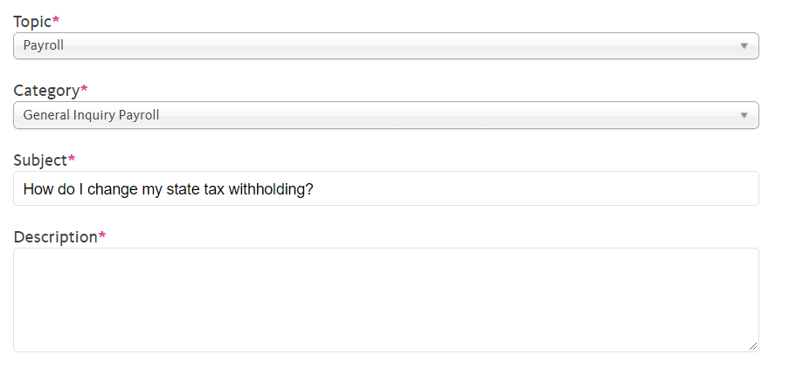
ON BEHALF OF SUBJECT
Click in the Subject field.
Enter the desired information in the Subject field.
For this example, enter How do I change my state tax withholding?

Slide 38
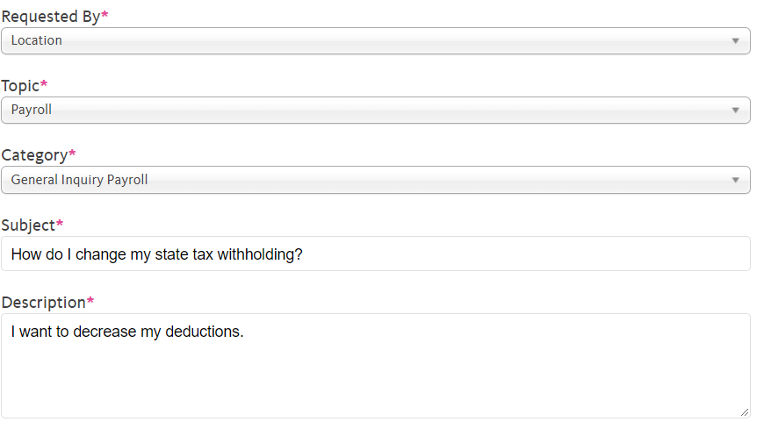
ON BEHALF OF DESCRIPTION
Click in the Description field.
Enter the desired information into the Description field.
For this example, enter I want to decrease my deductions.

Slide 39
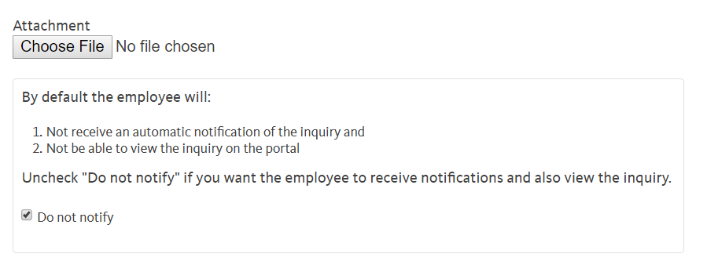
ON BEHALF OF ATTACHING A FILE
You can ONLY ADD ONE attachment when entering on behalf of others Cases. More attachments can be added after you save the initial entry.
Accepted formats include: MS Office suite, PDF, JPD, TIFF, PNG, or WAV.
By default, the Do not notify check box means that the employee will receive no notifications and cannot view the inquiry. If you want the employee to receive notifications and see the inquiry online, Deselect the check box.

Slide 40
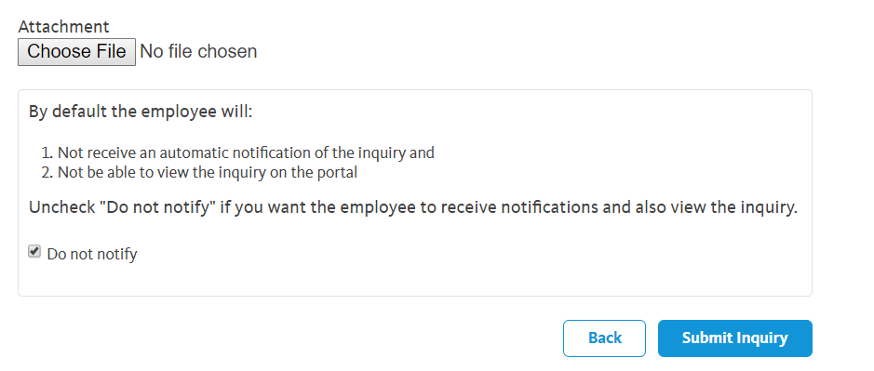
ON BEHALF OF SUBMIT INQUIRY
Click the Submit Inquiry button when completed.

Slide 41
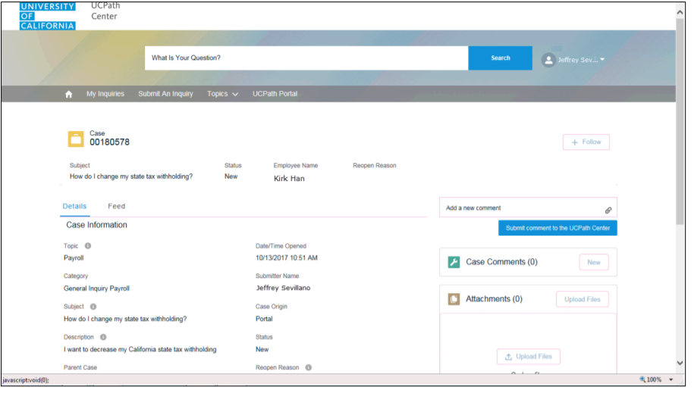
ON BEHALF OF CASE RESULTS
Results: a Case Number was assigned to the inquiry.
You can review the inquiry in the Details sections.
The Submitters Name appears.
You have Submitted an inquiry on behalf of an employee.
Case Number
Sonya Potter
Submitter’s Name
Sonya Potter

Slide 42
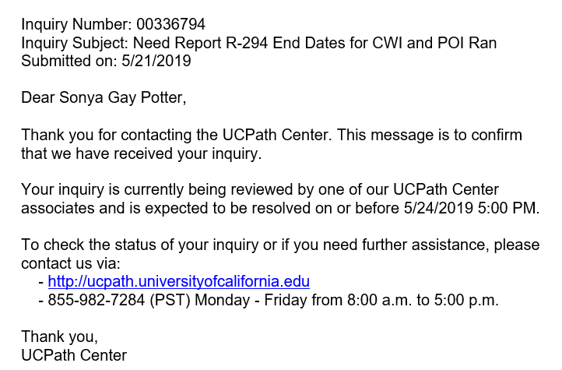
ON BEHALF OF EMAIL RECEIPT
Submitter will receive an email notification from UCPath with Inquiry number and a date to be resolved by.
IF you deselected the Do Not Notify checkbox, the employee will also receive an email with the same info.
00180578
How do I change my state tax withholding?

Slide 43
Monitor UCPath Center Case

Slide 44
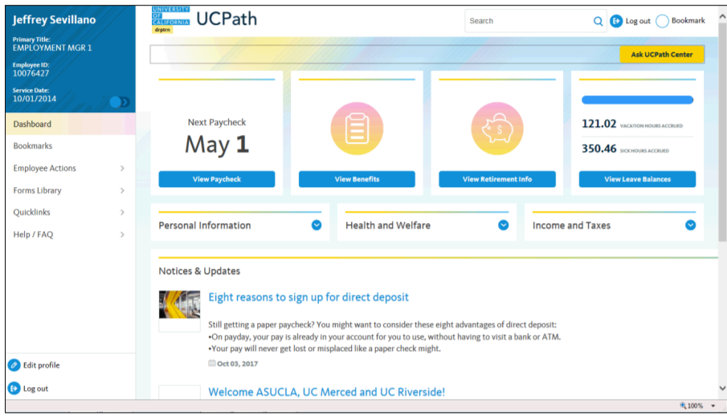
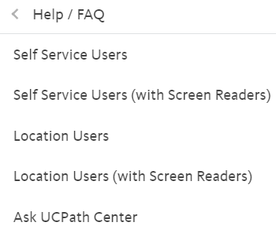
ON BEHALF OF NAVIGATION
Navigation: Help/FAQ> Ask UCPath Center
Note: This example uses sample images as seen on a computer. Sample images appear differently on a tablet or smartphone, but the steps remain the same.
Navigate to the Help/FAQ Link,
then click on the Ask UCPath Center

Slide 45
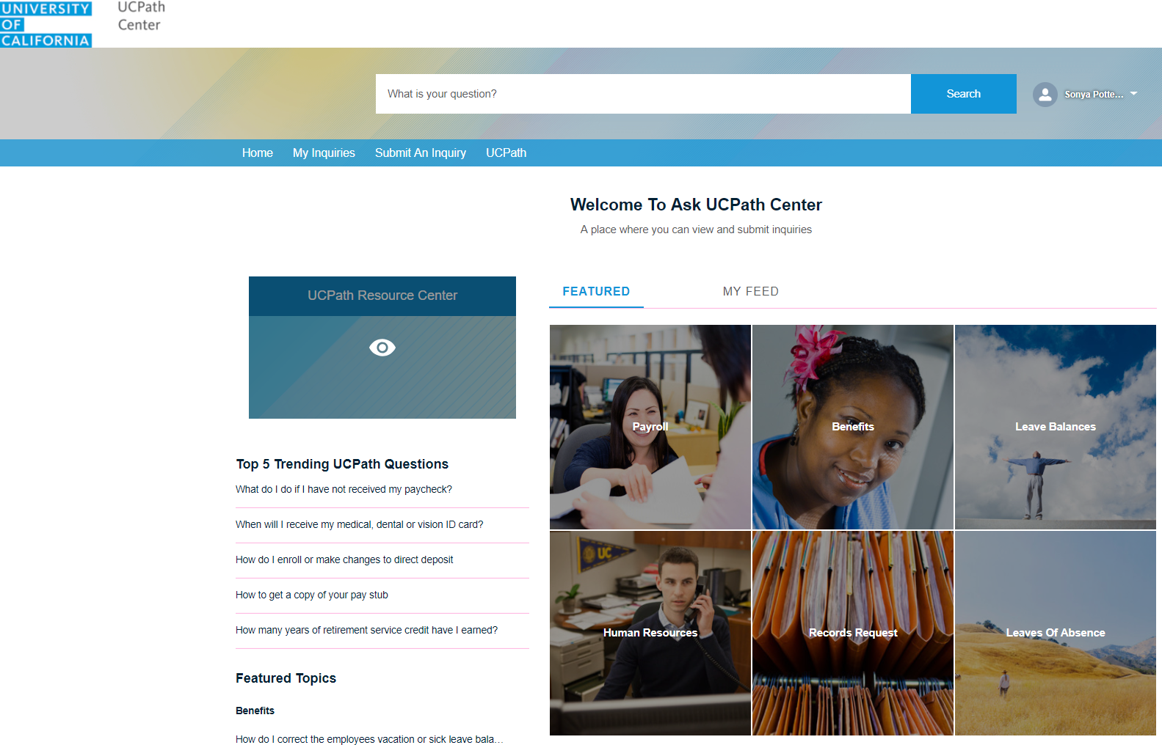
ON BEHALF OF INQUIRE LINK
The Welcome To Ask UCPath Center page appears.
The following links appear at the top of the page:
Home
My Inquiries
Submit an Inquiry
Topics
UCPath Portal
Click My Inquiries Link.

Slide 46
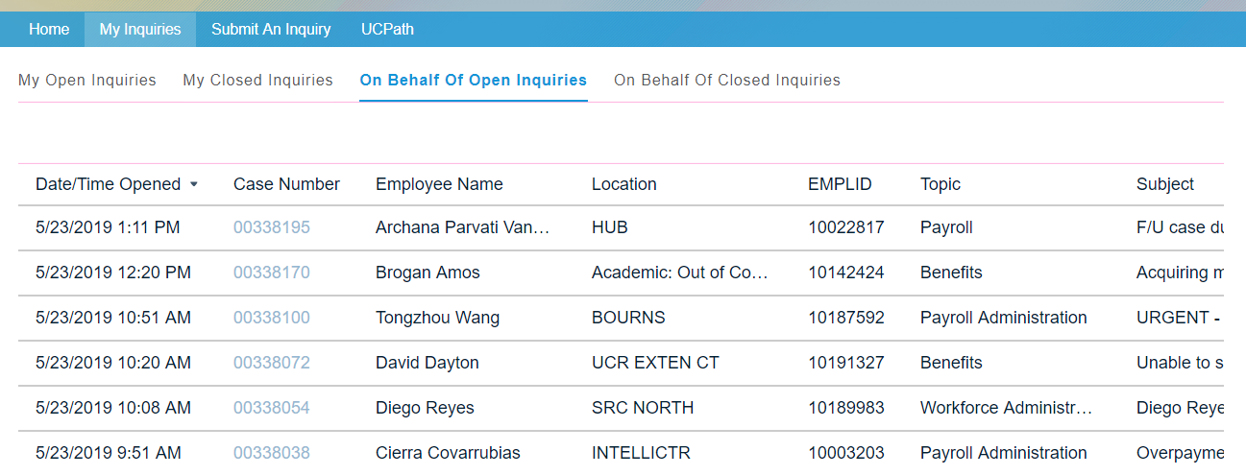
ON BEHALF OF OPEN / CLOSED INQUIRIES
Tabs appear at the top of the page. Most employees will have My Open Inquiries and My Closed Inquiries.
If you have the ability to submit inquires on behalf of others, two additional tabs appear: On behalf of Open Inquiries, and On Behalf of Closed Inquiries.
Use the On Behalf of Open Inquiries page to review the list of your On Behalf of cases. The inquiry you submitted most recently appears at the top of the list.
NOTE: Employee Names and ID’s removed for security purposes

Slide 47
ON BEHALF OF INQUIRIES LIST
To help you locate the specific case you want to monitor, the list displays the Date/Time Opened, Case Number, Topic, Subject, Status, Parent Case Number, Case Origin, and Submitter Name.
Click the scroll bar at bottom of page to view more columns.
Notice that the list is currently sorted by the date and time the case was opened.
The arrow next to the Date/Time Opened header indicates the column is sorted in ascending order, with the oldest at the top, and the newest at the bottom.
NOTE: Employee Names and ID’s removed for security purposes

Slide 48
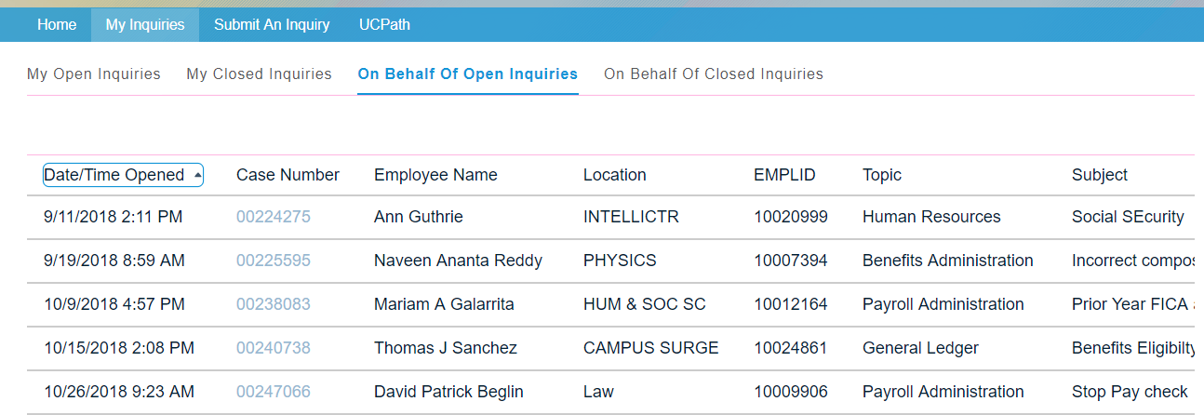
ON BEHALF OF INQUIRIES LIST
Sort your inquiries by clicking any column heading. You can only sort one column at a time; you cannot combine columns to sort.
Click the Date/Time Opened link.
Now the list is sorted in descending order; the oldest case is at the top of the list.
Click the Date/Time Opened link again to display the list in Ascending order, to place the newest case at the top of the list.
NOTE: Employee Names and ID’s removed for security purposes

Slide 49
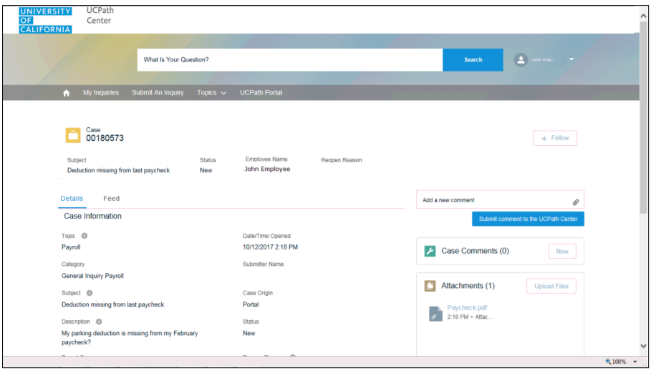
ON BEHALF OF CASE DISPLAY
Click a case number to display details for a specific inquiry

Slide 50
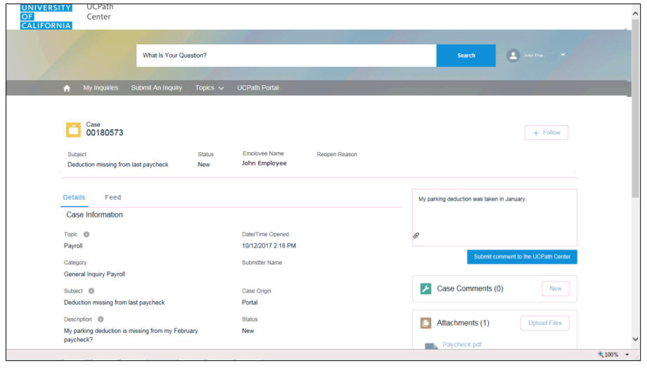
ON BEHALF OF ADD COMMENTS
If you add comments to a case, the comments are considered public, which means the employee and anyone who works the case can see the comment. UCPC employees who work the cases can choose to mark comments as internal, which means the employee/initiator will not see the comment.
Click in the Add a new comment field.
Enter the desired information into the Add a new comment field. For this example, see entry My parking deduction was taken in January.
My Parking deduction was taken in January

Slide 51
ON BEHALF OF ADD COMMENTS (continued)
Notice the Paperclip Icon below the comment text. You can click this button to add an attachment with your comment.
Paperclip Icon
Click the Submit Comment to the UCPath Center Button.

Slide 52
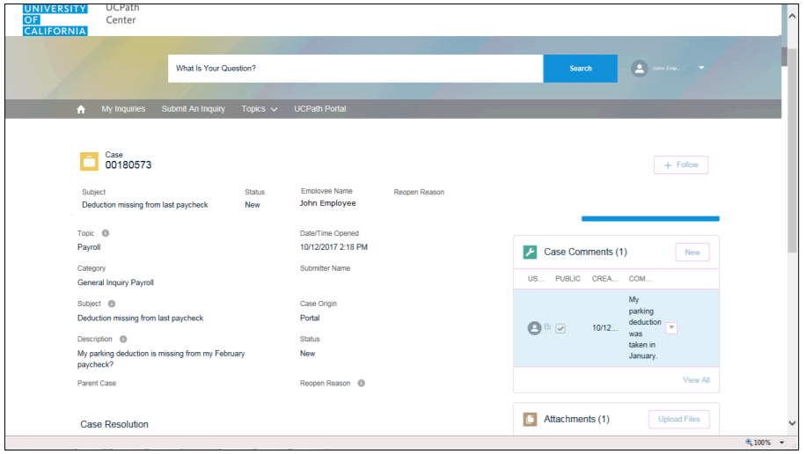
ON BEHALF OF CASE COMMENT SECTION
The Case Comments section displays the number of comments you entered, your name, and the creation date.
To view all comments, click the View All link.

Slide 53
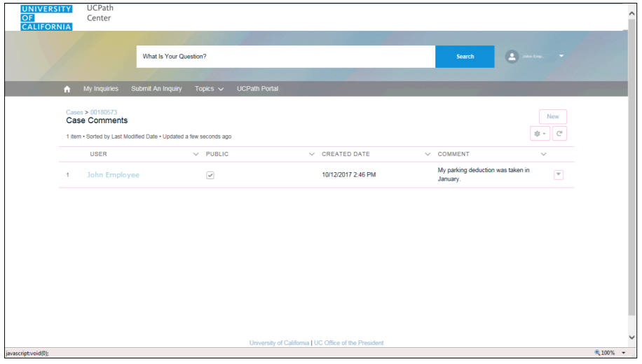
ON BEHALF OF CASE COMMENTS
The list of all comments appears. Remember that some comments may not be public and do not appear in the list. Click the Show More button.
Depending on your web browser, you may not see any items on the More menu. You cannot edit or delete case comments.
To return to the details, click the Case Number Link.
Note: Best Browsers to use are Firefox or Chrome

Slide 54
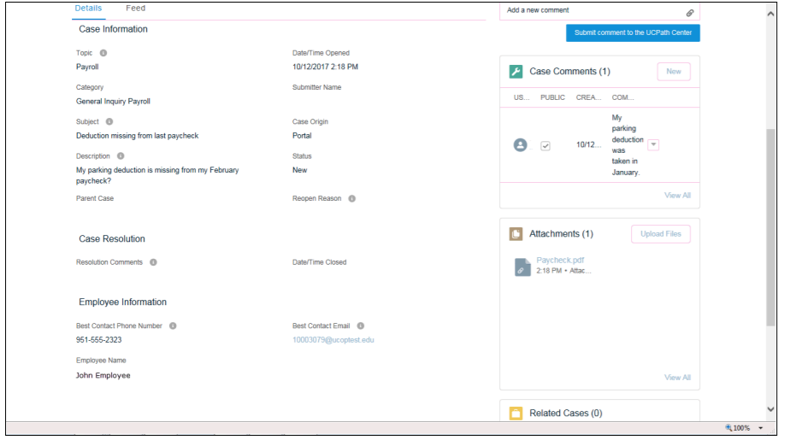
ON BEHALF OF ATTACHMENTS
When you are back in the Case, click the side scroll bar.
  You can add unlimited Attachments after the inquiry is saved.

Slide 55
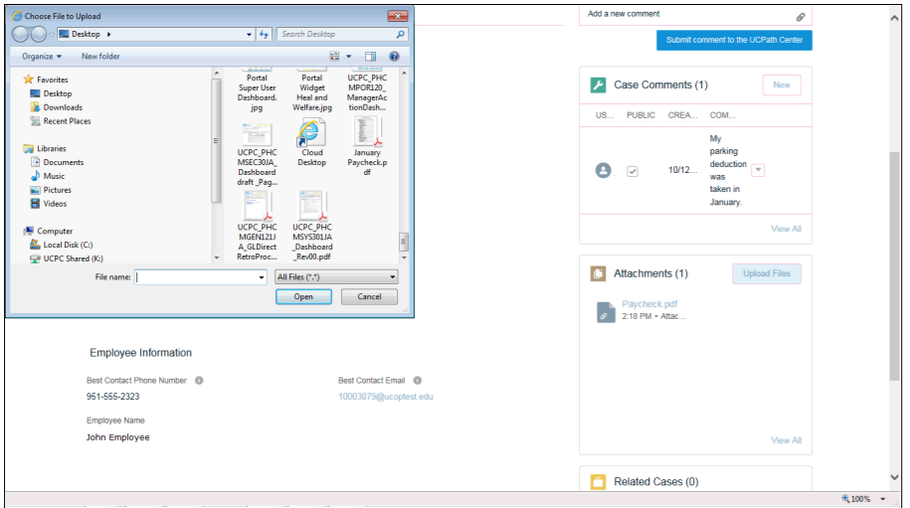
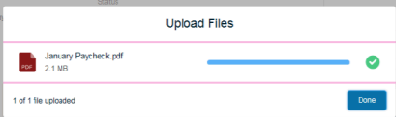
ON BEHALF OF ADD A FILE
Click the Upload Files Link.
Navigate to and select the appropriate file. Accepted formats include MS Office suite, PDF, JPG, TIFF, PNG or WAV.
Click the Open Button.
A message will confirm the file was uploaded.
Click Done.
2
1
3

Slide 56
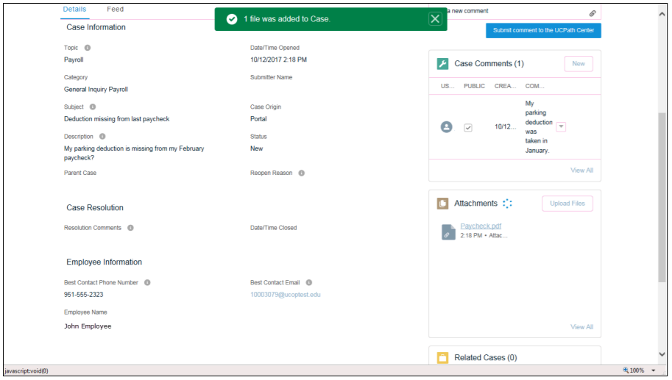
ON BEHALF OF ADD A FILE (continued)
Another message confirms the file was uploaded.
If the message does not automatically close, click the X to Close.

Slide 57
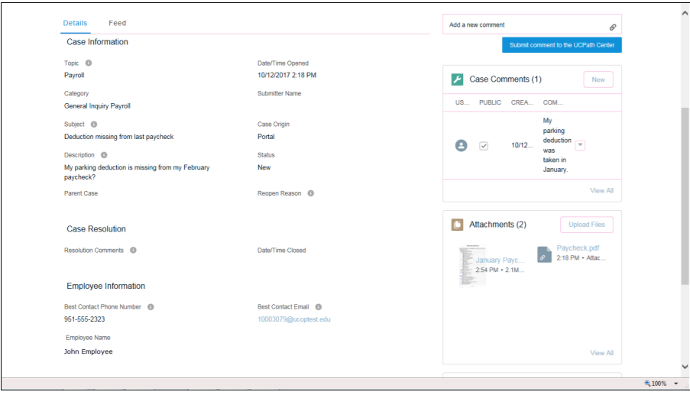
ON BEHALF OF VIEW FILES
  You can view all attachments in a list.
Click the View All Link.

Slide 58
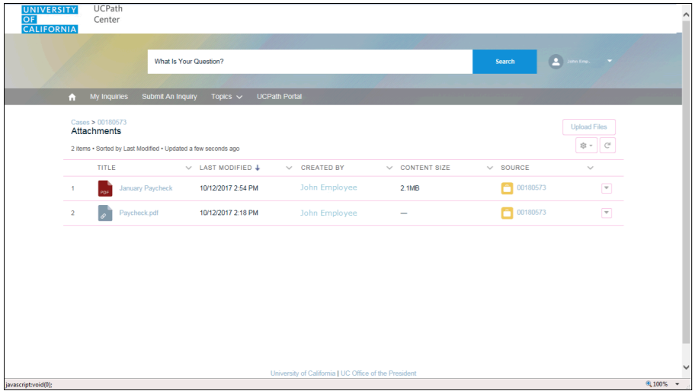
ON BEHALF OF VIEW FILES
The Attachments page lists all attachments connected to the inquiry.
Click the Show More Button.
Depending on your web browser, you may not see any items on the More menu.
You cannot delete attachments or upload replacement attachments, but you can download a copy of an attached file.
Click the Case Link to go back to the Case.
.
Note: Best Browsers to use are Firefox or Chrome

Slide 59
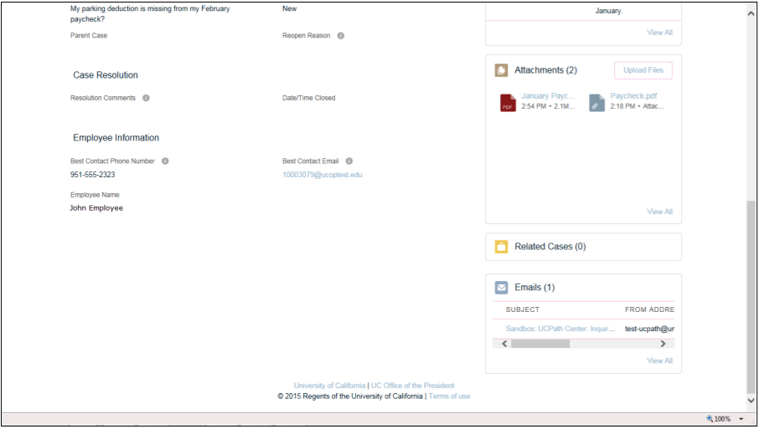
ON BEHALF OF RELATED CASES & EMAILS
Click the side scroll bar to view the Related Cases and Emails
Related Cases are linked to another Case. They could be a Parent or Child Case, or a Case UCPC deemed related
The Emails section displays any email messages associated with the case. However, UCPC can decide to make an email internal, which would not be viewable to a user.

Slide 60
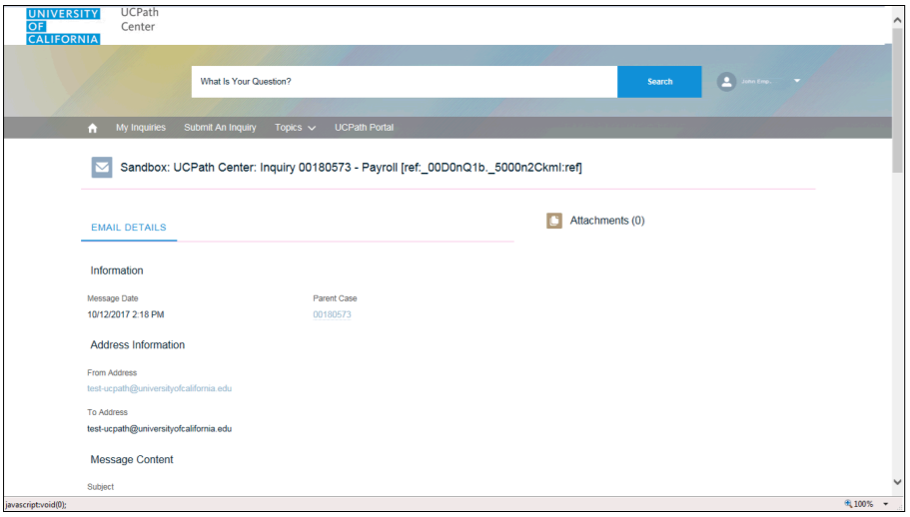
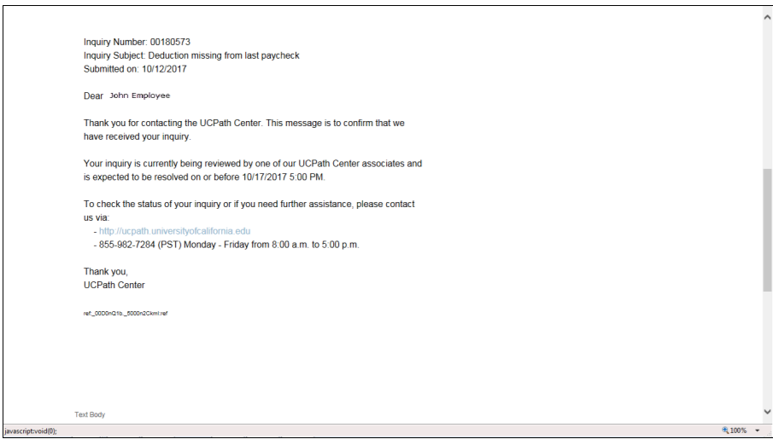
ON BEHALF OF RELATED CASES AND EMAILS
Click the Email link to review the email information as you scroll down the page via the scroll bar.
Click the Case number to return to the details of the case.

Slide 61
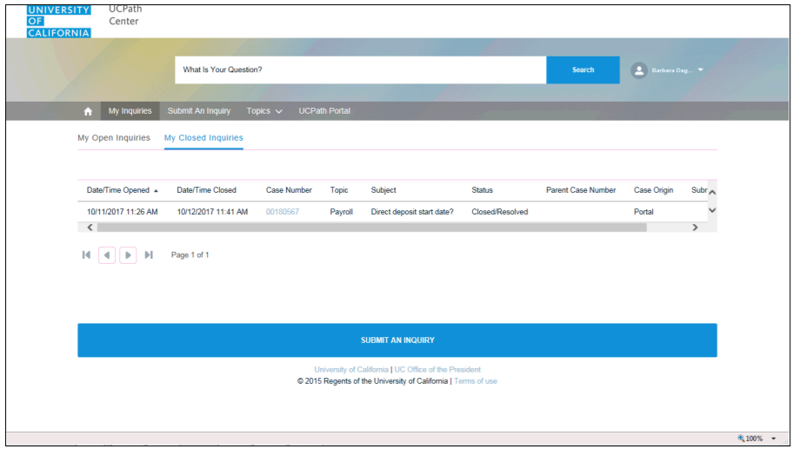
ON BEHALF OF CLOSED INQUIRES
To review closed inquiries, click the My Inquires link, then My Closed Inquires tab.
To review Closed Inquires, click the Case Number Link.
1
2
3

Slide 62
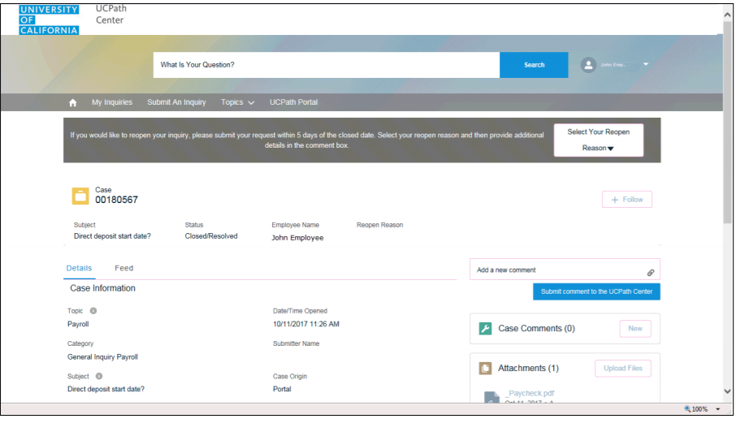
ON BEHALF OF CLOSED INQUIRES (continued)
Notice the Status is Closed Resolved.
Use the side scroll bar to view Case Comments, Attachments, Related Cases, and Emails.

Slide 63
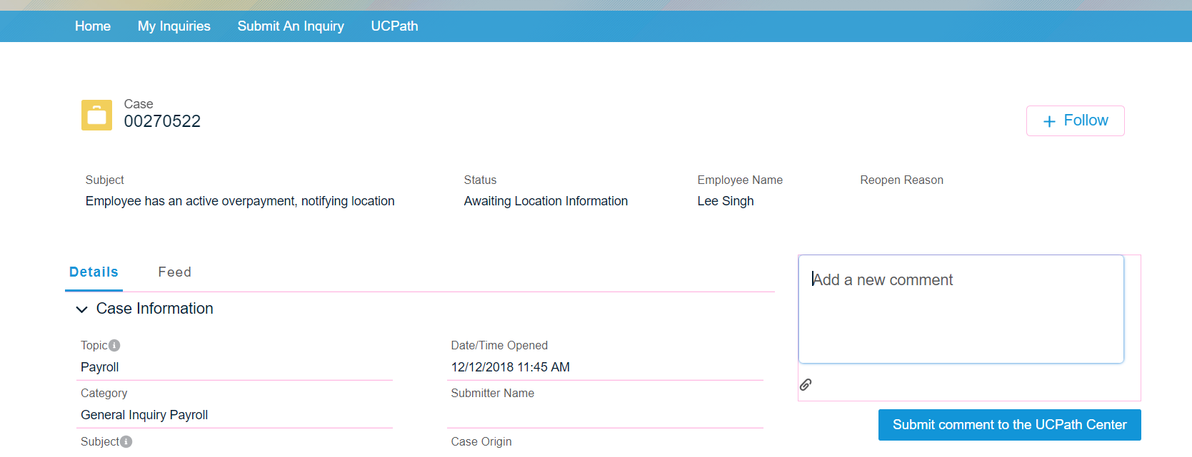
ON BEHALF OF CLOSED INQUIRES
Click on the Home tab to exit the Case.

Slide 64
Reopen Closed UCPath Center Case

Slide 65
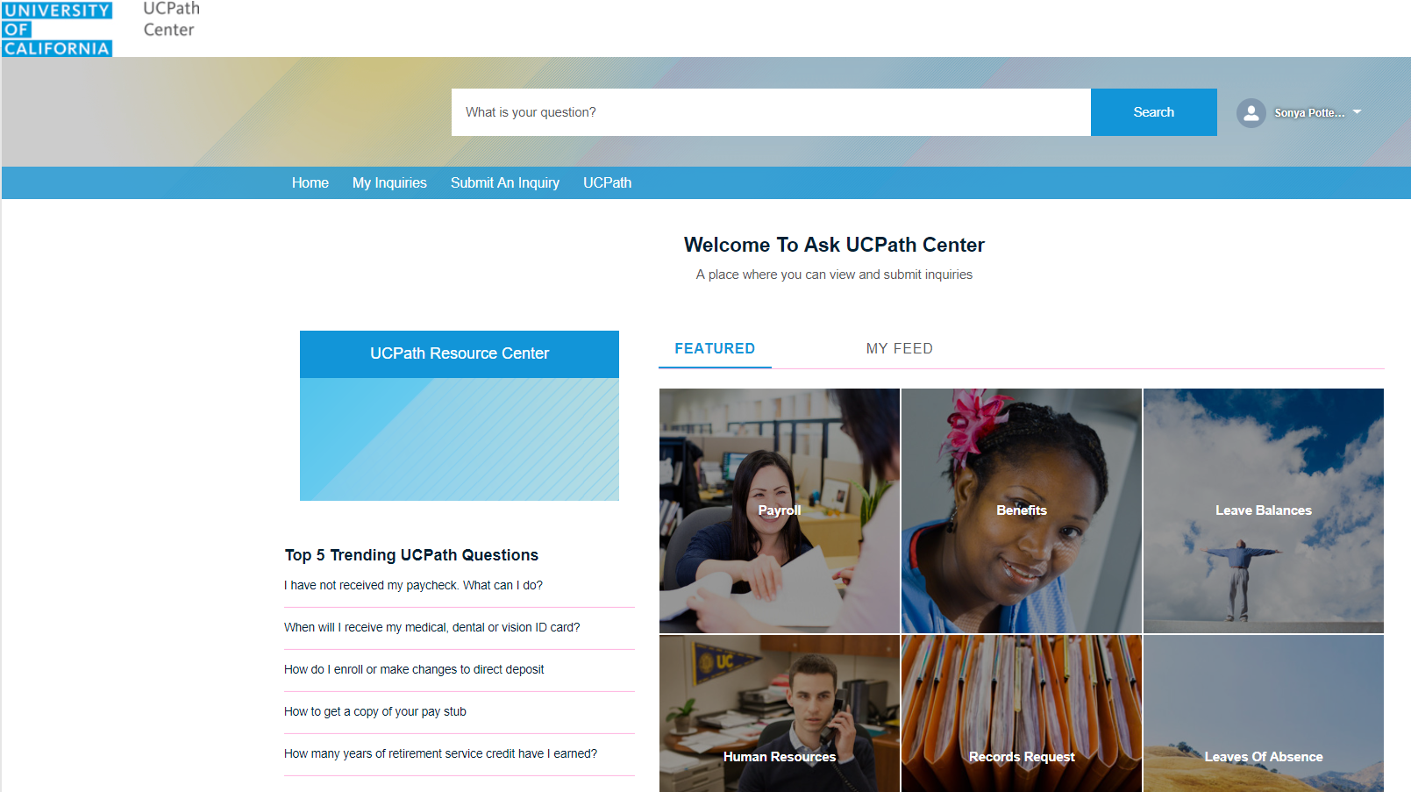
ON BEHALF OF REOPEN CLOSED UCPATH CENTER CASE
Navigation: Ask UCPath Center or Help/FAQ > Ask UCPath Center
If you have additional questions regarding a closed inquiry, click the My Inquiries link, or Ask UCPath.

Slide 66
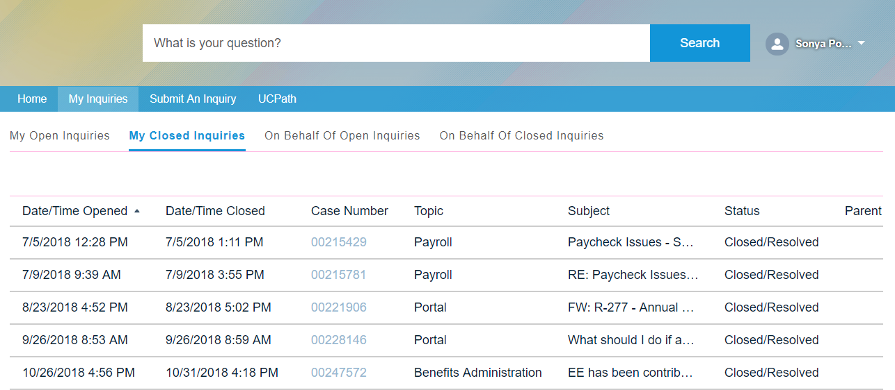
ON BEHALF OF CLOSED INQUIRES
Click the My Closed Inquires or if you have access to On Behalf of Closed Case Inquiries.
Click on the Case Number link of the case you would like to view.

Slide 67
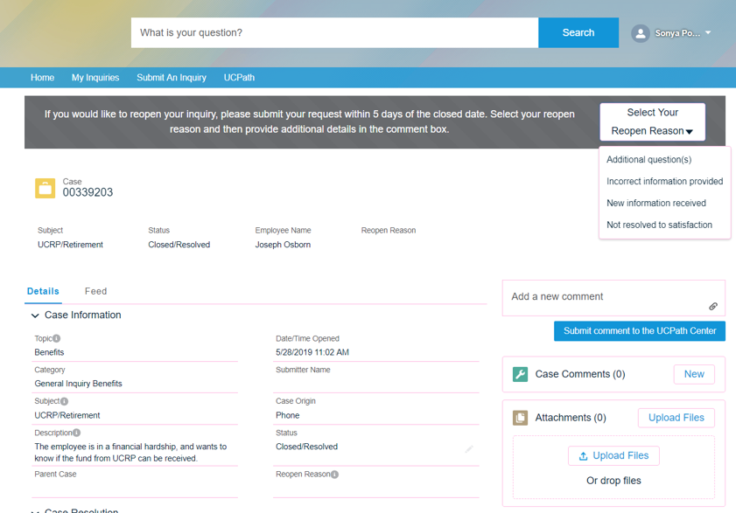
ON BEHALF OF REOPEN REASON
If the inquiry can be reopened, a banner appears at the top of the page.
Click the Select Your Reopen Reason button and select a reason associated with your inquiry.
Reasons include:
  Additional question(s)
  Incorrect information provided
  New Information received
  Not resolved to satisfaction
00180567
Status
New
Subject
Direct deposit start date?
Employee Name
John Employee
Payroll
10/13/2017 8:36 AM
General Inquiry Payroll
Direct deposit start date?
Portal
Only one of my two
Close/Resolved

Slide 68

ON BEHALF OF NEW CASE
In this example, we have selected Additional Questions.
Reopened cases receive a new case number. In this example, the original case number ended in 567; the new case number ends in 575.
The reason you reopened the case appears in the Reopen Reason field to the right of the Employee Name in the header.
Reopen Reason
Additional Questions
Subject
Direct Deposit Start Date?
Status
New
Employee Name
John Employee

Slide 69
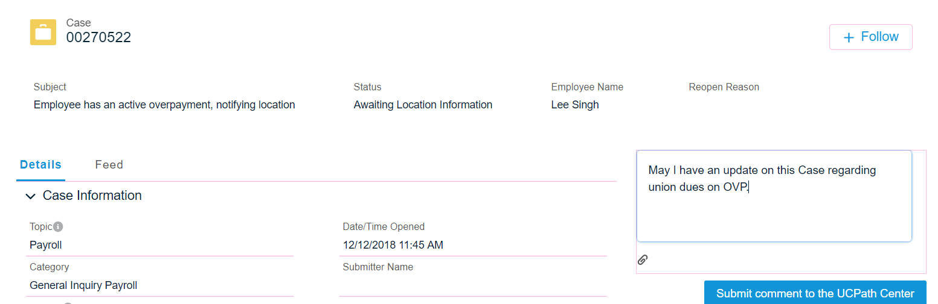
ON BEHALF OF ADD COMMENTS
You can now add comments to the case.
Note: If you add comments before picking the reason, you are entering comments on the closed case, not the new case.
Enter the desired information into the Add a new comment field.
You can add an attachment with the comment by clicking the Paperclip attachment icon
Next click the Submit comment to the UCPath Center.
How do I ensure the direct deposit always happens?
00180575
10/13/17 8:36 AM

Slide 70
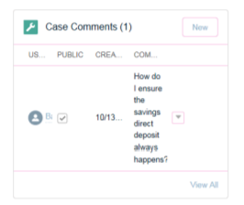
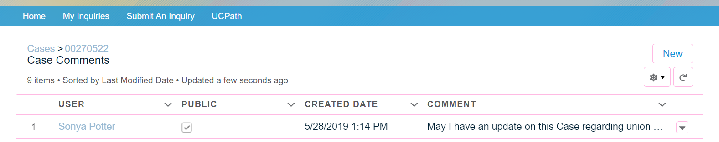
ON BEHALF OF REFRESH PAGE
Comments do not appear in the Case Comments section unless you refresh the page.
Navigate to the View All link at the bottom of the comments section.
Click View All.
The Case Comments window will appear.
Click the circle arrow icon.
View All

Slide 71
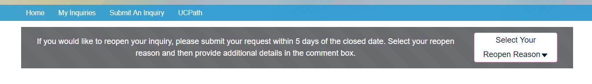
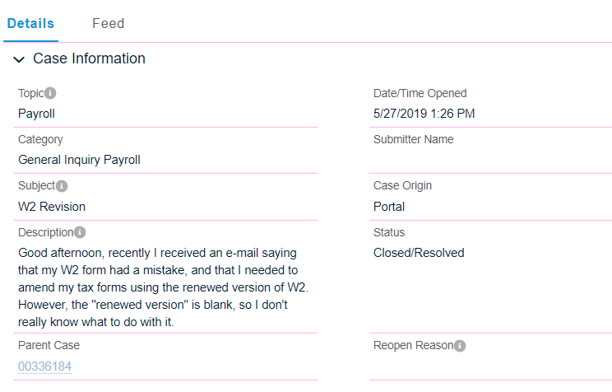
ON BEHALF OF MY INQUIRES
The Parent Case, which is the closed case, appears in the details of the new case, along with the Reopen Reason.
Return to the top of the page.
Click the My Inquires link.
10/13/2017 8:36 AM
John Employee
Direct deposit start date?
Only one of my two
New
Additional Questions

Slide 72
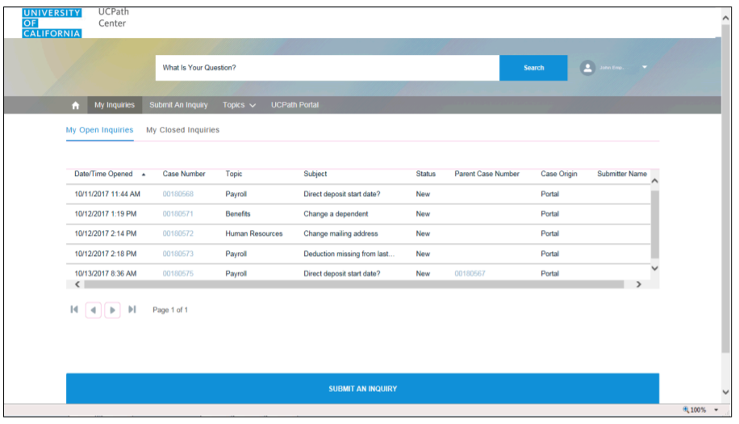
ON BEHALF OF END OF LESSON
The new inquiry appears in the My Open Inquires or Open Inquires list.
Note: the picture displays the My Open Inquiries.
Date/Time Opened

Slide 73


Slide 74
On Behalf of Demo

Slide 75
LEARNING OBJECTIVES REVIEW
Having completed this course, you should be able to:
Initiate a UCPath SalesForce Case
Monitor a UCPath SalesForce Case
Reopen a UCPath SalesForce Case
How to Edit SharePoint testing list

Slide 76


THINGS TO REMEMBER
Follow up on your cases weekly, however it can take UCPath a long time to complete a case, keep following up. If you do not get a response, you should contact Shannon Minter to escalate your matter shannon.minter@ucr.edu.
Phone Number to call for UCPC – Employee Service line (ES) 855-982-7284, Quality Care Unit (QCU) – 951-787-5470 used for escalation calls.
UCPath Center Portal has an area for Trending Questions and Feature Topics you can use to help to find answers for your questions - https://ucpathsupport.force.com/askucpath/s/
On Behalf of Topics and Categories, please refer to the list of Topics and Categories to categorized your Case correctly. If it is not categorized correctly, it could delay your issue from being reviewed timely by UCPath.

Slide 77
APPENDIX
On Behalf of Process Map
On Behalf of Road Map

Slide 78
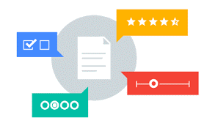
Your Feedback Please
http://bit.ly/ucpathpilottraining

Slide 79


