Slide 1
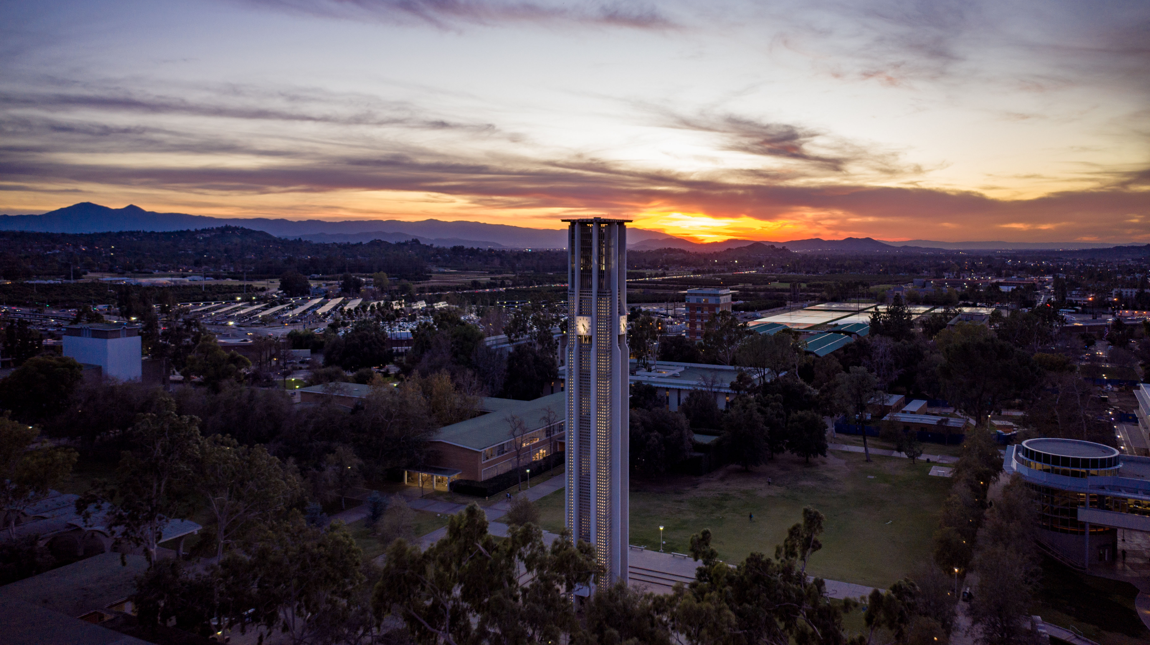


UCPath Banner Match Stakeholder
2/7/22

Slide 2

Agenda
UCPath/Banner Match Job Overview
Why we are changing
Specific Changes
Potential Impacts to Stakeholder groups
Feedback

Slide 3

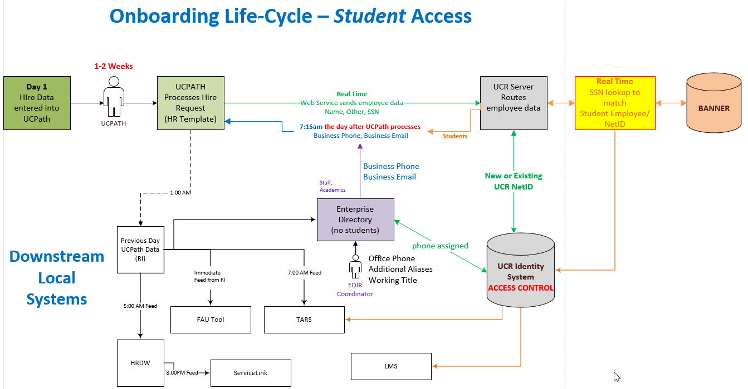
Onboarding Life-Cycle UCPath Access
UCR Student Identity Profile Process Flow
Students must pass the reconciliation job between UCPath and Banner
The only data point is SSN
This matches the UCPath employee ID to the student NetID
This completes the identity profile and allows the student employee to access local systems on start date:
- UCPath – Direct Deposit
- TARS – Timesheet
- LMS – Required Training
*If the student does not have an SSN, a helpdesk ticket needs to be opened requesting the IAM team manually associate the EMPLID and NetID
Notes:
Workflow diagram from last Oct 20, 2021

Slide 4
UCPath – Banner Match Program –Why Change??
Reconciles Student NetID
to the UCPath EMPLID
Based on a single data point → SSN
  Estimated success rate for student
  employee match is 60-70%
  30-40% failures are due to no SSN
  Estimated success rate for student CWR
  only job is 0
Without reconciliation:
  No UCPath access (Direct Deposit etc.)
  No Timesheet access
  No LMS access
  Additional local system access issues
IDENTITY MANAGEMENT
EMPLID
Employee Class
DOB
UC ID
Person Data
SSN
Notes:
This past year, CSC had over 73 tickets where RCA was a failure to match the student employee’s NetID & EMPLID. The HelpDesk and IAM had even more requesting manual reconciliation

Slide 5
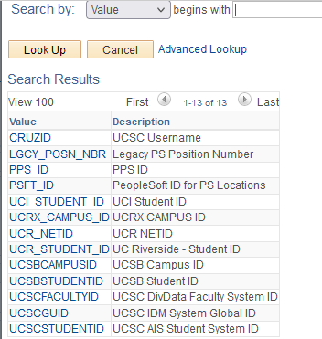

UCPath – Banner Match Program Changes
Expand the data point match to include:
Dependency: SMART HR Template must include one of the new values in the External System ID field on the Personal Data tab
UCR NetID
UNEX NetID
Student ID
SSN
Note: The UCR NetID can be a previously issued NetID for a Staff or Academic employee, but a HelpDesk ticket still needs to be opened to prevent a second NetID being issued.
Notes:
Students get a UCR NetID when applying to UCR
UCR NetIDs are like a SSN → once you have one assigned, you don’t need another one issued – ever.
The goal is to have a greater success rate!

Slide 6

Banner Match Program Changes
1-2 Weeks
Day 1
Hire Data entered into UCPath
UCPath Processes Hire Request (HR Template)
Real Time
Web Service sends employee data
Coding is in progress and is estimated 3-4 weeks – 60% complete
SSC, IAM and CSC will assist with Testing
  Would like to include a Banner contact
Failed Match Error Log
New or Existing UCR NetID
New Code:
Student ID Match
Student NetID Match
UNEX NetID Match
Failed Match Error Log
Sent to Monitored Slack Channel

Slide 7
UCPath – Banner Match Program Impacts
Stakeholder Impacts:
  Reduced requests to add SSN in Banner
    New WorkStudy students or other Financial programs will need to ensure SSN is in Banner
  ZUSESXR report: No longer an SSN indicator
    New reports may need to be written
  Other impacts for consideration?
Notes:
SSC question: Can SSCs (limited) be given view access to Banner (with training)?

Slide 8
