Slide 1
AB119 UPDATES

Slide 2
AB119 IMPLEMENTATION
State Assembly Bill 119 (AB119) signed into law in 2017, contains a legal requirement for public institutions to have available the physical location of a represented employee’s “workstation”. UCOP Labor Relations is providing oversight and guidance for this effort and requires each UC location meet the compliance requirement in AB119 by the end of the calendar year (UCOP) to avoid legal ramifications. This requires updates to the UCPath System no later than December 2021.
Data Collection Status
Recent Updates
Next Steps
Received Data from 26 ORGs
Pending Data from 1 ORG
Downstream Impacts
Impacts to HRDW have been assessed by ITS and any needed mitigations will be implemented
Upstream Impacts
Upstream impacts have been assessed and will be mitigated in the short term through interim business process changes. In the long term, changes to upstream systems (e.g., ServiceLink and Snapshot) are currently being evaluated
SOM Affiliates outside of UCR campus
FMS will be able to handle buildings that are external to UCR, if needed
November 2021
Update configuration tables
Central PayPath mass update
Unit Review & data update
December 2021
Final Central review of data and confirmation to UCOP

Slide 3
AB119 IMPLEMENTATION TIMEILNE
PHASE 1: AB119 System & Data Update
November 9th
Changes to location table data will be seen in UCPath
Units that submit new positions can use the default department code (after December 13th you will need to comply with new location values)
If you do not have a default department code please contact Kameron from the CSC at kameron.johnson@ucr.edu for guidance during this phase
November 9th - November 15th
Kameron will be updating centrally (mass updates for existing employees from the spreadsheets you submitted)
November 15th - December 13th
CSC will work with your teams to confirm and update any outstanding records centrally for that time period (before December 13th) to reach full AB119 compliance
PHASE II: AB119 Compliance Rollout
December 13th Forward
Once there is a finalization, the updates will be submitted directly from the units to SSCs and transacted in UCPath

Slide 4
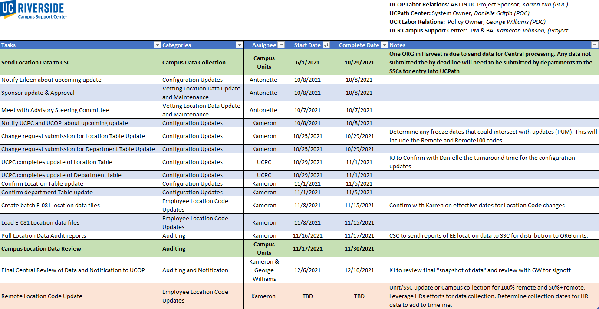
Project schedule*
* Communication Dates TBD | Dates may be adjusted as needed

