Slide 1
Compliance
December 2019
I-9 Compliance Review

Slide 2
Systemwide Compliance Review
The purpose of the internal I-9 audit is to ensure compliance with U.S. Citizenship and Immigration Services (USCIS) regulations. The scope of the audit will include the review of active and separated employee I-9s.
The reason for this audit is to ensure active and separated employee Form I-9s are in compliance with the requirements of USCIS, and adhere to the requirements of UC and UCR policies and local procedures.
1

Slide 3
Systemwide Compliance Review
Employees can expect the process to be based on neutral and non-discriminatory criteria. Department and Shared Service Center (SSC) representatives will be trained on USCIS required standards for completing information, collecting data and correcting inaccurate or omitted information.
Departments and SSC will review paper I-9s and when necessary, contact employees to correct errors or omissions in section 1. In the event there is an error or an omission in section 2 or 3, departments and SSCs will notify the employee to submit the appropriate documentation within ten business days (two weeks).
2

Slide 4
Systemwide Compliance Review
Given every employer must complete a Form I-9 for every new employee hired after November 6, 1986, any UCR employee identified as missing a Form I-9 will be asked to complete a new I-9 and submit the appropriate documentation. Departments and SSC will notify employees who are missing a paper I-9 (unless the employee’s information is in Tracker I-9) to submit the appropriate documentation within ten business days (two weeks).
3

Slide 5
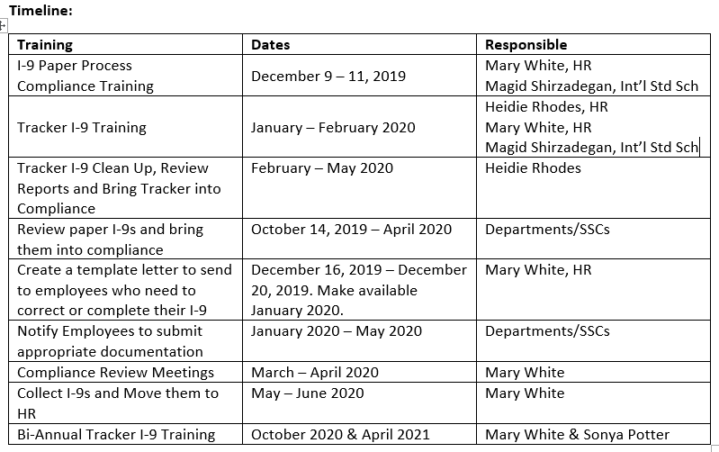
UCR Internal I-9 Compliance Audit
2019-2020
4

Slide 6
Who the Policy Applies to
Scope:
All University of California (UC) campuses are required to:
verify the identity and employment authorization of each person hired,
complete and retain a Form I-9 Employment Eligibility Verification for each employee,
refrain from discriminating against individuals on the basis of national origin or citizenship.
Definition of Employee:
Faculty, staff, or any other paid workforce member - contractor, researcher, student worker.
5

Slide 7
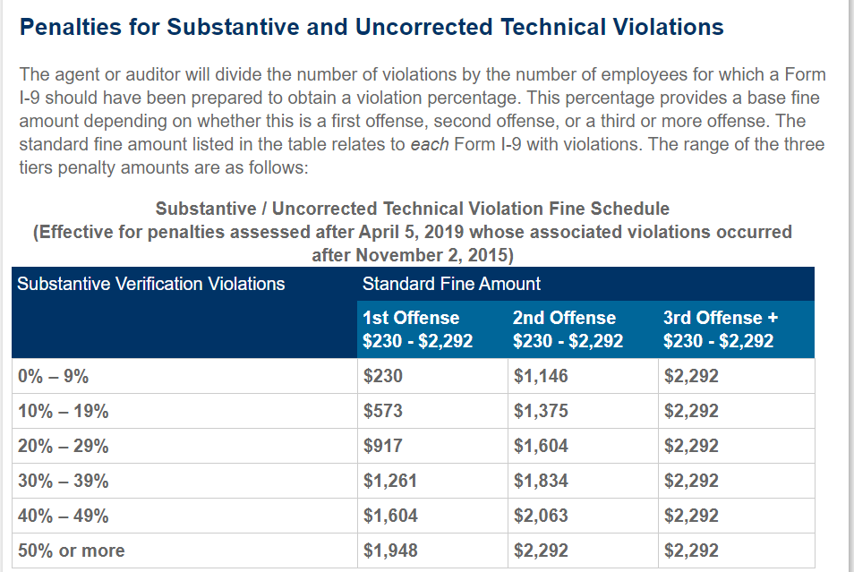
6

Slide 8
What Questions Were Asked?
Where are the historical/paper I-9s files kept?
Where do you keep I-9s for separated employees?
What type of documentation is attached to the I-9?
Are you missing I-9s?
Clarified roles of subject-matter experts (Privacy Officials, Records Management Coordinators, and Information Practices Coordinators)
7

Slide 9
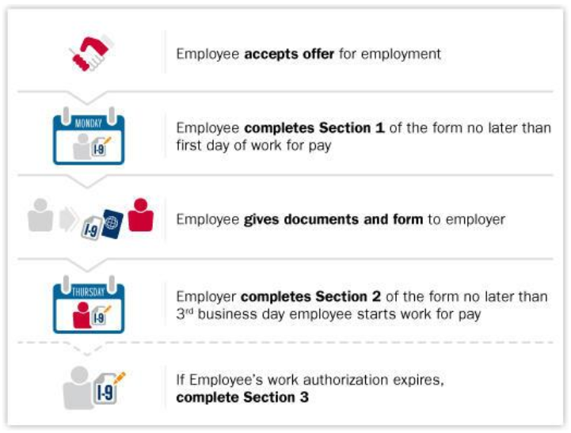
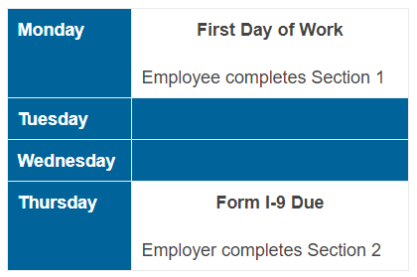
8

Slide 10
Section 1 – Employee Information and Attestation
Newly hired employees must complete and sign Section 1 no later than the first day of employment.
Section 1 should never be completed before the employee accepts a job offer.
The employee must complete each field in Section 1.
9

Slide 11
Employee Information
Last Name: Full legal last name. If there are two last names or a hyphenated last name, it should include both names in the Last Name field.
Examples: De La Cruz, O’Neill, Garcia Lopez, Smith-Johnson.
First Name: Full legal first name.
Examples: Jessica, John-Paul, Tae Young, D’Shaun.
Middle Initial: Middle initial is the first letter of the second given name, or the first letter of the middle name, if any. If the employee has more than one middle name, the first letter of the first middle name should be entered. If there isn’t a middle name, enter N/A in this field.
If the employee only has one name, the employee should enter it in the appropriate field, then enter “Unknown” in the First Name field or in the Last Name field, but not both.
10

Slide 12
Employee Information cont’d
Other Last Names Used: All other last names used, if any (e.g., maiden name). The employee should enter N/A if they have not used other last names.
Address (Street Name and Number): Street name and number of the current address of the employees residence.
Apartment: The number(s) or letter(s) that identify(ies) the apartment. If there is no apartment, the employee should enter N/A.
City or Town: The city, town or village should be entered in this field. If the residence is not located in a city, town or village, enter the county, township, reservation, etc., in the field.
State: The abbreviation of the employee’s state or territory should be entered in this field.
Zip Code: Five-digit zip code.
Date of Birth: The employee’s date of birth should be entered as a 2-digit month, 2-digit day, and 4-digit year (mm/dd/yyyy).
11

Slide 13
Employee Information cont’d
U.S. Social Security Number: Providing the 9-digit Social Security number is voluntary on Form I-9 unless an employer participates in E-verify. Given we participate in E-verify and the employee was issued a Social Security number, it must be provided in the field; or if the employee applied for, but have not yet received a Social Security number, the employee will leave this field blank until the employee receives a Social Security number.
Employee’s E-mail Address (Optional): Email addresses are optional on Form I-9, but the field cannot be left blank. The employee may use either their personal or work email address in the field or enter N/A.
Employee’s Telephone Number (Optional): Telephone numbers are optional, but the field cannot be left blank. The employee must enter the area code and telephone number or N/A.
12

Slide 14
Employee Attestation
13

Slide 15
Preparer and/or Translator Certification
14

Slide 16
Preparer and/or Translator
Employees needing assistance to correct or enter omitted information in Section 1 can have a preparer and/or translator help with the correction or omitted information.
The preparer or translator should:
• Make the correction or note the omitted information or help the employee make the correction or note the omitted information. The employee or preparer or translator should draw a line through the incorrect information and enter the correct information or note the omitted information;
• Have the employee initial and date the correction or omitted information if able; and
• Initial and date the correction or omitted information next to the employee’s initials.
15

Slide 17
Preparer and/or Translator (cont’d)
If the preparer and/or translator who helped with a correction or noted omitted information completed the preparer and/or translator certification block when the employee initially completed the Form I-9, he or she should not complete the certification block again.
If the preparer and/or translator did not previously complete the preparer and/or translator certification block, he or she should:
• Complete the certification block; or
• If the certification block was previously completed by a different preparer and/or translator:
o Draw a line through the previous preparer and/or translator information; and
o Enter the new preparer and/or translator information (and indicate “for corrections”).
If the employee is no longer working for the university, the university should attach to the existing form a signed and dated statement identifying the error or omission and explaining why corrections could not be made (e.g., because the employee no longer works for the university).
16

Slide 18
Section 1 - Complete
Department/SSC must ensure that all parts of Form I-9 are properly completed; otherwise UC may be subject to penalties under federal law. Section 1 must be completed no later than the employee’s first day of employment.
Departments/SSC may not ask an individual who has not accepted a job offer to complete Section 1.
17

Slide 19
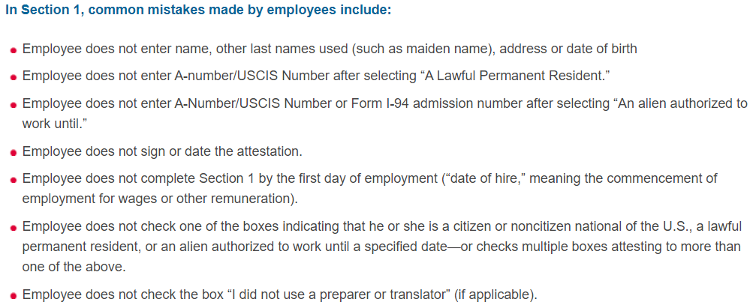
18

Slide 20
Correcting Section 1
Departments/SSC
Ensure that all parts of Form I-9 are properly completed; or UC may be subject to penalties under federal law.
Section 1 must be completed no later than the employee’s first day of employment.
Do not ask an individual who has not accepted a job offer to complete Section 1.
Departments/SSC may not correct errors or omissions in Section 1.
If an error or omission is discovered in Section 1, the department/SSC must ask the employee to correct the error, initial and date them.
The best way to correct the error is to have the employee:
• Draw a line through the incorrect information;
• Enter the correct or omitted information; and
• Initial and date the correction or omitted information.
19

Slide 21
Section 2 – Employer or Authorized Representative Review and Verification
20

Slide 22
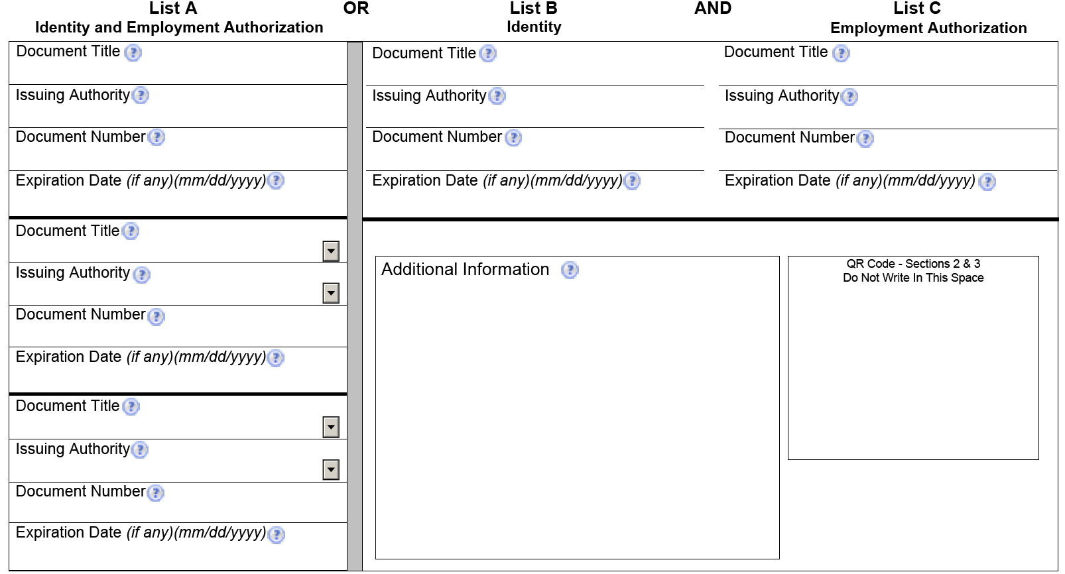
Section 2 – Identity and Employment Authorization
21

Slide 23
Failure of an Employee to Present Acceptable Documents
The university may terminate an employee who fails to produce an acceptable document or documents, or an acceptable receipt for a document within three business days of the date employment begins.
If a department/SSC fails to properly complete Form I-9 there is a risk of violating section 274A of the INA and will make the university subject to civil money penalties.
22

Slide 24
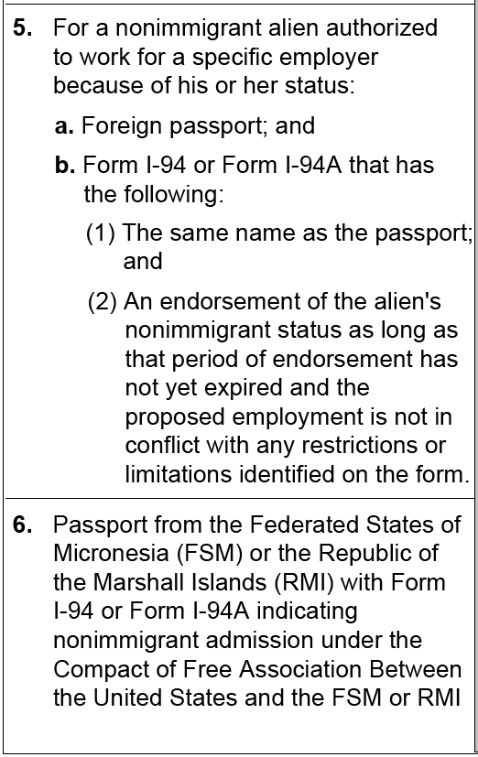
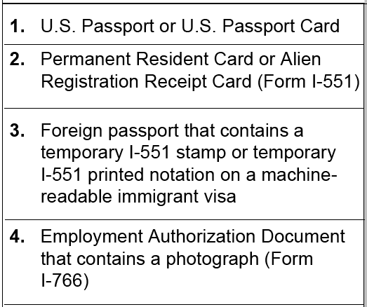
Section 2 – List A: Identity and Authorization
23

Slide 25
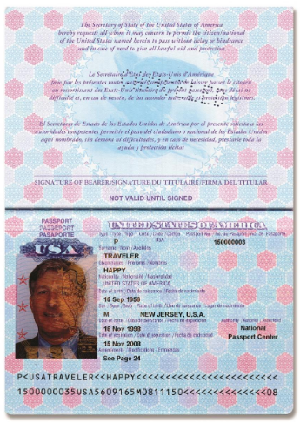
List A - Illustrations
24

Slide 26
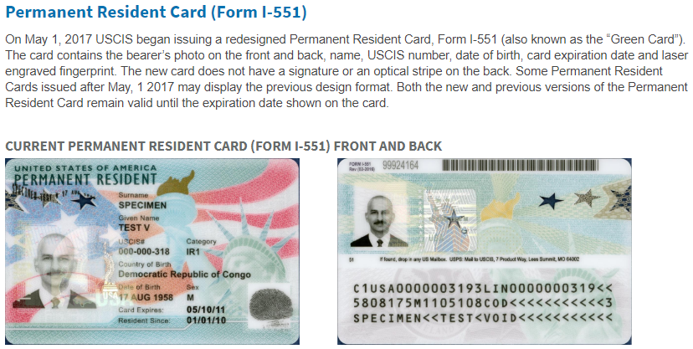
List A - Illustrations
25

Slide 27
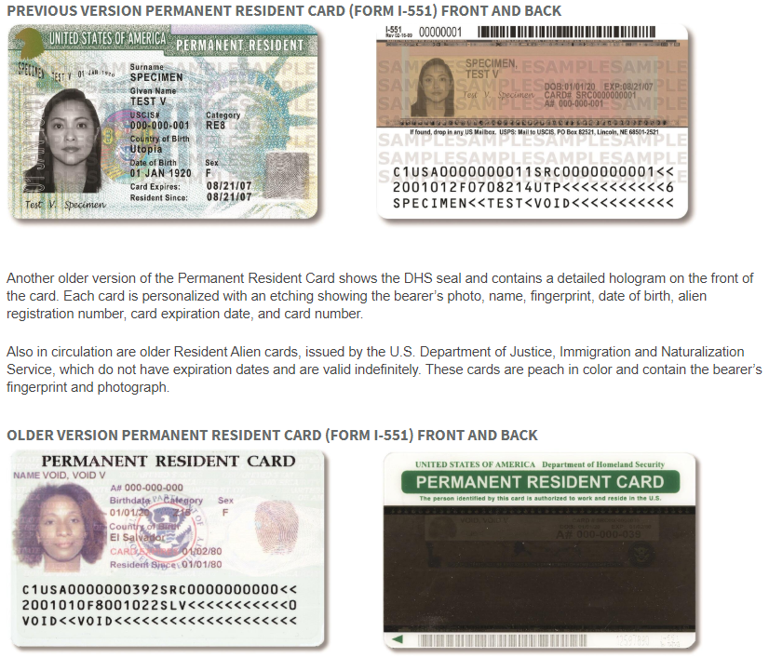
List A - Illustrations
26

Slide 28
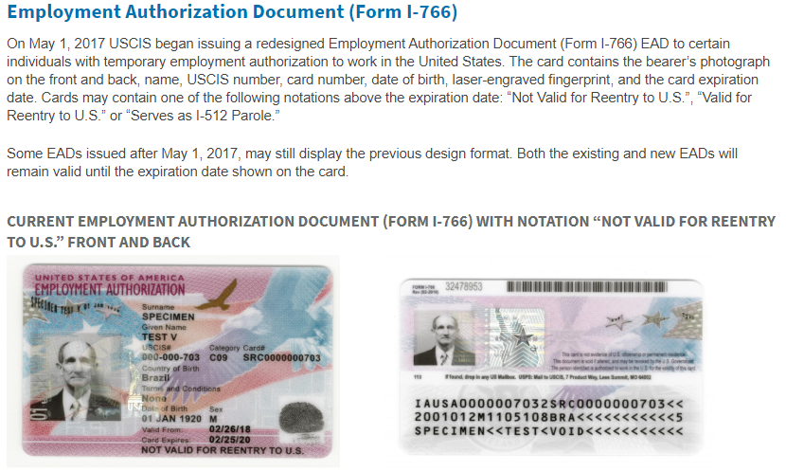
List A - Illustrations
27

Slide 29
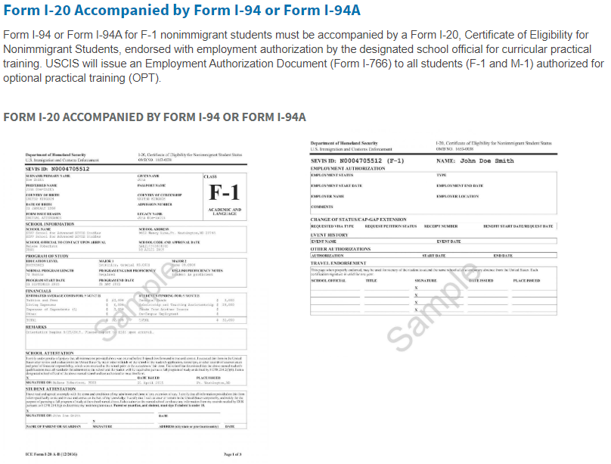
List A - Illustrations
28

Slide 30
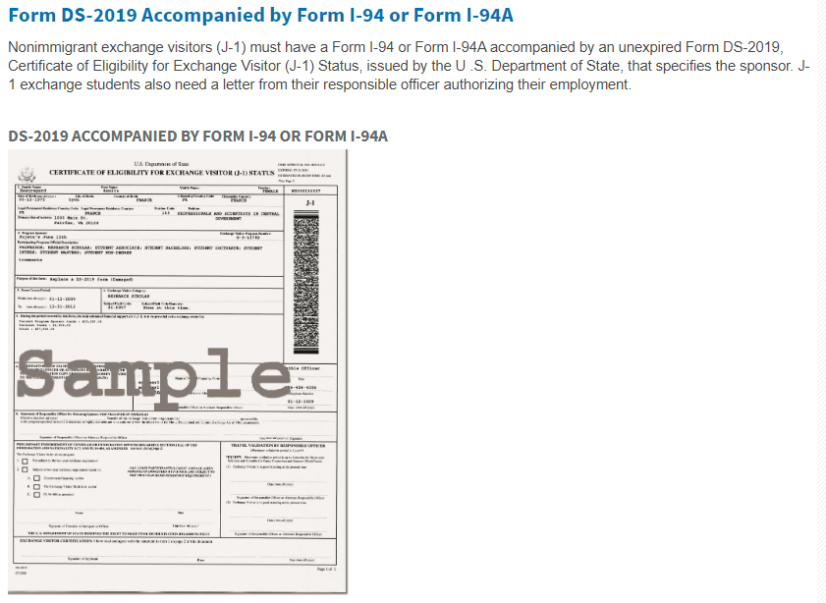
List A - Illustrations
29

Slide 31
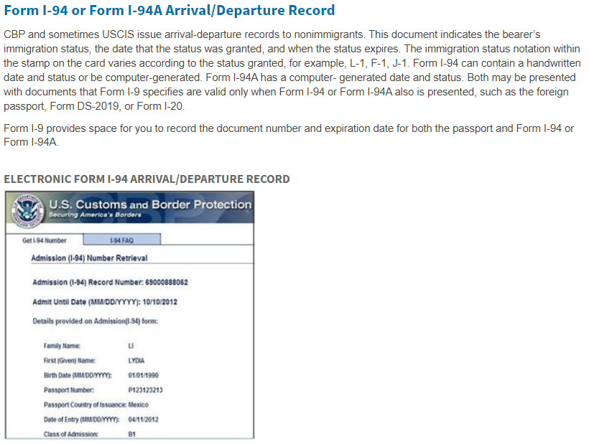
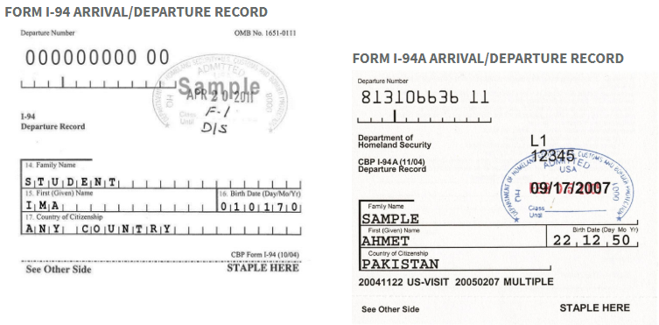
List A - Illustrations
30

Slide 32
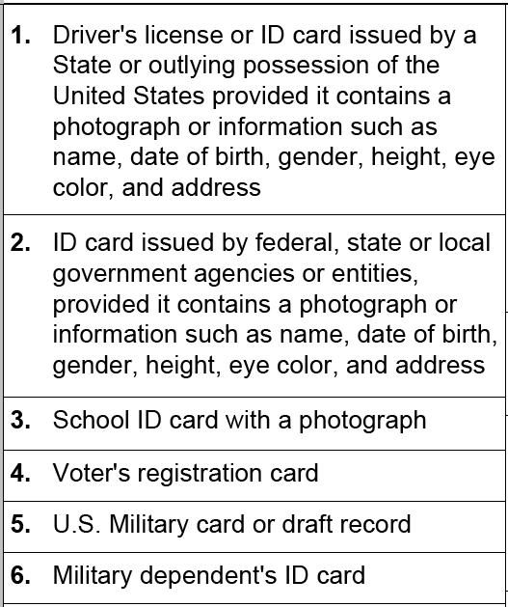
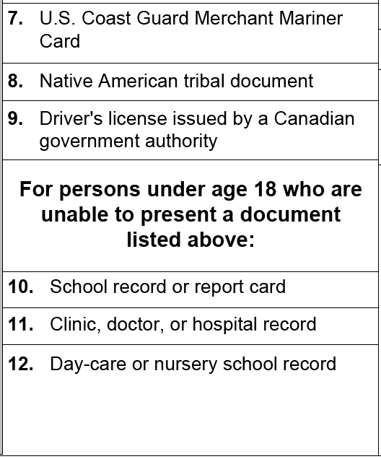
Section 2 – List B: Establish Identity
31

Slide 33
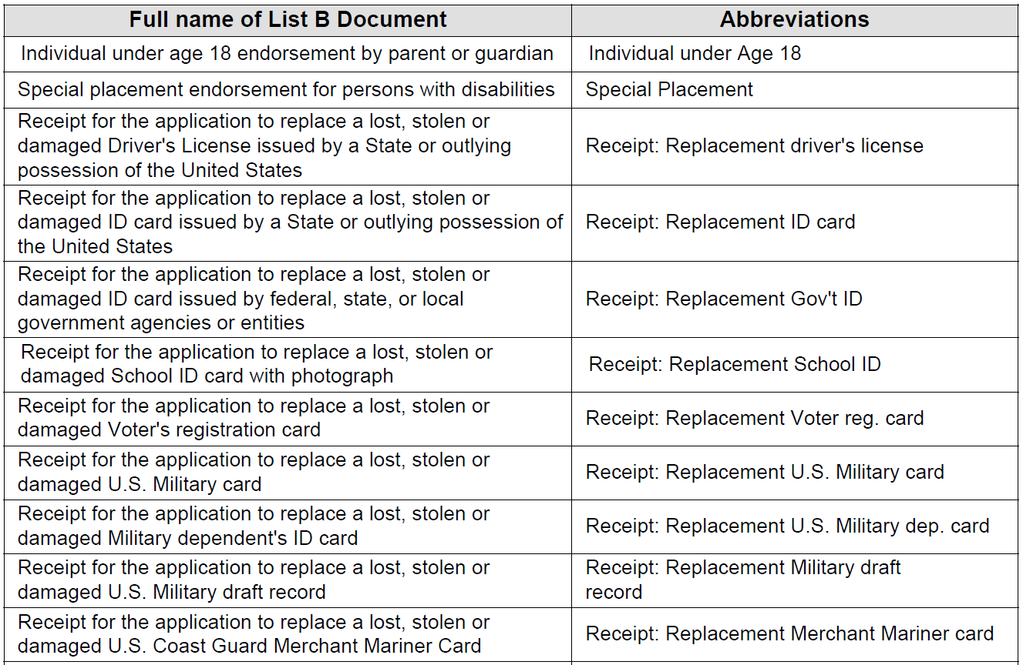
Abbreviations
32

Slide 34
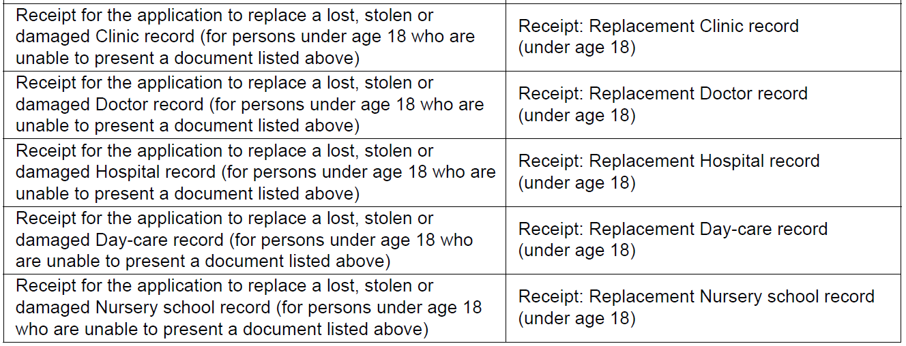
33

Slide 35
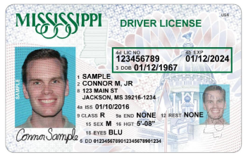
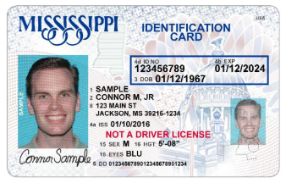
List B: Illustrations
34

Slide 36
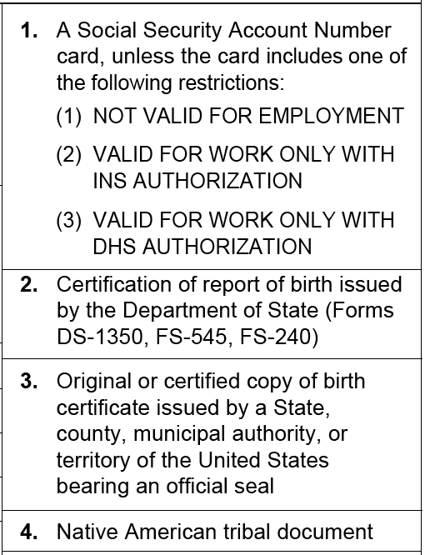
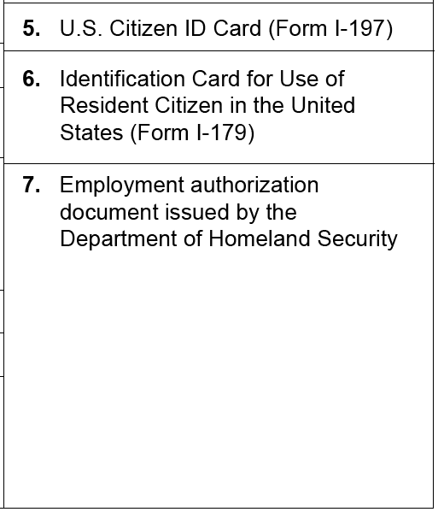
Section 2 – List C: Establish Authorization
35

Slide 37
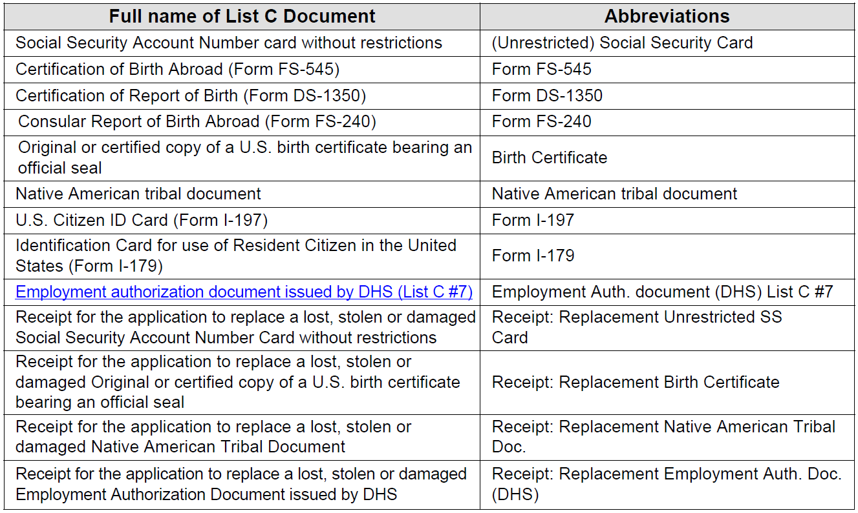
Approved Abbreviations
36

Slide 38
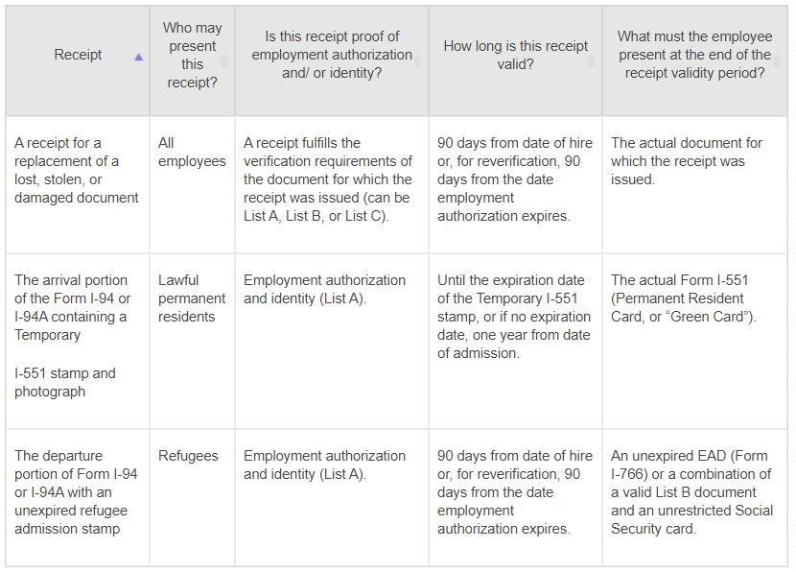
Section 2 – Acceptable Receipts
37

Slide 39
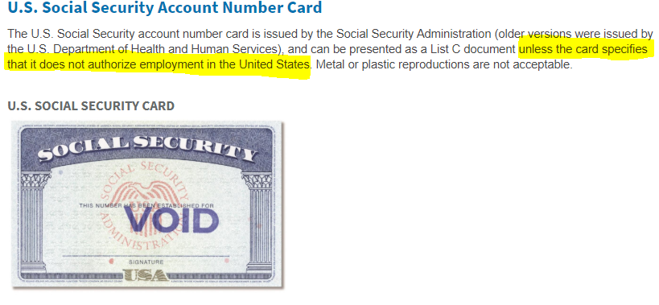
List C: Illustrations
38

Slide 40
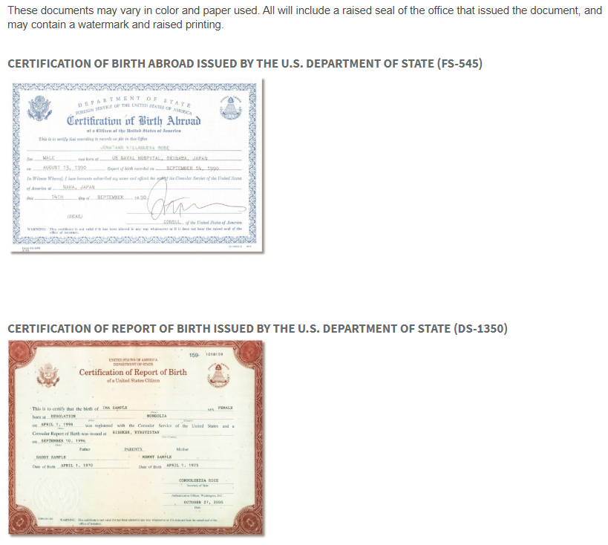
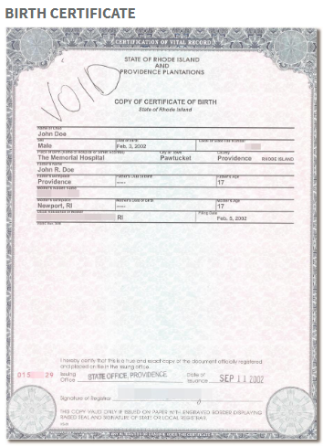
List C: Illustrations
39

Slide 41
Section 2 – Employer Certification
40

Slide 42
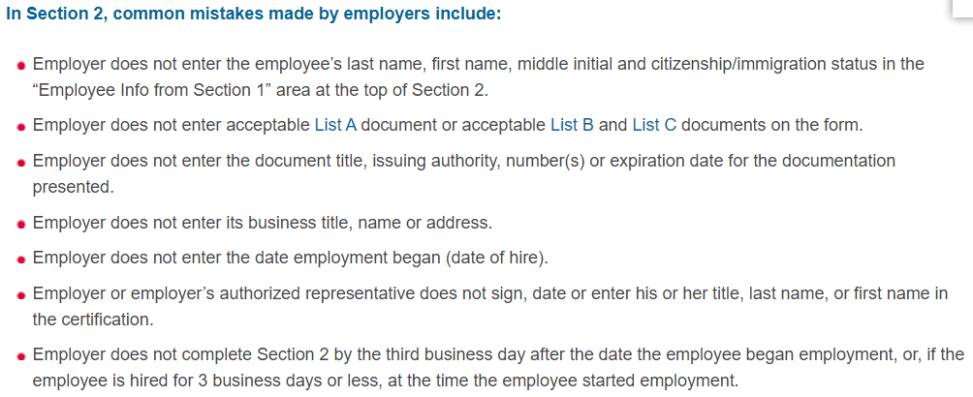
41

Slide 43
Section 3 – Reverification and Rehires
42

Slide 44
Section 3 – Recording Changes of Name
43

Slide 45
44

Slide 46
Correcting Section 2 and 3
The university may only correct errors made in Section 2 or Section 3 of the Form I-9.
The best way to correct the form is to:
• Draw a line through the incorrect information;
• Enter the correct or omitted information; and
• Initial and date the correction or omitted information.
The university should not conceal any changes made on the Form I-9—for example, by erasing text or using correction fluid, nor should the university backdate the Form I-9.
If the university made multiple errors in Section 2 or 3 of the form we may redo the section(s) containing the errors on a new Form I-9, and attach it to the previously completed form.
The university should attach an explanation of the changes made to an existing Form I-9 or the reason a new Form I-9 was completed, and sign and date the explanation.
45

Slide 47
Rules for Correcting Errors or Omissions
To correct the form:
Draw a line through the incorrect information.
Enter the correct information.
Initial and date the correction.
To correct multiple, recording errors on the form, you may redo the section on a new Form I-9 and attach it to the old form. A new Form I-9 can also be completed if major errors (such as entire sections being left blank or Section 2 being completed based on unacceptable documents) need to be corrected. A note should be included in the file regarding the reason you made changes to an existing Form I-9 or completed a new Form I-9.
Be sure not to conceal any changes made on the form (other than simple notation errors when copying document information). Doing so may lead to increased liability under federal immigration law.
If you have made changes on a Form I-9 using correction fluid, we recommend that you attach a signed and dated note to the corrected Forms I-9 explaining what happened.
46

Slide 48
Retention – Retaining the Form I-9 and Copies
The university must retain a Form I-9 for each person hired.
This requirement applies from the date of hire, even if:
the employment ends shortly after hired,
the hired employee never completes work for pay, or
Never finishes the Form I-9.
Retaining copies of documentation:
Departments/SSC are still required to fully complete and retain Form I-9.
If copies are retained, the university must do so for all employees, regardless of actual or perceived national origin or citizenship status, or the university may be in violation of anti-discrimination laws.

Slide 49
Recordkeeping Requirements
Retention Rules
After termination, must retain until
Three years after the date or hire, or
One year after the date of termination whichever is later
Retention Rules Example/Retention Calculator
Hired: 01/16/2013
Left: 01/16/2017
3 years after hire date = 01/16/2016
1 year after term = 01/16/2018
Retain until: 01/31/2018
Ensure the employee is no longer with UCR or UC before destroying the Form I-9.
47

Slide 50
International Students & Scholars
Rules for International Employees

Slide 51
Frequently Asked Questions

Slide 52
What should the university do when it discovers during an internal audit that (1) a Form I-9 for an employee was not completed or is missing, or (2) an entire section on the Form I-9 was left blank?
If a Form I-9 was never completed or is missing, the current version of the Form I-9 should be completed as soon as possible.
If an original Form I-9 exists but either Section 1 or Section 2 was never completed, the employee (for Section 1) or the university (for Section 2) should complete the section as soon as possible.
In both scenarios, the university should not backdate the form, but should clearly state the actual date employment began in the certification portion of Section 2.
The university should attach a signed and dated explanation of the corrective action taken.

Slide 53
May the university complete new Forms I-9 for existing employees whose Forms I-9 do not contain sufficient documentation to meet employment eligibility verification requirements?
The university should staple the completed and signed Section 2 or 3 of the current version of the Form I-9 to the employee’s previous Form I-9, together with a signed and dated explanation of the corrective action taken.
The university should not backdate the Form I-9. The university must give an employee the option to present acceptable documentation of the employee’s choice to bring the Form I-9 into compliance with the INA.

Slide 54
What should the university do when it discovers during an internal audit that (1) a Form I-9 for an employee was not completed or is missing, or (2) an entire section on the Form I-9 was left blank?
If a Form I-9 was never completed or is missing, the current version of the Form I-9 should be completed as soon as possible.
If an original Form I-9 exists but either Section 1 or Section 2 was never completed, the employee (for Section 1) or the university (for Section 2) should complete the section as soon as possible.
In both scenarios, the university should not backdate the form, but should clearly state the actual date employment began in the certification portion of Section 2.
The university should attach a signed and dated explanation of the corrective action taken.

Slide 55
What should the university do if an internal audit reveals that the wrong version of the Form I-9 was completed?
As long as the Form I-9 documentation presented was acceptable under the Form I-9 rules that were current at the time of hire, the employer may correct the error by stapling the outdated completed form to a blank current version, and signing the current blank version noting why the current blank version is attached (e.g., wrong edition was used at time of hire).
In the alternative, the university may draft an explanation and attach it to the outdated completed Form I-9 explaining that the wrong form was filled out correctly and in good faith.

Slide 56
How should the university determine during an internal audit whether documentation presented for Section 2 of the Form I-9 met employment eligibility verification requirements?
Documentation presented for Section 2 of the Form I-9 is sufficient as long as the documentation was acceptable under the requirements of the Form I-9 in effect at the time the Form I-9 was completed.
As the Lists of Acceptable Documents have changed over the years, the university should not assume documentation in Section 2 of the Form I-9 is insufficient simply because it does not satisfy current Form I-9 rules or appear on the Lists of Acceptable Documents currently in effect.

Slide 57
What information should the university communicate to employees before and during an internal audit?
It is recommended that university develop a transparent process for interacting with employees during any internal audit.
This includes informing the employees in writing that the university will conduct an internal audit of Forms I-9, explaining the scope and reason for the internal audit, and stating whether the internal audit is independent of or in response to a government directive (which it is).
When a deficiency is discovered in an employee’s Form I-9, the university should notify the affected employee, in private, of the specific deficiency.

Slide 58
Resources
Guidance for Employers Conducting Internal Employment Eligibility Verification Form I-9 Audits
https://www.justice.gov/crt/file/798276/download
UCR Policy – Employment Eligibility (Form I-9) 650-28
https://fboapps.ucr.edu/policies/index.php?path=viewPolicies.php&policy=650-28
International Students and Scholars
https://international.ucr.edu/studentsandscholars
U.S. Citizenship and Immigration Services (USCIS) – Handbook for Employers M-274
https://www.uscis.gov/en/book/toc/59502

Slide 59
Contacts
Magid Shirzadegan – International Student and Scholars
Director of International Students & Scholars
E-mail: magid.shirzadegan@ucr.edu
(951) 827-4117
Mary White – Human Resources
Principal HR Policy and Communications Analyst
E-mail: hrpolicy@ucr.edu
(951) 827-2622

