Slide 1
Ucr ucpath transaction pilot
Ucpath Phase ii summary Review

Slide 2

TRAINER INTRODUCTION
LaKesha Welch, Alexandra Rollins, Antonette Toney
Department: UCPath Campus Support Center

Slide 3
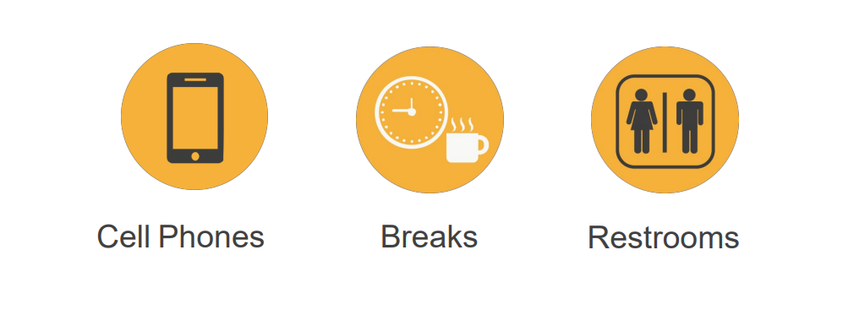
HOUSEKEEPING

Slide 4
LEARNING OBJECTIVES
Understand how to transact in UCPath with each process
Understand key things when transacting within each process
Understand the policy of each process
Insert Learning Objective Review Topic Here

Slide 5
Involuntary Termination Policies

Slide 6
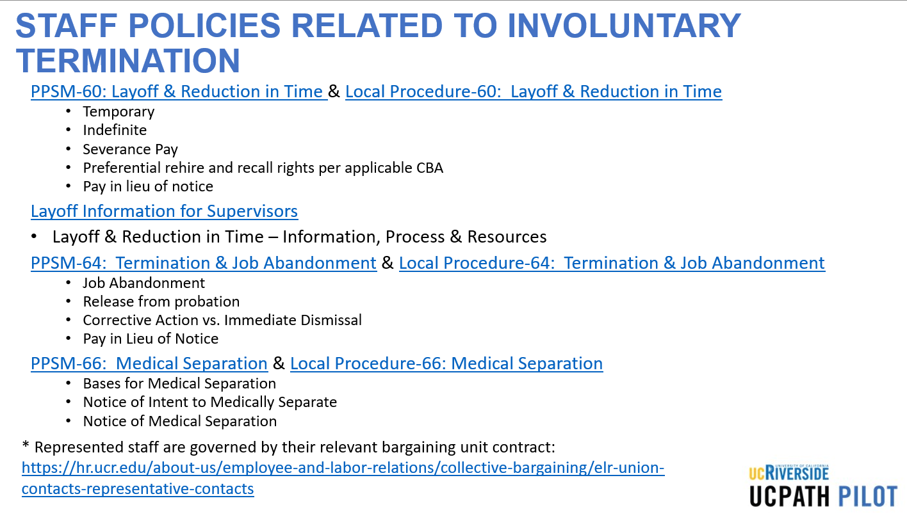
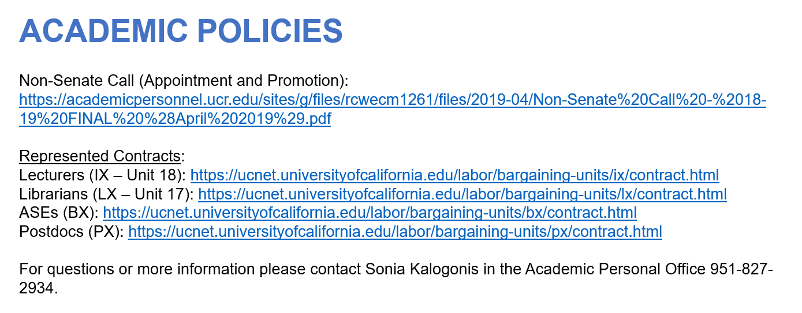
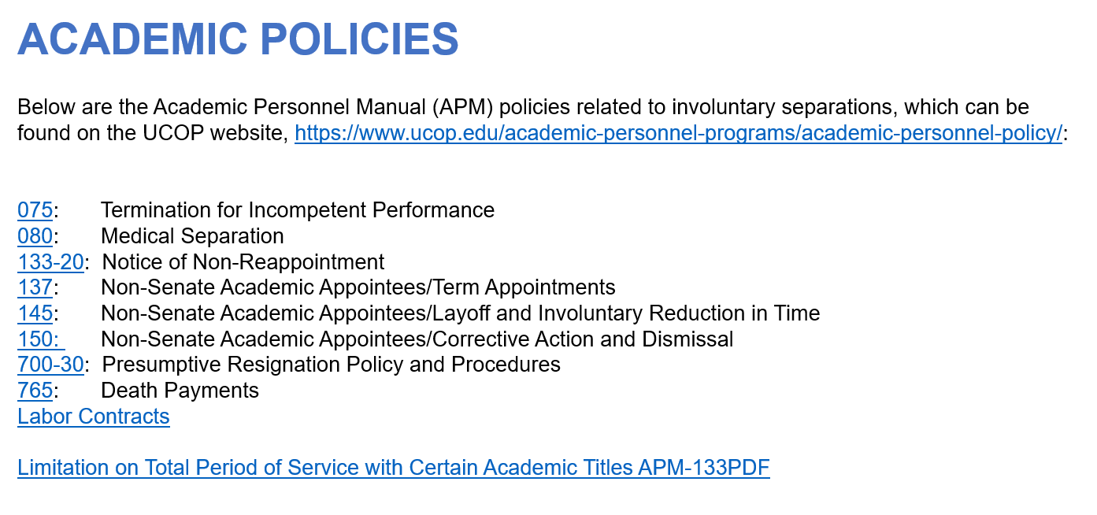
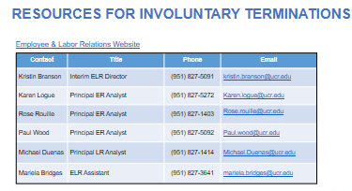
POLICIES RELATED TO INVOLUNTARY TERMINATION

Slide 7
Involuntary Termination Transactions

Slide 8

INVOLUNTARY TERMINATION CHECKLIST REVIEW

Slide 9
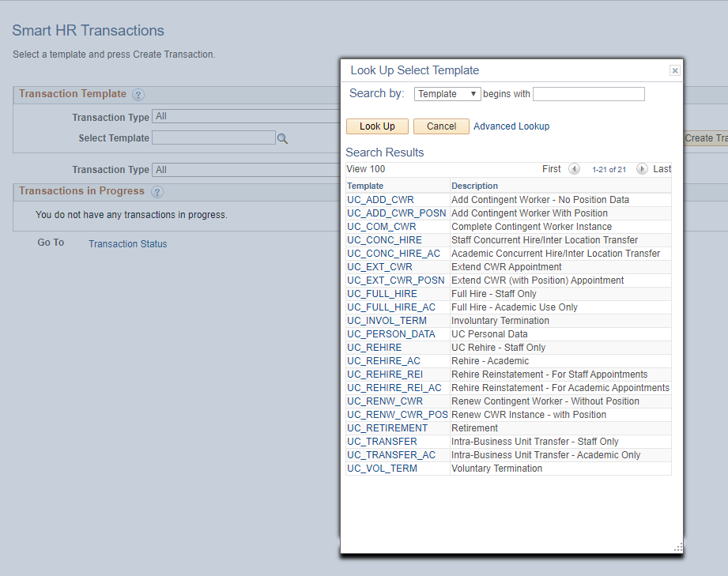
SELECTING THE CORRECT TEMPLATE
Navigation: PeopleSoft Menu > Workforce Administration > Smart HR Template > Smart HR Transactions
There are two templates available for terminations Involuntary and Voluntary, make sure to choose the correct one.
Notes:
Screen shot of the involuntary term form

Slide 10
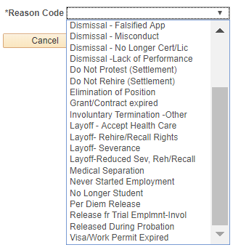
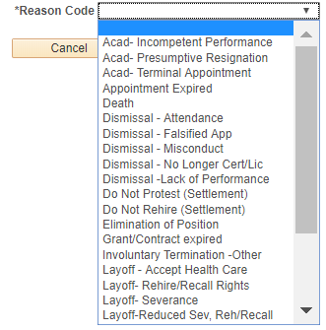
TRANSACTIONS PAGE – REASON CODES
Navigation: PeopleSoft Menu > Workforce Administration > Smart HR Template > Smart HR Transactions
Enter the details for the termination, and be sure to select the appropriate Reason Code.
Select the correct Employee ID and Employment Record Number for the job to terminate. If the employee has multiple assignments, submit a termination template for all jobs, as necessary.

Slide 11

FINAL PAY
If in a represented position, your final paycheck is processed within 72 hours from when UCPath Center receives request for issuance of final payment. All other positions will be paid on the next on cycle paycheck once UCPath Center receives request for issuance of final payment.

Slide 12


THINGS TO REMEMBER WHEN TRANSACTING
If termination is due to death, only one termination template should be initiated. UCPC WFA Production will terminate all other UC Jobs for the employee.
Shared Service Centers will continue to transact for final pay. Final Pay should be submitted for any employee.
The template does not require any documentation to be added but it is recommended to attach any HR documentation you may have.
The Last Date Worked automatically populates with a date that is one day prior to the Effective Date. The Last Date Worked field can be changed, if needed; however, the Last Date Worked must be prior to the Effective Date. If the Last Date Worked was not the day prior you MUST change the date to what the last day was.

Slide 13
RESOURCES
Resource material regarding how to transact within UCPath for Involuntary Termination is located here please utilize these documents as a reference for how to transact.
Involuntary Termination:
View Person Organizational Summary
Initiate Involuntary Termination Template Transaction
Involuntary Termination Infographic
Involuntary Termination Process Workbook
Involuntary Termination Process Map

Slide 14

QUESTIONS
Pilot Unit are you prepared to initiate Involuntary Termination Templates and if not what else do you need to be successful?
SSC’s are you prepared to approve Involuntary Termination Templates, if not what else do you need to be successful?
Are there any other questions comments of feedback or things we need to cover or review for involuntary terminations in time for an 11/5/19 Go-Live?

Slide 15
Onboarding Policies for EMPL Class 5, 9 and 10

Slide 16
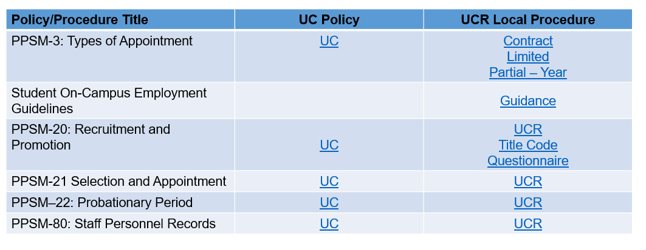
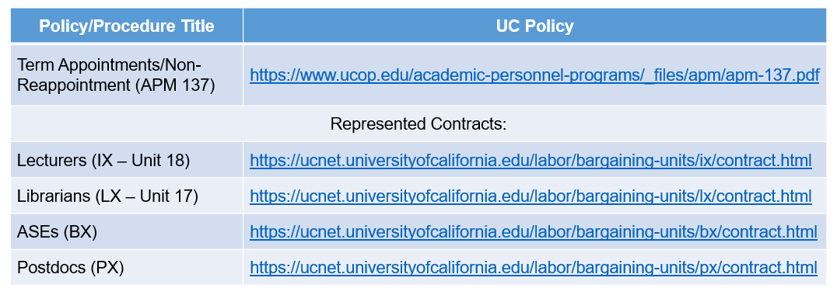
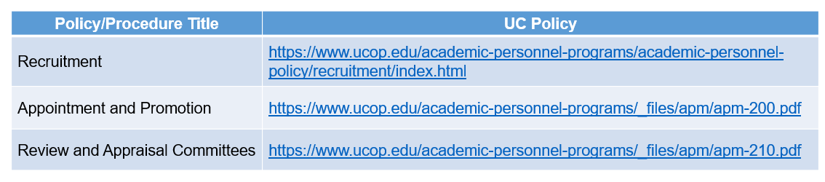
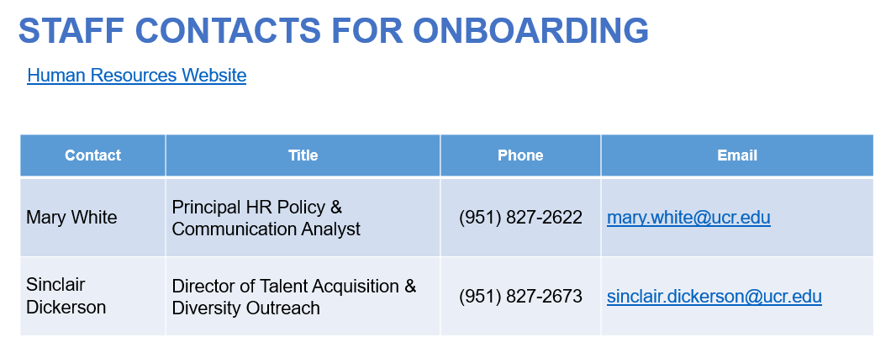
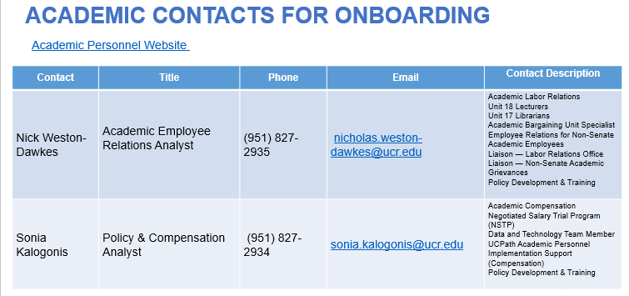
POLICIES RELATED TO ONBOARDING
Staff
Academic

Slide 17
Onboarding EMPL Class 5, 9 and 10 Transactions

Slide 18
ONBOARDING CHECKLIST REVIEW

Slide 19
SELECTING THE CORRECT TEMPLATE
Navigation: PeopleSoft Menu > Workforce Administration > Smart HR Template > Smart HR Transactions
There is a template specific to academic and another specific to staff. For example:
  UC Full Hire - Staff Only
  UC Full Hire - Academic Use Only
Phase II Includes Onboarding for the following EMPL classes:
  5 – Student: Casual/Restricted
  9 – Academic: Faculty
  10 – Academic: Non Faculty
The following are out of scope for Phase II:
  All other EMPL classes
  Inter/Intra Campus Transfers

Slide 20
SELECTING THE CORRECT TEMPLATE
Navigation: PeopleSoft Menu > Workforce Administration > Smart HR Template > Smart HR Transactions
Use the UC_FULL_HIRE templates to create a new record for an employee who receives compensation through UCPath Payroll processing
Use the UC_CONC_HIRE template when a staff or academic employee needs to add an additional job, which is concurrent to his or her existing job with UC.
Use the UC_REHIRE templates to rehire a previous UC employee from the same business unit (BU).
Notes:
The Rehire template can be used when there is an existing employee record within the same BU.
If the employee’s only terminated employee record is at a different BU, you must use the HIRE template with the appropriate rehire reason code.

Slide 21
EMPL CLASSES COMMON ATTRIBUTES
EMPL Class 5 Student: Casual/Restricted | EMPL Class 9 Academic: Faculty | EMPL Class 10 Academic: Non Faculty
Hourly, paid through TARS biweekly Less than 50% during academic year Placed on short work break over the summer (sometimes) Non-exempt They don’t have benefits Some are paid in recurring additional pay with no compensation on job | They are placed on Reserved Abeyance (RES ABY) only if they have a concurrent 100% faculty administrative appointment Monthly Exempt Eligible for full benefits Not all are eligible for benefits because it depends on their percentage and number of hours Ladder Faculty Lectures Instructional Faculty | Eligible for Short Work Break per the (SWB) matrix Most are monthly and some are hourly Mostly 5AC (Academic Compensation) 5MH group (Monthly hourly) Eligible for Benefits This depends on FTE and length of the appointment. (Eligibility Guidelines Link)

Slide 22
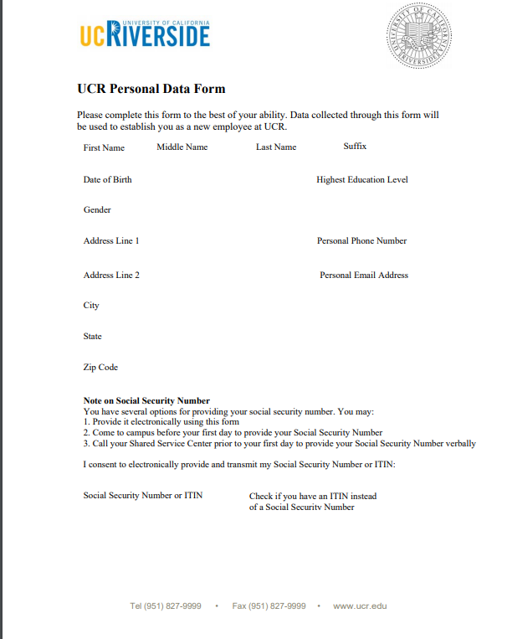
PREHIRE PROCESS
The Transactional Unit will obtain additional information through the UCR Personal Data From and update the template by initiating a Personal Data Change template. To update the Oath Signature the Transactional Unit Initiator will do it through the Person Profile page.
Getting more information per the Hand Off course discussion

Slide 23
PREHIRE PROCESS - PERSON PROFILE
Navigation: PeopleSoft Menu > Workforce Development > Profile Management > Profiles > Person Profile
The Person Profile component contains several tabs that store a variety of information about an employee.
Transactional Unit Initiators can view and update information in the Person Profile component for employees for which they have security access
Person Profile Information Examples
  Honors and Awards
  Licenses and Certificates
  Degrees
  UC Specialty Codes
  UC Prior Service Code
  UC Separation Destination Code
  Oath & Patent Signature Dates
  Multi-Location Agreements
  UC Student Status
  Credit Card
  Employment Verification
  UC I-9 Information

Slide 24
THINGS TO REMEMBER WHEN TRANSACTING
If you are processing a Prehire, remember to start the template prior to the in-person session to get the NetID. The SSC is responsible for conducting the in-person onboarding meeting and sending the Employee Onboarding Packet.
Each template will have 5 tabs, be sure to cycle through all five tabs prior to submitting.
Always check the Person Organizational Summary Page, downstream impacts can occur if an employee has a prior EMPL record that is not factored in during the hire process.
Recurring additional pay can be processed on the hire template but:
  This often gets dropped by UCPC during the processing of the hire template because it is a manual entry processed by UCPC.
  The recommendation is to wait until the hire template has been completed by UCPC and enter or key the recurring additional pay via PayPath.

Slide 25
RESOURCES
Resource material regarding how to transact within UCPath for Onboarding is located here please utilize these documents as a reference for how to transact.
Onboarding:
View Person Organizational Summary
Initiate Concurrent Hire Template Transaction (Academic)
Initiate Concurrent Hire Template Transaction (Staff)
Initiate Concurrent Hire Template Transaction (Academic)
Initiate Concurrent Hire Template Transaction (Staff)
Initiate Full Hire Template Transaction (Academic)
Initiate Full Hire Template Transaction (Staff)
Initiate Rehire Template Transaction (Academic)
Initiate Rehire Template Transaction (Staff)

Slide 26
QUESTIONS
Pilot Unit are you prepared to initiate Onboarding Templates and if not what else do you need to be successful?
SSC’s are you prepared to approve Onboarding Templates, if not what else do you need to be successful?
Are there any other questions comments of feedback or things we need to cover or review for involuntary terminations in time for an 11/5/19 Go-Live?

Slide 27
PayPath Policies for EMPL Class 5, 9 and 10

Slide 28
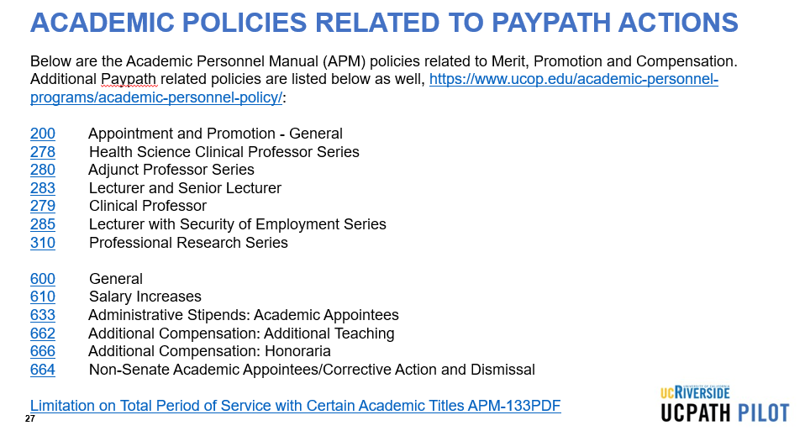
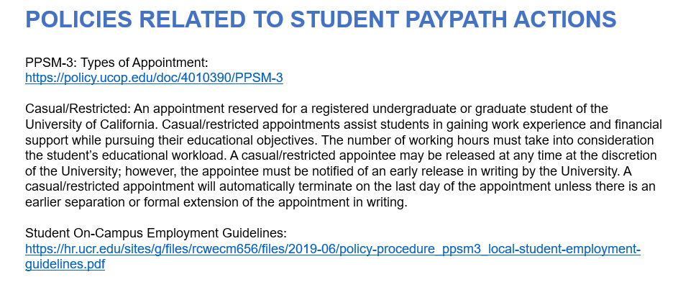
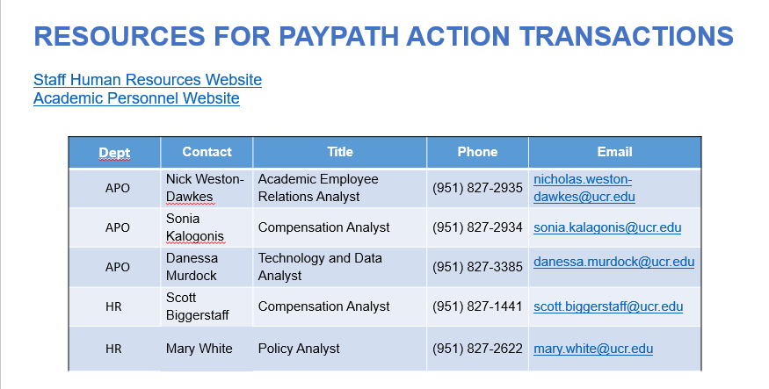
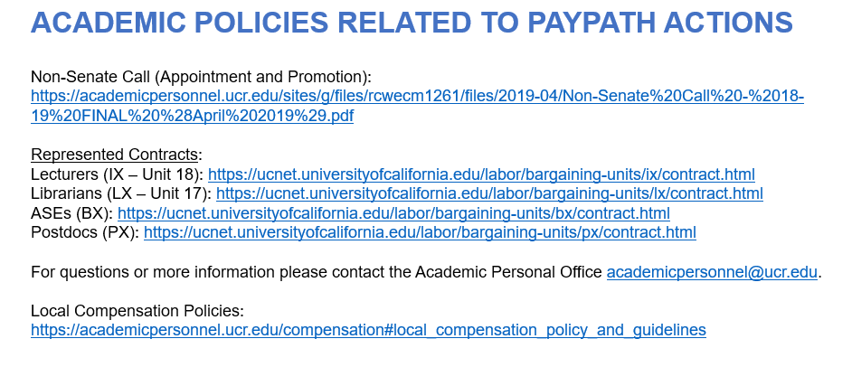
ACADEMIC POLICIES RELATED TO PAYPATH ACTIONS

Slide 29
PayPath EMPL Class 5, 9 and 10 Transactions

Slide 30
PAYPATH CHECKLIST REVIEW

Slide 31
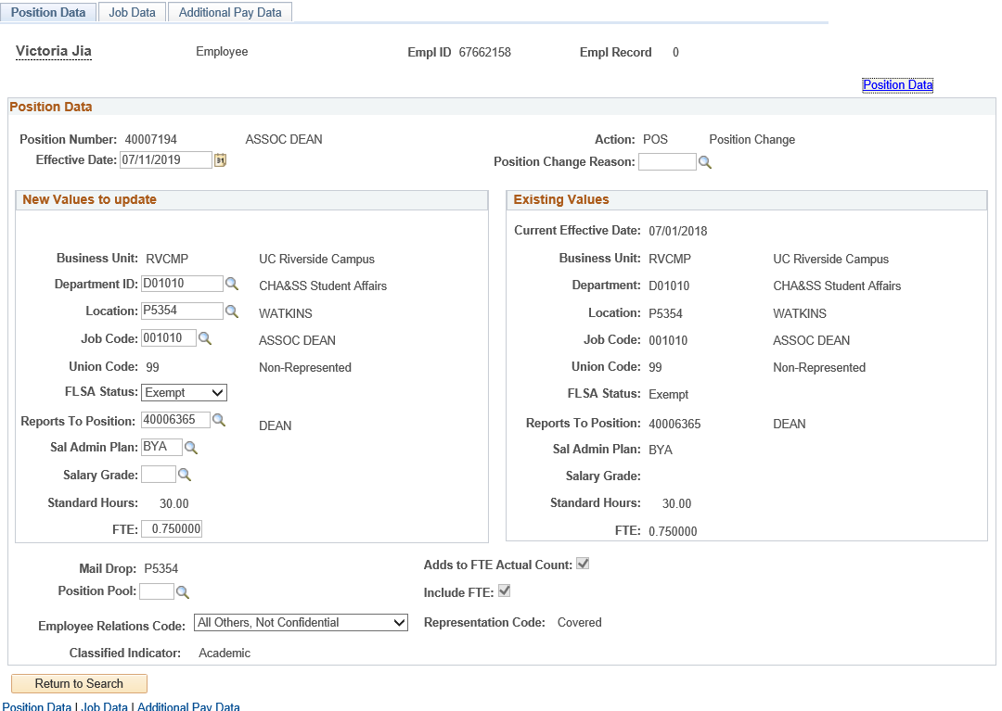
PAYPATH TRANSACTION
Navigation: PeopleSoft Menu > UC Customizations > UC Extensions > PayPath Actions
The PayPath Actions component is comprised of three pages: Position Data, Job Data, and Additional Pay Data.

Slide 32
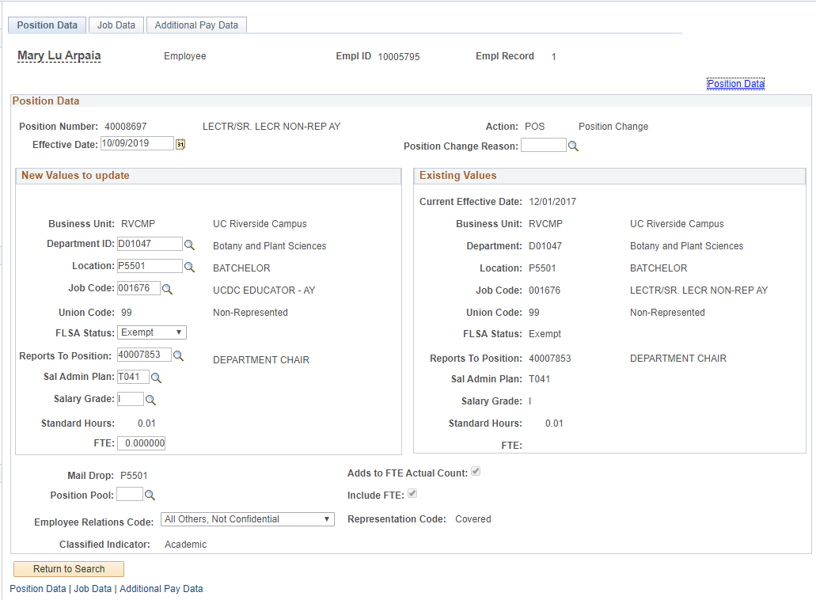
TRANSACTION PAGE - POSITION DATA PAGE
Navigation: PeopleSoft Menu > UC Customizations > UC Extensions > PayPath Actions
For Position Data Changes, the Action is always the same: POS. You need to complete only the Position Change Reason.
Use the Position Data page to enter changes to position data.
You must enter the Effective Date and the Position Change Reason fields before entering the update.
The Effective Date cannot be the same date as any existing effective date for the employee in the Position Information component. This is because there is no effective date sequencing for position information. Use the Position Data link to review employee position information including existing effective dates.
Position information updated on this page also updates the Job Data page.

Slide 33
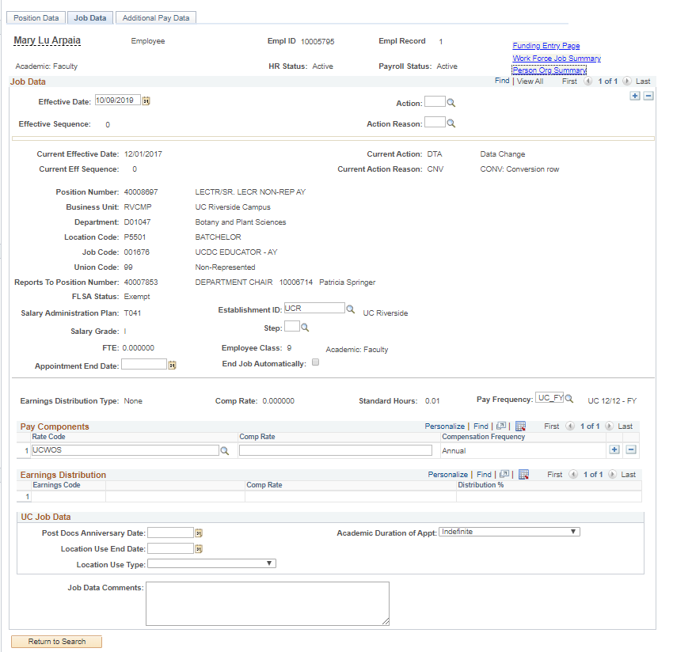
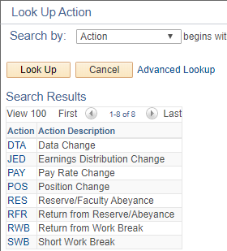
TRANSACTIONS PAGE - JOB DATA PAGE
Navigation: PeopleSoft Menu > UC Customizations > UC Extensions > PayPath Actions
Action Reason Codes
Use the Job Data page to enter updates to job-related data such as pay, earnings distribution, and short work break.
You must enter the Effective Date and the Action and Action Reason fields before entering an update.
Tip: Click + to add multiple job data changes in the same transaction. Multiple changes can be entered only for the same Effective Date.
Notes:
Use the Job Data page to enter updates to job-related data such as pay, earnings distribution and short work break.
You must enter the Effective Date and the Action and Action Reason fields before entering an update.

Slide 34
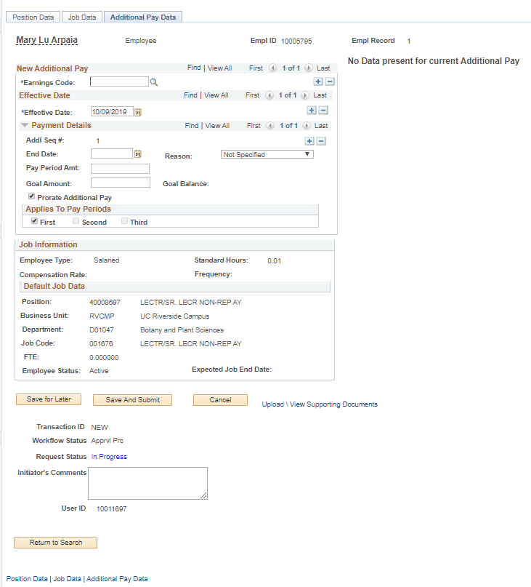
TRANSACTION PAGE - ADDITIONAL PAY DATA PAGE
Navigation: PeopleSoft Menu > UC Customizations > UC Extensions > PayPath Actions
Enter the Earnings Code, Effective Date, and Pay Period Amount.
Use the PayPath Actions Additional Pay Data page to enter specific information about the payment.
Ignore Goal Amount and Prorate Additional Pay.

Slide 35
EMPL CLASSES
EMPL Class 5 Student: Casual/Restricted | EMPL Class 9 Academic: Faculty | EMPL Class 10 Academic: Non Faculty
Hourly, paid through TARS biweekly Less than 50% during academic year Placed on short work break over the summer (sometimes) Non-exempt They don’t have benefits Some are paid in recurring additional pay with no compensation on job | They are placed on Reserved Abeyance (RES ABY) only if they have a concurrent 100% faculty administrative appointment Monthly Exempt Eligible for full benefits Not all are eligible for benefits because it depends on their percentage and number of hours Ladder Faculty Lectures Instructional Faculty | Eligible for Short Work Break per the (SWB) matrix Most are monthly and some are hourly Mostly 5AC (Academic Compensation) 5MH group (Monthly hourly) Eligible for Benefits This depends on FTE and length of the appointment. (Eligibility Guidelines Link)

Slide 36
THINGS TO REMEMBER WHEN TRANSACTING
PayPath only pulls up and allows for transacting on active jobs/employees
The Position and Job Data Changes entered in PayPath must have the same effective date.
A Job has to have an end date extended, before a secondary transaction can be entered.
Position Data changes in PayPath Actions can be initiated for filled positions where only one employee is assigned to the position
If a Positon Data change is made, PayPath automatically updates the employee’s Job Data page to display the new position information.

Slide 37
THINGS TO REMEMBER WHEN TRANSACTING
PayPath Actions is a component that contains a subset of fields on Position and Job Data and is a clone of the “Recurring Additionall Pay” page
There are two PayPath Actions components: One for Staff and one for Academic
Most PayPath changes commit to database after approval
There are two types of additional pay transactions:
  One time – applies to a single pay cycle or non-consecutive pay cycles.
  Recurring – payments are paid over multiple, consecutive pay periods.
Additional pay transactions entered in PayPath are routed for approvals and then transferred to a Payroll staging table to be processed automatically by UCPC Payroll

Slide 38
THINGS TO REMEMBER WHEN TRANSACTING
Make sure to monitor the end date using the job record end date monitoring report. If the appointment is not automatically terminated it will result in an overpayment.
If you have changes that fall on different effective dates, you must enter a separate PayPath transaction for each effective date. Also, you must wait until the first PayPath transaction has completed the approval process before entering the next transaction
Exception for Additional Pay Data:
  You can enter multiple Effective Dates for Additional Pay Data transactions.
After approval, confirm what was initiated and approved is actually reflected in PayPath
Retroactive dating is available for additional Pay. In the Effective Date field, enter the previous pay period date that the additional pay should have started.

Slide 39
RESOURCES
Resource material regarding how to transact within UCPath for PayPath is located here please utilize these documents as a reference for how to transact.
PayPath:
View Person Organizational Summary
Action Reason Code and Descriptions (Academic)
Action Reason Code and Descriptions (Staff)
PayPath Job Aids
PayPath Infographic
PayPath FLSA Infographic
PayPath Process Workbook
PayPath Process Map

Slide 40
QUESTIONS
Pilot Unit are you prepared to initiate PayPath Transactions and if not what else do you need to be successful?
SSC’s are you prepared to approve PayPath Transactions, if not what else do you need to be successful?
Are there any other questions comments of feedback or things we need to cover or review for involuntary terminations in time for an 11/5/19 Go-Live?

Slide 41
Mass PayPath Transactions

Slide 42
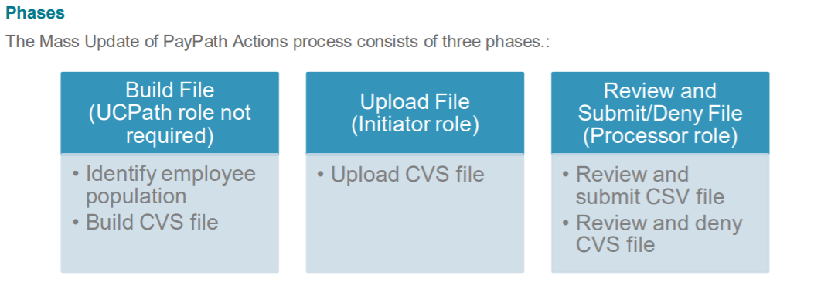
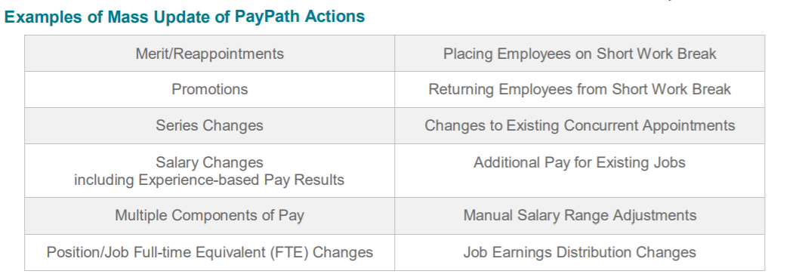
MASS PROCESSING OVERVIEW
Mass Update of PayPath Actions is a custom process in UCPath for University of California (UC) Locations to facilitate mass data changes for Academic and Staff personnel with regard to position, job, compensation and additional pay.
Pilot Unit
CSC
CSC

Slide 43
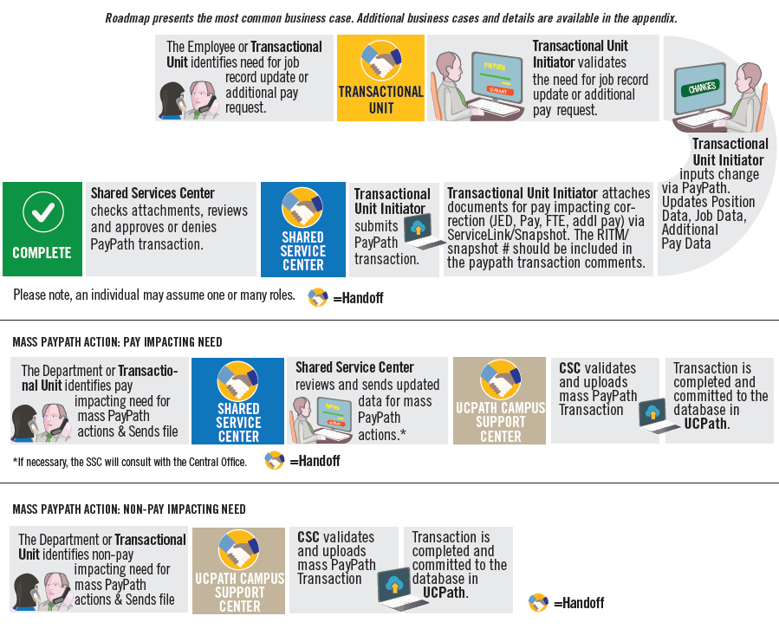
MASS PROCESSING HIGH LEVEL OVERVIEW

Slide 44
MASS PROCESSING ATTRIBUTES
Contingent Workers can be processed via the Mass PayPath upload. There is a specific template for CWR with a position.
Mass PayPath cannot be used for terminations
Must keep file format as CSV
Commas, spaces, dashes or slashes cannot be used in the CSV file
The Mass PayPath file must be saved in the below format
  CSV file using the naming convention
  BusinessUnit_E081_MASSUPDATEPAYPATH_YYYYMMDD.
  Example: RVCMP_E081_MASSUPDATEPAYPATH_20191016.

Slide 45
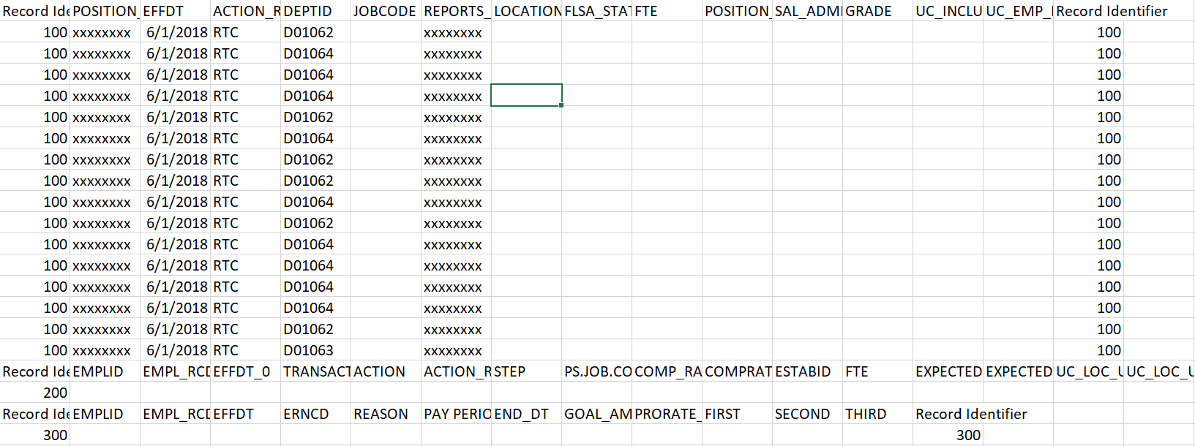
MASS PROCESSING – REPORTS TO CHANGE (RTC)

Slide 46
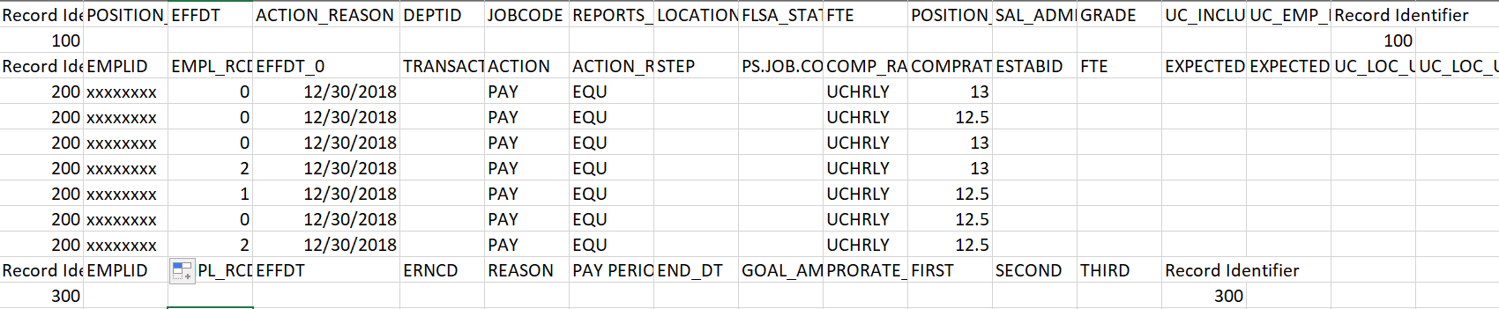
MASS PROCESSING – PAY RATE UPDATE (PAY/EQU)

Slide 47
THINGS TO REMEMBER WHEN TRANSACTING
Mass PayPath upload is a faster way to transact for multiple transactions of the same kind.
40 Mass updates are the equivalent to 40 separate transactions WITHOUT having to key each in the system one by one
Mass updates can be pay or non pay impacting
Instructions must be followed exactly to avoid any fall outs

Slide 48
RESOURCES
Resource material regarding how to transact within UCPath for Mass Processing is located here please utilize these documents as a reference for how to transact.
Mass Processing:
Job Aid: Complete the CSV File Template for PayPath Actions
Mass Paypath upload template

Slide 49
QUESTIONS
Pilot Unit are you prepared to initiate Mass Processing Transactions and if not what else do you need to be successful?
SSC’s are you prepared to approve Mass Processing Transactions, if not what else do you need to be successful?
Are there any other questions comments of feedback or things we need to cover or review for involuntary terminations in time for an 11/5/19 Go-Live?

Slide 50
Payroll and Pay Impacting Concepts

Slide 51
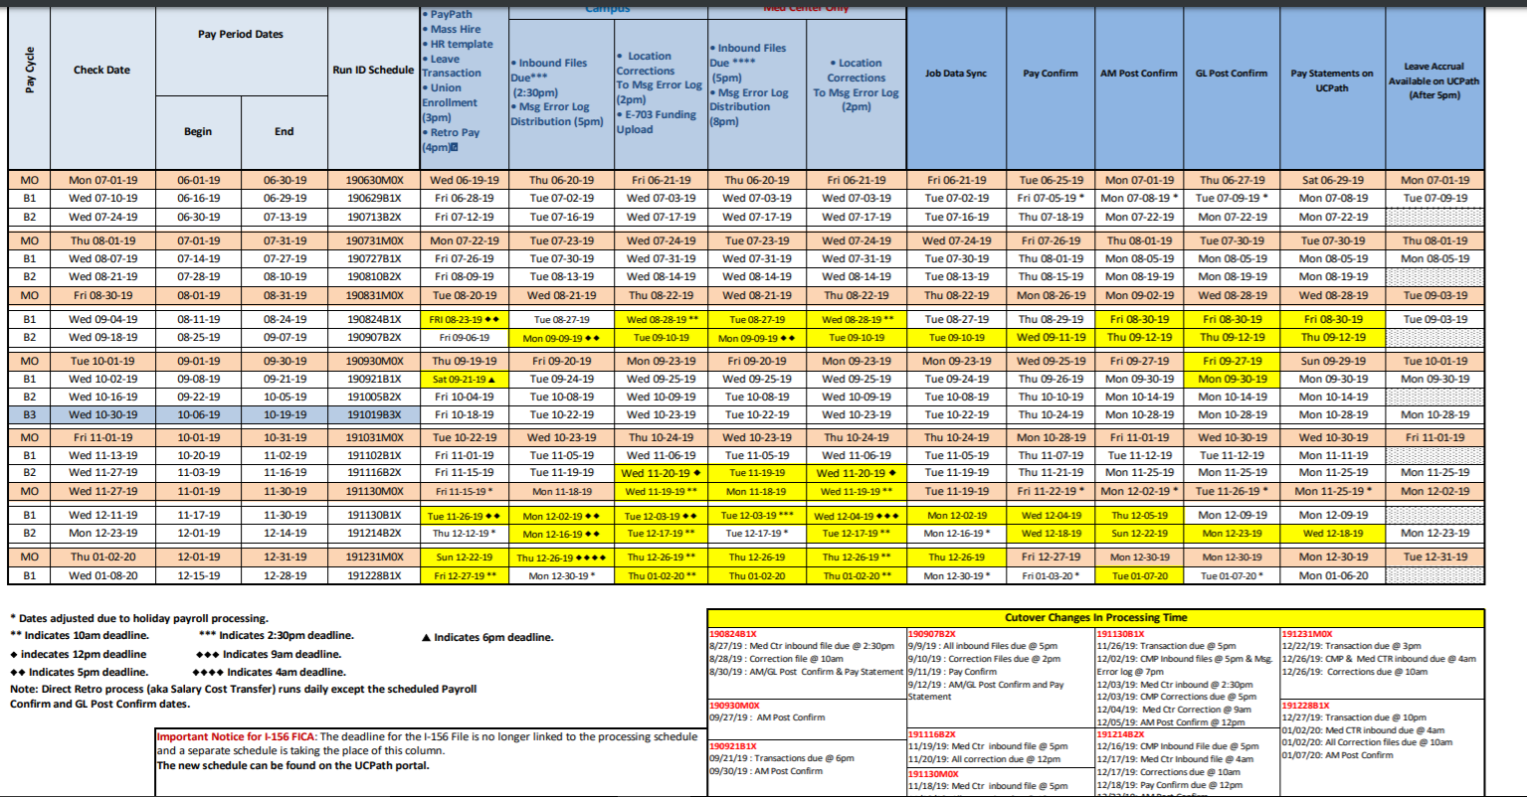
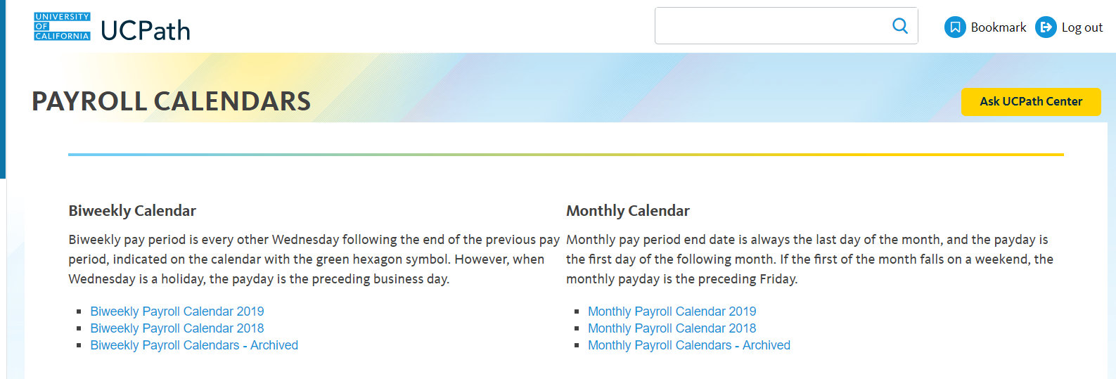
TRANSACTION PAGE
SCHEDULES & CALENDARS IN UCPATH PORTAL
Reminder: Please keep in mind SSC & UCPC SLA for all Phase II transactions
Navigation to Payroll Processing Schedules
UCPath Portal > Quicklinks > Payroll Calendars & Schedules > Payroll Processing Schedules
Navigation to Payroll Calendars
UCPath Portal > Quicklinks > Payroll Calendars & Schedules > Payroll Calendars
Pay mitigations

Slide 52
THINGS TO REMEMBER WHEN TRANSACTING
Payroll Deadlines are enforced by the UCPath Center for all UC Locations.
Payroll Deadlines cannot be moved or rescheduled by locations.
Monthly-paid and Biweekly-paid employee populations are processed in separate Payroll instances and adhere to different Payroll Processing deadlines.
The UCPath Center Publishes a new Payroll Schedule for the year in the UCPath Portal.
The UCPath Payroll Processing Schedule is subject to change throughout year.

Slide 53
THINGS TO REMEMBER
FTE, FLSA, Salary Admin Plan, Grade and Step are pay impacting fields updated by location
Pay group is a pay impacting field that is updated by UCPC
Paypath and Self service links are the best methods for processing additional pay
Leave accruals are available in UCPath after AM post confirm process runs at the end of the month
Leave takes are reported in arrears, so the takes will not be reflected in
  UCPath until the following accrual run

Slide 54
RESOURCES
Link to 2019 UCPath Payroll Processing Schedule
Link to 2019 Biweekly Payroll Calendar
Link to 2019 Monthly Payroll Calendar
Link to UCR Payroll Calendars and Schedules
  Note: these calendars are based on UCPath Payroll Processing Schedule.

Slide 55
QUESTIONS
Pilot Unit are you prepared to initiate Payroll Transactions and if not what else do you need to be successful?
SSC’s are you prepared to approve Payroll Transactions, if not what else do you need to be successful?
Are there any other questions comments of feedback or things we need to cover or review for involuntary terminations in time for an 11/5/19 Go-Live?

Slide 56
Approval Workflow Engine (AWE)

Slide 57
APPROVAL WORKFLOW ENGINE (AWE) CHECKLIST REVIEW

Slide 58
What is AWE?
AWE is the UCPath functionality that routes transactions for review and approval.
The AWE process ensures the appropriate users review and approve transaction.
Location Approver options include:
Approve
Deny

Slide 59
What to Approve!
Properly formed valid transaction
  Correct action reason code used
  All required fields have been completed
Approved personnel transaction accurately entered into the template
  Review attachments and/or comments
  Effective date is correct
Approve

Slide 60
What to DENY!
Required fields are incomplete
Incorrect reason action reason code used
Missing attachments
Incorrect effective date
Information on template does not match transaction
The transaction does not match what is stated in comments
Deny

Slide 61
Phase II AWE Approvals
Phase II approvals will be completed by designated Transaction unit approvers
AWE Approvals
Contingent Worker (CWR)
Personal Data
Voluntary Termination
One Time Pay

Slide 62
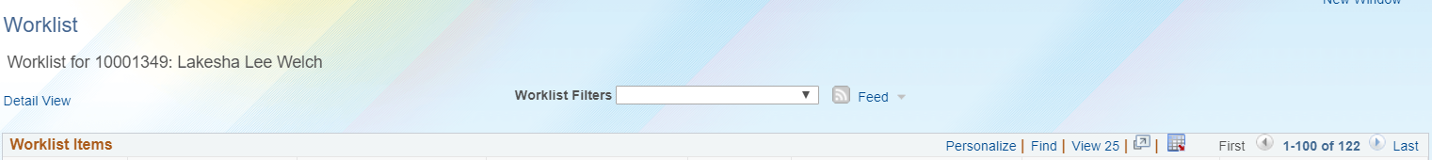

CONTINGENT WORKER
Navigation: PeopleSoft Menu > Worklist > Worklist
This example shows the worklist with a pending approval for Contingent Worker request.
LaKesha Welch
Click the link to review transaction to approve or deny.

Slide 63
VOLUNTARY TERMINATION & PERSONAL DATA
Navigation: PeopleSoft Menu > Worklist > Worklist
This example shows the worklist with a pending approval for Voluntary Termination and Personal Data request.
LaKesha Welch
LaKesha Welch
Click the link to review transaction to approve or deny.
LaKesha Welch

Slide 64
ONE TIME PAY
Navigation: PeopleSoft Menu > Worklist > Worklist
This example shows the worklist with a pending approval for One Time Pay request.
Click the link to review transaction to approve or deny.

Slide 65

THINGS TO REMEMBER WHEN TRANSACTING
When approving be sure the transaction is: Properly formed valid transaction and Approved personnel transaction accurately entered into the template.
Sorting and CTRL + F are best to manage and search for pilot transactions pending approval
Notifications will be received for ALL transactions in your Dept/ORG. Remember sorting and searching by transactor name to approve pending transactions will be key to managing approvals
It takes 4 clicks to approve a template and 1 click to approve One time pay
3 Places to approve templates: Worklist, email notifications and SS Smart HR Transactions
3 place to approve One time payments: Worklist, email notifications and Approve One-Time Payments

Slide 66
QUESTIONS
Pilot Unit are you prepared to initiate Template Transactions and if not what else do you need to be successful?
SSC’s are you prepared to approve Phase 1 Template Transactions, if not what else do you need to be successful?
Are there any other questions comments of feedback or things we need to cover or review for involuntary terminations in time for an 11/5/19 Go-Live?

Slide 67
On Behalf of Case Management Overview

Slide 68
HOW TO COMPLETE JOB & POSITION UPDATE FORMS
Locate the forms on the portal.
Review the form to ensure you have all the required information for the type of Position or Job Data update.
Review the form to ensure you have all the required information for the type of Position or Job Data update.
Open an On Behalf of case for the employee the update is occurring for.
Attach the form to the case and submit to UCPC for processing.
Ensure to follow up on any UCPC response for more information or clarification to avoid case cancelation.

Slide 69
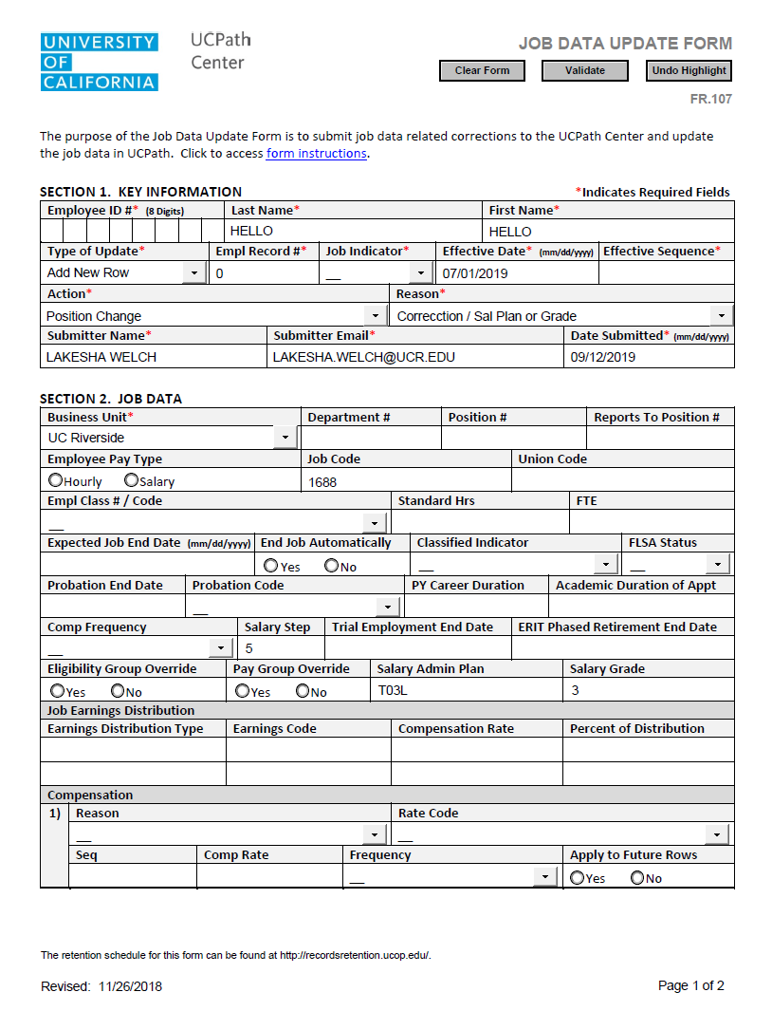
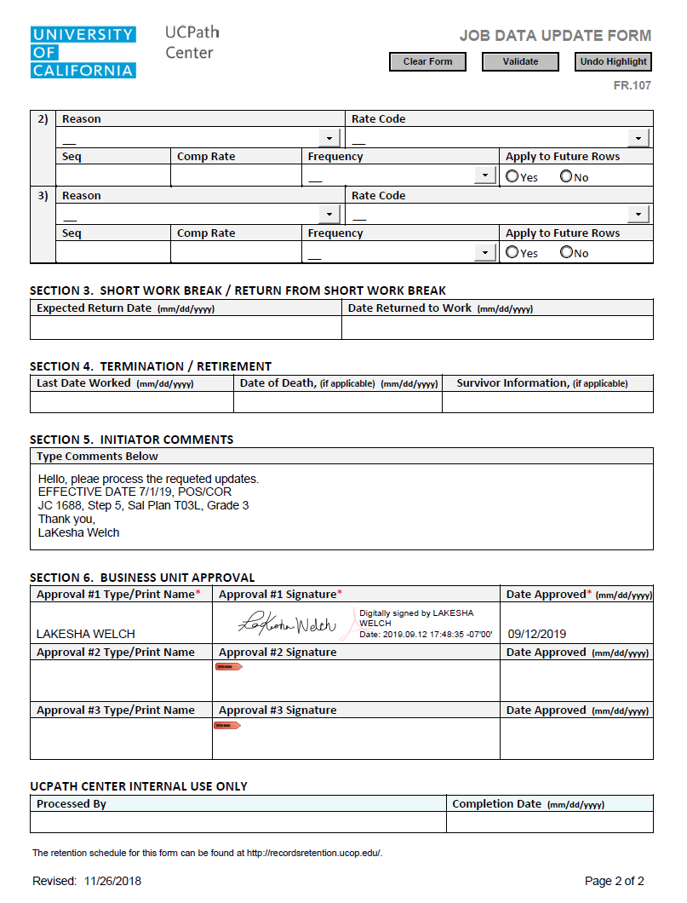
Navigation: PeopleSoft Menu > Forms Library > Access Forms > Job Data Update

Slide 70
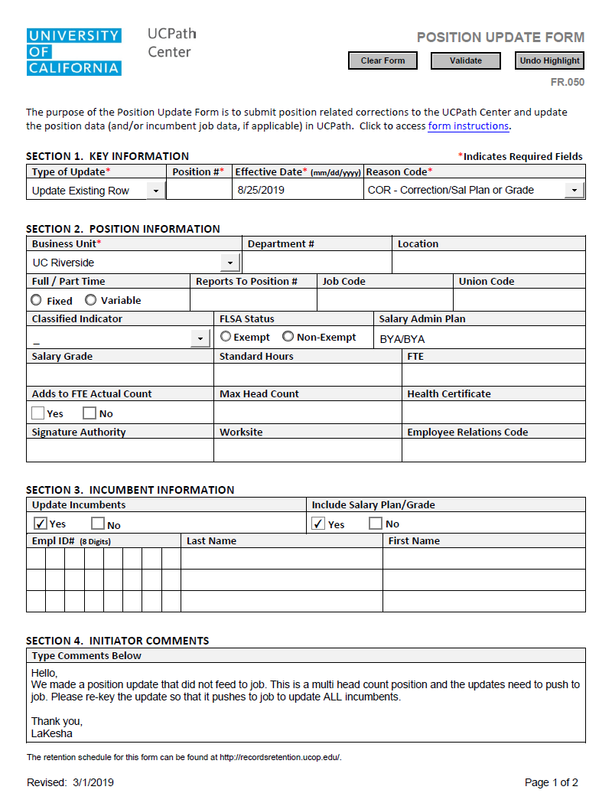
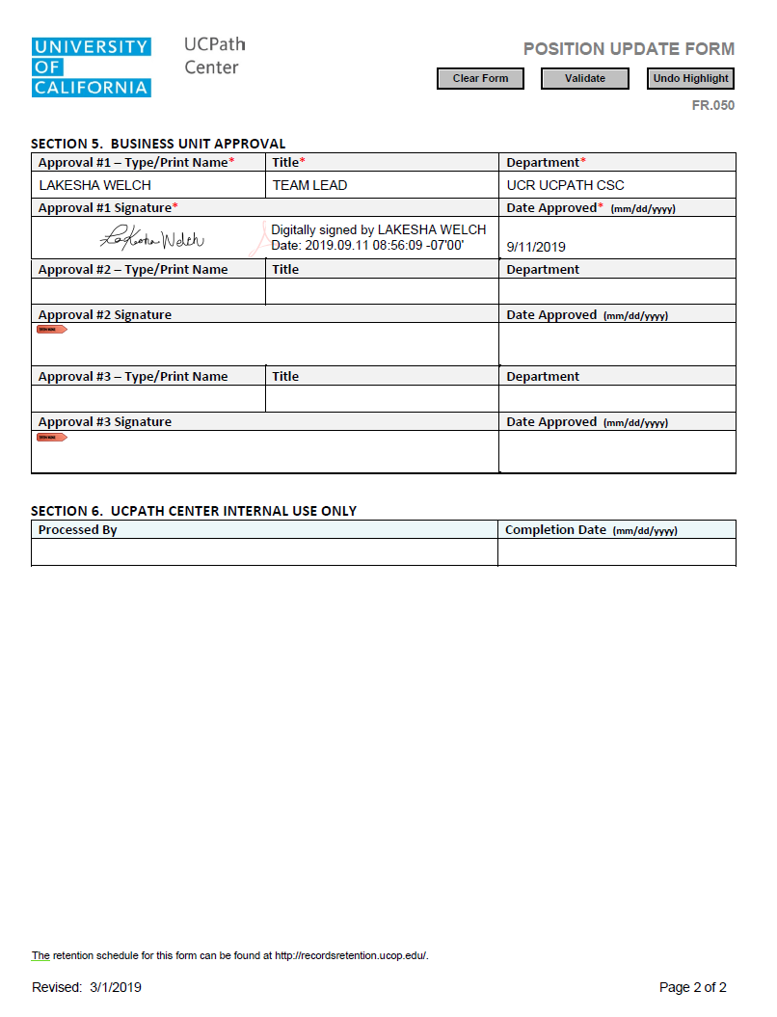
Navigation: PeopleSoft Menu > Forms Library > Access Forms > Position Update

Slide 71
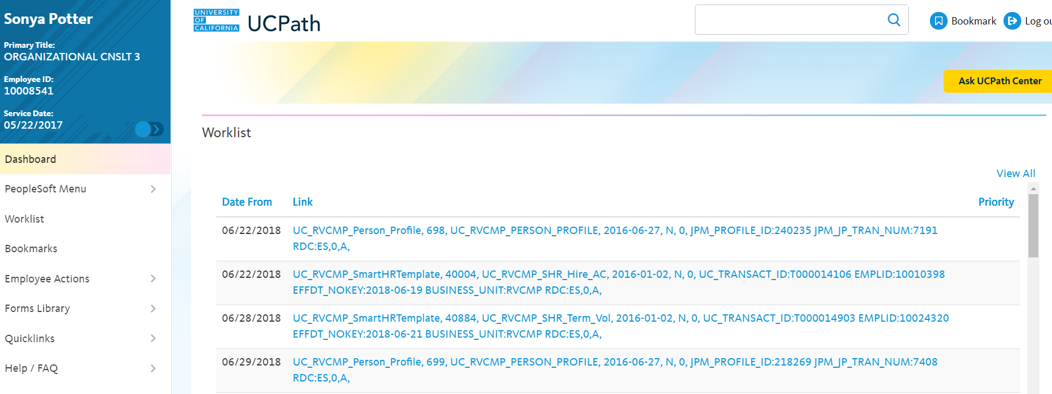
TRANSACTION PAGE
Navigation: UCPath Center > Ask UCPath Center
Navigation: UCPath Center > Help/FAQ > Ask UCPath Center
Click the Ask UCPath Center Button

Slide 72
THINGS TO REMEMBER WHEN OPENING CASE WITH UCPC
Follow up on your cases weekly, however it can take UCPath a long time to complete a case, keep following up. If you do not get a response, you should contact the CSC support team at ucpathhelp@ucr.edu to escalate your matter.
Phone Number to call for UCPC – Employee Service line (ES) 855-982-7284, Quality Care Unit (QCU) – 951-787-5470 used for escalation calls.
UCPath Center Portal has an area for Trending Questions and Feature Topics you can use to help to find answers for your questions - https://ucpathsupport.force.com/askucpath/s/
On Behalf of Topics and Categories, please refer to the list of Topics and Categories to categorized your Case correctly. If it is not categorized correctly, it could delay your issue from being reviewed timely by UCPath.

Slide 73
RESOURCES
Resource material regarding how to open on Behalf of Cases to UCPath is located here please utilize these documents as a reference.
On Behalf of Case Management:
Submit Case to UCPath Center
Submit Case (on Behalf of Employee) to UCPath Center
Reopen Closed UCPath Center Case
Monitor UCPath Center Cases
On Behalf of Case Management Infographic
On Behalf of Case Management Process Workbook
On Behalf of Case Management Process Map

Slide 74
QUESTIONS
Pilot Unit are you prepared to initiate On Behalf Case Management cases and if not what else do you need to be successful?
Are there any other questions comments of feedback or things we need to cover or review for involuntary terminations in time for an 11/5/19 Go-Live?

Slide 75
Position Control Transactions

Slide 76
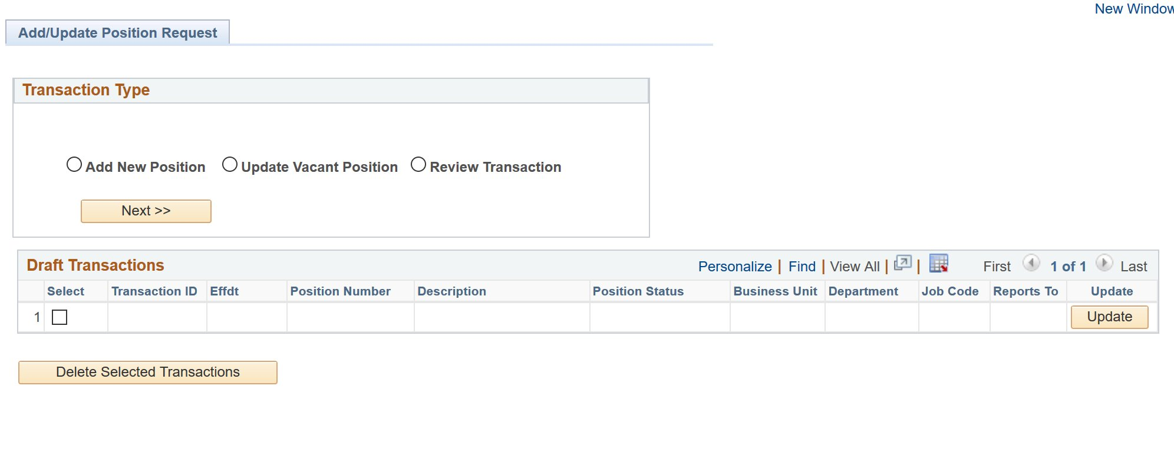
TRANSACTION PAGE
Navigation: PeopleSoft Menu > UC Customizations > UC Extensions > Position Control Request
The system displays the Add/Update Position Request page.
Click the Add New Position option and click Next to begin the steps for adding a new position control request.
Click the Update Vacant Position option and then click Next to begin the steps for initiating a position update control request.

Slide 77
THINGS TO REMEMBER WHEN TRANSACTING
It is important to review the HRDW Position Report for existing positions; this can be used before creating new positions.
If new position has a complex FAU or earn codes, such as add’l comp, summer salary etc., submit request to SSC to create.
Wait 1 day to add FAU positon in FAU tool. Failure to add FAU prior to any funds being paid will result in the funds hitting the default fund and require a SCT.
Changes to multi-head count positions can only be made by a Position Administrator in a Shared Services Center.
Keep in mind that the position needs to be created before you initiate the hire template.
Be sure to validate all fields on the position request template.

Slide 78
THINGS TO REMEMBER
Position Control Initiators use Position Control Requests to add positions or update vacant positions.
PayPath Initiators update positions that have a single incumbent using the PayPath Actions component.
A vacant position is one that is unfilled on or after the Effective Date you enter on the Find an Existing Value page of the Position Control Request.
Because there is not an incumbent employee, there are fewer downstream effects to updating a vacant position.
Position Control Requests utilize AWE to route transactions locally for approval before being routed to UCPath.

Slide 79
RESOURCES
Resource material regarding how to transact within UCPath using Position Control is located here please utilize these documents as a reference for how to transact.
Position Control:
View Position Information
Initiate Update Vacant Position Request
Initiate New Position Control Request
Position Control Infographic
Position Control Process Workbook
Position Control Process Map
Position Control Checklist

Slide 80
QUESTIONS
Pilot Unit are you prepared to initiate Position Control Requests and if not what else do you need to be successful?
SSC’s are you prepared to approve Positon Control Requests, if not what else do you need to be successful?
Are there any other questions comments of feedback or things we need to cover or review for involuntary terminations in time for an 11/5/19 Go-Live?

Slide 81
Phase I Processes

Slide 82
Contingent Worker Policies

Slide 83

POLICIES RELATED TO CONTINGENT WORKERS
CWRs DO NOT need to sign the Oath per policy.

Slide 84
Contingent Worker Transactions

Slide 85
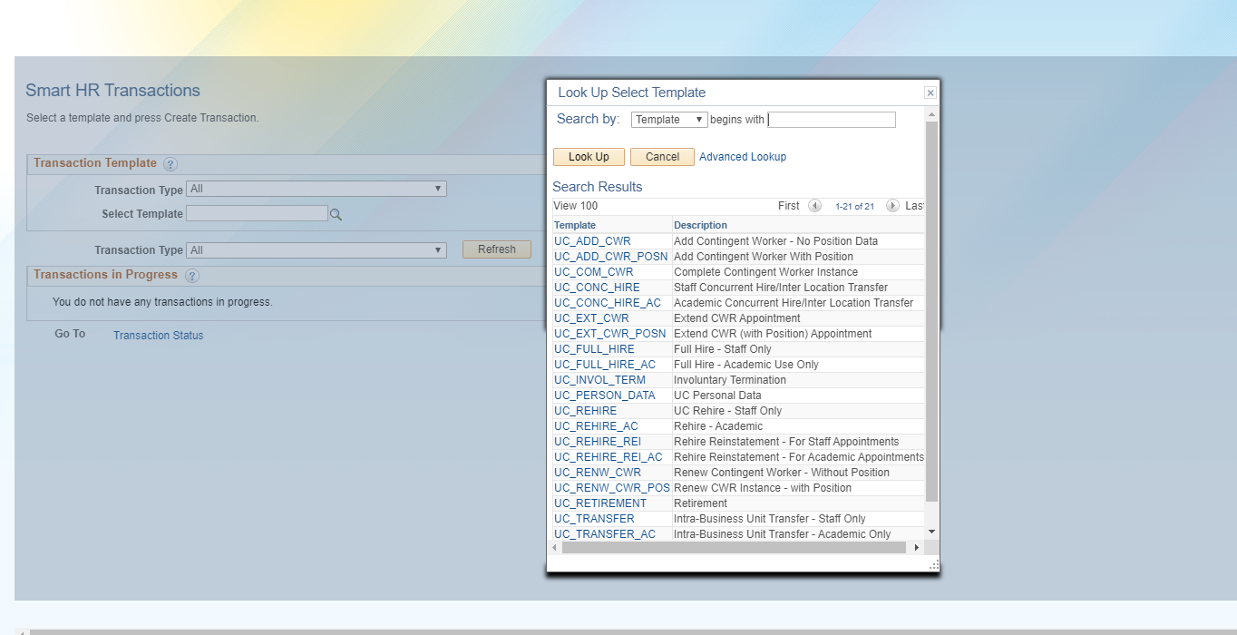
TRANSACTION PAGE
Navigation: PeopleSoft Menu > Workforce Administration > Smart HR Template > Smart HR Transactions

Slide 86
CONTINGENT WORKERS
If a contingent worker in your department supervises UCR employees, you will need to create a position for them first. Generally, contingent workers will not supervise UCR employees and will therefore not require a position. In that case, contingent worker can be added to UCPath using a job code. Job codes for contingent workers ALWAYS start with the prefix CWR.
If a contingent worker does NOT supervise UCR Employee(s), they can be Onboarded without a Position.

Slide 87
THINGS TO REMEMBER WHEN TRANSACTING
SSC’s will continue to enter background check results in UCPath on the Security Clearance for both Phase 1 and Phase 2.
CWR’s need to be entered into UCPath and ALSO go through the Net ID Affiliate process. An enhancement that automatically generates a Net ID after a template is submitted in UCPath is pending.
Transactional Unit will attach the Personal Data Form and Appointment Letter to TBH.
CWR’s do not need to sign the Oath.
When completing a CWR the last date worked field value defaults to one business day prior to the effective date you entered on the previous page. You can update this value, if necessary.

Slide 88
RESOURCES
Resource material regarding how to transact within UCPath for Contingent Worker is located here please utilize these documents as a reference for how to transact.
Contingent Worker:
Contingent Worker Template Transactions – Action Reason Codes and Descriptions
Initiate Renew Contingent Worker (With Position) Template Transaction
Initiate Renew Contingent Worker (No Position) Template Transaction
Initiate Extend Contingent Worker (With Position) Template Transaction
Initiate Extend Contingent Worker (No Position) Template Transaction
Initiate Complete Contingent Worker Instance Template Transaction
Initiate Add Contingent Worker (With Position) Template Transaction
Initiate Add Contingent Worker (No Position) Template Transaction
CWR Onboarding Checklist
Contingent Worker Infographic
CWR Process Workbook
CWR Process Map

Slide 89
QUESTIONS
Pilot Unit are you prepared to initiate Contingent Worker Template Transactions and if not what else do you need to be successful?
SSC’s are you prepared to approve Contingent Worker Template Transactions, if not what else do you need to be successful?
Are there any other questions comments of feedback or things we need to cover or review for involuntary terminations in time for an 11/5/19 Go-Live?

Slide 90
Personal Data Changes Transactions

Slide 91
TRANSACTION PAGE
Navigation: PeopleSoft Menu > Workforce Administration > Smart HR Template > Smart HR Transactions
The Personal Data Changes template does not have any Reason Codes.

Slide 92
THINGS TO REMEMBER WHEN TRANSACTING
Employees can make most updates to their personal data directly in UCPath and are written directly to the database.
Documentation is required when updating Education Degree/Highest Degree Achieved, Licensure/Certification, Legal Name or Gender.
Changes requiring documentation is will not be written to the database until change is verified.
When personal data changes are made by the SSC or Transactional Pilot, AWE is required.

Slide 93
RESOURCES
Resource material regarding how to transact within UCPath for Personal Data is located here please utilize these documents as a reference for how to transact.
Personal Data Change:
Personal Date Changes Matrix
Personal Data Change Template Transactions – Action Reason Codes and Descriptions
Initiate Personal Data Change Template Transaction (Staff/Acad)
Update Personal Information – Security Clearance
Update Personal Information – Additional Names
Update Personal Information – Emergency Contacts
View Personal Information
Personal Data Change Infographic
Personal Data Change Process Workbook
Personal Data Change Process Map

Slide 94
QUESTIONS
Pilot Unit are you prepared to initiate Personal Data Changes and if not what else do you need to be successful?
SSC’s are you prepared to approve Personal Date Changes if not what else do you need to be successful?
Are there any other questions comments of feedback or things we need to cover or review for involuntary terminations in time for an 11/5/19 Go-Live?

Slide 95
Person of Interest Transactions

Slide 96
POI TRANSACTIONS
Navigation: PeopleSoft Menu > UC Customization > UC Extensions > Person of Interest -Add
ADD POI
Use the Add Person of Interest component in UCPath to add a new person of interest for a person who does not have a Person ID in UCPath
ADD POI Relationship
Use the Add POI relationship to add a relationship to an existing Person ID
Maintain POI
Use to update the Planned Exit date for a POI instance.
Use to change the POI Status for a POI instance from Active to Inactive.
Navigation: PeopleSoft Menu > Workforce Administration > Personal Information > Organizational Relationship >
Add POI Relationship
Navigation: PeopleSoft Menu > Workforce Administration > Personal Information > Organizational Relationship >
Maintain POI Relationship

Slide 97
THINGS TO REMEMBER WHEN TRANSCTING
Locations are responsible for adding and maintaining POI records in UCPath. A POI is not an employee of the University; and will not receive compensation through UCPath.
A POI does not have Position Data or Job Data in UCPath.
POIs are assigned a Person ID, instead of an Employee ID. If a POI later becomes an employee or a Contingent Worker (CWR), then their assigned Person ID becomes their Employee ID.
POI records that create a Person ID in UCPath are approved using Automated Workflow Engine (AWE). POI instances added to existing Person IDs do not use AWE.
UCPath Center does not add nor maintain POI records in UCPath. However, only UCPC can update a POI’s address and phone number. Locations must create a case to have UCPC update this information.

Slide 98
RESOURCES
Resource material regarding how to transact within UCPath for Person of Interest is located here please utilize these documents as a reference for how to transact.
Person of Interest:
View Person Organizational Summary
Extend or Inactivate POI
Approve POI
Add Person of Interest
Add Person of Interest Relationship
POI Infographic
POI Process Workbook
POI Process Map

Slide 99
QUESTIONS
Pilot Unit are you prepared to initiate POI Transactions and if not what else do you need to be successful?
SSC’s are you prepared to approve POI Transactions if not what else do you need to be successful?
Are there any other questions comments of feedback or things we need to cover or review for involuntary terminations in time for an 11/5/19 Go-Live?

Slide 100
One-Time Pay Transactions

Slide 101
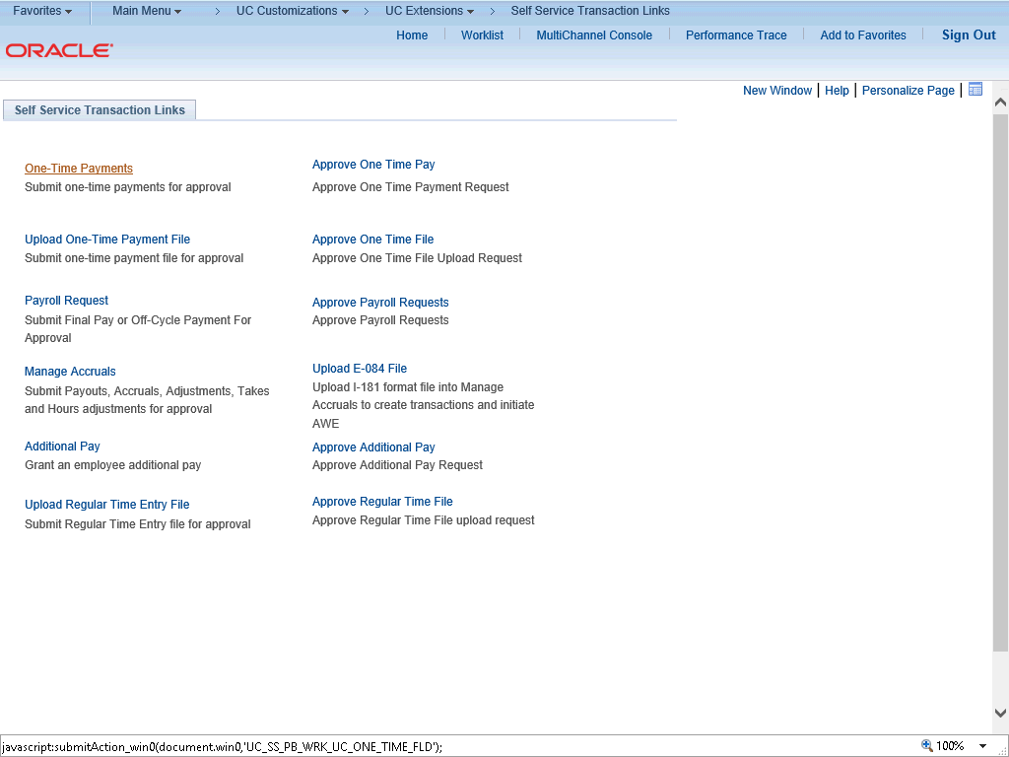
TRANSACTION PAGE – ONE TIME PAY
Navigation: PeopleSoft Menu > UC Customizations > UC Extensions > Self Service Transactions Links
Use this task to submit a one-time payment request in UCPath.

Slide 102
THINGS TO REMEMBER WHEN TRANSACTING
The One-Time Pay transaction page in UCPath does not have the ability to upload attachments.
SSCs cannot clone denied one-time payments, if they are denied they always have to be re-entered.
Transactional Unit submits one-time payment transaction, and SSC will approve the transaction.
Transactional Units can only submit one-time payment transactions for employees within their accountability structure.
If you override the existing Chartfield values in your request, the override values appear in the Chartfield Detail section.

Slide 103
QUESTIONS
Pilot Unit are you prepared to initiate One-Time Pay Transactions and if not what else do you need to be successful?
SSC’s are you prepared to approve One-Time Pay Transactions if not what else do you need to be successful?
Are there any other questions comments of feedback or things we need to cover or review for involuntary terminations in time for an 11/5/19 Go-Live?

Slide 104
Voluntary Termination & Retirement Transactions

Slide 105
SELECTING THE CORRECT TEMPLATE
Navigation: PeopleSoft Menu > Workforce Administration > Smart HR Template > Smart HR Transactions

Slide 106
THINGS TO REMEMBER WHEN TRANSACTING
Voluntary and Involuntary transactions are very similar, be sure to select the appropriate template when creating the transaction. Be sure to select the correct Action/Reason code, or if needed, contact Labor and Relations for direction on which one is the appropriate one to use for the employee.
For best practice attach any supporting documentation you have. For example letter or resignation.
The Last Date Worked auto populates with a date that is one day prior to the Effective Date.
Initiators can submit templates only for employees within departments for which they have security access. If needed, you must coordinate with other departments for terminating other UC jobs.
In the event that UCPath cancels a transaction, the transactional unit will need to notify the SSC of the cancellation.

Slide 107
RESOURCES
Resource material regarding how to transact within UCPath for Offboarding Voluntary Termination and Retirement is located here please utilize these documents as a reference for how to transact.
Offboarding Voluntary Termination:
Offboarding Checklist
Voluntary Termination / Retirement Template Transactions – Action Reason Codes and Descriptions
Initiate Voluntary Termination Template Transaction
Voluntary Termination (Offboarding) Infographic
Voluntary Termination (Offboarding) Process Workbook
Voluntary Termination (Offboarding) Process Map

Slide 108
QUESTIONS
Pilot Unit are you prepared to initiate Voluntary and Retirement Template Transactions and if not what else do you need to be successful?
SSC’s are you prepared to approve Voluntary and Retirement Template Transactions if not what else do you need to be successful?
Are there any other questions comments of feedback or things we need to cover or review for involuntary terminations in time for an 11/5/19 Go-Live?

Slide 109
SSC/UNIT BREAKOUT
Notes:
#1 – Voluntary Termination
#2 - Coordinate with other SSC/Depts.
#3 - SSC

Slide 110
APPENDIX
On behalf case management Process Map
Position control Process Map
Contingent worker Process Map
Personal data changes Process Map
Person of interest Process Map
One–time payments Process Map
Voluntary termination Process Map
Involuntary termination Process Map
Onboarding EMPL Class 5, 9 and 10 Process Map
PayPath EMPL Class 5, 9 and 10 Process Map

Slide 111
APPENDIX
Navigation: PeopleSoft Menu > Workforce Administration > Personal Information > Person Organizational Summary
Navigation: PeopleSoft Menu > Workforce Administration > Smart HR Template > Smart HR Transactions
Navigation: PeopleSoft Menu > UCPath Workcenter
Navigation: PeopleSoft Menu > Workforce Administration > Job Information > Review Job Information > Workforce Job Summary
Navigation: PeopleSoft Menu > Workforce Administration > Smart HR Template > Transaction Status
Navigation: PeopleSoft Menu > UC Customizations > UC Extensions > Position Control Request
Navigation: PeopleSoft Menu > UC Customizations > UC Extensions > PayPath Actions

Slide 112
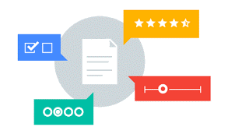
Your Feedback Please
http://bit.ly/pilottrainingphase2

Slide 113


Slide 114


