Slide 1

Ucr ucpath transaction pilot
APPROVAL WORKFLOW ENGINE OVERVIEW

Slide 2

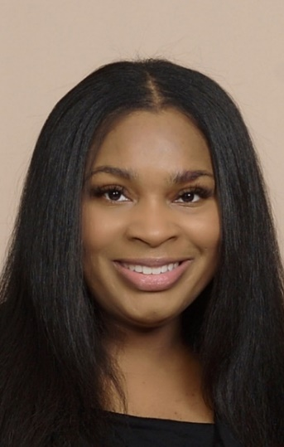
TRAINER INTRODUCTION
LaKesha Welch
Title: UCPath Business Support Analyst, Team Lead
Department: UCPath Campus Support Center
Years @UC: 5 1/2
Previous Experience: 15 years Lead Business Analyst/Functional Analyst Support

Slide 3
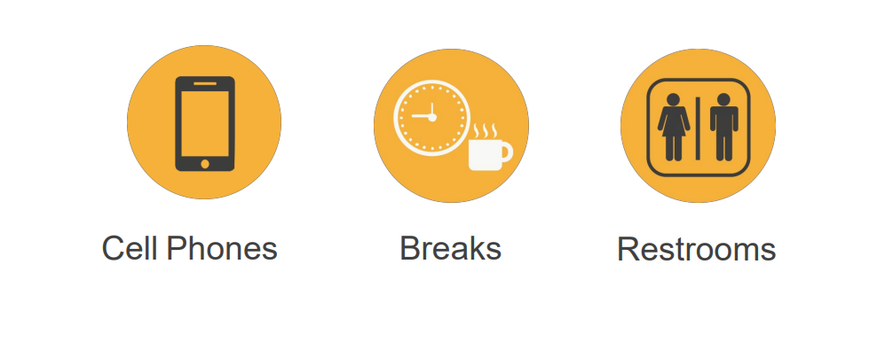
HOUSEKEEPING

Slide 4
LEARNING OBJECTIVES
Describe Approval Workflow Engine in UCPath
Learn what to look for to approve/deny a transaction
Learn best practices on how to manage Worklist
Recognize and define key UCPath terms and acronyms
Learn how to manage approvals
Refresher on where to find pending transactions

Slide 5
LEARNING TOPICS
AWE OVERVIEW AND APPROVALS
PHASE II APPROVALS
APPROVING CONTINGENT WORKER, VOLUNTARY TERM, PERSONAL DATA AND ONE TIME PAY
BEST PRACTICES FOR MANAGING WORKLIST
MANAGING APPROVALS
TRANSACTOR/APPROVER – WHERE TO GO FOR PENDING APPROVALS
UCPATH TERMS AND ACRONYMS
LEARNING OBJECTIVES REVIEW
THINGS TO REMEMBER

Slide 6
AWE Overview and Approvals

Slide 7
What is AWE?
AWE is the UCPath functionality that routes transactions for review and approval.
The AWE process ensures the appropriate users review and approve transaction.
Location Approver options include:
Approve
Deny

Slide 8
When to Approve!
Properly formed valid transaction
  Correct action reason code used
  All required fields have been completed
Approved personnel transaction accurately entered into the template
  Review attachments and/or comments
  Effective date is correct
Approve

Slide 9
When to DENY!
Required fields are incomplete
Incorrect reason action reason code used
Missing attachments
Incorrect effective date
Information on template does not match transaction
The transaction does not match what is stated in comments
Deny

Slide 10
Phase II AWE Approvals
Phase II approvals will be completed by designated Transaction unit approvers
AWE Approvals
Contingent Worker (CWR)
Personal Data
Voluntary Termination
One Time Pay

Slide 11
APPROVING CONTINGENT WORKER

Slide 12
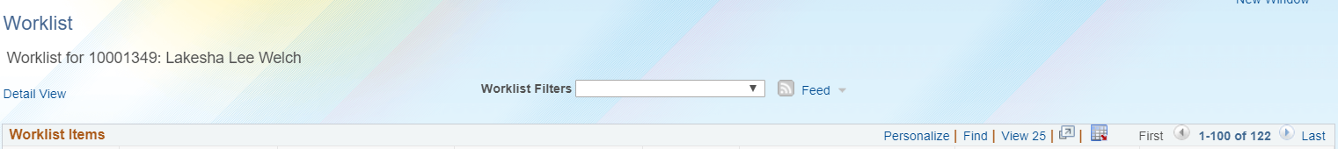
CONTINGENT WORKER
Navigation: PeopleSoft Menu > Worklist > Worklist
This example shows the worklist with a pending approval for Contingent Worker request.
LaKesha Welch
Click the link to review transaction to approve or deny.

Slide 13
4
CLICKS

Slide 14
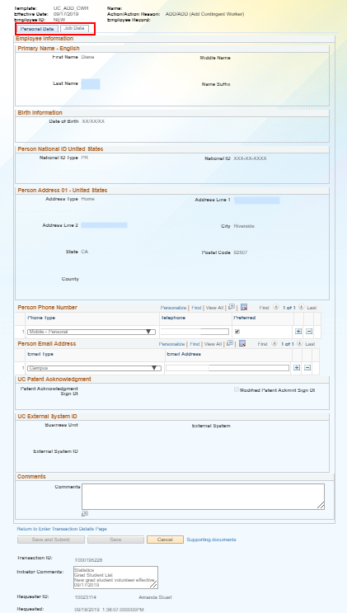
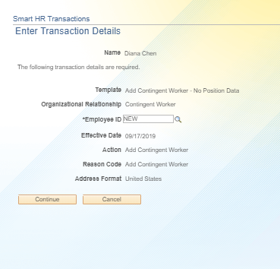
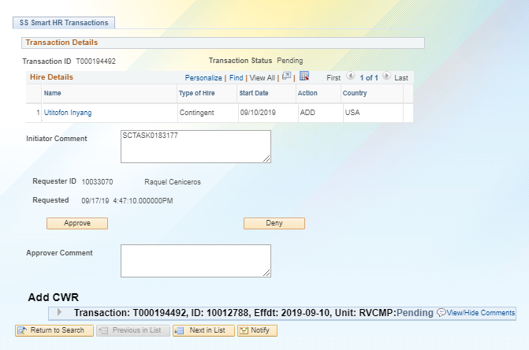
CWR PENDING APPROVAL
1
Click on the Person’s Name to review the template ttransaction details.
2
Click Continue.
4
When the review is complete, click the Cancel button to return to the approval page.
The Save and Submit button is greyed out because this is the original transaction.
3

Slide 15
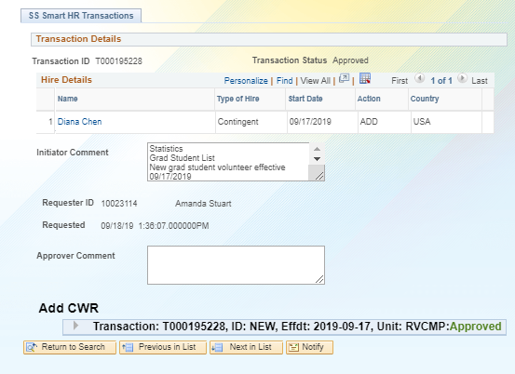
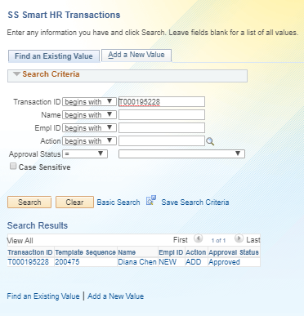
CWR APPROVED
This example shows an approved Contingent Worker request.
Below you can see that the template was Approved.
Navigation: PeopleSoft Menu > UC Customizations > UC Extensions > SS Smart HR Transactions

Slide 16
HANDS ON

Slide 17
BEST PRACTICES FOR MANAGING WORKLIST

Slide 18
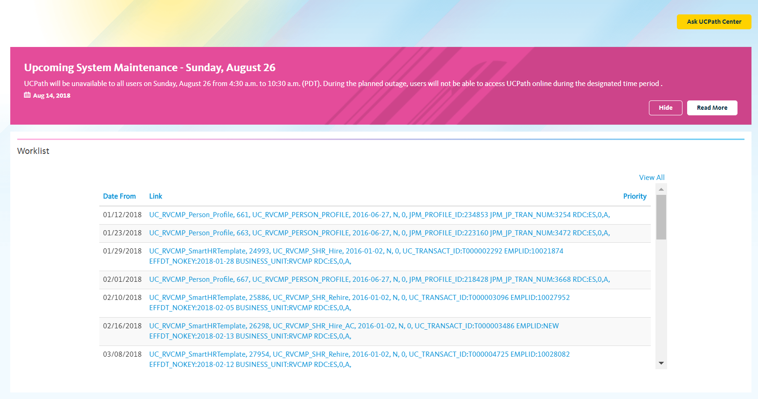
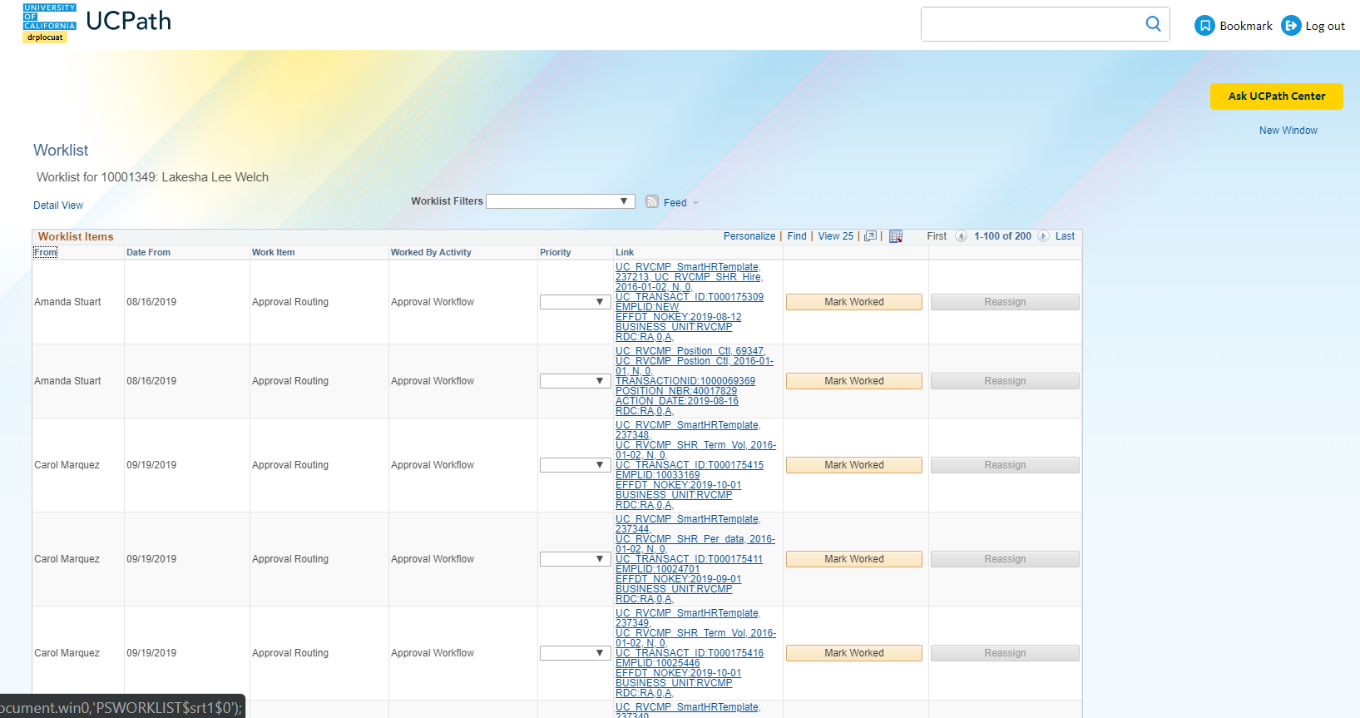
WORKLIST
Navigation: DASHBOARD
Navigation: PeopleSoft Menu > Worklist > Worklist
18

Slide 19


BEST PRACTICES: UCPATH WORKLIST & AWE MANAGEMENT
Utilize worklist sort options on the page. Review and sort worklist by initiator “From”. UCPath sorts by first name.
Ensure you are reviewing all pages of worklist data.
19

Slide 20
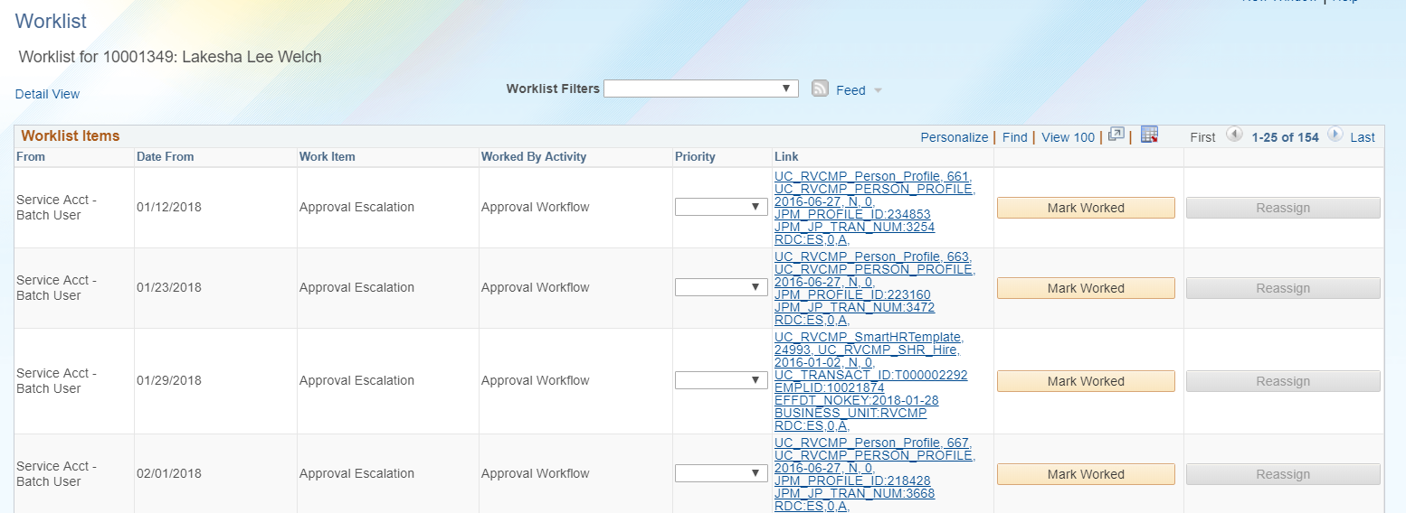
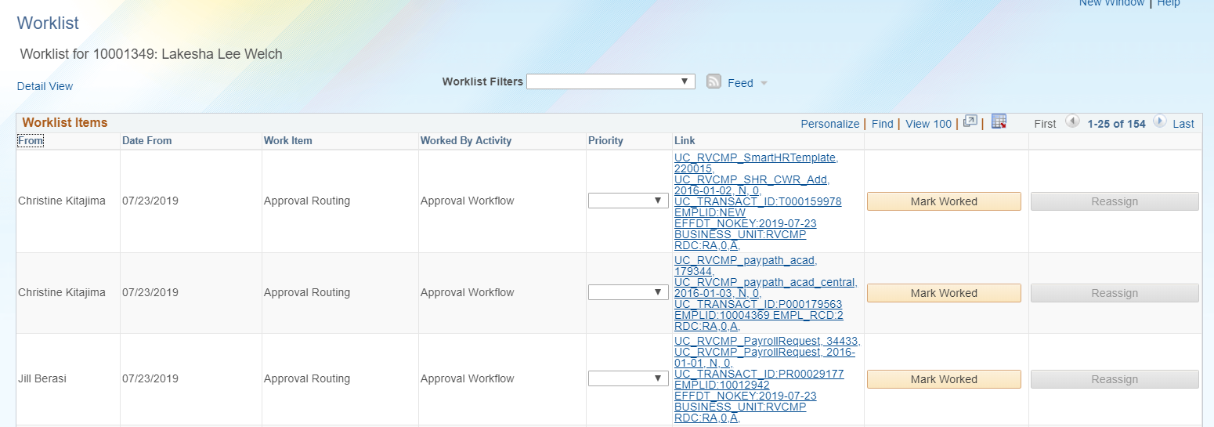
EXAMPLE: UCPATH WORKLIST
Unsorted worklist
Sorted worklist
20

Slide 21

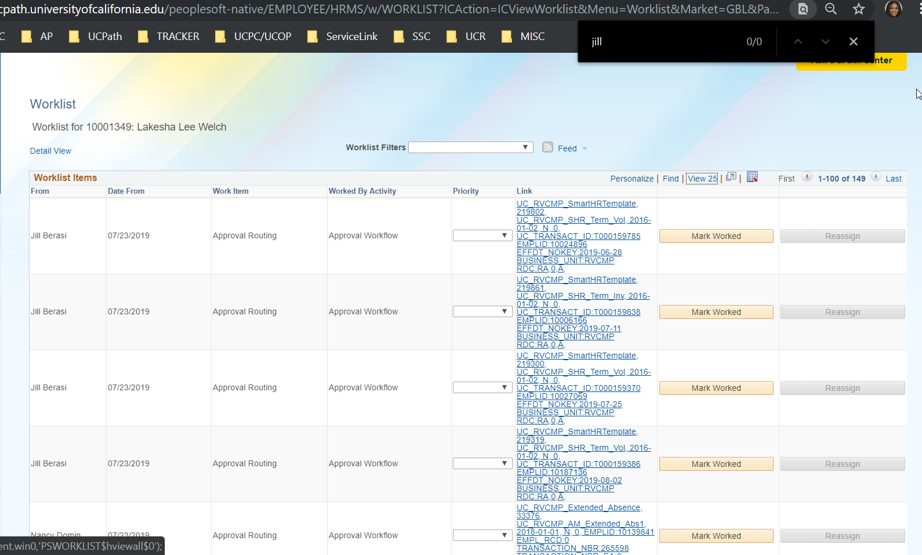
BEST PRACTICES: UCPATH WORKLIST & AWE MANAGEMENT
Control find function (Ctrl + F). If you are looking for a specific transaction, results will render quicker.
21

Slide 22

WORKLIST PAIN POINTS
No meaningful filter
Not enough detail in worklist
Not enough detail in email notification to create rules
No search function
We are working on submitting a change request to make the worklist more functional. This type of request is not a priority for UCPC, but the enhancement will come.
22

Slide 23
APPROVING VOLUNTARY TERMINATION & PERSONAL DATA

Slide 24
VOLUNTARY TERMINATION & PERSONAL DATA
Navigation: PeopleSoft Menu > Worklist > Worklist
This example shows the worklist with a pending approval for Voluntary Termination and Personal Data request.
LaKesha Welch
LaKesha Welch
Click the link to review transaction to approve or deny.
LaKesha Welch

Slide 25
4
CLICKS

Slide 26
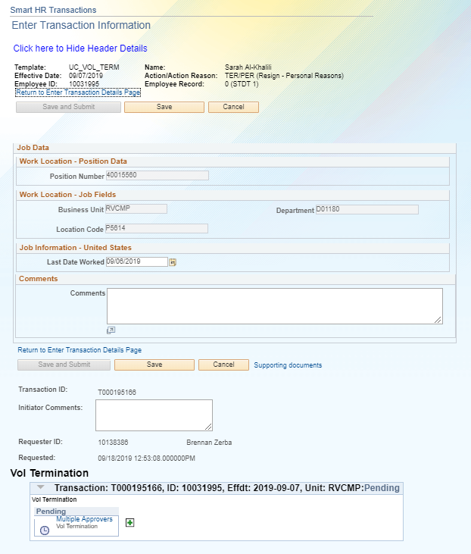
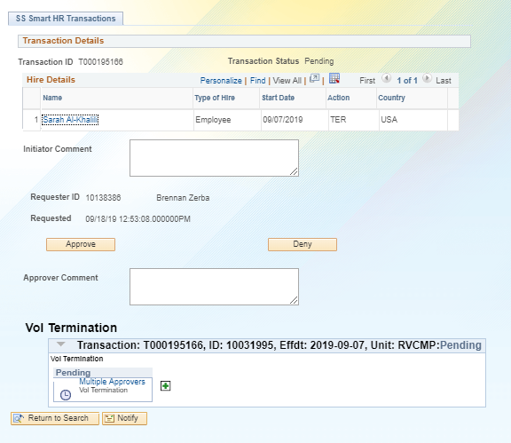
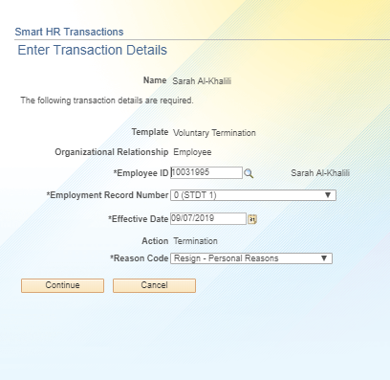
VOLUNTARY TERMINATION PENDING APPROVAL
Click on the Person’s Name to review the template ttransaction details.
1
2
4
When the review is complete, click the Cancel button to return to the approval page.
Click Continue.
3
The Save and Submit button is greyed out because this is the original transaction.

Slide 27
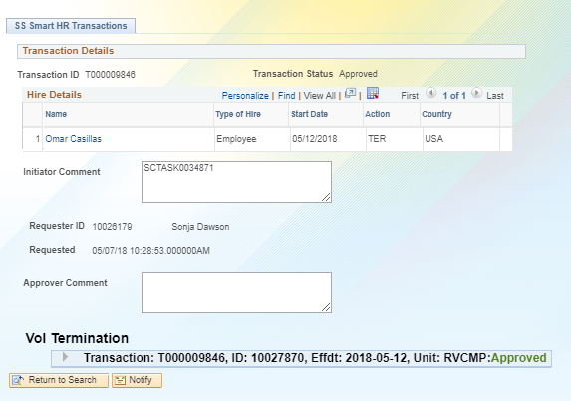
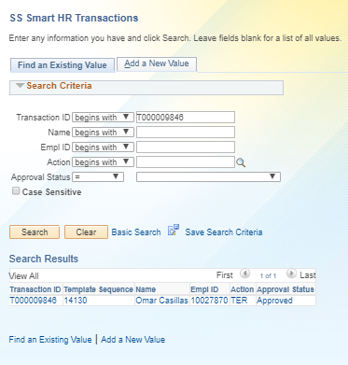
VOLUNTARY TERMINATION APPROVED
Below you can see that the template was Approved.
Navigation: PeopleSoft Menu > UC Customizations > UC Extensions > SS Smart HR Transactions

Slide 28
HANDS ON

Slide 29
APPROVING ONE TIME PAY

Slide 30
ONE TIME PAY
Navigation: PeopleSoft Menu > Worklist > Worklist
This example shows the worklist with a pending approval for One Time Pay request.
Click the link to review transaction to approve or deny.

Slide 31
1
CLICK

Slide 32
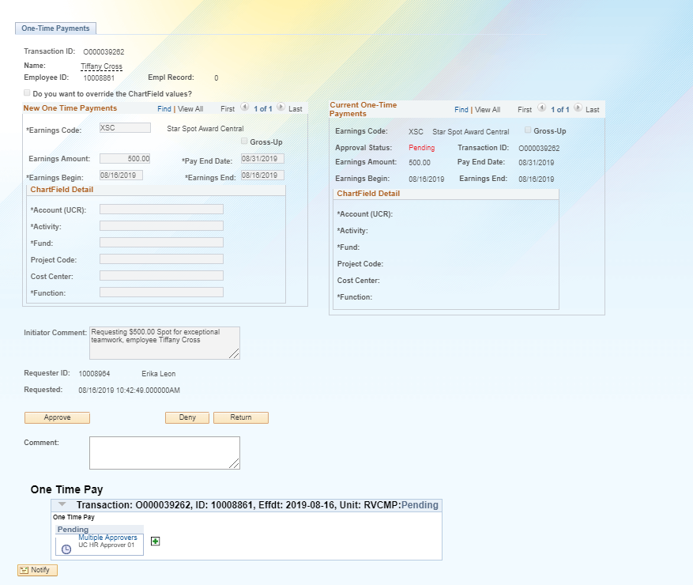
ONE TIME PAY TRANSACTION PENDING APPROVAL
In this example, we will be approving the one time pay transaction. Click Approve.
1

Slide 33
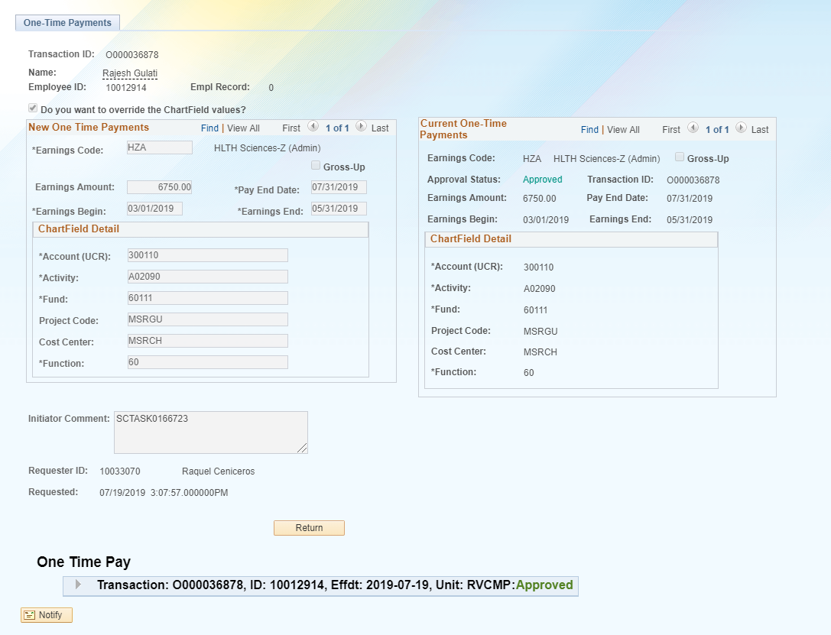
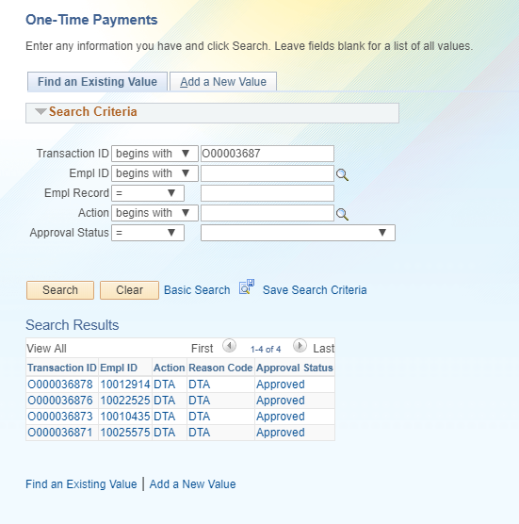
ONE TIME PAY TRANSACTION APPROVED
Below you can see that the template was Approved.
Navigation: PeopleSoft Menu > UC Customizations > UC Extensions > Self Service Transaction Links > Approve One-time Payments

Slide 34
HANDS ON

Slide 35
MANAGING APPROVALS

Slide 36
MANAGING APPROVALS
Approvals
WORKLIST
EMAIL NOTIFICATIONS
SS SMART TRANSACTION
SELF SERVICE LINKS
Approvals can be managed many different ways:

Slide 37
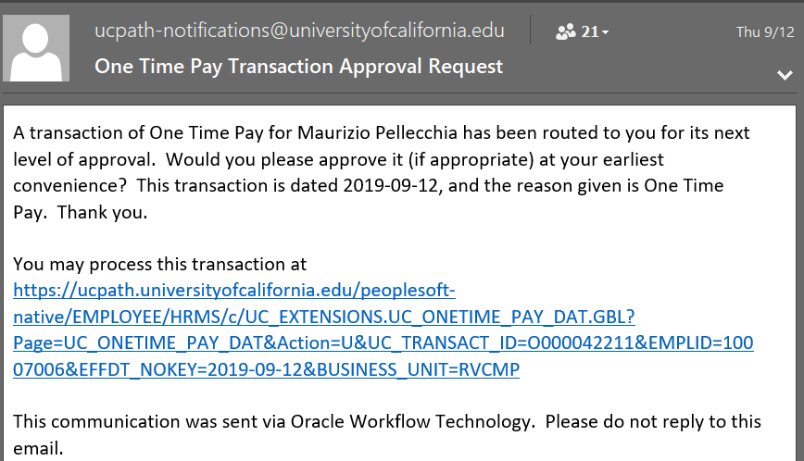
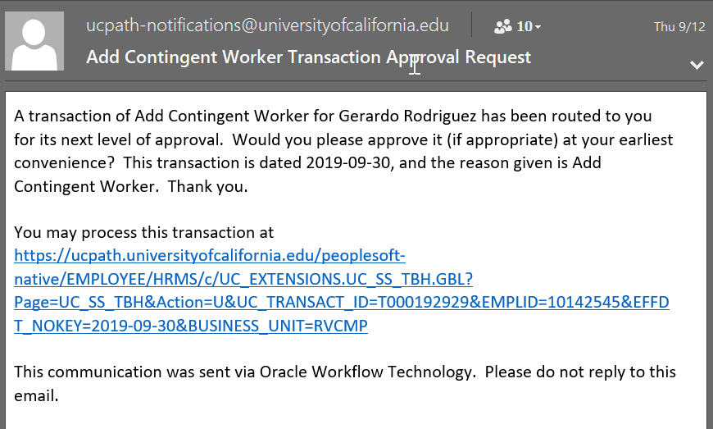
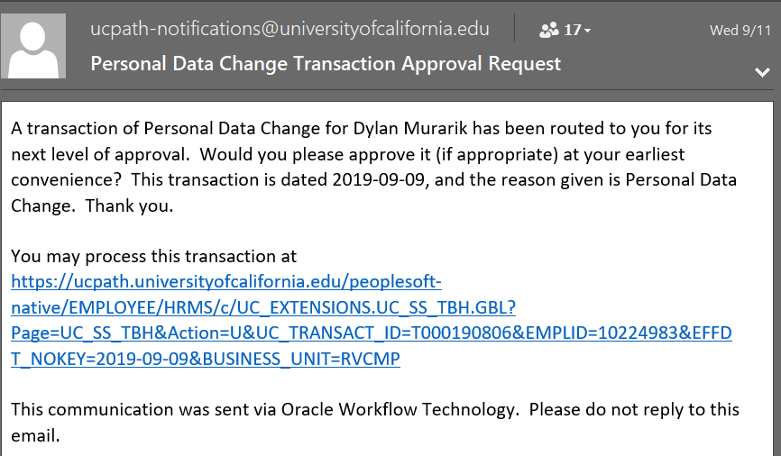
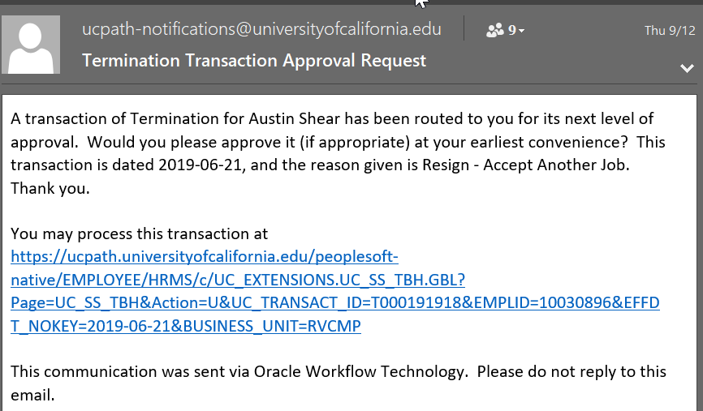
NOTIFICATION - DEMO

Slide 38
HANDS ON

Slide 39
ARE YOU A TRANSACTOR AND APPROVER?

Slide 40
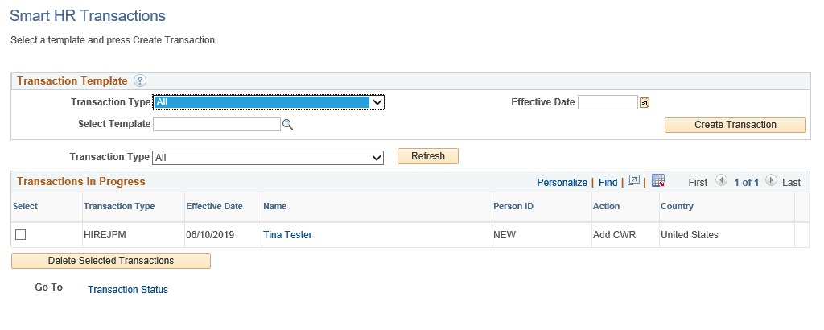
WHERE CAN I VIEW LOCAL PENDING TRANSACTION?
Navigation: PeopleSoft Menu > Workforce Administration > Smart HR Template > Smart HR Transactions
Use the Smart HR Transactions page to:
  View the status of your template transactions in progress, pending local Approval.
  View comments entered by a Location Initiator or Approver.
  Review the template entry details (the fields are view-only).
  This page is used to clone locally DENIED transactions. Tip: The cloned (new) transaction appears below the original denied transaction in the default sorting of the list.
Click for UCPC Job Aid

Slide 41
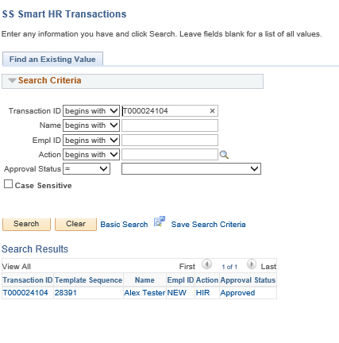
WHERE CAN I VIEW LOCAL PENDING TRANSACTION?
Navigation: PeopleSoft Menu > UC Customizations > UC Extensions > SS Smart HR Transactions
Use the SS Smart HR Transactions page to:
  View the status of all template transactions within your accountability structure pending local approval.
  View comments entered by a Location Initiator or Approver.
  Review the template entry details (the fields are view-only).
Click for UCPC Job Aid

Slide 42
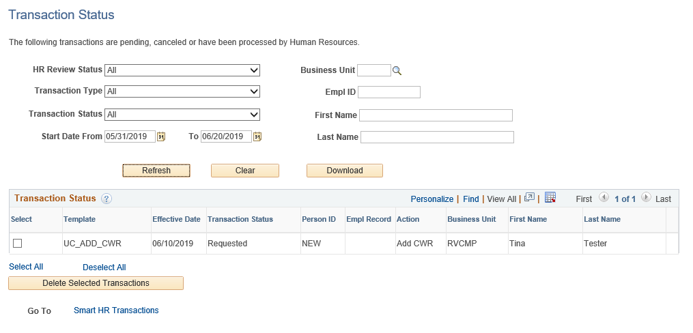
WHERE CAN I VIEW UCPC PENDING TRANSACTIONS?
Navigation: PeopleSoft Menu > Workforce Administration > Smart HR Template > Transaction Status
Use the Transaction Status page to view the status of templates after they have completed local AWE.
This page tracks the status of templates after they have been routed and approved at the Locations.
This page is also used to clone a template transaction that was cancelled by UCPC.
2. Transaction Status values are:
Requested, Completed, Hired/Added,
Denied, and Cancel.
1. Adjust the selection criteria as needed to filter the displayed transactions.
1
2
3
3. If a transaction is cancelled or denied, you can View Comments to see why it was cancelled / denied on this page, then Clone the existing template information into a new template, correct, and resubmit.

Slide 43
UCPATH TERMS AND ACRONYMS

Slide 44
UCPATH KEY TERMS AND ACRONYMS – APPROVAL WORKFLOW ENGINE (AWE)
AWE
Designated Approvers
Templates: Approved Transaction sent to UCPath Center for finalization
Paypath: Approved transaction committed to Database
Addl pay: Approved transaction routed to staging table and pulled in during payroll processing
AWE systematically routes transactions in UCPath to designated roles for approval at UCR. Once these UCR approvals are complete, transactions are either routed to the UCPath Center for finalization, committed to the database, or routed to staging table and pulled in during payroll processing.
.

Slide 45
UCPATH KEY TERMS AND ACRONYMS - WORKLIST
CWR
ONE TIME PAY
PERSONAL DATA
VOLUNTARY TERMINATION
WORKLIST
The Worklist is the automated to‐do list that PeopleSoft Workflow creates.
From the worklist, you can directly access the pages you need to perform the next action, and then return to the worklist for your next item.

Slide 46
UCPATH KEY TERMS AND ACRONYMS - WORKFLOW
The sequential flow of tasks and information in a business process:
TASK
INFORMATION
TASK

Slide 47
UCPATH KEY TERMS AND ACRONYMS – EFFECTIVE DATING
Effective Dating is used to maintain and view a complete chronological record of historic, current and future data.
Current Effective Date
Date that is less than or equal to the current system date
Historic Effective Date
Dates that are less than the current information
Retro Effective Date
Date prior to the current pay period begin date
Future Effective Date
Effective dates that are greater than the current information

Slide 48
LEARNING OBJECTIVES REVIEW
Having completed this course, you should be able to:
Describe Approval Workflow Engine in UCPath
Learn what to look for to approve/deny a transaction
Learn how to manage Worklist
Recognize and define key UCPath terms and acronyms
Learn how to manage approvals
Know where to find pending transactions

Slide 49


THINGS TO REMEMBER
When approving be sure the transaction is: Properly formed valid transaction and Approved personnel transaction accurately entered into the template.
Sorting and CTRL + F are best to manage and search for pilot transactions pending approval
Notifications will be received for ALL transactions in your Dept/ORG. Remember sorting and searching by transactor name to approve pending transactions will be key to managing approvals
It takes 4 clicks to approve a template and 1 click to approve One time pay
3 Places to approve templates: Worklist, email notifications and SS Smart HR Transactions
3 place to approve One time payments: Worklist, email notifications and Approve One-Time Payments

Slide 50
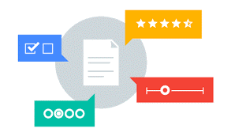
Your Feedback Please
http://bit.ly/pilottrainingphase2

Slide 51


Slide 52


