Slide 1
Ucr ucpath transaction pilot
DAY 2 – paypath for Empl class 5, 9 and 10

Slide 2
POLICIES RELATED TO PAYPATH ACTIONS

Slide 3
ACADEMIC POLICIES RELATED TO PAYPATH ACTIONS
Below are the Academic Personnel Manual (APM) policies related to Merit, Promotion and Compensation. Additional Paypath related policies are listed below as well, https://www.ucop.edu/academic-personnel-programs/academic-personnel-policy/:
200 Appointment and Promotion - General
278 Health Science Clinical Professor Series
280 Adjunct Professor Series
283 Lecturer and Senior Lecturer
279 Clinical Professor
285 Lecturer with Security of Employment Series
310 Professional Research Series
600 General
610 Salary Increases
633 Administrative Stipends: Academic Appointees
662 Additional Compensation: Additional Teaching
666 Additional Compensation: Honoraria
664 Non-Senate Academic Appointees/Corrective Action and Dismissal
Limitation on Total Period of Service with Certain Academic Titles APM-133PDF

Slide 4
ACADEMIC POLICIES RELATED TO PAYPATH ACTIONS
Non-Senate Call (Appointment and Promotion): https://academicpersonnel.ucr.edu/sites/g/files/rcwecm1261/files/2019-04/Non-Senate%20Call%20-%2018-19%20FINAL%20%28April%202019%29.pdf
Represented Contracts:
Lecturers (IX – Unit 18): https://ucnet.universityofcalifornia.edu/labor/bargaining-units/ix/contract.html
Librarians (LX – Unit 17): https://ucnet.universityofcalifornia.edu/labor/bargaining-units/lx/contract.html
ASEs (BX): https://ucnet.universityofcalifornia.edu/labor/bargaining-units/bx/contract.html
Postdocs (PX): https://ucnet.universityofcalifornia.edu/labor/bargaining-units/px/contract.html
For questions or more information please contact the Academic Personal Office academicpersonnel@ucr.edu.
Local Compensation Policies:
https://academicpersonnel.ucr.edu/compensation#local_compensation_policy_and_guidelines

Slide 5
STUDENT COMPENSATION
After the completion of at least two quarters in the department, in which performance has been satisfactory or better, casual-restricted appointments may receive a within-range merit increase of up to $0.75 per hour once a fiscal year.
Salary Range | Minimum | 1st Quartile | Midpoint | Maximum
Student 1 Title Code xxx | $12.00/hr | $13.25/hr | $14.50/hr | $17.00/hr
Student 2 Title Code xxx | $12.50/hr | $17.50/hr | $22.50/hr | $32.50/hr

Slide 6
STUDENT EMPLOYMENT DUTIES
Student Assistants perform duties ranging from routine to advanced and/or specialized in a variety of positions, which typically require the use of manual, administrative, advising, public contact, and/or analytical skills.
Office/General: Provide general office support such as greet visitors, file, type and scan documents; enter, update or maintain spreadsheets/data applications, run reports, assist with research questions and special projects.
Library Services: Under supervision, perform routine administrative duties such as file, retrieve and copy materials; sort mail, shelve books, circulation desk duties, and customer service.
Transportation: Under supervision, assist visitors at campus Information Kiosks, serve as event parking attendants and service as traffic control guides.

Slide 7
WORK SCHEDULE
Casual-restricted appointments should be established at less than 20 hours or 50% time.* Appointments may temporarily exceed 50% time during the summer for those periods when a student is not enrolled full-time. However, if this occurs the student may be eligible to earn holiday pay and sick leave accrual.
Any UCR student may work in a student assistant position:
during the student’s academic school year
during the summer immediately prior to the student’s first fall quarter at UCR (provided the student registered for fall quarter and will definitely attend UCR)
during the summer immediately following the student’s UCR graduation
during the quarter immediately following completion of courses to fulfill graduation or completion of school as a registered student.
*To ensure that the student maintains his/her educational goals as the foremost priority, the appointment percentage should remain below 50% and flexibility should be granted in scheduling work for student employees.

Slide 8
STAFF POLICIES RELATED TO PAYPATH ACTIONS
PPSM-60: Layoff & Reduction in Time & Local Procedure-60: Layoff & Reduction in Time
Temporary
Indefinite
Severance Pay
Preferential rehire and recall rights per applicable CBA
Pay in lieu of notice
Layoff Information for Supervisors
Layoff & Reduction in Time – Information, Process & Resources
PPSM-64: Termination & Job Abandonment & Local Procedure-64: Termination & Job Abandonment
Job Abandonment
Release from probation
Corrective Action vs. Immediate Dismissal
Pay in Lieu of Notice
PPSM-66: Medical Separation & Local Procedure-66: Medical Separation
Bases for Medical Separation
Notice of Intent to Medically Separate
Notice of Medical Separation
* Represented staff are governed by their relevant bargaining unit contract: https://hr.ucr.edu/about-us/employee-and-labor-relations/collective-bargaining/elr-union-contacts-representative-contacts

Slide 9
RESOURCES FOR PAYPATH ACTION TRANSACTIONS
Staff Human Resources Website
Academic Personnel Website
Dept | Contact | Title | Phone | Email
APO | Nick Weston- Dawkes | Academic Employee Relations Analyst | (951) 827-5091 | nicholas.weston-dawkes@ucr.edu
APO | Sonia Kalogonis | Compensation Analyst | (951) 827-5272 | sonia.kalagonis@ucr.edu
APO | Danessa Murdock | Technology and Data Analyst | (951) 827-1403 | danessa.murdock@ucr.edu
HR | Scott Biggerstaff | Compensation Analyst | (951) 827-5092 | scott.biggerstaff@ucr.edu
HR | Mary White | Policy Analyst | (951) 827-1414 | mary.white@ucr.edu

Slide 10
EMPL CLASS 9 DEMO
REGULARIZATION (REG)
Notes:
(Example: If they have a student that is working with the Dean or Org head and they are dealing with confidential documents then they need to send information to HR to have their ELR updated to the confidential. This example applies to all of them.

Slide 12
PAY
PAY RATE CHANGE

Slide 13
PAY- Pay Rate Change– Common Action Reason Codes
COMMON
ACADEMIC
STAFF
AAS
Advancement to Above-Scale
AMR
Academic Merit/Reappointment
NEG
Change in Negotiated Salary
OFF
Off Scale Increase
OSD
Off Scale Decrease
ROP
Change to Record-Only Pay Rate
U18
Unit 18 Salary Increase
WOS
Move to WOS (Without Salary)
ACR
Accretion to Bargaining Unit
JRD
Job Reclass – Downward
JRL
Job Reclass – Lateral
JRU
Job Reclass – Upward
MER
Merit
REF
Range Adjustment/Comp Refresh
ATB
Across-The-Board
DEM
Demotion
EQU
Equity
MIN
Bring to Meet Minimum
PRO
Promotion/Academic Promotion
STI
Step Increase/Progression

Slide 14
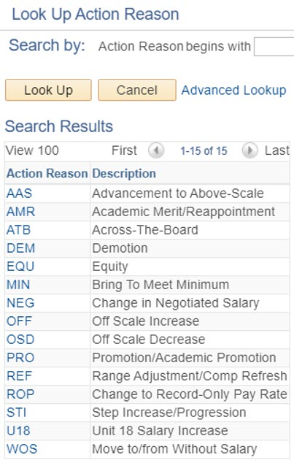
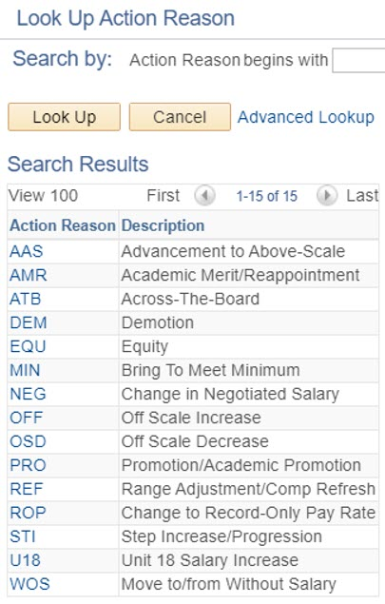
PAY- Pay Rate Change
Empl Class 5
Empl Class 9
Empl Class 10

Slide 15
RWB
RETURN FROM SHORT WORK BREAK

Slide 16
RWB– Return from Short Work Break- Common Action Reason Codes
COMMON
ACADEMIC
STAFF
RWB
Return from Short Work Break
P09
Partial Year Career- 09 Months
P10
Partial Year Career- 10 Months
P11
Partial Year Career- 11 Months

Slide 17
RFR
RETURN FROM SHORT WORK BREAK/ABEYANCE

Slide 18
RFR- Return from Reserve/Abeyance- Common Action Reason Codes
COMMON
ACADEMIC
STAFF
RFR
Return to Normal Appointment

Slide 19
CHECK YOUR UNDERSTANDING
If you need to make Job Earnings Distribution (JED) changes in PayPath, what page do you use?
Employee Reduction in Time (ERIT) is what an example of what type of change?
This action can be used to stop pay for an employee in the system for a temporary period of time, and moves them to a “work break” status.
Notes:
Job Data Page
Job Data change
Short Work Break

Slide 20
ADDITIONAL PAY OVERVIEW
Additional Pay is any compensation above a University employee’s regular base compensation.
There are two types of additional pay transactions:
One time – applies to a single pay cycle or non-consecutive pay cycles.
Recurring – payments are paid over multiple, consecutive pay periods.
Additional pay transactions entered in PayPath are routed for approvals and then transferred to a Payroll staging table to be processed automatically by UCPC Payroll additional pay batch upload process.
Additional pay must be entered as a flat per pay period amount.
All pro-rated payments should be calculated prior to entering the flat amount.
When an employee is hired and the Hire Template transaction has been submitted for approval, the employee is not available in PayPath until the Hire Template has been approved and processed by UCPC WFA Production.
After the employee is available in PayPath, the employee’s additional pay data cannot be updated until the Payroll nightly process has assigned the employee’s pay group.

Slide 21
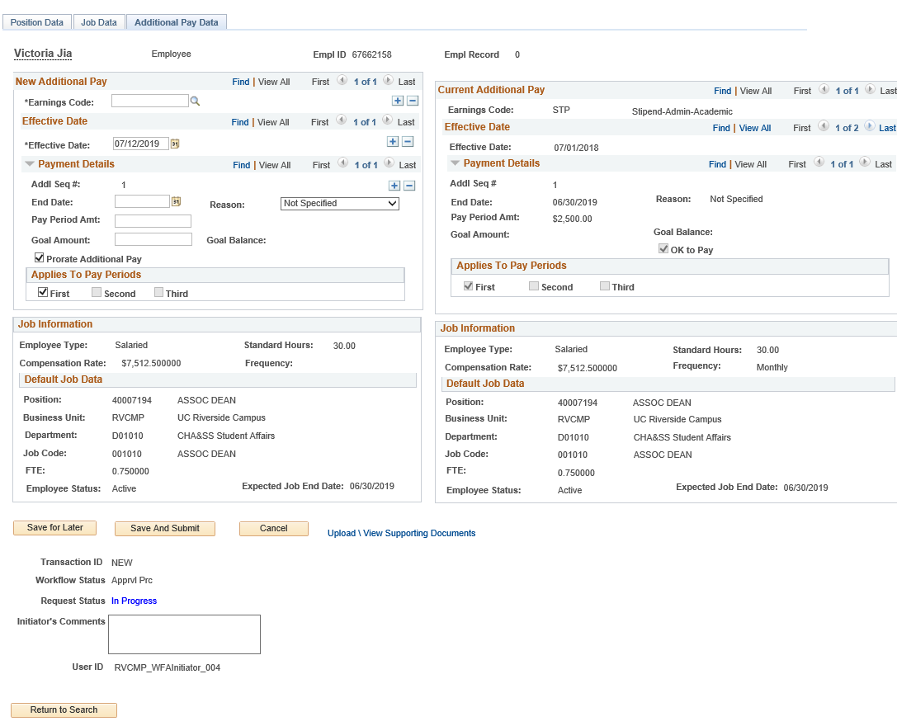
ADDITIONAL PAY DATA PAGE
Navigation: PeopleSoft Menu > UC Customizations > UC Extensions > PayPath Actions
Enter the Earnings Code, Effective Date, and Pay Period Amount. You can also enter a Goal Amount or End Date.
In this example, the employee has existing additional pay, which displays in the Current Additional Pay section.
This section displays a summary of the employee’s current job data.
Use the PayPath Actions Additional Pay Data page to enter specific information about the payment.
Ignore Goal Amount and Prorate Additional Pay.

Slide 22
UPDATE ADDITIONAL PAY
Navigation: PeopleSoft Menu > UC Customizations > UC Extensions > PayPath Actions
Updates can be made to existing recurring additional pay transactions.
The update must be for the same Earnings Code.
The update must have an Effective Date that is within the existing recurring pay Effective Date (start date) and End Date.
After you enter the Earnings Code and the new Effective Date, the current recurring information populates, and the Override Data button appears. Click the Override Data button to open the recurring information fields for edit.

Slide 23
RETROACTIVE ADDITIONAL PAY
Navigation: PeopleSoft Menu > UC Customizations > UC Extensions > PayPath Actions
Retroactive dating is available for additional pay.
The steps for entering a retroactive additional pay transaction are similar to any other additional pay, with the exception of the Effective Date.
In the Effective Date field, enter the previous pay period date that the additional pay should have started.

Slide 24
CHECK YOUR UNDERSTANDING
There are how many types of additional pay transactions?
When would you use one time pay?
When would you use recurring pay?
Notes:
One-time – applies to a single pay cycle or non-consecutive pay cycles.
Recurring – payments are paid over multiple, consecutive pay periods.

Slide 25
HANDS ON

Slide 26
ADVANCE TOPICS

Slide 27
PAYPATH ATTRIBUTES - ADVANCED
Job has to have an end date extended, if expired, before a secondary transaction can be entered
PayPath changes don’t commit to database right away for pay group, pay frequency, and additional pay changes. You won’t be able to transact on your current employee until approval is complete i.e. until pending transaction is approved
Does not show any POI’S (Views in Person Org Summary or the POI page)
Recurring pay additional pay can be processed with Position and Job data changes
When removing
UCWOS comp rate
code the system will process updates via overnight batch process before the earn code shows in additional pay. One day waiting period required before transacting
in add’l pay.
Pay frequency (pay group) changes need to batch overnight before committing to database
Each time there is an update processed via PayPath the system runs the benefits eligibility process
The PayPath Actions pages display the latest effective dated row. Keep in mind that this could be a future dated row.

Slide 28
MANAGING EXPECTED JOB END DATES & END JOB AUTOMATICALLY

Slide 29
MANAGING EXPECTED JOB END DATES AND END JOB AUTOMATICALLY
CSC is sending JRED (Job Record End Date) report quarterly to help manage end dates to avoid jobs ending automatically (if the box is checked)
Make sure to monitor the end date using the job record end date monitoring report. If the “end job automatically” box is checked employee will automatically be terminated. These appointments need to be placed on a short work break or their appointment needs to be updated. If the appointment is not automatically terminated it will result in an overpayment.

Slide 30
PAYPATH CORRECTIONS

Slide 31
PAYPATH CORRECTIONS
Text

Slide 32
FLSA OVERRIDE

Slide 33
FLSA ALIGNMENT MULTIPLE JOBS
Employees may only have one FLSA status
A consult with the AP/HR central office needs to occur prior to entering/updating the UCPath data to assess and align the appointee FLSA status.
Two academic jobs - AP consult only
Two staff jobs - HR consult only
One academic/one staff job - AP and HR consult
FLSA status is determined to be non-exempt
Exempt job is changed via Paypath or position control (POS/FLS) to non-Exempt.
Exempt job compensation is converted to hourly pay.
Pay group is changed to an Hourly Non-Exempt Pay group (5ST) by UCPC
Both jobs submit hours.
FLSA status is determined to be Exempt
Non-Exempt Hourly job is changed via Paypath or position control (POS/FLS) to Exempt
Pay group is changed on Hourly job to an Hourly Exempt Pay group (5MH or 5BH) by UCPC. The hourly job can report hours as an exempt EE
Once the FLSA is determined for the Employee the following process will need to take place:
When one of the job ends the FLSA status on the existing job may be reverted back in Paypath (POS/FL3). Please reach out to AP/HR central office if you need guidance on the reversal.

Slide 34
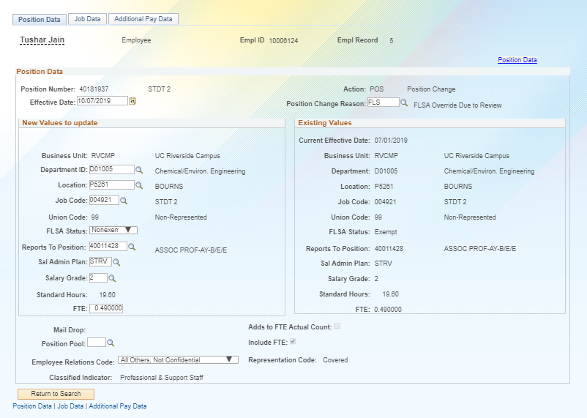

Slide 35
EFFECTIVE DATING

Slide 36
PAYPATH ACTIONS – EFFECTIVE DATES
Each Position Data and/or Job Data transaction must have the same Effective Date.
UCPath prevents the entry of multiple effective dates.
After you enter the Effective Date on one of the tabs, the Effective Date field becomes view-only on the other tabs and for new rows.
If you have changes that fall on different effective dates, you must enter a separate PayPath transaction for each effective date. Also, you must wait until the first PayPath transaction has completed the approval process before entering the next transaction.
Exception for Additional Pay Data:
You can enter multiple Effective Dates for Additional Pay Data transactions.

Slide 37
RETROACTIVE CHANGES

Slide 38
RETROACTIVE CHANGES
Changes can be entered retroactively for Position Data and Job Data.
If a retro date is prior to your Locations UCPath conversion date, it must be submitted to UCPath Center via a case.
After the change is approved, it is saved to UCPath, and the update is applied to the appropriate position data component and job data component in the appropriate row, according to the Effective Date.
For position and job updates, all rows of data after the retro change are also updated.
Notes:
DEMO - The PayPath Actions pages display the latest effective dated row. Keep in mind that this could be a future dated row.

Slide 39
PAYPATH FUTURE DATING

Slide 40
PAYPATH FUTURE DATING
ISSUE: There are issues with future dated rows being overwritten by current rows. SSC has advised to not put in a future dated row

Slide 41
WOS APPOINTEES

Slide 42
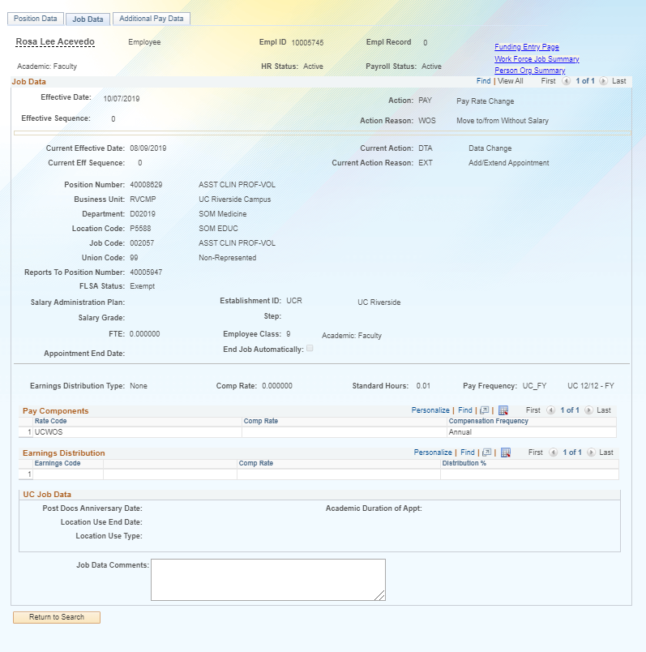
WOS APPOINTEES

Slide 43
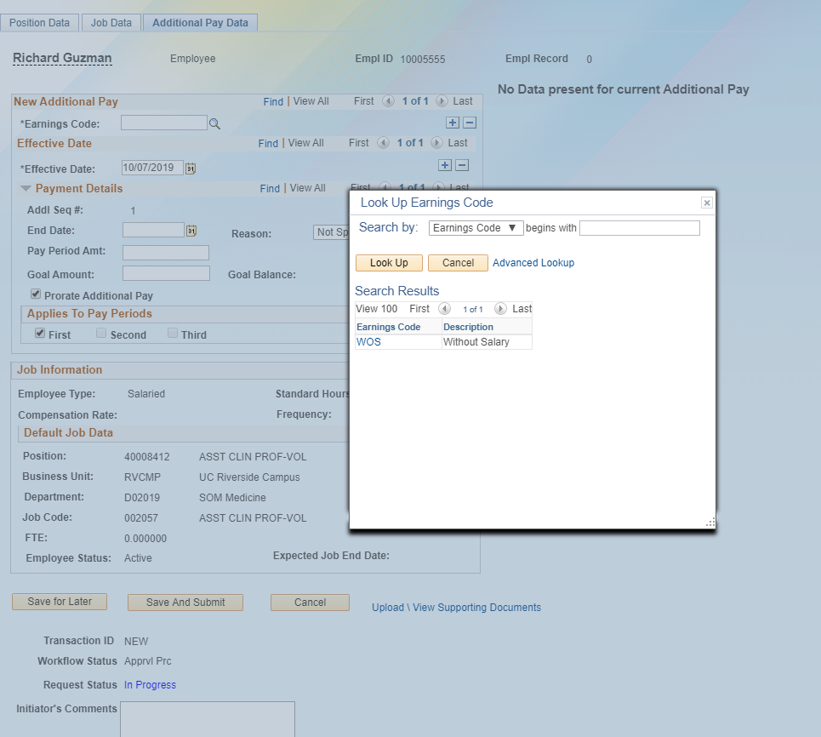
WOS APPOINTEES

Slide 44
PAY IMPACTING FIELDS

Slide 45
PAY IMPACTING FIELDS
FTE
Salary Admin Plan
Grade
Step
Pay Group
Comp Rate
Rate Code
Frequency
FLSA

Slide 46
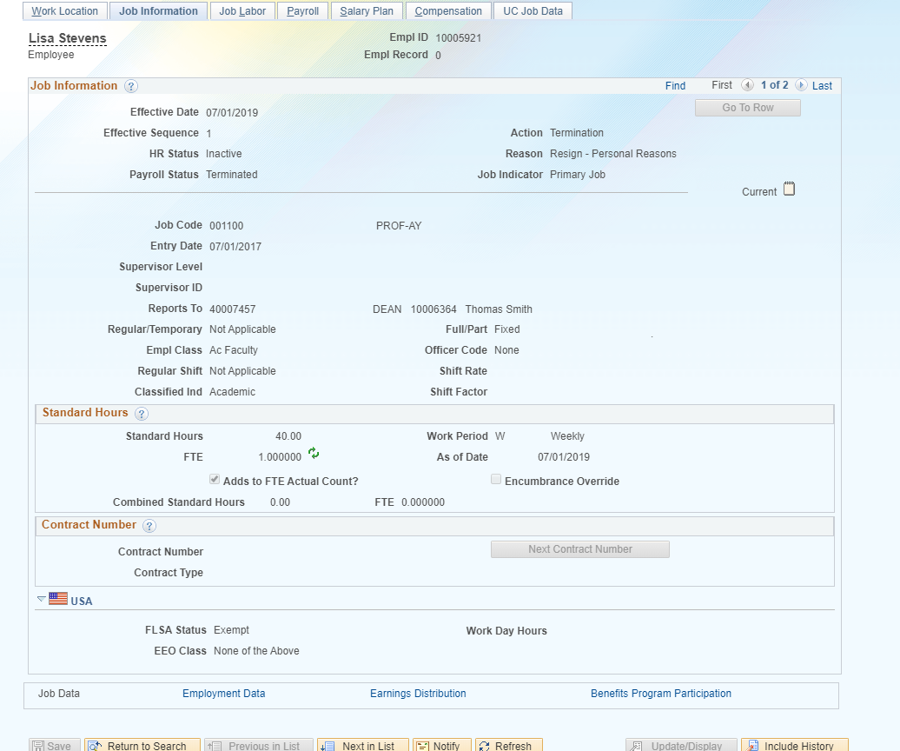
JOB DATA OVERVIEW
Pay impacting fields
FTE
FLSA
Is and can alter pay if not correctly set on position.
Updated by the location.

Slide 47
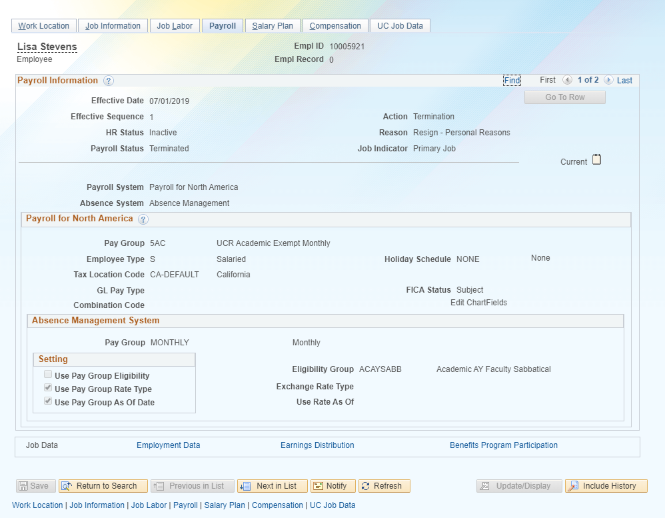
JOB DATA OVERVIEW
Pay impacting fields
Pay Group
Can impact pay if not correctly set up per job details. Becomes a problem with concurrent jobs.
Can only be updated by UCPC.

Slide 48
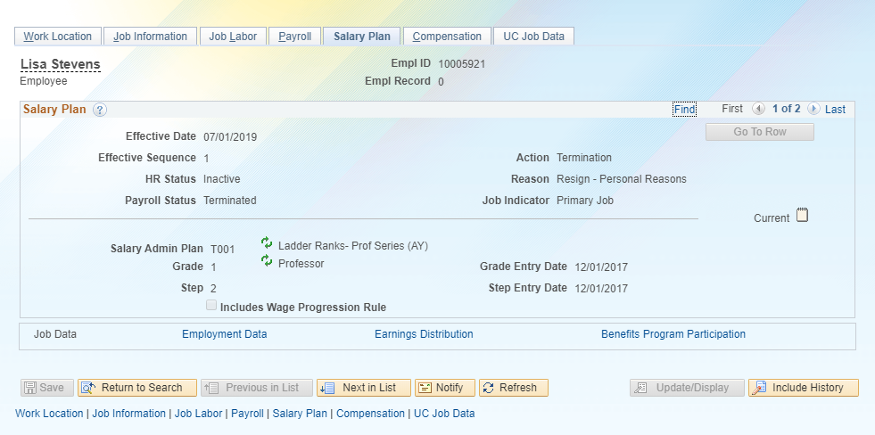
JOB DATA OVERVIEW
Pay impacting fields
Salary Admin Plan
Grade
Step
Can impact pay if not correctly set on position.
Updated by the location.

Slide 49
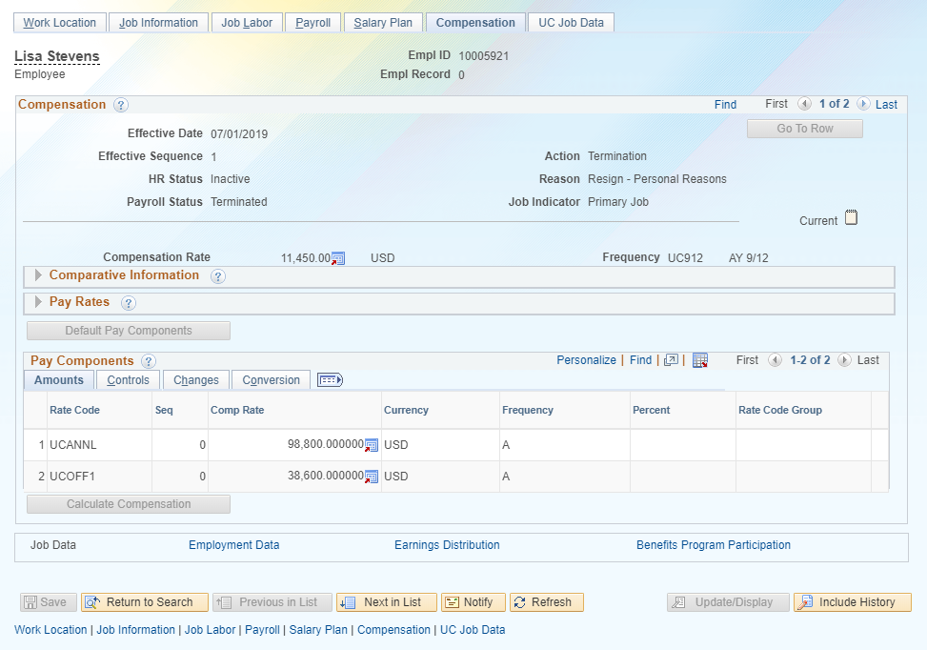
JOB DATA OVERVIEW
Pay impacting fields
Comp rate
Rate code
Frequency
Can impact pay if not correctly set on position.
Updated by the location.

Slide 50
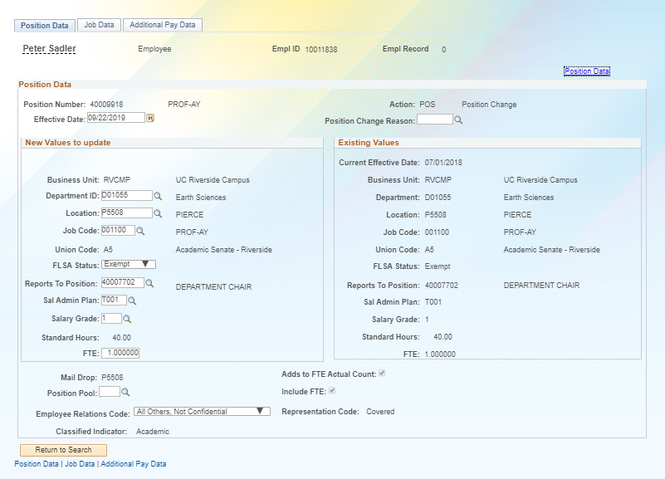
PAYPATH OVERVIEW
Pay impacting fields
FLSA
Sal Admin Plan
Salary Grade
FTE

Slide 51
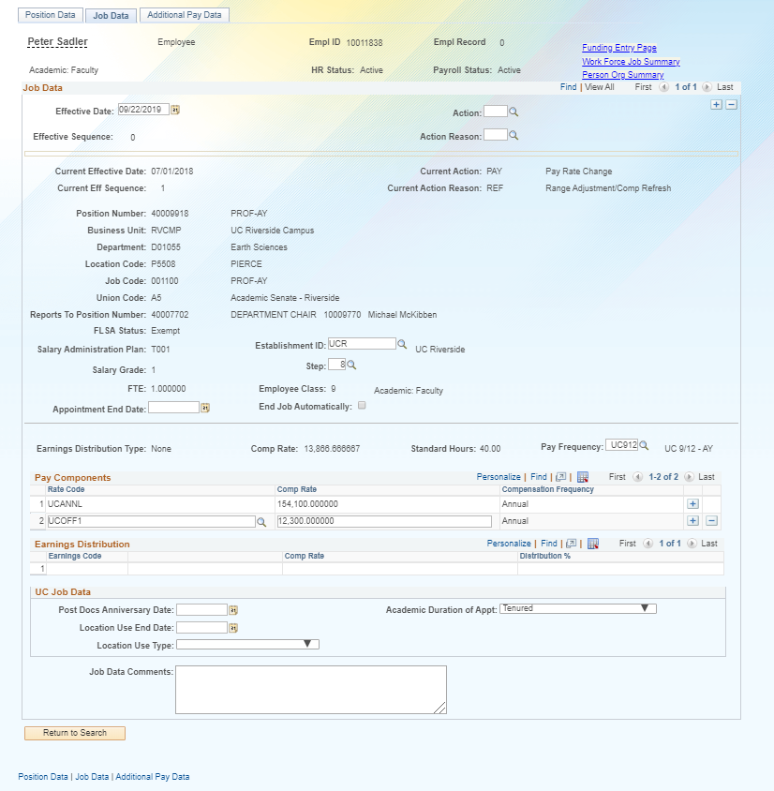
PAYPATH OVERVIEW
Pay impacting fields
Step
Pay Frequency
Comp Rate
Rate Code
Earnings Distribution Type (JED)

Slide 52
MONITORING AND AUDITING TRANSACTIONS

Slide 53
MONITORING AND AUDITING TRANSACTIONS
After approval, confirm what was initiated and approved is actually reflected in PayPath
Transactional Units are responsible for auditing all transactions for their accountability structure
If there are inaccuracies Department/Org/Transactional Units are responsible for ensuring that they are fixed by either correcting them directly or by working with their SSC (per the on behalf of case management matrix or the transaction matrix)
POSSC, CITRUS and HARVEST will do a 2ND level audit on select transaction types and will work with the transactional units on identified issues

Slide 54
UCPATH PROCESSES

Slide 55
UCPATH PROCESSES
E-024 PRIMARY JOB DERIVATION
Derive the new primary job for HR and Benefits based on the changes to the HR primary job (see slide for hierarchy rules)
E-019 AUTOMATE PAY GROUP ASSIGNMENT
The new process will automatically assign new Pay group based rules:
EE has Empl Class change
EE has FLSA status and Comp rate code change
EE has a Job code change
EE has Union code change (this applies to the firefighters for Davis)
EE has Citizenship status and/or NRA income code changes
EE has Alternate work week changes
E-042 BENEFIT ELIGIBILITY
Determines EE benefit eligibility using three factors: percentage, duration, and appointment type. To maintain eligibility employee must maintain an average regular paid time of at least 17.5 hours per week in an eligible appointment type after the 1 year anniversary.

Slide 56
PRIMARY JOB DERIVATION E- 024
HR Primary Job – The Job record that is considered an employee’s main Job.
Benefits Primary Job – The Job records that will set an employee’s Benefits Eligibility.
The E-024 process is scheduled to run nightly to re-derive the primary job when concurrent jobs are added or job data is updated, thus causing an update to the primary job assignments.
This process can happen across business units
Downstream impacts can occur if this is not corrected (i.e. parking citations, LMS log in blocked, benefits)
Notes:
(My Notes) Business rules are hierarchy based and once jobs are equal than the FTE trumps the other, but at times job codes can do this)

Slide 57
PRIMARY JOB DERIVATION E-024
*If you see that the primary job is not correct or accurate you need to work with your Shared Service Center to escalate this issue
Primary job Derivation is based on:
Employees Higher FTE = Primary Job
If FTE is the same, then
Classified Indicator = “MSP”
Classified Indicator = “PSS”
Classified Indicator = “SMG”
If none of the criteria above derives the Primary Job, then the Appointment with the higher salary (comp rate at full time equivalent) should be used as the primary job.
If none of the criteria above derives the Primary Job, then the earlier appointment start date should be used as the Primary Job.
Empl Class =
“Academic – Post Doc”
“Academic – Faculty”
“Academic – Deans/Faculty Administrators”
“Academic - Non-Faculty”
“Academic – Recall”
Empl Class =
“Career”
“Partial Year Career”
“Contract”
“Limited”
Empl Class =
“Per Diem”
“Floater”
“Academic- Student”
“Casual Restricted”
“Rehired Retiree”

Slide 58
WORK STUDY

Slide 59
WORK STUDY
Students employed in Work-Study jobs earn money for their college costs through part-time employment in approved on-campus jobs or off-campus jobs at nonprofit and community service agencies. UCR also employs students who are not eligible for Work-Study in similar campus jobs and provides job listings for off-campus positions through our Career Center.
During the summer students are not eligible for work study so their appointments will need to end, or they will need to be placed in a separate position, or they should be placed on a Short Work Break (SWB).
Students eligible for work study have a portion of their work salary paid by financial aid grants
https://financialaid.ucr.edu/types-of-financial-aid/work-study

Slide 60
ROLES

Slide 61
Transaction Roles
1: Transactional Unit
2: ORG Authority
3: Shared Services Center
4: Central Office
5: UCPath Center

Slide 62
Transaction Roles
Transactional Unit initiates PayPath Actions
Transactional Unit resubmits PayPath Transaction when transaction has been cancelled/denied by the SSC AWE Approver
Transactional Unit is responsible for auditing all transactions
Represent the needs of the individual Transactional Unit and ORG as appropriate
1: Transactional Unit (Initiator)
2: ORG Authority
3: Shared Services Center (AWE Approver)
4: Central Office
5: UCPath Center

Slide 63
Transaction Roles
Responsible for ensuring the appropriate policy is followed.
1: Transactional Unit (Initiator)
2: ORG Authority
3: Shared Services Center (AWE Approver)
4: Central Office
5: UCPath Center

Slide 64
Transaction Roles
Responsible for AWE approval
SSCs will do a 2nd level audit on select transaction types
1: Transactional Unit (Initiator)
2: ORG Authority
3: Shared Services Center (AWE Approver)
4: Central Office
5: UCPath Center

Slide 65
Transaction Roles
Responsible for process design, and policy guidelines.
Provide subject matter expertise in policy related questions.
1: Transactional Unit (Initiator)
2: ORG Authority
3: Shared Services Center (AWE Approver)
4: Central Office
5: UCPath Center

Slide 66
Transaction Roles
Processes corrections if Applicable
1: Transactional Unit (Initiator)
2: ORG Authority
3: Shared Services Center (AWE Approver)
4: Central Office
5: UCPath Center

Slide 67
PERSON ORGANIZATIONAL SUMMARY OVERVIEW

Slide 68
PERSON ORGANIZATIONAL SUMMARY
Navigation: PeopleSoft Menu > Workforce Administration > Personal Information > Person Organizational Summary
Use the Person Org Summary page to view a summary of an employee’s current organizational relationship, including HR and payroll status and all current job assignment details.
The Person Org Summary page displays current employee information for all organizational relationships:
Employee
Contingent Worker (CWR)
Person of Interest (POI)
An employee may have more than one organizational relationship concurrently. For example, the person may be an employee at one UC Location, and a CWR at another.
This page does not display historical or future-dated employment details.
You can view job assignment information for any UC employee; it is not restricted by business unit.

Slide 69
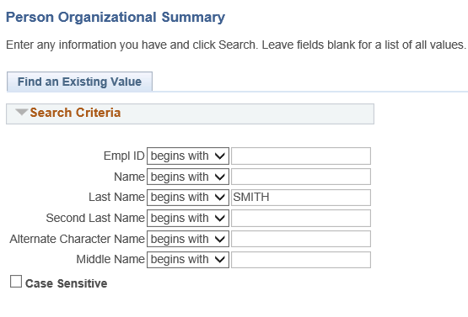
PERSON ORGANIZATIONAL SUMMARY: SEARCH PAGE
Navigation: PeopleSoft Menu > Workforce Administration > Personal Information> Person Organizational Summary
Review the Person Organizational Summary page.
Search by Last Name and determine if a POI, CWR, or EMP instance already exists for the person.
Example: Check to see if Naomi Smith exists in UCPath. Enter her last name and click Search.

Slide 70
PERSON ORGANIZATIONAL SUMMARY
Navigation: PeopleSoft Menu > Workforce Administration > Personal Information > Person Organizational Summary
The header displays the employee’s status information. If there is more than one row of data, click the View All link.

Slide 71
SharePoint Instructions and Hands on Training

Slide 72
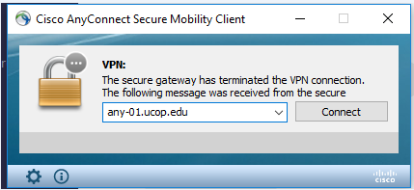
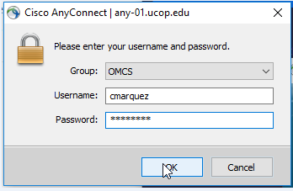
SHAREPOINT LIST INSTRUCTIONS
Open the Cisco AnyConnect client
Enter the VPN name: ANY-01.UCOP.EDU
Click Connect
Select the Group: OMCS
Enter your username and password
Once Connected to the VPN go to https://drppuat02.universityofcalifornia.edu/home
Enter the Tester ID\Password provided in the SharePoint Scenarios.

Slide 73
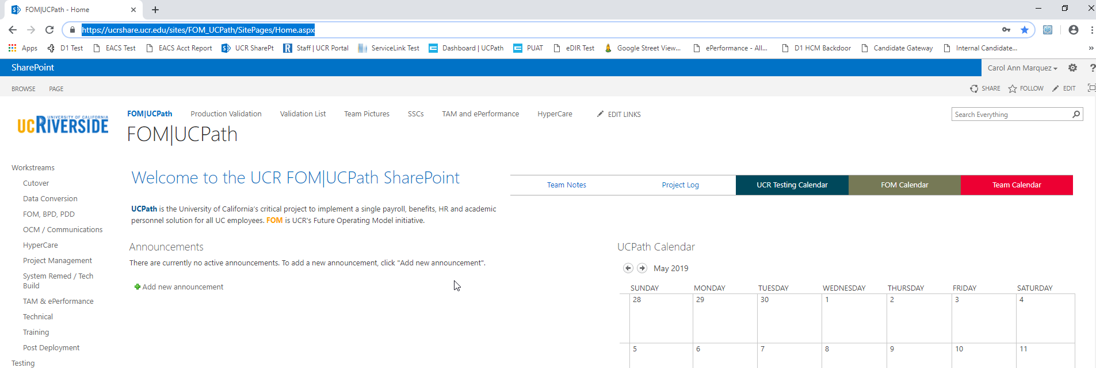
SHAREPOINT LIST INSTRUCTIONS
Testing SharePoint: https://ucrshare.ucr.edu/sites/FOM_UCPath/SitePages/Home.aspx
Preferred browsers are Internet Explorer and Chrome. (Save the link as a favorite)
Select UCPath Transaction Training Scenarios from the left side Quick Menu:

Slide 74
VIEWING LIST OPTIONS
When the list opens, note the tabs at the top of the screen:

Slide 75
VIEWING LIST OPTIONS part 2
By selecting ‘List’ you can filter the view on the process you are transacting. The default view is All Transactions. Select a specific transaction type to view the list containing only those transactions:

Slide 76
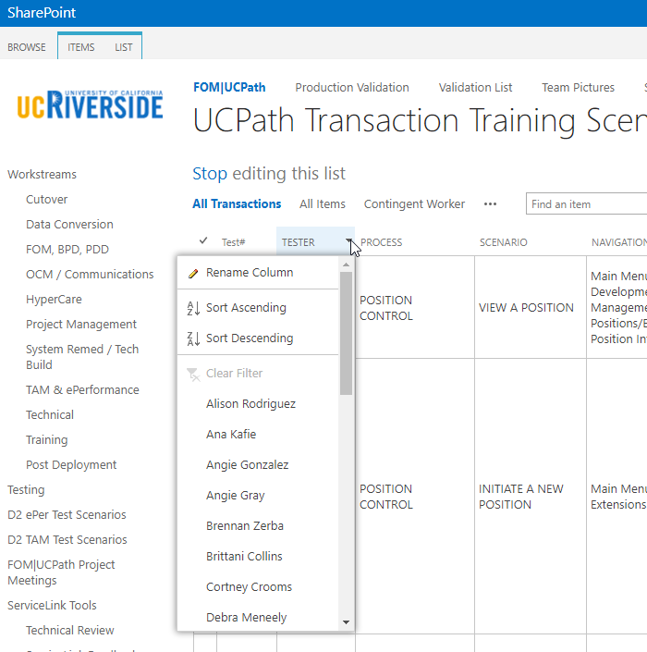
UPDATING AND EDITING A SHAREPOINT LIST
Many functions of a SharePoint list are similar to MS Excel, except that it is in a central location, and can be accessed / updated by multiple people at the same time.
Use the list headers to filter and sort. Only you will see these temporary changes.
By selecting your name in the drop-down, you will have easy access to only your transactions. This is especially helpful if your name appears several pages into the list.

Slide 77
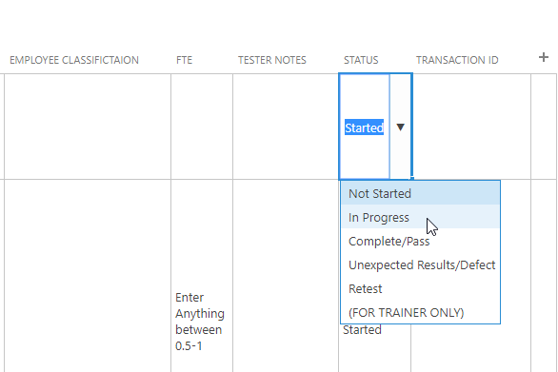
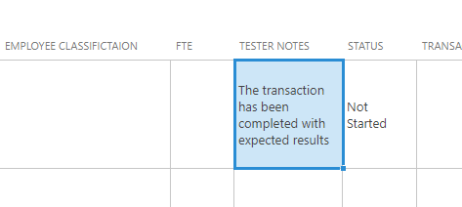
UPDATING AND EDITING A SHAREPOINT LIST part 2
You can update your test by editing directly by clicking into the cell. Some cells are controlled by a drop-down choice; others are free-form. To save your change, click in another cell.

Slide 78
LEARNING OBJECTIVES REVIEW
Having completed this course, you should be able to:
Describe the PayPath Transaction system process.
Initiate Position Data, Job Data Changes, and Additional Pay.
Initiate various PayPath combination transactions.

Slide 79
THINGS TO REMEMBER
Person ORG summary before any transaction is entered into the system
PayPath Actions component is comprised of 3 pages
The pages that make up PayPath Actions component are Position, Job and Additional pay
Each Position Data and/or Job Data transaction must have the same effective date
PayPath only pulls up and allows for transacting on active jobs/employees
Paypath has 8 common action codes for both Staff and Academic transactions
Position Data changes in PayPath Actions can be initiated for filled positions where only one employee is assigned to the position

Slide 80
APPENDIX
PayPath Process Map
PayPath Process Design Workbook
PayPath Checklist
Employee Class
Short Work Break Matrix

Slide 81
Your Feedback Please
http://bit.ly/ucpathpilottrainingphase2

