Slide 1
Ucr ucpath transaction pilot
DAY 1 – paypath for Empl class 5, 9 and 10

Slide 2
SET UP
Notes:
Has everyone already gotten into the system, please connect

Slide 3
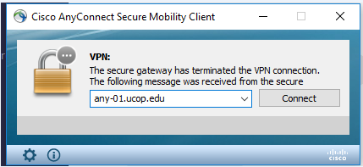
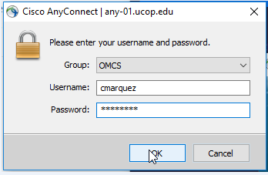
LOG IN INSTRUCTIONS
Open the Cisco AnyConnect client
Enter the VPN name: ANY-01.UCOP.EDU
Click Connect
Select the Group: OMCS
Enter your username and password
ALSO JOIN ZOOM: 9092609322
Once Connected to the VPN go to https://drppuat02.universityofcalifornia.edu/home
Enter the Tester ID\Password provided in the SharePoint Scenarios.
Notes:
Has everyone already gotten into the system, please connect

Slide 4
TRAINER INTRODUCTION
LaKesha Welch, Alexandra Rollins, Antonette Toney
Department: UCPath Campus Support Center

Slide 5
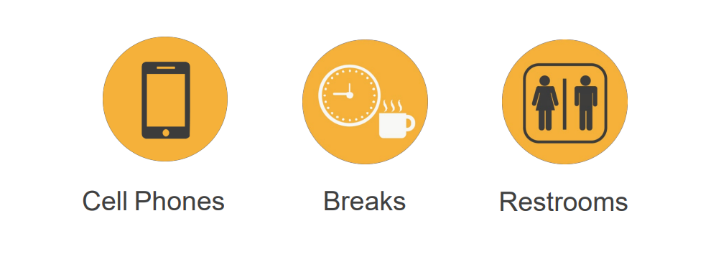
HOUSEKEEPING

Slide 6
LEARNING OBJECTIVES

Slide 7
LEARNING OBJECTIVES
Describe the PayPath Actions Page
Describe the PayPath Transaction process
Define the 8 + 1 ACTION codes common to Staff and Academic Paypath actions
Understand multiple paypath attributes
Select the correct action and reason code AKA “action reason code” for the required transaction
Initiate position data changes, job data changes and Additional Pay transactions

Slide 8
PAYPATH DEFINITION

Slide 9
PAYPATH ACTIONS OVERVIEW
The PayPath Actions page is a customized component (CEMLI E-102) designed just for UC that offers a one-stop shop for processing various types of transactions, and the flexibility to submit multiple actions in a single transaction.
Paypath Actions is a component that contains a subset of the Fields on POSITION and JOBDATA. And, is a clone of the “Recurring” ADDITIONAL PAY PAGE.
PayPath Actions Transactions
Position Data Changes
Job Data Changes
Additional Pay

Slide 10
PAYPATH ACTIONS EXAMPLES
Examples of changes requested through PayPath Actions:
Academic Merit, Promotion or Change in Series
Position and/or Job Data FTE Changes
Salary Only Changes / Pay Rate Changes
Summer Compensation
Change in Status from Without Salary (WOS) to Paid or Paid to WOS
Short Work Break / Return from Short Work Break
Abeyance / Return from Abeyance
Changes to existing concurrent appointments
Recurring Additional Pay Payments
Retro Academic Merits, Promotions, Series Changes
Phased Retirement or Employee Reduction In Time (ERIT)
Probationary Status and Trial Employment Changes

Slide 11
PAYPATH TRANSACTION – SYSTEM PROCESS
Navigation: PeopleSoft Menu > UC Customizations > UC Extensions > PayPath Actions
Enter and Submit PayPath Transaction
Review / Approve PayPath Transaction
View Employee Data
Navigate to PayPath Actions component
PayPath Initiator
PayPath Initiator
PayPath Approver
All

Slide 12
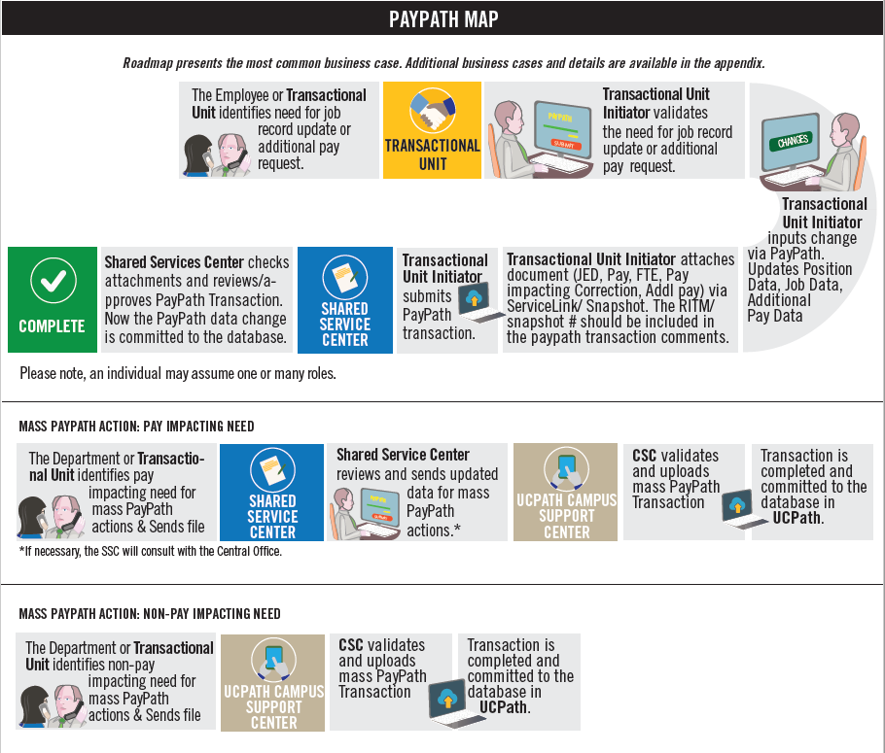

Slide 13
PAYPATH ACTIONS PAGES
There are two PayPath Actions components;
One for ACADEMIC
One for STAFF
The appropriate component displays based on the type of employee selected.
The following types of transactions are processed for staff and academic employees using PayPath Actions:
PayPath Actions Transactions
Position Data Changes
Job Data Changes
Additional Pay

Slide 14
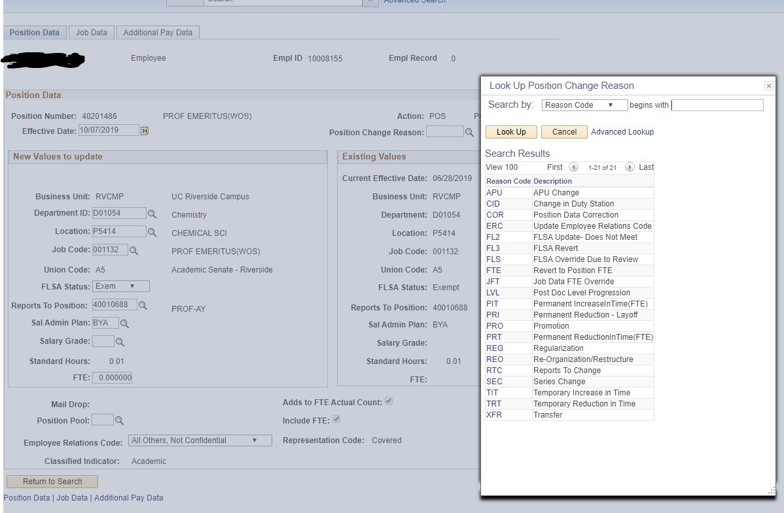
ACADEMIC PAYPATH PAGE
ACADEMIC Reason Codes
APU – APU Change
REG - Regularization
ACADEMIC Jobcode

Slide 15
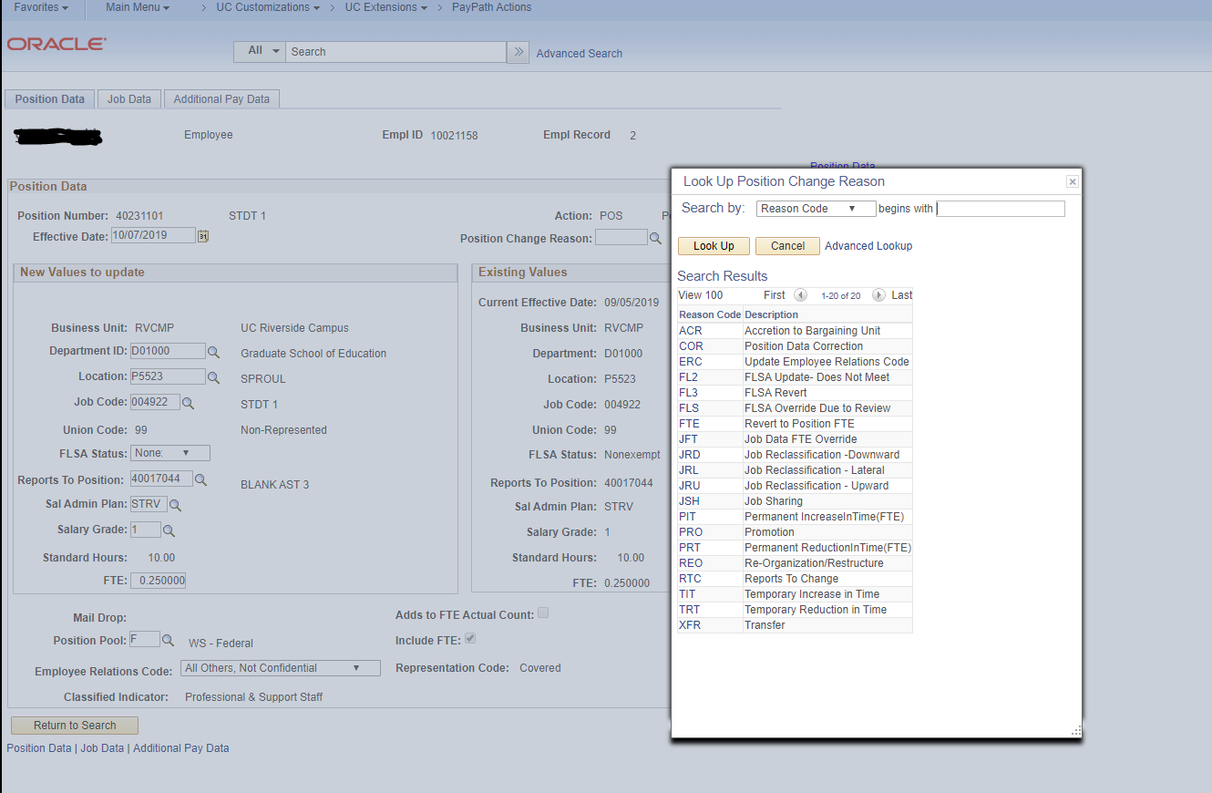
STAFF PAYPATH PAGE
STAFF Reason Codes
JRD – Job Reclassification Downward
ACR – Accretion to Bargaining Unit
STAFF Jobcode

Slide 16
PAYPATH ACTIONS & INDIVIDUAL PAGES
The PayPath Actions page is used for transacting on select Position Fields, select Job Data fields, and all of Recurring Additional Pay Fields. The links to Paypath pages & to the the individual component pages are below.
PAYPATH
POSITION
JOB DATA
ADDITIONAL PAY

Slide 17
PAYPATH ATTRIBUTES

Slide 18
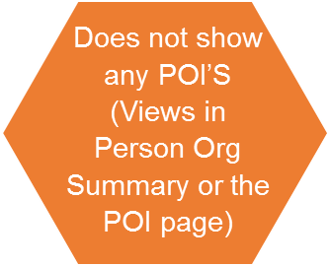
PAYPATH ATTRIBUTES - GENERAL
Most PayPath changes commits to database after approval
PayPath only shows active job records
The PayPath Actions pages display the latest effective dated row. Keep in mind that this could be a future dated row.
Paypath only only allows for changes on Single Incumbent Positions
PayPath does not show CWR’s (Viewed in Job Data)
The Position and Job Data Change entered in Paypath must have the same effective date.

Slide 19
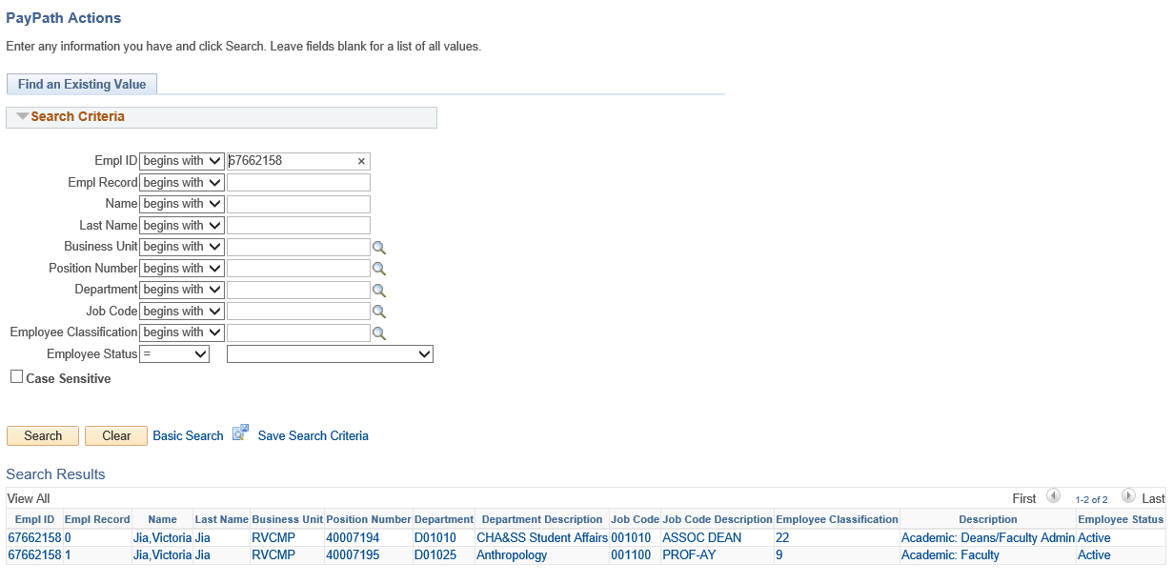
PAYPATH TRANSACTION
Navigation: PeopleSoft Menu > UC Customizations > UC Extensions > PayPath Actions
Enter search criteria to locate an employee. In this example, a search was performed on Employee 67662158.

Slide 20
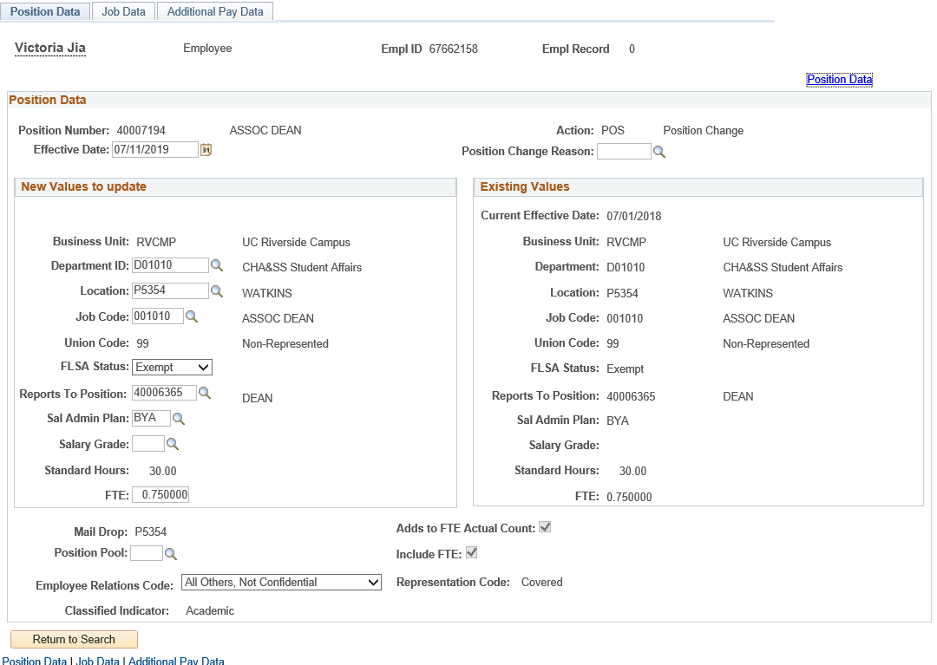
PAYPATH TRANSACTION
Navigation: PeopleSoft Menu > UC Customizations > UC Extensions > PayPath Actions
The PayPath Actions component is comprised of three pages: Position Data, Job Data, and Additional Pay Data. Navigate to the appropriate page to enter the related update.

Slide 21
PAYPATH ACTIONS – POSITION DATA PAGE
Navigation: PeopleSoft Menu > UC Customizations> UC Extensions > PayPath Actions
Use the Position Data page to enter changes to the position data. The Position Data provides two areas: Existing Values and New Values to update. This allows you to compare the existing position information while you enter the updated information. If the employee is in a multi-headcount position, the fields of the Position Data page are view-only, and you cannot enter changes. However, you can still enter Job Data changes.

Slide 22
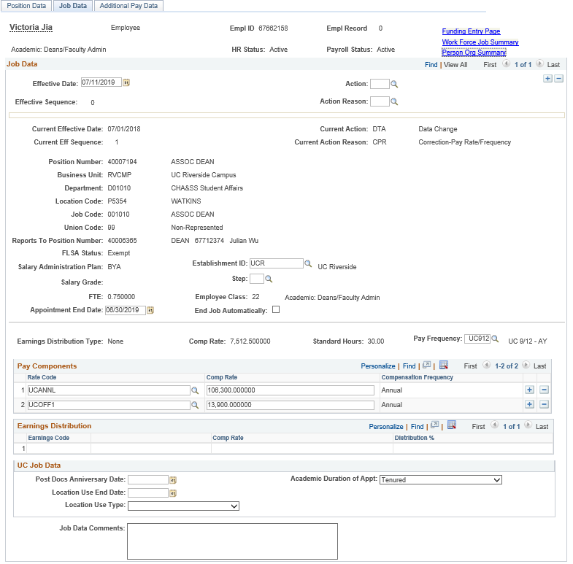
PAYPATH ACTIONS – JOB DATA PAGE
Navigation: PeopleSoft Menu > UC Customizations > UC Extensions > PayPath Actions
Use the Job Data page to enter various job data changes.

Slide 23
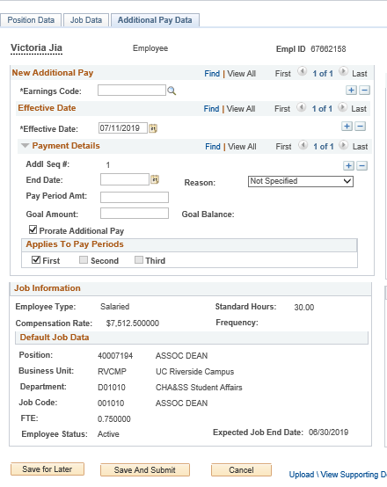
PAYPATH ACTIONS – ADDITIONAL PAY DATA PAGE
Navigation: PeopleSoft Menu > UC Customizations > UC Extensions > PayPath Actions
Use the top portion of the Additional Pay Data page to enter new additional pay information for an employee. If the employee has current additional pay information, it appears on the right side of the page.
The middle section provides details about the employee’s current Job Information.
Use the bottom portion of this page to:
Upload or view supporting documents.
Enter comments to the Approver.
View the Transaction ID, Workflow Status, and Request Status.
The buttons allow you to save the transaction for later processing, submit the transaction for approval, or cancel the transaction.

Slide 24
ACTION REASON CODES

Slide 25
ACTION REASON CODES
There are a total to 8 common ACTION codes for Academic and Staff Paypath Actions Pages
DTA - Data Changes
JED – Job Earnings Distribution Changes
PAY – Pay Changes
POS – Position Changes
RES – Reserve Abeyance
RFR – Return from Reserve Abeyance
RWB – Return from Short Work Break
SWB – Short Work Break
In Addition to the 8 common Action codes above, + 1 Recurring Additional Pay Transactions may be submitted on the Additional Pay Tab on either the Academic or the Staff PayPath Action page.
There currently a total of 66 Action Reason Codes for Academic and a total of 60 Action Reasons Codes for Staff
8 + 1

Slide 26
CHECK YOUR UNDERSTANDING
The PayPath Actions component is comprised of _________pages?
The pages that make up PayPath Actions component are _______ __________ _________ and ________________________?
Each Position Data and/or Job Data transaction must have the same _________?
PayPath only pulls up and allows for transating on ___________ jobs?
Paypath has __________ common action codes for both Staff and Academic transactions.
Notes:
3
Positon, Job and Additional Pay
Effective Date

Slide 27
POSITION DATA CHANGES

Slide 28
POSITION DATA OVERVIEW
Position Data changes can be initiated for filled positions where only one employee is assigned to the position.
The PayPath Actions search page restricts you from accessing a position that is vacant. The system displays a message: “No matching values. You have entered a position number that is vacant.”
The Position Data page appears in display-only mode if the employee selected is in a multi-headcount position, therefore restricting any position data updates.
You can still enter Job Data updates for employees in a multi-headcount position.
If the employee should be broken off from an existing multi-headcount position, their job data must first be updated with the new position.

Slide 29
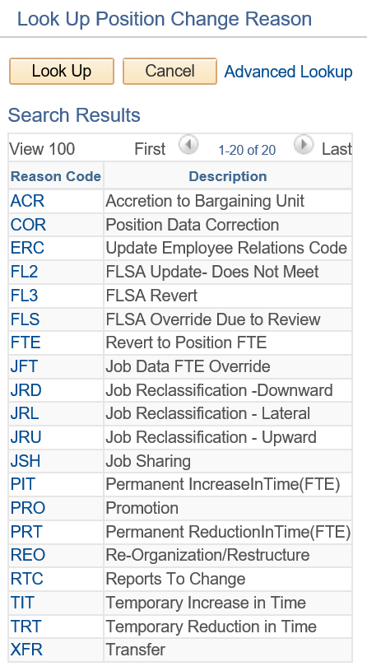
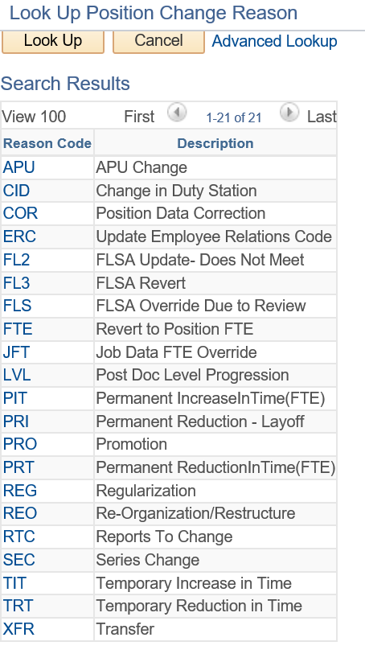
POSITION CHANGE ACTION CODES

Slide 30
POSITION DATA CHANGES
When a Position Data change is entered, a new row with the same Effective Date is automatically inserted in the Job Data page and displays the updated position information.
All Job Data fields that are controlled by Position Data appear as display-only.
If needed, you can add additional Job Data rows (with the same effective date) to add job-related updates.
For example:
Position Data change: Employee promoted to a new job code.
Job Data change: Employee receives a pay rate increase.

Slide 31
POSITION DATA CHANGE – ACTION REASON CODE
Action and Action Reason codes further define the purpose of Position Data Change transactions.
For Position Data Changes, the Action is always the same: POS. You need to complete only the Position Change Reason.

Slide 32
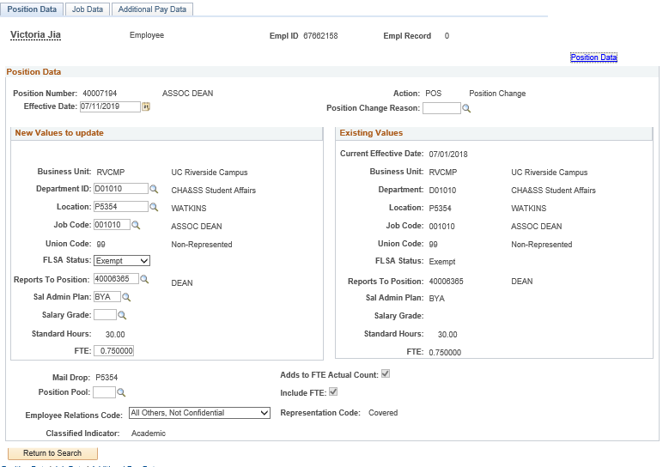
POSITION DATA PAGE
Navigation: PeopleSoft Menu > UC Customizations > UC Extensions > PayPath Actions
Enter the Effective Date for the position update.
Enter the Position Change Reason for the position update.
Use the Position Data page to enter changes to position data.
You must enter the Effective Date and the Position Change Reason fields before entering the update.
The Effective Date cannot be the same date as any existing effective date for the employee in the Position Information component. This is because there is no effective date sequencing for position information. Use the Position Data link to review employee position information including existing effective dates.
Position information updated on this page also updates the Job Data page.
Enter the updates in the editable field(s).

Slide 33
POS- Position Change – Common Action Reason Codes
COMMON
ACADEMIC
STAFF
COR
Position Data Correction
ERC
Update Employee Relations Code
APU
APU Change
CID
Change in Duty Station
LVL
Post Doc Level Progression
REG
Regularization
SEC
Series Change
PRI
Permanent Reduction - Layoff
PRO
Promotion
JRD
Job Reclassification – Downward
JRL
Job Reclassification – Lateral
JRU
Job Reclassification – Upward
JSH
Job Sharing
FLS
FLSA Override Due To Review
JTE
Revert To Position FTE
FL2
FLSA Update- Does Not Meet
JFT
Job Data FTE Override
PIT
Permanent Increase in Time
FL3
FLSA Revert
REO Pre-Organization / Restructure
RTC
Reports To Change
PRT
Permanent Reduction in Time (FTE)
TRT
Temporary Reduction in Time
TIT
Temporary Increase in Time
XFT
Transfer

Slide 34
DEMO
POSITION CHANGE

Slide 35
EMPL CLASS 5

Slide 36
GENERAL DESCRIPTIONS AND ATTRIBUTES
Hourly, paid through TARS biweekly
Less than 50% during academic year
Placed on short work break over the summer (sometimes)
Non-exempt
They don’t have benefits
Some are paid in recurring additional pay with no compensation on job
(Examples: Student activity officials, americorp members, recreational instructors etc.)

Slide 37
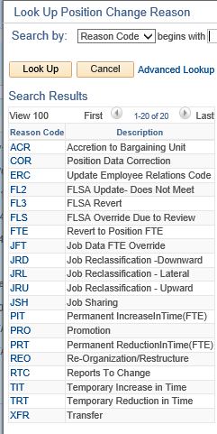
POS- Position Change – EMPL CLASS 5
Student – Casual/Restricted

Slide 38
EMPL CLASS 5 DEMO
Reports To Change (RTC)

Slide 39
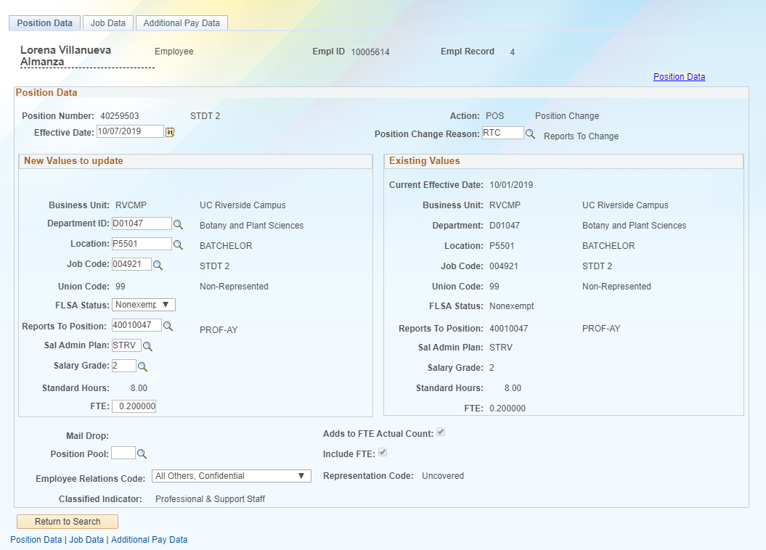

Slide 40
EMPL CLASS 5 DEMO
Employee Relations Code (ERC)
Notes:
(Example: If they have a student that is working with the Dean or Org head and they are dealing with confidential documents then they need to send information to HR to have their ELR updated to the confidential. This example applies to all of them.

Slide 41
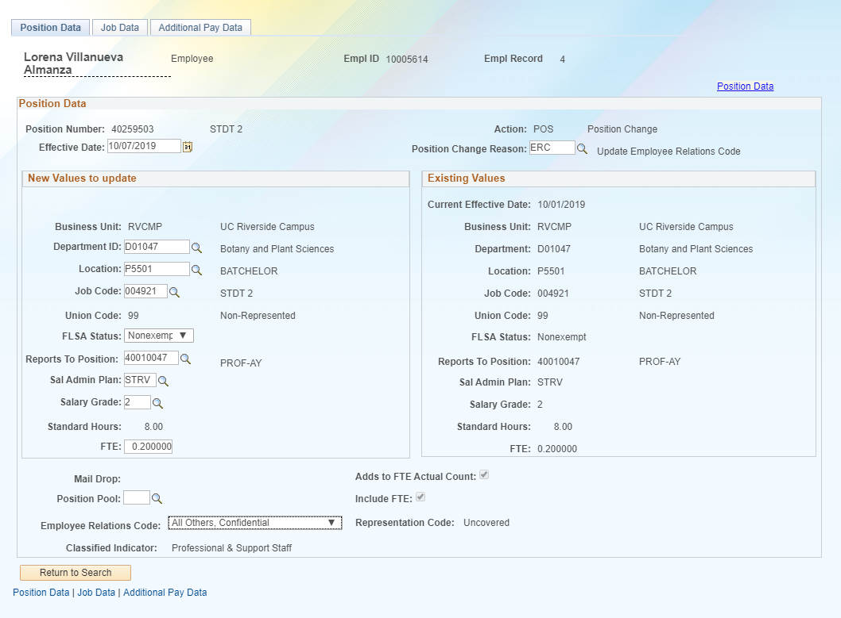
Notes:
(Example: If they have a student that is working with the Dean or Org head and they are dealing with confidential documents then they need to send information to HR to have their ELR updated to the confidential. This example applies to all of them.

Slide 42
EMPL CLASS 9

Slide 43
GENERAL DESCRIPTIONS AND ATTRIBUTES
Reserved Abeyance (RES ABY) only if they have a concurrent 100% faculty administrative appointment
Monthly
Exempt
Eligible for full benefits
Not all are eligible for benefits because it depends on their percentage and number of hours
Ladder Faculty
Lectures
Instructional Faculty

Slide 44
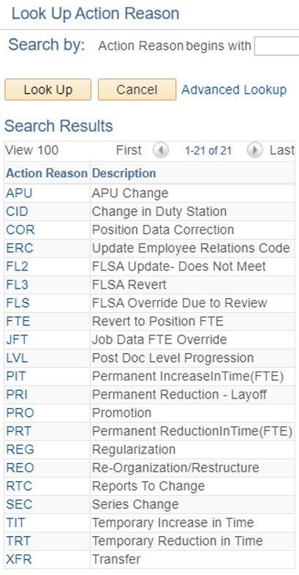
POS- Position Change – EMPL CLASS 9
Academic – Faculty

Slide 45
EMPL CLASS 9 DEMO
Change in Duty Station (CID)
Notes:
(Example: If they have a student that is working with the Dean or Org head and they are dealing with confidential documents then they need to send information to HR to have their ELR updated to the confidential. This example applies to all of them.

Slide 46
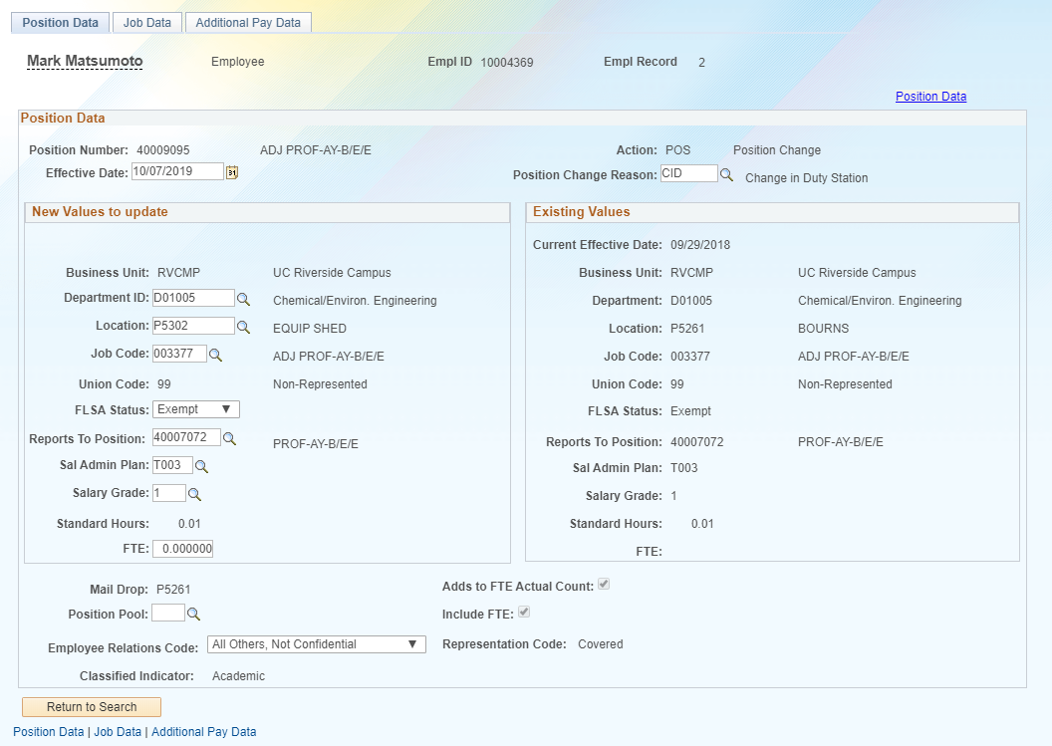

Slide 47
EMPL CLASS 10

Slide 48
GENERAL DESCRIPTIONS AND ATTRIBUTES
Eligible for Short Work Break per the (SWB) matrix
Most are monthly and some are hourly
Mostly 5AC (Academic Compensation)
5MH group (Monthly hourly)
Eligible for Benefits
This depends on FTE and length of the appointment. (Eligibility Guidelines Link)

Slide 49
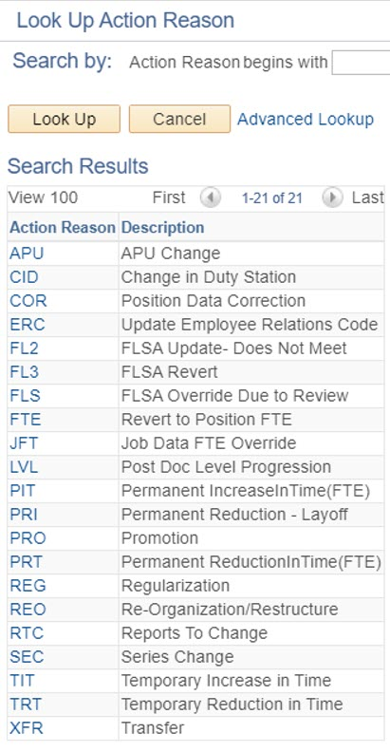
POS- Position Change – EMPL Class 10
Academic – Non Faculty

Slide 50
CHECK YOUR UNDERSTANDING
Position Data changes in PayPath Actions can be initiated for what types of positions?
Position information that is updates on the Position Data page also updates the position-related information in the _______ page?
In addition to the effective date you must always enter the __________?
Notes:
Position Data changes in PayPath Actions can be initiated for filled positions where only one employee is assigned to the position.
Job Data
Positon Change Reason

Slide 51
EMPL CLASS 10 DEMO
PROMOTION (PRO)

Slide 52
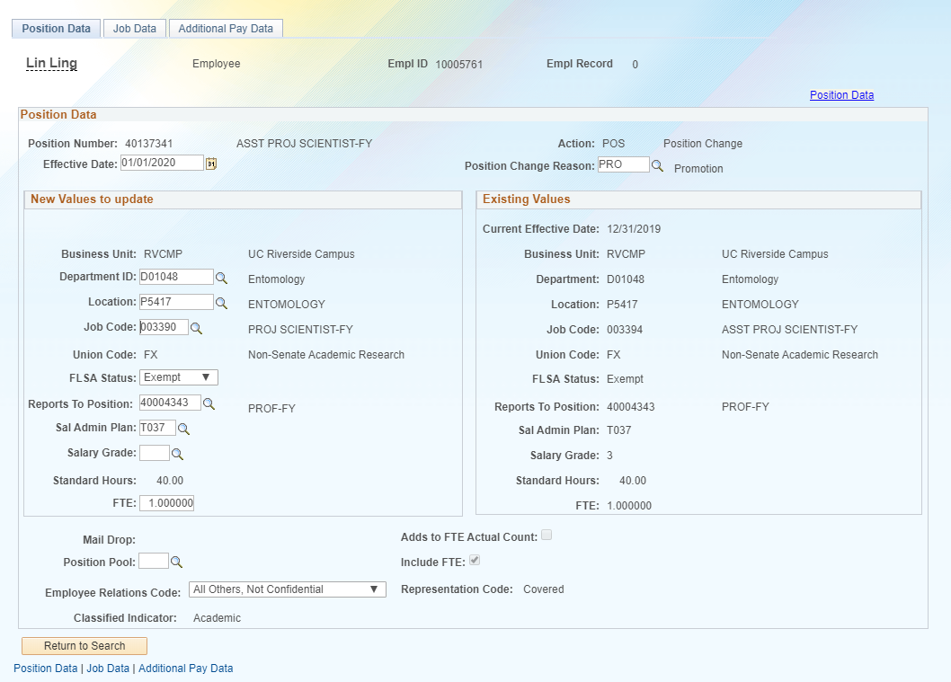

Slide 53
EMPL CLASS 10 DEMO
Temporary Reduction in Time (TRT)

Slide 55
HANDS ON

Slide 56
TRY IT!
Do a RTC Report to change for 2 different employees with applicable empl classes in your unit
Do a TRT temporary reduction in time with applicable empl classes in your unit
Do a PRT permanent increase in time for with applicable empl classes in your unit
Do a PRO Promotion with applicable empl classes in your unit OR
Do a ERC Employee Relation code change

Slide 57
JOB DATA CHANGES

Slide 58
JOB DATA CHANGES OVERVIEW
The Job Data page is used for many types of job-related updates, which can be made independent of a Position Data change.
However, if a Position Data change is made, PayPath automatically updates the employee’s Job Data page to display the new position information.
There are many types of Job Data changes, most of which fall into the first three categories.
Data
Pay Rate
Job Earnings Distribution (JED)
Short Work Break

Slide 59
CHANGE TYPE - DATA
Examples of data changes requested through PayPath include:
Extension of Appointment End Date
Extension of Location Use End Date
Academic Reappointment
Change from Limited to Career Status and Change of Employee Class (Staff Only)
Update to Probation Code and/or Probation Date
Data

Slide 60
CHANGE TYPE – PAY CHANGE
Examples of pay changes requested through PayPath include:
Change to rate of pay for staff or academic
Merit/Reappointment
Equity increases
Changes to negotiated salaries
Adjustments to off-scale salary amounts
Step increase progression
Pay components (for example, X, X’, or Annual Salary) automatically populate based on selection of a salary step.
Pay Rate

Slide 61
CHANGE TYPE – JOB EARNINGS DISTRIBUTION
The Job Earnings Distribution (JED) is primarily used to distribute earnings by earn codes, either by percentage or by amount, and is important for exempt employees as it controls how much they are paid when an adjustment to their FTE is not applicable.
Examples of JED changes requested through PayPath include:
Employee Reduction in Time (ERIT)
Phased Retirement Program
HSCP-related automated JED by Earn Code
NSTP-Negotiated Salary Trial Program
Job Earnings Distribution (JED)

Slide 62
CHANGE TYPE – SHORT WORK BREAK
The UCPath Short Work Break (SWB) process refers to placing an employee on, or returning them from, a short work break.
The action of SWB can be used to stop pay for an employee in the system for a temporary period of time and moves them to a “work break” status.
Employees on SWB are monitored on a regular basis. The UCPath Center is responsible for monitoring the Short Work Break Audit Report, and works with Locations to confirm the appropriate course of action regarding the employee on SWB.
Short Work Break

Slide 63
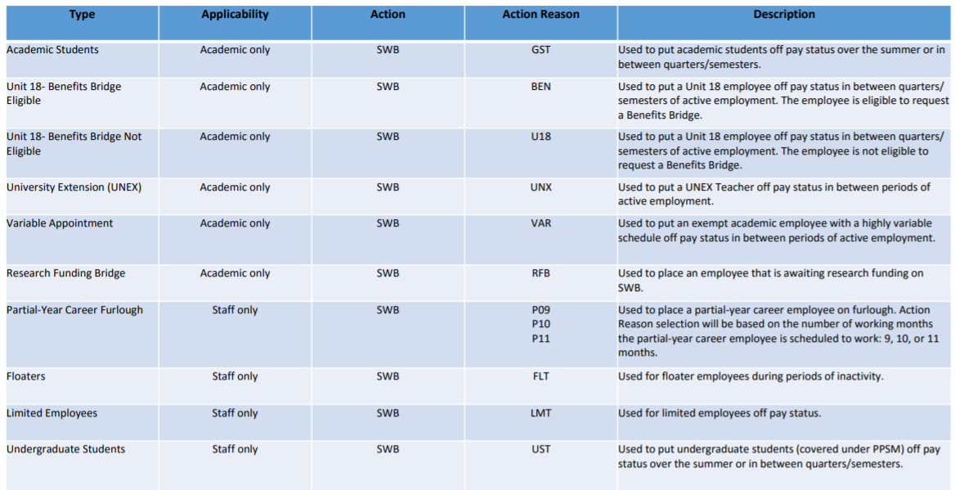
SHORT WORK BREAK
Short Work Break Matrix

Slide 64
MULTIPLE JOB DATA CHANGES
Effective Date sequencing is important when compensation is involved. Guidelines for entering multiple rows of Job Data in a single transaction:
Must be the same Effective Date.
The sequence number is automatically populated when you add a row in the Job Data tab.
Enter the rows in sequential order or the order in which they occur.
Seq. 0 is the first update, then add a row.
Seq. 1 is the next update, then add a row.
Seq. 2 is the next update, and so forth.
Ask KJ for someone that fits this example:
Action | Effective Date | Effective Seq. | Notes
Position Promotion | 3/1/2016 | 0 | Position Data change automatically inserts the first row in PayPath Job Data.
Pay Rate Change / Promotion | 3/1/2016 | 1 | Second row added by user.
Pay Rate Change / Equity | 3/1/2016 | 2 | Third row added by user.

Slide 65
JOB DATA PAGE
Navigation: PeopleSoft Menu > UC Customizations > UC Extensions > PayPath Actions
Enter the Action and Action Reason for the job data update.
Enter the Effective Date for the job data update.
Click + to add multiple job data changes in the same transaction. Multiple changes can be entered only for the same Effective Date.
Use the Job Data page to enter updates to job-related data such as pay, earnings distribution, and short work break.
You must enter the Effective Date and the Action and Action Reason fields before entering an update.
Use the PayPath Job Data Comments to record details about the position and/or job changes.
Notes:
Use the Job Data page to enter updates to job-related data such as pay, earnings distribution and short work break.
You must enter the Effective Date and the Action and Action Reason fields before entering an update.

Slide 66
DTA
DATA CHANGES

Slide 67
DTA– Data Change Common Action Reason Codes
ACADEMIC
COMMON
STAFF
ASM
Active Service Modified Duties
ASR
Return from ASMD
CNT
New Contract (Contract Pay)
EPR
Extension Pending Review
FRQ
Update Job Comp Frequency
PST
Update Post Doc Anniversary Dt
RCN
Remove Contract Pay
REA
Academic Reappointment
UCC
Update off Scale Rate Code
COR
Correction- Non Pay Related
CAR
Limited to Career
ERI
Update ERIT End Date
PHR
Update Phased Retirement End Dt
PRB
Update Probation Code/End Date
TRL
Update Trial Employment Date
CPR
Correction- Non Pay Related
EXP
Extend Expected Return Date
EXT
Add/Extend Appointment
CPT
Change in Percent Time (FTE)
TMF
Update Auto Termination Flag
LUE
Update Location Use End Date

Slide 68
EMPL CLASS 5 DEMO (EXT)

Slide 69
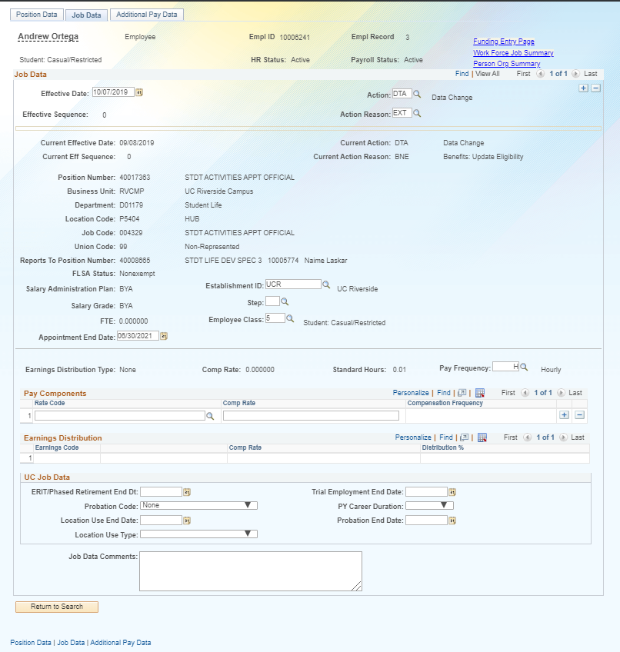

Slide 70
EMPL CLASS 5 DEMO (CPR)

Slide 71
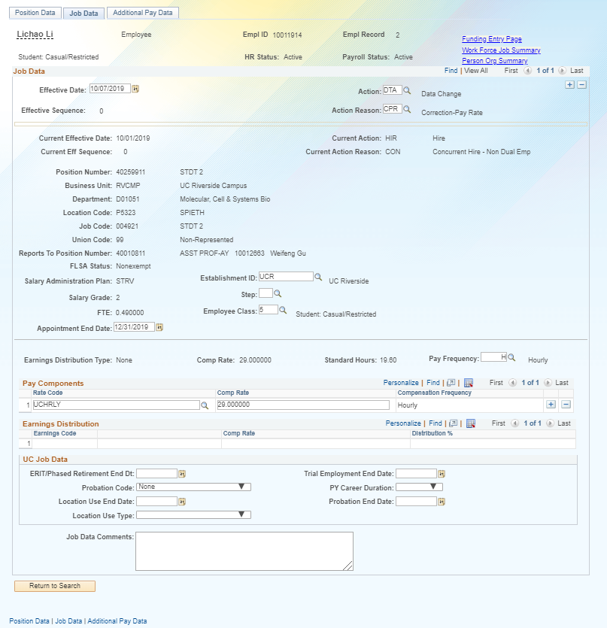

Slide 72
EMPL CLASS 9 DEMO
(ASM)

Slide 73
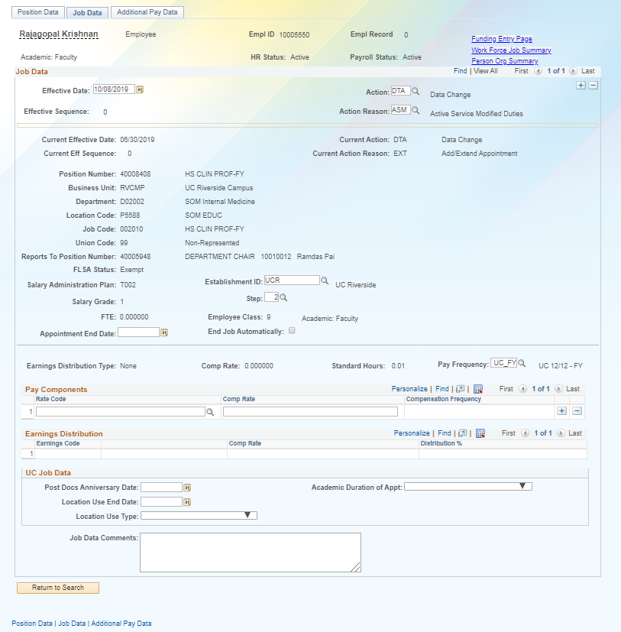

Slide 74
EMPL CLASS 9 DEMO
(REA)

Slide 75
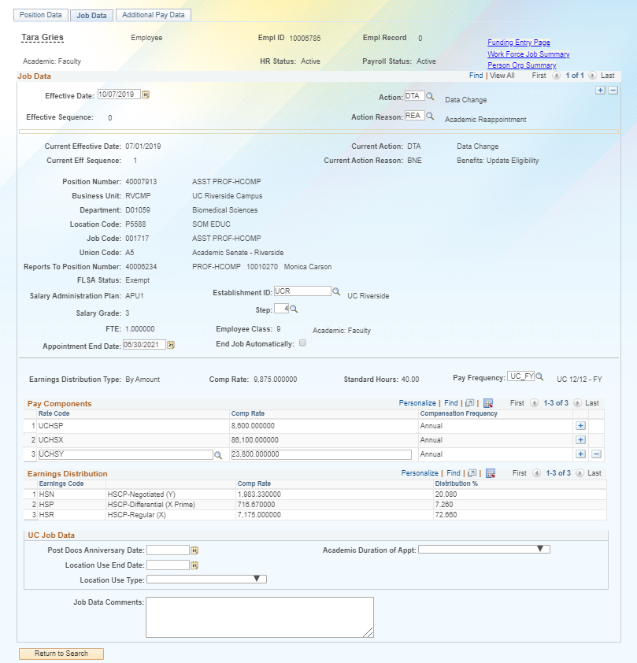

Slide 76
SWB
SHORT WORK BREAK

Slide 77
SWB- Short Work Break – No Common Action Reason Codes
ACADEMIC
STAFF
BEN U18-Benefits Bridge Eligible
GST Academic Students
RFB Research Funding Bridge
U18 U18-Benefits Bridge Not Elig
UNX University Extension
VAR Academic Variable Appointment
Floaters/TOPS FLT
Limited Employees LMT
Partial Year Career - 09 Months P09
Partial Year Career – 10 Months P10
Partial Year Career – 11 Months P11
Staff Students UST

Slide 78
SHORT WORK BREAK ATTRIBUTES
Short Work Break SWB
Place an Employee on SWB
Return employee back to work
Extend Short Work Break
Terminate employee

Slide 79
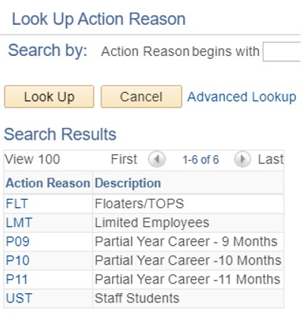
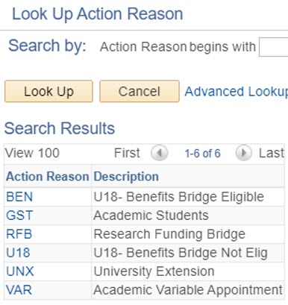
SWB- Short Work Break – No Common Action Reason Codes
Empl Class 5
Empl Class 9 & 10

Slide 80
EMPL CLASS 5 DEMO (UST)

Slide 81
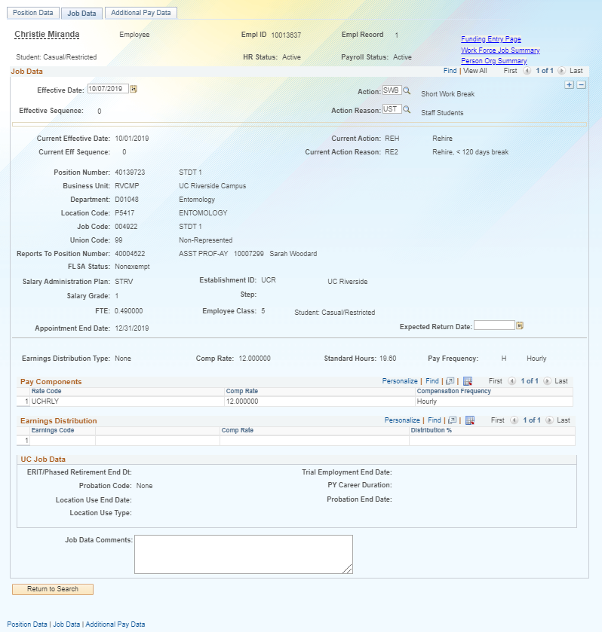

Slide 82
EMPL CLASS 9 DEMO (UNX)

Slide 83
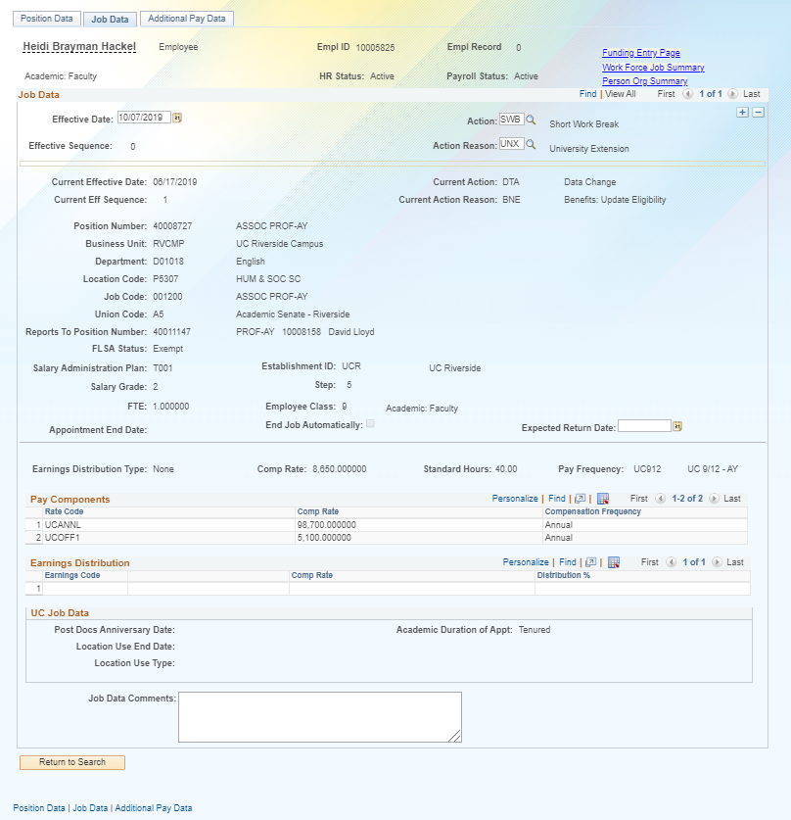

Slide 84
EMPL CLASS 10 DEMO (VAR)

Slide 85
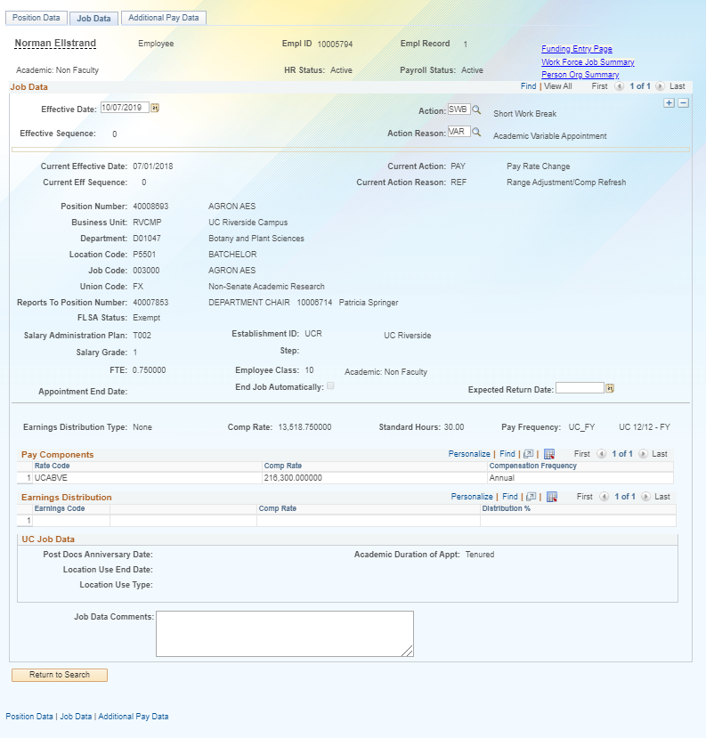

Slide 86
JED
JOB EARNINGS DISTRIBUTION

Slide 87
JED– Earnings Distribution Change - Common Action Reason Codes
ACADEMIC
COMMON
STAFF
JED
Negotiated Compensation Plans
ERT
ERIT-EE Reduction in Time
PHR
Update Phased Retirement End Dt
RET
Return to Normal Hours/Dist

Slide 88
EMPL CLASS 10 DEMO (JED)

Slide 89
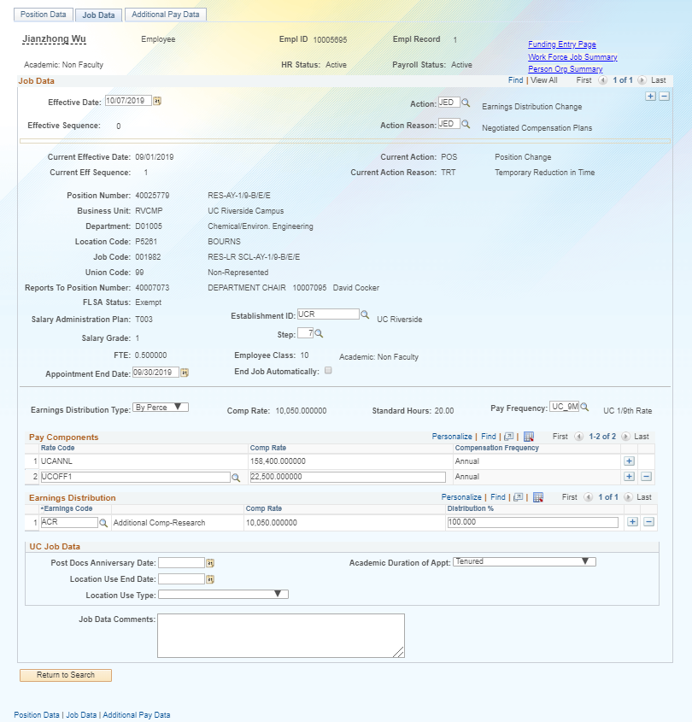

Slide 90
RES
RESERVE FACULTY ABEYANCE

Slide 91
RESERVE ABEYANCE ATTRIBUTES
Reserve Abeyance RES/ABY
Place and academic employee on RES/ABY
Return academic employee back to work
Extend academic employees RES/ABY
Terminate academic employee

Slide 92
RES- Reserve/Faculty Abeyance– No Common Action Reason Codes
ACADEMIC
STAFF
ABY Faculty Abeyance
RES Reserve Appointment (Staff)

Slide 93
EMPL CLASS 9 DEMO Faculty Abeyance (ABY)

Slide 94
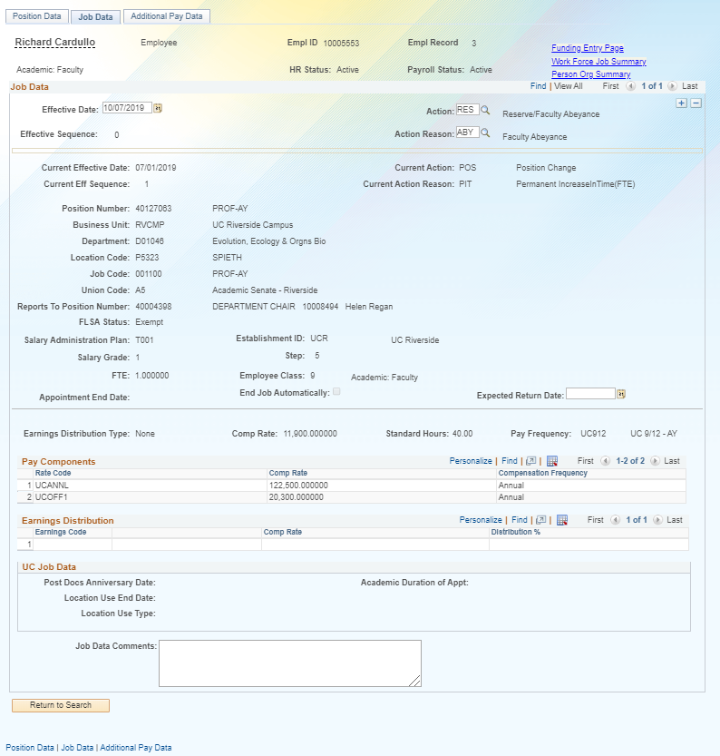

Slide 95
HANDS ON

Slide 98
SharePoint Instructions and Hands on Training

Slide 99
SHAREPOINT LIST INSTRUCTIONS
Open the Cisco AnyConnect client
Enter the VPN name: ANY-01.UCOP.EDU
Click Connect
Select the Group: OMCS
Enter your username and password
Once Connected to the VPN go to https://drppuat02.universityofcalifornia.edu/home
Enter the Tester ID\Password provided in the SharePoint Scenarios.

Slide 100
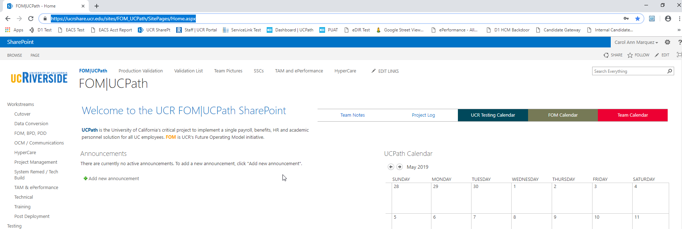
SHAREPOINT LIST INSTRUCTIONS
Testing SharePoint: https://ucrshare.ucr.edu/sites/FOM_UCPath/SitePages/Home.aspx
Preferred browsers are Internet Explorer and Chrome. (Save the link as a favorite)
Select UCPath Transaction Training Scenarios from the left side Quick Menu:

Slide 101
VIEWING LIST OPTIONS
When the list opens, note the tabs at the top of the screen:

Slide 102
VIEWING LIST OPTIONS part 2
By selecting ‘List’ you can filter the view on the process you are transacting. The default view is All Transactions. Select a specific transaction type to view the list containing only those transactions:

Slide 103
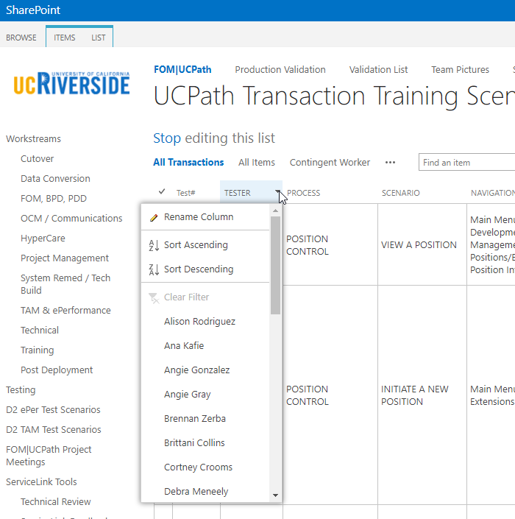
UPDATING AND EDITING A SHAREPOINT LIST
Many functions of a SharePoint list are similar to MS Excel, except that it is in a central location, and can be accessed / updated by multiple people at the same time.
Use the list headers to filter and sort. Only you will see these temporary changes.
By selecting your name in the drop-down, you will have easy access to only your transactions. This is especially helpful if your name appears several pages into the list.

Slide 104
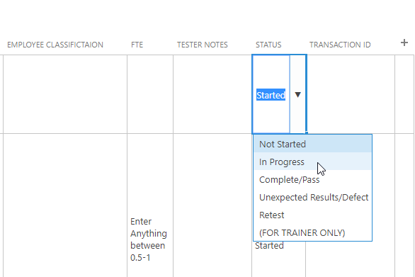
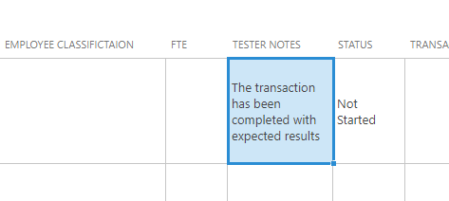
UPDATING AND EDITING A SHAREPOINT LIST part 2
You can update your test by editing directly by clicking into the cell. Some cells are controlled by a drop-down choice; others are free-form. To save your change, click in another cell.

Slide 105
LEARNING OBJECTIVES REVIEW
Having completed this course, you should be able to:
Describe the PayPath Transaction system process.
Initiate Position Data, Job Data Changes, and Additional Pay.
Initiate various PayPath combination transactions.

Slide 106
APPENDIX
PayPath Process Map
PayPath Process Design Workbook
PayPath Checklist
Employee Class
Short Work Break Matrix

Slide 107
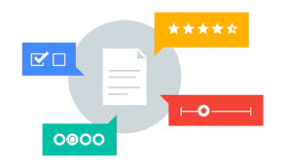
Your Feedback Please
http://bit.ly/ucpathpilottrainingphase2

