Slide 1
Ucr ucpath transaction pilot
Offboarding involuntary termination

Slide 2
TRAINER INTRODUCTION
Sonya Potter
Title: Graduate Student Support Lead UCPath Business Support Analyst
Department: Campus Support Center
Years @UC: 2 years
Previous Experience: 16+ years of experience in creating detailed business processes, re-case business flow into system specifications, develop job aids, training, and testing documents for established national industry competitive technology platforms.

Slide 3
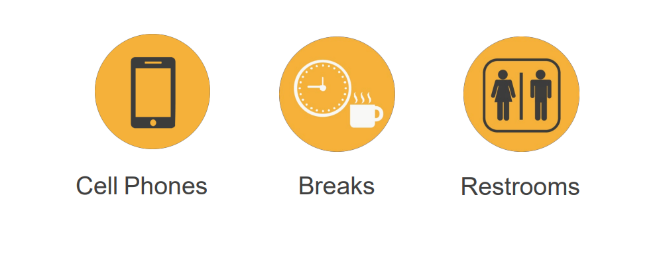
HOUSEKEEPING

Slide 4
LEARNING OBJECTIVES
Understand what an Involuntary Termination is
Review Involuntary Termination Process Overview
Review Involuntary Termination Action Reason Codes
Review Involuntary Termination Template Transaction
Gain skill in transacting Involuntary Terminations

Slide 5
AGENDA
Activity | Time
Intro, Objectives, and Topics | 1:00 – 1:10
Policies Related to Onboarding | 1:10 – 1:30
Definition & Overview | 1:30 – 1:40
Process | 1:40 – 2:10
Break | 2:10 – 2:20
AR Codes | 2:20 – 2:30
AR Code Educational Activity | 2:30 – 2:45
Roles | 2:45 – 3:00
Access PLUAT | 3:00 – 3:05
Initiating as a Class | 3:05 – 3:30
Initiating Independently | 3:30 – 4:00
Transaction Status | 4:00 – 4:15
Change Impacts | 4:15 – 4:30
SharePoint Instruction /Hands on Scenario Activities | 4:30 – 4:45
Q & A, Feedback, and Close | 4:45 – 5:00

Slide 6
Policies Related to Involuntary Termination

Slide 7
POLICIES RELATED TO INVOLUNTARY TERMINATION*
PPSM-60: Layoff & Reduction in Time & Local Procedure-60: Layoff & Reduction in Time
Temporary
Indefinite
Severance Pay
Preferential rehire and recall rights per applicable CBA
Pay in lieu of notice
Layoff Information for Supervisors
Layoff & Reduction in Time – Information, Process & Resources
PPSM-64: Termination & Job Abandonment & Local Procedure-64: Termination & Job Abandonment
Job Abandonment
Release from probation
Corrective Action vs. Immediate Dismissal
Pay in Lieu of Notice
PPSM-66: Medical Separation & Local Procedure-66: Medical Separation
Bases for Medical Separation
Notice of Intent to Medically Separate
Notice of Medical Separation
* Represented staff are governed by their relevant bargaining unit contract: https://hr.ucr.edu/about-us/employee-and-labor-relations/collective-bargaining/elr-union-contacts-representative-contacts

Slide 8
KEY POLICY POINTS RELATED TO INVOLUNTARY TERMINATION
Employees may exercise their right to file a complaint regarding an adverse employment action. To mitigate risk, hiring managers should follow a formal separation process in accordance with UC policies, CBAs and applicable law. This may include:
Maintaining records of annual performance evaluations and performance improvements plans.
Records of timely and progressive disciplinary actions.
Keeping a paper trail of all the events, communications and personnel actions leading up to the separation.
Working closely with their HRPB/HR Officer to address employee issues as soon as they arise documenting the steps taken to resolve the issue. The HRBP/HR Officer will work with Employee and Labor Relations as soon as the department has decided to separate an employee.
In the event of a reduction in force, the HRBP and ELR will help departments manage the layoff action from designing an implementation strategy to managing post-employment issues.
Promptly engage the campus disability management coordinator regarding employee reasonable accommodation due to a disability and respond to employee concerns in a timely manner.

Slide 9
RESOURCES FOR INVOLUNTARY TERMINATIONS
Employee & Labor Relations Website
Contact | Title | Phone | Email
Kristin Branson | Interim ELR Director | (951) 827-5091 | kristin.branson@ucr.edu
Karen Logue | Principal ER Analyst | (951) 827-5272 | Karen.logue@ucr.edu
Rose Rouille | Principal ER Analyst | (951) 827-1403 | Rose.rouille@ucr.edu
Paul Wood | Principal ER Analyst | (951) 827-5092 | Paul.wood@ucr.edu
Michael Duenas | Principal LR Analyst | (951) 827-1414 | Michael.Duenas@ucr.edu
Mariela Bridges | ELR Assistant | (951) 827-3641 | mariela.bridges@ucr.edu

Slide 10
ACADEMIC POLICIES
Below are the Academic Personnel Manual (APM) policies related to involuntary separations, which can be found on the UCOP website, https://www.ucop.edu/academic-personnel-programs/academic-personnel-policy/:
075: Termination for Incompetent Performance
080: Medical Separation
133-20: Notice of Non-Reappointment
137: Non-Senate Academic Appointees/Term Appointments
145: Non-Senate Academic Appointees/Layoff and Involuntary Reduction in Time
150: Non-Senate Academic Appointees/Corrective Action and Dismissal
700-30: Presumptive Resignation Policy and Procedures
765: Death Payments
Labor Contracts
Limitation on Total Period of Service with Certain Academic Titles APM-133PDF

Slide 11
ACADEMIC POLICIES
Non-Senate Call (Appointment and Promotion): https://academicpersonnel.ucr.edu/sites/g/files/rcwecm1261/files/2019-04/Non-Senate%20Call%20-%2018-19%20FINAL%20%28April%202019%29.pdf
Represented Contracts:
Lecturers (IX – Unit 18): https://ucnet.universityofcalifornia.edu/labor/bargaining-units/ix/contract.html
Librarians (LX – Unit 17): https://ucnet.universityofcalifornia.edu/labor/bargaining-units/lx/contract.html
ASEs (BX): https://ucnet.universityofcalifornia.edu/labor/bargaining-units/bx/contract.html
Postdocs (PX): https://ucnet.universityofcalifornia.edu/labor/bargaining-units/px/contract.html
For questions or more information please contact Sonia Kalogonis in the Academic Personal Office 951-827-2934.

Slide 12
Involuntary Termination Definition

Slide 13
INVOLUNTARY TERMINATION DEFINITION
An involuntary termination is a separation action initiated by the campus or is as result of the death of an employee.
The Involuntary Termination process starts when the Department/Org. decides to terminate or layoff an employee, or learns of the death of an employee.
Involuntary Terminations are processed for both staff and academic employees. There are benefits and payroll implications for Involuntary Terminations, these are dealt with in separate processes.
The process ends with the confirmation that the employee has been separated, all access to systems and facilities has been updated or terminated and all outstanding university and employee obligations related to compensation are settled. Lastly, the final payment information is transferred to the UCPath Center Payroll Production team.

Slide 14
Involuntary Termination Process Overview

Slide 15
INVOLUNTARY TERMINATION - OVERVIEW
There are two templates available for terminations: Voluntary and Involuntary.
Initiate an Involuntary termination template when:
A Department or Org. decides to Terminate an Employee, or upon the Death of an Employee.
Available Templates
NOTE: The process of initiating a Voluntary Termination template was discussed during Phase I of the Pilot.

Slide 16
INVOLUNTARY TERMINATION – OVERVIEW
The termination template is used for academic and staff terminations.
Initiators can submit templates only for employees within departments for which they have security access.
If needed, you must coordinate with other departments for terminating other UC jobs.

Slide 17
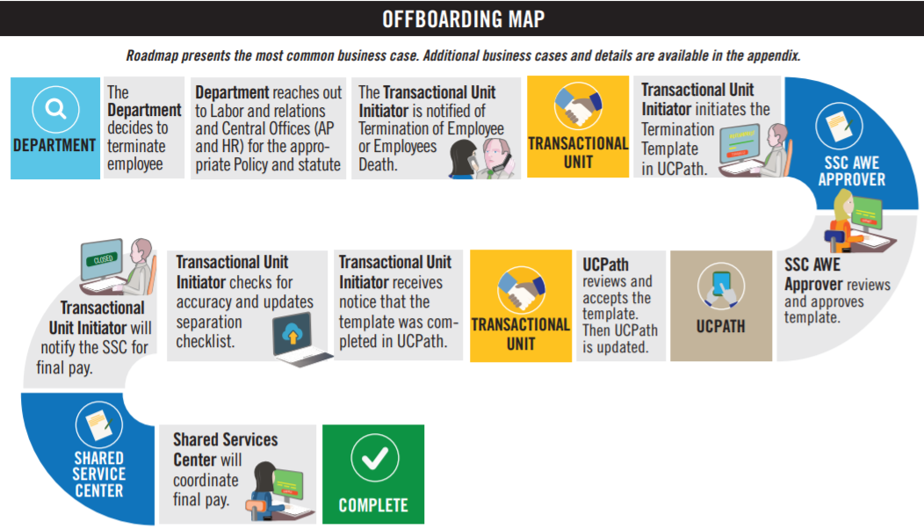
HIGH LEVEL PROCESS OVERVIEW
PHASE2
For complete map, consult the Involuntary Termination Infographic

Slide 18
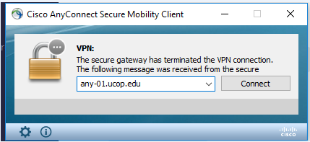
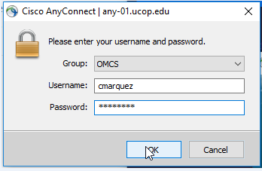
SHAREPOINT LIST INSTRUCTIONS
Open the Cisco AnyConnect client
Enter the VPN name: ANY-01.UCOP.EDU
Click Connect
Select the Group: OMCS
Enter your username and password
Once Connected to the VPN go to https://drppuat02.universityofcalifornia.edu/home
Enter the Tester ID\Password provided in the SharePoint Scenarios.

Slide 19
TERMINATION – KEY SYSTEM STEPS
Important:
When reviewing the Person Org Summary Page, look for other jobs the employee may have. This will help to coordinate with other Depts./Orgs.
Enter termination details and attach supporting documents as needed
Review Person Org Summary page
Navigate to the
Smart HR Transactions page
Initiate final pay
Select the Termination template
Save and Submit
Important:
The SSC will initiate final pay on Involuntary Terminations.
Notes:
DEMONSTRATE

Slide 20
CHECK YOUR UNDERSTANDING
What template is used to process a Retirement?
How do you terminate an employee from all jobs?
Who is the AWE Approver for Involuntary Termination Phase II?
Notes:
#1 – Voluntary Termination
#2 - Coordinate with other SSC/Depts.
#3 - SSC

Slide 21
Involuntary Termination Action Reason Codes

Slide 22
INVOLUNTARY TERMINATION ACTION REASON CODES
There are various Action Reason Codes for Involuntary Termination. Some, however, are for very specific circumstances. If you have a question on which Action Reason Code to use, please contact AP or HR Central Offices for guidance.
Action Reason | Description
Acad-Incompetent Performance | Academic Personnel Use. Used for termination of employee due to poor performance per APM 075
Acad – Presumptive Resignation | Academic Personnel Use. Used for when an appointee chooses not to return to his/her University appointment following the expiration of a leave of absence, or chooses to be absent from that appointment without obtaining prior approval for a leave. Per APM 700-30
Acad – Terminal Appointment | Academic Personnel Use. Used to terminate an academic appointee who did not receive tenure.
Appointment Expired | Used for the termination of an appointment with a fixed end date or expiration of contract in accordance with terms of the contract or appointment
Death | Used to terminate employment due to death
Dismissal – Attendance | Used for termination due to employees excessive absences
Dismissal – Falsified App | Used for termination due to falsifying information on application
Dismissal – Misconduct | Used for termination due to misconduct
Dismissal – No Longer Cert/Lic | Used for termination due to lack of license or certificate
Dismissal – Lack of Performance | Used for termination due to poor performance
Do Not Protest (Settlement) | Used to terminate someone who has a settlement with the University. UCPath Center will not protest any UI claims if the employee has this action/reason code.

Slide 23
INVOLUNTARY TERMINATION ACTION REASON CODES
Action Reason | Description
Layoff – Rehire/Recall Rights | Used for indefinite Layoff – Rehire/Recall Rights
Do Not Rehire (Settlement) | Agreement/Settlement – Employee agrees not to return. See Appendix A for example
Layoff – Severance | Used for indefinite Layoff – Severance
Layoff – Reduce Sev, Reh/Recall | Used for indefinite Layoff – Reduced Severance and Preferential Rehire/Recall Rights
Medical Separation | Used for termination due to an employee who became unable to perform essential functions of his position due to a disability
Never Started Employment | Used for termination of an employee who never started employment. This is used to void the employment record rather than deleting it
No Longer Student | Used for termination of an employee who graduated or is no longer a student
Per Diem Release | Used to terminate an employee due to the end of a per diem appointment
Release fr Trial Emplmnt-Invol | Used for release from trial employment initiated by the university
Released During Probation | Used to terminate an employee due to not passing probation
Visa/Work Permit Expired | Used to terminate an employee due to expiration of Visa or Work Permit
Notes:
Have discussion regarding what action/reason codes

Slide 24
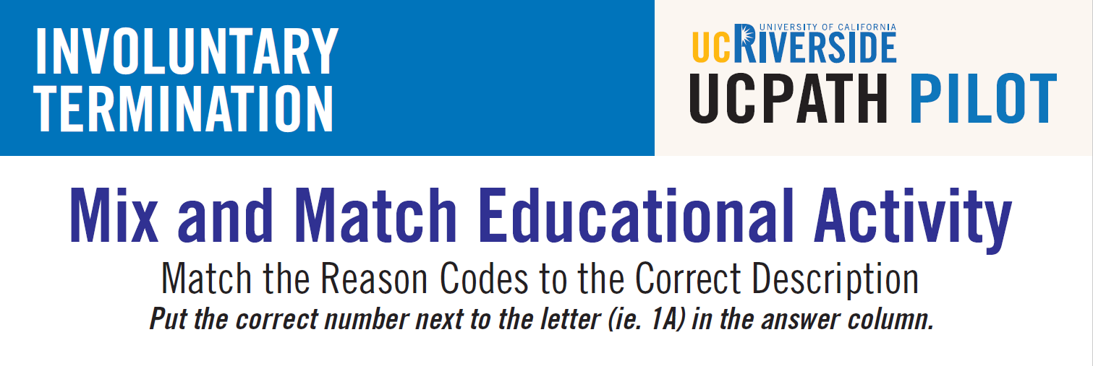
DO YOU KNOW YOUR ACTION/REASON CODES? Educational Activity

Slide 25
DO YOU KNOW YOUR ACTION/REASON CODES? Educational Activity
Action Reason | Match the Description | Description
1. ACE - APPOINTMENT EXPIRED | 1-I | I. USE FOR THE TERMINATION OF AN APPOINTMENT WITH A FIXED END DATE OR EXPIRATION OF CONTRACT IN ACCORDANCE WITH THE TERMS OF THE CONTRACT OR APPOINTMENT.
2. DEA - DEATH | 2-G | G. USE FOR TERMINATION DUE TO DEATH.
3. DNR - DO NOT REHIRE (SETTLEMENT) | 3-E | E. AGREEMENT/SETTLEMENT - EMPLOYEE AGREES NOT TO RETURN.
4. INV - INVOLUNTARY TERMINATION -OTHER | 4-F | F. USE FOR TERMINATION FOR OTHER REASONS NOT STATED.
5. ATT - DISMISSAL - ATTENDANCE | 5-H | H. USE FOR TERMINATION DUE TO ATTENDANCE.
6. RRR - LAYOFF - REHIRE/RECALL RIGHTS | 6-A | A. USE FOR INDEFINITE LAYOFF - REHIRE/RECALL RIGHTS.
7. SEV - LAYOFF - SEVERANCE | 7-J | J. USE FOR INDEFINITE LAYOFF - SEVERANCE.
8. RDS - LAYOFF-REDUCED SEV. REH/RECALL | 8-B | B. USE FOR INDEFINITE LAYOFF - REDUCED SEVERANCE AND PREFERENTIAL REHIRE/RECALL RIGHTS.
9. NSE - NEVER STARTED EMPLOYMENT | 9-D | D. USE FOR TERMINATION OF APPOINTMENT DUE TO PROSPECTIVE EMPLOYEE NEVER STARTING WORK. THIS IS USED TO VOID THE EMPLOYMENT RECORD RATHER THAN DELETING IT.
10. GRD - NO LONGER STUDENT | 10-C | C. USE FOR TERMINATION DUE TO EMPLOYEE GRADUATING OR NO LONGER STUDENT STATUS.

Slide 26
CHECK YOUR UNDERSTANDING
What should you do if you have a question on which Action Reason Code to use?
Who will process final pay on an Involuntary Termination?
True or False: One of the responsibilities of the department when Offboarding an employee is to Remove System Access?
Notes:
#1 – Refer to this presentation, and contact the AP/HR office if needed.
#2 – SSC
#3 - True

Slide 27
Roles Description

Slide 28
TRANSACTION ROLES
1: Employee
2: Department
3: Shared Service Center
4: International Students and Scholars Office
5: Central Office
6: Transactional Unit
7: UCPath Center
8: Org Authority

Slide 29
TRANSACTION ROLES
Is informed from supervisor/department of termination
Returns UC assets to department
1: Employee
2: Department
3: Shared Service Center
4: International Students and Scholars Office
5: Central Office
6: Transactional Unit
7: UCPath Center
8: Org Authority

Slide 30
TRANSACTION ROLES
Informs the Transactional Unit of the employee’s termination
Fulfills Offboarding department tasks such as:
Coordination of return of assets
Remove or revise system access
1: Employee
2: Department
3: Shared Service Center
4: International Students and Scholars Office
5: Central Office
6: Transactional Unit
7: UCPath Center
8: Org Authority

Slide 31
TRANSACTION ROLES
Transacts final pay
AWE Approver for transaction (for Phase II)
Maintain performance metric spreadsheet (AWE denials & UCPC cancellations)
1: Employee
2: Department
3: Shared Service Center
4: International Students and Scholars Office
5: Central Office
6: Transactional Unit
7: UCPath Center
8: Org Authority

Slide 32
TRANSACTION ROLES
Is notified of the employee’s Offboarding if the employee is a non-resident
1: Employee
2: Department
3: Shared Service Center
4: International Students and Scholars Office
5: Central Office
6: Transactional Unit
7: UCPath Center
8: Org Authority

Slide 33
TRANSACTION ROLES
Responsible for HR/AP process designs
Provide subject matter expertise in technical/complex areas
Interface with HR/AP business partners and institutional leadership
APO is notified by Org. AP directors of Offboarding and deaths for academic positions
1: Employee
2: Department
3: Shared Service Center
4: International Students and Scholars Office
5: Central Office
6: Transactional Unit
7: UCPath Center
8: Org Authority

Slide 34
TRANSACTION ROLES
Primary point of contact for managers and unit level leadership
Represents the needs of the individual business unit
Initiates UCPath Template for Involuntary Offboarding & Death
Sends the Shared Service Center notification of when to process Final Pay
Sends SSC notification if UCPC Cancels a transaction
Monitors Transaction Status page for transaction status
Opens UCPath cases on behalf of employees when needed (see On Behalf Case Management Workbook)
1: Employee
2: Department
3: Shared Service Center
4: International Students and Scholars Office
5: Central Office
6: Transactional Unit
7: UCPath Center
8: Org Authority

Slide 35
TRANSACTION ROLES
Processes Involuntary Termination templates
Notifies initiator when transaction is canceled or approved
Processes final pay per policy/bargaining unit contracts
1: Employee
2: Department
3: Shared Service Center
4: International Students and Scholars Office
5: Central Office
6: Transactional Unit
7: UCPath Center
8: Org Authority

Slide 36
TRANSACTION ROLES
Responsible for ensuring the appropriate policy is followed
1: Employee
2: Department
3: Shared Service Center
4: International Students and Scholars Office
5: Central Office
6: Transactional Unit
7: UCPath Center
8: Org Authority

Slide 37
Initiate Involuntary Offboarding
Notes:
This is where we as a group will start to initiate together a transaction.

Slide 38
INITIATE INVOLUNTARY TERMINATION TEMPLATE
Navigation: PeopleSoft Menu > Workforce Administration > Smart HR Template > Smart HR Transactions
Enter the Effective Date of the template Transaction
Click Create Transaction to begin entry of the template transaction.
The Effective Date field is the effective date of the selected template action. The date you enter in this field automatically populates the Effective Date field on the Enter Transaction Details page. You can update the Effective Date on the Enter Transaction Details page, if needed.
Select the appropriate termination template - Involuntary

Slide 39
ENTER TRANSACTIONS DETAILS PAGE
Important:
The Effective Date is populated based on your entry on the previous page.
Ensure that you entered the correct
Effective Date.
Enter the details for the termination.
Effective Date Definition:
Date on which the associated information takes effect. The information is in effect until a new entry is made with a more current effective date. We do not have “stop dates” on effective dated data. The Effective Date usually defaults to the system's current date.
Effective Dating: Effective Dating is used to maintain and view a complete chronological record of historic, current, and future data.
Current Effective Date – Date that is less than or equal to the current system date.’
Historic Effective Date – Dates that are less than the current information
Future Effective Date – Effective dates that are greater than the current information
Retro Effective Date – Date prior to the current pay period begin date
Select the correct Employee ID and Employment Record Number for the job to terminate. If the employee has multiple assignments, submit a termination template for all jobs, as necessary.
Click Continue to enter the remaining details of the template.
Death
Select the appropriate Reason Code
NOTE: Upon the death of an employee you only need to submit one transaction, as UCPath will terminate all jobs upon notification of death.

Slide 40
ENTER TRANSACTION INFORMATION
The Last Date Worked automatically populates with a date that is one day prior to the Effective Date.
If the Effective Date is a Monday, the Last Date Worked defaults to the previous workday (Friday).
The Last Date Worked field can be changed, if needed; however, the Last Date Worked must be prior to the Effective Date.
IF the Last Date Worked was not the day prior you MUST change the date to what the last day was.
Update the Last Date Worked if needed, and enter a Comment

Slide 41
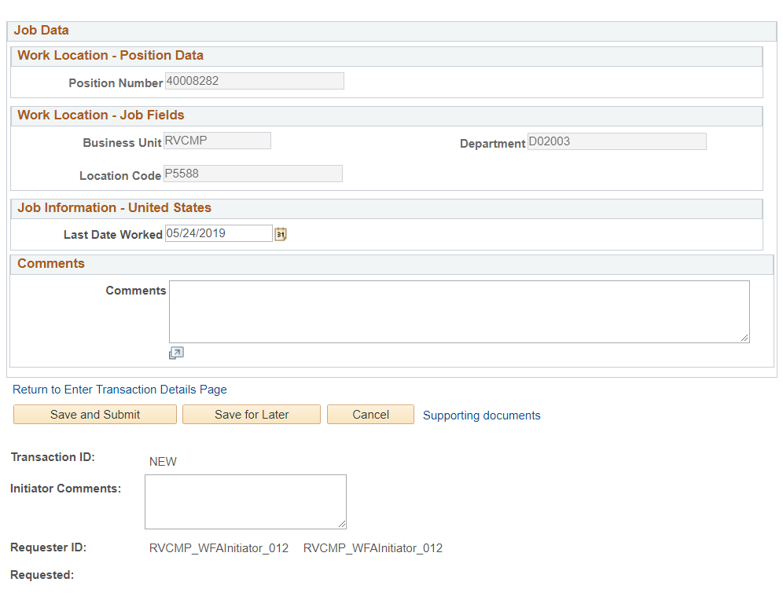
INVOLUNTARY TERMINATION TEMPLATE SUPPORTING DOCS
Use the Supporting documents link to attach supporting documents:
Notes:
The second step in initiating a transaction is attaching the supporting docs

Slide 42
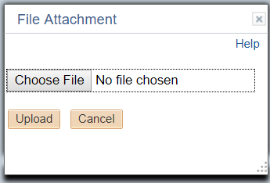
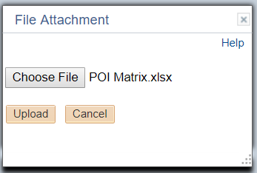
INVOLUNTARY TERMINATION TEMPLATE SUPPORTING DOCS
The supporting documents window will appear
Click the Upload button
The File Attachment window will appear
Click the Choose File button
Your document window will open, select the document and click OK
The File Attachment window will appear again with the chosen file
Click the Upload button
The supporting documents window will appear again with the file attachment
Click OK

Slide 43
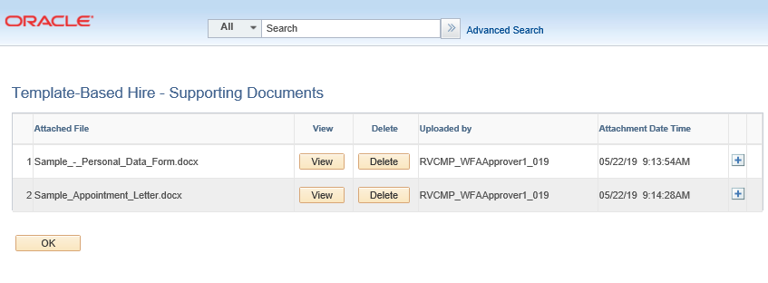
DELETING SUPPORTING DOCUMENTS
Click Delete to remove supporting documents provided by the Transitional Unit Initiator.
Click the Yes button.

Slide 44
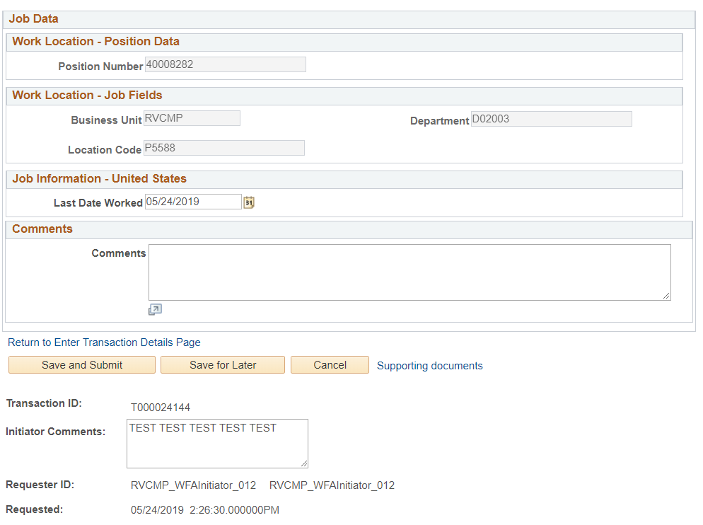
INVOLUNTARY TERMINATION TEMPLATE SAVE & SUBMIT
Select Save and Submit.
NOTE: You can select the Save for Later button if you are not finished with the transaction and will come back to it later.
Important
After you Save and Submit, The Transaction ID will generate
Make Note of the Transaction ID for future reference

Slide 45
CHECK YOUR UNDERSTANDING
Where in UCPath do you start the transaction for Involuntary Termination?
If the effective date is 9/23/2019, what is the last day worked date?
How is the Last Day worked populated?
What is the importance of insuring the effective date and last day worked is accurate?
Notes:
#1 – Smart HR Transactions
#2 – Friday, September 20, 2019
#3 – Auto-populates one day prior to the effective date, except when the effective date falls on a Monday , then it’s the prior Friday.
#4 – Last day work is not correct it could create an artificial break in service which has serious down stream impacts (Benefits etc.)

Slide 46
AWE APPROVER ROLE
For Phase 2 of the Pilot, the Shared Service Center will be responsible for validating and approving the Template Based Transactions for Involuntary Termination via AWE.

Slide 47
TRY IT 1. TERM EMPLOYEE FOR NOT SHOWING UP OR CALLING FOR 10 DAYS 2. TERM EMPLOYEE FOR NOT MEETING MINIMUM PERFORMANCE EXPECTATIONS
Reminder: Don’t forget to write down your transaction number
Notes:
1. Action Reason Code ATT - Dismissal - Attendance
2. Action Reason Code PRF - Dismissal - Lack of Performance

Slide 48
Transaction Status
Notes:
Show how to view at AWE local level and how to view at UCPath level – Trans number is only used at local level, UCPC uses name or date to look up trans.
Sometimes Transactions would be denied by the SSC, due to incorrect dates,

Slide 49
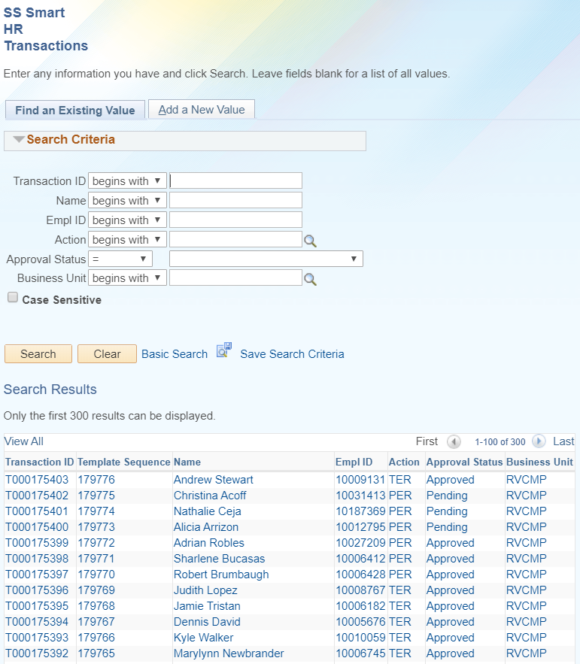
TRANSACTION STATUS FOR LOCAL AWE
Navigation: PeopleSoft Menu > UC Customization > SS Smart HR Transactions > Find an Existing Value
The transaction will remain in a Pending Status until the AWE Approver approves or denies the transaction.
If Approved, the next step in the process will be UCPath review.
UCPath has the option of Approving or Cancelling the transaction.
To search for a transaction, enter the Transaction ID in the field and click Search. Your transaction will then display.
To see all transactions in your accountability structure, simply click Search.
Open the transaction from this view by clicking on the Transaction ID
Notes:
The Smart HR Transactions will display all transactions (pending, approved or denied) in your accountability structure.

Slide 50
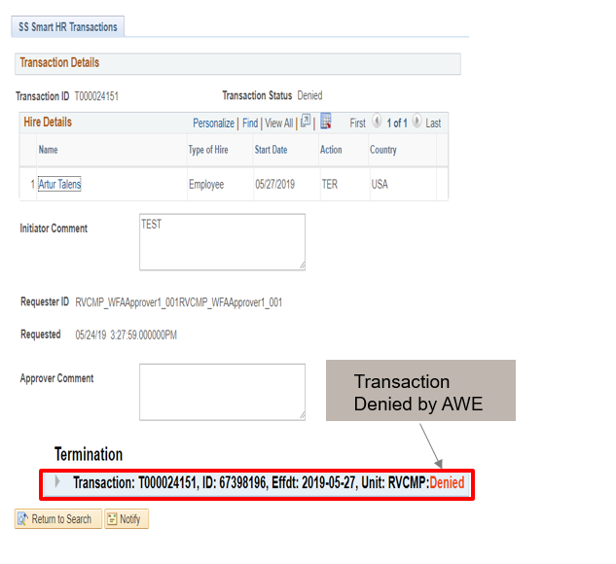
TRANSACTION LOCALLY DENIED
Navigation: PeopleSoft Menu > Workforce Administration > Smart HR Template > SS Smart HR Transactions > Transaction Details
In the event that the template is denied by the Shared Service Center AWE approver (i.e. incorrect name spelling, wrong date, etc.), the template is returned (with comments) to the Transactional Unit Initiator to correct and resubmit.
The Transactional Unit Initiator will be able to clone the transaction from the Transaction Status page.
Transaction Denied by AWE
To view denial comments from the AWE Approver, click on the arrow.

Slide 51
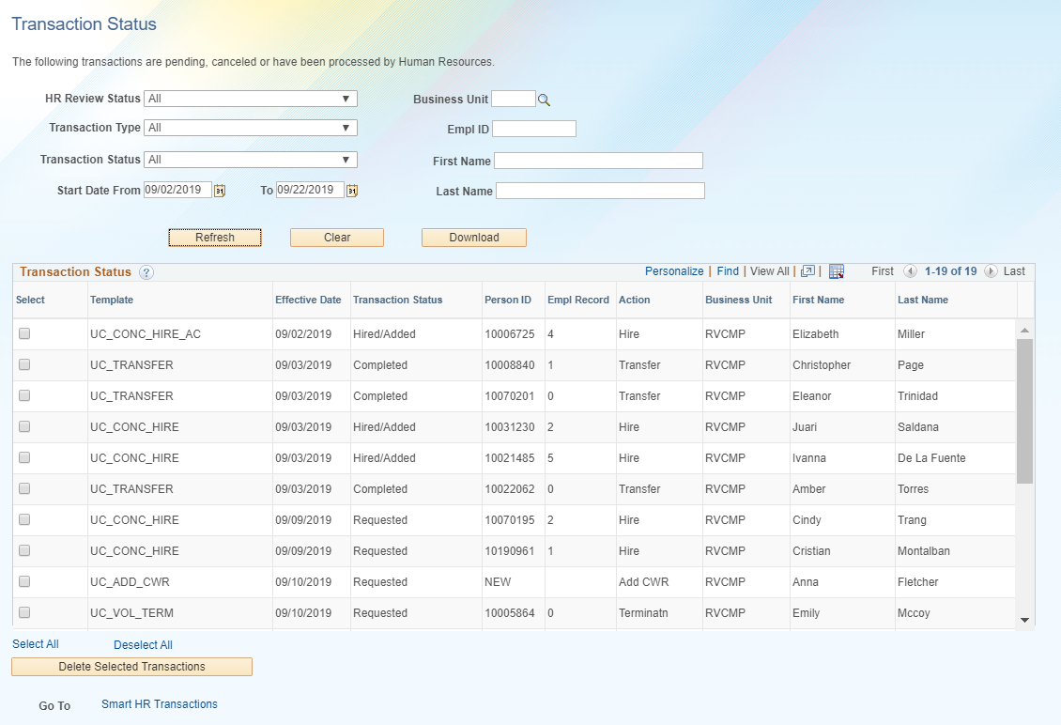
TRANSACTION STATUS FOR UCPC
Navigation: PeopleSoft Menu > Workforce Administration > Smart HR Template > Smart HR Transactions > Transaction Details
This view will display all Transactions that are in your accountability structure and the Transaction Status from UCPC.

Slide 52
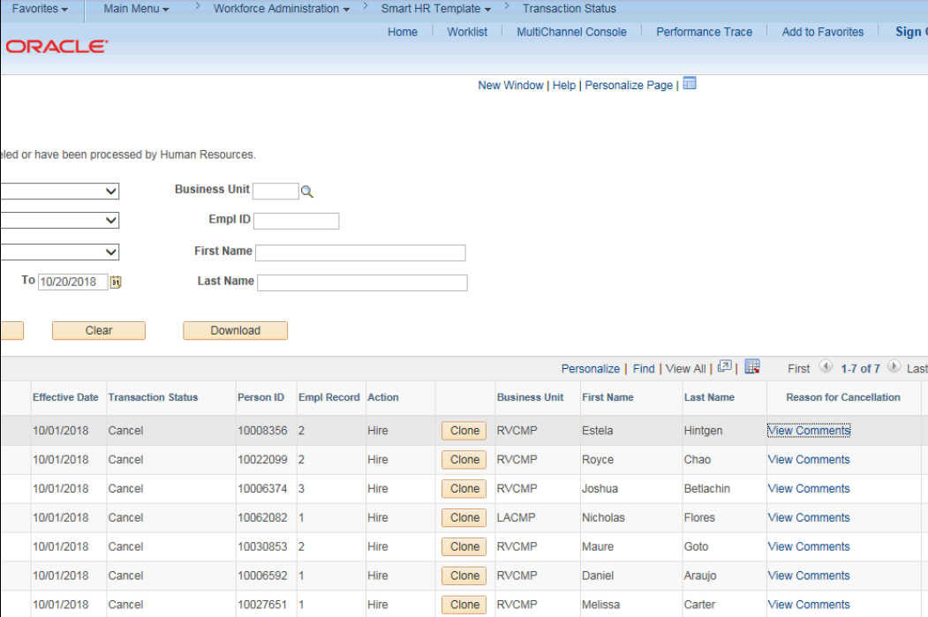
VIEW CANCELLED COMMENTS FROM UCPC
Navigation: PeopleSoft Menu > Workforce Administration > Smart HR Template > Transaction Status
When a transaction is cancelled by UCPC WFA Production, comments are entered to explain why the transaction was cancelled (effective date wrong, action reason code wrong etc.).
Template Initiators can View Comments under Reason for Cancellation and, if needed, Clone the transaction to resubmit it with necessary corrections.
Note: To view comments about a transaction that was denied by a Location AWE Approver, you must navigate to the SS Smart HR Transactions page and review the Approver Comments field.
Click for UCPC Job Aid

Slide 53
CHECK YOUR UNDERSTANDING
Why would a transaction be denied by the Shared Service Center?
What does UCPath do when they Cancel a Transaction?
Where do you monitor a Local AWE Transaction?
Notes:
#1 – Anything reasonable
#2 – Send email confirmation to Transactor and update notes in UCPath
#3 – Transaction Details view

Slide 54
Change Impacts

Slide 55
CHANGE IMPACTS
The submission and approval of the template transaction for Involuntary Termination will be initiated by the Transactional Unit, this used to be processed by the SSC
The Transactional Unit will supply the Employee with Unemployment Insurance notices if Termination is due to Lay Off
The Shared Service Center will approve the transaction and process final pay. Notification of that final pay be processed shall be sent from the transactional unit to the SSC via email/ServiceLink, as directed
In the event that UCPath Cancels a transaction, the transactional unit will need to notify the Shared Service Center

Slide 56
TERMINATION – FINAL PAY
Final pay is required when an employee is separated, and ALL OTHER JOBS ARE TERMINATED OR RETIRED.
Transactional Unit notifies the SSC that Final Pay is due.
The Shared Service Center will processes Final Pay.
Notes:
Final pay is a separate action from termination

Slide 57
SharePoint Instructions & Hands on Training

Slide 58
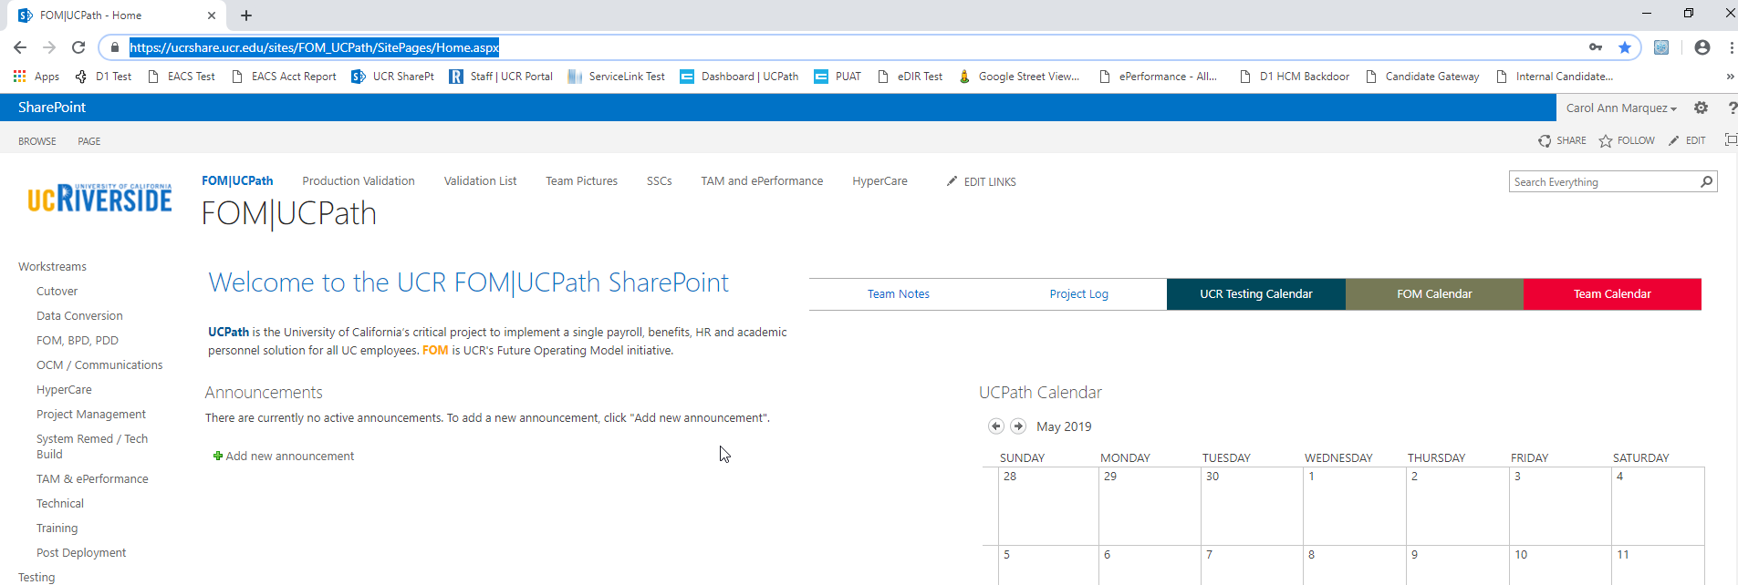
SHAREPOINT LIST INSTRUCTIONS
Testing SharePoint: https://ucrshare.ucr.edu/sites/FOM_UCPath/SitePages/Home.aspx
Preferred browsers are Internet Explorer and Chrome. (Save the link as a favorite)
Select UCPath Transaction Training Scenarios from the left side Quick Menu:

Slide 59
VIEWING LIST OPTIONS
When the list opens, note the tabs at the top of the screen:

Slide 60
VIEWING LIST OPTIONS part 2
By selecting ‘List’ you can filter the view on the process you are transacting. The default view is All Transactions. Select a specific transaction type to view the list containing only those transactions:

Slide 61
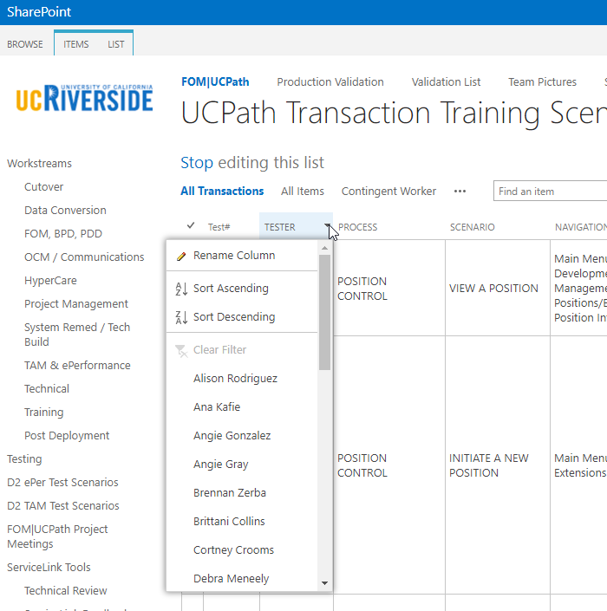
UPDATING AND EDITING A SHAREPOINT LIST
Many functions of a SharePoint list are similar to MS Excel, except that it is in a central location and can be accessed / updated by multiple people at the same time.
Use the list headers to filter and sort. Only you will see these temporary changes.
By selecting your name in the drop-down, you will have easy access to only your transactions. This is especially helpful if your name appears several pages into the list.

Slide 62
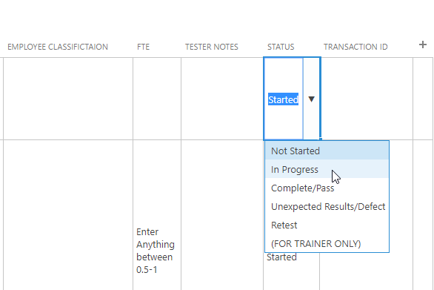
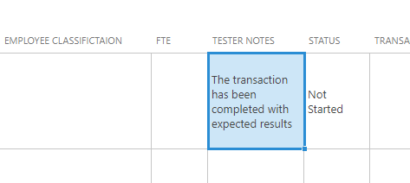
UPDATING AND EDITING A SHAREPOINT LIST part 2
You can update your test by editing directly by clicking into the cell. Some cells are controlled by a drop-down choice; others are free-form. To save your change, click in another cell.

Slide 63
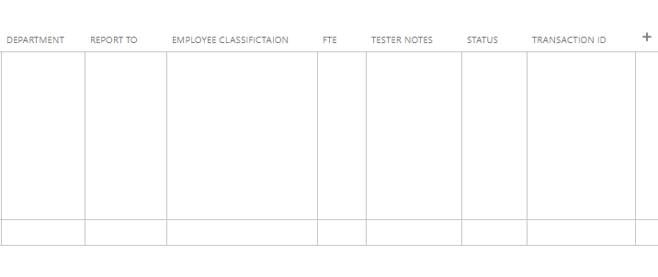
UPDATING INVOLUNTARY TERMINATION ON SHAREPOINT
You can update your scenario by editing directly into the cell. Some cells are controlled by a drop-down choice; others are free-form. To save your change, click in another cell.
INVOLUNTARY TERMINATION

Slide 65
Your Feedback Please
http://bit.ly/pilottrainingphase2

