Slide 1
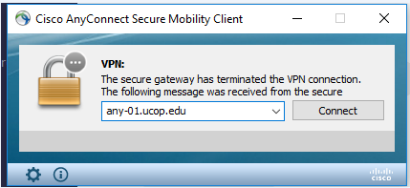
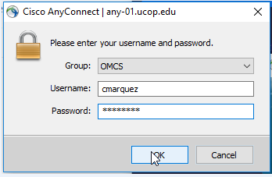
LOG IN INSTRUCTIONS
Open the Cisco AnyConnect client
Enter the VPN name: ANY-01.UCOP.EDU
Click Connect
Select the Group: OMCS
Enter your username and password
Once Connected to the VPN go to https://drppuat02.universityofcalifornia.edu/home
Enter the Tester ID\Password provided in the SharePoint Scenarios.
Notes:
Has everyone already gotten into the system, please connect

Slide 2
Ucr ucpath transaction pilot
Onboarding Empl class 5, 9, 10

Slide 3
TRAINER INTRODUCTION
Alexandra Rollins, LaKesha Welch, Heidie Rhodes
Title: Varies
Department: UCPath Campus Support Center
Year @UC: Varies
Previous Experience: Varies

Slide 4
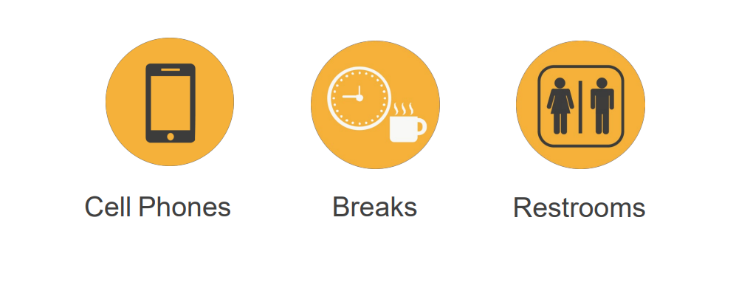
HOUSEKEEPING

Slide 5
AGENDA
Topics
Login and Learning Objectives
Onboarding Definitions
Policies Related to Onboarding
Process Overview
Break
AR Codes
AR Code Educational Activity
Unique Onboarding Considerations
Roles/HRDW Demo
Initiating as a Class
Initiating Independently
Change Impacts
Hands on Scenario Activities
Q & A, Feedback, and Close

Slide 6
LEARNING OBJECTIVES
Understand the various types of Onboarding included in the Pilot
Identify the templates used to initiate hire transactions
Identify the correct action reason codes for hire templates
Gain skill in processing, full hire, rehire and concurrent hire transactions

Slide 7
Definition

Slide 8
ONBOARDING
UC Definition: Onboarding is the series of tasks that begins with a candidate formally accepting an offer of employment and ends with the new employee being ready for work in terms of employment relationship and access/setup.
It includes employment activities (new hire paperwork, benefits, I-9, criminal background check), logistical activities (ID card, parking, internet access, keys), and other new hire processing activities.
Common Definition: Onboarding is the action or process of integrating a new employee into an organization or familiarizing a new customer or client with one's products or services.

Slide 9
Policies Related to Onboarding

Slide 10
POLICIES RELATED TO ONBOARDING
Policy/Procedure Title | UC Policy | UCR Local Procedure
PPSM-3: Types of Appointment | UC | Contract Limited Partial – Year
Student On-Campus Employment Guidelines |  | Guidance
PPSM-20: Recruitment and Promotion | UC | UCR Title Code Questionnaire
PPSM-21 Selection and Appointment | UC | UCR
PPSM–22: Probationary Period | UC | UCR
PPSM-80: Staff Personnel Records | UC | UCR

Slide 11
APPOINTMENT TYPES (EMPLOYEE CLASSES)
PPSM-3: Types of Appointment https://policy.ucop.edu/doc/4010390/PPSM-3
UCR Local Procedure 3:
Casual Restricted/Student Employee – Employee Class 5
Contract
Limited
Partial-Year
PPSM-20: Recruitment and Promotion
https://policy.ucop.edu/doc/4010393/PPSM-20
UCR Local Procedure 20 – NOT APPLICABLE TO EMPLOYEE CLASS 5 – CASUAL RESTRICTED/STUDENTS
PPSM-21: Selection and Appointment http://policy.ucop.edu/doc/4010394
UCR Local Procedure 21
Background Check Requirement by Title Code – Title Code
For Employee Class 5, Use Critical Position Questionnaire to determine the minimum background check required.

Slide 12
STUDENT/CASUAL/RESTRICTED APPOINTMENT
An appointment reserved for a registered undergraduate student of the University of California.
A casual/restricted appointment will automatically terminate on the last day of the appointment unless there is an earlier separation or formal extension of the appointment in writing.
Student employment is intended to provide financial support and practical experience in the pursuit of the student’s educational goals.
Student 1 (title code xxx)
Casual-restricted appointment*
Student 2 (title code xxx)
Casual-restricted appointment*
* Refer to University of California – Policy PPSM-3 https://policy.ucop.edu/doc/4010390/PPSM-3

Slide 13
EMPLOYMENT ELIGIBILITY: I-9
All U.S employers, including the University of California (UC), are required to verify the identity and employment authorization of each person hired, complete and retain a Form I-9 Employment Eligibility Verification for each employee, and refrain from discriminating against individuals on the basis of national origin or citizenship.
Employee Designated to Conduct Form I-9 Verification
An employee designated to review Form I-9’s is required to attest under penalty of perjury, that to the best of their knowledge, the individual hired is authorized to work in the United States, and that any documents presented appear to be genuine and related to the individual.
UCR Campus Policy 650-28: Employment Eligibility (Form I-9)

Slide 14
STUDENT COMPENSATION
After the completion of at least two quarters in the department, in which performance has been satisfactory or better, casual-restricted appointments may receive a within-range merit increase of up to $0.75 per hour once a fiscal year.
Salary Range | Minimum | 1st Quartile | Midpoint | Maximum
Student 1 Title Code xxx | $12.00/hr | $13.25/hr | $14.50/hr | $17.00/hr
Student 2 Title Code xxx | $12.50/hr | $17.50/hr | $22.50/hr | $32.50/hr

Slide 15
STUDENT EMPLOYMENT DUTIES
Student Assistants perform duties ranging from routine to advanced and/or specialized in a variety of positions, which typically require the use of manual, administrative, advising, public contact, and/or analytical skills.
Office/General: Provide general office support such as greet visitors, file, type and scan documents; enter, update or maintain spreadsheets/data applications, run reports, assist with research questions and special projects.
Library Services: Under supervision, perform routine administrative duties such as file, retrieve and copy materials; sort mail, shelve books, circulation desk duties, and customer service.
Transportation: Under supervision, assist visitors at campus Information Kiosks, serve as event parking attendants and service as traffic control guides.

Slide 16
WORK SCHEDULE
Casual-restricted appointments should be established at less than 20 hours or 50% time.* Appointments may temporarily exceed 50% time during the summer for those periods when a student is not enrolled full-time. However, if this occurs the student may be eligible to earn holiday pay and sick leave accrual.
Any UCR student may work in a student assistant position:
during the student’s academic school year
during the summer immediately prior to the student’s first fall quarter at UCR (provided the student registered for fall quarter and will definitely attend UCR)
during the summer immediately following the student’s UCR graduation
during the quarter immediately following completion of courses to fulfill graduation or completion of school as a registered student.
*To ensure that the student maintains his/her educational goals as the foremost priority, the appointment percentage should remain below 50% and flexibility should be granted in scheduling work for student employees.

Slide 17
FREQUENTLY ASKED QUESTIONS
Is there a policy that limits the number of hours a student may work?
University of California Personnel Policies for Staff Member (PPSM)-3: Types of Appointment describes casual/restricted appointments. UCR limits appointments to less than 20 hours (50%), whenever students are in school.
2. Are students covered by a collective bargaining agreement?
While there are some academic student represented titles, undergraduate students working in the student assistant job codes are nonrepresented, non-exempt employees who are not represented by a union. For the purpose of these guidelines, student 1 and 2 are covered by PPSM.
3. Are student assistants eligible for Jury Duty Leave?
Yes, student assistants are eligible for Jury Duty Leave. Jury Duty should be paid according to PPSM-2.2.10: Absence from Work for non-exempt employees.
4. Are University Extension (UNEX) students excluded from casual/restricted (student employment) appointments.
Yes. UNEX students should not be hired into a casual/restricted appointment if they are not registered as a UCR student and working toward an undergraduate or graduate degree. Exception: If a student has dual enrollment (UCR & UNEX), an exception may be allowed.

Slide 18
VOLUNTEER (Without Salary) Appointments
Student Intern – a student seeking to enhance their academic and career goals by gaining supervised practical experience and applying classroom theory to real world situations.
Volunteer – an individual providing service directly to and under the supervision of the university with no promise or expectation of compensation.
Other volunteer appointments include Contingent Workers (CWR) and Person of Interest (POI)
Volunteer Without Salary Policy

Slide 19
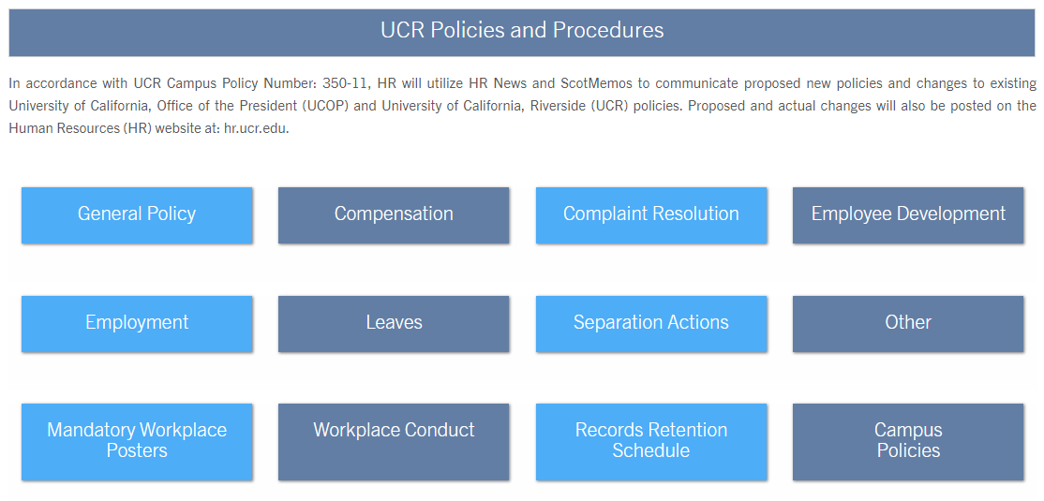
HR POLICY WEBPAGE
https://hr.ucr.edu/policies-and-procedures/personnel-policies-local-procedures

Slide 20
HR CONTACTS FOR ONBOARDING
Human Resources Website
Contact | Title | Phone | Email
Mary White | Principal HR Policy & Communication Analyst | (951) 827-2622 | mary.white@ucr.edu
Sinclair Dickerson | Director of Talent Acquisition & Diversity Outreach | (951) 827-2673 | sinclair.dickerson@ucr.edu

Slide 21
ACADEMIC POLICIES RELATED TO ONBOARDING
Policy/Procedure Title | UC Policy
Term Appointments/Non-Reappointment (APM 137) | https://www.ucop.edu/academic-personnel-programs/_files/apm/apm-137.pdf
Represented Contracts:
Lecturers (IX – Unit 18) | https://ucnet.universityofcalifornia.edu/labor/bargaining-units/ix/contract.html
Librarians (LX – Unit 17) | https://ucnet.universityofcalifornia.edu/labor/bargaining-units/lx/contract.html
ASEs (BX) | https://ucnet.universityofcalifornia.edu/labor/bargaining-units/bx/contract.html
Postdocs (PX) | https://ucnet.universityofcalifornia.edu/labor/bargaining-units/px/contract.html

Slide 22
ACADEMIC POLICIES RELATED TO ONBOARDING
Policy/Procedure Title | UC Policy
Recruitment | https://www.ucop.edu/academic-personnel-programs/academic-personnel-policy/recruitment/index.html
Appointment and Promotion | https://www.ucop.edu/academic-personnel-programs/_files/apm/apm-200.pdf
Review and Appraisal Committees | https://www.ucop.edu/academic-personnel-programs/_files/apm/apm-210.pdf

Slide 23
AP CONTACTS FOR ONBOARDING
Academic Personnel Website
Contact | Title | Phone | Email | Contact Description
Nick Weston-Dawkes | Academic Employee Relations Analyst | (951) 827-2935 | nicholas.weston-dawkes@ucr.edu | Academic Labor Relations Unit 18 Lecturers Unit 17 Librarians Academic Bargaining Unit Specialist Employee Relations for Non-Senate Academic Employees Liaison — Labor Relations Office Liaison — Non-Senate Academic Grievances Policy Development & Training
Sonia Kalogonis | Policy & Compensation Analyst | (951) 827-2934 | sonia.kalogonis@ucr.edu | Academic Compensation Negotiated Salary Trial Program (NSTP) Data and Technology Team Member UCPath Academic Personnel Implementation Support (Compensation) Policy Development & Training

Slide 24
LOG IN INSTRUCTIONS
Open the Cisco AnyConnect client
Enter the VPN name: ANY-01.UCOP.EDU
Click Connect
Select the Group: OMCS
Enter your username and password
Once Connected to the VPN go to https://drppuat02.universityofcalifornia.edu/home
Enter the Tester ID\Password provided in the SharePoint Scenarios.
Notes:
Has everyone already gotten into the system, please connect

Slide 25
Onboarding Process Overview

Slide 26
ONBOARDING – OVERVIEW
In many cases, there is a template specific to academic and another specific to staff. For example:
UC Full Hire - Staff Only
UC Full Hire - Academic Use Only
Phase II Includes Onboarding for the following EMPL classes:
5 – Student: Casual/Restricted
9 – Academic: Faculty
10 – Academic: Non Faculty
The following are out of scope for Phase II:
All other EMPL classes
Inter/Intra Campus Transfers
Available Phase II Onboarding Templates
Template | Description
UC_ADD_CWR | Add Contingent Worker - No Position Data
UC_ADD_CWR_POSN | Add Contingent Worker With Position
UC_CONC_HIRE | Staff Concurrent Hire/Inter Location Transfer
UC_CONC_HIRE_AC | Academic Concurrent Hire/Inter Location Transfer
UC_FULL_HIRE | Full Hire - Staff Only
UC_FULL_HIRE_AC | Full Hire - Academic Use Only
UC_REHIRE | UC Rehire - Staff Only
UC_REHIRE_AC | Rehire - Academic
UC_REHIRE_REI | Rehire Reinstatement - For Staff Appointments
UC_REHIRE_REI_AC | Rehire Reinstatement - For Academic Appointments

Slide 27
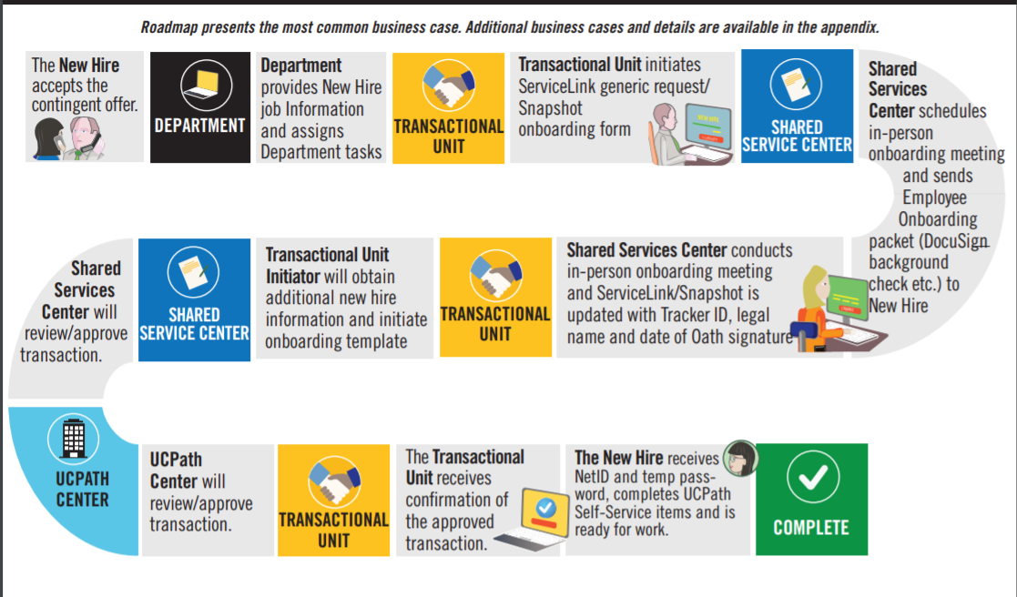
ONBOARDING
The process begins when the New Hire accepts a contingent offer of employment from UCR
The process uses Approval Workflow Engine (AWE) to allow routing of the request from the transactional unit through the Shared Services Centers and to UCPath for approval
Once approved, the new hire is ready to work

Slide 28
ONBOARDING – KEY SYSTEM STEPS
Look for other jobs the employee may have, this will help you coordinate with other Depts/Orgs and Locations (i.e. Multi-Location Agreement Appointment [MLA]
Enter the Onboarding details and attach supporting documents as needed
Review Person Org Summary page
Navigate to the
Smart HR Transactions page
Select the Onboarding template
Save and Submit
Notes:
Doing this in just a minute and if we need a refresher we will demonstrate it

Slide 29
DEMO

Slide 30
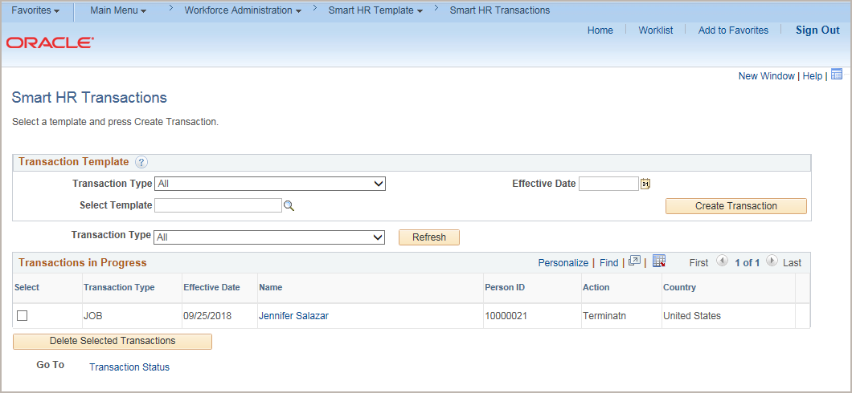
TEMPLATE TRANSACTIONS - NAVIGATION
Navigation: PeopleSoft Menu > Workforce Administration > Smart HR Transactions
The Smart HR Transactions page is the starting point to initiate a template transaction.

Slide 31
CHECK YOUR UNDERSTANDING
What EMPL classes are included in Phase II?
What type of appointment are in EMPL Class, 5, 9, 10?
What are some examples of onboarding you can process with the Smart HR Transactions page?
Notes:
5, 9 and 10
Students casual restricted, faculty, non faculty
Full hire, rehire, concurrent hire

Slide 32
Action Reason Codes

Slide 33
ACTION/REASON CODES
Action | Reason | Description | Comments
HIR | ACP | Academic Hire with Contract Pay | Used to hire an academic year employee with Contract Pay. This can also be used for a concurrent hire.
HIR | CN1 | Academic Concurrent Hire | Academic Use Only
HIR | CNV | Conversion Use Only | Used during initial conversion only. Should not be used for any other hires.
HIR | CON | Concurrent Hire – Non Dual Employment | Used to add a concurrent employee record (appointment).
HIR | DEE | Concurrent Hire – Dual Employment | Used to add a concurrent dual-employment job.
HIR | EMR | Rehire: Emeritus Faculty | Academic Personnel Use: As an emeritus job to a retired faculty.
HIR | HIR | Hire – No Prior UC Affiliation | New employee. Employee has never been on pay status with UC.
HIR | PR2 | Rehire, from Layoff-Pref <120 | Rehire following a layoff and secured through the preferential rehire process within 120 day of separation.
HIR | PRF | Rehire, from Layoff-Pref >=120 | Rehire following a layoff and secured through the preferential rehire process where there is greater or equal to 120 days of separation
HIR | RC2 | Rehire, Staff Recall <120 | Used to rehire a former UC employee eligible under layoff recall policies within 120 days of separation.

Slide 34
ACTION/REASON CODES
Action | Reason | Description | Comments
HIR | RE2 | Rehire, <120 Days Break | Used for a regular rehire to return to pay status following less than 120 days of break in service.
HIR | RE3 | Rehire, >=120 Days Break | Used for a regular rehire to return to pay status following a greater than or equal to 120 days break in service.
HIR | REC | Rehire: Staff Recall >=120 | Used to rehire a former UC employee eligible under layoff recall policies greater than or equal to 120 days of separation.
HIR | REI | Rehire: Reinstatement | Return to pay status following an involuntary break in service that was not a layoff.
HIR | RET | Rehire: Rehired Retiree | Return to pay status, in accordance with the Policy on Reemployment of UC Retired Employees, following a retirement, and the employee continues to draw retirement benefits.
HIR | RL2 | Rehire, fr Layoff-No Pref <120 | Rehire following a layoff and not secured through the preferential rehire process within 120 days of separation.
HIR | RLO | Rehire, fr Layoff-No Pref >=120 | Rehire following a layoff and not secured through the preferential rehire process where there is greater than or equal to 120 days of separation.
HIR | RSR | Rehire: Retirement Suspended | Rehire following a layoff and secured through the preferential rehire process within 120 days of separation.
HIR | WPR | With Prior UC Affiliation | Used to hire someone who has a prior affiliation (Contingent Worker, Person of Interest) with UC

Slide 35
ACTION/REASON CODES
Action | Reason | Description | Comments
REH | ACA | Academic Recall | Use for rehires from the same business unit. Use for recall of retired academic. For Job Codes that are without salary (WOS), be sure to also enter the Comp Rate as UCWOS.
REH | EMR | Emeritus Faculty | Use to add an emeritus job to retired faculty. For Job Codes that are without salary (WOS), be sure to also enter the Comp Rate as UCWOS.
REH | RSR | Rehire - Retirement Suspended | Use for rehires from the same business unit. Use to return to pay status following a retirement with retirement suspended and employee become an active UCRP member again.
REH | RL2 | Rehire fr Layoff-No Pref, <120 | Use for rehires from the same business unit. Use to rehire following a layoff and not secured through the preferential rehire process within 120 days of separation.
REH | RLO | Rehire fr Layoff-No Pref,>=120 | Use for rehires from the same business unit. Use to rehire following a layoff and not secured through the preferential rehire process where there is greater or equal to 120 days of separation.
REH | PR2 | Rehire fr Layoff-Pref, <120 | Use for rehires from the same business unit. Use to rehire following a layoff and secured through the preferential rehire process within 120 days of separation.
REH | PRF | Rehire fr Layoff-Pref, >=120 | Use for rehires from the same business unit. Use to rehire following a layoff and secured through the preferential rehire process where there is greater than or equal to 120 days of separation.
REH | RE2 | Rehire, <120 days break | Use for rehires from the same business unit. Use for a regular rehire to return to pay status following less than 120 days of break in service.
REH | REH | Rehire, > or = 120 days break | Use for rehires from the same business unit. Use for a regular rehire to return to pay status following a greater than or equal to 120 days of break in service.

Slide 36
ACTION/REASON CODES
Action | Reason | Description | Comments
REH | RET | Rehired Retiree | Use for rehires from the same business unit. Use to return to pay status, in accordance with the Policy on Reemployment of UC Retired Employees, following a retirement, and the employee continues to draw retirement benefits. Rehire-Retirees require the completed UBEN1039 form to be attached to the template transaction.
REH | RC2 | RC2 - Staff Recall, <120 | Use for rehires from the same business unit. Use to rehire a former UC employee eligible under layoff recall policies within 120 days of separation.
REH | REC | REC - Staff Recall, >=120 | Use for rehires from the same business unit. Use to rehire a former UC employee eligible under layoff recall policies greater than or equal to 120 days of separation.
REH | REI | REI - Reinstatement | Use to reinstate an employee (staff) that was automatically terminated.
REH | REI | REI - Reinstatement | Use to reinstate an employee (academic) that was automatically terminated.
CONC | CN1 | Academic Concurrent Hire | Use to add a concurrent job (either Dual or Non-Dual employment).
CONC | DEE | Concurrent Hire - Dual Empl | Use to add a concurrent dual-employment job.
CONC | CON | Concurrent Hire - Non Dual Emp | Use to add a concurrent employee record (appointment). This means that an employee is working in two or more jobs at the same time in different departments and/or job codes.

Slide 37
COMMON ONBOARDING TRANSACTIONS
# | Description | Prior location | Prior Employee Class | Template | Action | Reason | Comments
1 | With Prior UC Affiliation | Any UC Location on UCPath | CWI/POI | UC_FULL_HIRE or UC_FULL_HIRE_AC | HIR | WPR | Used to hire someone who has a prior affiliation (Contingent Worker, Person of Interest) with UC
2 | Rehire, <120 Days Break | Any UC Location on UCPath EXCEPT UCR | All, EXCEPT CWI/POI | UC_FULL_HIRE or UC_FULL_HIRE_AC | HIR | RE2 | Used for a regular rehire to return to pay status following less than 120 days of break in service.
3 | Rehire, >=120 Days Break | Any UC Location on UCPath EXCEPT UCR | All, EXCEPT CWI/POI | UC_FULL_HIRE or UC_FULL_HIRE_AC | HIR | RE3 | Used for a regular rehire to return to pay status following a greater than or equal to 120 days break in service.
4 | Rehire, <120 Days Break | UCR | All, EXCEPT CWI/POI | UC_REHIRE or UC_REHIRE_AC | Rehire | RE2 | Used for a regular rehire to return to pay status following less than 120 days of break in service.
5 | Rehire, >=120 Days Break | UCR | All, EXCEPT CWI/POI | UC_REHIRE or UC_REHIRE_AC | Rehire | RE3 | Used for a regular rehire to return to pay status following a greater than or equal to 120 days break in service.
6 | Hire – No Prior UC Affiliation | N/A | N/A | UC_FULL_HIRE or UC_FULL_HIRE_AC | HIR | HIR | New employee. Employee has never been on pay status with UC.

Slide 38
DO YOU KNOW YOUR ACTION/REASON CODES FOR ONBOARDING?
Educational Activity

Slide 39
UNIQUE ONBOARDING CONSIDERATIONS

Slide 40
Multi-Location Agreement - MLA
A Host UCPath – Home Campus PPS (If UCR is Host campus, payroll completes 3rd bullet from the below, no SSC/Department/ORG interaction)
Home campus adds an appointment and sets up FAU distribution
Home campus creates and sends a journal to Host campus, debits financial control, and credit suspense account
Host UCPath – Home Campus UCPath (SSC/ Department/ORG interaction)
Host campus creates a position
Host campus sets up position funding using host department FAU
Home UCPath – Host Campus PPS (If UCR is Home campus, payroll completes all of the below, No SSC/Department/ORG interaction)
Home campus creates a position
Home campus set ups position funding
Host campus responds to journal, debits Host department, and credits financial control
Host campus hires employee into position (concurrent job)
No need for journal entries
Home campus add employee into position (concurrent job)
Home campus creates and sends a journal to Host campus, debits financial control, and credit suspense account
Host campus responds to journal, debits Host department, and credits financial control
The Multi-Location Pay process begins when an employee is employed by two or more locations, such as working multiple jobs within multiple business units

Slide 41
CONTRACT PAY – ACADEMIC -AY MID QUARTER HIRES
Contract Pay is used in UCPath when you cannot use an existing job frequency (UC9, UC10, UC11) to pay an employee correctly. This type of hire is used primarily for AY Faculty who are hired mid quarter and the per the APM, the daily rate is used to calculate their pay.
To set up contract pay, a start and end date is needed to setup the “contract” payments. These dates define the contract term and the payment term. Total Compensation must be added to the comments along with the start and end date. Template: Academic Hire w/ Contract Pay
For contract pay entries you must enter the contract pay reason and the contract period begin and end dates
If the contract pay must be prorated, you must override the Comp Rate Code by entering UCCNTR in the Comp Rate Code field.
After you enter the Step, the Comp Rate Code and Compensation Rate fields default. Delete the default compensation to enter the prorated contract pay:
Delete the existing compensation row.
2. Enter Comp Rate Code as UCCNTR.
3. Enter the prorated Compensation Rate.
4. Enter Compensation Frequency of C.
Note: If the employee is to receive the full compensation during the contract period, leave the default compensation and only change the Compensation Frequency to C.
Sample Comments: For this example, enter Contract Pay. Late Start. Prorated.
Contract Start Date: 10/9/2019
Contract End Date: 12/31/2019.

Slide 42
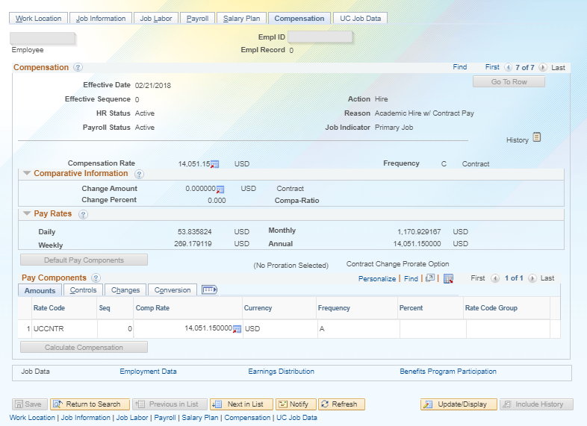
CONTRACT PAY – EXAMPLE
Template: Academic Hire w/ Contract Pay

Slide 43
PAY CYCLE ALIGNMENT MULTIPLE JOBS
Note: The goal is to keep the appointee on a consistent pay cycle and align them with the pay cycle of their primary affiliation, highest salary and most consistent to keep them from moving back and forth between pay cycles.
Employees in UCPath may only be paid on one pay cycle.
Monthly job with a Biweekly concurrent job
When an employee has a Monthly job with a 5AC monthly exempt pay group and a Biweekly concurrent job is added with a 5BH Biweekly exempt hourly pay group. The campus has to reach out to UCPC to notify them of the appropriate pay cycle. The UCPC will override one of the pay groups to align with one pay cycle.
Biweekly concurrent job with an existing Monthly job
If a Biweekly pay cycle is determined and the existing job is Monthly. The concurrent job can be added and the pay group can default. However, the first job will need to be overridden with the 5BE (Biweekly Exempt) pay group. You will need to work with your SSC to submit a case to the UCPC for the pay group override on the existing job.
A comment should be added to the concurrent hire template to do a manual override of the pay group to align with one pay cycle.
Note: when the second job ends or is placed on a SWB, it may be necessary to have the pay group override flag removed on the existing job so that it will default to the native pay group. This should be determined on a case by case basis.

Slide 44
FLSA ALIGNMENT MULTIPLE JOBS
Employees may only have one FLSA status
A consult with the AP/HR central office needs to occur prior to entering/updating the UCPath data to assess and align the appointee FLSA status.
Two academic jobs - AP consult only
Two staff jobs - HR consult only
One academic/one staff job - AP and HR consult
FLSA status is determined to be non-exempt
Exempt job is changed via Paypath or position control (POS/FLS) to non-Exempt.
Exempt job compensation is converted to hourly pay.
Pay group is changed to an Hourly Non-Exempt Pay group (5ST) by UCPC
Both jobs submit hours.
FLSA status is determined to be Exempt
Non-Exempt Hourly job is changed via Paypath or position control (POS/FLS) to Exempt
Pay group is changed on Hourly job to an Hourly Exempt Pay group (5MH or 5BH) by UCPC. The hourly job can report hours as an exempt EE
Once the FLSA is determined for the Employee the following process will need to take place:
When one of the job ends the FLSA status on the existing job may be reverted back in Paypath (POS/FL3). Please reach out to AP/HR central office if you need guidance on the reversal.

Slide 45
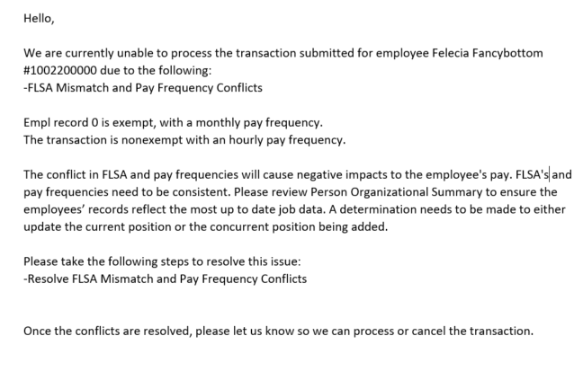
FLSA MISMATCH UCPC EMAIL/CASE EXAMPLE

Slide 46
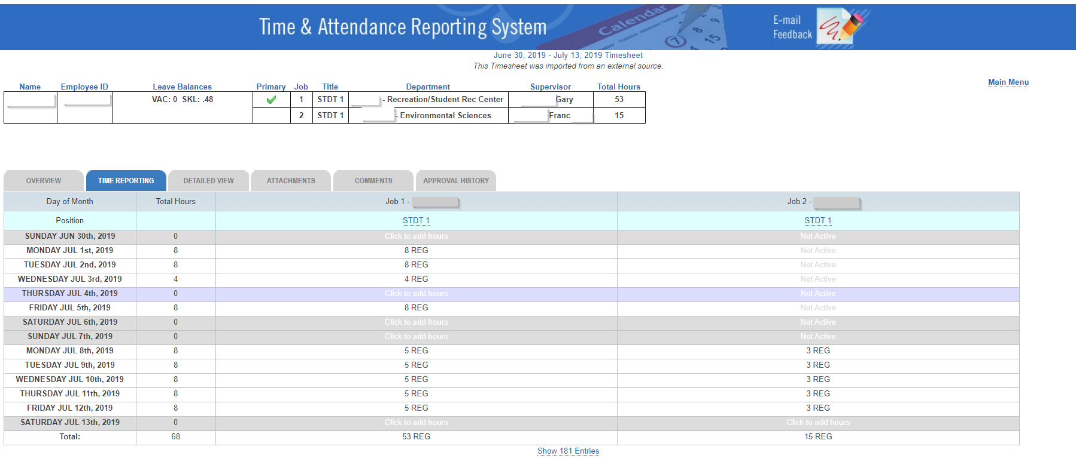
CONCURRENT JOB TIMESHEET EXAMPLE

Slide 47
HIGHER EDUCATION EMPLOYERS RELATIONS ACT (HEERA) CODE
Definition: An employee required to develop or present management positions for collective bargaining, and/or an employee whose duties normally require access to information which contributes significantly to the development of such management positions
If you are onboarding a staff position and believe their HEERA code should be confidential contact Employee and Labor Relations prior to initiating the template.
If the position is academic contact Academic Personnel
HEERA CODE Link

Slide 48
JOB EARNINGS DISTRIBUTION (JED)
The Job Earnings Distribution (JED) is primarily used to distribute earnings by earn codes either by percentage or by amount, and is important for exempt employees as it controls how much they are paid when an adjustment to their FTE is not applicable.
Non-Exempt employees’ pay is generated based on their hours submitted in Time and Attendance.
Anything that is not a REG earn code you need to use JED to convert. An example of where you would use this is on Summer Salary because summer research pay is not considered a regular earning.
There are three different ways to enter Summer Salary:
Add as additional compensation on an existing job
Add as base compensation on a new or concurrent job
Add as additional compensation on a new or concurrent job
Notes:
Explain what jed is
Anything that is not a REG earn code you need to use JED to convert the REG, use it on summer salary because summer research pay is not REG earnings. UCPC definition of JED. Job aid that Carmela put together. They will use this for summer salary on campus
Pilot does not cover summer salary (Because Pilot does not go through the summer)

Slide 49
RECURRING ADDITIONAL PAY
Recurring additional pay can be processed on the hire template but:
This often gets dropped by UCPC during the processing of the hire template because it is a manual entry processed by UCPC
The recommendation is to wait until the hire template has been completed by UCPC and enter or key the recurring additional pay via PayPath.
Using PayPath will allow the recurring additional pay to go to the staging table to be processed automatically by UCPC payroll
The recurring additional tab on the hire template is not meant for use with one-time payment

Slide 50
Roles

Slide 51
Transaction Roles
1: Transactional Unit
2: ORG Authority
3: Shared Services Center
4: Central Office
5: UCPath Center

Slide 52
Transaction Roles
If no position number is provided work with department to identify the correct position number. The HRDW position report is the resource to use.
Initiates ServiceLink generic request/Snapshot onboarding form.
If this is a Prehire Template is started prior to in person session to get NetID
TU will validate the name on the Personal Data form. If they do not match the TU will initiate a Personal Date Change Template.
Completes Smart HR Template for Onboarding Full Hire, Rehire or Concurrent Hire.
Resolves issue and resubmits.
Receives confirmation transaction is approved.
Validate/Complete the Department tasks notes on the Onboarding Checklist. (If TU is equal to the department).
Represent the needs of the individual Transactional Unit and ORG as appropriate.
1: Transactional Unit (Initiator)
2: ORG Authority
3: Shared Services Center (AWE Approver)
4: Central Office
5: UCPath Center

Slide 53
DEMO HRDW Position Report

Slide 54
Transaction Roles
Responsible for ensuring the appropriate policy is followed.
1: Transactional Unit (Initiator)
2: ORG Authority
3: Shared Services Center (AWE Approver)
4: Central Office
5: UCPath Center

Slide 55
Transaction Roles
Schedule in person onboarding meeting
Send Employee Onboarding packet (DocuSign background check etc.) to New Hire
Conduct In person onboarding meeting
Update ServiceLink/Snapshot with Tracker ID, legal name and date of Oath signature
Review, approve or deny transaction.
Validate/Complete Onboarding Checklist.
1: Transactional Unit (Initiator)
2: ORG Authority
3: Shared Services Center (AWE Approver)
4: Central Office
5: UCPath Center

Slide 56
Transaction Roles
Responsible for assisting with any policy questions.
1: Transactional Unit (Initiator)
2: ORG Authority
3: Shared Services Center (AWE Approver)
4: Central Office
5: UCPath Center

Slide 57
Transaction Roles
Approve hire and rehire, concurrent hire templates.
1: Transactional Unit (Initiator)
2: ORG Authority
3: Shared Services Center (AWE Approver)
4: Central Office
5: UCPath Center

Slide 58
CHECK YOUR UNDERSTANDING
Who is responsible for sending the Employee Onboarding packet (DocuSign background check etc.) to New Hire
What is one thing to keep in mind with recurring additional pay?
What is primary job derivation based on?
Notes:
SSC
Recurring additional pay can be processed on the hire template but….
This often gets dropped by UCPC during the processing of the hire template because it is a manual entry processed by UCPC
The recommendation is to wait until the hire template has been completed by UCPC and enter or key the recurring additional pay via PayPath.
Using PayPath will allow the recurring additional pay to go to the staging table to be processed automatically by UCPC payroll
The recurring additional tab on the hire template is not meant for use with one-time payment
3. Hierarchy
(Lakesha to review CEMLI)
FTE, the higher FTE indicates the primary job, this impacts benefits, pay etc.
If you see that the primary job is not correct or accurate you need to work with your Shared Service Center to escalate this issue

Slide 59
Person Organizational Summary Overview

Slide 60
Demo Person Organizational
Notes:
Concept on Net ID (CWR) hire a faculty member that was a CWR they were a student volunteer and hire (that is not an employee and then you hire them get this from Bob and Kameron)

Slide 61
PERSON ORGANIZATIONAL SUMMARY
Navigation: PeopleSoft Menu > Workforce Administration > Personal Information > Person Organizational Summary
Use the Person Org Summary page to view a summary of an employee’s current organizational relationship, including HR and payroll status and all current job assignment details.
The Person Org Summary page displays current employee information for all organizational relationships:
Employee
Contingent Worker (CWR)
Person of Interest (POI)
An employee may have more than one organizational relationship concurrently. For example, the person may be an employee at one UC Location, and a CWR at another.
This page does not display historical or future-dated employment details.
You can view job assignment information for any UC employee; it is not restricted by business unit.

Slide 62
PERSON ORGANIZATIONAL SUMMARY
Navigation: PeopleSoft Menu > Workforce Administration > Personal Information > Person Organizational Summary
Downstream impacts can occur if an employee has a prior EMPL record that is not factored in during the hire process. (Note: Students can’t go over 1 FTE)
See if they have had an EMPL record, if it is inactive or active, determine if they need to be rehired.
Look to see if they have a concurrent job and if you need to align FLSA status.
Look to see if they already have an FTE percentage that will put them over 100%
Examples: If you hire somebody that already has a record, you need to merge EMPL records.
If you don’t put in EMPL ID in the template, then you have to merge the Net ID

Slide 63
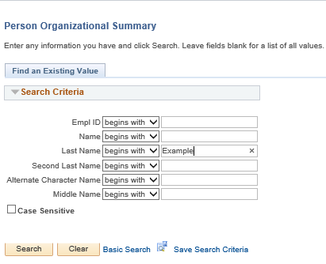
PERSON ORGANIZATIONAL SUMMARY: SEARCH PAGE
Navigation: PeopleSoft Menu > Workforce Administration > Personal Information > Person Organizational Summary
Review the Person Organizational Summary page.
Search by Last Name and determine if a POI, CWR, or EMP instance already exists for the person.
Example: Check to see if Naomi Smith exists in UCPath. Enter her last name and click Search.

Slide 64
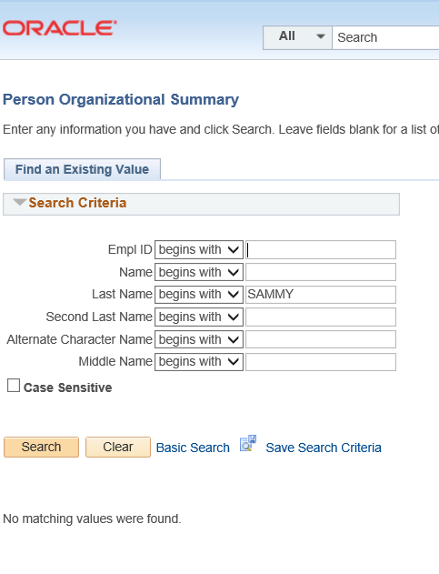
PERSON ORGANIZATIONAL SUMMARY: NO MATCH
Navigation: PeopleSoft Menu > Workforce Administration > Personal Information > Person Organizational Summary
The following example shows that there are no matching values found, for the name entered.
1

Slide 65
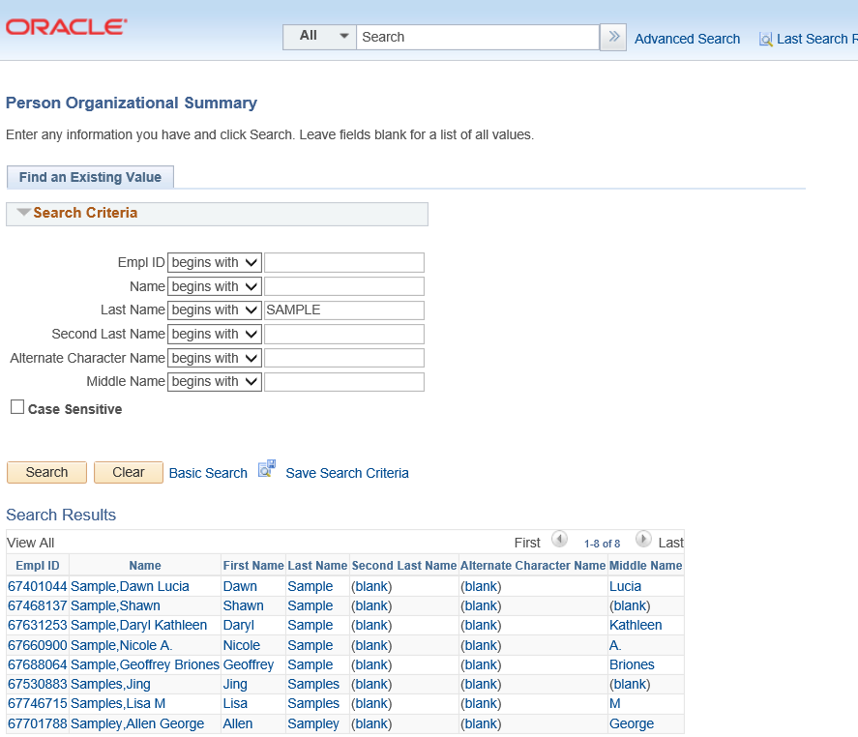
PERSON ORGANIZATIONAL SUMMARY: POSSIBLE MATCH
Navigation: PeopleSoft Menu > Workforce Administration > Personal Information > Person Organizational Summary
The following example shows that there are many matching values found, for the name entered.
1

Slide 66
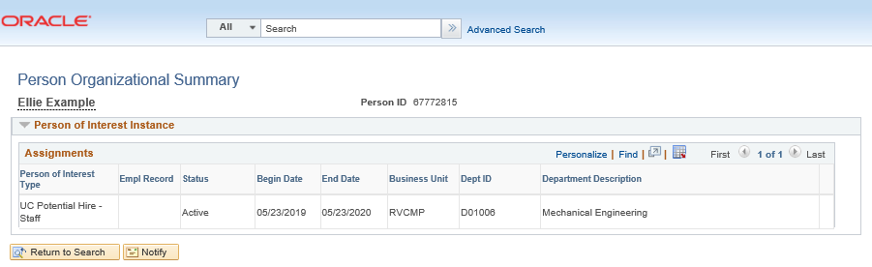
PERSON ORGANIZATIONAL SUMMARY: EXACT MATCH
Navigation: PeopleSoft Menu > Workforce Administration > Personal Information > Person Organizational Summary
The following example shows that Ellie Example has a Person ID in UCPath and an existing POI instance for UC Riverside.
1

Slide 67
PERSON ORGANIZATIONAL SUMMARY
Navigation: PeopleSoft Menu > Workforce Administration > Personal Information > Person Organizational Summary
The header displays the employee’s status information. If there is more than one row of data, click the View All link.

Slide 68
COMPENSATION

Slide 69
COMPENSATION TYPE EXAMPLES
Most common:
UCHRLY Hourly Rate [Staff/Acad]
UCANNL Annual Rate [Staff/Acad]
SOM example:
UCHSP HSCP "X Prime" - Annual Rate
UCHSX HSCP "X" - Annual Rate
UCHSY HSCP Negotiated [FIRM]
Academic example:
UCABVE Above Scale [Acad]
UCOFF1 Off Scale - Eligible [Acad]
UCOFF2 Off Scale - Ineligible [Acad]
Record Only:
UCWOS Without Salary

Slide 70
Initiate a Full Hire

Slide 71
TEMPLATE TABS
Each template will have the following Tabs that may need to be filled out. Be sure to cycle through all five tabs prior to submitting.
Personal Data
Job Data
Earns Dist
Addl Pay
Person Profile

Slide 72
SMART HR TRANSACTIONS
Navigation: PeopleSoft Menu > Workforce Administration > Smart HR Template > Smart HR Transactions
The Smart HR Transactions page is the starting point to initiate a template transaction.
The Transaction Type field is not used by UC.
Use the Select Template field to select the appropriate template.
You also can delete transactions you have initiated, as long as they have not been approved.

Slide 73
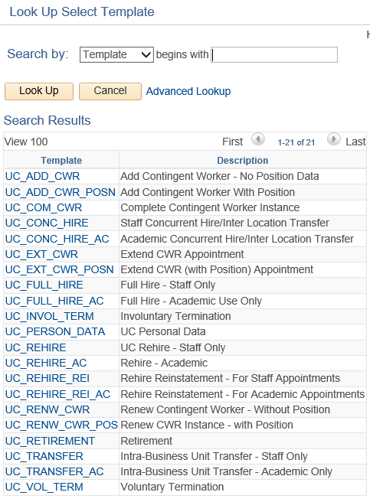
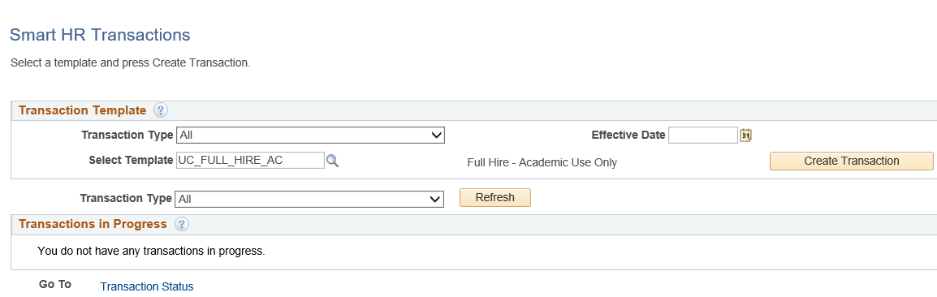
SMART HR TRANSACTIONS
Navigation: PeopleSoft Menu > Workforce Administration > Smart HR Template > Smart HR Transactions
Use the Select Template look up to select the template for the transaction you need to initiate.
Click the Search button to select a template.

Slide 74
SMART HR TRANSACTIONS
Navigation: PeopleSoft Menu > Workforce Administration > Smart HR Template > Smart HR Transactions
After you select the template, and select the Effective Date, click the Create Transaction button.
Click the Search button to select a template.

Slide 75
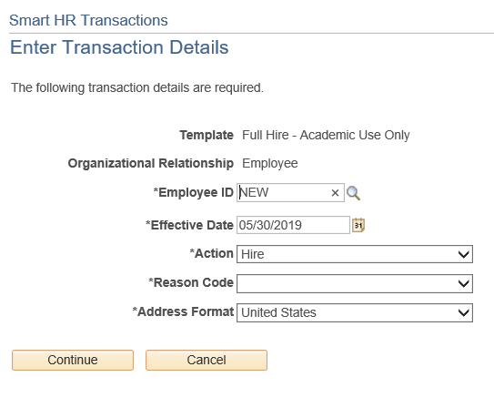
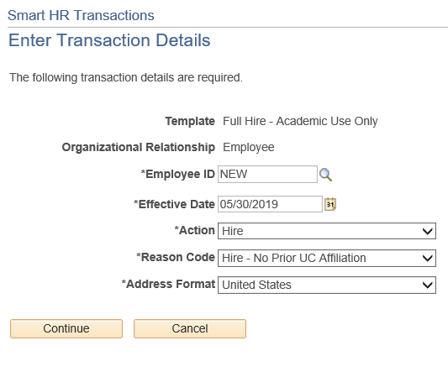
SMART HR TRANSACTIONS
Navigation: PeopleSoft Menu > Workforce Administration > Smart HR Template > Smart HR Transactions
Select the appropriate Reason Code. Each template has a unique list of Reason codes.
Click the Continue button.
For new hires, in the Employee ID field, accept the default of NEW.
Ensure that you select the correct Job Effective Date and Reason Code. These fields are important entry points for the employee’s record and have many downstream effects.
In the Address Format field, accept the default of United States.

Slide 76
FULL HIRE PERSONAL DATA
The academic full hire template appears. There are five tabs on this template: Personal Data, Job Data, Earns Dist, Addl Pay, and Person Profile.
Click in the First Name field.
Click in the Last Name field.
Click in the Date of Birth field.
Click the Look Up Ethnic Group button.
Select the appropriate Military Status, If known, or leave the field blank.
Select the Highest Education Level, If known or accept the default of A (Not Indicated).
Select the Phone Type.
A Preferred phone number must be identified by selecting the check box.
Select Email Type.

Slide 77
FULL HIRE PERSONAL DATA
In the National ID Type field, accept the default of PR for Social Security. Every effort should be taken to include the SSN before submitting the template.
Click in the Address Line 1 field.
Click in City field.
Click in State field.
Click in Postal Code field.
Notes:
If applicable, use the UC External System ID section to enter external system information to facilitate matching of IDs with IDM systems. If providing the information, you must enter values for all three fields. The Business Unit in this section must match the Business Unit associated with the Position Number you enter on the Job Data tab (the next tab).

Slide 78
FULL HIRE PERSONAL DATA
If the new hire has an existing tracker profile, then you can add their Tracker Profile ID and indicate whether their I-9 section 2 needs to be completed remotely. This information is copied to the employee's Person Profile component.
Click in the Tracker Profile ID field.
Use the Comments field to enter specific details or an explanation regarding the transaction. Click the Job Data tab.

Slide 79
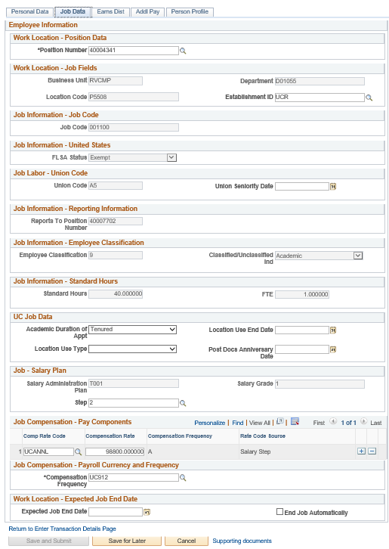
FULL HIRE JOB DATA
Click Position number. The following fields will automatically populate based on Position number. You only have access to position numbers within your business unit.
Business Unit
Location Code
Department
Establishment ID
Job Code
FLSA Status
Union Code
Reports to Position number
Employee Classification
Classified/Unclassified
Standard Hours
FTE
Salary Administration Plan
Salary Grade
Compensation frequency all default

Slide 80
FULL HIRE JOB DATA
Enter Academic Duration of Appointment. This is for locations to track additional information relating to the Expected Job End Date field. Options include:
Continuing (Unit 18)
End Date (Academic Term Appts)
Indefinite
Potential Security
Security (LSOE)
Tenure Track (Ladder Rank)
Tenured

Slide 81
FULL HIRE JOB DATA
Select the Step.
The Comp Rate Code, Compensation Rate, and Compensation Frequency fields are automatically populated based on the Step that was entered.
You can add additional compensation rows by clicking the add a row (+) button. For example, if you need to add an off scale component.
Use the Supporting documents link to attach supporting documents for the new hire.
An Expected Job End Date should be entered for all academic employee classes, except:
3 - Academic Recall
9 - Faculty
10 - Non-Faculty
11 - Academic Student
14 - Academic Contingent Worker
21 - Emeriti
22 - Deans/Faculty Administrators
23 - Post Docs
Notes:
The payroll-related Compensation Frequency field automatically populates based on the job code. The payroll-related Compensation Frequency field automatically populates based on the job code. If the Compensation Frequency in the Job Compensation - Pay Components section is A, then the Compensation Frequency in the Job Compensation - Payroll Currency and Frequency section can be any of the following: B, M, UC912, UC_10, UC_11, UC_12, UC_9M or UC_FY. If the Compensation Frequency in the Job Compensation - Pay Components section is H, then the Compensation Frequency in the Job Compensation - Payroll Currency and Frequency section should be H.
If the End Job Automatically check box is selected the UCPath Center will run a process to terminate the employee as of the Expected Job End Date.

Slide 82
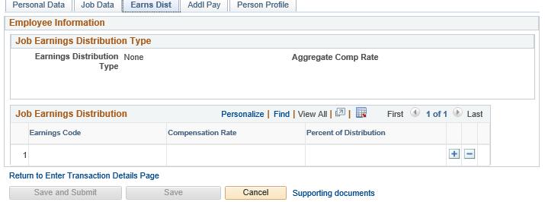
FULL HIRE EARNS DISTRIBUTION
Click the Earns Dist tab.
In most cases, the Job Earnings Distribution section is automated.
The Job Earnings Distribution section also can be used to manually enter distribution information.
After the Earnings Distribution Type is selected, the Aggregate Comp Rate field is populated with the monthly amount.
If By Amount is selected, the total of all compensation rates entered must add up to the monthly comp rate.
If By Percent is selected, the total of all percentages entered must add up to 100%.
For certain academic comp rate codes, such as Health Science Comp Plan, earnings codes are defaulted based on the Comp Rate Code entered on the Job Data tab. Also in those cases, earning distribution type is By Amount, and amounts are automatically calculated.

Slide 83
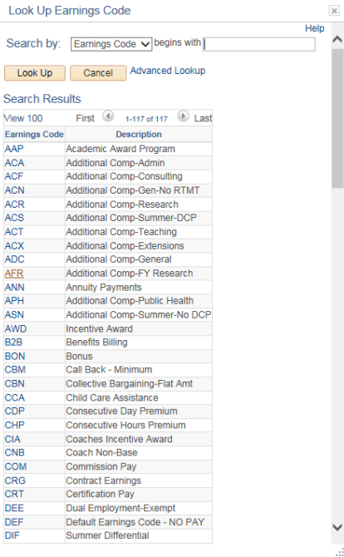
FULL HIRE ADDITIONAL PAY
Click the Addl Pay tab.
There may be cases where an employee is paid a recurring flat amount. In these types of cases, the compensation section is not populated on the Job Data tab. Instead, the Additional Pay section is used.
It is recommended not to use this template for one time additional pay. Instead, use the one time payments page.
Use Supporting documents to attach supporting documents.
Click the Save and Submit button.

Slide 84
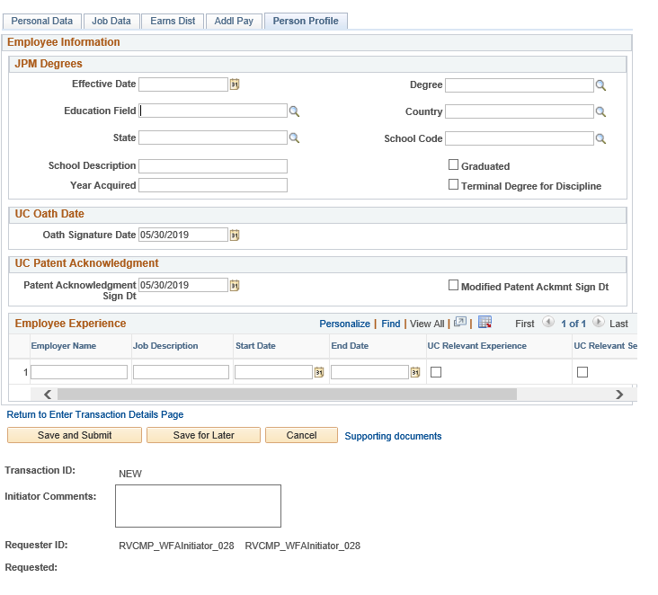
FULL HIRE PERSON PROFILE
Click on Person Profile.
Use the Person Profile page to enter the employee's Degrees, Oath Signature Date, and Patent Acknowledgment signature date. Click in the Oath Signature Date field.
Click in the Patent Acknowledgment Sign Dt field.
Use the Supporting documents link to attach supporting documents for the new hire.
Enter comments for the Approver in the Initiator Comments field. Comments you enter here appear only with the request; they do not appear on the employee’s record after the transaction is processed to completion. You can enter Initiator Comments on any of the tabs within this template.
Click Save and Submit button.
Notes:
The information entered in the JPM Degrees, UC Oath Date and UC Patent Acknowledgement sections is copied to the employee's Person Profile component after the template is processed by UCPC WFA Production.

Slide 85
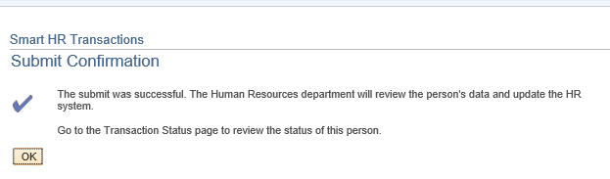
FULL HIRE CONFIRMATION
Once the transaction has been submitted, the Initiator will receive a confirmation.
Click the OK button to go to the Transaction Status page to review the status of this person.
The template transaction is routed for approval, and appears in the Transactions in Progress section until it is processed.
You have initiated a Full Hire Academic template transaction.

Slide 86
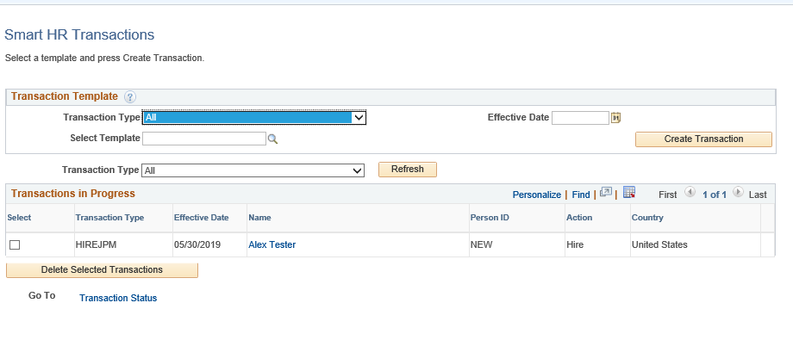
FULL HIRE SMART HR TRANSACTIONS
You will be able to view your submitted transaction in the Smart HR Transactions page.

Slide 87
Demo Full Hire Undergraduate Student
Notes:
Demo as a class

Slide 88
TRY IT 1. HIRE AN HOURLY UNDERGRADUATE STUDENT WHO HAS NEVER WORKED FOR UC 2. HIRE A ACACEMIC INDIVIDUAL WHO HAS PRIOR UC AFFILIATION AND IS BEING HIRED INTO JOB CODE 003330 ON STEP 2
Reminder: Don’t forget to write down your transaction number

Slide 89
Demo Full Hire Professor

Slide 90
TRY IT 1. HIRE AN ACADEMIC WITH A STIPEND OF $500 PER MONTH 2. HIRE A FULL PROFESSOR
Reminder: Don’t forget to write down your transaction number

Slide 91
Initiate a Rehire

Slide 92
SMART HR TRANSACTIONS
Navigation: PeopleSoft Menu > Workforce Administration > Smart HR Template > Smart HR Transactions
The Smart HR Transactions page is the starting point to initiate a template transaction.
The Transaction Type field is not used by UC.
Use the Select Template field to select the appropriate template.
You also can delete transactions you have initiated, as long as they have not been approved.

Slide 93
SMART HR TRANSACTIONS
Navigation: PeopleSoft Menu > Workforce Administration > Smart HR Template > Smart HR Transactions
Use the Select Template look up to select the template for the transaction you need to initiate.
Click the Search button to select a template.

Slide 94
SMART HR TRANSACTIONS
Navigation: PeopleSoft Menu > Workforce Administration > Smart HR Template > Smart HR Transactions
After you select the template, and select the Effective Date, click the Create Transaction button.
Click the Search button to select a template.

Slide 95
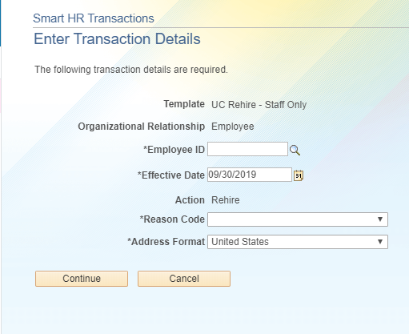
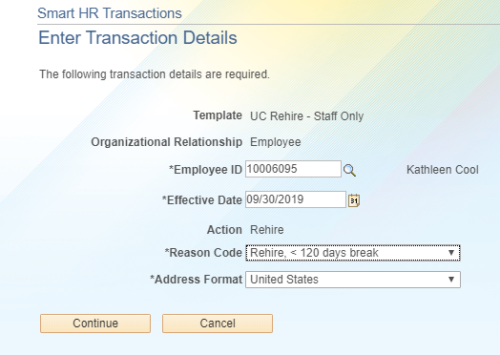
SMART HR TRANSACTIONS
Navigation: PeopleSoft Menu > Workforce Administration > Smart HR Template > Smart HR Transactions
Select the appropriate Employee ID and Reason Code.
Click the Continue button.

Slide 96
SMART HR TRANSACTIONS
Navigation: PeopleSoft Menu > Workforce Administration > Smart HR Template > Smart HR Transactions
Select the OK button.

Slide 97
REHIRE PERSONAL DATA
The rehire template appears. There are five tabs on this template: Personal Data, Job Data, Earns Dist, Addl Pay, and Employee Experience

Slide 98
REHIRE JOB DATA
Click Position number. The following fields will automatically populate based on Position number. You only have access to position numbers within your business unit.
Business Unit
Location Code
Department
Establishment ID
Job Code
FLSA Status
Union Code
Reports to Position number
Employee Classification
Classified/Unclassified
Standard Hours
FTE
Salary Administration Plan
Salary Grade
Compensation frequency all default

Slide 99
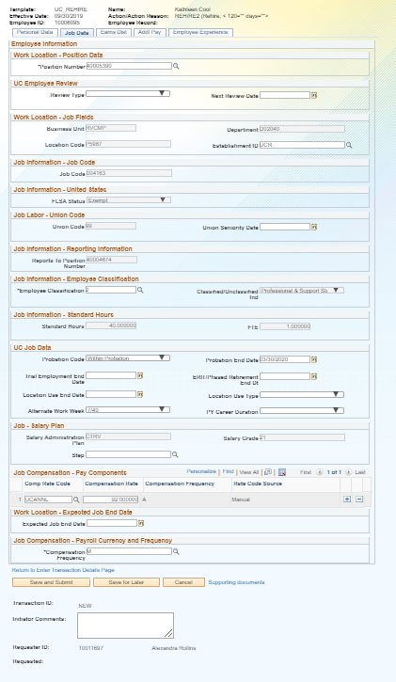
REHIRE JOB DATA
Select or update the following fields:
Employee Classification
Update Probation Code and Probation End Date
Comp Rate Code
Compensation Rate

Slide 100
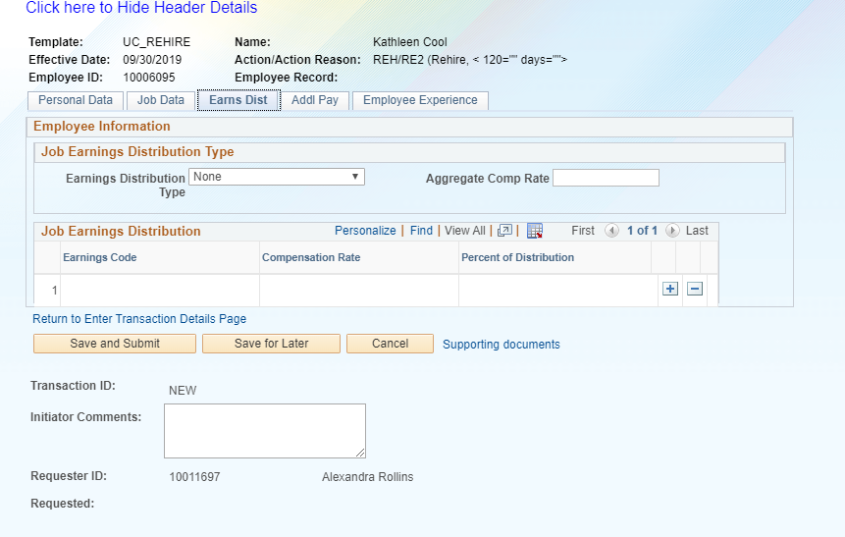
REHIRE EARNS DIST

Slide 101
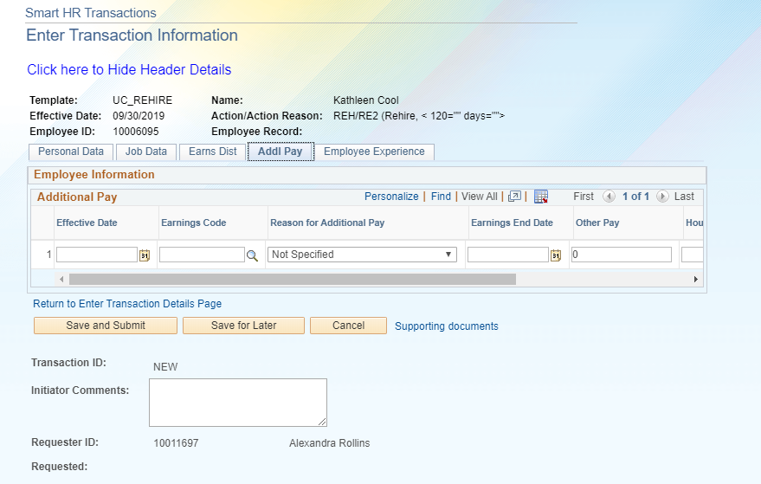
REHIRE ADDITIONAL PAY

Slide 102
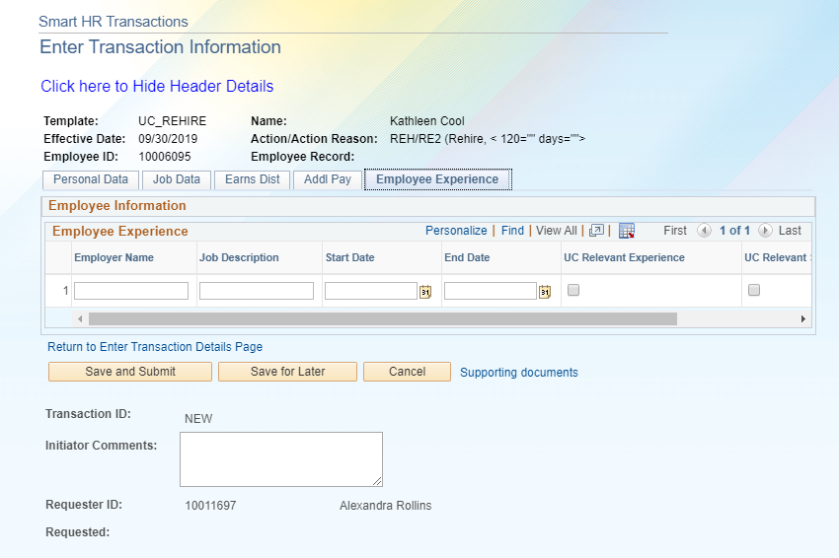
REHIRE EMPLOYEE EXPERIENCE

Slide 103
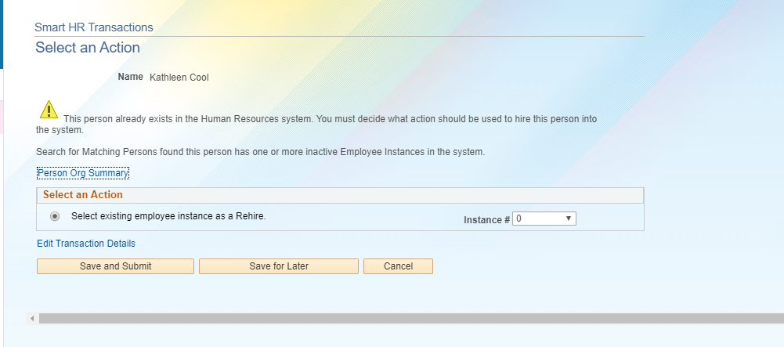
REHIRE SELECT AN ACTION

Slide 104
Demo a Rehire

Slide 105
TRY IT 1. REHIRE AN ACADEMIC EMPLOYEE WHO SEPARATED 6 MONTHS AGO 2. REHIRE A STUDENT WHO SEPARATED 6 WEEKS AGO
Reminder: Don’t forget to write down your transaction number

Slide 106
Initiate a Concurrent Hire

Slide 107
CONCURRENT HIRE
Available Templates
A staff or academic employee adds an additional job, which is concurrent to his or her existing job with UC.
Non-Dual: Two or more jobs that do not exceed a total percent time of 100%.
Dual: Two or more jobs that exceed a total percent time of 100%.
A separate concurrent hire template is available for academic and for staff.

Slide 108
SMART HR TRANSACTIONS
Navigation: PeopleSoft Menu > Workforce Administration > Smart HR Template > Smart HR Transactions
The Smart HR Transactions page is the starting point to initiate a template transaction.
The Transaction Type field is not used by UC.
Use the Select Template field to select the appropriate template.
You also can delete transactions you have initiated, as long as they have not been approved.

Slide 109
SMART HR TRANSACTIONS
Navigation: PeopleSoft Menu > Workforce Administration > Smart HR Template > Smart HR Transactions
Use the Select Template look up to select the template for the transaction you need to initiate.
Click the Search button to select a template.

Slide 110
SMART HR TRANSACTIONS
Navigation: PeopleSoft Menu > Workforce Administration > Smart HR Template > Smart HR Transactions
After you select the template, and select the Effective Date, click the Create Transaction button.
Notes:
Transferred employees must NOT have a break in service.

Slide 111
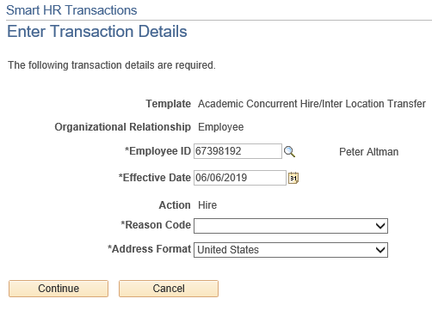
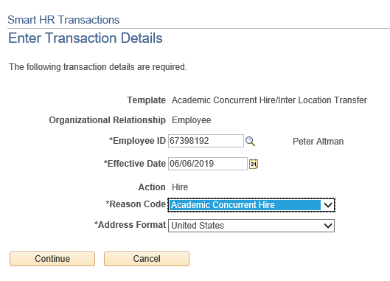
SMART HR TRANSACTIONS
Navigation: PeopleSoft Menu > Workforce Administration > Smart HR Template > Smart HR Transactions
Select the appropriate Reason Code. Each template has a unique list of Reason codes.
Click the Continue button. Click the OK button when the UCPath message indicating the individual is in the system appears.
1
Use Academic Concurrent Hire to add either a Dual or Non-Dual employment.
Notes:
Use Academic Inter BU Transfer for an inter-business unit transfer of an academic employee. Example: A faculty member from UCLA is transferred to a new position at UCR. There is no break in Service. This type of transfer is OUTSIDE UCR (BU – Campus/Location).

Slide 112
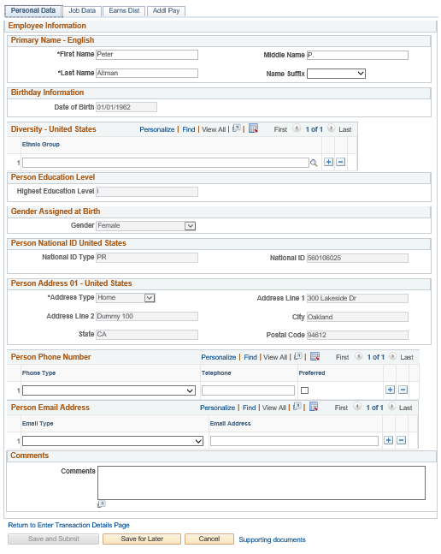
CONCURRENT HIRE PERSONAL DATA
The concurrent hire template appears. Four tabs are available on this template: Personal Data, Job Data, Earns Dist, and Addl Pay.
The employee's personal data automatically populates from the employee's existing personal data information. If a change is required for personal data, it should be submitted using Employee Self Service or the Personal Data Change Template.

Slide 113
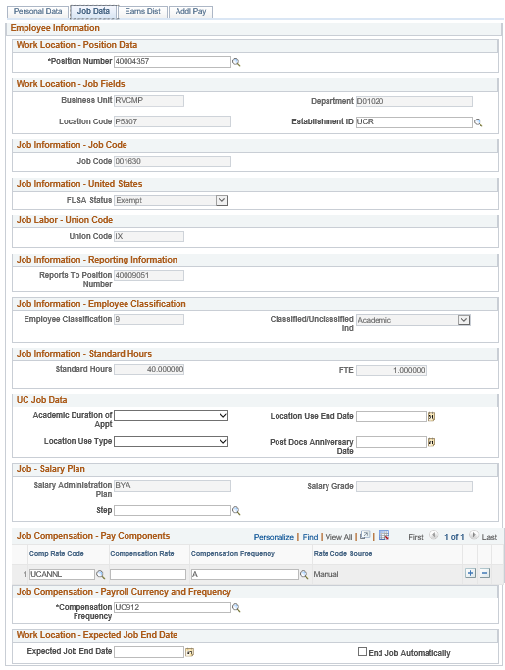
CONCURRENT HIRE JOB DATA
Enter the Position Number of the concurrent job, or search for it using the look up. You only have access to position numbers within your business unit. The following fields will automatically populate based on Position number:
Business Unit
Location Code
Department
Establishment ID
Job Code
FLSA Status
Union Code
Reports to Position number
Employee Classification
Classified/Unclassified
Standard Hours
FTE

Slide 114
CONCURRENT HIRE JOB DATA
Some job codes have steps associated with them.
For this example, the job code is not associated with the step.
Select the Comp Rate Code. Once selected, the Compensation Frequency is automatically populated.
Comp Rate Codes are used to define each component of the employee’s base salary.
Compensation Rate is the amount paid at the compensation frequency.
Notes:
When a Step is entered, UCPath automatically updates the Job Compensation - Pay Components fields and the compensation information cannot be changed. Some job codes do not have steps associated with them, in which case the Job Compensation - Pay Components fields must be manually entered. If the job has above scale component of pay, then step does not need to be selected. Enter applicable above scale comp rate codes in the Job Compensation - Pay Components section.

Slide 115
CONCURRENT HIRE JOB DATA
If the employment is a short term assignment or temporary hire, enter the date the position ends in the Expected Job End Date field. An expected end date should be entered for all academic employee classes, except:
3 - Academic Recall
9 - Faculty
10 - Non-Faculty
11 - Academic Student
14 - Academic Contingent Worker
21 - Emeriti
22 - Deans/Faculty Administrators
23 - Post Docs

Slide 116
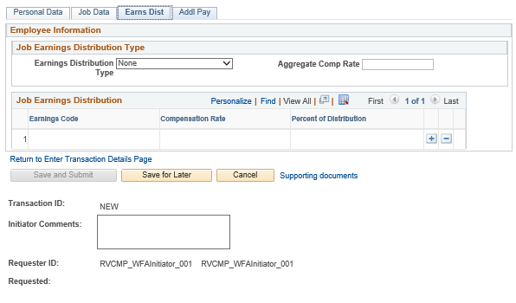
CONCURRENT HIRE EARNS DISTRIBUTION
Click the Earns Dist tab.
In most cases, the Job Earnings Distribution section is automated.
The Job Earnings Distribution section also can be used to manually enter distribution information.
After the Earnings Distribution Type is selected, the Aggregate Comp Rate field is populated with the monthly amount.
If By Amount is selected, the total of all compensation rates entered must add up to the monthly comp rate.
If By Percent is selected, the total of all percentages entered must add up to 100%.
For certain academic comp rate codes, such as Health Science Comp Plan, earnings codes are defaulted based on the Comp Rate Code entered on the Job Data tab. Also in those cases, earning distribution type is By Amount, and amounts are automatically calculated.
Notes:
If the Comp Rate code entered on the Job Data tab has a mapped Earnings Code, the Job Earnings Distribution section is updated automatically.

Slide 117
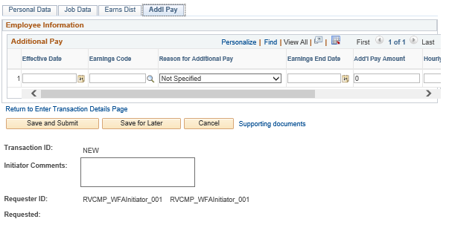
CONCURRENT HIRE ADDITIONAL PAY
Click the Addl Pay tab.
There may be cases where an employee is paid a recurring flat amount. In these types of cases, the compensation section is not populated on the Job Data tab. Instead, the Additional Pay section is used.
It is recommended not to use this template for one time additional pay. Instead, use the One Time Payments page.
Use Supporting documents to attach supporting documents for concurrent hire.
Click the Save and Submit button.

Slide 118
FULL HIRE CONFIRMATION
Once the transaction has been submitted, the Initiator will receive a confirmation.
Click the OK button to go to the Transaction Status page to review the status of this person.
The template transaction is routed for approval, and appears in the Transactions in Progress section until it is processed.
You have initiated a Full Hire Academic template transaction.

Slide 119
FULL HIRE SMART HR TRANSACTIONS
You will be able to view your submitted transaction in the Smart HR Transactions page.

Slide 120
Demo a Concurrent Hire

Slide 121
TRY IT To complete this exercise you will need to select an employee in your accountability who has a job with less than a 100% FTE 1. HIRE A CONCURRENT ACADEMIC WITH A STIPEND OF $1,000 A MONTH 2. HIRE A CONCURRENT STAFF WITH NO ADDITIONAL PAY
Reminder: Don’t forget to write down your transaction number

Slide 122
Change Impacts

Slide 123
CHANGE IMPACTS
The submission and approval of the template transaction for Onboarding will be initiated by the Transactional Unit; this used to be processed by the SSC
The Shared Service Center will approve the Onboarding transaction
In the event that UCPath Cancels a transaction, the transactional unit will need to notify the Shared Service Center

Slide 124
Additional Information

Slide 125
How to Clone a Denied Transaction

Slide 126
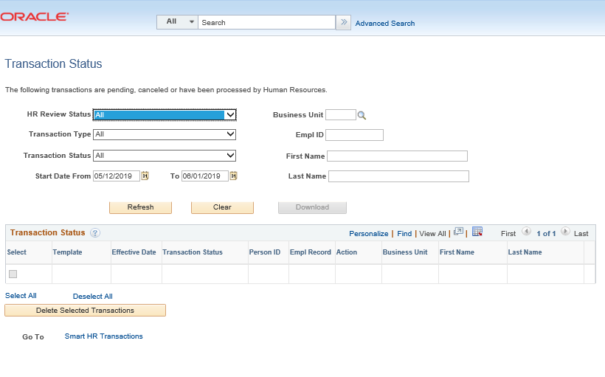
CLONING A TRANSACTION
Navigation: PeopleSoft Menu > Workforce Administration > Smart HR Template > Transaction Status
The AWE Approver denied the transaction, which is routed back to the Initiator’s Transaction Status page.
Click Refresh on the Transaction Status page to view your transactions.

Slide 127
CLONING A TRANSACTION
Navigation: PeopleSoft Menu > Workforce Administration > Smart HR Template > Transaction Status
The Initiator is able to Clone transaction by clicking on the Clone button.
Once you click the Clone button, the button will grey out.
Go to Smart HR Transactions at the bottom of the page to access the cloned template.
The cloning function is available when:
A template transaction is denied by a Location Approver,
Or when a template transaction is cancelled by UCPC WFA Production.
Clone button will grey out what you click on it.
Click on Smart HR Transactions.

Slide 128
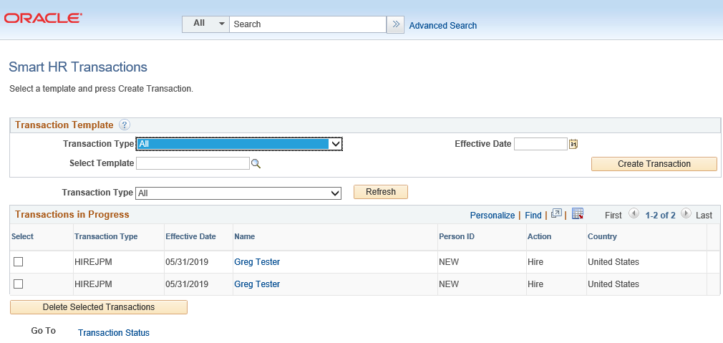
CLONING A TRANSACTION
Initiator will be able to view the cloned transaction.
Transaction number 2 is the cloned transaction; click on this transaction to resubmit.
Transaction number 1 is the original transaction; click on this transaction to view denial comments.
TIP:
If you click on the original transaction #1, you will not be able to click the Save and Submit button because it will be greyed out. The cloned transaction will always be on the bottom of the original transaction.
1
Original Transaction
2
Cloned Transaction

Slide 129
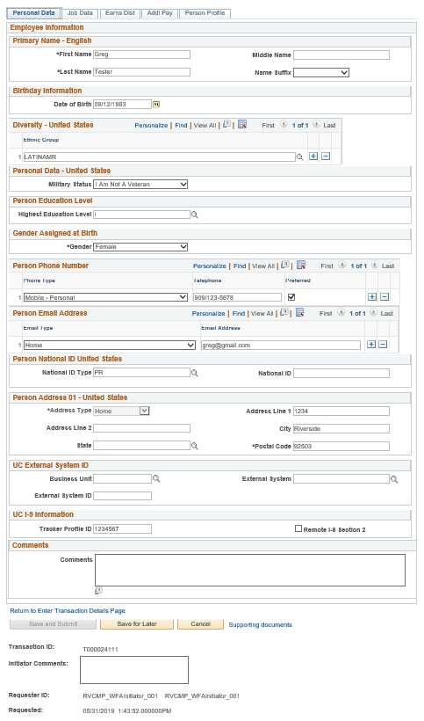
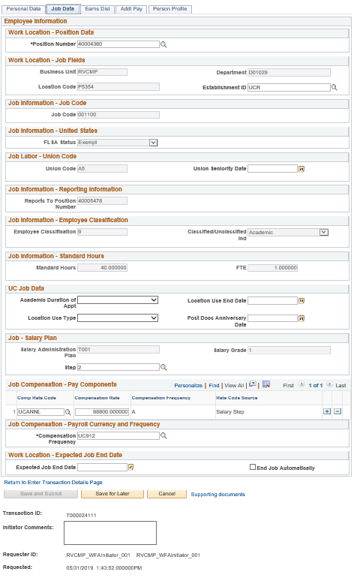
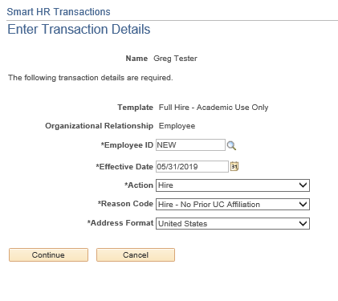
RESUBMITTING A CLONED TRANSACTION
Navigation: PeopleSoft Menu > Workforce Administration > Smart HR Template > Transaction Status
Click on the Continue button to view Transaction Details.

Slide 130
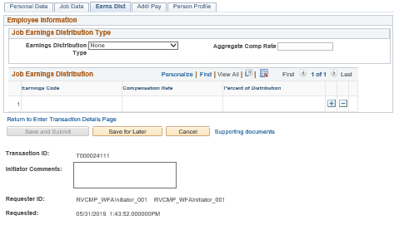
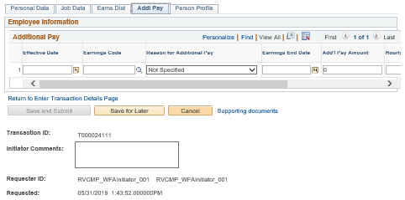
CLONING A TRANSACTION
Navigation: PeopleSoft Menu > Workforce Administration > Smart HR Template > Transaction Status

Slide 131
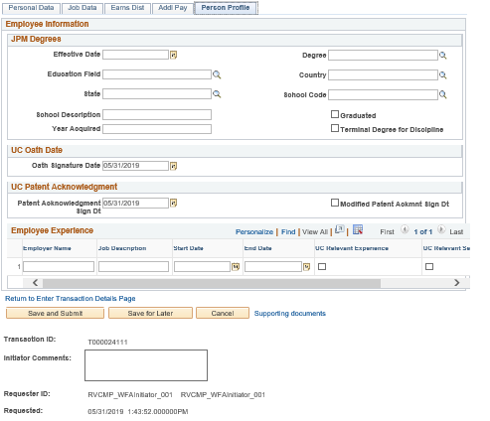
CLONING A TRANSACTION
Navigation: PeopleSoft Menu > Workforce Administration > Smart HR Template > Transaction Status
Once you have corrected what needs to be corrected, resubmit the transaction by clicking on Save and Submit.

Slide 132
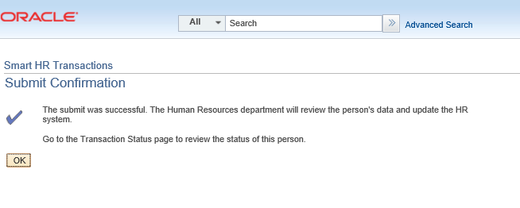
SUBMIT CONFIRMATION
Once the transaction has been submitted, the Initiator will receive a confirmation.
Click the OK button to go to the Transaction Status page to review the status of this person.
The template transaction is routed for approval and appears in the Transactions in Progress section until it is processed.
You have resubmitted a full hire academic template transaction.
The template transaction is routed to AWE for approval.

Slide 133
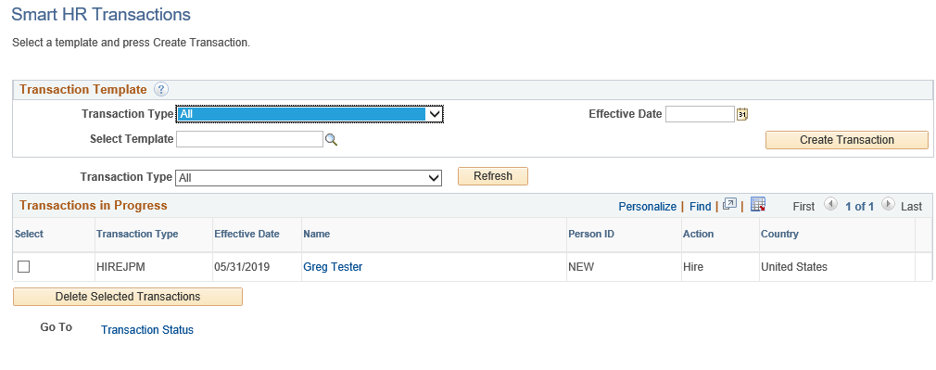
VIEW DENIAL COMMENTS ON ORIGINAL TRANSACTION
Navigation: PeopleSoft Menu > Workforce Administration > Smart HR Template > Smart HR Transactions
Click on person’s name.
The Transaction Details will appear on the screen. Click on Continue.
Initiator views comments in the Smart HR Transactions page.
Initiator clones in the Transaction Status page.

Slide 134
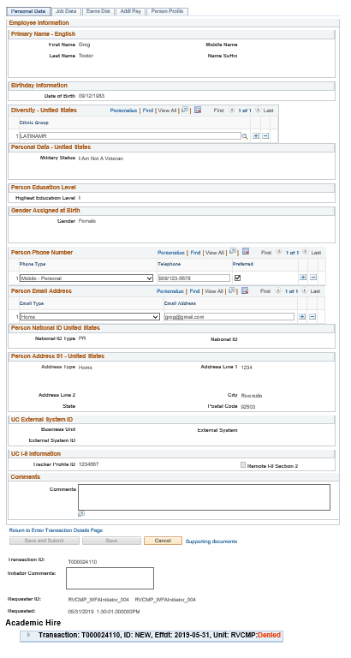
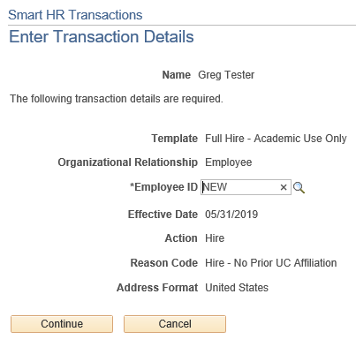
VIEW DENIAL COMMENTS
Navigation: PeopleSoft Menu > Workforce Administration > Smart HR Template > Smart HR Transactions
Click the Continue button on the Transaction Details page.
To view denial comments from the AWE Approver, click on the arrow.

Slide 135
Transaction Status

Slide 136
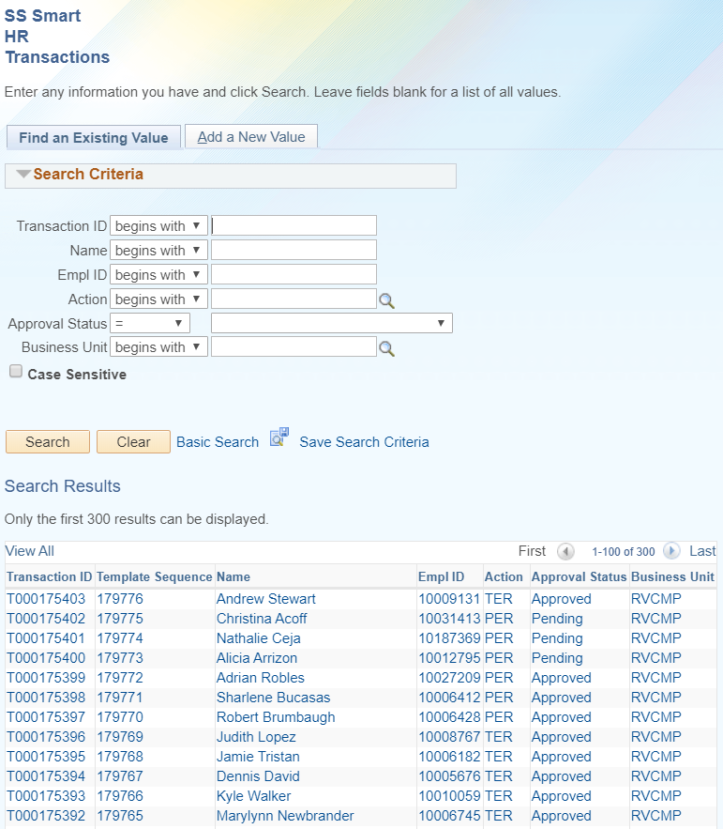
TRANSACTION STATUS FOR LOCAL AWE
Navigation: PeopleSoft Menu > UC Customization > SS Smart HR Transactions > Find an Existing Value
The transaction will remain in a Pending Status until the AWE Approver approves or denies the transaction.
If Approved, the next step in the process will be UCPath review.
UCPath has the option of Approving or Cancelling the transaction.
To search for a transaction, enter the Transaction ID in the field and click Search. Your transaction will then display.
To see all transactions in your accountability structure, simply click Search.
Open the transaction from this view by clicking on the Transaction ID
Notes:
The Smart HR Transactions will display all transactions (pending, approved or denied) in your accountability structure.

Slide 137
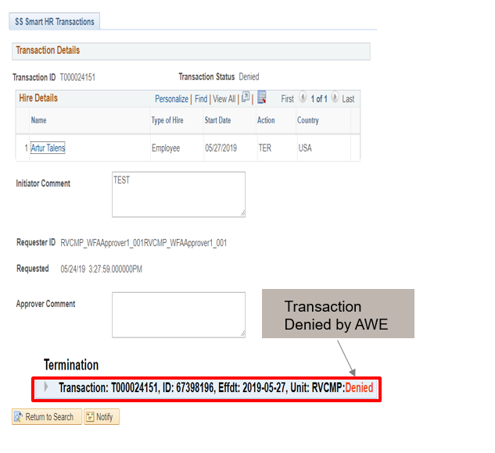
TRANSACTION LOCALLY DENIED
Navigation: PeopleSoft Menu > Workforce Administration > Smart HR Template > SS Smart HR Transactions > Transaction Details
In the event that the template is denied by the Shared Service Center AWE approver (i.e. incorrect name spelling, wrong date, etc.), the template is returned (with comments) to the Transactional Unit Initiator to correct and resubmit.
The Transactional Unit Initiator will be able to clone the transaction from the Transaction Status page.
Transaction Denied by AWE
To view denial comments from the AWE Approver, click on the arrow.

Slide 138
TRANSACTION STATUS FOR UCPC
Navigation: PeopleSoft Menu > Workforce Administration > Smart HR Template > Smart HR Transactions > Transaction Details
This view will display all Transactions that are in your accountability structure and the Transaction Status from UCPC.

Slide 139
VIEW CANCELLED COMMENTS FROM UCPC
Navigation: PeopleSoft Menu > Workforce Administration > Smart HR Template > Transaction Status
When a transaction is cancelled by UCPC WFA Production, comments are entered to explain why the transaction was cancelled (effective date wrong, action reason code wrong etc.).
Template Initiators can View Comments under Reason for Cancellation and, if needed, Clone the transaction to resubmit it with necessary corrections.
Note: To view comments about a transaction that was denied by a Location AWE Approver, you must navigate to the SS Smart HR Transactions page and review the Approver Comments field.
Click for UCPC Job Aid

Slide 140
SharePoint Instructions and Hands on Training

Slide 141
SHAREPOINT LIST INSTRUCTIONS
Testing SharePoint: https://ucrshare.ucr.edu/sites/FOM_UCPath/SitePages/Home.aspx
Preferred browsers are Internet Explorer and Chrome. (Save the link as a favorite)
Select UCPath Transaction Training Scenarios from the left side Quick Menu:

Slide 142
VIEWING LIST OPTIONS
When the list opens, note the tabs at the top of the screen:

Slide 143
VIEWING LIST OPTIONS part 2
By selecting ‘List’ you can filter the view on the process you are transacting. The default view is All Transactions. Select a specific transaction type to view the list containing only those transactions:

Slide 144
UPDATING AND EDITING A SHAREPOINT LIST
Many functions of a SharePoint list are similar to MS Excel, except that it is in a central location, and can be accessed / updated by multiple people at the same time.
Use the list headers to filter and sort. Only you will see these temporary changes.
By selecting your name in the drop-down, you will have easy access to only your transactions. This is especially helpful if your name appears several pages into the list.

Slide 145
APPENDIX
Onboarding EMPL Class 5, 9, 10 Process Map
Onboarding EMPL Class 5, 9, 10 Process Design Workbook
Job Code Table
Onboarding Checklist

Slide 146
Your Feedback Please
http://bit.ly/pilottrainingphase2

