Slide 1

Ucr ucpath transaction pilot
Advanced Payroll CALENDAR PROCESSING and Advanced Downstream Impacts

Slide 2

TRAINER INTRODUCTION
NAMES: Antonette Toney, LaKesha Welch, Andrea Campos, Rose Silvas, Sarah Dillon, Kameron Johnson,
Titles: Varies ☺
Departments: UCPath Campus Support Center, Business Financial Services, Harvest Shared Service Center
Years @UC: Varies ☺
Previous Experience: Varies ☺

Slide 3
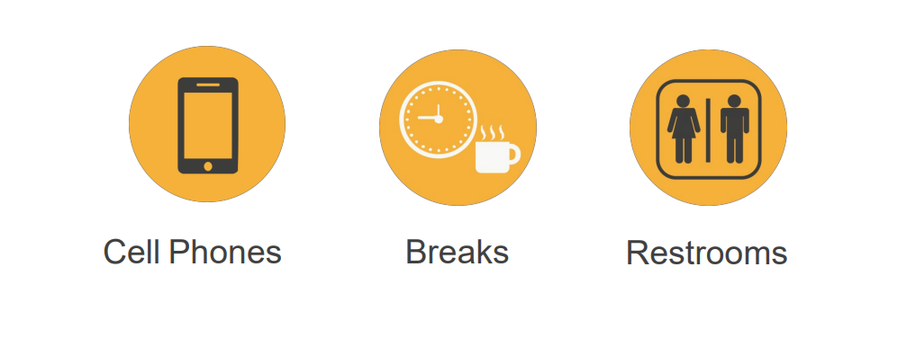
HOUSEKEEPING

Slide 4
AGENDA
Phase II Overview & Course Overview
WFA - Paypath / Job Data Overview Demo / Hands On
Payroll Calendar Overview
Payroll Calc Processing
Pay Confirm Overview – PayCheck Preview Overview- Demo and Hands On
Pay Mitigation Demo / Hands on
Notes:
Marry the data flow and the payroll processing calendar. Provide them with understanding of the pay impacting fields and all the pieces that drive pay, gross pay. Net pay. Review individual records, review reports, audit in batch. What to do when they find errors and correct. Walkthrough telling the story.
Best practices
What to do when they find issues with pay calc
What to do when they find issues with confirm
What to do when they find issues on Job
What to do when they find out they need a correction
Options for monitoring and auditing

Slide 5
AGENDA
Paycheck Preview Review Demo
Accrual Process Demo
General Ledger Walkthrough
Learning Objectives Review
Things to Remember
Appendix
Notes:
Marry the data flow and the payroll processing calendar. Provide them with understanding of the pay impacting fields and all the pieces that drive pay, gross pay. Net pay. Review individual records, review reports, audit in batch. What to do when they find errors and correct. Walkthrough telling the story.
Best practices
What to do when they find issues with pay calc
What to do when they find issues with confirm
What to do when they find issues on Job
What to do when they find out they need a correction
Options for monitoring and auditing

Slide 6
PHASE II OVERVIEW

Slide 7
Pilot Phase II – Unit initiation & Approval
Onboarding/
Off-boarding for Persons of Interest
Personal Data & Personal Profile Changes
Position Data Management
On Behalf of Case Management
Voluntary Termination – Staff & Academic
Onboarding &
Off-boarding for Contingent Workers
One-Time Additional Pay
*On/Off-boarding & PayPath for Deans & Faculty Admins
Onboarding – Select Academics & Casual/Restricted Staff
Involuntary Termination – Staff & Academics
PayPath – Select Academics & Casual/Restricted Staff
New for Phase II:

Slide 8
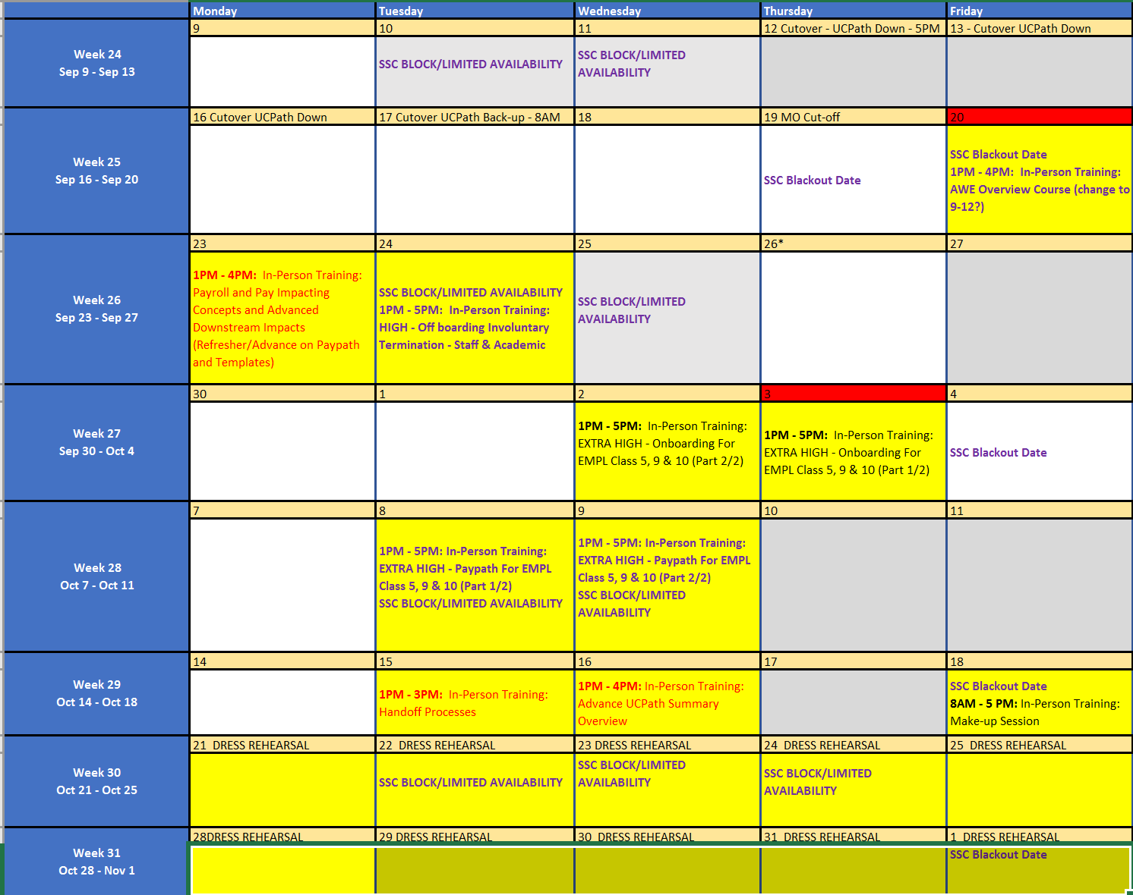
Phase II Training calendar

Slide 9
DATA FLOW
WFA-
OnboardingTemplates (Person Profile)
Job Data (PayPath)
Additional Pay
Payroll Processing
UCPC PAYROLL PROCESS AND DATA FLOW
+
Transaction Cutoff
External Files and Docs
(I-181 & I-618)
TARS and One Time Pays
Corrections due for External Files
Pay Calculation
Pay Confirm
Absence Management Processing
GL Processing
Deductions and Vendor Files
UCPC PAYROLL PROCESSING CALENDAR
Notes:
Marry the data flow and the payroll processing calendar. Provide them with understanding of the pay impacting fields and all the pieces that drive pay, gross pay. Net pay. Review individual records, review reports, audit in batch. What to do when they find errors and correct. Walkthrough telling the story.
Best practices
What to do when they find issues with pay calc
What to do when they find issues with confirm
What to do when they find issues on Job
What to do when they find out they need a correction
Options for monitoring and auditing

Slide 10
COURSE OVERVIEW
Course Overview
Data Flow Overview from Data Upstream
Templates, landing in job, moving to payroll ending with GL
UCPC Payroll Process and Data Flow Map
Upstream data
Getting data from UCPath
Transaction Perspective
Position
Where does it end up… Paypath

Slide 11
PAYPATH & JOB DATA OVERVIEW

Slide 12
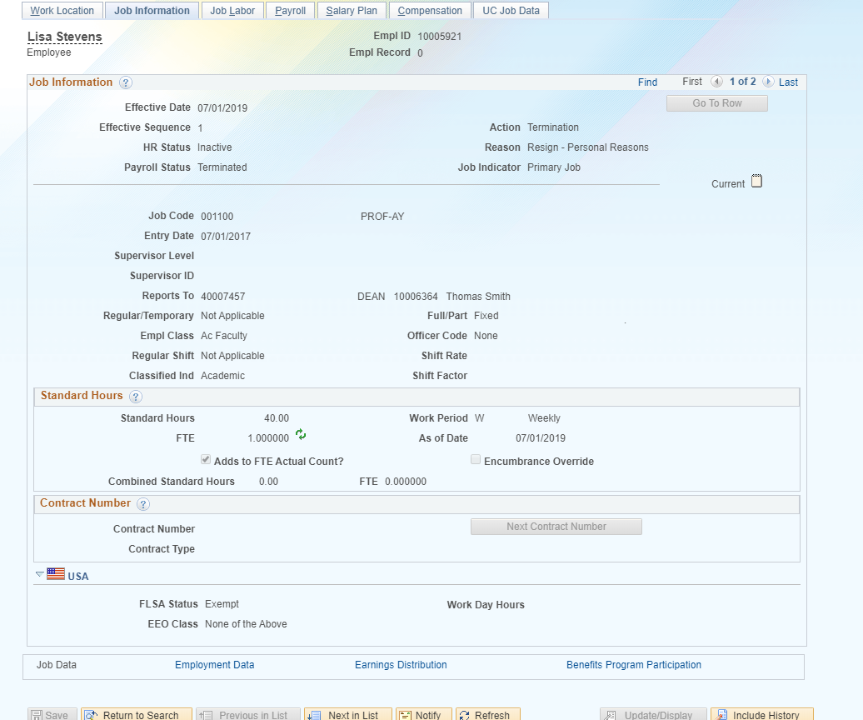
JOB DATA OVERVIEW
Pay impacting fields
FTE
FLSA
Is and can alter pay if not correctly set on position.
Updated by the location.

Slide 13
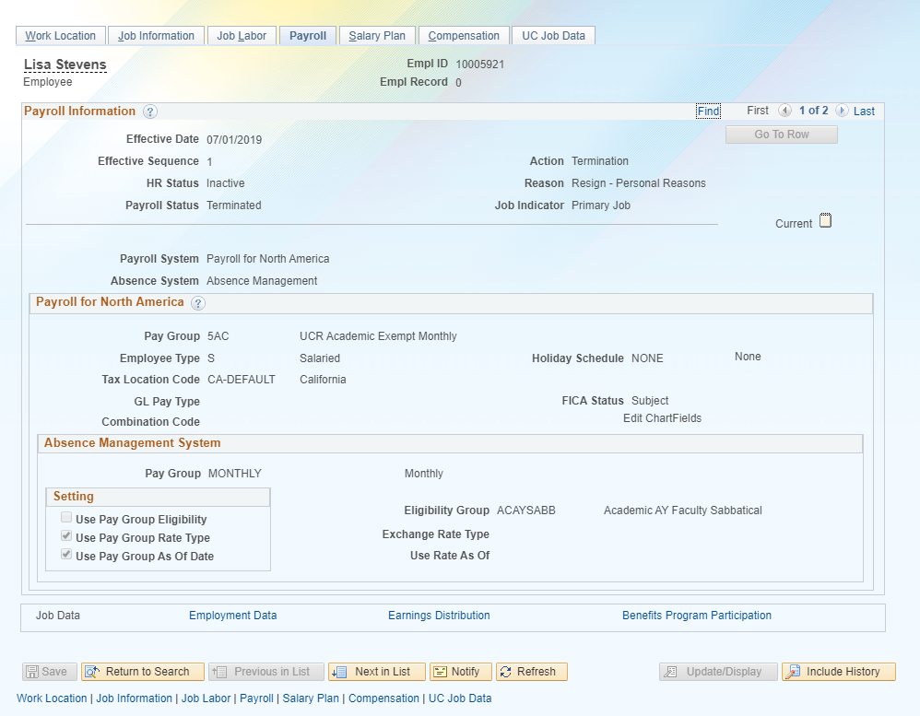
JOB DATA OVERVIEW
Pay impacting fields
Pay Group
Can impact pay if not correctly set up per job details. Becomes a problem with concurrent jobs.
Can only be updated by UCPC.

Slide 14
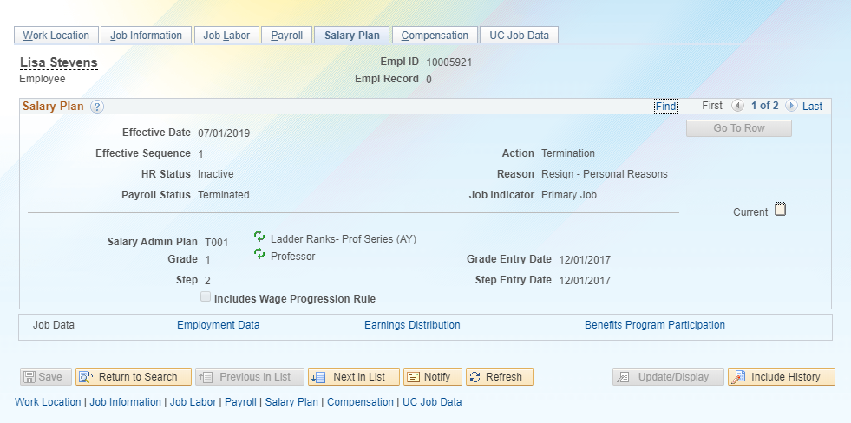
JOB DATA OVERVIEW
Pay impacting fields
Salary Admin Plan
Grade
Step
Can impact pay if not correctly set on position.
Updated by the location.

Slide 15
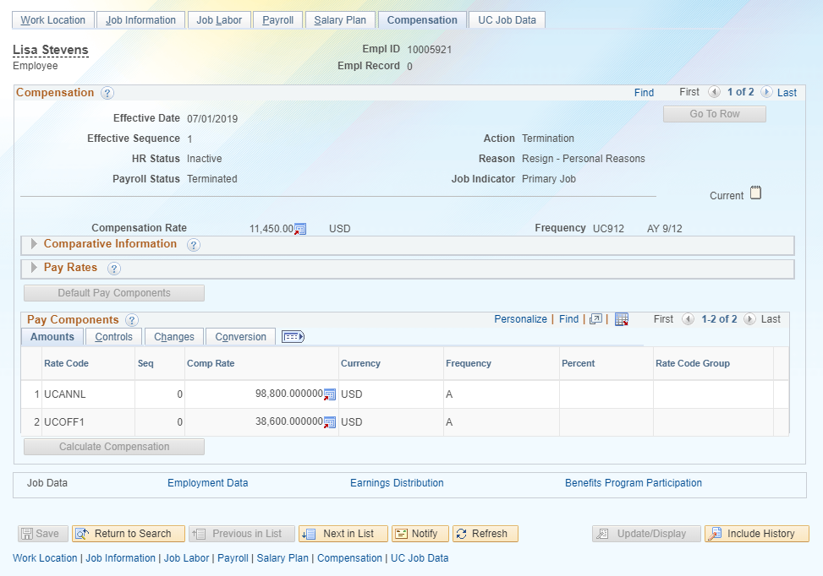
JOB DATA OVERVIEW
Pay impacting fields
Comp rate
Rate code
Frequency
Can impact pay if not correctly set on position.
Updated by the location.

Slide 16
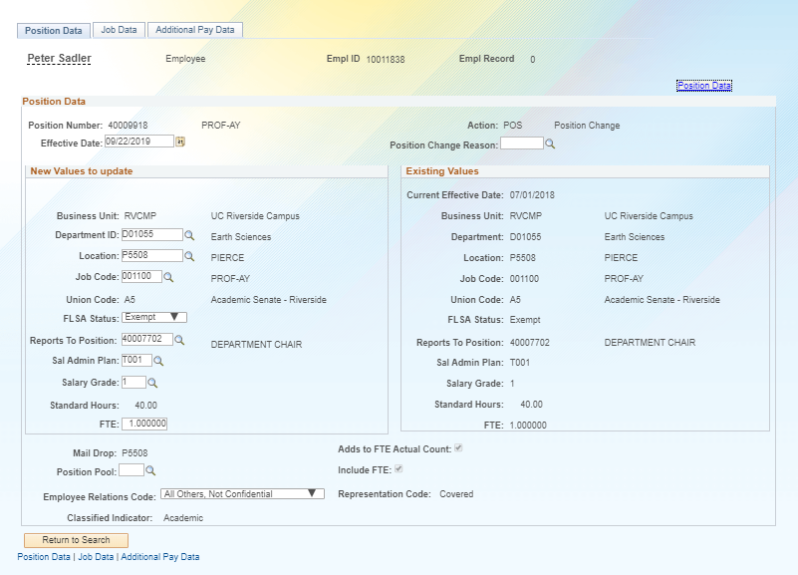
PAYPATH OVERVIEW
Pay impacting fields
FLSA
Sal Admin Plan
Salary Grade
FTE

Slide 17
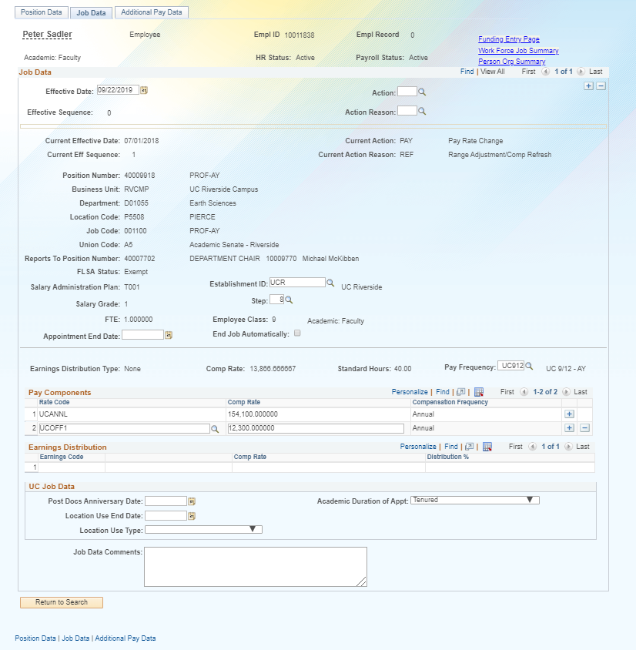
PAYPATH OVERVIEW
Pay impacting fields
Step
Pay Frequency
Comp Rate
Rate Code
Earnings Distribution Type (JED)

Slide 18
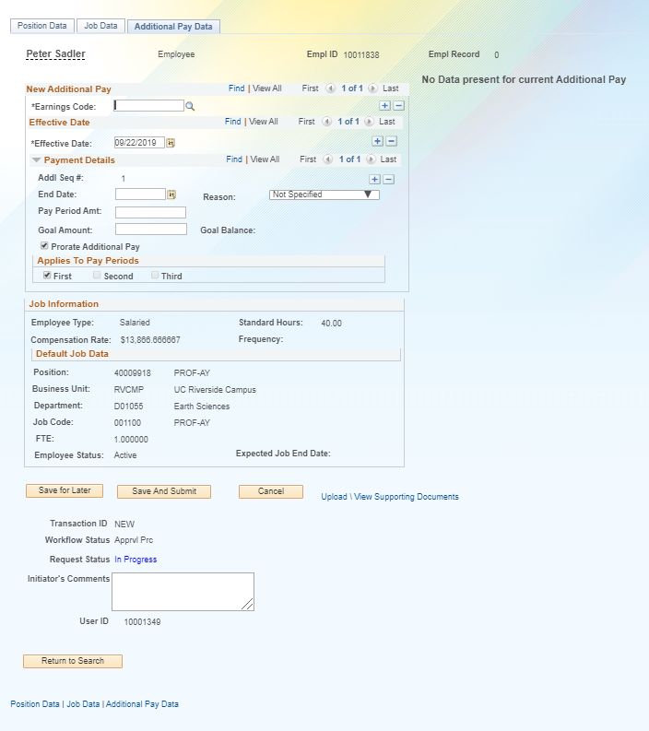
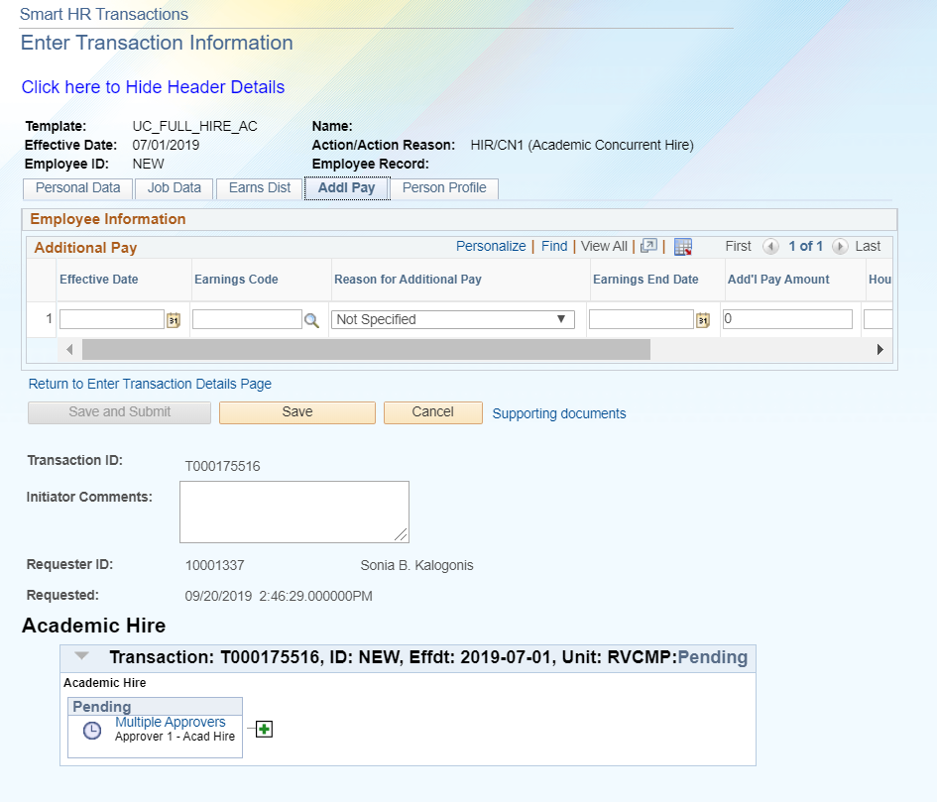
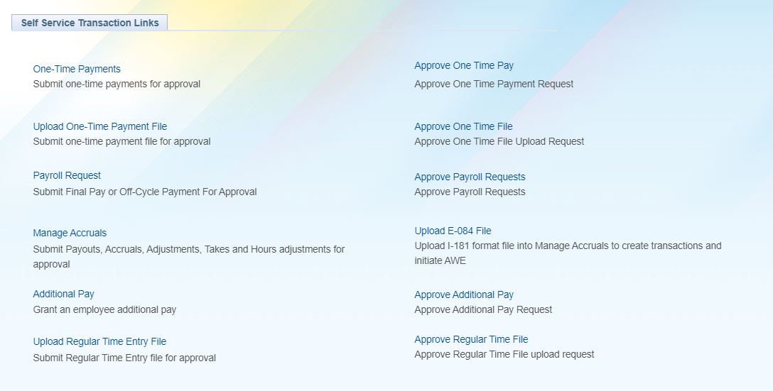
PAYPATH OVERVIEW
Re-occurring additional pay.
Re-occurring additional pay can be processed multiple different ways.
The best method is via Paypath or Self Service Links

Slide 19
PAYROLL CALENDAR OVERVIEW

Slide 20

PAYROLL CALENDARS DEFINITION
The UCPath Payroll Process involves a series of actions and interfaces to process gross to net paychecks and finalize the payroll balances each pay cycle.
The process begins with calculating initial hours, taxes, and deductions. An iterative calculation routine will produce various validation edits for review, as well as data for subsequent processes and reports.
The process ends when payments are calculated and confirmed in UCPath, and employees receive both their paychecks and earnings statements correctly through direct deposit or paper check.
The UCPath Center enforces a strict timeline for payroll processing deadlines that all UC locations must adhere to.

Slide 21
EXTERNAL FILES OVERVIEW
Critical Payroll Interface Files
Employee time reporting records are sent to UCPath via the I-181 Time & Attendance interface file from TARS for regular hours and leave takes for biweekly employees and leave takes for monthly employees.
The I-618 Flat Dollar Amount interface file is used to submit one-time pay to UCPath en masse (e.g. STAR Awards for an entire division).
Other pay-impacting interface files submitted before payroll:
  I-171 General Deductions interface file is used to submit payroll deductions.
  I-178 Parking Corrections interface file is used to submit parking deductions.
  I-378 One Time Deductions interface file is used to submit parking citations.

Slide 22
PAYROLL QUERIES FROM UCPC
Zero Gross or Zero Net
  Lists all active employees who have a zero gross or zero net check. This could be due to benefits deductions or taxes and therefore is not an error but needs review.
Hourly Employee No Earnings
  Lists all hourly employees who are active but have no calculated earnings this period.
Over 80 REG Hours Query
  Lists any BW employees who have more than 80 REG hours in the current period.
Net Greater Than
  Query lists any employees who have a net pay greater than $35,000 for Biweekly and $75,000 for monthly.

Slide 23
PAYROLL QUERIES FROM UCPC
Loaded Retro Transactions
  This query is based on the Retroactive Earnings process in UCPath.
  Details all employees who will receive retroactive earnings in the current pay cycle.
Shift Differential Transactions Unable to Process
  This query will identify transactions with Shift Differentials (SDF) that were not processed in initial payroll stages. This occurs if the employee has a Job Code that is not configured in UCPath to receive Shift Differential earnings.
  Location receives exception report the day prior to pay confirm (timing is not consistent) and (in most cases) has until the Correction File Deadline to submit corrections, if necessary.
Transactions Unable to Process
  This query is shared when there are transactions that could not be processed during the Pay Calculation process. This includes One-Time Pay transactions that were submitted after the cut off or that contain invalid pay groups, etc.

Slide 24
CORRECTIONS TO ERRORS BEFORE PAYROLL
Interface File Error Logs
When inbound interfaces are processed in UCPath, error reports/logs are sent to locations when inaccuracies/errors have occurred.
These errors must be corrected by submitting a correction interface file in order to successfully process. In most cases, these errors are corrected at the SSC level, except for the parking files.
Error logs are received by the Payroll Coordination & Analysis team (BFS) and disseminated to the appropriate SSCs for review/correction.

Slide 25
ROLES AND RESPONSIBILITIES
BFS/Payroll Coordination & Analysis Role and Involvement
  Receive UCPC Payroll Queries and disseminate to appropriate SSCs.
  Escalate issues to the UCPC On Cycle Payroll Team or Retro Payroll team.
  Receive various interface error logs and disseminate to the appropriate SSCs.
SSC Roles and Involvement
  Review UCPC Payroll Queries and various interface error logs.
  Process corrections either using the TARS Express Page, UCPath data updates, or by submitting correction interface files (i.e. I-618 correction file).
  Reach out to departments for additional research and information.
  Escalate specific issues to BFS or the CSC.

Slide 26
ROLES AND RESPONSIBILITIES
UCPC Role and Involvement
  Send payroll queries to BFS.
  Review and research escalated payroll issues.
  Complete payroll processes and communicate issues to locations.
Pilot Unit Role and Involvement

Slide 27
PAYROLL CALCULATION

Slide 28
PAYROLL CALCULATION
Check view
Corrections
  Missed Pay
  Underpay
Upstream for corrections
When due?
How corrections are processed

Slide 29
PAYROLL CALCULATION
Definition
  Initial UCPath Payroll process that calculates paycheck data based on inputs (i.e. interface files, data changes, etc.) from upstream processes and configuration.
  The process begins with calculating initial hours, taxes, and deductions. An iterative calculation routine will produce various validation edits for review, as well as data for subsequent processes and reports.
  The process ends when payments are calculated. The Pay Confirm process follows Pay Calc, and employees receive both their paychecks and earnings statements correctly through direct deposit or paper check.

Slide 30
PAY CONFIRM

Slide 31
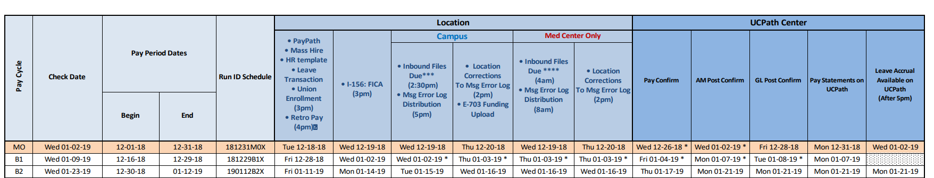
PAY CONFIRM
Definition
  The delivered process that finalizes paycheck data following the Pay Calculation process.
  Following Pay Confirm, earnings statements are accessible to employees in the UCPath Portal for that particular pay period.
  Additionally, accrual balances are visible to employees in the UCPath portal; balance based on leave takes reporting in the payroll month.

Slide 32
PAY CONFIRM
Demo
Hands-on Exercise

Slide 33
PROCESS TO CORRECT PAY

Slide 34
INSTANT PAY CARD – NET PAY OPTION
Definition
  The Instant Pay Card Net Pay process provides an option to expedite payment to an employee to mitigate issues caused by employee missing their regularly scheduled pay and experiencing a financial hardship.
  UCPC has authorized campuses to submit Instant Pay Card requests for 70% of the employee’s anticipated gross earnings.
  This percentage serves as a buffer until the actual earnings amount is determined (gross earnings less deductions) through the employee’s normal payment method.
  UCPC provided UCR with Instant Pay Cards and they are secured in the vault at Main Cashiers Office in the Student Service building.

Slide 35
INSTANT PAY CARD – NET PAY OPTION
Important Terms and Definitions
  Instant Pay Card (IPC)
    Expedited payment method for UC employees experiencing missed or incorrect pay to receive payment via Debit Visa card.
  Consent Form
    Form required by UCPC for employees to authorize receiving earnings through IPC payment method.
  Delivery Method Form
    Form required by BFS for employee to elect how they wish to receive the IPC.
  COSSC SharePoint Site
    Collaboration SharePoint Site for SSCs to submit IPC request to BFS.
  Proxy ID
    Unique identifier for Instant Pay Card packet/envelope.

Slide 36
INSTANT PAY CARD – NET PAY OPTION
Process Overview
  An active UCR employee identifies either missing or incorrect pay.
  SSC confirms missing/incorrect pay and works with employee on Instant Pay Card (IPC) option if the situation has resulted in a financial hardship for the employee.
  Employee signs consent form for IPC and selects a Delivery Method (either pick up at Student Services Building or receive via FedEx).
  SSC reviews employee’s previous earnings statements and calculates 70% of gross earnings amount to load onto the IPC.
  SSC submits an IPC request to the BFS/Payroll Coordination & Analysis team via designated SharePoint site.
  BFS reviews the documents for completion and submits a request to the UCPath Center (attaching consent form and assigning a Proxy ID).

Slide 37
INSTANT PAY CARD – NET PAY OPTION
Process Overview – Continued
  UCPC receives information from UCR and processes IPC payment.
  UCPC notifies UCR BFS team when the funds (70% estimation) has been loaded to the IPC.
  UCR BFS team notifies SSC, Student Business Services (SBS) – Main Cashiers Office, and Employee when the card is ready for pick up or delivery.
  SBS pulls the IPC from the vault in the Cashiers Room.
  Employee appears in person at the SBS Cashiers Office with a valid/government issues ID and signs pick up form to confirm card has been picked up.
  SBS notifies BFS that employee has picked up card.
  SSC creates an E-078 Off Cycle Request to pay employee any remaining earnings and to create deduction for IPC on next paycheck.
  IPC request is marked as Complete by BFS in SharePoint.

Slide 38
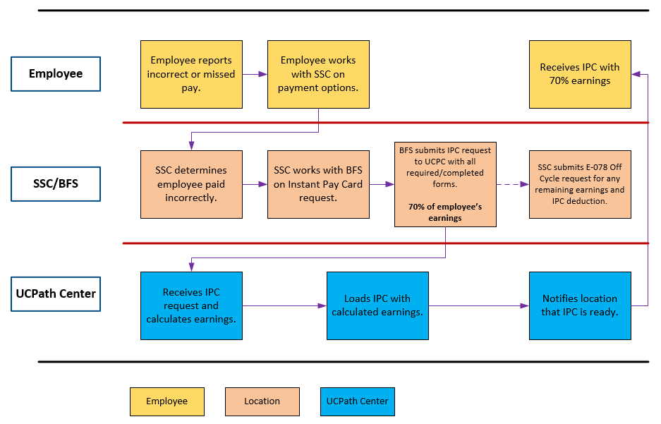
INSTANT PAY CARD – NET PAY OPTION
High-level Process Flow

Slide 39
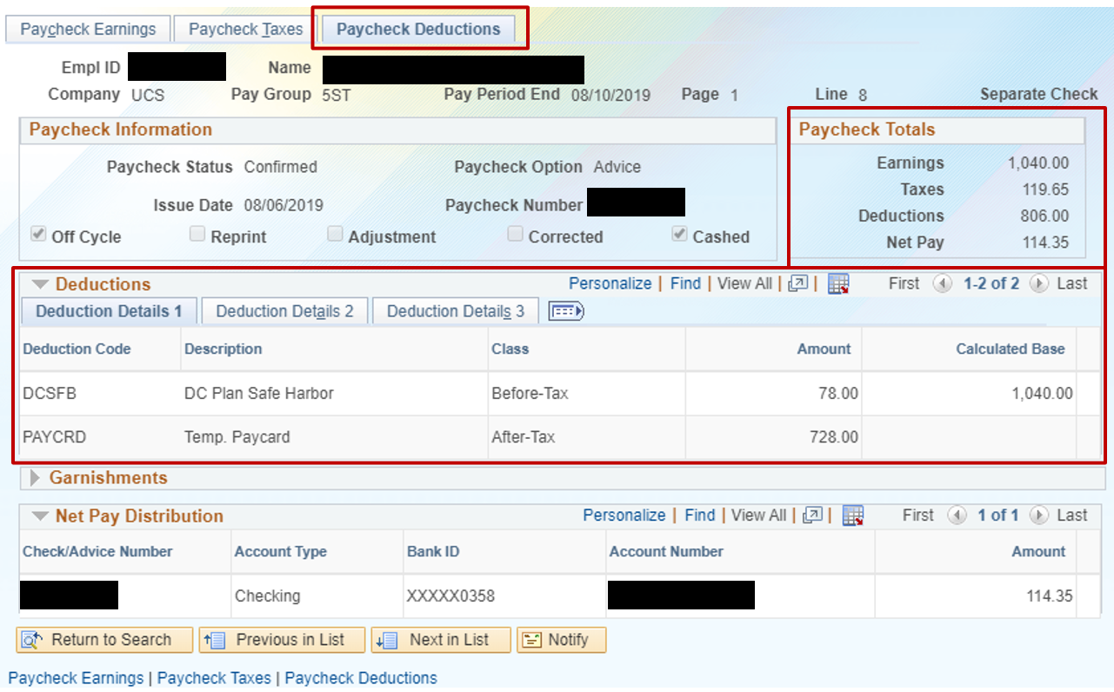
INSTANT PAY CARD – NET PAY OPTION
Redacted Paycheck

Slide 40
INSTANT PAY CARD – NET PAY OPTION
Instant Pay Card Envelope Contents

Slide 41
OFF CYCLE

Slide 42
OFF CYCLE (Sarah Dillon)
Process for requesting off cycle request
What the SSCs do to process off cycles
ServiceLink form used for Off Cycles
Turn-around time
Issues
Follow up
Off Cycle Dashboard
SSC pain points

Slide 43
CSC ESCALATION

Slide 44
CSC ESCALATION
When you escalate to the CSC
What the CSC does to assist with mitigating pay issues

Slide 45
PAYCHECK REVIEW DEMO

Slide 46
PAYCHECK REVIEW DEMO
See screen

Slide 47
ACCRUALS

Slide 48
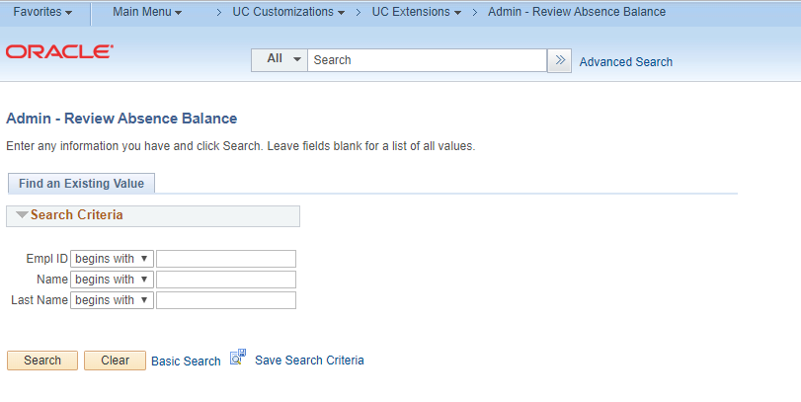
ACCRUALS
AM Post Confirm runs in UCPath
  New Leave Accruals available to view in UCPath on the Admin – Review Absence Balance page (Main Menu -> UC Customizations -> UC Extensions -> Admin – Review Absence Balance)

Slide 49
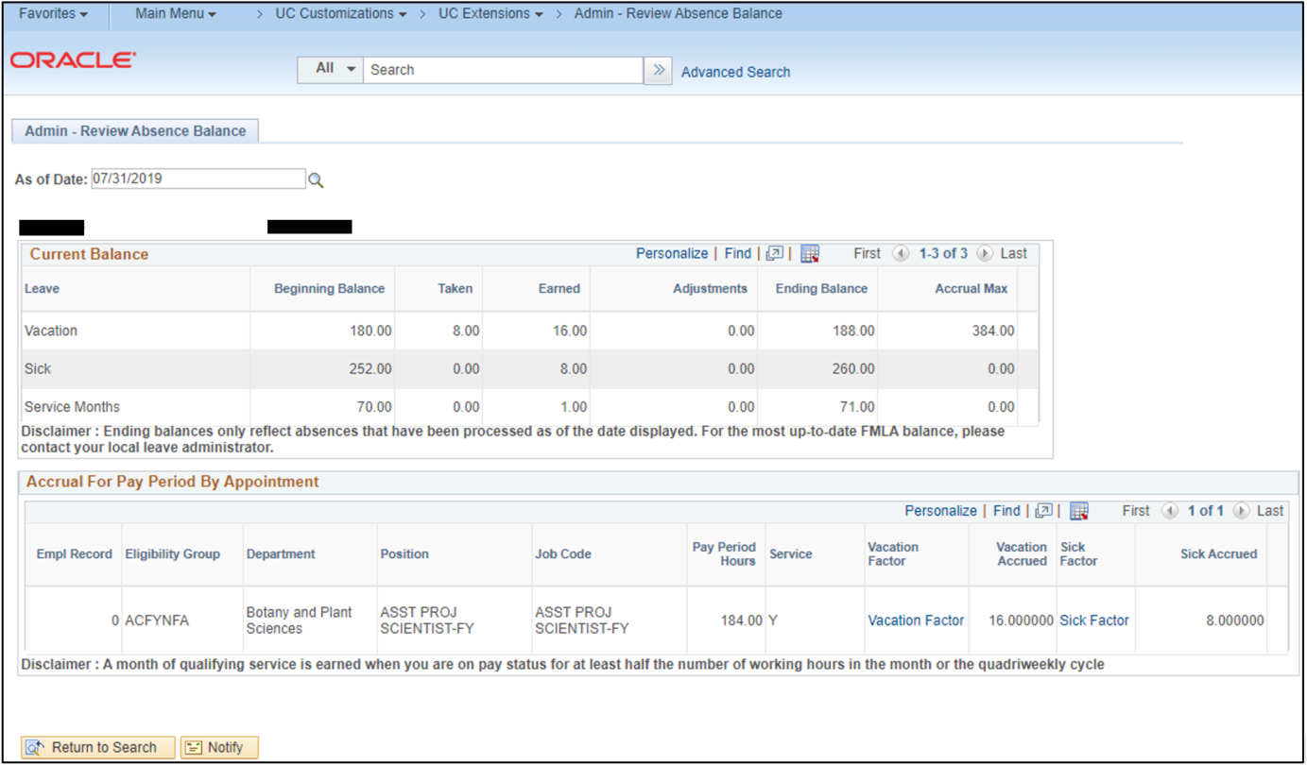
ACCRUALS
View current or historic leave accruals by accrual/pay period end date
  Search by “As of Date” which corresponds to the MO or BW pay period end date
Retroactive takes will show in the period they were used
  Leave takes are reported in arrears, so the takes will not be reflected in UCPath until the following accrual run (Ex. 8 hrs vacation used in July will not show up as a take in UCPath until the August accrual run at the end of the month)

Slide 50
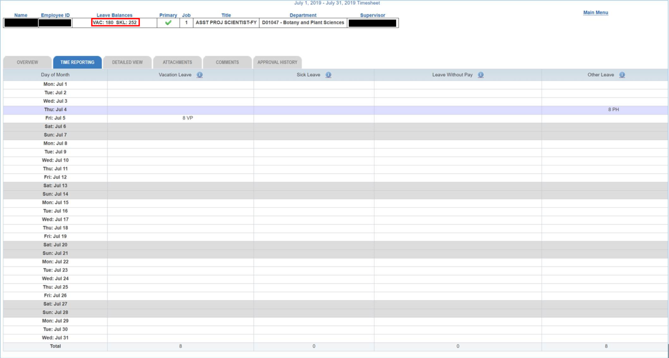
ACCRUALS
UCPath vs. TARS
  The beginning balance in UCPath for an accrual period should match the amount on the timesheet in TARS for the corresponding period

Slide 51
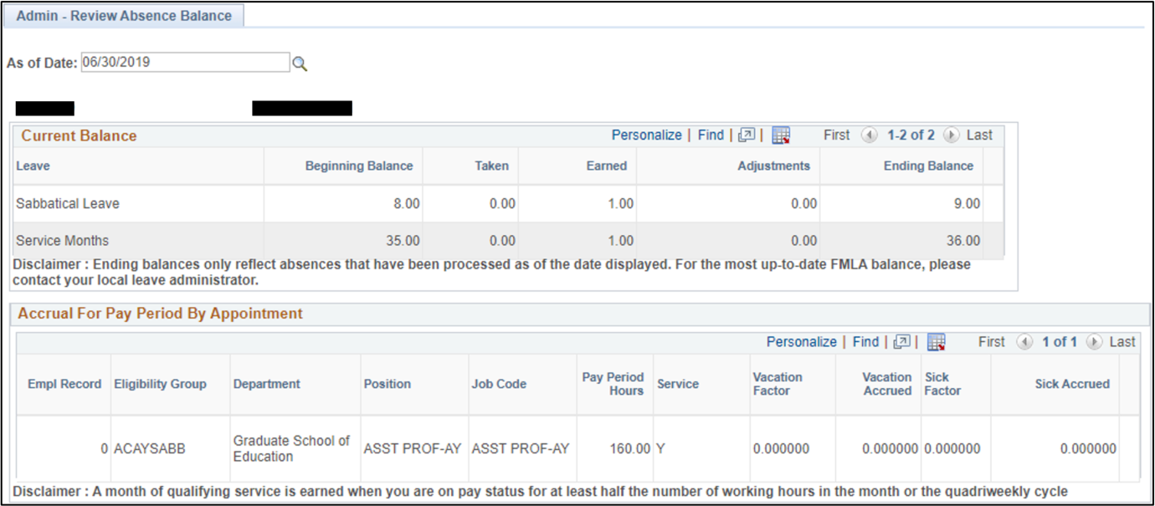
ACCRUALS
Sabbatical accruals will not show until the month they get one full credit
Ex.) An employee accrues 0.25 Sabbatical credits per month starting in March, the accrual will not show up until the June accrual run.

Slide 52
GL – WRAP UP

Slide 53
GENERAL LEDGER OVERVIEW
Time entries flow into UCPath via the I-181 interface file.
One-time payments are either processed via the I-618 interface file or entered directly into UCPath (via Self Service Transaction Links or PayPath).
All of these entries are attached to Earn Codes, which is how UCPath categorizes payroll expenditures.
The GL process takes specific details into consideration, such as employee information, job data, earn code, etc.

Slide 54
GENERAL LEDGER OVERVIEW
Departments use SuperDOPE to query payroll expenditures and see the FAU that entries were charged against.
If FAU entries are incorrect, authorized department personnel will typically update position funding using the FAU Change Request Tool, and/or perform a Salary Cost Transfer to move the expenses to an alternate FAU. This is done using the SCT Change Tool.

Slide 55
GENERAL LEDGER OVERVIEW - ASSESSMENTS
Vacation Leave Assessments (VLA) and Composite Benefit Rates (CBR) are assessments that are charged to a department against an employee’s gross salary.
These are assessed as part of the Journal Modification process that is run during the GL Post Confirm procedures.
Based on the earn code configuration set up in the Earn Code Table, a pay line will be assessed these charges accordingly, but not all earnings are subject to these charges.
Both VLA and CBR, charge the department to fund a liability pool.
The assessment rates for both charges are managed by the Budget Office, and are approved by UCOP.

Slide 56
GENERAL LEDGER OVERVIEW – JOB DATA IMPACTS
An employee’s job data impacts a number of downstream payroll areas.
Employee Class, FLSA Status, Eligibility Configuration, Job Code drive the applied CBR Group and Rate.
If there is a change to any of these fields, for example an employee moves from Full Benefits to Core, it can adjust the CBR Group, and subsequently adjust the CBR Rate.

Slide 57
GENERAL LEDGER OVERVIEW – JOB DATA IMPACTS
GP Eligibility Group directly affects the applied VLA Group and Rate.
CBR and VLA charges are purely configuration driven based on Workforce Administration (WFA) data, and as such the upstream values relating to these charges cause downstream impacts on the financials.

Slide 58
GENERAL LEDGER OVERVIEW – USE CASES FOR CBR
Common User Issues with CBR Configuration
Job code pushed Employee unexpectedly into a Local CBR Group.
Benefits Eligibility changed unexpectedly for employee (Core to Full), which moved them into a different CBR Group.
Employee Class changed unexpectedly for employee (Limited to Career), which moved them into a different CBR Group.

Slide 59
GENERAL LEDGER OVERVIEW – HELPFUL RESOURCES
Link to the User Group meetings from Accounting Office
Link to Benefit and Assessment Rates information
Link to Earn Code listing with Assessment flag

Slide 60
AUTOMATED PROCESSES

Slide 66
LEARNING OBJECTIVES REVIEW
Having completed this course, you should be able to:
Understand Milestones on UCPath Payroll Processing Schedule
Understand Criticality and Impact of Payroll Milestones
Recognize and define key UCPath terms and acronyms
Understand Payroll-impacting Inbound Files
Understand UCPath Automated Processes

Slide 67


THINGS TO REMEMBER
Payroll Deadlines are enforced by the UCPath Center for all UC Locations.
Payroll Deadlines cannot be moved or rescheduled by locations.
Monthly-paid and Biweekly-paid employee populations are processed in separate Payroll instances and adhere to different Payroll Processing deadlines.
The UCPath Center Publishes a new Payroll Schedule for the year in the UCPath Portal.
The UCPath Payroll Processing Schedule is subject to change throughout year.

Slide 68
THINGS TO REMEMBER
FTE, FLSA, Salary Admin Plan, Grade and Step are pay impacting fields updated by location
Pay group is a pay impacting field that is updated by UCPC
Paypath and Self service links are the best methods for processing additional pay
Leave accruals are available in UCPath after AM post confirm process runs at the end of the month
Leave takes are reported in arrears, so the takes will not be reflected in
  UCPath until the following accrual run

Slide 69
APPENDIX
Link to 2019 UCPath Payroll Processing Schedule
Link to 2019 Biweekly Payroll Calendar
Link to 2019 Monthly Payroll Calendar
Link to UCR Payroll Calendars and Schedules
  Note: these calendars are based on UCPath Payroll Processing Schedule.

Slide 70

Your Feedback Please http://bit.ly/pilottrainingphase2

Slide 71


Slide 72


